Slide 1
Introduction to the Poultry Industry

Slide 2
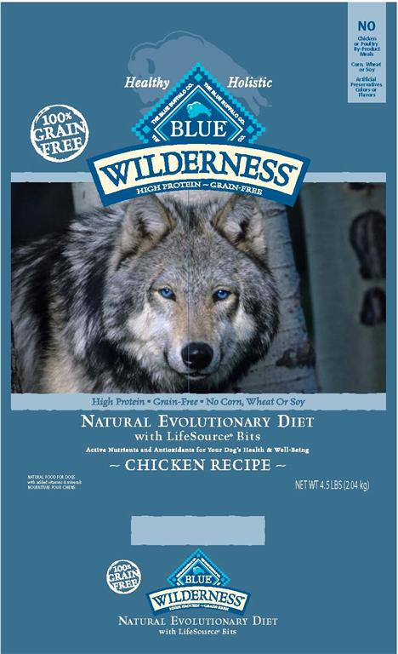
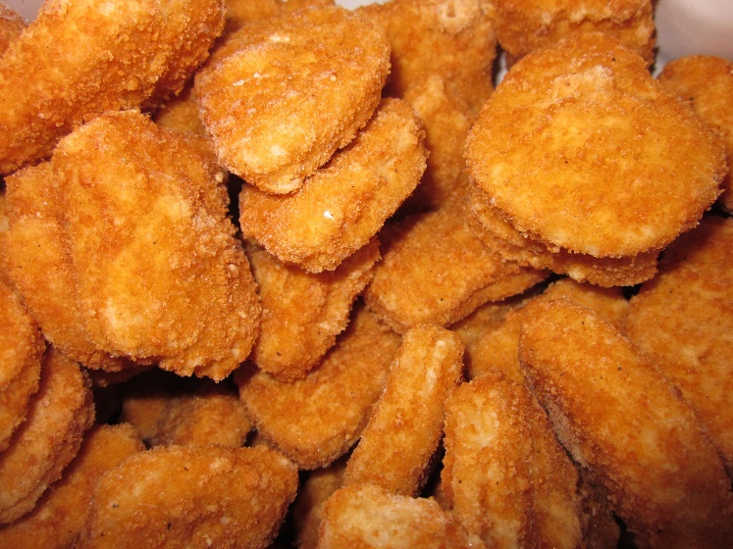
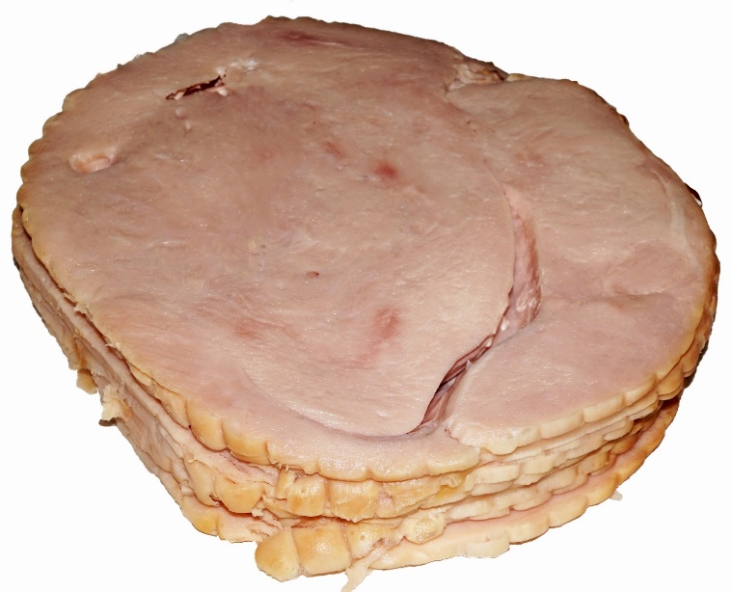

Slide 3

Ag Minute: Vertical Integration

Slide 4
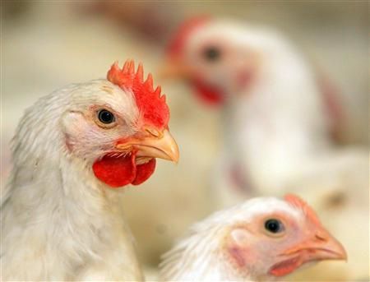
The Poultry Industry
There are many segments of the poultry industry.
These segments are all interlinked and, many times, are owned by the same company.
This type of ownership is called vertical integration.

Slide 5
Vertical Integration
It is a style of business management that allows for maximum control of the products produced.
It is much like a ladder concept, as each segment relies on the segment below it to supply it with what it needs while that segment must produce the product the next segment needs.
It is like a hierarchy of needs that are met within one company.
It allows the poultry industry to develop their product efficiently and to produce a high quality product.

Slide 6
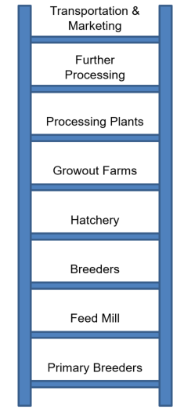
The Structure
Generally has 8 levels
  Primary Breeders
  Feed Mill
  Breeders
  Hatchery
  Growout Farms
  Processing Plants
  Further Processing
  Transportation and Marketing

Slide 7
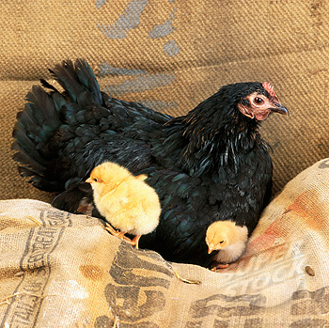
Primary Breeders
Their responsibility is to develop and reproduce strains of chicken that meet the requirements of chicken producers and processing companies.

Slide 8
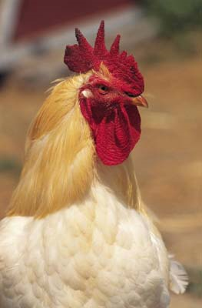
Primary Breeders
Through development and reproduction, they aim to achieve desirable characteristics such as abundant white meat and efficient feed conversion.
Breeder chicks with the appropriate mix of desirable characteristics are then sold to integrated chicken firms.

Slide 9
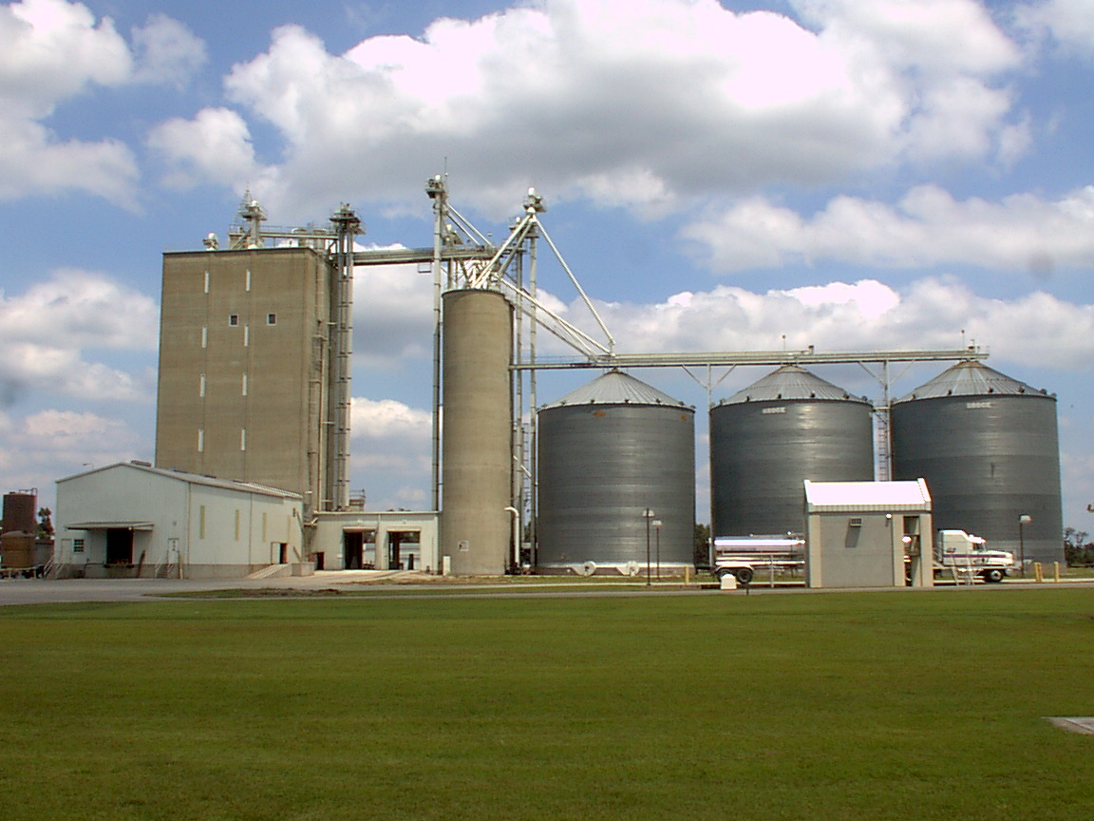
Feed Mill
Chicken companies own feed mills that convert raw materials into finished feed according to very specific formulas developed by poultry nutritionists
They produce different formulas to feed all the different nutrition stages of chickens.

Slide 10
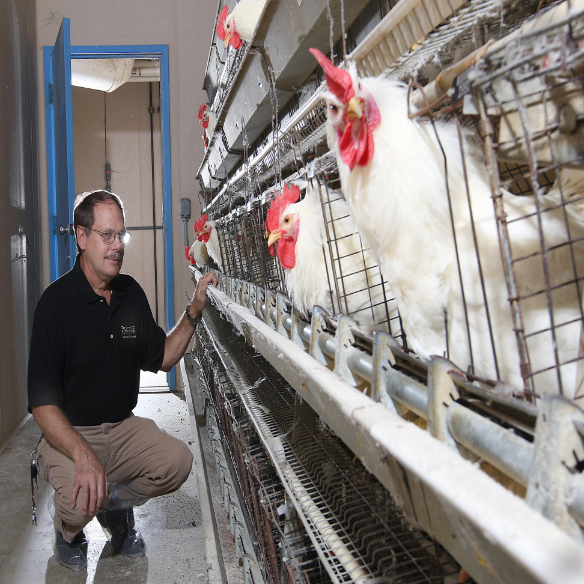
Breeders
Generally operated by contract growers who raise the breeder chicks to adult birds.
Breeding hens and roosters are kept under tight biosecurity on breeder farms to produce fertile hatching eggs.
The offspring of breeder parents become broilers for the market.

Slide 11
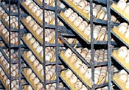
Hatchery
A specialized facility designed to hatch fertile eggs received from breeder farms.
Fertile eggs are placed in incubators and carefully monitored to ensure that correct temperature and humidity levels are maintained throughout the entire incubation period.

Slide 12
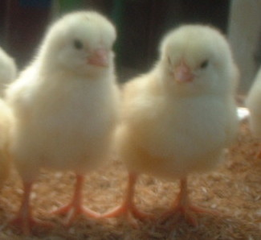
Hatchery
Toward the end of incubation, the eggs are placed in hatching trays where the chicks hatch by pecking their way through the large end of the egg.

Slide 13
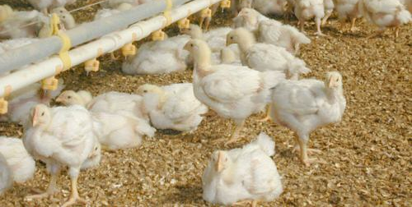
Growout Farms
The newly hatched chicks are transported to growout farms where independent farmers raise them to market weight under contract with the company.
The company provides the chicks, the feed and any necessary pharmaceuticals.

Slide 14
Growout Farms
The farmer provides the growout barns, water, bedding (“litter”), electricity and his or her own management skills.
The chickens reach market weight in six or seven weeks and are collected and transported to the processing plant.

Slide 15
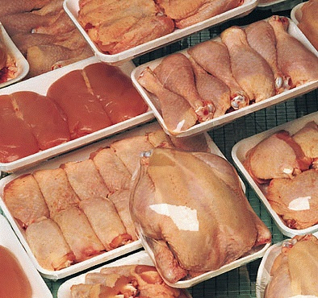
Processing Plants
The processing plant harvests the birds by humane standards and are inspected by the USDA for any disease or defects.
The carcasses are then chilled to limit the growth of bacteria.
Following chilling, they are packaged for distribution or cut into parts.

Slide 16
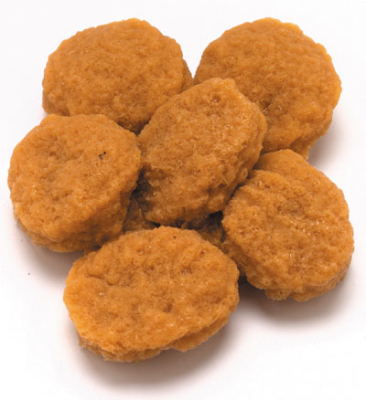
Further Processing
These are specialized operations or plants that receive whole chicken or cut-up parts and perform a variety of further processing steps.
These steps include cooking, breading or marinating.

Slide 17
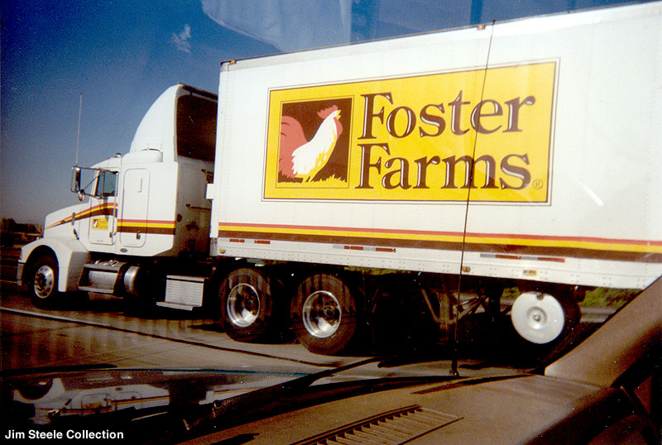
Transportation and Marketing
Chicken products are transported in refrigerated trucks from the processing and further processing plants to grocery stores, restaurants and other customers.

Slide 18
Value to the Economy
Vertical integration within the poultry industry gives producers greater control over the production of quality products that successfully meet consumer wants and needs.
Vertical integration results in a more cost effective production process and a more affordable product for the consumer.

Slide 19
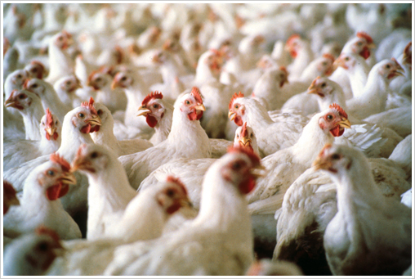
Chicken Breeds
The chicken industry has well over fifty breeds that are recognized by the American Poultry Association.
These breeds are broken down by classifications and use.
The uses of these animals are layers, meat and dual use.

Slide 20
Meat Breeds
They are not really breeds.
Instead, they are hybrid varieties or combinations of many different breeds.
These varieties are developed for specific characteristics:
  grow faster and larger.
  larger breast-meat yield.
  more efficient feed conversion.
  more disease resistance.
These varieties are used by broiler-producing companies that commercially produce broilers sold in supermarkets.
Weakness of these varieties:
  They do not lay as many eggs as the layer breeds.

Slide 21
Specific Variety Used in Industry
Cornish Cross
  White Cornish x White Plymouth Rock
    Their fast growth allows them to reach 4 to 5 lbs in
    6 weeks and 6 to 10 lbs in 8 to 12 weeks.
  White Cornish
    They are part of the English Class.
    They have a very broad and meaty body.
  White Plymouth Rock
    They are part of the American Class.
    They tend to be docile and a fairly good dual-purpose breed.

Slide 22
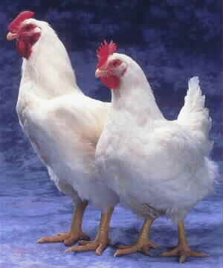
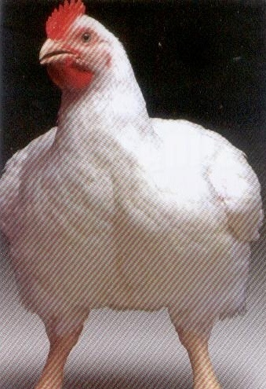
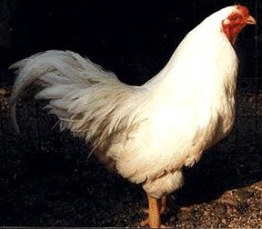
White Plymouth Rock
Cornish Cross
Cornish Hen

Slide 23
Layer Breeds
They have been genetically selected for high egg productivity.
They tend to be small bodied so they are undesirable for meat production.
  Their small bodies allow the bird to put more nutrients toward egg production instead of body size.
They are divided into two types:
  White egg layers and brown egg layers.
  Chicken breeds with white ear lobes lay white eggs, whereas chickens with red ear lobes lay brown eggs.

Slide 24
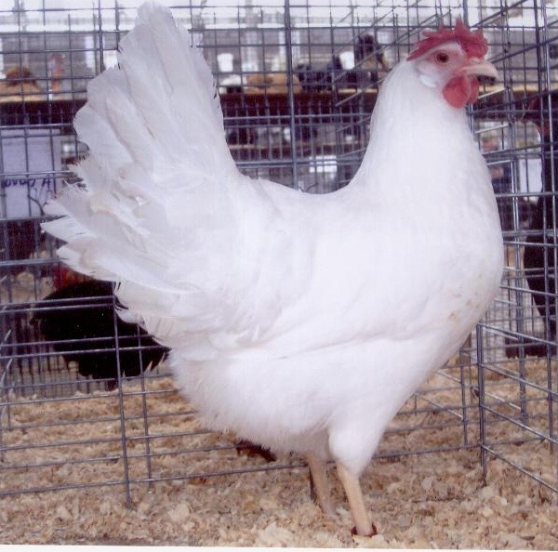
Specific Breeds Used in Industry
White Leghorns
  They are part of the Mediterranean Class.
  Very good layer of white eggs
  Basis of commercial egg industry

Slide 25
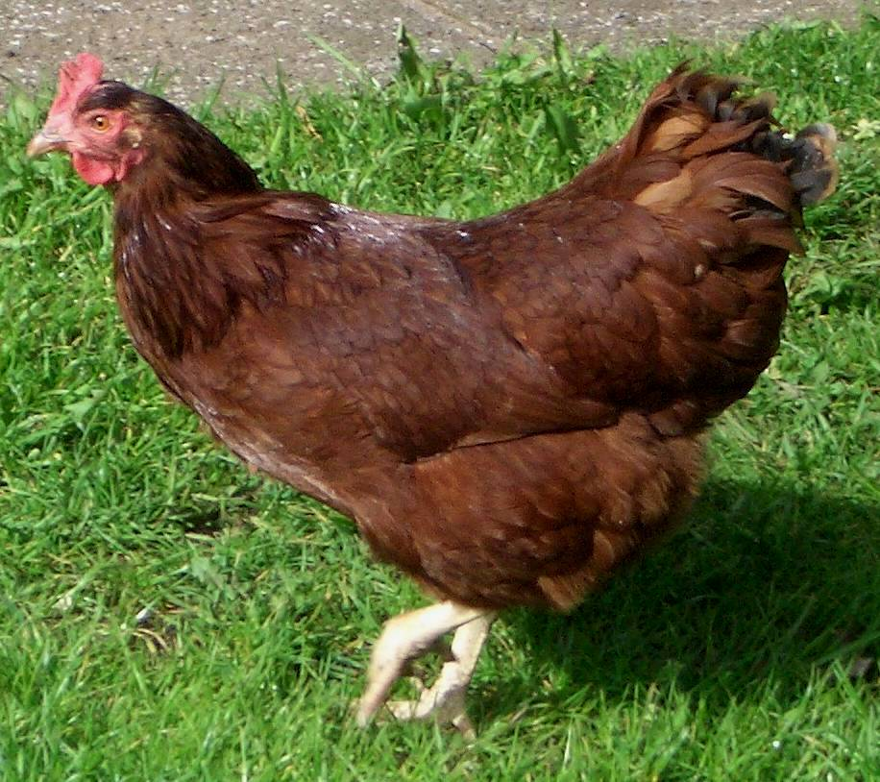
Specific Breeds Used in Industry
Rhode Island Red
  They are part of the American Class.
  They lay brown eggs.
  Production-bred strains lay very well.

Slide 26
Turkey Breeds
There are currently eight breeds of turkeys that are recognized by the American Poultry Association.
There are several breeds that are not officially recognized as a breed, but these are the varieties that are commercially used by the industry. These breeds are predominately used for meat.

Slide 27
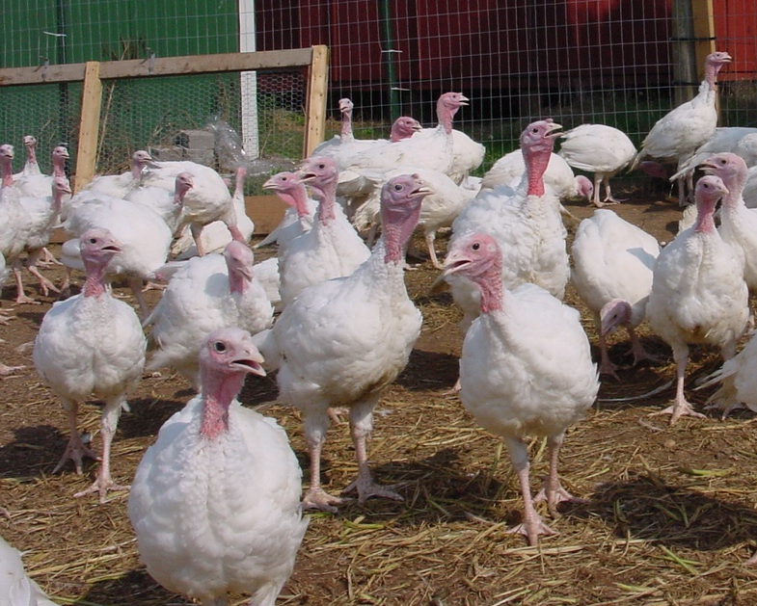
Meat Breed
Broad-Breasted White
  Commercially, the most widely used breed of domesticated turkey.
  They have shorter breast bones and legs than “standard” turkeys.
    They are unable to breed naturally and require assistance from humans.
  Produce more breast meat, and their pin feathers are less visible when the carcass is dressed due to their white color.

