Slide 1
History of Poultry Production

Slide 2
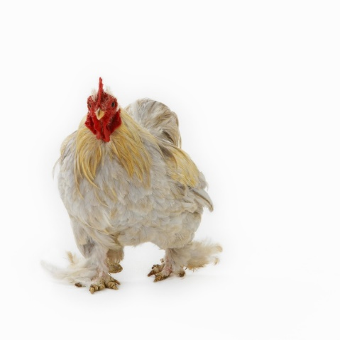
What is poultry?
Poultry is a term for domesticated fowl, particularly focusing on the species valued for their meat and egg use, such as chickens and turkeys. In this lesson, we will focus on chicken production of meat and eggs.

Slide 3
The 1800s to the early 1900s
Chicken Production
  Individual households and small flocks
    Backyard farming
    Egg and meat birds for family consumption
    Excess birds and eggs sold to neighbors
Egg Production
  Due to the lack of research and information, programs such as photoperiod cycling were nonexistent.
  Farmers did not know that lighting can have an impact on the laying cycles of chickens.

Slide 4
The 1920s and 1930s
Beginning of Broiler Production
  The increasing demand for eggs = an excess amount of young male birds
  Farmers would then sell these birds to the locals for meat.
  Increase in demand for meat birds
    Farmers began to notice some birds were better suited for laying eggs while others were better producers of meat.
  Farmers began to raise single purpose chickens used for one reason — either egg or meat production — as opposed to dual purpose chickens that were used for both egg and meat production but were just average in production.

Slide 5
The 1920s and 1930s, continued
  Selection of certain birds created the best yields for the farmer because they could specialize in one area with better birds.
  These backyard farmers began to sell eggs and live birds at local farmers markets.
  Broiler: a specialized meat bird (single purpose)

Slide 6
The 1940s
Do you/your parents buy whole-bird chickens or pieces?

Slide 7
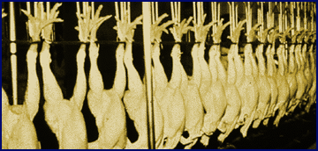
The beginning of processed chickens
Poultry industry begins to modernize.
Producers begin to sell their birds already processed — killed and cleaned.
The prominent way to buy a chicken became a “New York Dressed”:
  a plucked and slaughtered chicken carcass with its feet and head intact.

Slide 8
Separation of production stages
Producers begin to grow businesses.
  Needed more space to expand and profit
  Became fully integrated, or involved in all areas of the production process, and built facilities
    Hatcheries, feed-mills, farms and processing plants in separate locations
    Allowed expansion of the company in an area and also reduced the risks of potential diseases spreading throughout the different areas of production

Slide 9

Voluntary carcass grading
1949: the United States Department of Agriculture established a voluntary carcass grading of the birds
  Helped consumers determine the quality of the carcasses
  Set a standard to be met by producers

Slide 10
Egg Production in the 1940s
Wire-caged housing for egg layers begins
  Healthier and more efficient producers
    Eggs could be collected easier.
    Diseases were easier to prevent and control.

Slide 11
Egg Consumption Decline
Cholesterol Controversy
  Late 1940s: studies released proposing controversial negative effects of eggs because of high cholesterol.
Movement from Rural to Urban Living
  Less eggs being consumed as families began to move from their farms and rural areas into urban cities for work
  Less time and space for having personal flocks

Slide 12
1950-1960
Commercial broiler production
Vertical Integration
  Poultry industry moved to vertical integration: individuals involved in every stage of production, processing and marketing.
  Advantages: more efficient, responsive and profitable
  Mid-1960s: 90% of broilers produced came from vertically integrated operations.

Slide 13
Marketing
Television provides new marketing opportunities.
Poultry industry uses TV and media to promote more consumption of chicken, turkey and eggs.
  Advertising increased both consumer demand and brand name recognition.

Slide 14

National Broiler Council Established in 1954
Stimulated consumer demand
Name was changed in 1990 to the National Chicken Council.

Slide 15

USDA Mandatory Federal Inspection of Broilers, 1959
Mandatory inspection of all poultry plants producing meat for consumption for the safety of the consumer.

Slide 16
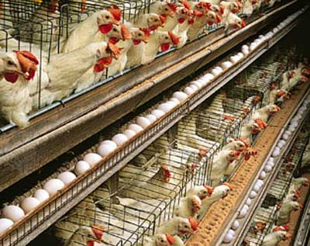
“Expansion of the egg industry” in the 1960s
A combined effort in producing, marketing and management to push the egg industry from an era of small flocks to one of commercial production
Quality of machinery from layer house to processing equipment improved drastically.

Slide 17
1970s to Present Day Production
Modern Production of Meat
Poultry industry moved to its present modern methods of production.
Research in nutritional discoveries, disease eradication programs, genetic improvements and new technologies.
Poultry has become an efficient, reliable and healthy source of protein.
The mechanization of processing and automation technologies is a major contributor.

Slide 18
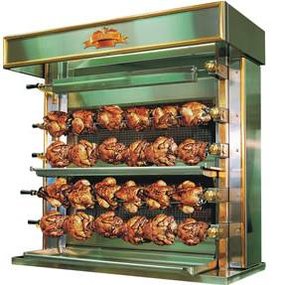
Consumer Population
Supply and Demand
  Dramatic increase in broiler consumption for a variety of reasons:
    1. Increased Health Perception: healthier protein to consume
    2. Increase in convenience vs. whole-bird sales:
      1980s: A shift in the type of meat products people could purchase at the market.
      Consumers preferred further processed and already cut-up meat compared to doing it themselves at home.
      New products: chicken tenders and other ready-to-eat frozen foods
      Convenience items: rotisserie chickens also became a big hit

Slide 19
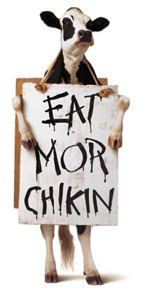
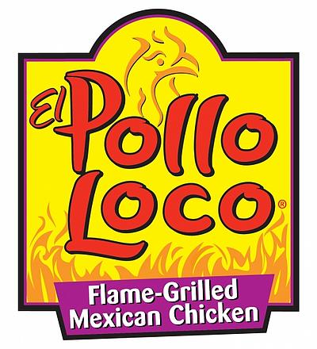
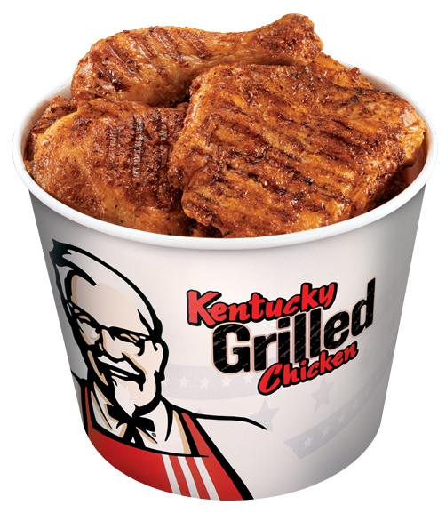

Consumer Population
3. Low cost: The price of chicken compared to other meat is lower because of efficiencies in productions.
4. Fast Food Outlets: Many meals at fast food restaurants now have chicken options or are solely chicken.

Slide 20
Chicken Surpasses Beef, 1992
    Chicken consumption outnumbered beef consumption, becoming the most consumed meat in the United States.
    Per capita consumption of chicken in the United States in 2008 showed that Americans ate more than 85 pounds of chicken that year!

Slide 21
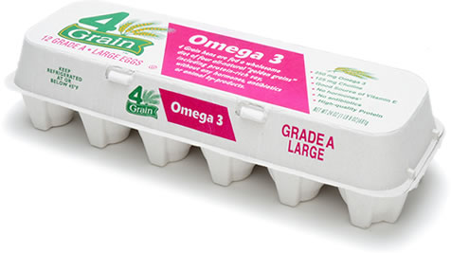
Designer Eggs
Designer Eggs: Eggs that have higher concentrations of
  Vitamin E and
  Omega-3 fatty acids (good for heart health).
Contributed to making eggs more appealing to health-conscious consumers, increasing sales

Slide 22
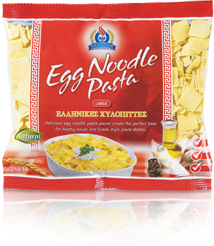
Egg Consumption Increase
    A steady rise of per capita egg consumption, or amount consumed per person. This rebound can be seen for three main reasons:
    Fast food implementation: eggs in breakfast foods.
    An increased health perception based on recent research.
    Further processed items that contain egg products: rice cakes, egg noodles, etc.

Slide 23
Expanded Exports,
1900s and 2000s
International markets sought:
  High demand for leg quarters and chicken feet
  Opportunities in Russia, China and Latin America
  Overall increase in worldwide demand
  20% of U.S. poultry production exported

Slide 24

HACCP
January 26, 1998
Further regulations for food safety.
HACCP required by the USDA in all slaughtering facilities of all species.
HACCP is “Hazard Analysis and Critical Control Points” enacted for protocol of cleanliness and safety by the plants, restaurants and food service industries.

Slide 25
The Impact of the Poultry Industry Today
The poultry industry has an enormous impact on the economy.
  Sales in excess of $60 billion annually
  One of the nation’s agricultural leaders
  Provides jobs for over 400,000 people
    Employees work in a variety of jobs: farm managers, processing plant workers, researchers, accountants and poultry executives.
  Indirectly provides jobs to hundreds of thousands more in affiliated industries
    Examples: trucking and feed ingredient suppliers.

Slide 26
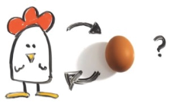
The questions is not
“What came first?” but rather
“What is coming next?”

