Slide 1
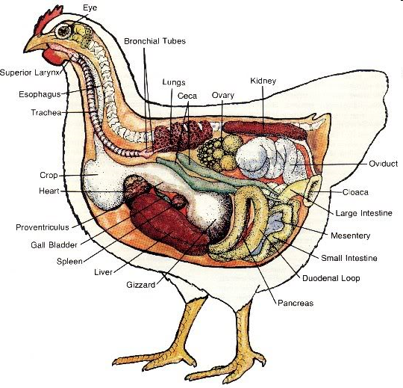
Poultry Anatomy and Physiology

Slide 2
What are differences between birds and mammals?
Feathers
Lack teeth
Lay eggs
Float and fly
Waste excreted from only one orifice

Slide 3
What is anatomy?
Anatomy is the science of the structure of animals.
Derived from the Greek word meaning “to cut up.”

Slide 4
What is physiology?
Physiology is the science that deals with the functions of the living organism and its parts.

Slide 5
Anatomical Terms
The following terms are used to describe locations on the animal body.
  Dorsal pertains to the upper surface of the animal.
  Ventral relates to the lower and abdominal surface.
  Cranial (or anterior) applies to the front or head.
  Caudal (or posterior) pertains to the tail or rear.

Slide 6
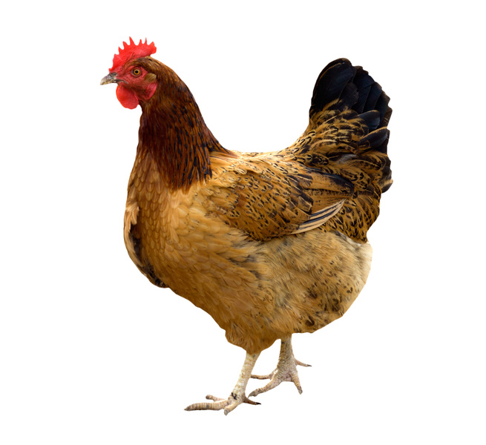
Anatomical Directional Terms
Dorsal
Cranial
Caudal
Ventral

Slide 7
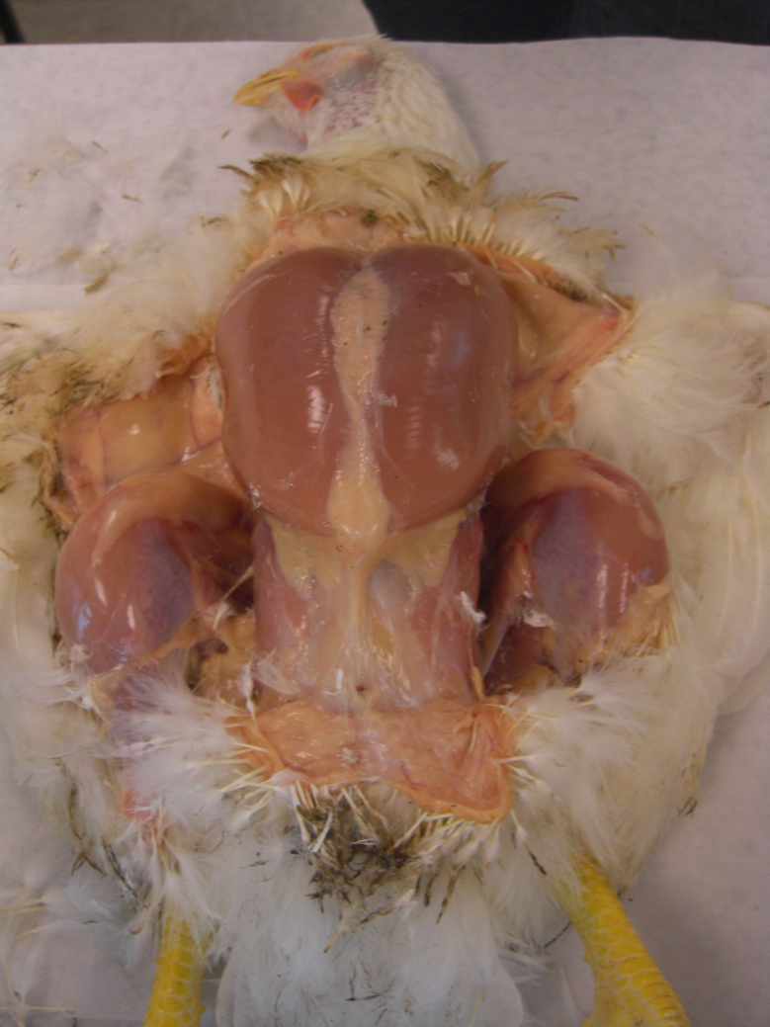
Body Systems of Poultry
Integumentary
Respiratory
Skeletal
Digestive
Circulatory
Urinary
Reproductive

Slide 8
Integumentary System
The skin, feathers and beak.
  Function: to protect the bird from external harm.
Skin
  Much like humans, with the exception of plumage production.
  Plumage: the outer covering of a bird’s body.
    Feathers, scales, filoplumes.
      Filoplumes: hair-like structures located at the base of feathers.
  Wattle: a red growth underneath the beak, that works in conjunction with the comb, an excess of skin on top of the head.
    Function: circulation of blood between the two regulates the temperature of the bird.
    The size of the comb is an indication of the levels of testosterone in the body. If the comb is large, this means more testosterone is present, often indicating the sex of the bird is male.

Slide 9
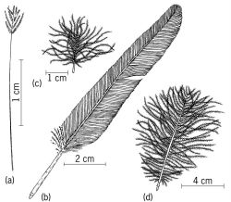
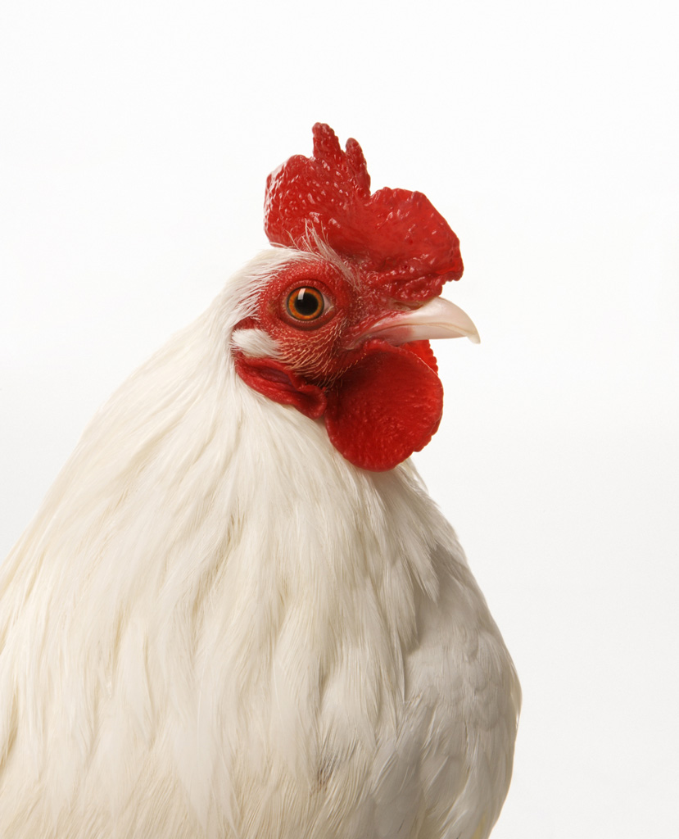
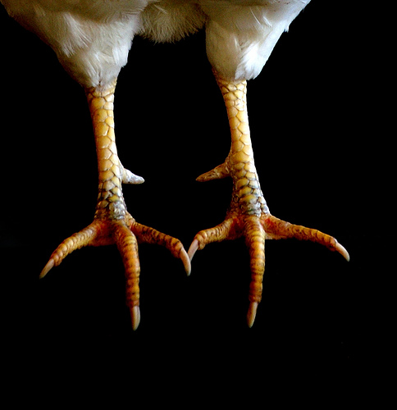
Filoplume
Comb
Beak
Wattle
Scales
Nails
Plumage

Slide 10
Scales and Plumage
Scales are located on the legs and feet.
The plumage is the outer covering of a bird’s body.
  Function: body cooling and heating for maintenance of body temperature; protects against abrasions and bruises when birds are in groups or lying on the ground.
  Plumage shape is particularly important for cooling since birds lack sweat glands.
  Although it is not common for production birds to fly, plumage type and form is an important determinant in flight for aerial species.

Slide 11
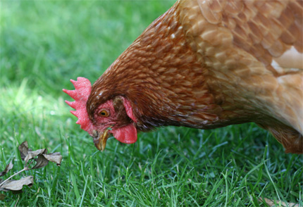
Beaks vs. Lips and Teeth
Birds have beaks as opposed to lips and teeth.
The beak is used for eating and drinking, as well as self-defense and protection from other animals

Slide 12
Respiratory System
Vastly different than the mammalian respiratory system.
Unlike mammals, birds lack a diaphragm to inflate and deflate the lungs.
  Instead, birds have nine air sacs located in the neck region and body cavity that function to inflate the lungs.
  Gas exchange occurs in the avian lung, and the air sacs function to move air in and out of the respiratory system.

Slide 13
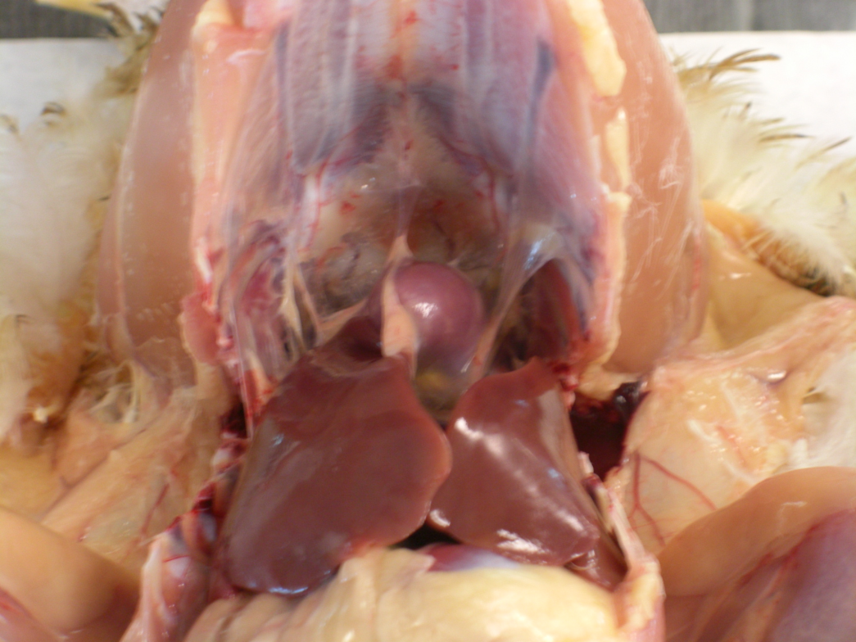
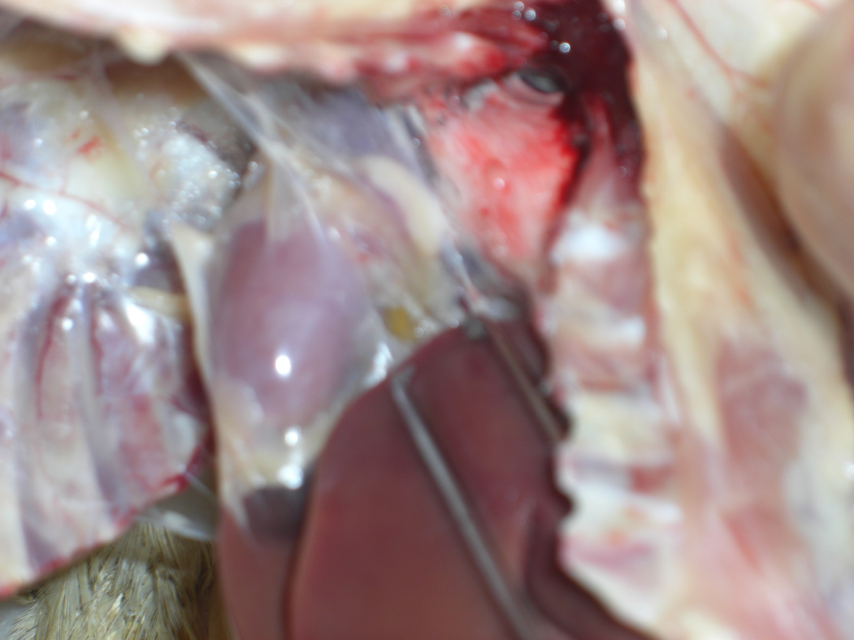
Heart
Air sac membrane
Air sac cavity
Liver
Cut ribs

Slide 14
Breathing Process
The breathing process has two phases: inhalation and exhalation.
  Inhalation: when the bird breathes in, air bypasses the lungs and enters the posterior air sacs. At the same time, air in the lungs from the last exhalation phase exits the lungs and enters the anterior air sacs.
  Exhalation: the bird releases air from the posterior air sacs, which enters the lungs. The air that filled the anterior air sacs from the inhalation phase is then released from the body through the trachea.
Nares are the nostrils located on the beak. They serve as the passageway for air to be breathed in and out of the trachea.

Slide 15
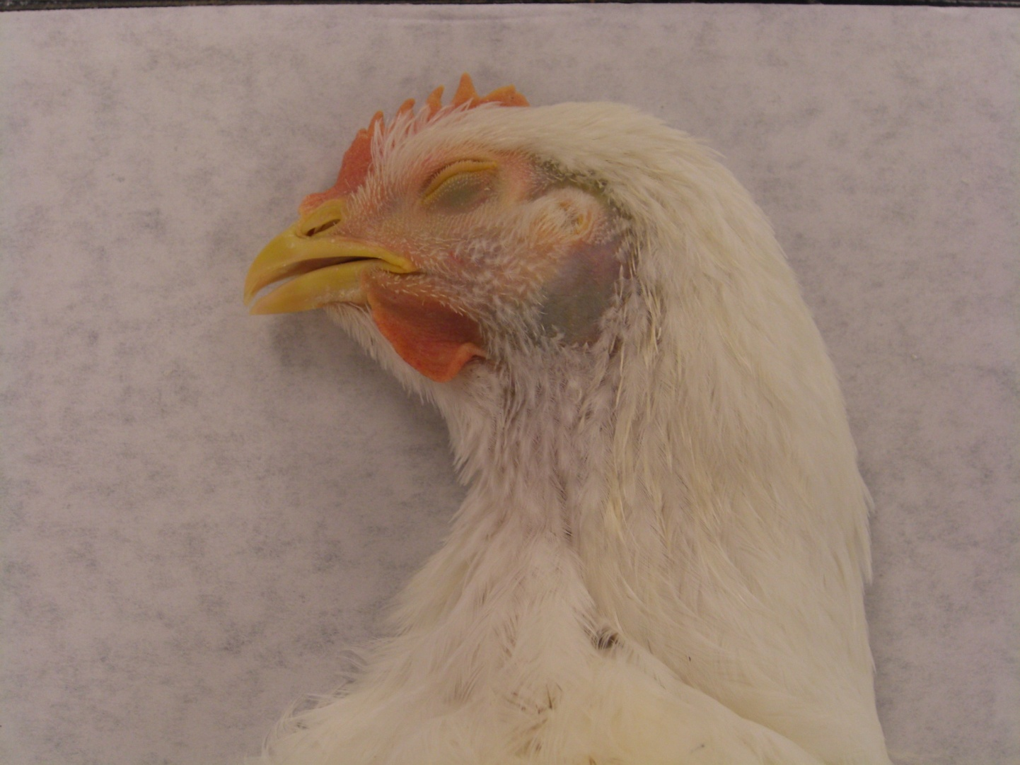

Slide 16
Skeletal System
1. Pneumatic Bones
  Poultry have pneumatic, or hollow, bones.
  Connect with the respiratory system
  Their light weight is an adaptation for flight.
2. Medullary Bone
  Medullary bone contains high amounts of calcium.
  This storage source is used by the female hen to produce the egg shell during reproductive periods.
3. Fused Bones
  Bones in the foot, or shank, are fused.
  Causes birds to walk upright
  Many vertebra along the backbone are fused for the purpose of flight.

Slide 17
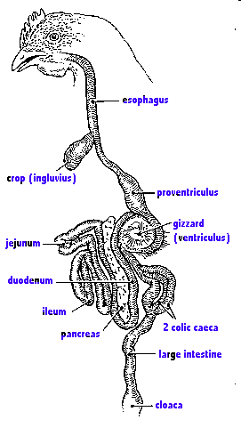
Digestive System
The University of Arizona: species info. Chickens and Turkeys 2008

Slide 18
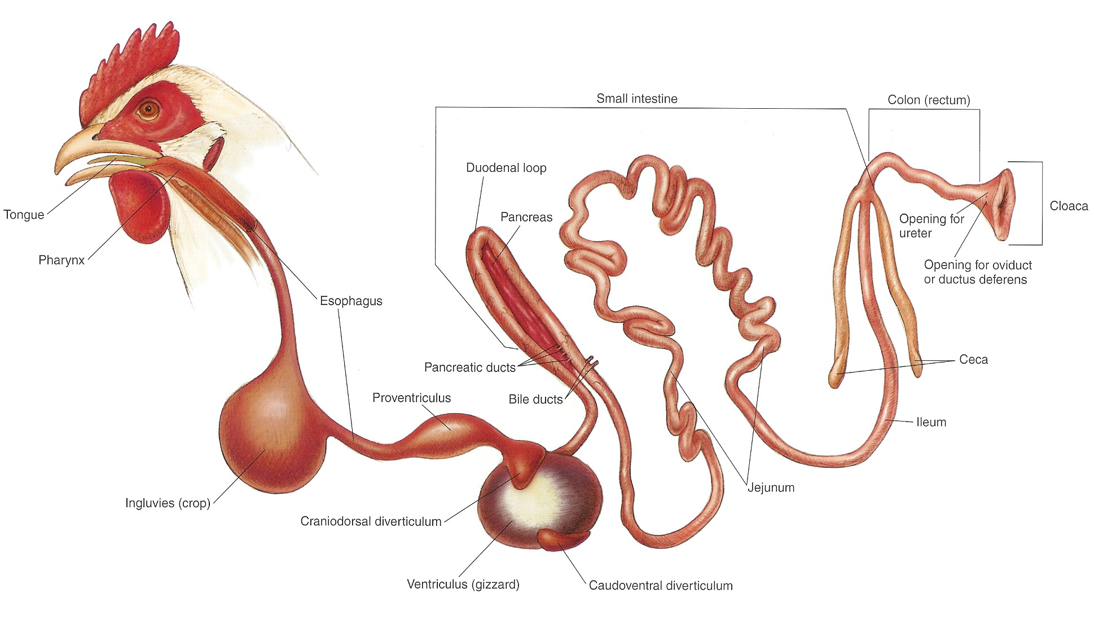

Slide 19

Parts of the Mouth
Tongue
Beak
Taste buds
Beak

Slide 20
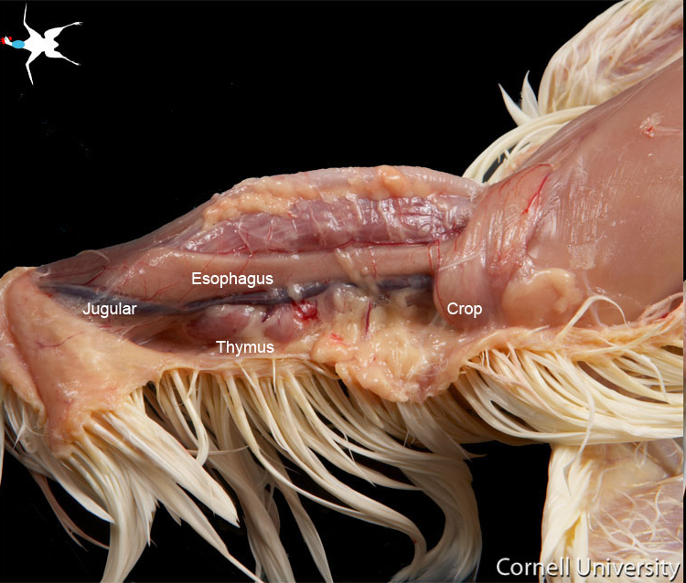
Esophagus
Flexible tube that connects mouth to the crop.

Slide 21
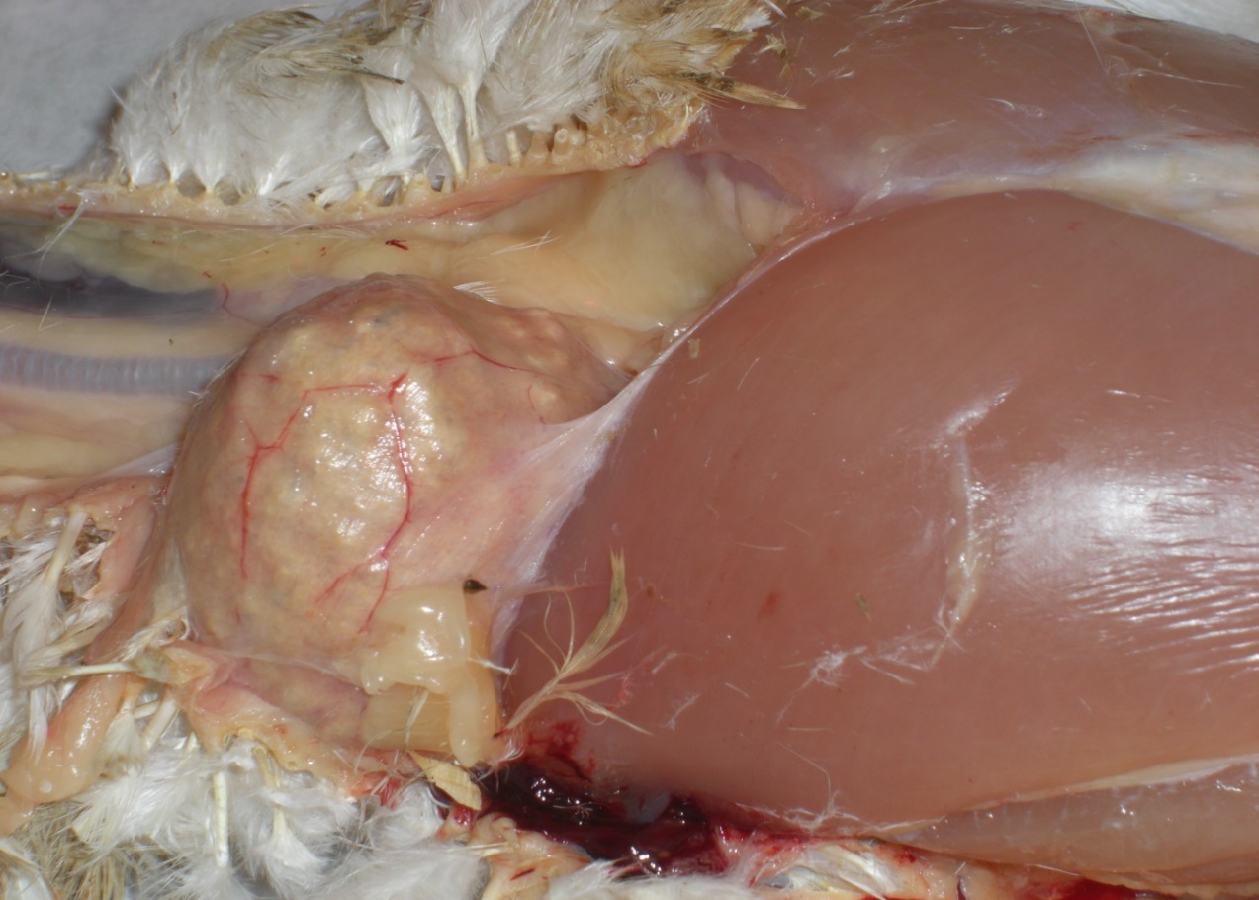
Crop
Function: Moistens food and serves as temporary storage for food
CROP

Slide 22
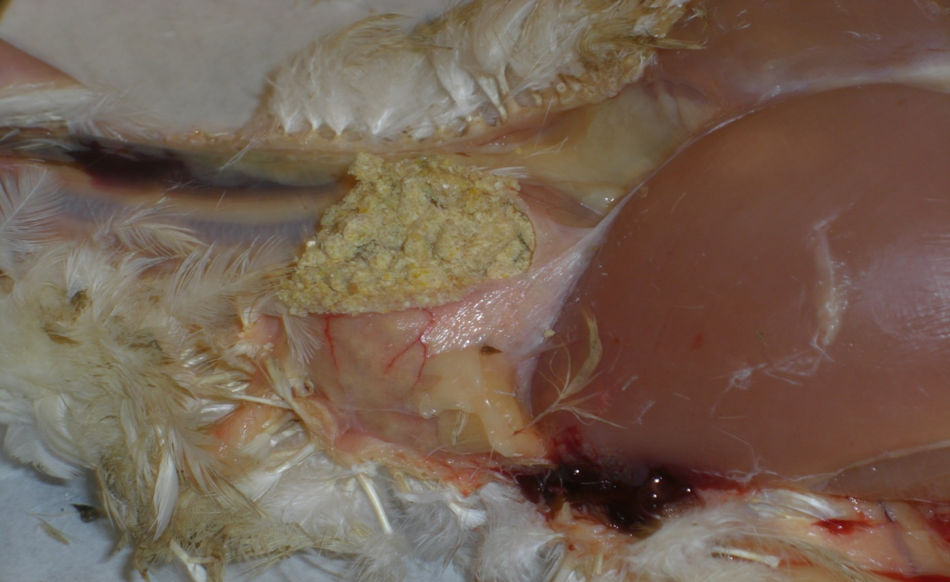
Cranial
Pectoralis muscle
This is a picture of an opened crop. Notice the yellow feed pellets that have been moistened while they were stored in this chicken’s crop.

Slide 23
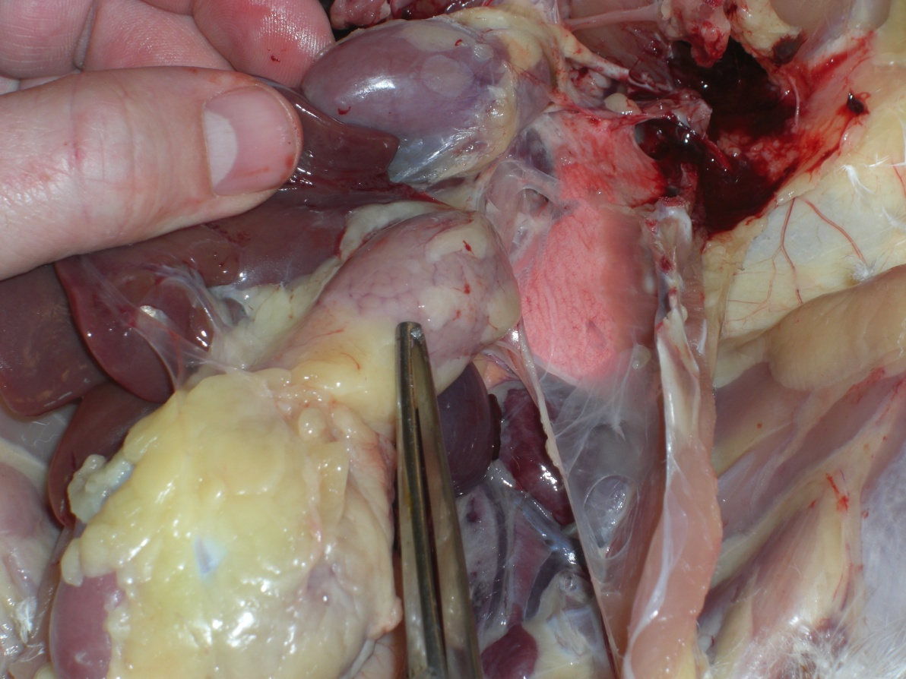
Proventriculus
The stomach of the bird.
Function: uses acids and digestive enzymes to break down food
Proventriculus

Slide 24
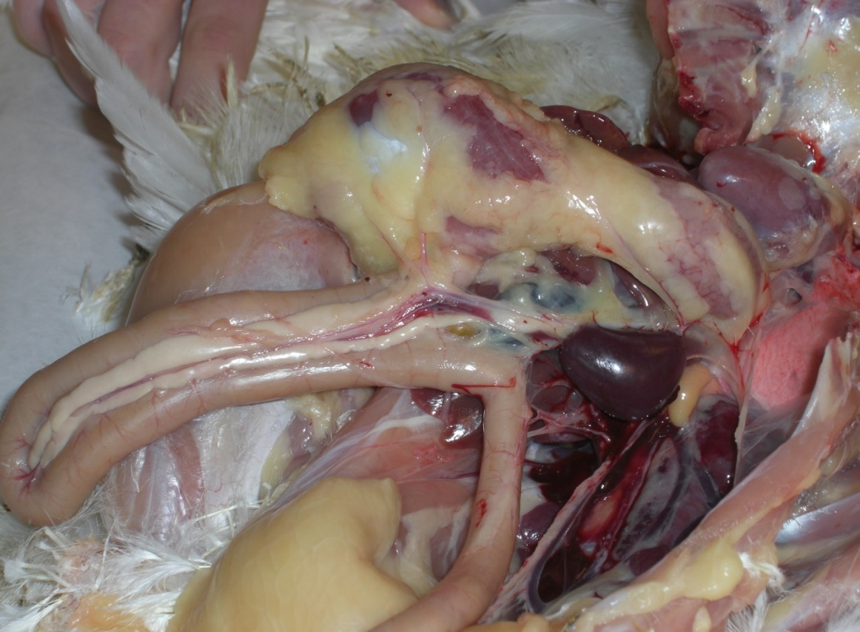
Gizzard
Function: like “teeth,” it mechanically grinds up food particles.
Gizzard

Slide 25
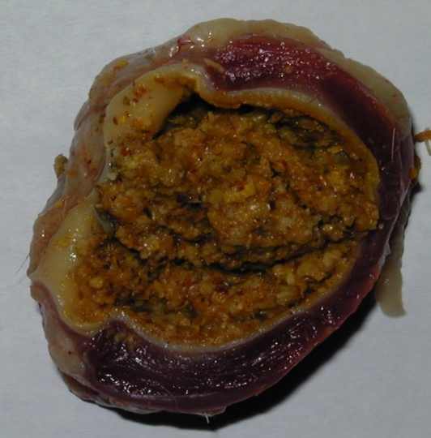
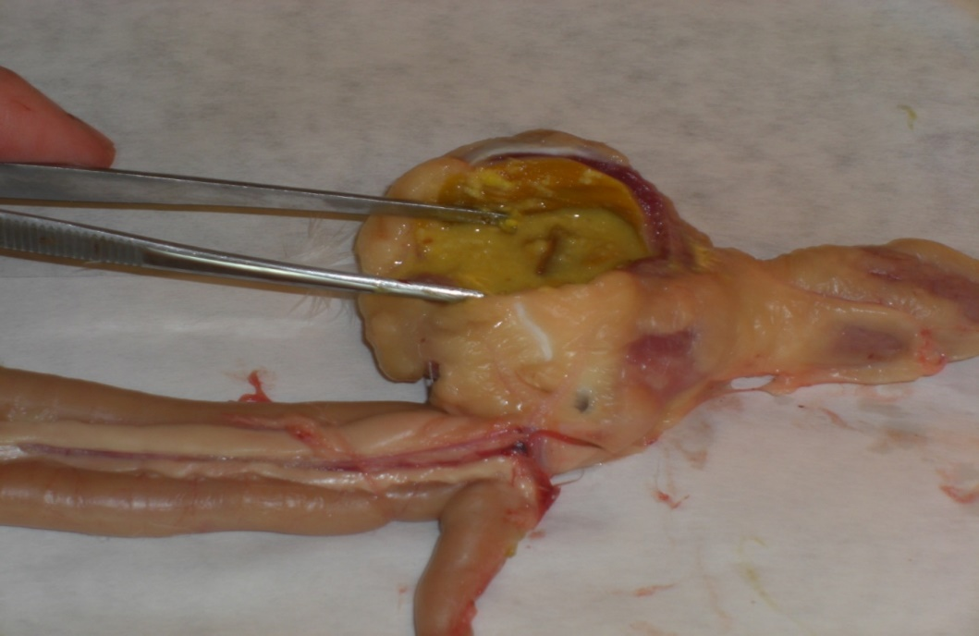
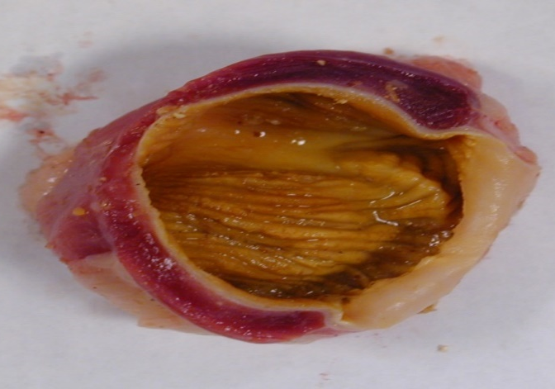
These pictures show a gizzard that has been opened. Notice how the feed inside it has been further digested.

Slide 26
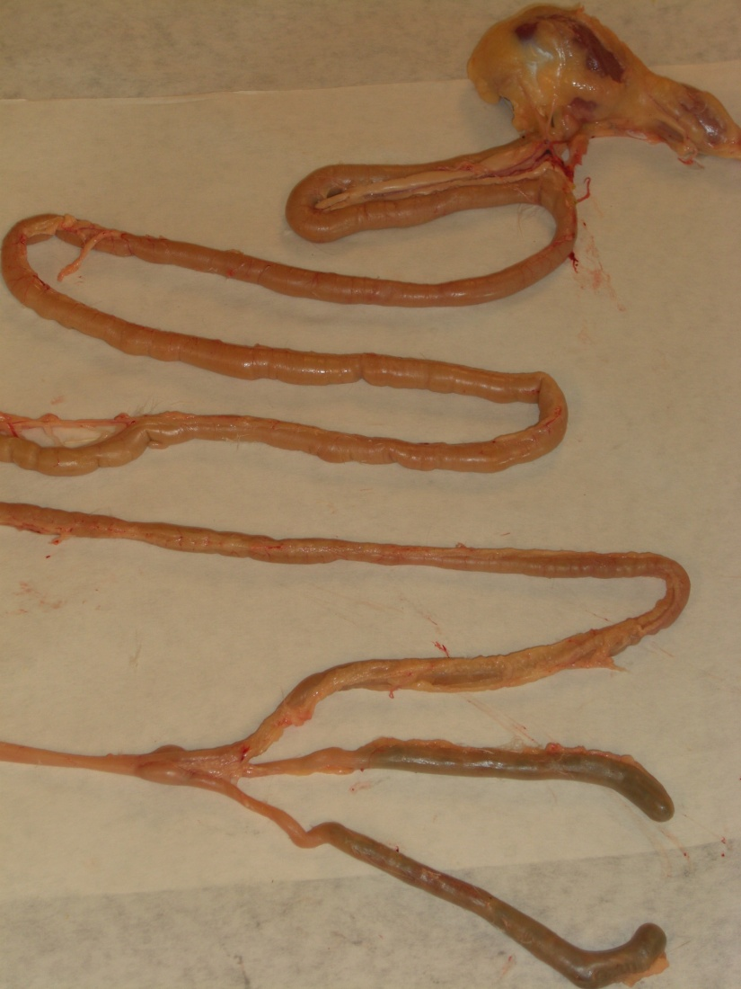
Small Intestine
Three sections:
- Duodenum
- Jejunum
- Ileum
Function: absorption of nutrients from food
Small Intestine

Slide 27
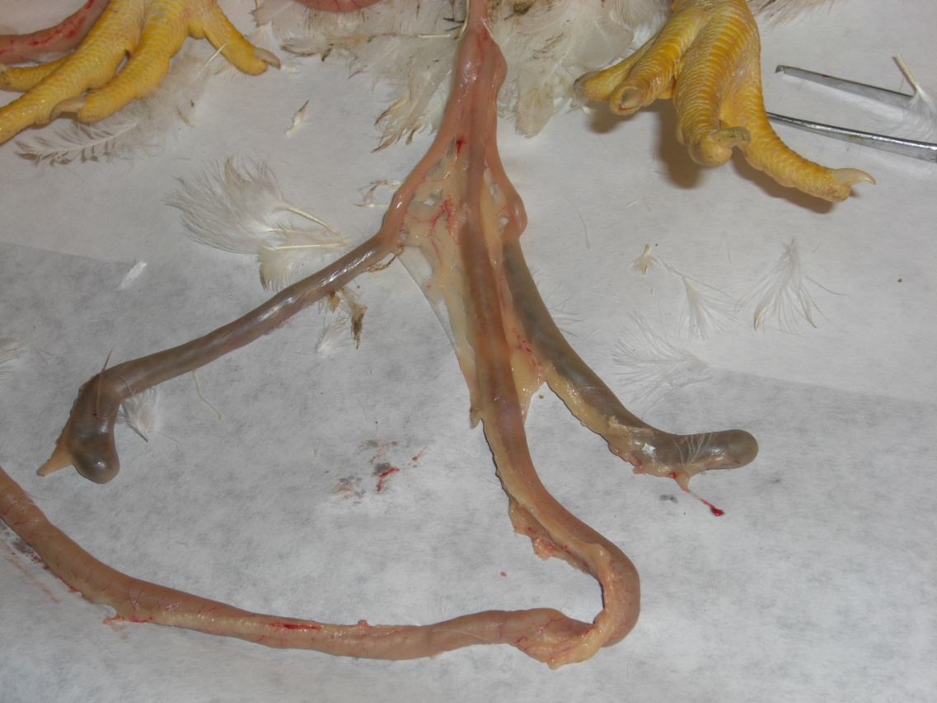
Ceca
Two ceca that are terminal pouches.
Function: fermentation of any leftover food particles and water absorption
Ceca

Slide 28
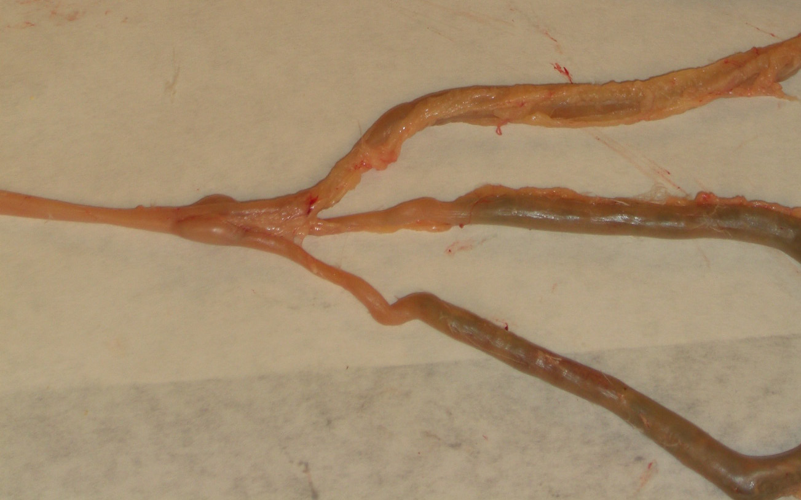
Colon
A.K.A. Large intestine
Function: water absorption
Large Intestine

Slide 29
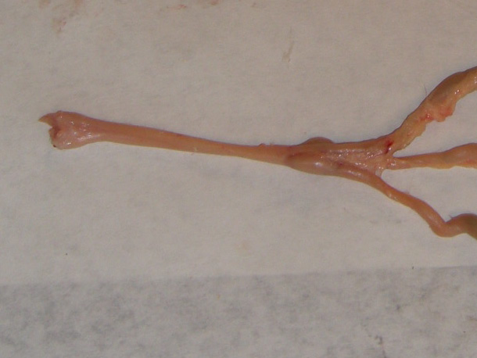
Cloaca
Also known as the vestibule
Function: responsible for expulsion of feces and urine through the vent
Cloaca

Slide 30
Liver
Multi-lobed organ
Functions:
- produce bile to digest fats (stored in gall bladder)
- detoxification
- store fat and fat-soluble vitamins (i.e., A,D,E, K)
- metabolize fats, carbohydrates and proteins that are in the diet.

Slide 31
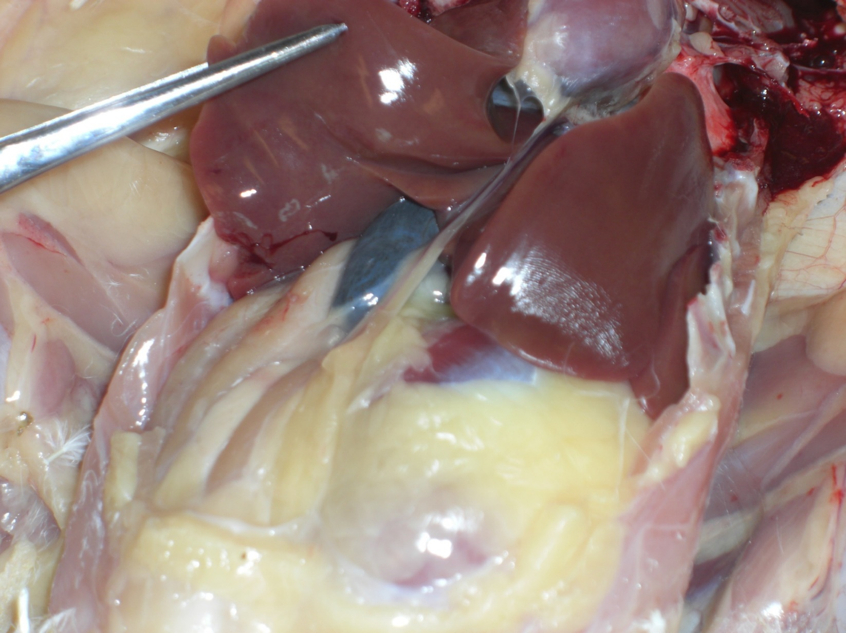
LIVER
GALL BLADDER

Slide 32
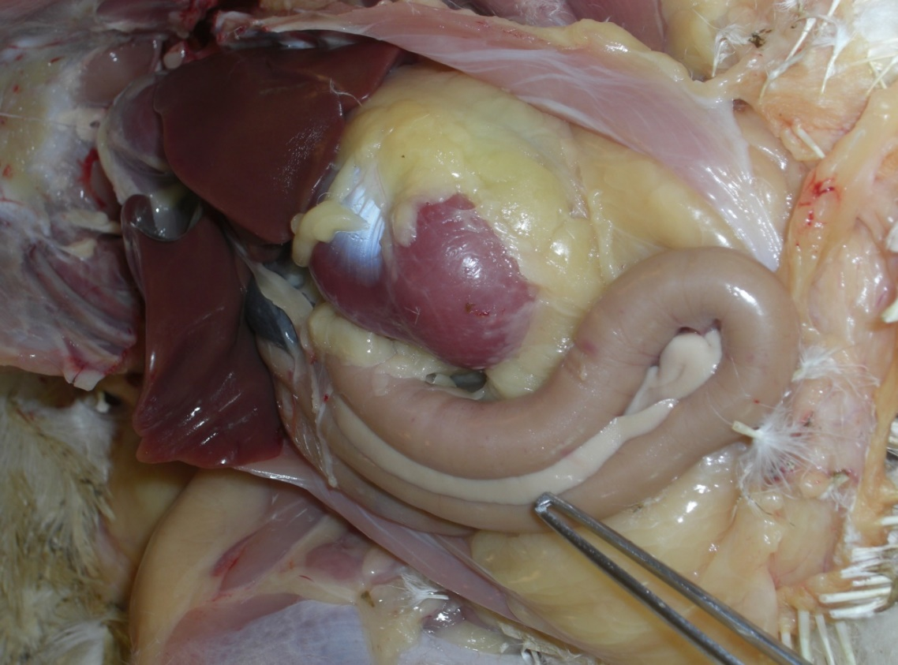
Pancreas
Function: Produces insulin, useful in carbohydrate digestion
Pancreas

Slide 33
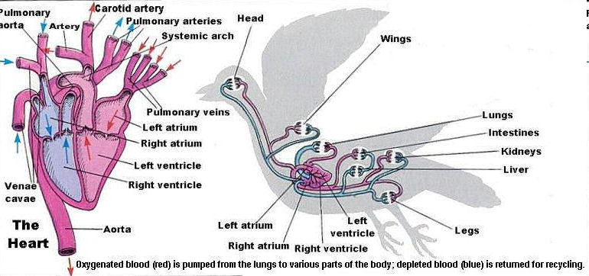
Circulatory System
Department of Biological Sciences. Eastern Kentucky University BIO 554 Ornithology

Slide 34
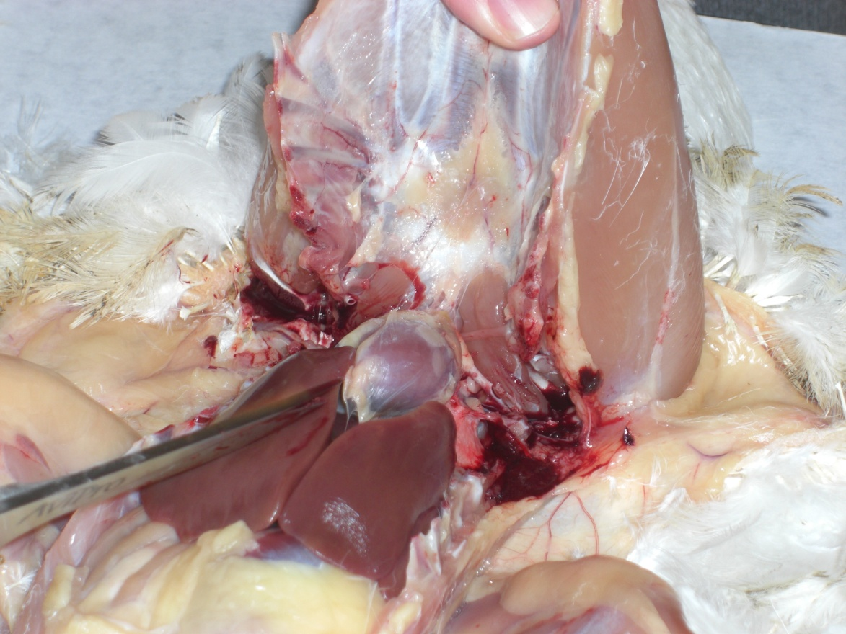
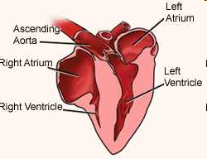
Heart
The heart pumps blood throughout the body to deliver oxygen and nutrients to tissues and to remove carbon dioxide and metabolic waste from tissues.

Slide 35
Blood Vessels
Arteries: carry blood from heart to the rest of the body.
Arterioles: direct blood to certain tissues of the body.
Capillaries: site of exchange between blood and tissues.
Veins: bring oxygenated blood back to the heart.

Slide 36
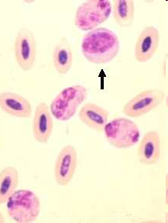
Blood
Components of Blood:
- Red Blood Cells (erythrocyte)
- White Blood Cells (leukocyte)
- Plasma
Red Blood Cell
White Blood Cell

Slide 37
Urinary System
Kidneys
  Two multi-lobular structures located in the rib cage
  Produce urine by removing waste products from the blood
Ureters
  Transport the liquids the kidneys filtrate from the kidneys to the cloaca for excretion
  Birds do not have a bladder.
    Urine is not stored but is instead excreted when produced.
Cloaca
  Feces and urine exit out of the bird’s body through this region in the abdominal cavity.
Uric Acid Excretion
  Poultry excreta contain uric acid.
    Very high in nitrogen and is semi-solid due to its low water content

Slide 38
Male Reproductive System
1. Two testes located internally in the body.
2. Ductus Deferens
Deliver semen from the testes to the phallus.
3. Rudimentary phallus
Poultry have no external penis, but rather an internal protuberance termed a rudimentary phallus.

Slide 39
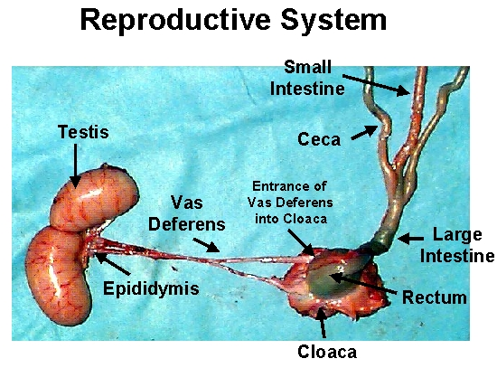

Slide 40
Female Reproductive System
1. Ovary
-Poultry have only one functioning ovary, usually the left ovary.
2. Oviduct
a. Function: to produce albumen (egg white), shell membrane and the shell around the yolk.
b. Five regions
  1. Infundibulum: receives the follicle and is the location of conception where the male and female gamete come together
  2. Magnum: produces the albumen
  3. Isthmus: produces the inner and outer shell membranes
  4. Uterus: plumps the egg, forms the shell and cuticle (seals pores of the egg shell) and determines the shell pigment
  5. Vagina: produces some cuticle, expels the egg and regulates timing of egg production

Slide 41
Female Reproductive System
3. Cloaca
- Also known as the vestibule. The common chamber through which the egg passes and is also responsible for the expulsion of feces and urine.
4. Vent
- the exterior opening through which passage occurs from the digestive system, the urinary tract and the reproductive tract
5. Ovulation
- The releasing of the egg yolk from the ovary to begin its journey through the oviduct
6. Oviposition: the process of laying the fully formed egg, which is regulated by hormones

Slide 42
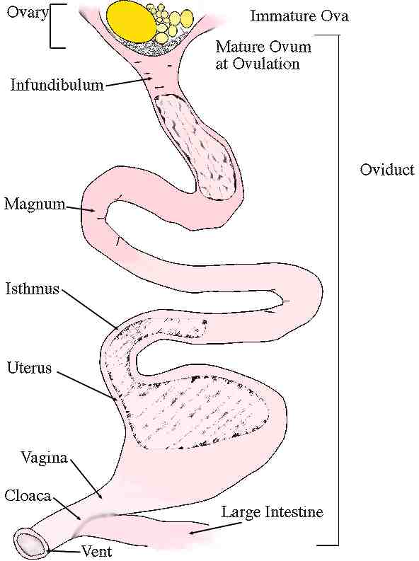
Female Reproductive System

