Slide 1
Chicken Genetics and Reproduction

Slide 2
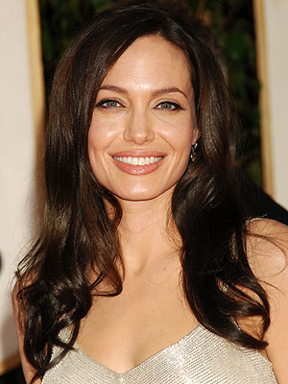

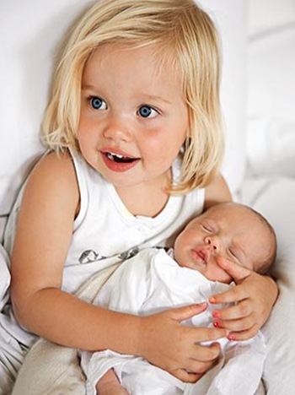
+
=

Slide 3
The goal of genetic selection in poultry is to produce desirable characteristics.
Geneticists want to mate the supermodels and body builders of the chicken world to get the highest quality offspring possible.
Ideally, the offspring will be better than either parent.
Similar to when two very attractive movie stars have a child who is even more attractive than either parent.

Slide 4
The Beginning of Genetic Selection

Slide 5
Domestication
The process of taking a group of animals from the wild and, through a process of selection, causing them to become accustomed to human interaction.
Domestication usually involves selecting for certain desirable characteristics by breeding two animals with the desirable characteristic.

Slide 6
Domestication of Poultry
Before modern production, a number of domesticated varieties of birds existed, each with their own unique qualities.
The two most common traits that were selected for were egg production and meat production. In some cases birds produced more meat to eat, while others were better for producing eggs, but most birds were good for both egg and meat production.
Birds that were used for both egg and meat production were known as dual purpose breeds.

Slide 7
Dual Purpose Breeds

Slide 8
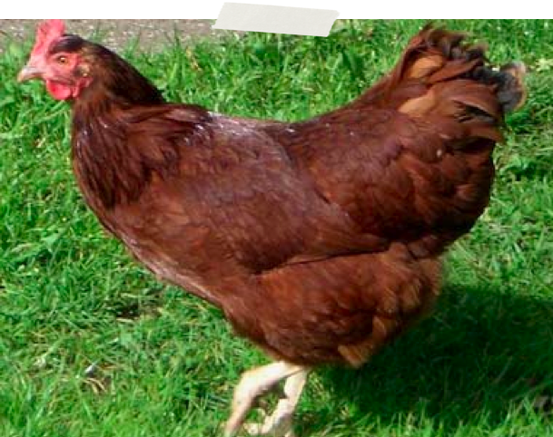
Rhode Island Red

Slide 9
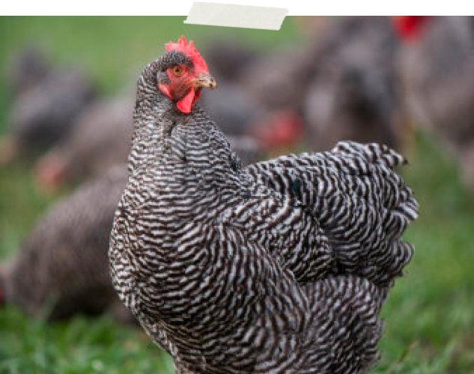
Plymouth Rock

Slide 10
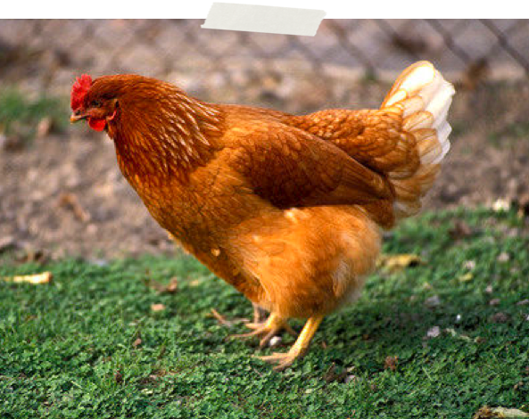
New Hampshire

Slide 11
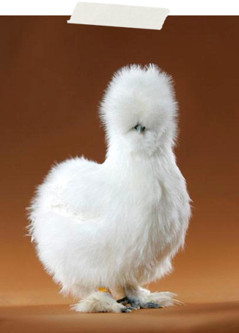
Other Qualities
Other birds were selected for different qualities.
Examples include different colored eggs, feathers on their feet, unique color, unique comb shape, etc.

Slide 12
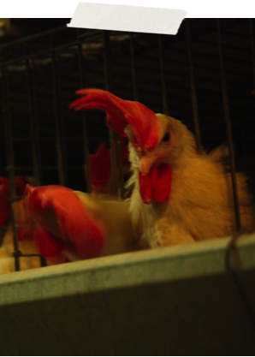
Transition to Single Purpose
More recently, birds began to be selected for either meat production or egg production instead of both.
These are called single purpose birds.

Slide 13
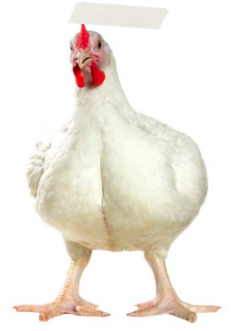

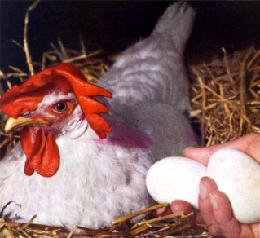
Specialization

Slide 14
Specialization
Specialization has allowed for much greater advances in egg and meat production characteristics.
Allows chicken to be an affordable source of protein because of the ability of broiler chickens to gain so much weight with so little feed
Also allows eggs to be relatively inexpensive because of the ability of laying hens to lay many eggs in a row

Slide 15
Genetic Selection

Slide 16
Genetic Selection
Selecting a desirable trait is the first step in genetic selection.
Desirable traits are different for broilers and laying hens.

Slide 17
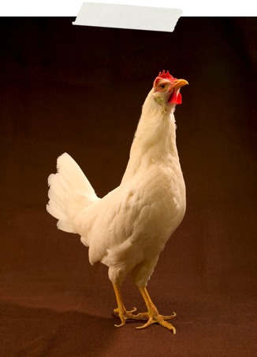
Laying Hens
Clutch length
Shell quality
Sexual maturity
Size
Temperament

Slide 18
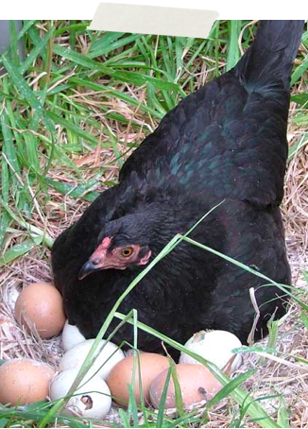
Clutch length
The number of consecutive days a hen lays an egg before taking a break.
Hens have a natural break that takes place in between egg laying periods.
The ability to lay a large number of eggs is a highly desirable trait.

Slide 19
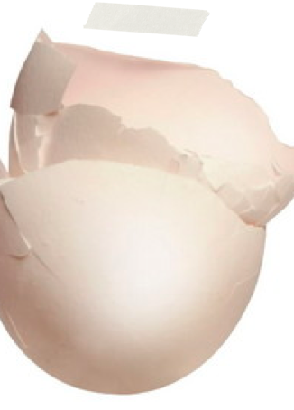
Shell Quality
A strong shell is necessary for the egg to be transported from the farm to the store.
Shells are made from calcium, so a bird’s ability to absorb calcium and convert it into egg shell is a highly desirable trait.

Slide 20
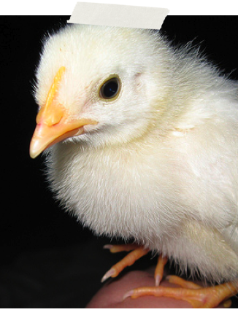
Sexual Maturity
The ability of a female chicken to reproduce, or produce eggs.
With very early maturity, birds will produce eggs sooner in life, increasing a farmer’s profitability.

Slide 21
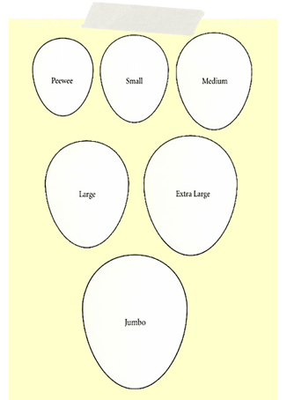
Size
Size of eggs: Consumers want mostly large eggs. If hens are producing medium or jumbo eggs, the return for producers will not be as high.
Size of the hen:
A large hen eats too much, and a hen that is too small cannot produce large enough eggs.

Slide 22
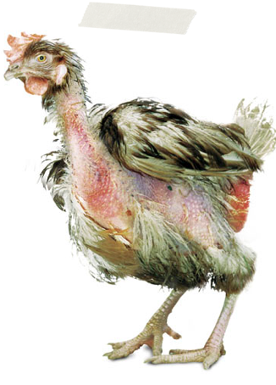
Temperament
Need birds with a good temperament, (birds that are not aggressive) because otherwise they will injure other birds around them by pecking them

Slide 23
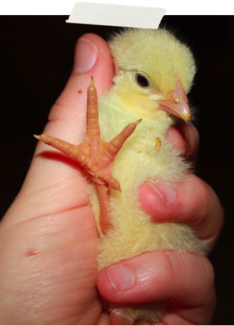
Broilers
Growth rate
Skeletal development
Resilience

Slide 24
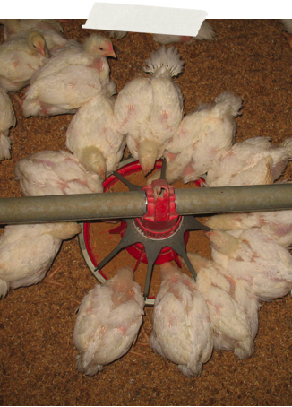
Growth Rate
The rate at which a meat bird grows
Feed conversion (the process of taking feed and converting it into body weight) is an important aspect of growth rate.

Slide 25
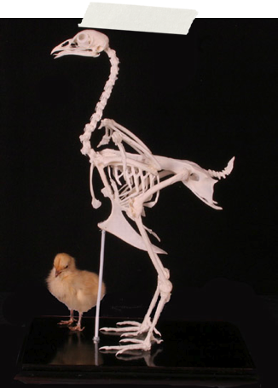
Skeletal Development
A strong skeleton is very important to support body weight.
Bones are synthesized from calcium, so a bird’s ability to absorb calcium and convert it into bone is very important.

Slide 26
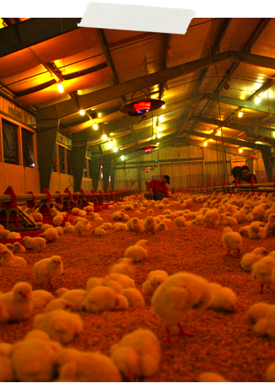
Resilience
The ability of the bird to withstand disease and other environmental factors

Slide 27
Quantifying the Trait
Quantify: the ability to measure the quantity of something.
Traits that are more easily quantified are easier to pass on.

Slide 28
Examples
Selecting for white feathered birds is relatively easy. White feathered birds are easy to see and breed together.
Selecting for birds with better bone development is much more difficult because bone development cannot simply be observed.

Slide 29
Heritability
Some traits are also easier to pass on than others. The ability of a trait to be passed on is known as heritability.
Traits with high heritability are passed on easily and improve quickly in the population.
Low rates of heritability take a much longer time to improve within the population.

Slide 30
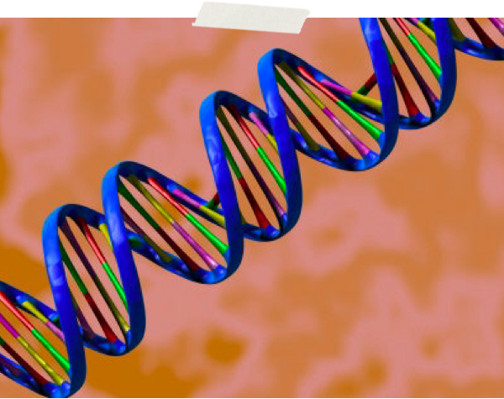
Genetic Selection and DNA

Slide 31
Breeding Stock
Sexually mature poultry of both sexes raised specifically to produce offspring
Each bird has genes made up of DNA that give the bird certain characteristics.
The color of the bird’s feathers, growth rate and sex of the bird are all genetically controlled characteristics.
Breeding stock have genes that give them desirable characteristics.

Slide 32
Genetic Selection and DNA, Breeding Stock
In the same way that animals can be selected for phenotypic traits, animals can also be selected for genotypic traits.
  Genotype is determined by sequencing DNA.
  DNA is composed of nucleotides that are arranged in unique sequences.
  DNA is packaged within chromosomes, and chromosomes are located within the nucleus of every cell.
  DNA provides the blueprint for the manufacturing of every protein within the cell.
  By measuring genetic markers, or sequences of DNA, within an individual, identification of genes associated with desired production characteristics can be determined.

Slide 33
Breeding Stock
Broiler breeders are selected for desired phenotypic and genotypic traits.
A relatively small number of broiler breeders are responsible for the production of millions of meat-type birds.
Broiler breeders are organized into a pyramid scheme that originates with an elite stock of birds.

Slide 34
Broiler Breeders
The elite stock is the most highly valued group of breeders since they contain the ideal genetics and are responsible for maintaining the genetic line.
The parent stock consists of the breeders that produce either the meat or egg-type bird that is used in commercial production.
Any desired phenotypic or genetic changes are made with the elite stock.
It typically takes 5 generations or more for a trait to be passed down from the elite stock to the commercial bird.
Consequently, poultry breeders have to anticipate the needs and desires of commercial birds well in advance.

Slide 35
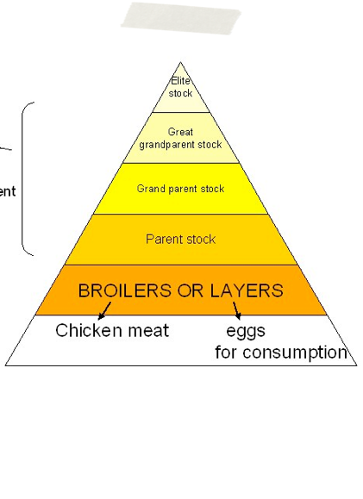
Breeding Timeline
It takes 5 generations or more to pass a trait down to the eggs and meat that we eat.

