Slide 1
Turkey Reproduction

Slide 2
Female Reproductive Tract
Female turkeys, called hens, have a complex system of organs that make up the reproductive system.
It is important that those interested in turkey production be familiar with these various organs and their functions to ensure productivity.

Slide 3
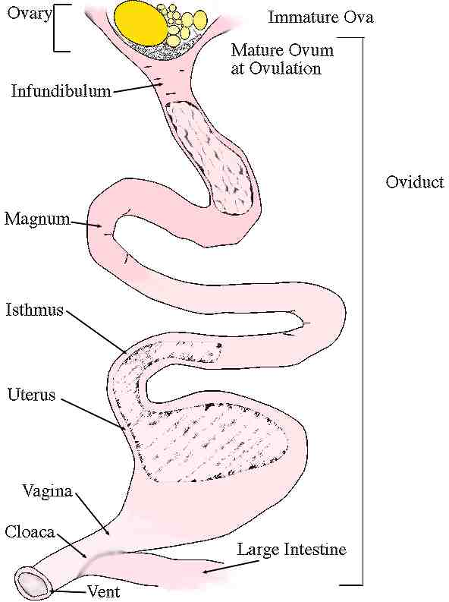
Female Turkey Reproductive Tract

Slide 4
Female Turkey Reproductive Tract
Made up of two main parts:
  Ovary
    Only the left ovary and oviduct matures in these birds.
    The ovary begins to convert ova to egg yolks.
    Yolks are released from the ovary into the body cavity when they reach the correct size.
    The ovulated yolk is retrieved by the infundibulum, which is the first part of the oviduct.

Slide 5
Female Turkey Reproductive Tract
2. Oviduct
  Made up of six main parts and is in charge of egg formation
  Main parts of the oviduct and their functions:
    Infundibulum: funnel shaped; catches the released yolk or ovum after the ovary releases it; fertilization occurs here
    Magnum: longest portion of the oviduct; produces bulk albumen also known as the egg white
    Isthmus: inner and outer shell membranes are secreted here.
    Uterus (Shell Gland): adds watery fluid to the albumen;

Slide 6
Female Turkey Reproductive Tract
    Uterus (Shell Gland): adds watery fluid to the albumen; chalazae is formed; egg shell is formed
    Vagina: muscular tube through which the egg is expelled; semen is stored here in deep tubule glands (semen can be stored from ten days to two weeks); as egg is laid the sperm is squeezed into the tract and migrates up to fertilize another egg
    Cloaca (vestibule) and Vent: the egg is expelled.

Slide 7
Male Turkey Reproductive Parts
The reproductive system in a male turkey, also called a tom, contains several interconnected parts that must all work together in order to have successful mating.

Slide 8
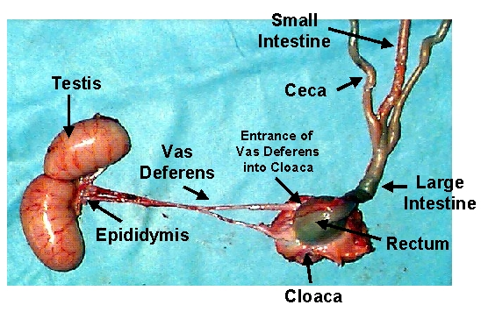
Male Turkey Reproductive Parts

Slide 9
Male Turkey Reproductive Parts
Some of the major organs found in the reproductive system of a tom:
  Testes: inside the body and attached in the middle of the back; shaped like beans with a cream color in immature birds and white in mature birds; produces sperm
      Sperm production increases when light increases (spring).
      Sperm production decreases when light decreases (autumn).
      Sperm is long and torpedo shaped.

Slide 10
Male Turkey Reproductive Parts
2. Vas Deferens
  Transports semen
  Semen matures here
  Storage of semen before ejaculation
  Unejaculated semen is broken down and reabsorbed here.

Slide 11
Male Turkey Reproductive Parts
3. Cloaca
  End of the reproductive tract where the sperm exits the body of the tom

Slide 12
Male Turkey Reproductive Parts
4. Papilla
  Organ in the wall of the cloaca that puts the sperm into the hen’s reproductive tract

Slide 13

Breeding Methods
There are two methods of breeding turkeys.
  Natural Mating
  Artificial Insemination

Slide 14
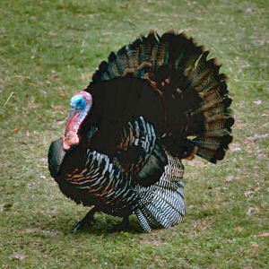
Natural Mating
    Peacocks aren’t the only birds who use their fancy tails to attract a mate.
      Male turkeys puff up their bodies and spread their tail feathers (just like a peacock).
      They grunt (make a “gobble, gobble” sound) and strut about shaking their feathers.
      This fancy turkey trot helps the male attract females for mating.
    Male mates directly with female.

Slide 15
Video
Watch the following videos to view the male turkey strut and call:
  https://youtu.be/3Hpl0oGcx3o
  https://youtu.be/tiOMrg4PdKY

Slide 16
Artificial Insemination
Placing sperm cells in contact with female reproductive cells by a method other than natural mating
This is the current standard and is used almost exclusively in commercial turkey production.

Slide 17
Before Egg Laying …
Fertilization occurs
Division and growth of living cells
Segregation of cells into groups of special functions (tissues)

Slide 18

Between Laying and Incubation …
  No growth
  Stage of inactive embryonic life

Slide 19
Incubation
Day one: blastoderm resumes activity, which means cells will continue to grow and divide
Day two: start of backbone; nervous system; head; blood islands: there is no heart yet, but a system of blood vessels is forming that lies on the yolk
Day three: heart beats; blood vessels very visible

Slide 20
Incubation
Day four: start of tongue; continued development of spine and beak; eyes pigmented
Day five: development of legs, wings
Day six: formation of reproductive organs and differentiation of sex; beak is barely visible; has all organs needed to sustain life

Slide 21
Incubation
Day seven: comb growth begins; egg tooth begins to appear
Days eight and nine: wing bent at elbow; ear passages visible
Days 10 and 11: egg tooth prominent; toe nails visible

Slide 22
Incubation
Days 12–15: lengthening of beak; feather germs more visible; eyelids start to grow over eyeball; ends of wings and legs getting longer
Days 16–19: mostly feathered; scales on legs; external ear almost surrounded by feather germ; beak hardening
Days 20 and 21: beak, claws and scales becoming firm

Slide 23
Incubation
Days 22 and 23: beak turns towards air cell
Days 24 and 25: eyes open and close; beak claps; starts to tuck; can sleep; vocal apparatus functional; yolk begins to be pulled into the body cavity

Slide 24
Incubation
Days 26 and 27: breaks into air cell; begins to breathe; makes noise; pips egg; nostrils open; yolk sac should be completely drawn into body cavity; embryo occupies almost the entire egg except the air cell; still not ready to hatch
Day 28: hatching should occur

