Slide 1
Broiler Production

Slide 2
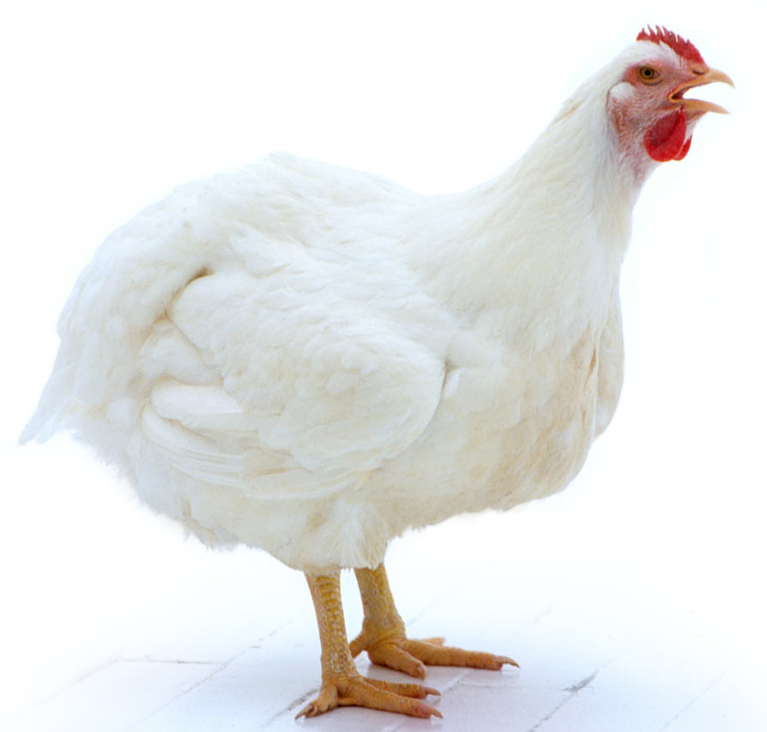
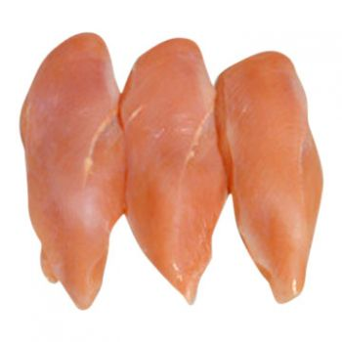
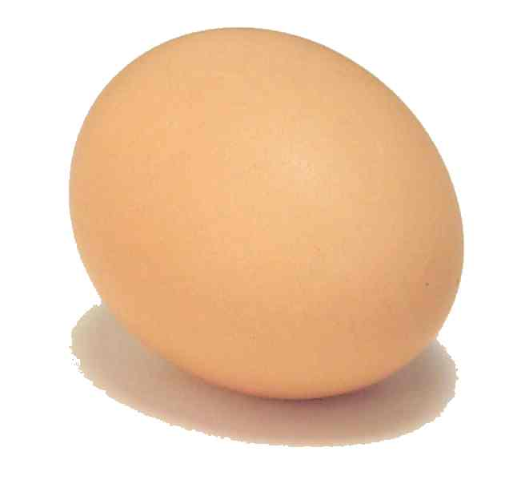
Production Segments Involved in the Production and Processing of Broilers
Broiler breeders
Hatchery
Grow-out farms
Processing plant
Feed mill
Animal health

Slide 3
Production Segments Involved in the Production and Processing of Broilers
    Broiler breeders
      Male (rooster) and female (hen) chickens that are of reproductive age
      Lay fertile eggs that develop to produce broilers

Slide 4
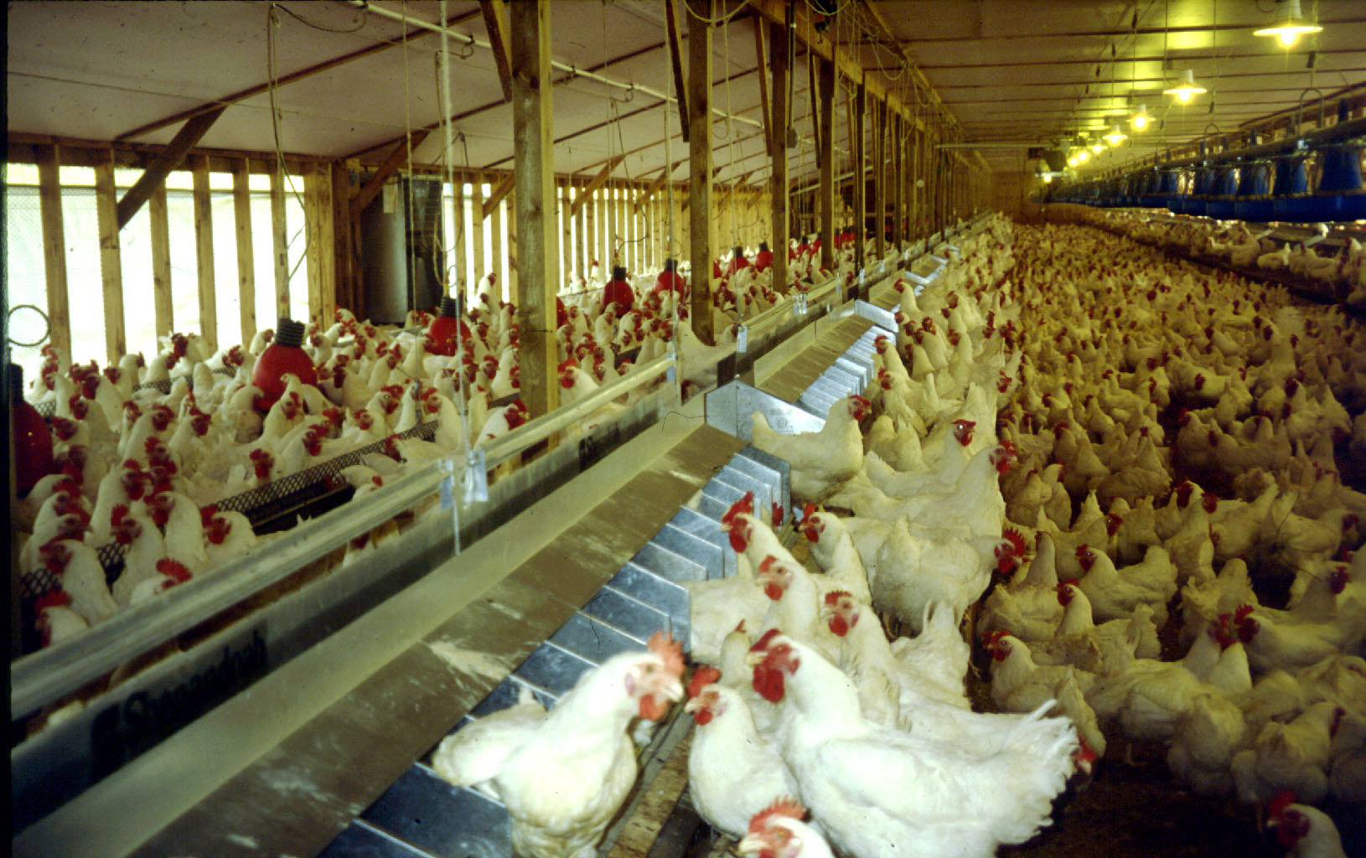
Broiler Breeders

Slide 5
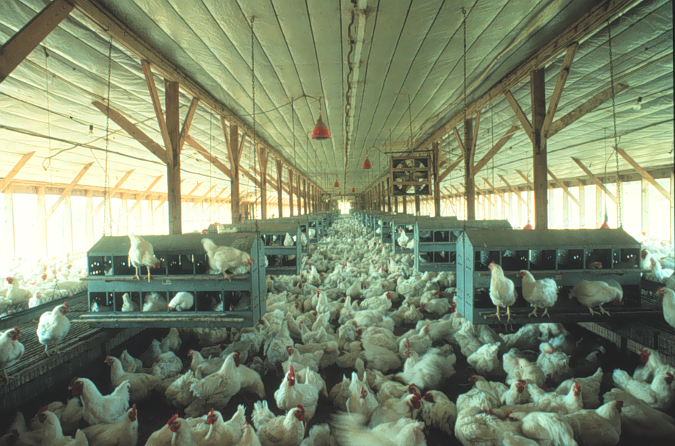
Broiler Breeders

Slide 6
Production Segments Involved in the Production and Processing of Broilers
    2. Hatchery
      The hatchery is responsible for the incubation and hatching of chicks from fertile eggs obtained from broiler breeders.
      The hatchery consists of incubation equipment responsible for maintaining ideal environmental conditions for embryo development.
        Setter/Incubator
        Hatcher

Slide 7
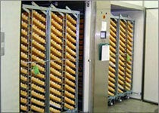
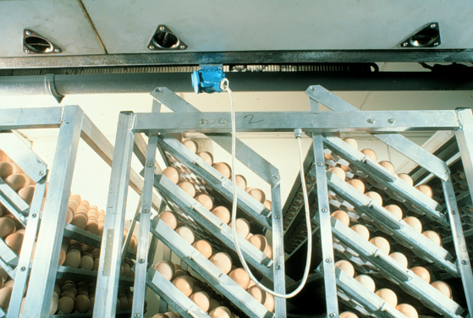
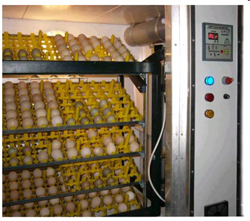
Setter/Incubator
Fertile eggs are incubated in the setter for 18 days.
The setter provides ideal temperature and humidity conditions for embryo development.
The eggs are stored on trays that are secured to incubator racks.
The setter also rotates eggs to ensure proper orientation of the developing embryo in the egg.

Slide 8
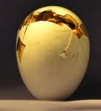
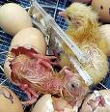
Hatcher
After 18 days in the setter, eggs are transferred from the trays to hatching baskets and are moved to the hatcher.
The hatcher provides ideal temperature and humidity for late-stage embryo development and hatching.
Unlike the setter, the hatcher does not rotate eggs.

Slide 9
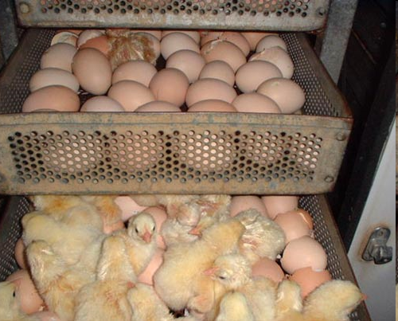
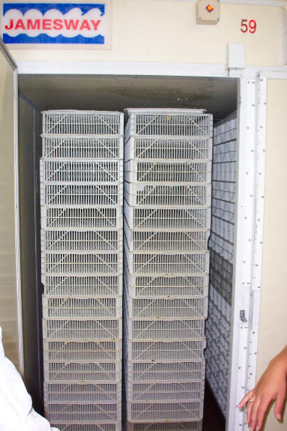
Hatcher
The chicks hatch after 3 days in the hatcher, resulting in a total incubation period of 21 days.
While in the egg, chicks use their beak to break out of the shell, a process referred to as pipping.
Chicks are damp when they exit the shell, or hatch, and the warm temperature in the hatcher plays an important role in drying the chick and maintaining their body temperature.

Slide 10
Production Segments Involved in the Production and Processing of Broilers
2. Hatchery
    Certain vaccinations may be administered “in ovo,” injected through the shell.
    Once hatched, chicks are removed from the hatching baskets and egg shell debris is discarded.
    Chicks are inspected and are serviced (vaccinated, loaded into boxes, etc.) prior to delivery to a grow-out farm.
    Chicks are counted into trays that are used for delivery to grow-out farms.

Slide 11
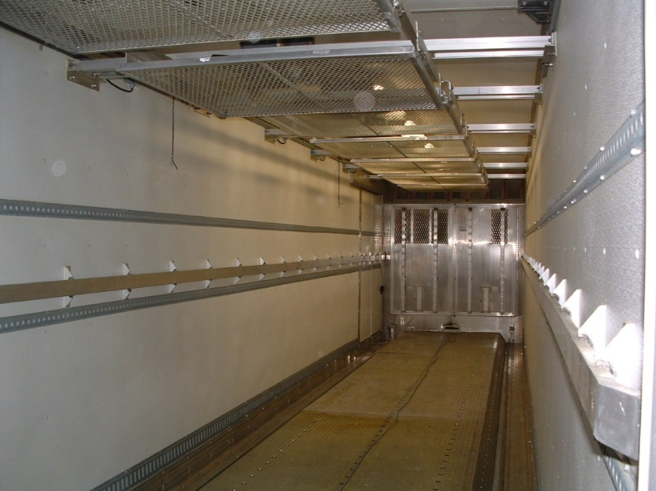
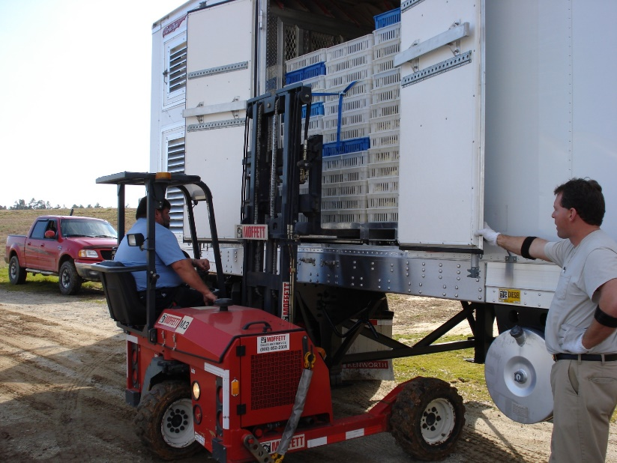
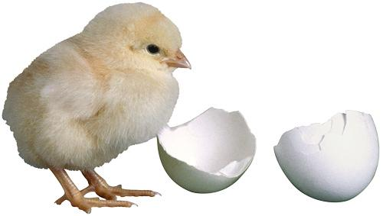
The chicks are loaded into an environmentally controlled delivery vehicle and are transported to the farm where they will be raised to market weight.

Slide 12
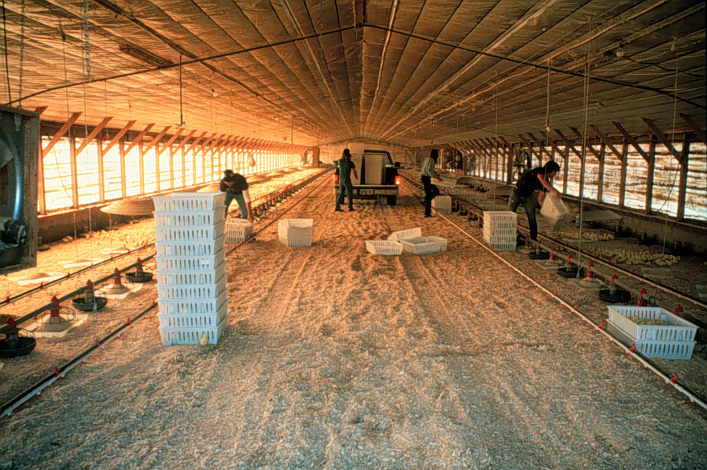
Grow-out Farm

Slide 13
Production Segments Involved in the Production and Processing of Broilers
3. Grow-out farms
  Grow-out farms are where broiler chickens are raised.
  Grow-out houses are specialized buildings that allow age-appropriate control of temperature, humidity, food delivery, water delivery and lighting of the broilers.
  The grow-out house provides birds the freedom to move throughout the house as they want.

Slide 14
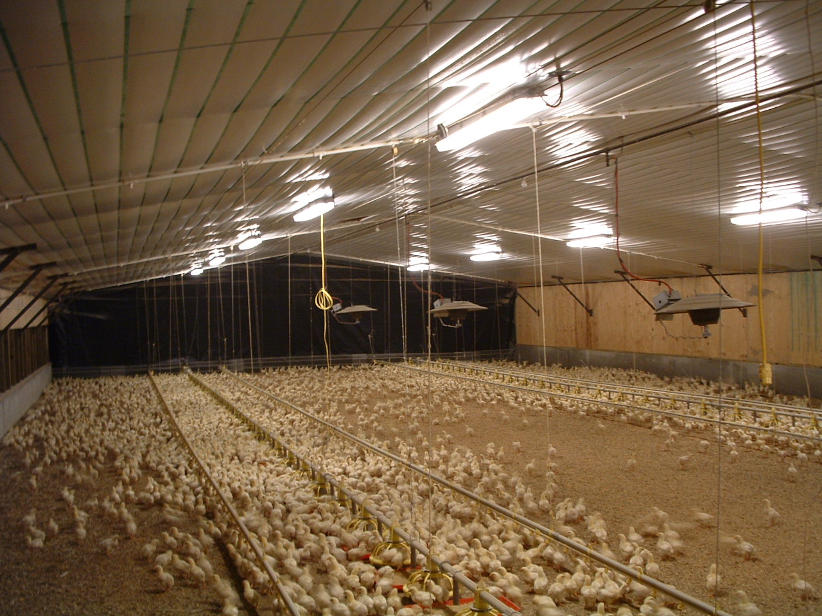
Grow-out Farm

Slide 15
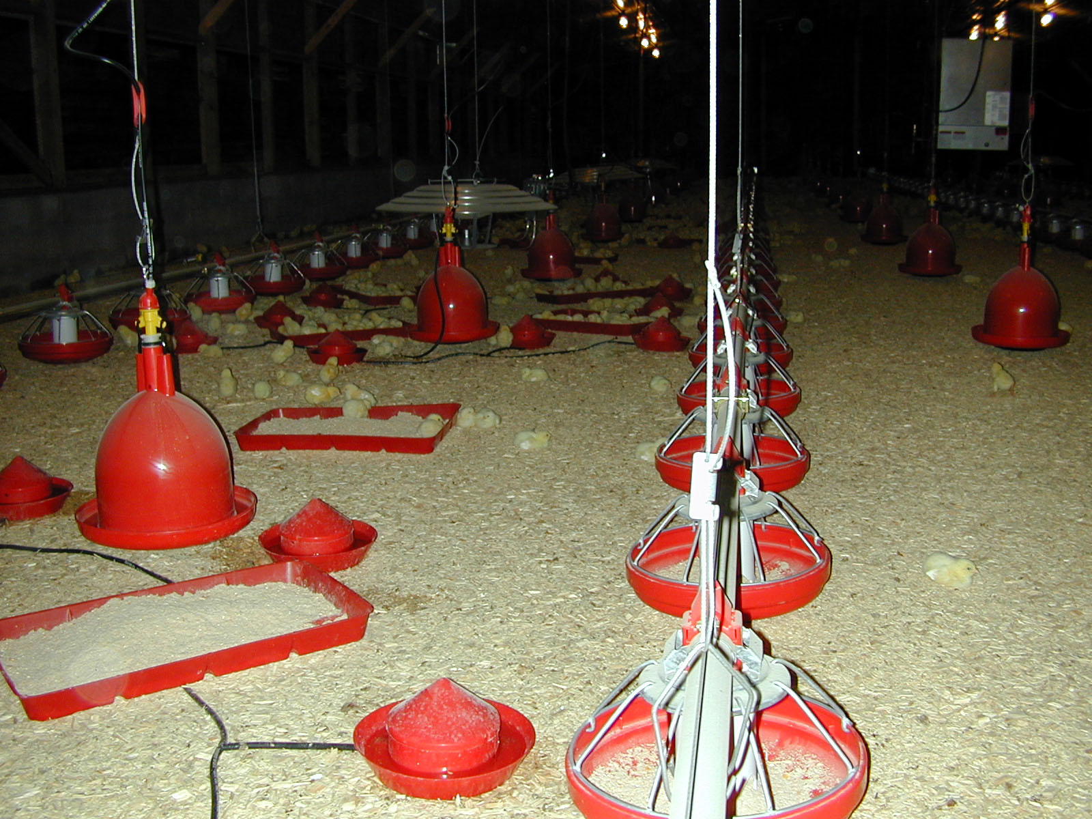
Grow-out Farm

Slide 16
Production Segments Involved in the Production and Processing of Broilers
3. Grow-out farms
  Grow-out houses are either curtain-sided or tunnel-ventilated.
    Curtain-sided
      These houses contain curtain that runs along both sides of the house that can be raised or lowered depending upon the external temperatures to maintain desired environmental conditions in the house.
    Tunnel-ventilated
      These houses contain solid walls on all sides of the house. One end of the house contains large exhaust fans while the other end of the house contains large cool cells.

Slide 17
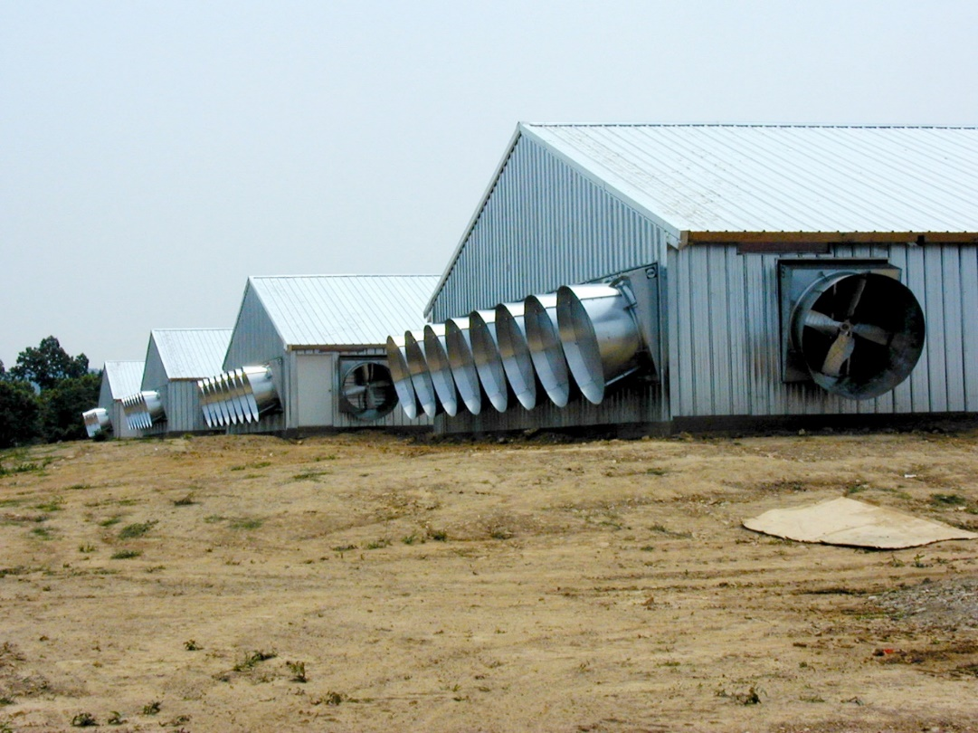
The exhaust fans function to exchange air within the grow out house.

Slide 19
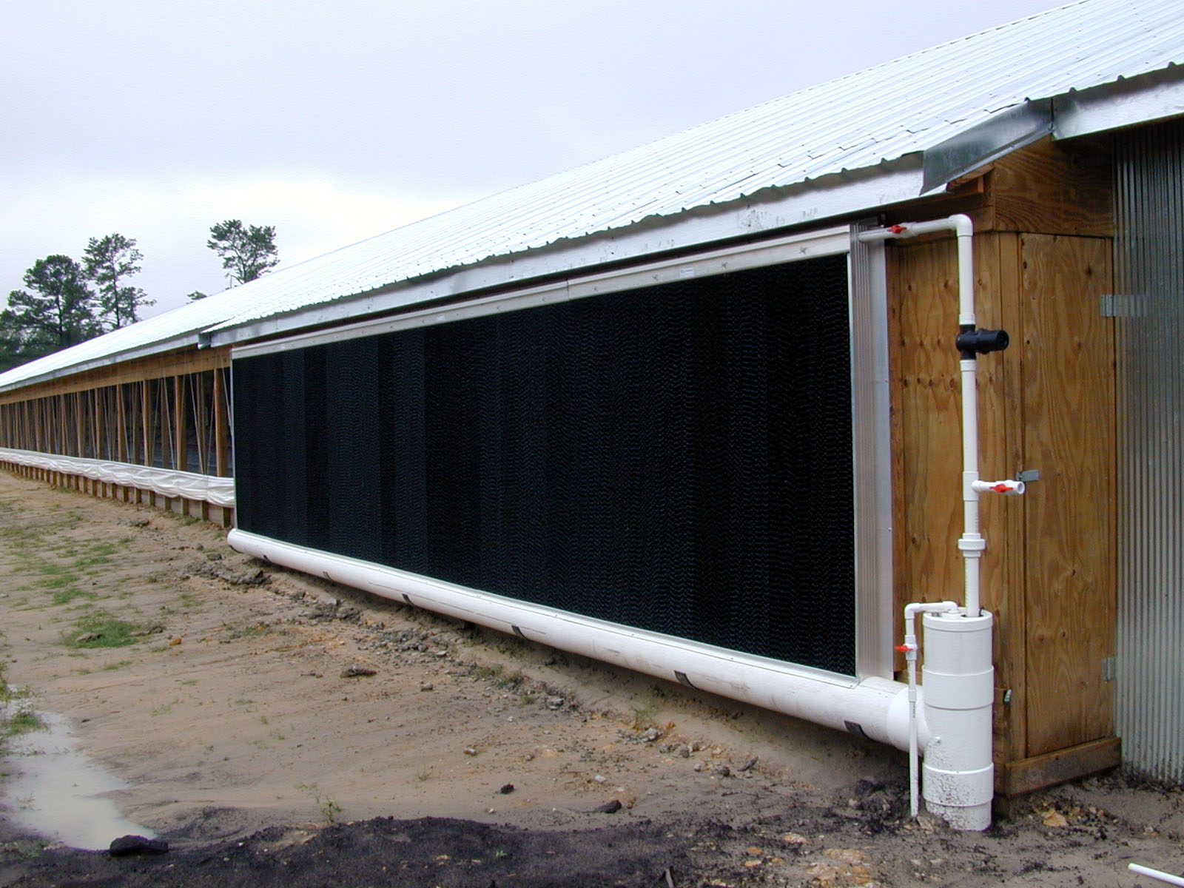
The cool cells function to cool air that enters the house.

Slide 20
Production Segments Involved in the Production and Processing of Broilers
3. Grow-out farms
  Grow-out houses contain automated feed lines that provide birds with access to feed at all times.
  Grow-out houses also contain water lines that provide birds with access to water at all times.

Slide 21
Production Segments Involved in the Production and Processing of Broilers
4. Processing plant
  The processing plant is the location where market-weight broilers are transported for harvesting.

Slide 22
Production Segments Involved in the Production and Processing of Broilers
5. Feed mill
  The feed mill is responsible for preparing finished feed. Different feed rations are used for newly hatched chicks (starter), birds in the development phase (developer) and mature birds (grower).

Slide 23
Production Segments Involved in the Production and Processing of Broilers
6. Animal health
  Many commercial broiler-producing companies employ veterinarians to develop, maintain and implement an animal health plan.

