Slide 1
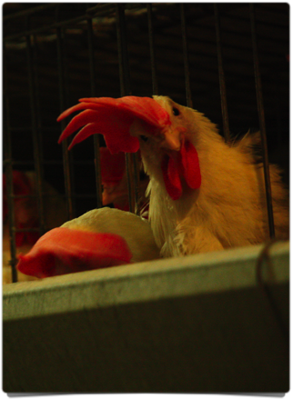
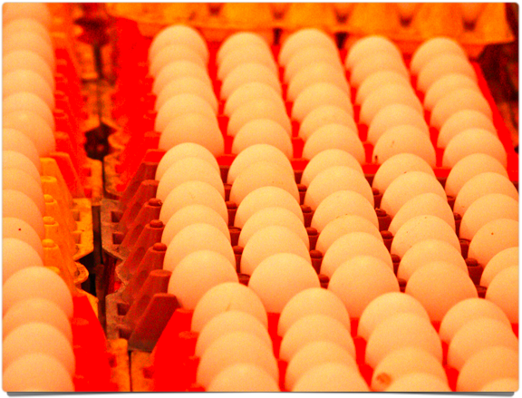
Egg Laying Hens

Slide 2
Understanding the Purpose of Egg Laying Hens

Slide 3
Why does the commercial poultry industry exist?
Laying hens produce eggs for human consumption.
In 2017, per capita egg consumption in the U.S. was 275 eggs per year.
  Equal to approximately 22.9 dozens

Slide 4
Consumption was down during the mid-twentieth century as people moved from farms to cities.
Health concerns also decreased consumption mid-century.
In recent years, better health perceptions and the use of eggs in fast food breakfasts have increased consumption to present rates.

Slide 5
Where are eggs found?

Slide 6
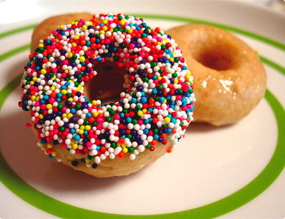
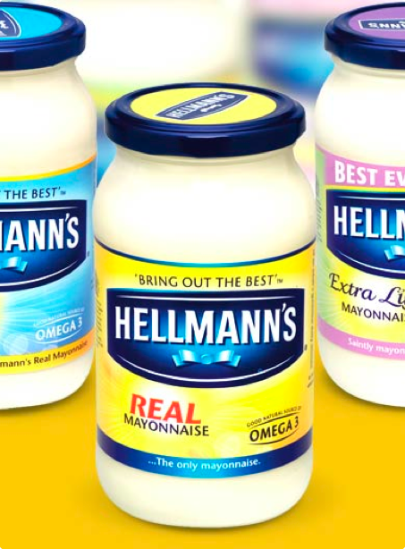
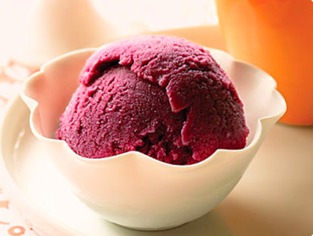

Slide 7


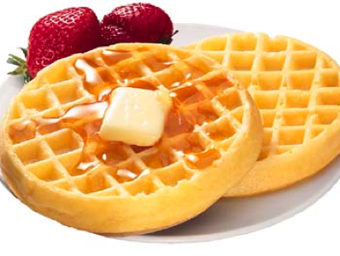

Slide 8
Other Egg Containing Foods ...
Jelly beans
Crackers
Cookies
Pudding
Pretzels
Marshmallows
Pie crust
Cake
Tartar sauce
Frosting
Some candies
Most foods that have been battered and fried

Slide 9
Where in the country do our eggs come from?

Slide 10
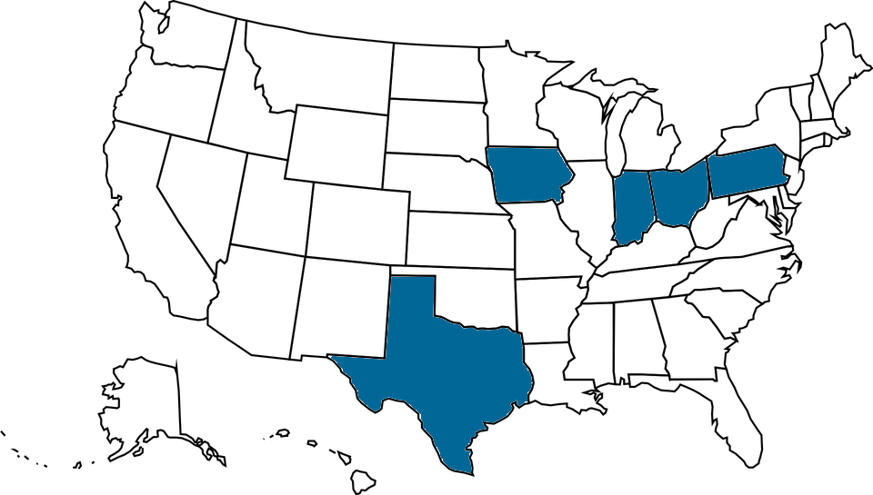
Top 5 producing states:
1. Iowa
2. Indiana
3. Ohio
4. Pennsylvania
5. Texas
These are the largest egg producing states, and they house approximately 50 percent of the laying hens in the U.S.
In the U.S. approximately 106 billion eggs were produced during 2017.

Slide 11
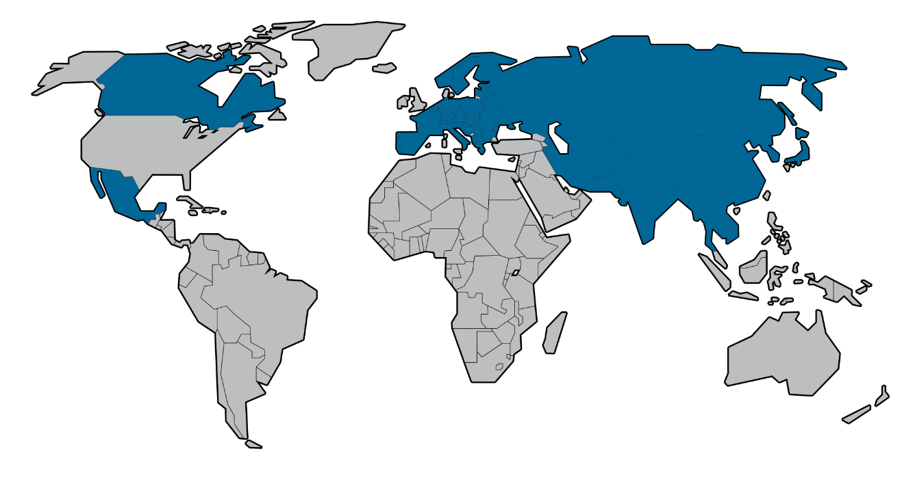
There are over 60 egg-producing companies with more than 1 million laying hens and 12 with more than 5 million.
In addition to producing eggs for the U.S., 252 million eggs were exported, mainly to Asian countries but also to Europe, Canada and Mexico.

Slide 12
Hen Reproductive Physiology and Egg Formation

Slide 13
An egg takes 23 to 27 hours to form and then be laid.
The shorter the time it takes the hen to form an egg, the more days in a row a hen will lay an egg.
The number of days in a row that a hen lays an egg is referred to as clutch length.
The term for the part of the hen where the egg is created is oviduct.

Slide 14
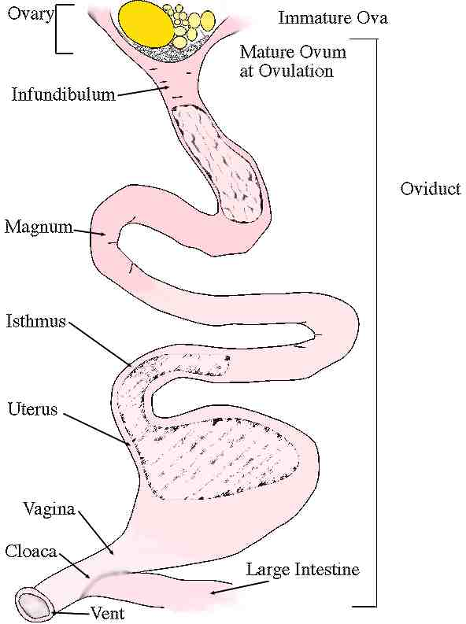
Parts of the Oviduct
Ovary
Infundibulum (Funnel)
Magnum
Isthmus
Uterus (Shell Gland)

Slide 15
Ovary
Hens only have one functional ovary (usually the left one).
The ovary contains a series of follicles that mature as yolk material is added to them. Follicles look like little balloons on the ovary.
Yolk material is manufactured in the liver.
When a follicle ruptures, ovulation occurs.
The ovulated yolk then leaves the ovary and makes its way down the reproductive tract.
If two follicles rupture at the same time, double-yolked eggs can form.

Slide 16
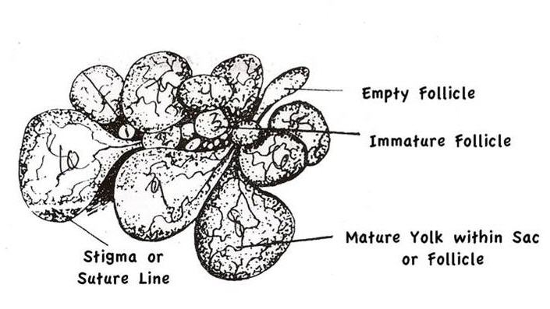
Ovary

Slide 17
Infundibulum (funnel)
After ovulation, the yolk enters the infundibulum, also known as the funnel.
The infundibulum is controlled by tactile (touch) stimulation, so any time something touches the inside of the funnel an egg forms.
This can lead to no-yolk eggs or eggs formed around a piece of the oviduct that has broken off in some cases
If the hens were allowed to breed, this is also where conception would take place.

Slide 18
Magnum
This is where the thick and thin egg white is formed.
Egg white is also called albumen.

Slide 19
Isthmus
The shell membranes form here.
The membranes are the thin, opaque films closest to the egg shell when you break it open.

Slide 20
Uterus
The egg spends most of it time in the uterus (approximately 20 of the 23 to 27 hours).
The shell forms. Most of the shell formation takes place at night.
Even though the shell appears solid, there are actually thousands of tiny pores in the shell that allow the developing chick to breath while inside.

Slide 21
Uterus
The shell color is added.
A protective cuticle (wax-like coating) is added.
The cuticle is like a natural sealant that prevents the egg from losing moisture too quickly.

Slide 22
Other Parts of the Reproductive Tract
Vagina: Acts as a transport from the uterus to the vent.
Cloaca: (Vestibule) Common chamber through which the egg passes.
Vent: Outer opening of the hens reproductive and digestive tracts. Eggs and the urine/feces mixture eventually pass through this opening.

Slide 23
Systems for Raising Laying Hens

Slide 24
Floor House
Hens are raised on the floor of a light- and temperature-controlled house.
Usually equipped with an automated feeding and watering system, as well as a mechanical nest for egg gathering
Hens are free to roam and congregate where they please.

Slide 25
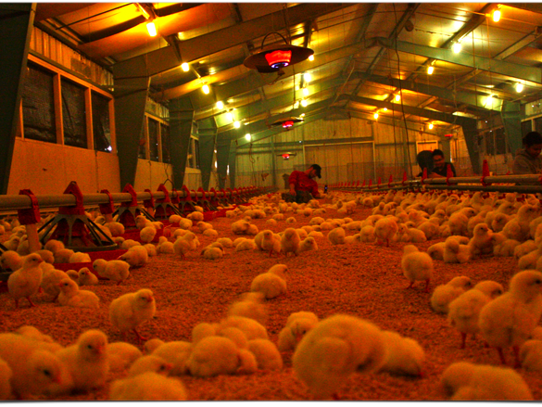
Floor House
These are actually broiler chicks not laying hens, but the house looks similar at this stage of life.

Slide 26
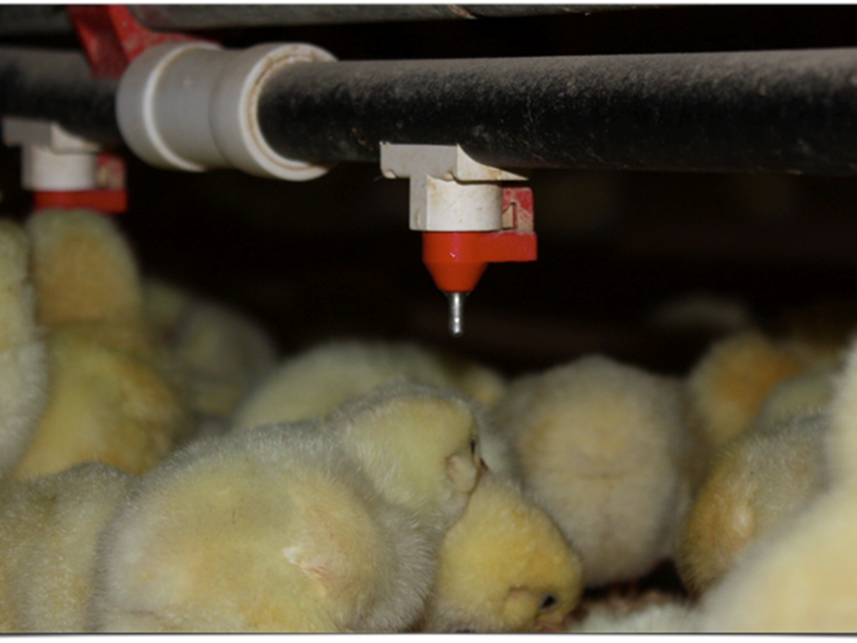
Nipple Watering System
Standard equipment in a floor house

Slide 27
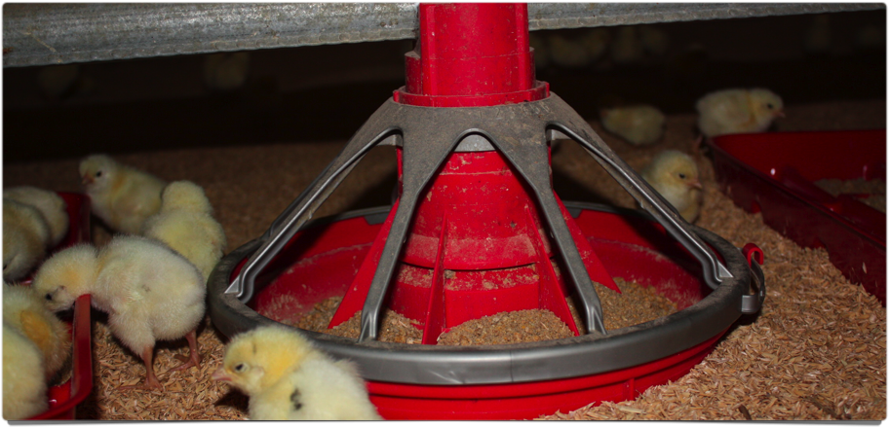
Automated feeder
Also standard equipment
Several designs exist

Slide 28
Cage House
Hens are raised in cages.
Sometimes, there will be a single layer of cages per house.
Normally, several rows of cages are stacked on top of one another (stacked deck house).
Cages have roll outs (areas to catch eggs) and normally have an automated egg-gathering system.
Normally have an automated feeding and watering system

Slide 29
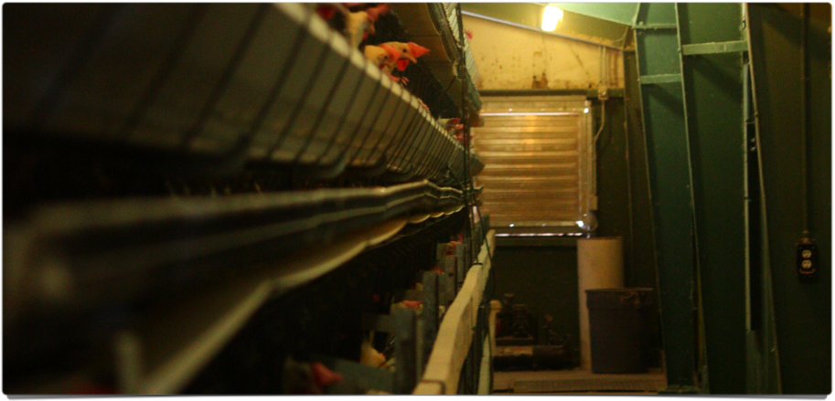
Cage house
Two layers of cages are visible, but four layers are present.

Slide 30
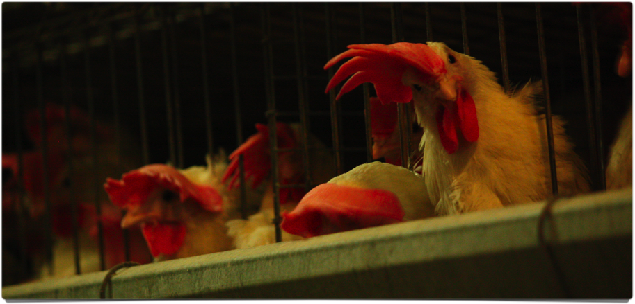
White Leghorns in a cage house
Note the feeder (metal trough)

Slide 31
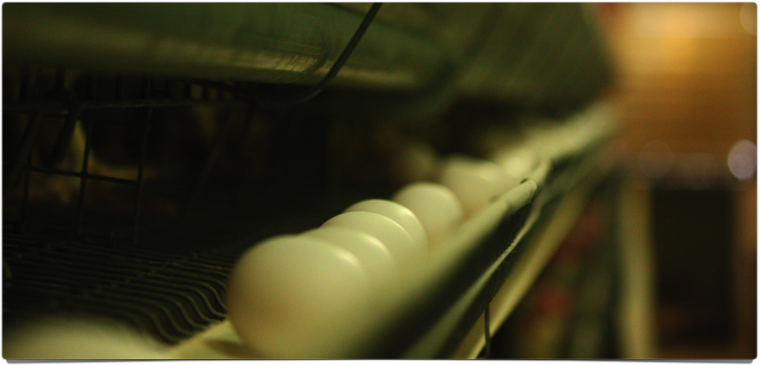
Egg Roll Outs
Most are padded to prevent eggs from breaking.

Slide 32
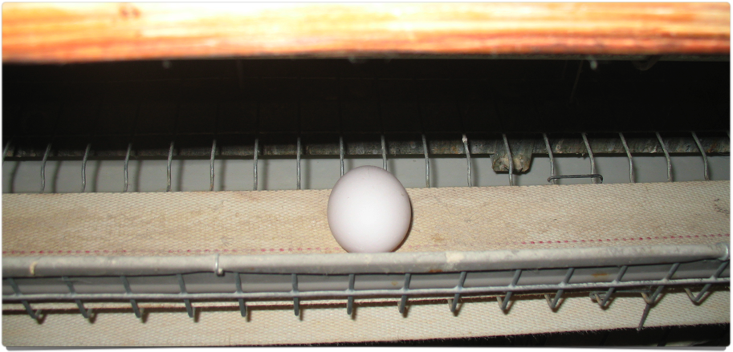
Egg Belt
Used to carry eggs to processing
Note the padding on the near edge of the roll out.

Slide 33
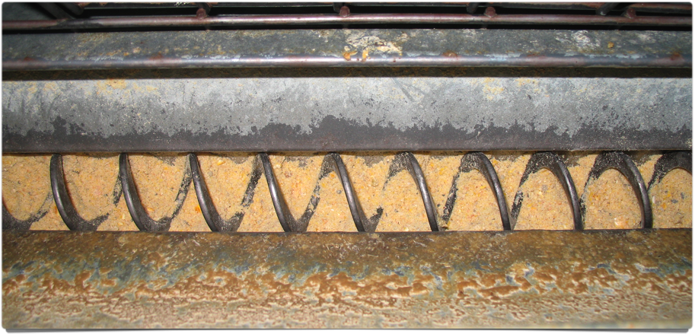
Auger Feeder
Used to bring feed to birds.

Slide 34
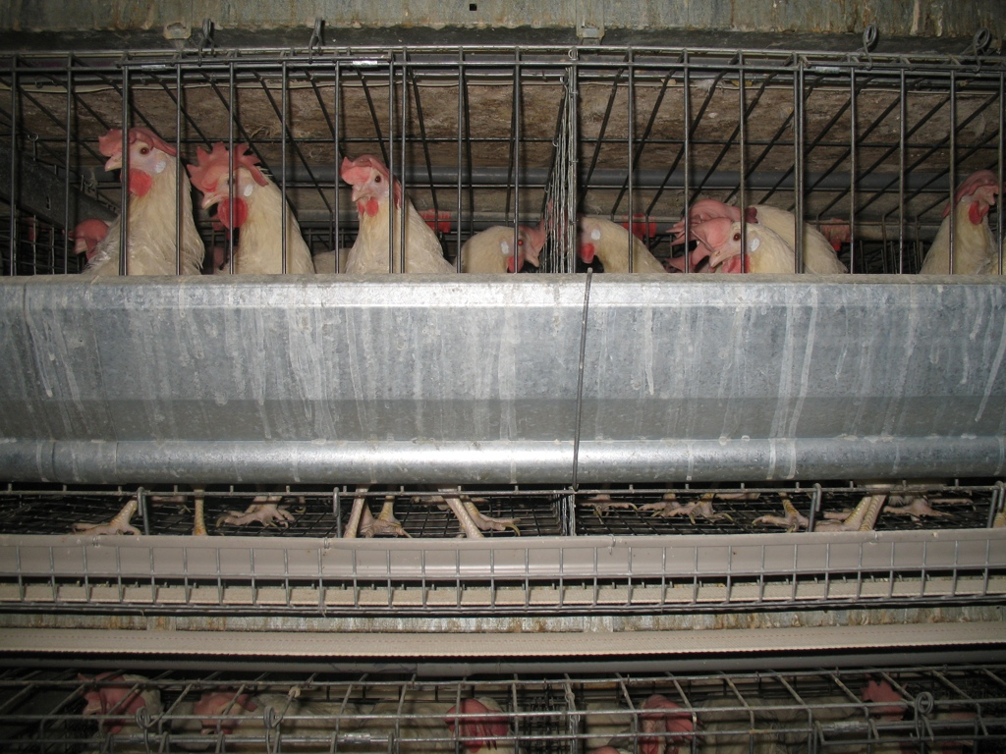


Feeder
Egg belt/ roll out

Slide 35
The Life Cycle of a Laying Hen

Slide 36
Laying hens usually have a two year production cycle.
Hens arrive at a grow-out facility at one day of age.
Immature hens (pullets) usually stay in the grow-out facility for approximately 18 weeks. It is critical that during this time pullets are not exposed to increasing day length.
Once hens have reached proper body weight, they can be moved to the lay house. During this period, hens should be exposed to an increasing day length.

