Slide 1
Turkey Production

Slide 2
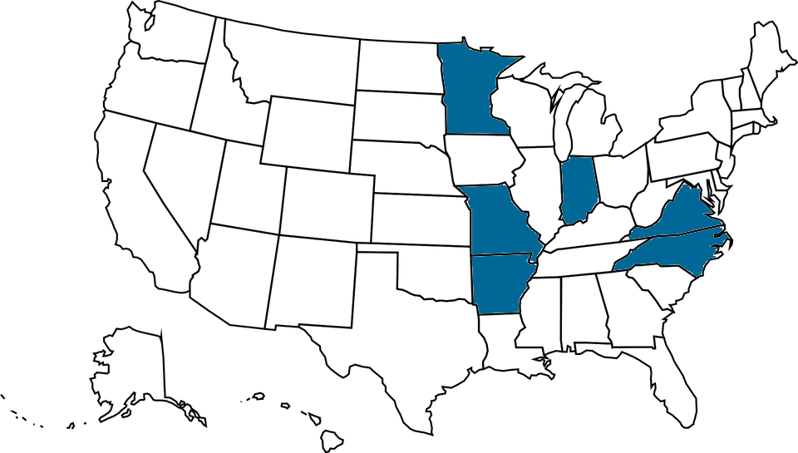
U.S. Turkey Production
Turkey produced in 2017
  243 million turkeys
  7.5 billion pounds
2017 top states by number produced
  Minnesota 42 million
  North Carolina 32.5 million
  Arkansas 26.5 million
  Indiana 20 million
  Missouri 18.8 million
  Virginia 16.8 million

Slide 3
Turkey Consumption in the U.S.
Turkey consumed
  U.S. 16.4 pounds per person
  28.5% of turkeys produced are consumed during holidays.

Slide 4
Uses for Turkey
Meat
  Bacon, lunch meat, ground meat, hot dogs
  Whole birds
By Products
  Feathers ground into animal feed
  Quill fibers used in nylon and yarn
  Grow-out house litter used as fertilizer or fuel source in electric power plants

Slide 5
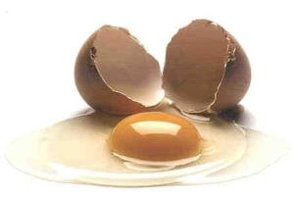
Selecting
Male turkeys selected for meat traits:
  Thicker thighs
  Plumper breast
  Meatier drumsticks
  Faster rate of growth
  Higher feed efficiency
Female turkeys selected for
  Fertility
  Hatchability
  Egg size
  Meat conformation

Slide 6
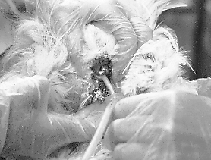
Method of Breeding
Artificial Insemination
  Due to the large breasts and mature size of toms, they can not breed naturally.
  Semen of 1 tom collected
  for every 10 hens.

Slide 7
Incubation
An incubator is a box that holds and rotates eggs while maintaining appropriate temperature, humidity and oxygen levels.
Turkey eggs are incubated for 28 days.
Species | Days Incubated
Turkey | 28
Chicken | 21
Ostrich | 42
Geese | 22-30

Slide 8
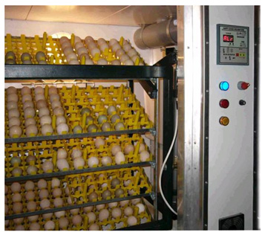
Six Keys to Incubation
Temperature (most critical)
  99.5°F to 100°F
  Inadequate temperature will lead to deformed poults and embryonic death.
Humidity
  60% to 65%
  Improper humidity affects the development of the shell and the poult’s ability to break it.

Slide 9
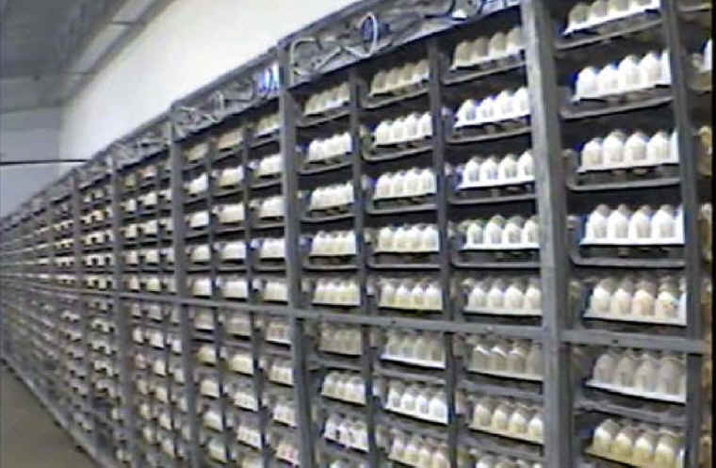
Six Keys to Incubation
Position of eggs
  Extremely important; if placed incorrectly poult will not be able to beak the shell and hatch out
  Large end of egg should be facing up or horizontal.
  Never with small end up as poult will die
Turning of eggs
  Eggs must be turned
  periodically or poults will
  become stuck to shell
  membrane.
  Should be turned at least
  5 times a day

Slide 10
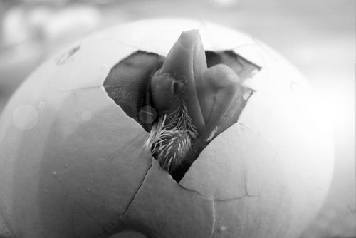
Six Keys to Incubation
Oxygen and Carbon Dioxide Content
  21% oxygen
    The closer to hatching, the more oxygen is needed.
  .5% CO₂; once CO₂ reaches 2%, embryos begin to die
Sanitation
  Must be kept disease free
  or new chicks will contract
  disease

Slide 11
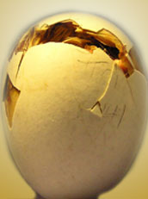
Hatching
Few days before hatching, eggs are moved from incubator to hatcher unit
Hatcher has increased humidity to assist in hatching process.
The tip of the poult’s beak, known as the shell tooth, will peck away at the
inside of the eggshell until the
shell is broken enough to push
the shell apart.
Hatching usually lasts
10 to 20 hours.

Slide 12
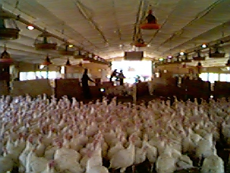
Two Commercial Paths
Breeders
  Reach sexual maturity at 30 weeks old.
  Capable of 25-week laying cycle.
    Lay 95 to 100 eggs, then they are “spent”
    Usually after laying cycle, hens are harvested for meat.
    Hens can be molted and go through a second laying cycle.
      Molting takes 3 months.
      Hens can then have another 25-week laying cycle.
      Produce fewer eggs in second cycle (75 to 80 eggs).
  Turkey eggs are not used for human
  consumption as they are more expensive.

Slide 13
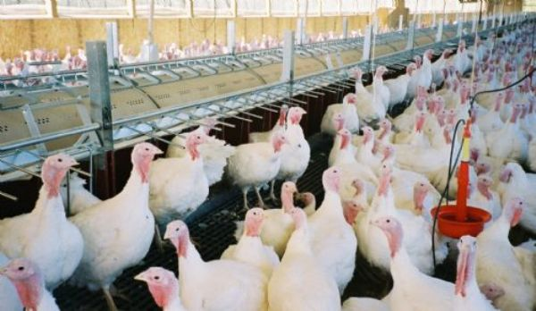
Breeder Turkeys
Breeder turkeys are generally reared in floor barns with litter as the flooring material.
  Clean nesting boxes are provided for hens to lay their eggs.
Feeding
  Must be limited as turkeys will eat until the food is gone.
  Turkeys given a specific amount each day or given food every other day.

Slide 14
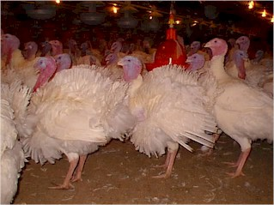
Market Birds
Toms marketed at 17 to 20 weeks of age
  Weighing 26.4 to 32.3 pounds
Hens marketed at 14 to 16 weeks of age
  14.7 to 17.5 pounds
Free fed to allow faster weight gain.
Fed high protein feed for
muscle development.

Slide 15
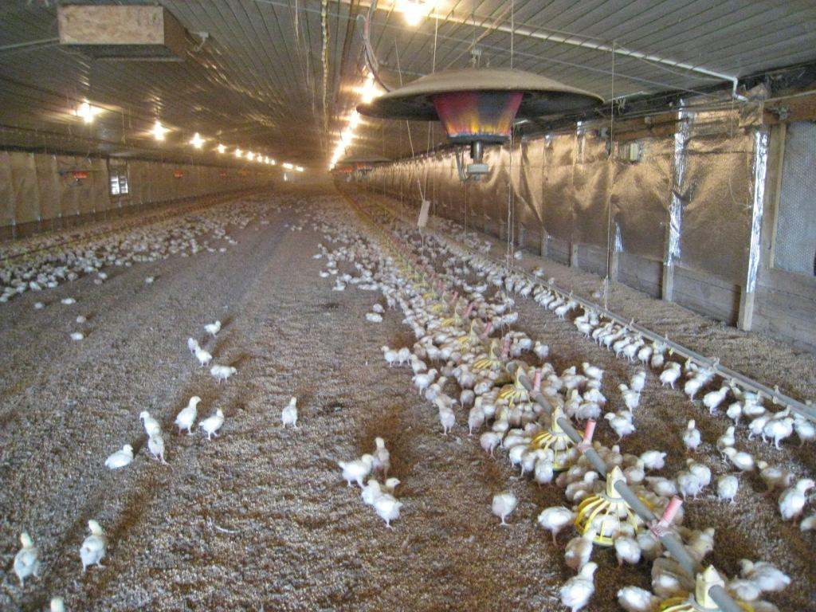
Two Types of Housing
Conventional (enclosed) housing
    Windowless houses with environmental control
Pole barn
    Long houses with open sides, can be closed off with curtains
Birds are provided 1 to 2 sq. ft. per bird.
Feeding and water
systems are computer
controlled.

