Slide 1


Slide 2
Egg Processing Systems
In-Line Processing
  Egg processing occurs at the same location as the egg production facility.
    This processing method is the most efficient method available of collecting and processing eggs. Eggs are delivered from the egg production facility to the egg processing facility by an enclosed and refrigerated conveyor system.
Egg handling and processing is performed with automated equipment.

Slide 3
Egg Processing Systems
Off-Line Processing
  Egg processing occurs separately from the egg production facility.
    This processing method utilizes satellite farms. Satellite farms are egg production facilities that are located at a different location from the egg processing facility.
    Eggs produced at satellite farms must be gathered and delivered to the egg processing facility.
    Egg handling and gathering is performed with automated equipment.

Slide 4
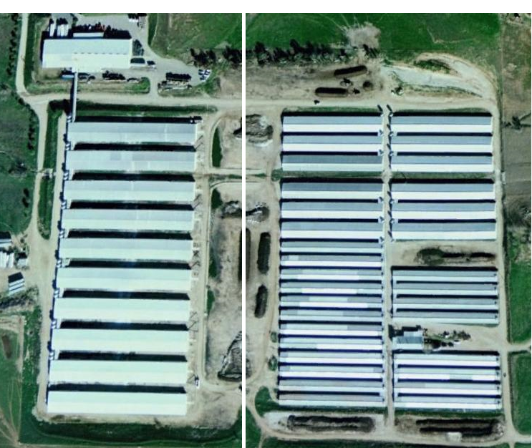
Egg Processing Systems
Egg Processing
Conveyor
Egg Production
In-line egg processing Off-line egg processing

Slide 5
Egg Processing Systems
Care of eggs on the farm
  Regardless of on-line or off-line processing, steps are taken to maintain egg quality on the farm.
    These include, but are not limited to, egg collection occurring several times daily, careful egg handling procedures, egg cooling, egg cleaning and use of clean packaging materials.

Slide 6
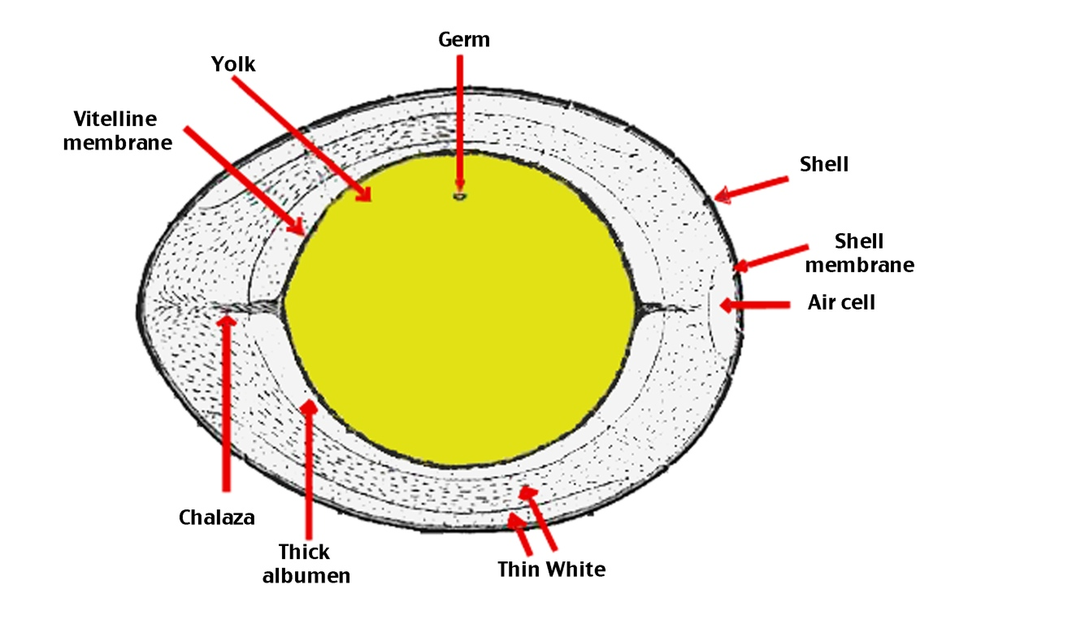

Slide 7
Yolk
The yellow part in the center of the egg.
The actual color of the egg yolk varies based on what the hen who laid the egg is fed.
Hens fed a diet high in corn or alfalfa tend to have a more dark yellow to orange-colored yolk because those feeds are high in a fat-soluble pigment called xanthophyll.
Hens who are fed a diet of mostly wheat, which is low in xanthophyll, would have a very light yellow or even slightly grayish yolk.

Slide 8
Yolk, continued
The yolk is separated from the white by the vitelline membrane.
The yolk provides “food” that is essential for the developing chick embryo.

Slide 9
Germ
The small white circle on the yolk.
In a fertile egg, this is where the embryo starts to develop.
In non-fertile eggs, this spot stays small and white.

Slide 10
Albumen
Also called the egg white
There are two types of albumen:
  Thick albumen: Located closest to the yolk. The less liquid, more dense portion of the white. The thick albumen is denser in fresher eggs than in older eggs.
  Thin albumen: The more liquid “runny” portion of the egg white.

Slide 11
Shell
The hard, normally white (may also be brown or greenish blue) coating that provides the egg’s solid structure and shape and protects the developing embryo.
The shell of an egg contains thousands of tiny pores.

Slide 12
Shell Membranes
Membranes that are located just inside the shell
Act as a barrier between the shell and the albumen

Slide 13
Air Cell
The small open space at the large end of an egg
Formed by the separation of the two shell membranes
Provides the chick with an air supply during the final stage of development just before hatching
Older non-fertile eggs will have a larger air cell due to moisture loss.

Slide 14
Chalaza
The small, white rope-like structures at both ends of the yolk
These structures help keep the yolk centered within the egg.
If the yolk were to come into contact with the shell during embryo development, the process would be aborted and the embryo would cease development.

Slide 15
Processing Functions
Cleaning the Eggs
  All eggs in the United States are washed in warm water with a mild detergent in order to remove any contaminants (manure, grease, blood, yolk, etc.) before they are sold for human consumption.
  Eggs are dried to remove any excess moisture prior to packaging.
  Removal of contaminants prevents egg spoilage by bacteria.
  Eggs that are not cleaned or that contain defects are removed from the processing line and are not packaged for human consumption.

Slide 16
Processing Functions
Grading
  Grading refers to the process of grouping eggs according to similar characteristics, such as quality and weight.
  Egg grading is performed by trained professionals from the United States Department of Agriculture (USDA).
  The USDA has a stringent set of requirements for the grading of fresh shell eggs.
  Egg grading is dependent upon examination of internal quality factors (e.g., condition of the egg white and yolk, air cell size).

Slide 17
U.S.D.A. Grading Diagram

Slide 18
Processing Functions
Grading, continued
  Internal quality factors can also be determined by candling.
  Candling involves holding the egg to a concentrated light source for visual inspection of internal defects, such as blood spots or double yolks.

Slide 19
Processing Functions
Grading, continued
  Egg grading is also dependent upon external quality factors (e.g., shape, texture, cleanliness and soundness of the shell).
  An egg with a AA grade contains the most desirable characteristics while an egg with a B grade contains the least desirable characteristics.
  External quality can be determined by candling for illumination and detection of egg shell cracks.

Slide 20
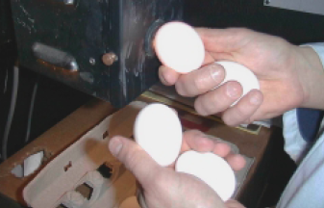
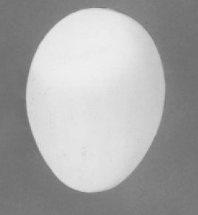
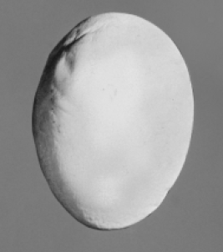
Candling
Ideal egg shape. Abnormal egg shape.

Slide 21
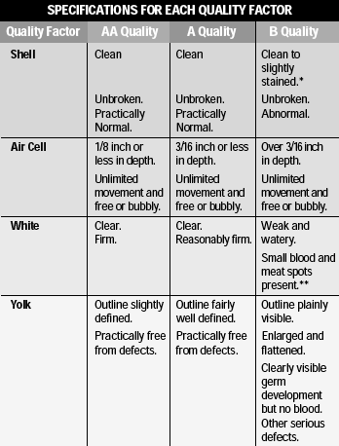
U.S.D.A. Grading Factors

Slide 22
Egg Sizes
Size determination
Sizes are determined by weight. There are six different weight categories: peewee, small, medium, large, extra large and jumbo. Each size category receives a different price on the farm and at the retail level.
    Minimum Average Weight for one dozen eggs:
        Peewee: 15 ounces
        Small: 18 ounces
        Medium: 21 ounces
        Large: 24 ounces
        Extra Large: 27 ounces
        Jumbo: 30 ounces

Slide 23
Packaging and Storage
Packaging
  Eggs are packaged into a variety of containers designed for safe shipment and enhanced product appearance for the consumer.
  Loose packaging is a simple way of moving large quantities of eggs in an efficient but also simple fashion. Loose packaging usually refers to either a thirty-egg large or extra large flat, or a twenty-egg jumbo flat. Loose sales mostly consist of sales to restaurants or other large quantity consumers.

Slide 24
Packaging and Storage
Packaging, continued
  In retail settings, eggs are often packaged in cartons containing either one dozen or eighteen eggs.
    This packaging method is designed to be handled by the final consumer and is therefore usually designed to be quite appealing.
    There are several different varieties of eggs available to the consumer, called designer eggs by the industry.

Slide 25
Care and Handling
Refrigeration
  Eggs must be cooled to a core temperature of
  45˚F.
  Eggs held prior to processing must also be cooled.
  All eggs being transported must be hauled in a refrigerated trailer so that the core temperature is held constant at 45˚F.

Slide 26
Care and Handling
Mechanical Handling
  Eggs are moved using conveyor systems between the production facility and the processing plant.
  The processing machinery is fully mechanical and most of the equipment on commercial farms works to wash, dry, sort by weight and quality and package the eggs into specified packaging.
  Once eggs are consolidated to pallets, fork lifts are used to handle the product.

Slide 27
Labeling
Sell by Date
  Every individual package of eggs processed must contain a sell by date that is set from the date of processing.
Julian Date
  This is the three=digit day number relative to the day in the year the eggs were processed. This date is calculated with January 1 as 001 and December 31 as 365. This date is listed next to the plant code.

Slide 28
Labeling
Grade
  Both the size of the eggs and the level of quality are printed on the carton. Most fresh shell eggs are signified by an A or AA grade.
Plant Code
  A code is printed on every carton produced in a processing plant. Each plant has its own individual code so that if there is a need to find the origin of the finished product, it can be traced all the way back to the processing plant.

Slide 29
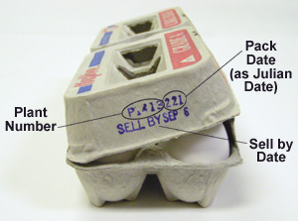
Carton Labeling

Slide 30
Labeling
Nutritional Facts
  Nutritional information is printed on every package for retail sale. This information varies slightly depending on the egg size and also the type of egg (designer eggs).
“Keep Refrigerated”
  All egg packages are labeled with a cautionary “keep refrigerated” label. Refrigeration helps reduce the growth of salmonella or other bacteria.

Slide 31
Labeling
U.E.P. “Animal Care Certified”
  Nationwide many egg farmers have voluntarily joined the United Egg Producers (U.E.P.), which develops regulations to ensure the overall welfare of chickens being used for egg production. When a farm becomes “Animal Care Certified,” this label informs the consumer that the product was produced in accordance with accepted animal welfare standards.

Slide 32
Types of Eggs You Can Buy at the Grocery Store

Slide 33
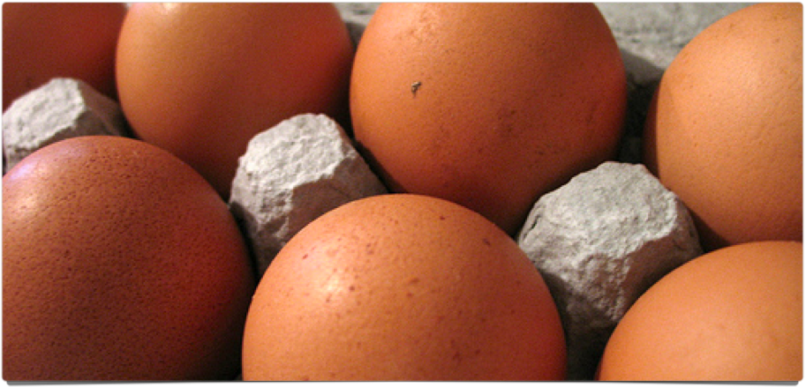
Brown Eggs
Just like regular white eggs, only brown

Slide 34
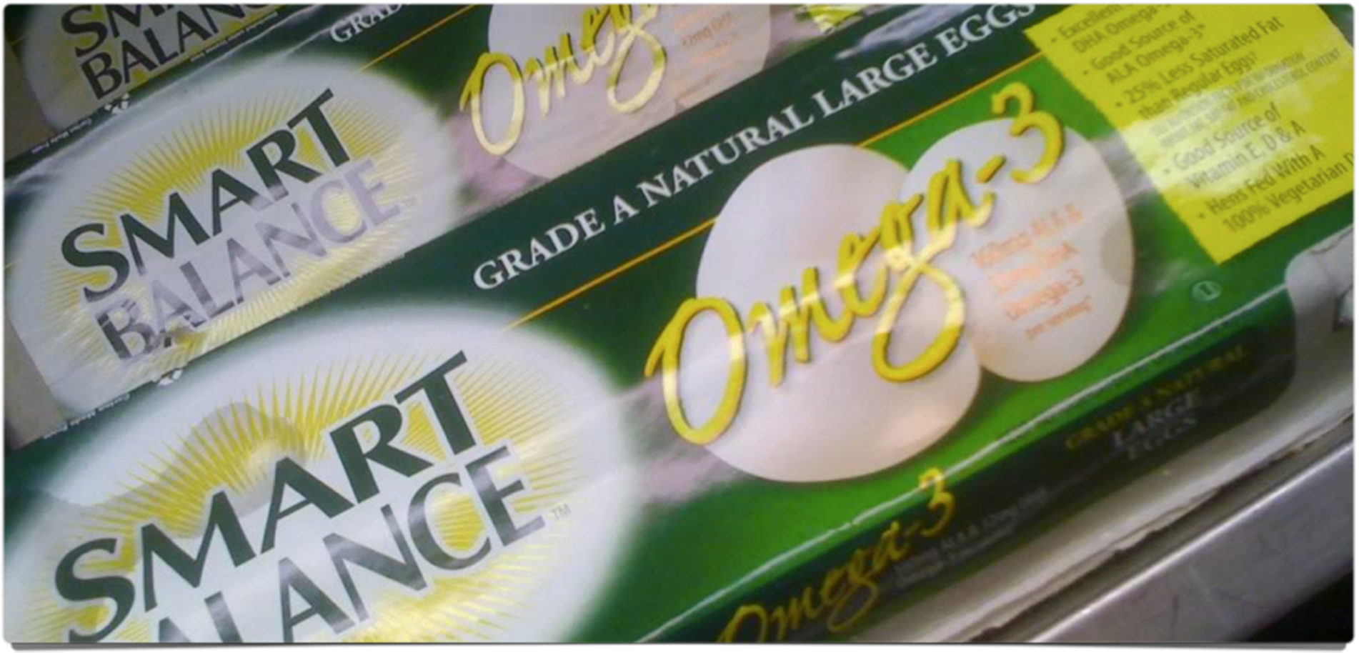
Omega-3 Eggs
Eggs contain omega-3 fatty acids
Provides perception of increased health benefits
Eggs are usually more expensive.

Slide 35
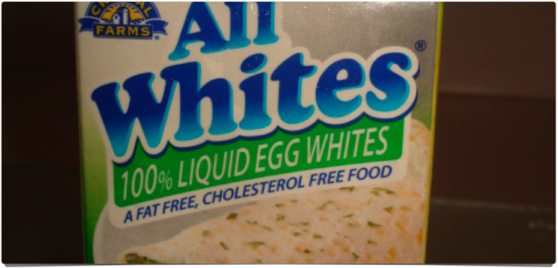
Reduced cholesterol or cholesterol free eggs
Viewed as a heart-healthier alternative to regular eggs

Slide 36
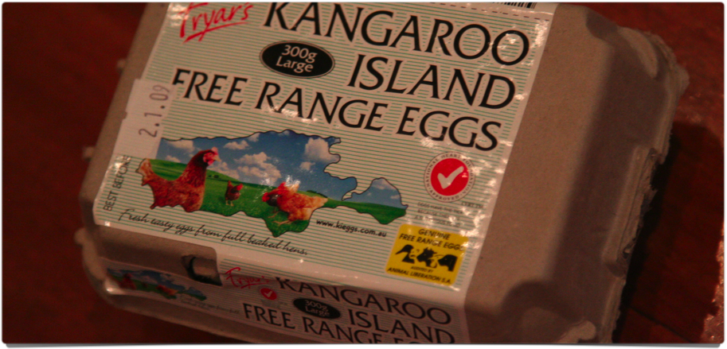
Free-Range Eggs
Hens are required to be given some access to the outdoors.
Usually eggs are much more expensive

Slide 37
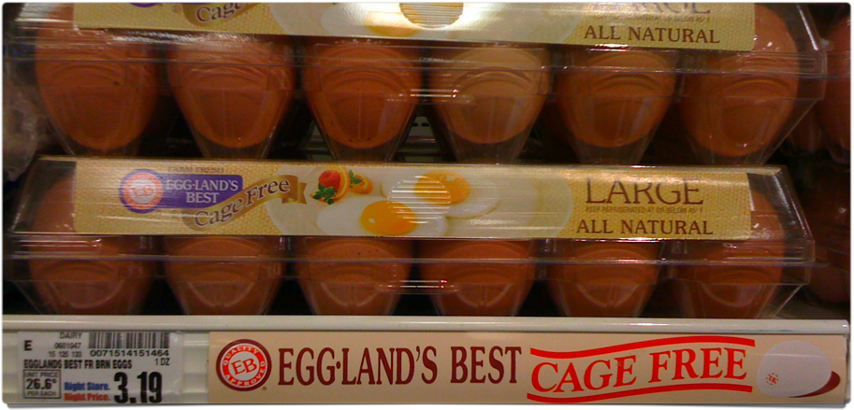
Cage-Free Eggs
Hens are typically housed in floor houses with nest boxes.
No access to outdoors
Eggs are usually more expensive

Slide 38
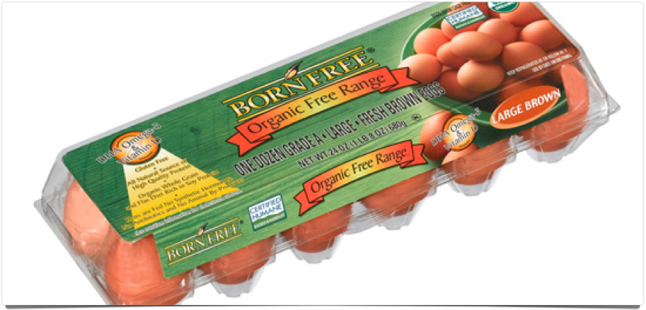
Organic Eggs
Hens must be fed a completely organic diet from hatching.
Since organic feed is expensive, eggs are more expensive.

Slide 39
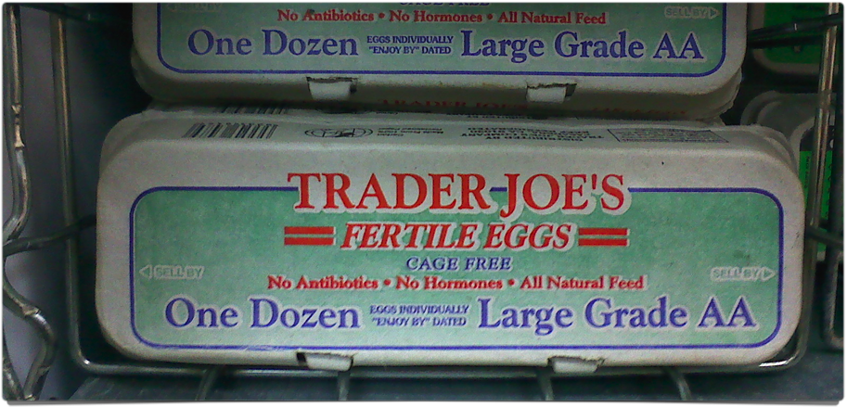
Fertile Eggs
Laid by a hen who was given the opportunity to mate

Slide 40
Be sure to keep fertile eggs refrigerated or the embryo could start to develop!
If that happens, what looks like a small black comma will form on the yolk’s surface.

Slide 41
