Slide 1
Unit One: Greenhouse Care and Maintenance
Lesson One:
Materials and Equipment
Lesson Objectives
Identify plant materials and equipment that are commonly used in the greenhouse industry.
Examine common growing media and evaluate their use in plant production.
Discuss the importance of irrigation and the equipment associated with those systems.
Footer description area.

Slide 2
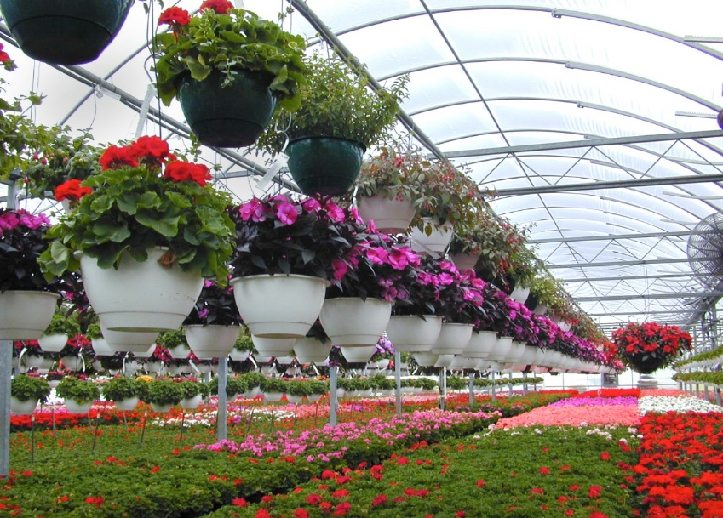
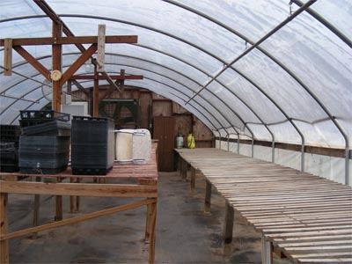
Introduction
Today you are the manager of a greenhouse...
Shopping List – Think, Pair, Share Activity:
What materials and equipment are necessary to run a greenhouse operation?

Slide 3
Materials and Equipment
Greenhouse Production Items
Anvil and Blade Pruner
Hook and Blade Pruner
Bulb Planter
Cell Pack Containers
Hanging Basket
Nursery Container
Scoop Shovel
Square-Point Shovel
Sharpening Stone
Propagation Mat
Propagation Trays
Greenhouse Thermostat
Soil Moisture Meter
pH Testing Meter
Polyethylene Film
Shade Fabric
PVC Pipe
PVC Pipe Cutter

Slide 4
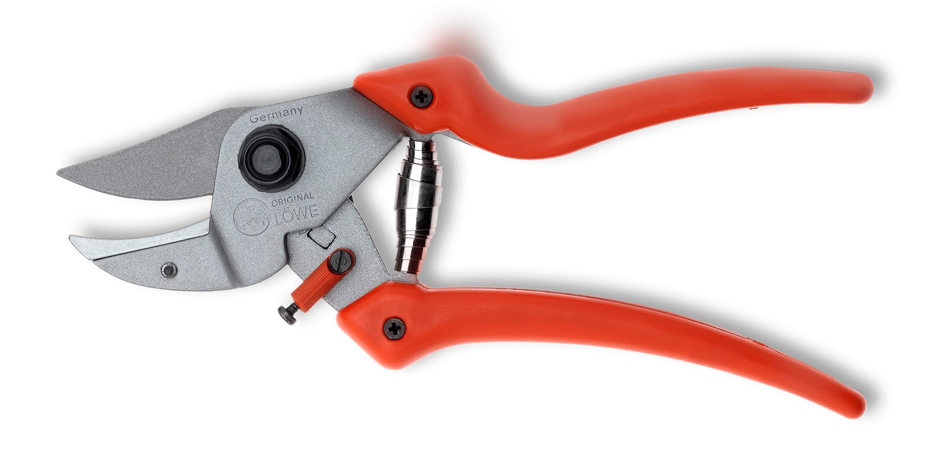
Anvil and Blade Pruner
Anvil pruners cut by pushing a blade through a material.
At the end of the cut, the blade's cutting edge meets the anvil.
http://www.original-lowe.com/uploads/tx_loeweproducts/7.107_offen.jpg

Slide 5
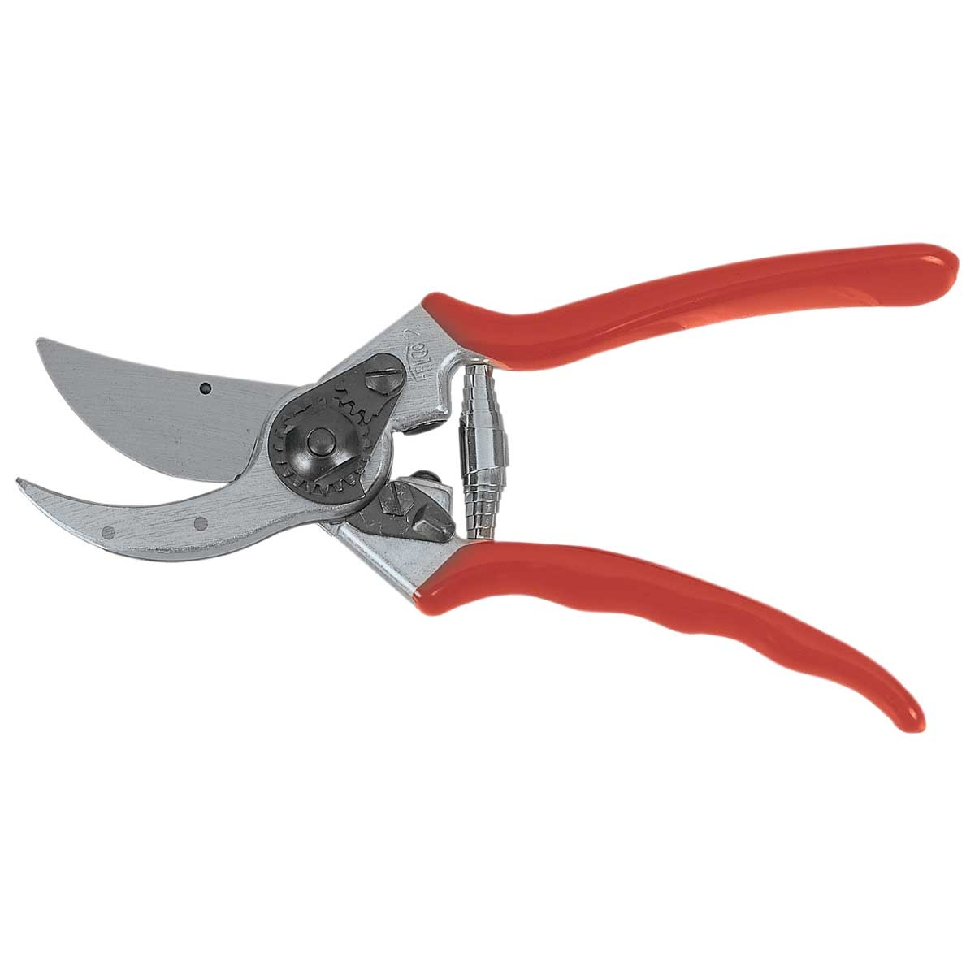
Hook and Blade (Bypass) Pruners
Bypass pruners have a blade sharpened on the outside edge that slides past a hook.
They make clean cuts, close to the stem but can't be used on branches larger than 1/2 inch in diameter.
http://www.gemplers.com/img/felco-classic-hand-F2-lrg.jpg

Slide 6
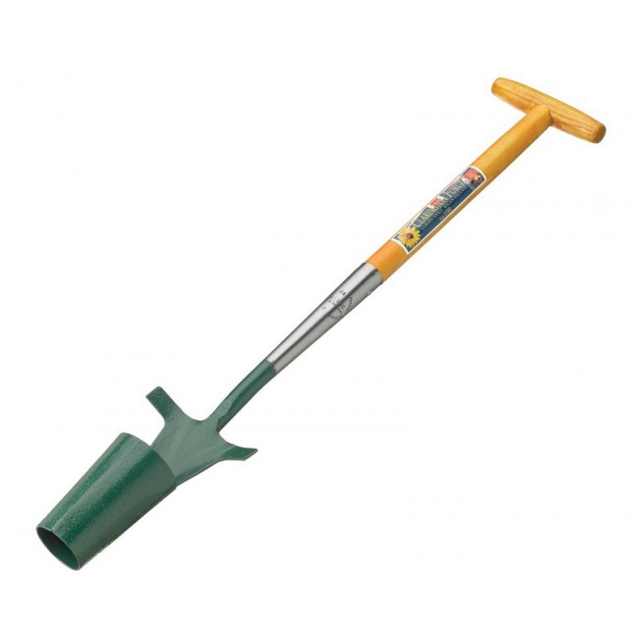
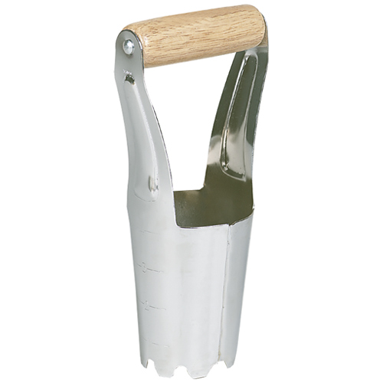
Bulb Planter
A bulb planter is a hand tool that has an open-ended cone sharpened on its bottom edge.
http://www.claringtonforge.com/media/catalog/product/cache/1/image/650x/9df78eab33525d08d6e5fb8d27136e95/i/m/image_65.jpg
http://ace.imageg.net/graphics/product_images/pACE-959626dt.jpg

Slide 7
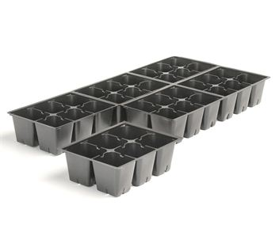
Cell Pack Container
A container made of
cellular plastic.
Varies in size (width and depth)
Used for holding flowers or plants.
http://www.torontonurseries.com/wp-content/uploads/2016/01/L-606-1.jpg

Slide 8
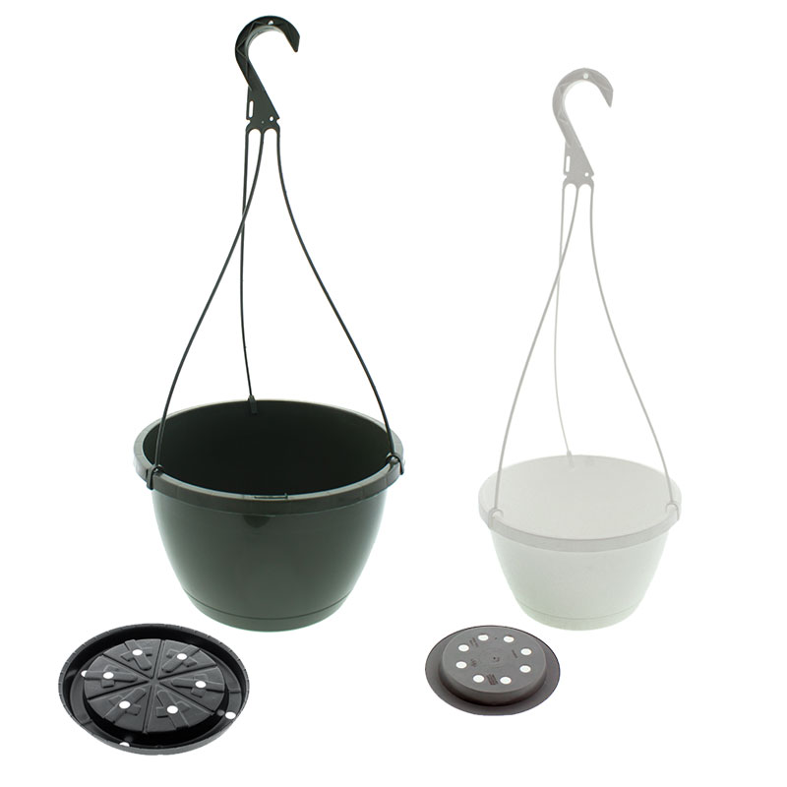
Hanging Baskets
A hanging basket is a suspended container used for growing decorative plants.
Hanging baskets are normally made from wire with an impervious, usually plastic, lining to retain the contents.
http://cdn.greenhousemegastore.com/images/uploads/12607_7026_popup.jpg

Slide 9
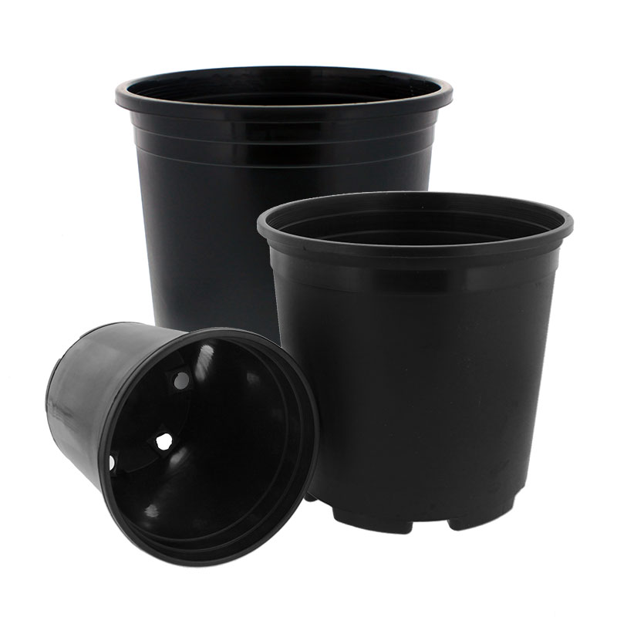
Nursery Container
Nursery containers have heavy-duty, wrap-around rims that are easy to handle and strong enough to pick up heavy plant material.
Superior drainage is engineered into both side and bottom drain designs. They typically come in black and are a minimum of a half-gallon in size.
http://cdn.greenhousemegastore.com/images/uploads/14395_5905_popup.jpg

Slide 10
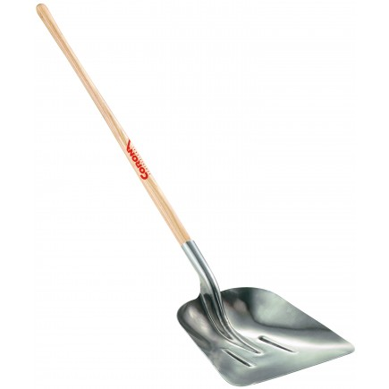
Scoop Shovel
A scoop shovel is used to scoop and move large quantities of material at once, such as small rocks, sand, soil, etc.
https://www.ewingirrigation.com/media/catalog/product/c/o/corona_aluminum_scoop_shovel_ss68000_1.jpg

Slide 11
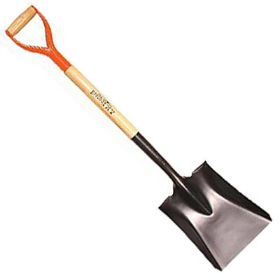
Square-Point Shovel
Square-point shovels can perform many of the same functions as garden spades (ex: lawn edging, transplanting small bushes and trees, cutting sod and small roots, dividing perennials and trenching).
Sharp, flat tips of square points are also utilized more for digging in hard-packed soils that demand more force to penetrate.
https://www.agriculturesolutions.com/images/stories/virtuemart/product/SPS30_1.jpg

Slide 12
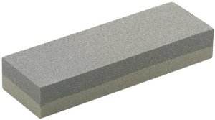
Sharpening Stone
Sharpening stones are used to grind and hone the edges of steel tools and implements.
http://ecx.images-amazon.com/images/I/41eC4CGczRL._SX300_.jpg

Slide 13
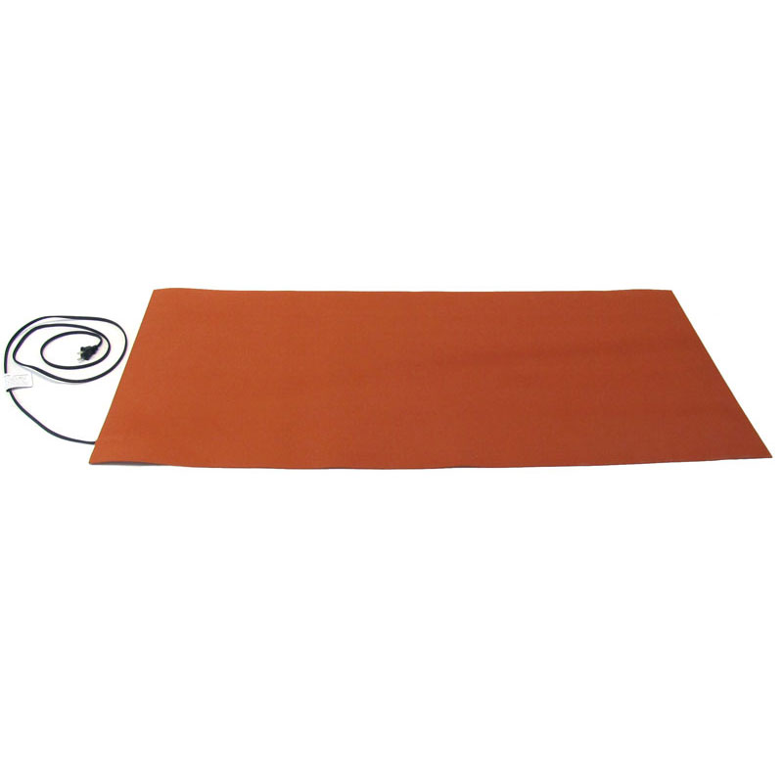
Propagation Mat
These heated rubber mats are made so that planters containing seedlings can be placed on top of the mat.
When combined with a lighting system, many plants can be grown indoors using these mats.
http://cdn.greenhousemegastore.com/images/uploads/2376_2795_popup.jpg
Notes:
In extreme cold, gardeners place a plastic cover over the planters/mats which creates a miniature greenhouse.
The constant and predictable heat allows people to garden in the winter months when it’s generally too cold for seedlings to survive.

Slide 14
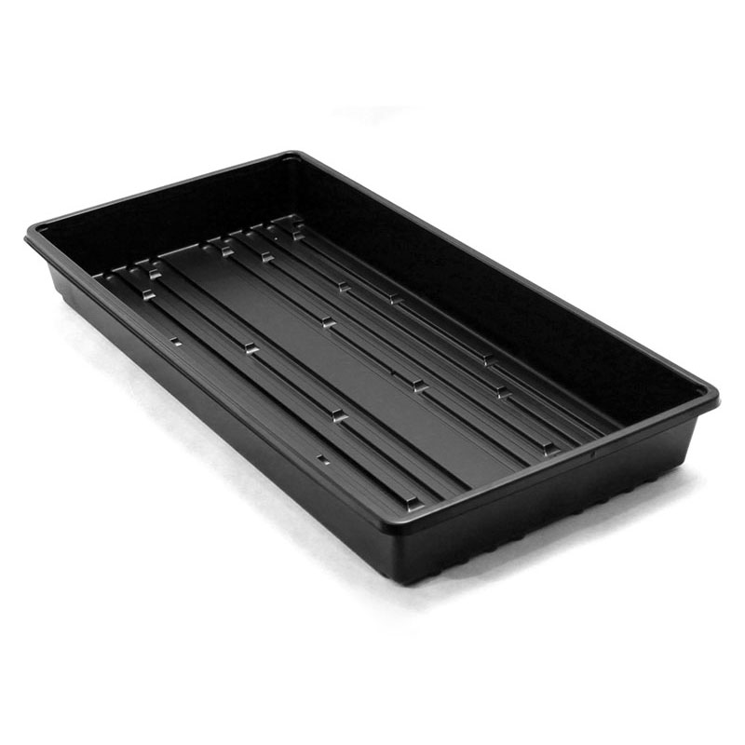
Propagation Trays
Propagation Trays provide extra depth for increased soil volume, allowing for a more mature plant and longer shelf life.
These are the most economical inserts for growers who do not use plug extractors or transplanters.
http://cdn.greenhousemegastore.com/images/uploads/1893_4510_popup.jpg

Slide 15
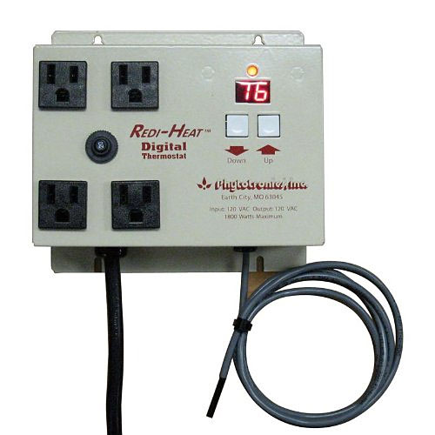
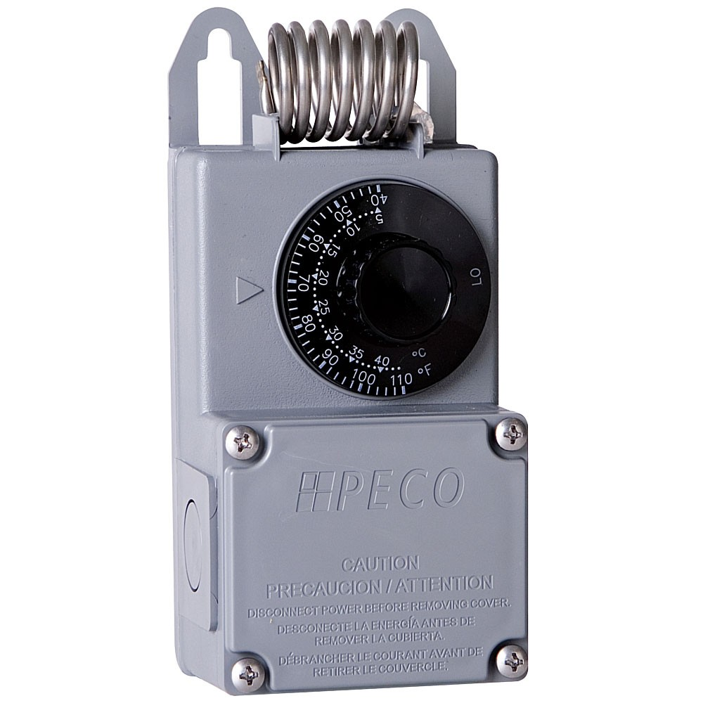
Greenhouse Thermostat
Thermostats are used to detect or control conditions in the greenhouse.
Equipment in the greenhouse is turned on and off to reach the desired temperature set on the thermostat.
http://cdn.greenhousemegastore.com/images/uploads/1476_1786_popup.jpg
http://media.qcsupply.com/catalog/product/cache/1/image/9df78eab33525d08d6e5fb8d27136e95/1/0/10004.jpg

Slide 16
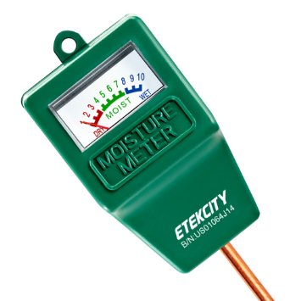
Soil Moisture Meter
A soil moisture meter is an instrument for determining the percentage of moisture in a material (such as soil), which is commonly found by measuring its electrical resistivity.
http://ecx.images-amazon.com/images/I/61GfDJbqWRL._SY355_.jpg

Slide 17
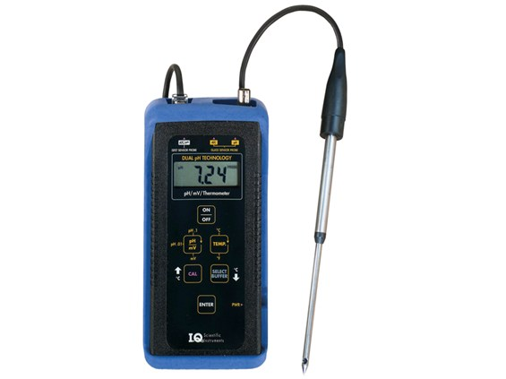
pH Testing Meter
A pH meter is a scientific instrument that measures the hydrogen-ion concentration (or pH) in a solution, indicating its acidity or alkalinity.
The pH meter measures the difference in electrical potential between a pH electrode and a reference electrode.
http://www.specmeters.com/assets/1/14/DimLarge/IQ-150-pH-Meter-ISFET-Probe.jpg

Slide 18
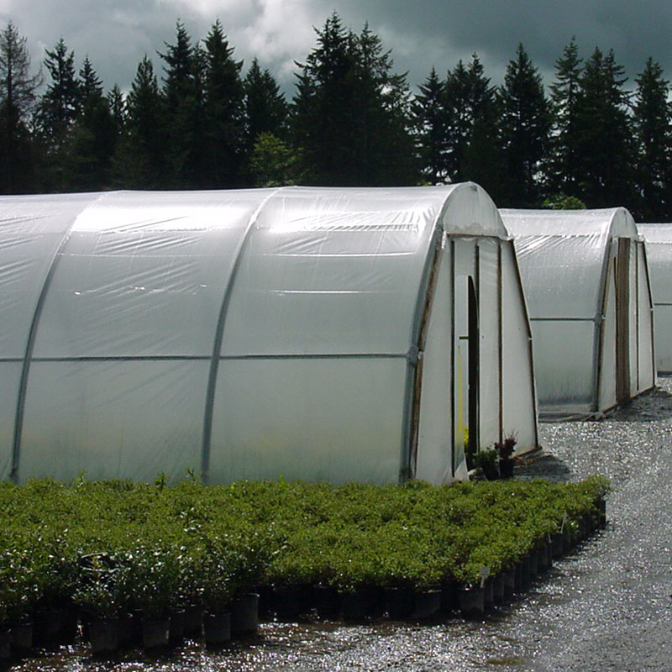
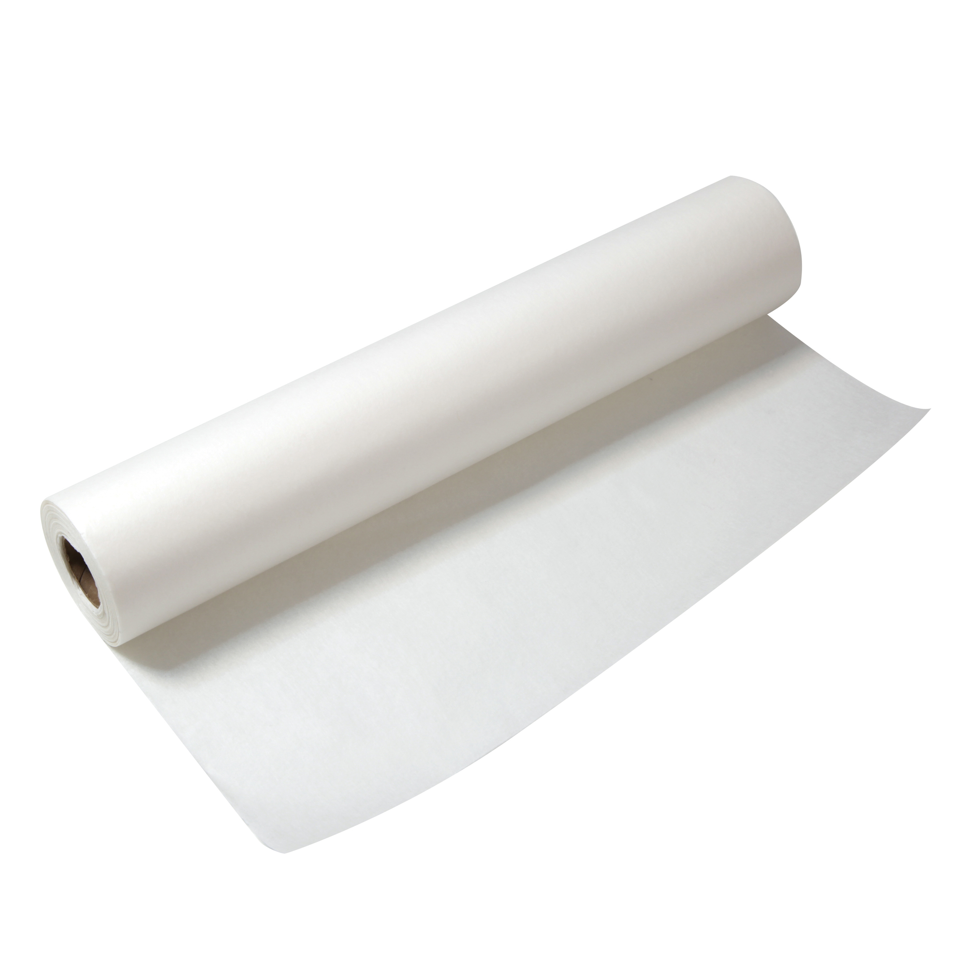
Polyethylene Film
Polyethylene film is a thick, flexible material that comes in sheets of various thickness (measured in mil) that can be used in single or double layers (for better insulation).
A quick and inexpensive option for growers.
Its translucency diffuses light well, bouncing the available sunlight and reducing shadows, both of which aid plant growth.
http://cdn.greenhousemegastore.com/images/uploads/2111_510_popup.jpg
http://www.hyatts.com/eCom/images/B/B12052.jpg

Slide 19
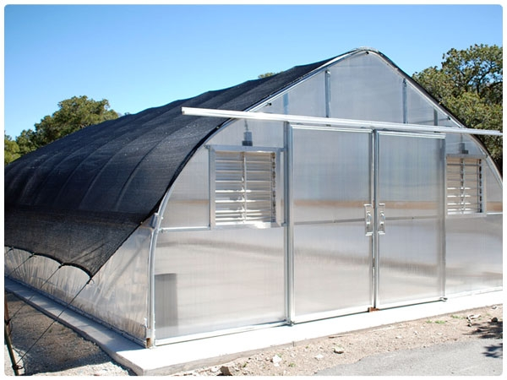
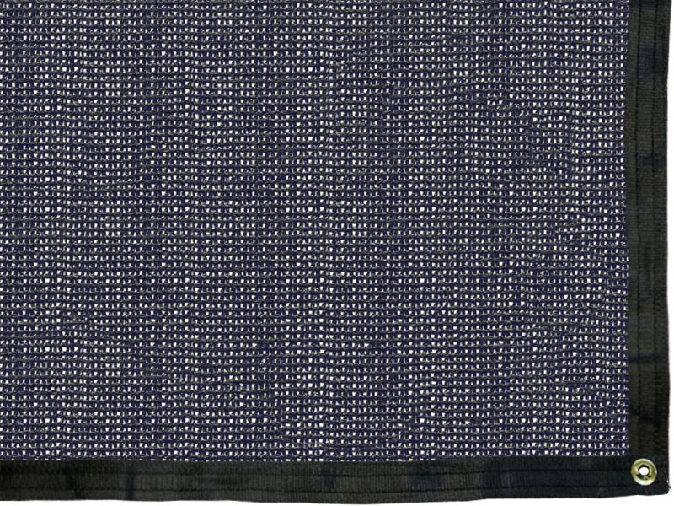
Shade Fabric
Shade fabric/cloth is a commercially available material for hanging over greenhouse glazing to cool it in summer months.
They are usually made of loosely woven polyester or aluminum and can be found in varying densities or degrees of shade from approximately 5% to 95%.
http://store.rimolgreenhouses.com/v/vspfiles/photos/shadeclothfinished-2.jpg
http://cdn.greenhousemegastore.com/images/uploads/2402_4034_popup.jpg

Slide 20
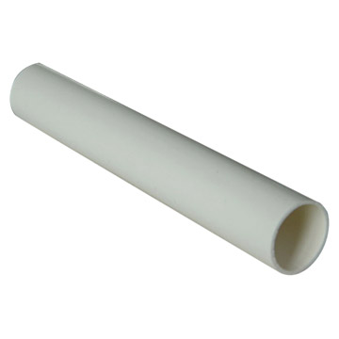
PVC Pipe
Polyvinyl chloride, commonly abbreviated as PVC, is the third-most widely produced synthetic plastic polymer.
PVC comes in two basic forms: rigid (sometimes abbreviated as RPVC) and flexible.
http://www.villages-news.com/wp-content/uploads/2015/12/img_large_18243.jpg

Slide 21
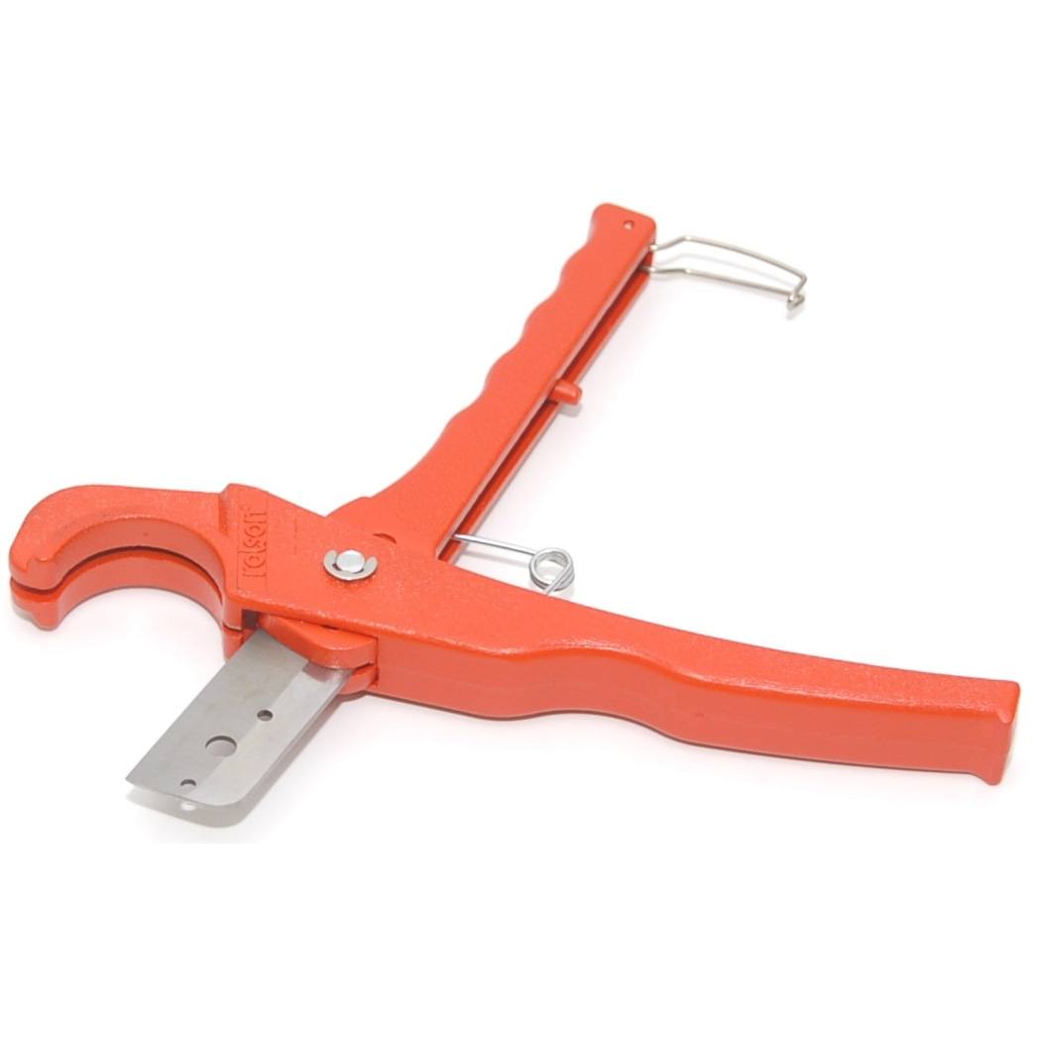
PVC Pipe Cutter
A PVC pipe cutter is a type of tool used to cut PVC pipe.
Besides producing a clean cut, the tool is often a faster, cleaner and more convenient way of cutting pipe than using a hacksaw.
http://selectproductsltd.com/images/sizes/SEL22436_PVC_Pipe_Cutters.jpg

Slide 22
Materials and Equipment
Growing Media and Material
Sphagnum Moss
Peat Moss
Perlite
Sand
Rice Hulls
Vermiculite
Coconut Coir
Peat Pots
Elle Pot
Rock Wool Growing Pots

Slide 23
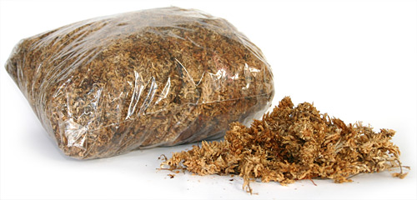
Sphagnum Moss
Living vegetation gathered from the tops of swamps, bogs and marshes and then dried out
Has a very acidic pH, relatively sterile and lightweight
Excellent moisture-holding capacity
http://www.recorpinc.com/images/moss/sphagnum-moss.jpg

Slide 24
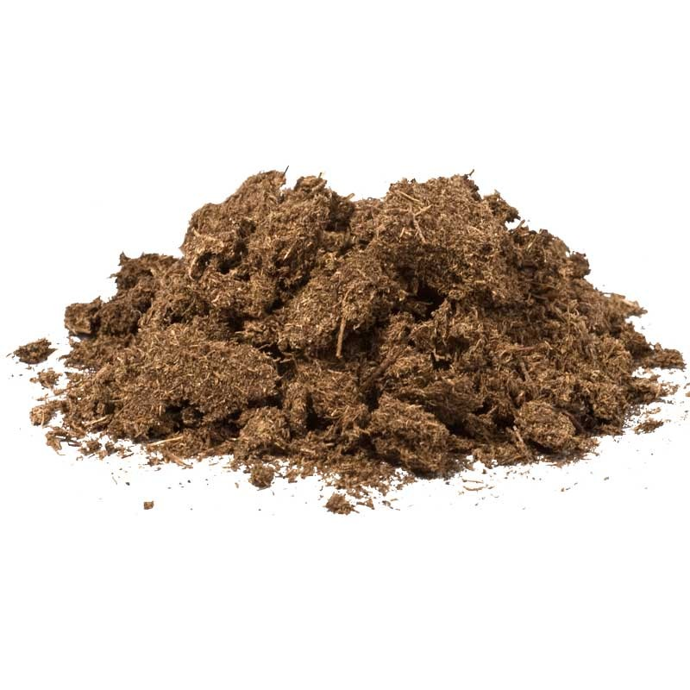
Peat Moss
Partially decomposed vegetation gathered from swamps, bogs or marshes and then ground up
Found below the living sphagnum moss
Good source of nitrogen with a high moisture-holding capacity
http://lghttp.17653.nexcesscdn.net/808B16/cdn_images/media/catalog/product/cache/1/thumbnail/9df78eab33525d08d6e5fb8d27136e95/p/s/pso100a.jpg

Slide 25
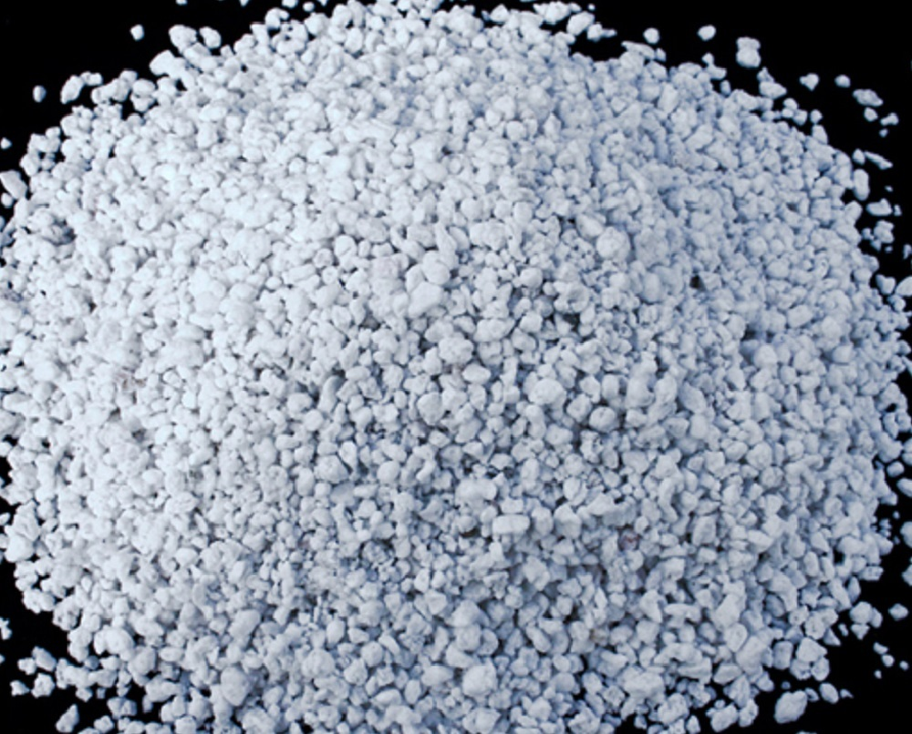
Perlite
A gray-white material derived from volcanic ash
Usually added to increase aeration in a growing media
Commonly used as media during propagation
http://garden.org/pics/2015-01-12/drdawg/12d404.jpg

Slide 26
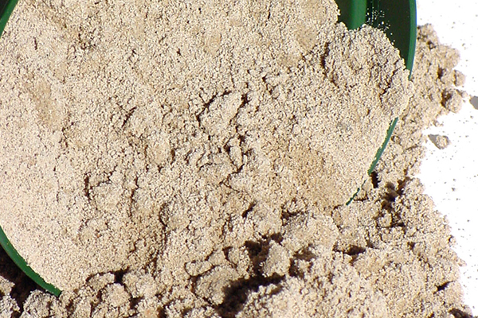
Sand
Not like the sand at a beach, this is finely ground stone
Contains the same elements as the parent material
Example: If the stone had high levels of calcium, the sand produced from that stone will have high levels of calcium.
Provides structure to growing media and increases drainage
http://hydroponicgardening.com/wp-content/uploads/2015/05/CoarseSand600400.jpg

Slide 27
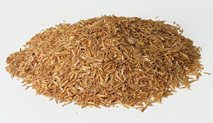
Rice Hulls
By-product of rice production
Adds aeration to the growing media
Has a high moisture-holding capacity
Used in combination with other growing media
  not to be used independently
http://cdn.arbico-organics.com/images/uploads/1309000-m.jpg

Slide 28
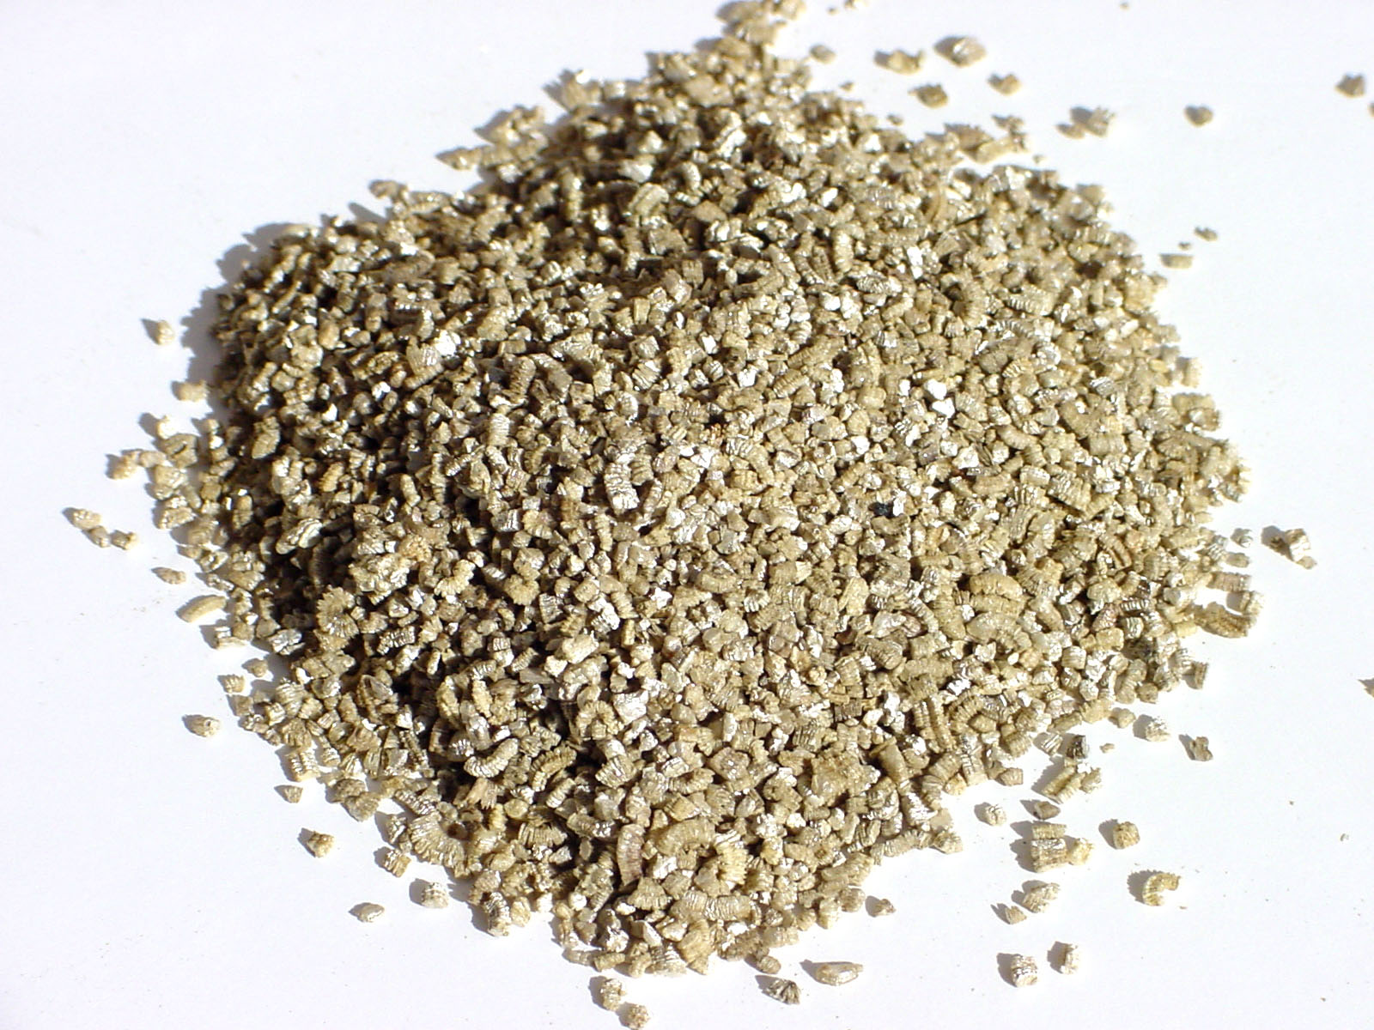
Vermiculite
Derived from heat- treated mica ore
Very lightweight with a neutral pH
Commonly used in media for seedlings
High moisture-holding capacity
http://cdn2.hubspot.net/hub/137863/file-522660781-jpg/images/vermiculite.jpg

Slide 29
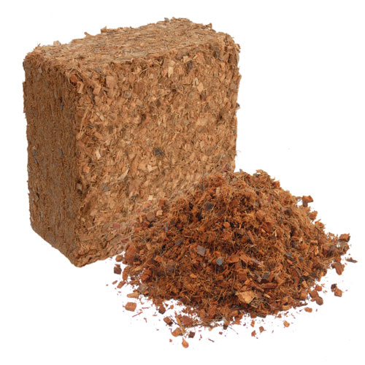
Coconut Coir
Made from the husk of a coconut
Hairy, fibrous material that is high in phosphorous and potassium
Commonly used in hanging baskets
High moisture-holding capacity with little shrinkage
http://www.soilless.org/wp-content/uploads/2016/04/CoirBlock_soillessorg.jpg

Slide 30
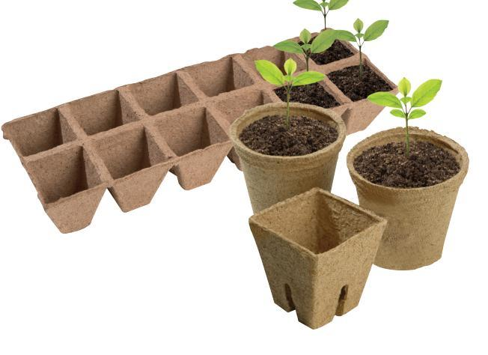
Peat Pots
Biodegradable plastic containers made from compressed peat moss
Can be transplanted directly into a new container
Reduces root damage or stress
Removes the need for conventional plastic containers
https://laidbackgardener.files.wordpress.com/2015/04/20150414c.jpg

Slide 31
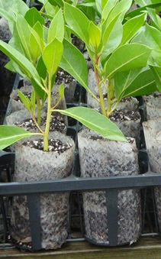
Elle Pots
Biodegradable paper containers made from cellulose
Can be transplanted directly into a new container
Reduces root damage or stress
Removes the need for conventional plastic containers
http://hort.ufl.edu/woody/images/ellepot.jpg

Slide 32
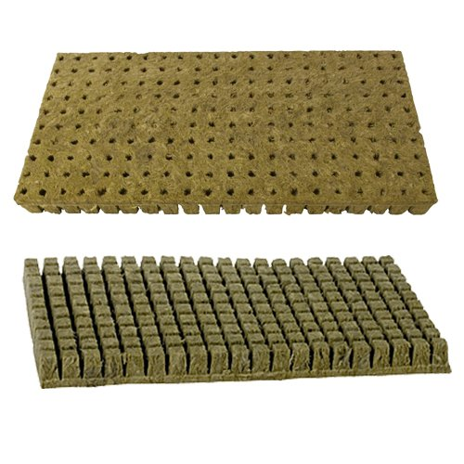
Rock Wool Growing Cells
Made from a mixture of inorganic materials
Weathers with time but not fully biodegradable
Can be transplanted directly into a new container
Reduces root damage or stress
Removes the need for conventional plastic plug trays
http://ecx.images-amazon.com/images/I/51nlxtWAe4L.jpg

Slide 33
Materials and Equipment
Watering and Irrigation Equipment
Hose Punch
Hose Repair Coupling
Hose-End Repair Fitting
Hose-End Sprayer
Hose-End Washer
Impulse Sprinkler
Irrigation Drip Emitter
Irrigation Timer
Irrigation Tape
Polyethylene Pipe
Spaghetti Tubing
Mist Nozzle
Oscillating Sprinkler
Siphon Proportioner
Solenoid Valve
Backflow Preventer
Fertilizer Injector
Water Breaker

Slide 34
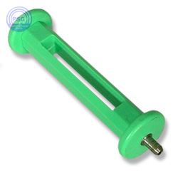
Hose Punch
Tool used to create small holes in plastic hose used in irrigation systems
The hole created by the hose punch is where irrigation heads can be inserted.
https://www.plumbingsupply.com/images/drip-deluxe-tubing-punch.jpg

Slide 35
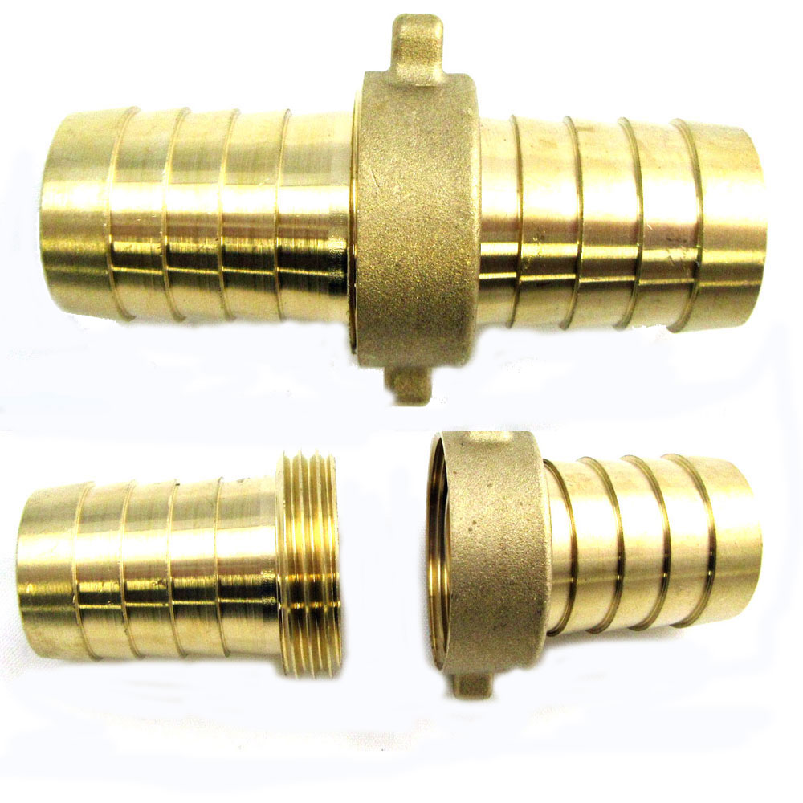
Hose Repair Coupling
A connector on the end of a hose to connect (or couple) it with another hose or an irrigation sprinkler.
http://www.easy-irrigation.co.uk/images/brass-hose-joiner-main.jpg

Slide 36
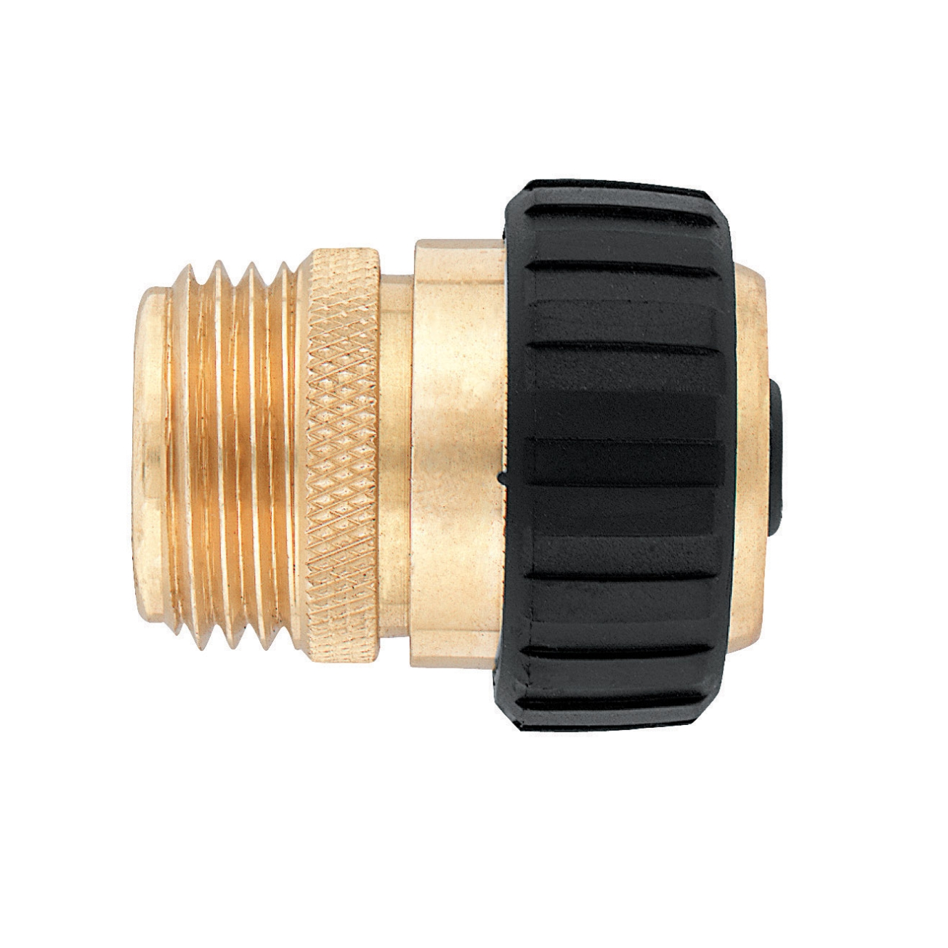
Hose-End Repair Fitting
A device attached to the end of the hose to facilitate connection.
http://ace.imageg.net/graphics/product_images/pACE3-14560784enh-z8.jpg

Slide 37
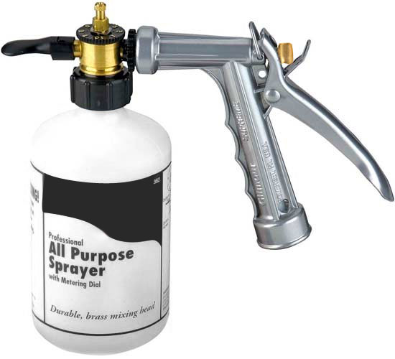
Hose-End Sprayer
A sprayer that fits on the end of a garden hose. It is used to apply fertilizer or other chemicals to the lawn or garden.
The water from the hose mixes with the contents of the sprayer to dilute the contents.
http://1274ym4fbva545shrh1giu44.wpengine.netdna-cdn.com/wp-content/uploads/2013/03/hose-end-sprayer.jpg

Slide 38
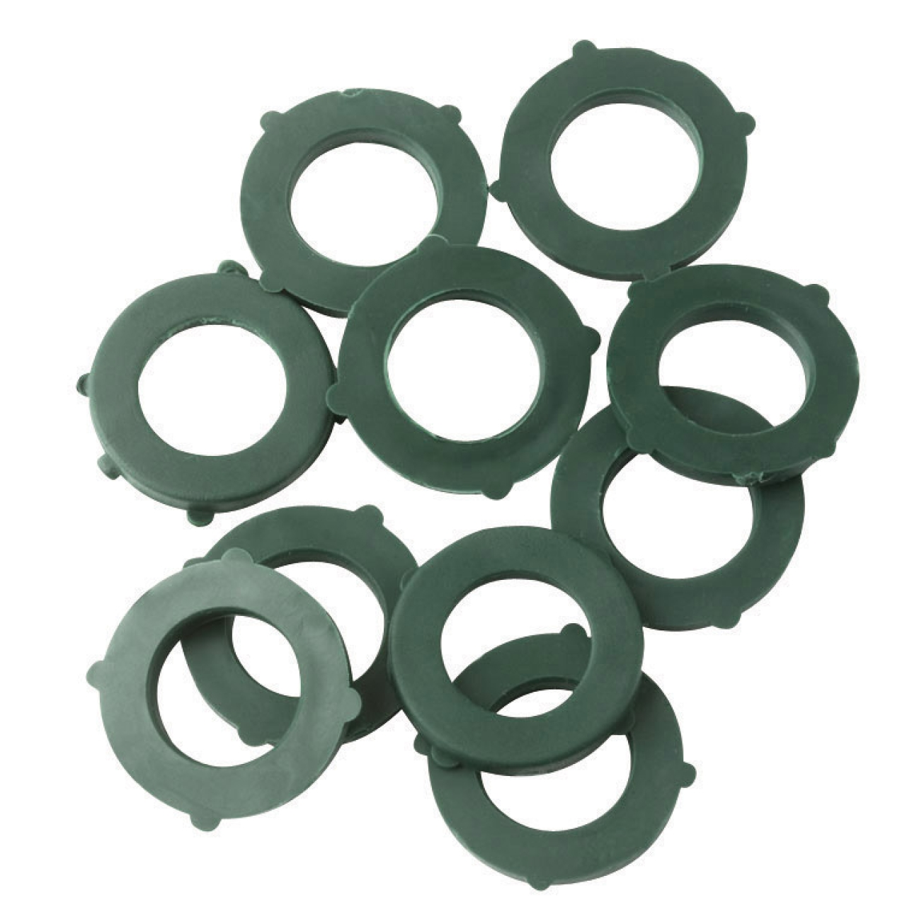
Hose-End Washer
Controls the pressure and stream of water coming out of the hose
http://ace.imageg.net/graphics/product_images/pACE3-7931135enh-z8.jpg

Slide 39
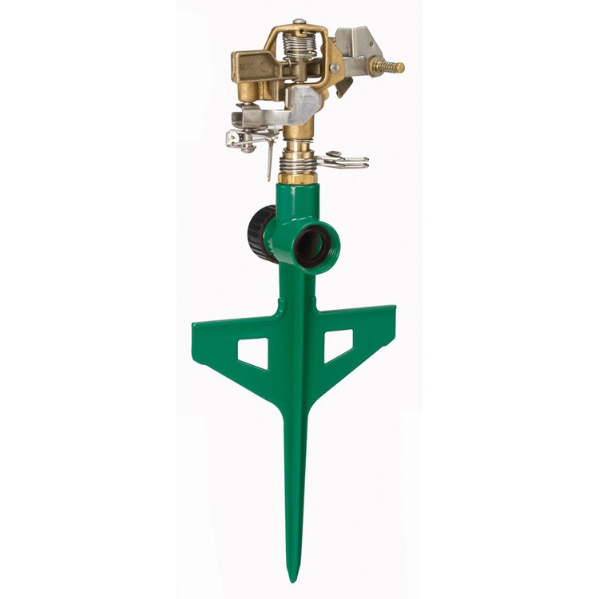
Impulse Sprinkler
This is a type of irrigation sprinkler in which the sprinkler head, driven in a circular motion by the force of the outgoing water, pivots on a bearing on top of its threaded attachment nut.
http://www.shopsteins.com/magento/media/catalog/product/cache/1/image/9df78eab33525d08d6e5fb8d27136e95/4/1/417837_detail.jpg

Slide 40
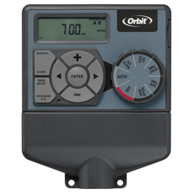
Irrigation Timer
An irrigation controller is a device to operate automatic irrigation systems such as lawn sprinklers and drip irrigation systems.
Most controllers have a means of setting the frequency of irrigation, the start time and the duration of watering.
http://images.lowes.com/product/converted/046878/046878289543lg.jpg

Slide 41
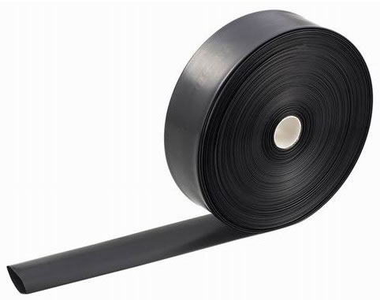
Irrigation Tape
Irrigation or drip tape is a type of thin-walled dripperline used in drip irrigation.
It’s sold flat, on reels containing several thousand feet.
The wall thickness typically ranges from 4 to 25 mils (0.1–0.6 mm).
Water exits the tape through emitters/drippers. Typical emitter spacing ranges from 6 to 24 inches (150-600 mm).
http://www.irrigation-tools.com/products/2-2-1.jpg

Slide 42
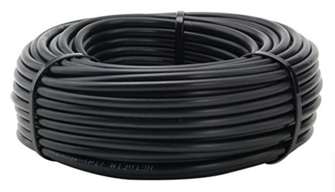
Polyethylene Pipe
Used in greenhouse and various irrigation systems
Polyethylene pipe is chemical resistant, so fertilizer and pesticide can travel through the pipe without contaminating other water systems.
http://www.greenhousemegastore.com/product/black-polyethylene-tubing/greenhouse-irrigation-fittings-hardware

Slide 43
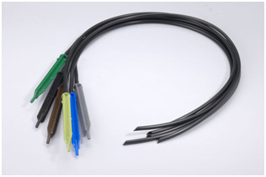
Spaghetti Tubing
Spaghetti tubing is a very fine plastic tubing used in drip irrigation, typically in gardens and greenhouses, with a small inside diameter, which may be 0.05" or smaller.
The end of the tube may have a plastic or lead weight to hold the tube in a pot.
https://www.berryhilldrip.com/images/T/spot%20spitter.jpg
Notes:
Spaghetti tubing is inserted directly into the supply tubing.
The flow is regulated by the inside diameter of the tube and the length of tubing used.
The smaller the diameter and the longer the tube, the greater the friction loss, thus reducing the pressure and flow.

Slide 44
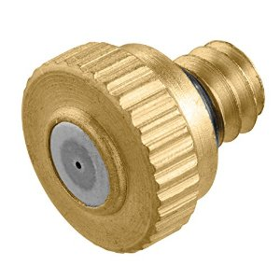
Mist Nozzle
Misting is a technique for minimizing plant moisture loss by controlled, periodic wetting of the foliage of cuttings which are being rooted.
This technique is helpful for rooting leafy cuttings.
http://ecx.images-amazon.com/images/I/51CWEAtwioL._SY300_.jpg

Slide 45
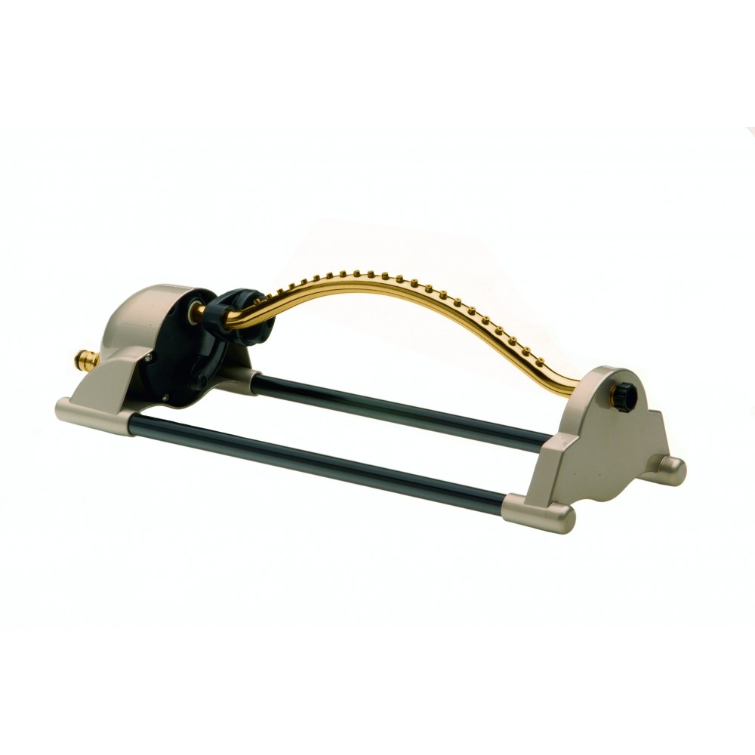
Oscillating Sprinkler
A sprinkler that has a bar that tips back and forth. It delivers a fine spray to a large area.
It can be set for square or rectangular areas.
http://www.waterirrigation.co.uk/media/catalog/product/cache/2/image/1000x1000/9df78eab33525d08d6e5fb8d27136e95/5/4/541.jpg

Slide 46
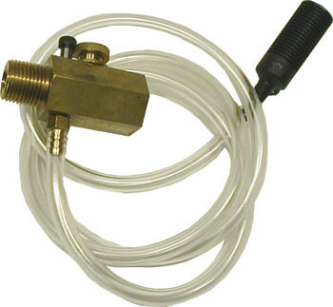
Siphon Proportioner
Easily and accurately applies a consistent rate of soluble fertilizer to lawn, garden or greenhouse plants
Attaches to a standard hose fitting and offers built-in back flow prevention should pressure fail
Brass body ensures durability and spring filter eliminates clogging
http://www.ultimatewasher.com/images/sm/stream-injector_lg.jpg

Slide 47
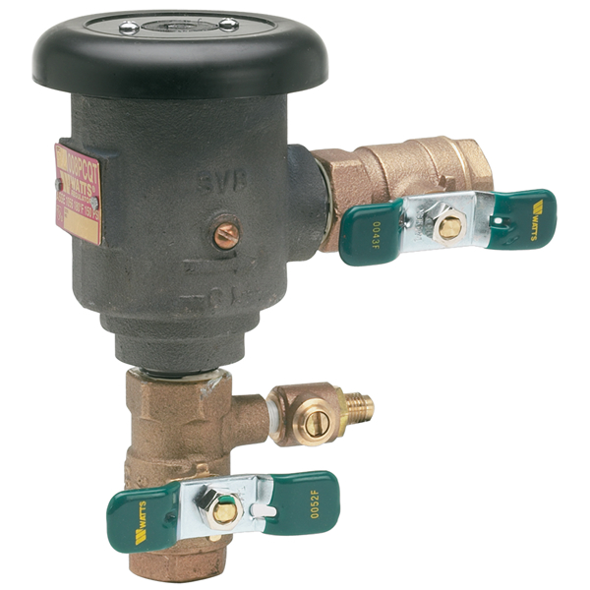
Backflow Preventer
A backflow prevention device is used to protect potable water supplies from contamination or pollution due to backflow.
Water pressure may fail or be reduced when a water main bursts, pipes freeze or there is unexpectedly high demand on the water system.
Reduced pressure in the pipe may allow contaminated water from the soil or from other sources to be drawn up into the system.
http://backflowparts.com//wp-content/gallery/watts/008.jpg

Slide 48
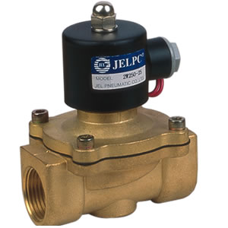
Solenoid Valve
A solenoid valve is an electromechanically operated valve. The valve is controlled by an electric current through a solenoid.
Their tasks are to shut off, release, dose, distribute or mix fluids. They are found in many application areas such as automatic irrigation systems.
http://www.valveandactuatorcompany.co.uk/cms_images_products/160_1_large.jpg

Slide 49
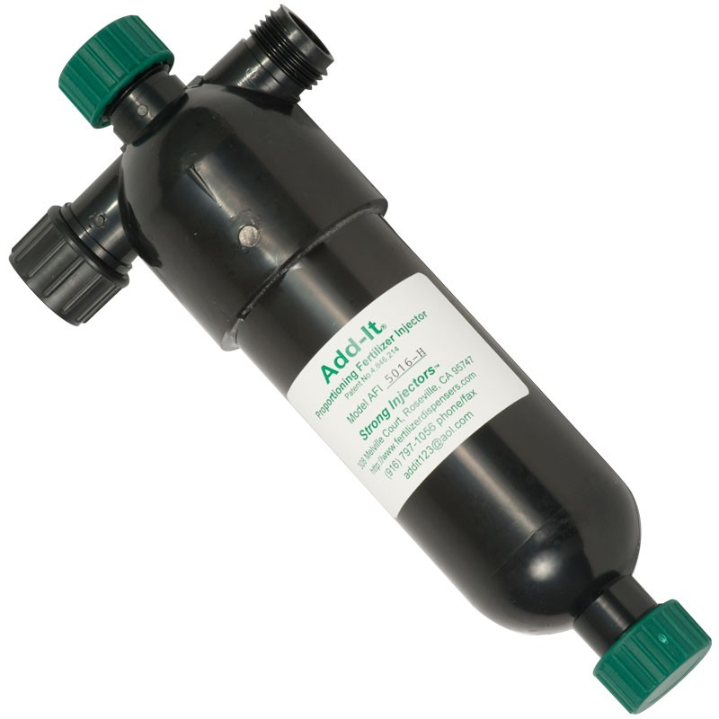
Fertilizer Injector
Fertilizer injectors are devices used to apply water-soluble fertilizers, pesticides, plant growth regulators, wetting agents and mineral acids during crop production.
They are a vital part of modern greenhouse or nursery operations.
http://lghttp.17653.nexcesscdn.net/808B16/cdn_images/media/catalog/product/cache/1/thumbnail/9df78eab33525d08d6e5fb8d27136e95/w/m/wmx200a.jpg

Slide 50

Water Breaker
Designed to offer a soft, aerated flow of water so the force of the water will not damage plants or disturb the soil
http://cdn3.volusion.com/atyw2.hvqa2/v/vspfiles/photos/DC-10-22368-2.jpg

Slide 51
Review
Let’s try that list again…
Shopping List: Reflect and Summarize
Create a new list using the items identified in today’s lesson.
You can only select 10 items.
Include what the item does and why you need it.
Example: Polyethylene Film – A strong, clear plastic that will be used to build the walls and roof of the greenhouse.

