Slide 1
Unit One: Greenhouse Care and Maintenance
Lesson Two:
Growing Procedures
Lesson Objectives
Discuss sexual and asexual reproduction in plants.
Examine techniques used when potting young plants and selecting growing medium.
Identify commonly used asexual propagation methods and rooting hormone.
Demonstrate the proper procedure for pinching plants.

Slide 2
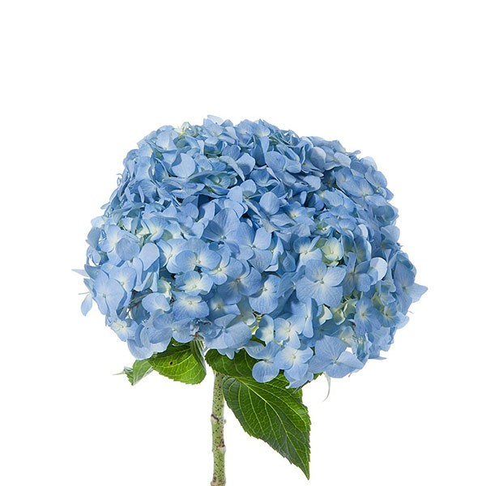
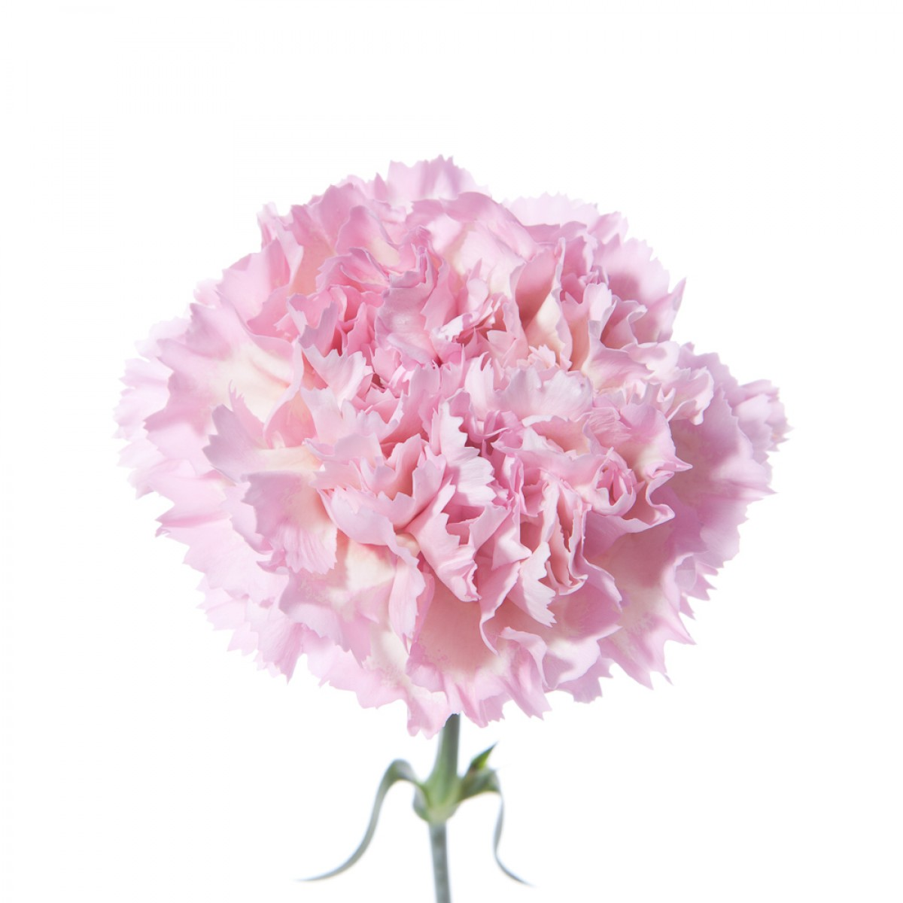
Introduction
Define the following terms:
Pollination
Germination
Propagation
Explain: How can plants reproduce?
http://www.flowermuse.com/media/catalog/product/cache/1/image/1200x1200/9df78eab33525d08d6e5fb8d27136e95/f/l/flwrmuse_110426-5.jpg
https://www.plantshed.com/media/catalog/product/cache/1/image/9df78eab33525d08d6e5fb8d27136e95/p/s/ps00092-blue-hydrangea.jpg

Slide 3
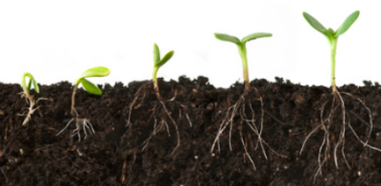
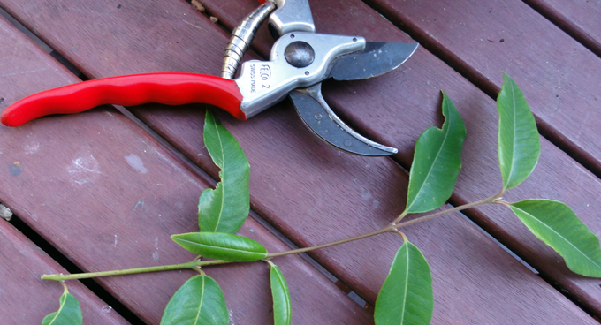
Sexual and Asexual Reproduction
Sexual Asexual
Requires pollination of an egg to create a seed
  Self-pollination
  Cross-pollination
New plant germinates from the seed
Requires no pollination
New plant is propagated from a single plant’s leaf, stem or root
http://ownyourfaith.us/wp-content/uploads/2015/02/Planting-Seeds-Image.jpg
http://www.sgaonline.org.au/images/pics/propagation/propagation1.jpg

Slide 4
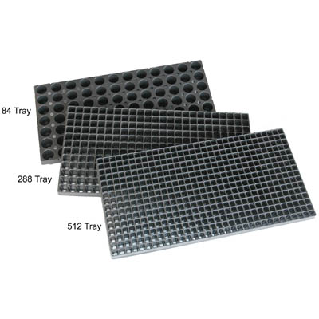
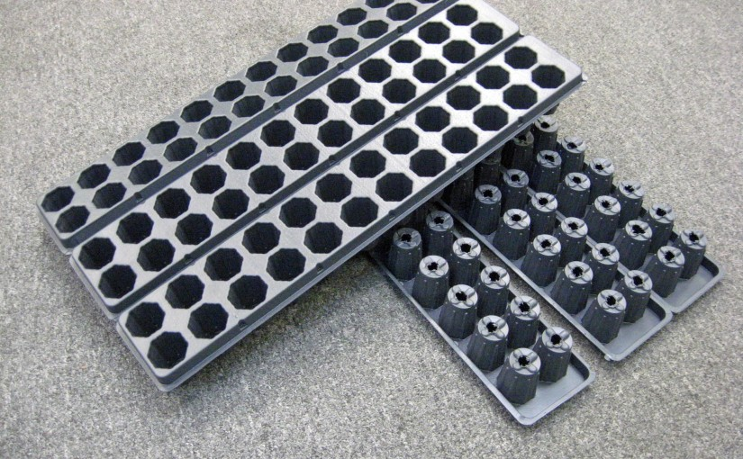
Potting Young Plants
Plugs and Liners
Plugs are plants grown from seedlings in 11” x 12” greenhouse trays. The cell size in the tray varies; the smaller the plugs the more cells per tray.
Liners are plants usually grown from cuttings in narrow strip trays. Liner cells are larger than plugs so there are fewer cells per tray.
https://www.harrisseeds.com/storefront/images/Product/large/40346.jpg
http://www.gpnmag.com/wp-content/uploads/2016/01/Blackmore_0-825x510.jpg

Slide 5
Potting Young Plants
Procedure
Select plugs or liners to be potted.
Fill container to the headspace if growing media is dry or to the container lip if media is wetted.
Using your index finger, a pencil or a marker, arrange holes around the container based on the number of plants being potted. Example: 5 arranged as a square with one in the middle, 3 arranged as a triangle, 1 centered

Slide 6
Potting Young Plants
Procedure, Continued
Make the depth of the hole appropriate to the type of plant.
Remove plant from tray using a pencil or marker to gently push the plant out from the bottom of the tray. Be careful not to damage the plant while in the process!

Slide 7
Potting Young Plants
Procedure, Continued
Place plant inside the hole and pack the growing medium around it. The medium should be firm to provide structure but not so firm the roots are compacted.
Label the plant by its name, variety and the day’s date using a pencil or marker.

Slide 8
Potting Young Plants
Procedure, Continued
Water the plant until water runs through the pot and out of the drain holes.
Make sure any debris or excess media is wiped away and that the label is clearly visible.

Slide 9
Asexual Plant Propagation
Ways to Propagate
Asexual Propagation is commonly used in the greenhouse industry and can be done in different ways depending on the plant you wish to propagate.
Cuttings, Grafting, Layering and Tissue Culture are all different propagation methods.

Slide 10
Asexual Plant Propagation
Ways to Propagate, Continued
Cuttings can be taken from the leaf or stem depending on the type of plant.
Hormones are chemicals that growers can apply to plants to affect their shape, size and growth rate.
Plant Growth Regulators (PGRs) are similar to hormones in that they manipulate the plants growth. They can be applied chemically or physically.

Slide 11
Asexual Plant Propagation
Hormones and PGRs
Physical Plant Growth Regulators:
    Nutrition
    Light
    Temperature
    Container size
Notes:
How much do they need to know about rooting hormones?

Slide 12
Asexual Plant Propagation
Hormones and PGRs
Plant hormones:
    Auxins
    Gibberellins
    Cytokinins
    Abscisic Acid
    Ethylene Gas

Slide 13
Asexual Plant Propagation
Hormones and PGRs
Rooting Hormone Products contain auxin and are commonly used during propagation with woody plants and many herbaceous perennials to increase initial rooting, root uniformity and root quality.

Slide 14
Asexual Plant Propagation
Procedures Stem Cutting
Prepare containers by sanitizing and filling them to the rim if growing media is dry or to the container lip if media is wetted.
Select a plant that is healthy and mature (not too young or old), free of insects, mites and diseases.

Slide 15
Asexual Plant Propagation
Procedures Stem Cutting
Before making the cut, first sanitize your scissors or snips. Then, make a cut at a 45-degree angle 1” down from the terminal stem and remove any lower leaves. Make sure when scissors or snips are not in use they are closed and out of the way.
If the plant species is moderately difficult to root, apply rotting hormone. To avoid contamination, put a small amount of rooting hormone in a separate container and discard after use.

Slide 16
Asexual Plant Propagation
Procedures, Continued Stem Cutting
Place the cutting into the growing medium deep enough that at least one node is below the surface and the stem is supported.
Pack the growing medium around the stem cutting so it is firm enough to provide structure but not so firm the roots are unable to grow.
Notes:
Helpful hint: if you are growing more than one of the same plant have students also label with their initials so they know who’s plant belongs to who.

Slide 17
Asexual Plant Propagation
Procedures, Continued Stem Cutting
Label the plant by its name, variety and the day’s date using a pencil or marker.
Water cutting until the water runs through the pot and out of the drain holes.
Make sure any debris or excess media is wiped away and that the label is clearly visible.
Notes:
Helpful hint: if you are growing more than one of the same plant have students also label with their initials so they know who’s plant belongs to who.

Slide 18
Asexual Plant Propagation
Procedures Leaf Cutting
Fill the container, select the plant, prepare the label and water the plant using the method for a stem cutting.
Before making the cut, first sanitize your scissors or snips in the solution. Then, cut the petiole at a 45-degree angle ½” to 1” down from the leaf. Make sure when scissors or snips are not in use they are closed and out of the way.

Slide 19
Asexual Plant Propagation
Procedures, Continued Leaf Cutting
If the plant species is moderately difficult to root, apply rotting hormone. To avoid contamination, put a small amount of rooting hormone in a separate container and discard after use.
Place the cutting into the growing medium ½” to 1” deep at a 45-degree angle so the new plant is not shaded by the parent plant.

Slide 20
Maintaining Growth
Pinching Plants
Pinching Plants is a pruning practice commonly used in poinsettia and chrysanthemum production.
Vertical Growth can cause these plants to appear “leggy” due to the high concentration of the hormone auxin in the tip of the stems.
Horizontal Growth is encouraged through this pruning practice by causing new stems to grow laterally from the sides instead of from the top of the plant.

Slide 21
Activity: Maintaining Growth
Procedure
Locate the grouping of leaves growing at the top of the plant.
Using your fingers, grasp the leaves by the nodes close to the stem and pull them from the stem.
A “Hard” Pinch will remove several nodes at one time from the top of the stem.
A “Soft” Pinch will remove just the terminal node and immature leaves.

Slide 22

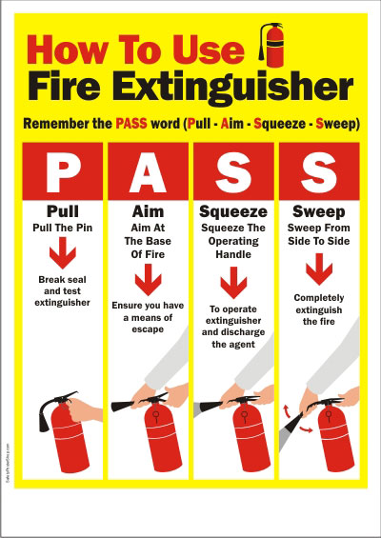
Reflection
Design a how-to poster explaining the steps of one of the growing procedures we discussed in this lesson.
https://mir-s3-cdn-cf.behance.net/project_modules/disp/8f903251803875.5608c27a0c826.png
What to Include:
Chronological steps for the procedure
A combination of words and images
Color and creativity!
http://www.safetypostershop.com/wp-content/uploads/2012/01/FireExtinguisher-PASS.jpg

