Slide 1
Nursery/Landscape Unit One
Lesson Two
Weeds

Slide 2
Resources
University of California — Pest Management Program
http://ipm.ucanr.edu/PMG/menu.weeds.html
Clemson University — Extension
http://www.clemson.edu/extension/hgic/pests/weeds/hgic2321.html

Slide 3
Annual Bluegrass
Description
Annual bluegrass grows to 6–8 inches if left unmowed.
The stems are flattened, light green and bent at the base.
Leaf blades are normally crinkled part way down and are 1–3 inches long.
Also, a distinctive feature of annual bluegrass is its boat-shaped tips.

Slide 4
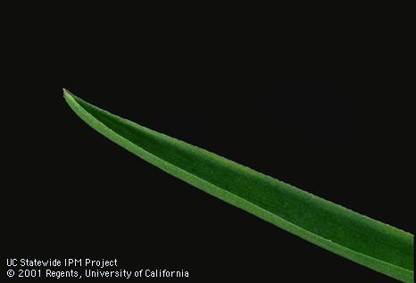
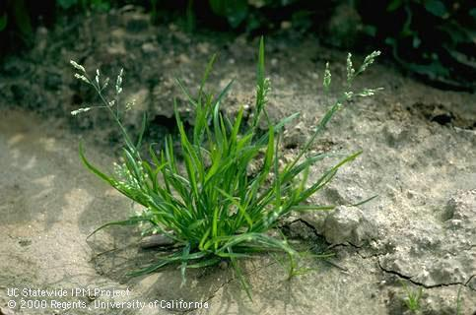
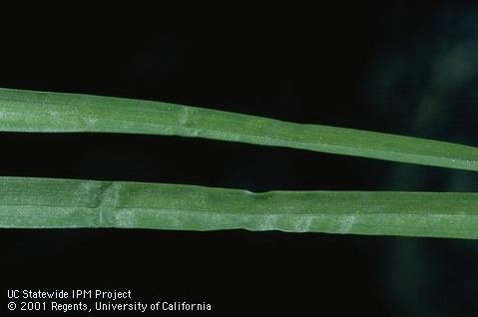
Annual Bluegrass
Boat Shaped Tips
Crinkled Blades
http://ipm.ucanr.edu/PMG/PESTNOTES/pn7464.html

Slide 5
Annual Bluegrass
Management
The best control against annual bluegrass is preventing new infestations from taking hold.
Hand pulling/hoeing is the best method for removal since mowers and string trimmers can spread the seeds; however it is not the most efficient.
Multiple techniques need to be used to control an annual bluegrass population.
Correct water application, seeding patches, using a pre-emergence herbicide and hand pulling all lead to successful bluegrass management.

Slide 6
Broadleaf Plantain
Description
Its smooth, oval-shaped leaves that are 2–6 inches long gave the broadleaf plantain its name.
Typically grows best in moist areas, compacted soil and partial-to-full sunlight exposure.
The broadleaf plantain has a fibrous roots system in the top 18 inches of topsoil.

Slide 7
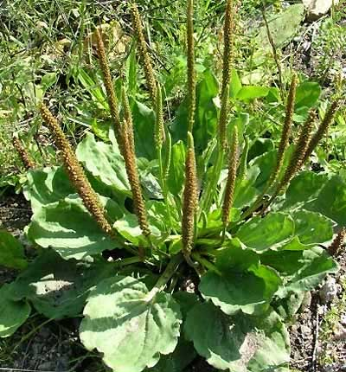
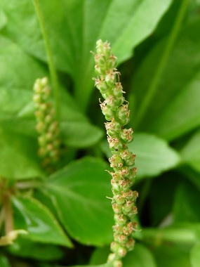
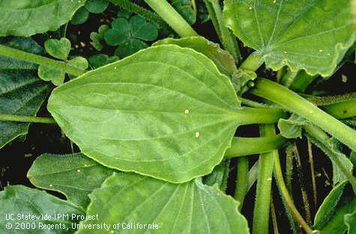
Broadleaf Plantain
http://www.ediblewildfood.com/images/broadleaf-plantain-pictures/broadleaf-plantain-picture.jpg
https://middlepath.com.au/plant/img/plantain-broadleaf_01_plant-in-flower.jpg
http://ipm.ucanr.edu/PMG/PESTNOTES/pn7478.html

Slide 8
Buckhorn Plantain
Description
The buckhorn plantain has long, narrow, oval-shaped leaves that are between 3–12 inches long and ¾- to 1½- inches wide.
The flowering stocks of the buckhorn plantain are much longer than broadleaf plantain measuring 12-18 inches.
Buckhorn plantain has a taproot, which means the root must be completely removed while weeding.

Slide 9
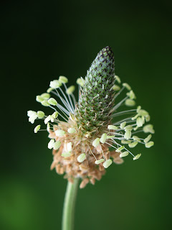
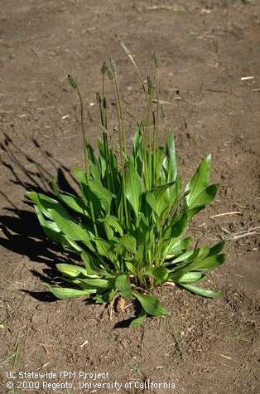
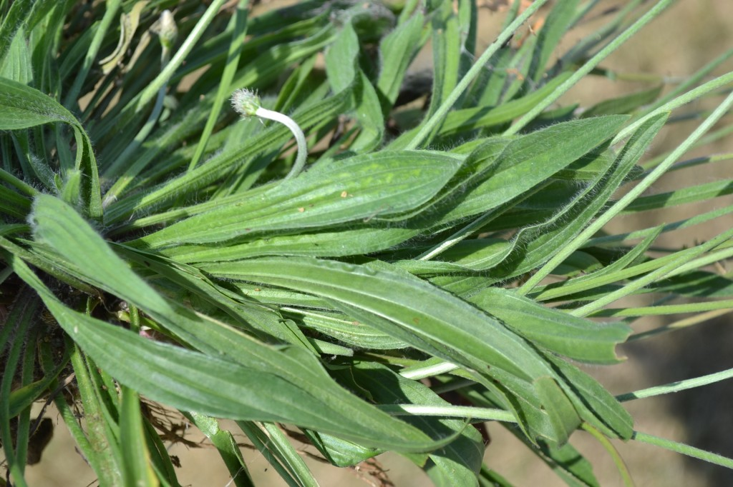
Buckhorn Plantain
https://1.bp.blogspot.com/__OOpzs3KGa4/RmyuqyTHuhI/AAAAAAAABFk/tah_WzJY1bU/s320/IMG_2358.JPG
http://ipm.ucanr.edu/PMG/PESTNOTES/pn7478.html
http://cleancutproperty.com/wp-content/uploads/2012/06/Buckhorn-Plantain-Leaves-1024x682.jpg

Slide 10
Broadleaf/Buckhorn Plantain
Management
Removing plants by hand before they produce seeds helps dramatically.
Pre-emergence herbicides commonly used to manage crabgrass do not work with plantains. Isoxaben, a broadleaf pre-emergence, has been proven helpful.
Application of 2,4-D and triclopyr are most effective when plantains are still in their seedling stage. Once established, only 2,4-D will work.

Slide 11
Chickweed
Description
In turf, it rarely grows taller than 2 inches but can reach up to 6 inches.
The small white flowers have 10 petals
Has a slim tap root and the upper leaves will be just under an inch long without a stem.
Timely removal of chickweed is crucial as it can harbor harmful pests and diseases.

Slide 12
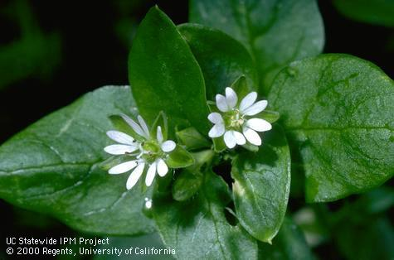
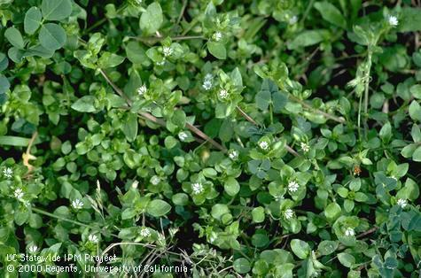
Chickweed
http://ipm.ucanr.edu/PMG/S/W-CP-SMED-FL.001.html
http://ipm.ucanr.edu/PMG/S/W-CP-SMED-MP.002.html

Slide 13
Chickweed
Management
Cultural practices include using mulch in flower beds and not over irrigating or fertilizing.
Hand weeding and hoeing work best when chickweed populations and the area being controlled are small.
When covering a large area, chemical practices can be used. However, proper timing of application is necessary.

Slide 14
Clovers
Description
All clovers are legumes; therefore, they have a symbiotic relationship with rhizobium and supply their own nitrogen needs.
Clovers are commonly mistaken for oxalis. The biggest difference is the indentation on the topside of clover leaves and the difference in their flowers.
Clovers have very distinct “pea-like” flowers.

Slide 15
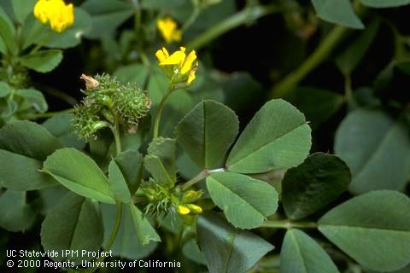
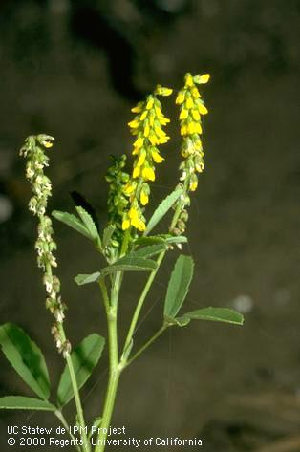
Clovers
http://ipm.ucanr.edu/PMG/M/W-LG-MPOL-FR.001.html
http://ipm.ucanr.edu/PMG/M/W-LG-MOFF-FL.002.html

Slide 16
Clovers
Management
Clover is relatively easy to control through cultural practices.
Hand weeding and mulching work best.
When using chemical control, a pre-emergent herbicide is best.
Once a clover plant appears chemical application will do little to remove the plant.

Slide 17
Crabgrass
Description
Since crabgrass is light green and can continue to grow even when mowed down to ¼ inch it can be hard to spot in turf grass.
Typically grows in clumps that can range from ¼-inch to 6 inches tall.
A reddish tint can sometimes be found at the base of the blade.

Slide 18
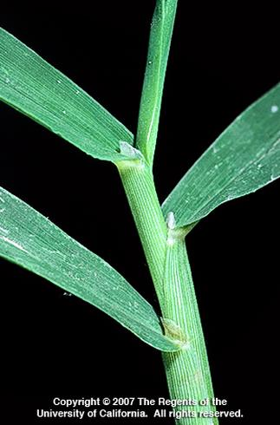
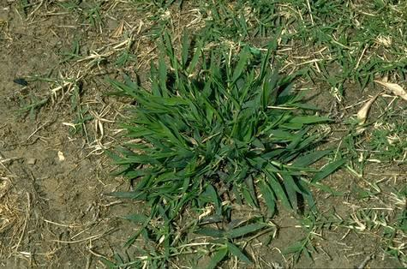
Crabgrass
http://ipm.ucanr.edu/PMG/D/W-GM-DISC-MP.001.html
http://ipm.ucanr.edu/PMG/D/W-GM-DISC-OK.001.html

Slide 19
Crabgrass
Management
There are many cultural practices that can help manage crabgrass including
  Mowing the turf to recommended height, heavily seeding patches in turf and proper irrigation
Chemical practices can be used but are difficult once crabgrass has emerged.
Dithiopyr has been shown to be effective but must be applied by a professional. Chemicals available to homeowners do not provide full protection.

Slide 20
Dandelion
Description
Dandelions have taproots that typically reach around 6–18 inches.
Flowering stalks can grow anywhere from 6–24 inches tall
The flower is a vibrant yellow and once ready to seed exposes the characteristic white puffball.

Slide 21
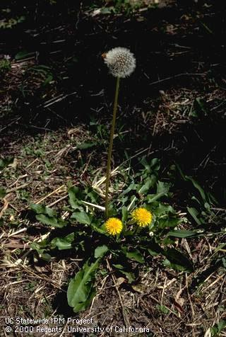
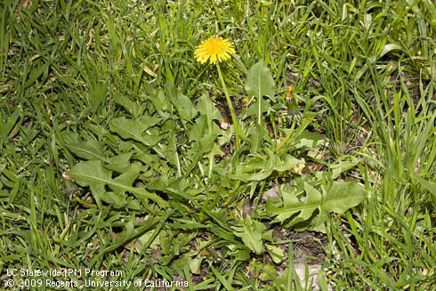
Dandelion
http://ipm.ucanr.edu/PMG/T/W-CO-TOFF-MP.013.html
http://ipm.ucanr.edu/PMG/T/W-CO-TOFF-MP.001.html

Slide 22
Dandelion
Management
Because of a dandelion’s deep taproot, hand weeding is very impractical for removal.
Since dandelion seeds are transported through the air, it can be difficult to prevent new infestations.
Pre-emergents commonly used for crabgrass have no effect; however, isoxaben used for broad leaves has been proven to work.

Slide 23
Henbit
Description
Henbit is a winter annual with greenish to purplish square stems.
Its flowers are reddish purple and has spots on the lower leaves.
Henbit can grow up to 16 inches and has a fibrous root system.

Slide 24
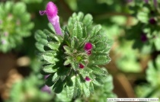
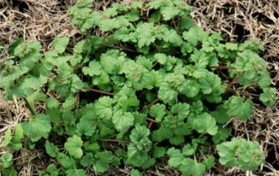
Henbit
http://www.clemson.edu/extension/hgic/graphics/2321/lamium_amplexicaule_2_klr.jpg
http://www.lawn-care-academy.com/images/henbit2.jpg

Slide 25
Henbit
Management
Cultural practices include hand weeding and applying mulch in landscape beds.
The best chemical practice is a three-way herbicide. This will include 2,4-D, dicamba and mecoprop.
It is important to know which type of turf the herbicide is being applied to because lower doses of 2,4-D may be needed.

Slide 26
Nutsedge
Description
While nutsedge may look like a grass, it is a true sedge.
The most obvious identifier is its three triangular-shaped stems.
Nutsedge produces tubers, which are sometime referred to as “nuts.”

Slide 27
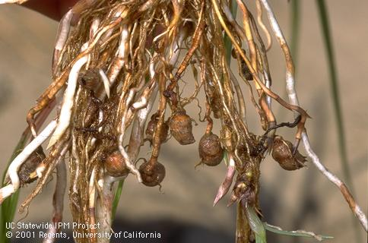
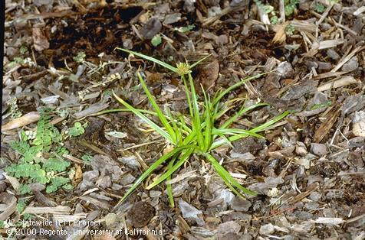
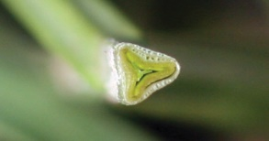
Nutsedge
http://ipm.ucanr.edu/PMG/C/W-CY-CESC-RS.009.html
http://ipm.ucanr.edu/PMG/C/W-CY-CESC-MP.008.html
http://www.ipm.msu.edu/uploads/images/YellowNutsedgeStem.jpg

Slide 28
Nutsedge
Management
There are no chemical controls that fully manage nutsedge. They only aid in reducing the population.
The key to nutsedge removal is stopping the production of new tubers.
Remove small nutsedge plants before they have 5–6 leaves. Repeat every 2–3 weeks throughout the growing season to stop production of tubers.
With every new shoot grown, the tubers expend energy until their reserves are depleted. Then the plant will die.

Slide 29
Oxalis
Description
The leaves contain three heart-shaped leaflets at the tip of the stem and can be green or purplish.
Oxalis has bright yellow flowers with 5 petals, and there will be 2–5 flowers per plant.
At night or in intense light, the leaves will fold down into themselves.

Slide 30
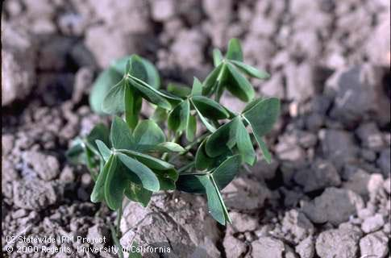
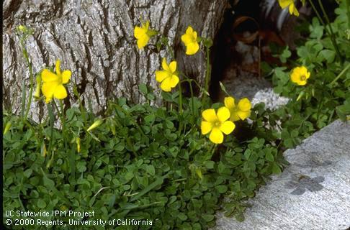
Oxalis
http://ipm.ucanr.edu/PMG/O/W-OX-OCOR-SG.002.html
http://ipm.ucanr.edu/PMG/O/W-OX-OPES-FL.001.html

Slide 31
Oxalis
Management
Varying mowing, irrigation and fertilization will not work to control oxalis. The only cultural practice is to hand weed.
To have the greatest effect with herbicide make sure the temperature and moisture are right. This can be found on a chemical’s label.
Triclopyr and fluroxypyr are the two best chemicals to use against established oxalis. However, triclopyr is more readily available to homeowners.

Slide 32
Purslane
Description
The leaves are stockless, oval shaped, shiny and smooth.
Purslane has a reddish stem and can grow up to 12 inches.
Purslane can produce up to 240,000 seeds that can still germinate decades after being released.

Slide 33
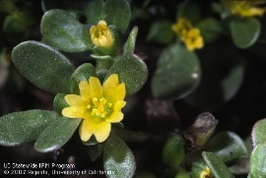
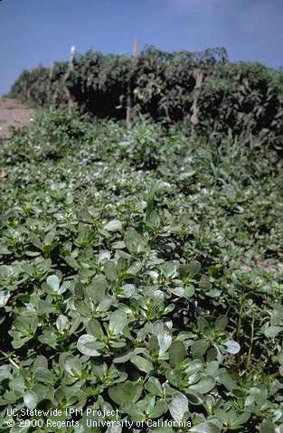
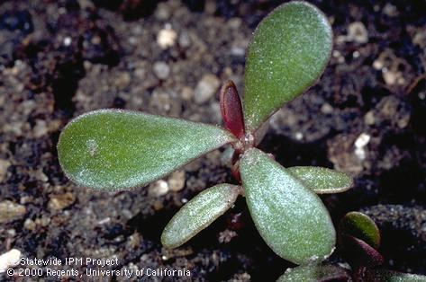
Purslane
http://ipm.ucanr.edu/PMG/P/W-PO-POLE-FL.006.html
http://ipm.ucanr.edu/PMG/P/W-PO-POLE-IF.002.html
http://ipm.ucanr.edu/PMG/P/W-PO-POLE-SG.003.html

Slide 34
Purslane
Management
Hand weeding and mulching are the best cultural practices. Tilling may resurface seeds since purslane germinates toward the top of the soil.
A natural biological control is the purslane sawfly. However, the effectiveness of this control varies. Typically, when enough purslane is present to support a sawfly population, the weed has already seeded.
Common chemicals used in pre- and post-emergence can be used to control purslane.

