Slide 1
Unit One: Greenhouse Care and Maintenance
Lesson Three:
Handling Chemicals
Lesson Objectives
Identify the correct personal protective equipment that must be worn while handling chemicals.
Examine the use of chemicals commonly used in the floriculture industry.
Demonstrate an understanding of proper handling, application and storage of chemicals.

Slide 2

Introduction
http://www.johnyoungsigns.co.uk/img/SafetySignsCarouselImages2.jpg
Complete the Greenhouse Safety Pretest

Slide 3
Personal Protective Equipment
What is PPE?
Anything used or worn by a person to minimize risk to the person's health or safety.
Goggles
Safety goggles
Hearing protection
Dust mask
Gas mask
Compressed air sprayer
Respirator
Chemical resistant gloves
Spray suit
Apron
Footwear

Slide 4
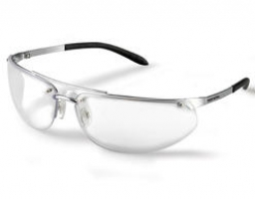
Goggles
These goggles resemble glasses.
The lenses protect debris from going into your eye directly.
However, debris can enter from the sides and behind the lenses.
https://www.howarthtimber.co.uk/assets/d5eb5376f8445088982f2c1e2cc012a1a6f82e42.jpg/width/256/height/200

Slide 5
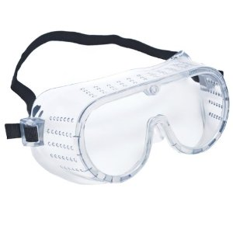
Safety Goggles
These goggles cover your eyes more then the previous goggles.
Debris is blocked by the lenses and can’t enter on the sides or from behind the lenses.
http://ecx.images-amazon.com/images/I/41F-N%2Blo2rL._SY300_.jpg

Slide 6
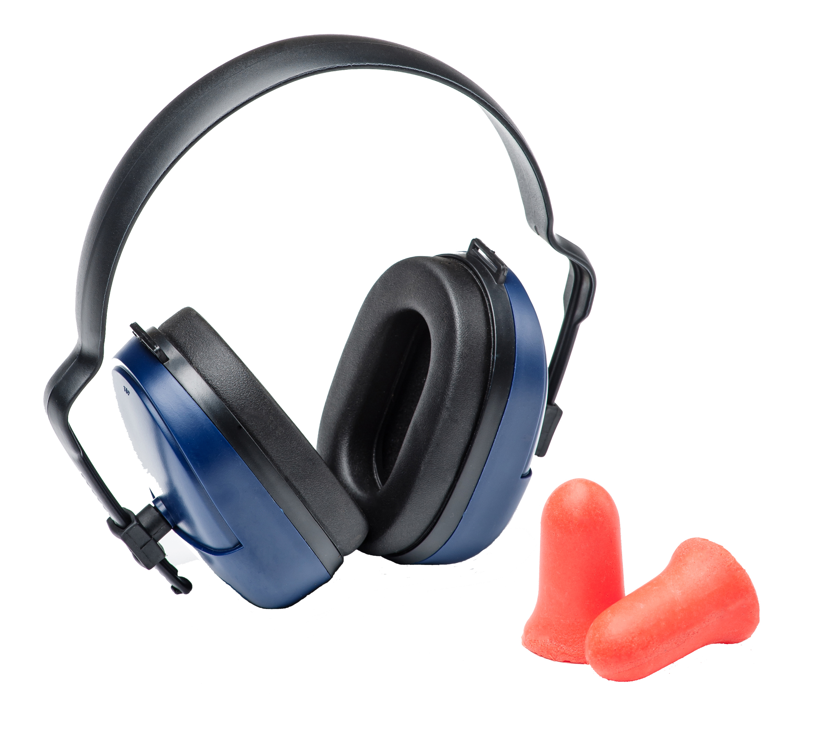
Hearing Protection
Prevents hearing damage or loss.
Should be worn when working with equipment that produces noise over 85 decibels.
https://www.continentalcarbonic.com/cmss_files/imagelibrary/Safety%20hearing%20headgrear%20and%20ear%20plugs2%20copy.jpg

Slide 7
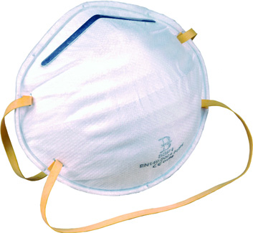
Dust Mask
Worn around the nose and mouth.
Prevents the inhalation of dust particles.
Doesn’t protect against chemicals, gases or vapors.
http://www.industrialworkwear.com/images/product/BBP1l.jpg

Slide 8
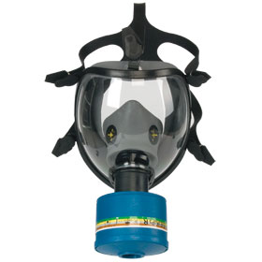
Gas Mask
A mask that protects the face, eyes and lungs.
Connected to a single cartridge that works to purify the air you are breathing.
Prevents the inhalation of poisonous chemical fumes, gas and vapors.
http://i00.i.aliimg.com/img/pb/747/294/209/1228454683190_hz_myalibaba_web6_1470.jpg

Slide 9
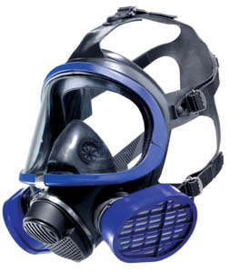
Respirator
A mask that protects the face, eyes and lungs.
It has two filters that works to purify the air you are breathing.
Prevents the inhalation of poisonous chemical fumes, gas and vapors.
http://www.mcieast.marines.mil/Portals/33/Documents/Safety/OSH/respiratory_protection.jpg

Slide 10
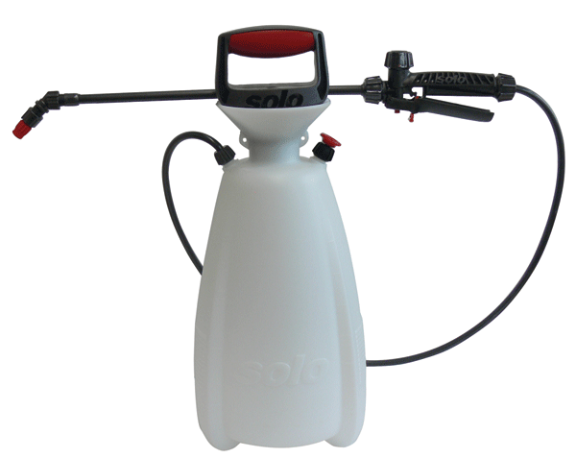
Compressed Air Sprayer
Can be carried or worn like a backpack.
Sprays liquid chemicals with ease and accuracy.
http://solousa.com/store/shop_image/product/f5936a9dbc16eb3dd5ceab8b5463cb97.gif

Slide 11

Chemical Resistant Gloves
Larger then conventional latex gloves.
Made of a chemical resistant material.
Protects from chemical absorption through dermal contact.
https://envirosafetyproducts.files.wordpress.com/2010/12/chemical-resistant-300x200.jpg

Slide 12
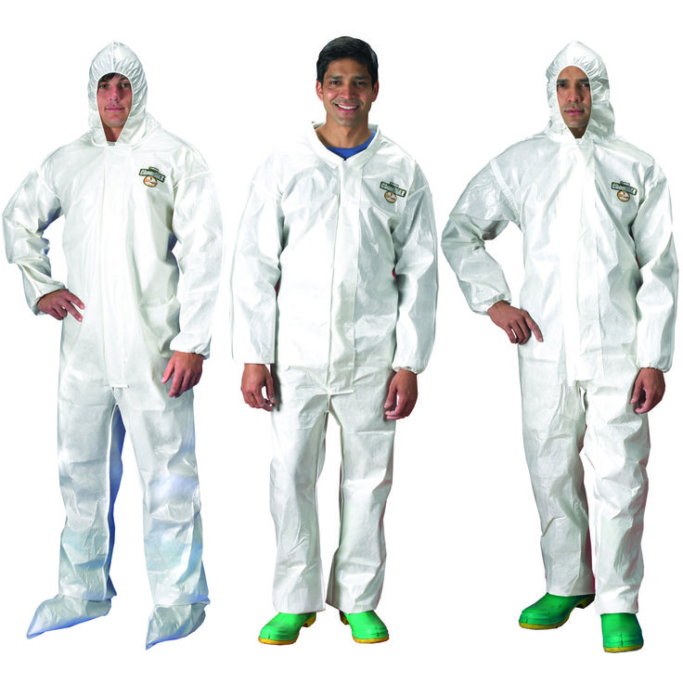
Spray Suit
Full-body suit with a hood.
Made of a chemical resistant material; it can be flame retardant.
Protects from chemical absorption through dermal contact and chemical spills that could ruin clothing.
https://s-media-cache-ak0.pinimg.com/736x/d4/f1/19/d4f119a6fbd3247936bdf71a25072299.jpg

Slide 13
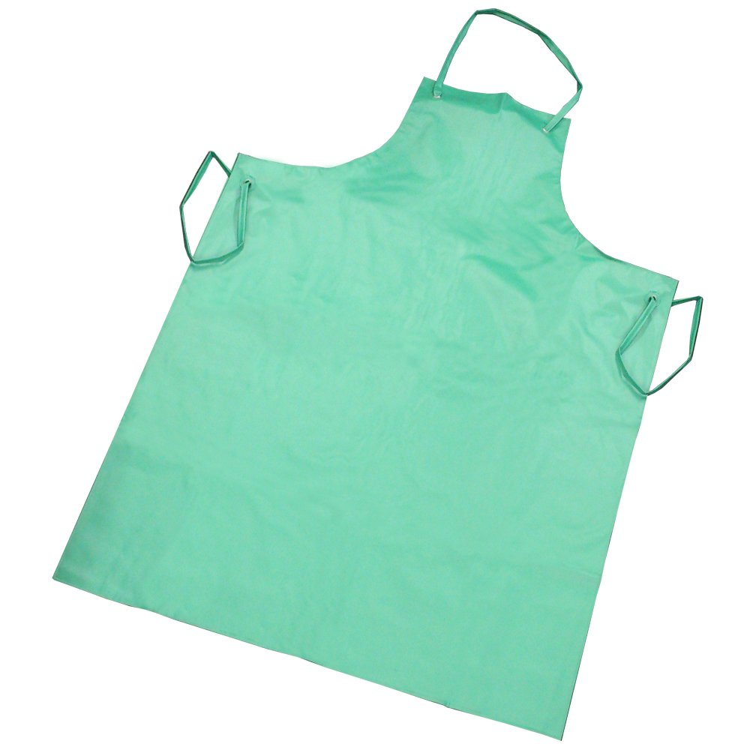
Apron
Fits around your neck and covers the front of you body.
Made of a chemical resistant material; it can be flame retardant.
Protects from chemical splashes and spills that could ruin clothing.
http://images.rsis.co.uk/images/products/zoom/1377185194-14079800.jpg

Slide 14
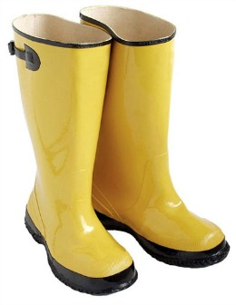

Footwear
Always wear closed-toed shoes.
Depending on the work, can be steel-toed or rubber boots.
Protects feet from chemical absorption and injury.
https://www.asasupplies.com/images/Oil%20Spill%20Clean%20Up%20Boots.jpg
https://files.ctctcdn.com/100d7ccb001/63ae7025-9844-4796-b9cc-7ecd6548fe44.jpg

Slide 15
Chemicals in Floriculture
Fertilizers and Pesticides
Chemicals are often applied to plants in the form of fertilizers or pesticides.
The purpose of these chemicals is to increase the health and production of the plant.
When working with any chemicals, it is the applicator’s responsibility to follow the Environmental Protection Agency (EPA) Regulations on how to handle, apply, store and dispose of the chemicals to avoid harm to humans, animals or the environment.

Slide 16
Fertilizers
Fertilizers are used to amend the chemical properties of the soil or growing medium.
Complete Fertilizers includes the macronutrients nitrogen (N), phosphorous (P) and potassium (K).
  This is represented as the fertilizer grade in a percentage.
Example: 10-5-10 fertilizer (10%N-5%P-10%K)

Slide 17
Fertilizers
Fertilizers are used to amend the chemical properties of the soil or growing medium.
Inorganic Fertilizers are single element concentrations.
  They can be used to amend the plant’s required nutrients.
    Examples: Ammonium sulfate, sodium nitrate and potassium chloride

Slide 18
Fertilizers
Fertilizers are used to amend the chemical properties of the soil or growing medium.
Organic Fertilizers contain plant and animal residue as well as mined minerals.
  They are slow releasing and have a low nutrient analysis.
    Examples: Manure or blood/bone meal

Slide 19
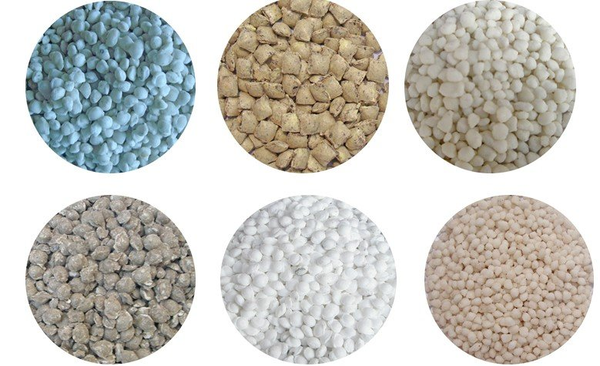
Granular Fertilizers
Dry Application is used with low-analysis complete or inorganic fertilizers.
Examples: 6-8-6 or potassium chloride
This Granular Fertilizer is applied before planting and is mixed into the soil or growing medium.
The nutrient content and availability is at a low rate.
If too much of these fertilizers are applied, the resulting high levels of soluble salt can damage the plant.
http://i00.i.aliimg.com/img/pb/992/406/329/329406992_055.jpg

Slide 20
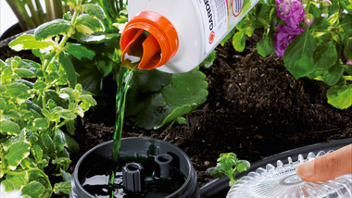
Water-Soluble Fertilizers
Liquid Application is common in inorganic and complete fertilizers with a higher nutrient analysis.
Examples: 15-30-15, 20-10-20, 20-5-30
The nutrients in this Water-Soluble Fertilizer can be applied through the irrigation system in a process called Fertigation.
Liquid fertilizers can be applied more frequently then dry fertilizers. Once a month, every two weeks or daily depending on concentration levels.
http://cdn.gardena.com/dimage.axd/newFatureImage/ga250-533/380x214/e84cd49.png

Slide 21
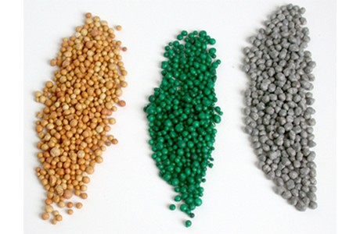
Resin-Coated Fertilizers
Controlled-Release Fertilizers do not release their nutrients all at once.
Examples: Urea formaldehydes (UFN), magnesium ammonium phosphate (Magamp) and Osmocote
While all fertilizers release their nutrients at a controlled rate, these fertilizer particles are coated and designed to release available nutrients slower than the others.
Resin-Coated Fertilizer is influenced greatly by the temperature of the soil or growing medium and the size of the particles.
http://www.hortidaily.com/images/2014/0910/fertilizer2.jpg

Slide 22
Fertilizer Activity
Read scenario 1 and 2 on the Chemical Problem Solving Worksheet and answer the questions.
Scenario 1
How will the All Purpose Fertilizer be applied?
How many pounds of nitrogen are in a 30 pound bag?
What is the total weight (in pounds) of nitrogen, phosphorous and potassium?
Scenario 2
Using the table, how many pounds of fertilizer will go into the 55-gallon tank?
How is this application different from scenario 1?

Slide 23
Pesticides
Pesticides are any material used to control, kill or repel a pest. They are classified based on the type of pest it destroys:
Fungicides – Fungus
Herbicides – Weeds
Insecticides – Insects
Miticides - Mites
Molluscicides – Mollusks (snails and slugs)
Nematocides - Nematodes
Rodenticides – Rodents

Slide 24
Handling Pesticides
Because of the chemical components in pesticides, they can be poisonous or toxic to humans or the environment if not handled correctly.
Poison can enter the body through
  Swallowing – Oral contact
  Touching – Skin/Dermal contact
  Breathing – Inhalation

Slide 25
Handling Pesticides
A poisonous toxicity level is measured as follows:
  Acute Toxicity measures how poisonous a pesticide is after one exposure. Oral and dermal acute toxicity is measured in Lethal Dose (LD) and inhalation toxicity is measured in Lethal Concentration (LC). The lower the LD/LC number the more poisonous the substance.
  Chronic Toxicity measures how poisonous a pesticide is over a period of time after extended use. There is no standard measurement for chronic toxicity.

Slide 26
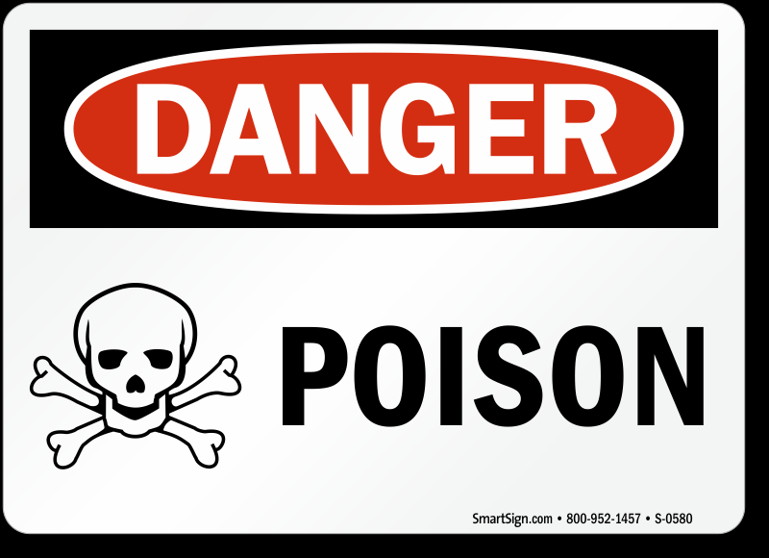


EPA Rules on Pesticide Use
Toxicity I
“Danger-Poison” signal word
Post warning signs
48 hour no re-entry
Toxicity II
“Warning” signal word
24 hour no re-entry
Toxicity III
“Caution” signal word
Re-entry after dust/mist settles
Toxicity IV
No signal word
May re-enter immediately
http://images.mysafetysign.com/img/lg/S/poison-danger-sign-s-0580.png
http://www.deenergize.com/img/WARNING_Signal_Word_Headers.gif
http://cdn-5.freeclipartnow.com/d/41699-1/caution-sign-w-exclamation.jpg

Slide 27
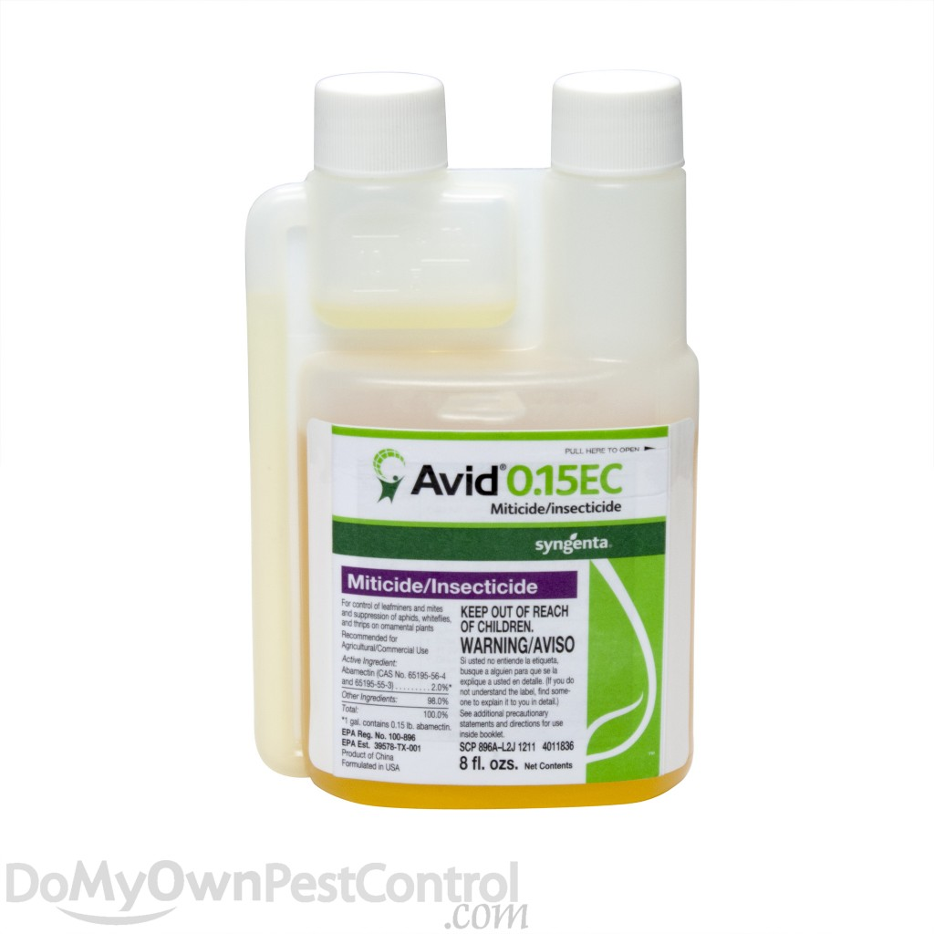


Emulsion Concentrate Pesticides
Emulsifiable Concentrates contain a combination of active ingredient and solvent that needs to be mixed with water before it is applied.
The formulation mixed with water forms an emulsion, which is a colloidal suspension of a liquid in another liquid and looks like milk.
Emulsifiable concentrates are easily absorbed through the skin so spray suit and chemical resistant gloves are required.
http://4.bp.blogspot.com/-IU_v-d9si_s/T7Q2xQWoYBI/AAAAAAAAA9A/DZaj08WMyC4/s1600/ISO+M006+Gloves+Required.jpg
http://signsforsafety.co.uk/wp-content/uploads/2015/11/SW-5651JJ-450x450.gif
http://cdn.domyownpestcontrol.com/images/thumbnails4/2330-1.jpg.thumb_1024x1024.jpg

Slide 28
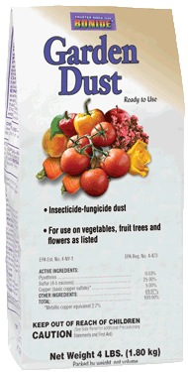
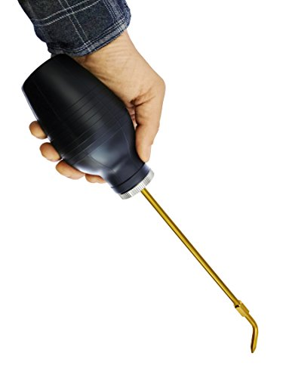

Dust Pesticides
Dusts are ready-to-use and usually contain a low percentage of active ingredient.
Dusts are always used dry, and they easily drift in the air so proper goggles and a dust mask are required during application to prevent irritation and inhalation.
Applied using a duster, which helps spread the chemical evenly.
http://www.clipartbest.com/cliparts/biy/akp/biyakpEiL.jpeg
http://www.gardencitygardensupply.com/media/catalog/product/cache/1/image/9df78eab33525d08d6e5fb8d27136e95/i/m/image_1412.jpg
http://valuechimp.com/wp-content/uploads/2016/04/Insect-Buster-Dispenser-for-Diatomaceous-Earth-and-Other-Powdered-Insecticides-and-Pesticides-Non-Toxic-and-Natural-Bulb-Duster-and-Insecticide-Applicator-by-Dr-Killigans-0-3.jpg

Slide 29
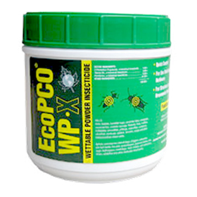
Wettable Powder Pesticides
Wettable powders are dry, finely ground formulations that look like dusts but must be mixed with water and applied as a spray.
They are less easily absorbed through the skin and eyes than emulsion concentrates and other liquids, but like dusts, they may be inhaled, so a dust mask is required.
http://www.clipartbest.com/cliparts/biy/akp/biyakpEiL.jpeg
http://www.pestpoolandlawn.com/images/products/large_50_ecoWPX.jpg

Slide 30

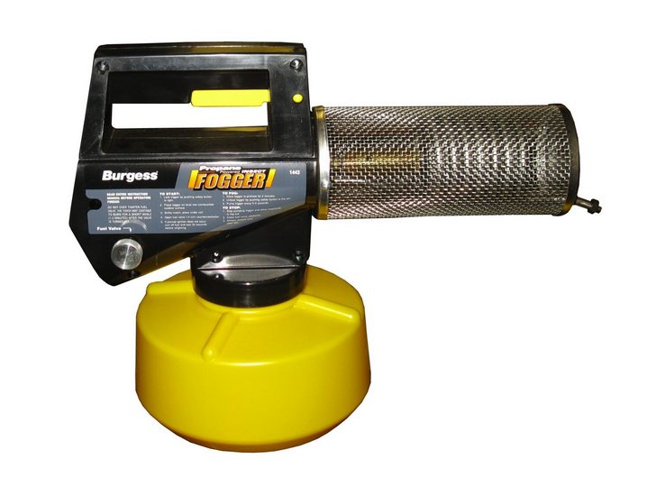

Fogger Pesticides
Foggers are fumigant pesticides that form poisonous gases when applied.
Some active ingredients are volatile liquids or solids when packaged under high pressure but change to gases when released.
Fumigants are highly toxic to humans and require the use of a spray suit and respirators or gas masks.
http://signsforsafety.co.uk/wp-content/uploads/2015/11/SW-5651JJ-450x450.gif
https://usercontent2.hubstatic.com/8714845_f260.jpg
http://www.accidental.com.au/media/catalog/product/half-face-repirator-pictos.jpg
http://insectcop.net/wp-content/uploads/2015/03/burgess-1443-propane-fogger.png

Slide 31
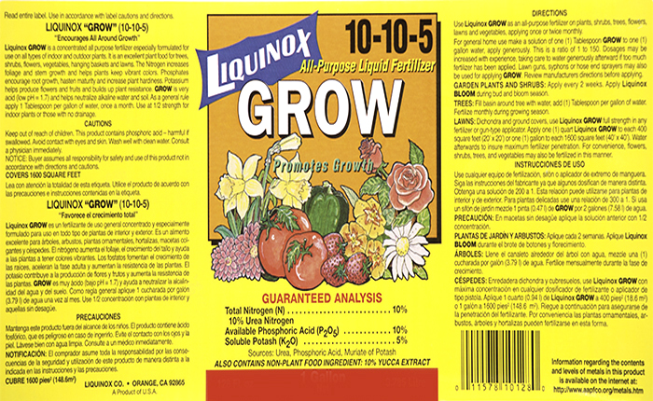
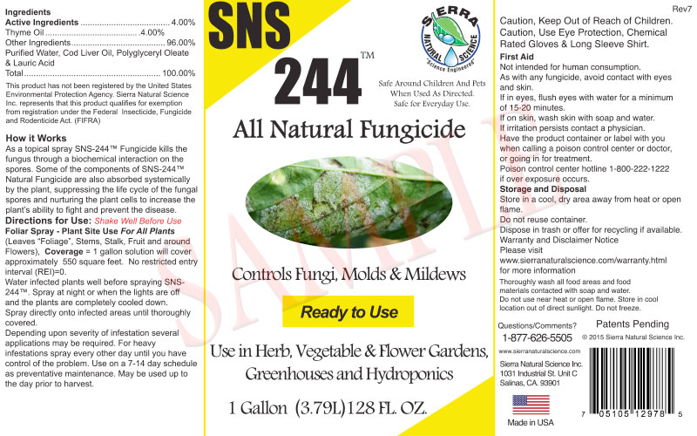
Reading the Label
Whenever you are using chemicals, ALWAYS READ THE LABEL CAREFULLY.
While the logos and color may differ, the same key information is included on every bag.
Instructions on how to handle, mix, apply, store and dispose of the pesticide are all included on the label.
http://liquinox.com/product/img/stock_images/700x430_1.jpg
http://sierranaturalscience.com/wp-content/uploads/2015/11/SNS-244RTU-Gallon-Label-R7.jpg

Slide 32
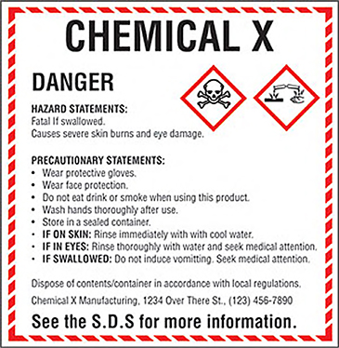
Hazards and Safety Precautions
This section of the label will categorize the level of toxicity, identify a signal word and list safety precautions.
Knowing these precautions will help you determine how toxic the chemicals you are working with are and what PPE is necessary when handling them.

Slide 33
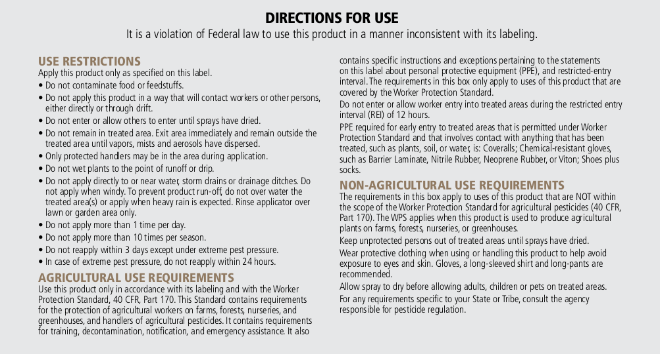
Directions for Use
This section will include the specifics for handling and applying the chemical.
It is important to read this carefully AND FOLLOW THE DIRECTIONS.
https://www.naturalorganicwarehouse.com/image/data/MGK/Directions%20for%20Use.png

Slide 34
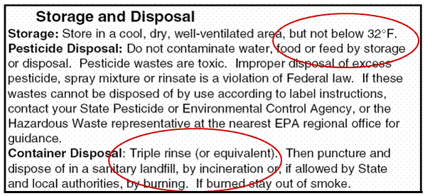
Storage and Disposal
All chemicals should be stored in their original containers.
Specific temperature requirements will be identified on the label, otherwise keep at room temperature.
Keep away from children, animals and food in a room you can lock.
Specific disposal requirements will be identified on the label, otherwise follow your state regulations.
https://pesticidestewardship.org/homeowner/PublishingImages/StorageandDisp.GIF

Slide 35
Controlling Spills
In the event a container is damaged you will have to transfer the chemicals to a new container and label it correctly.
First, clean any spills that occurred using a cleaning detergent and water.
Once the area has been cleaned, transfer the remaining non-contaminated chemicals into a new container.
Once the new container has been filled, seal it and label it with the chemical’s information.
To do this, remove the entire label off the old container and fasten it to the new container.
Dispose of the old container properly.

Slide 36
Pesticide Activity
Read scenario 3 on the Chemical Problem Solving Worksheet and answer the questions.
What kind of PPE needs to be worn when applying this pesticide?
How should this pesticide be stored?
What must you do before you recycle or burn this container?
Will the pesticide treat whiteflies inside a greenhouse?
How many tablespoons need to be mixed with a 25-gallon sprayer at a high rate?

Slide 37
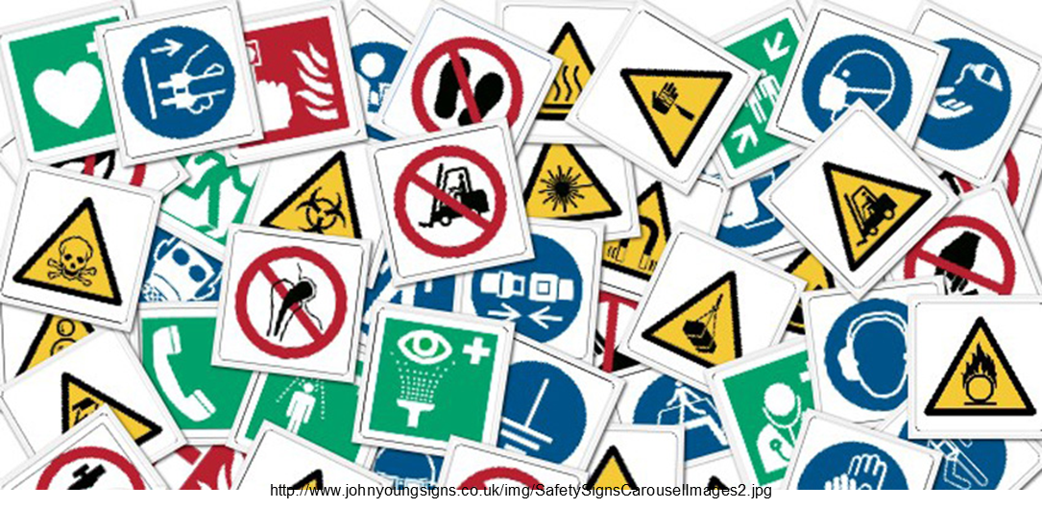
Review
Complete the Greenhouse Safety Post-test

