Slide 1
Nursery/Landscape Unit One
Lesson Three
Plant Diseases

Slide 2
Resources
University of California — Pest Management Program
http://ipm.ucanr.edu/PMG/diseases/diseaseslist.html
University of Minnesota Extension
https://www.extension.umn.edu/garden/yard-garden/trees-shrubs/crown-gall/
https://www.extension.umn.edu/garden/yard-garden/trees-shrubs/cedar-apple-rust-and-gymnosporangium-rusts/
University of Georgia Extension
http://extension.uga.edu/publications/detail.cfm?number=B1238
Cornell University
http://plantclinic.cornell.edu/factsheets/treecankers.pdf

Slide 3
Unit One: Identification
Lesson Three:
Plant Diseases and Physiological Problems
Lesson Objectives:
Identify common diseases found in nursery/landscape plants.
Evaluate the causes and effects of diseases in nursery/landscape plants.
Discuss cure and prevention strategies for diseases in nursery/landscape plants.

Slide 4
Identification
Diseases
Anthracnose
Apple scab
Black spot
Botrytis — gray mold
Canker
Cedar — apple rust
Crown gall
Fire blight
Powdery mildew
Root rot

Slide 5
Anthracnose
Overview
Anthracnose is a fungus that occurs primarily on leaves and twigs.
On deciduous trees, the fungus winters in twigs or fallen leaves, and when the weather warms and conditions are at the right moisture levels, it will reoccur and spread.
Anthracnose is a big threat in climates that aren’t too dry over the summers and have long springs.

Slide 6
Anthracnose
Symptoms
Anthracnose causes dark, sunken lesions on leaves, bark and fruit on infected trees.
Twigs and whole branches can be killed off or deformed.
Since anthracnose can target so many different species, the symptoms can look different depending on species and climate.
Unless serious defoliation and dieback occurs every year, no serious harm will come to infected plants.

Slide 7
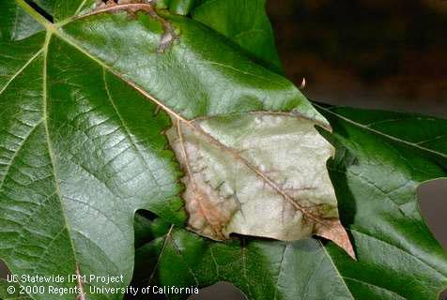
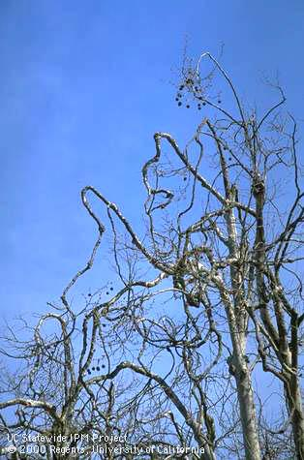
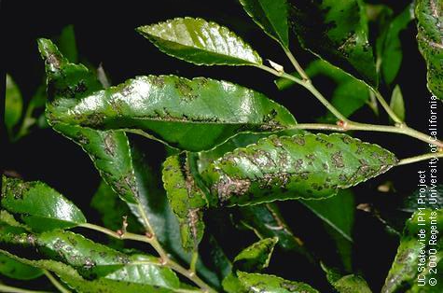
Anthracnose
http://ipm.ucanr.edu/PMG/A/D-WO-AVEN-FO.005.html
http://ipm.ucanr.edu/PMG/A/D-WO-AVEN-BT.001.html
http://ipm.ucanr.edu/PMG/S/D-WO-SULM-FO.003.html

Slide 8
Anthracnose
Prevention/Treatment
Prevention
Planting fungi resistant plants can help ward off anthracnose.
If a plant is already infected, rake/remove any fallen leaves and twigs.
Treatment:
Chemically — Fungicide can only help prevent the establishment or spreading of fungi. Application before the rainy season is required.
Culturally — Pruning/removing infected leaves and smaller twigs or branches controls the spread of the fungus. Do not irrigate in a way that wets the leaves.

Slide 9
Apple Scab
Overview
Apple scab can destroy an entire crop of apples.
Apple scab can target both fruit-bearing apple trees and ornamental crabapple trees.
For the fungus to spread, wet conditions are needed. The fungus will winter on fallen materials, and spores will spread when moisture and temperature are correct.

Slide 10
Apple Scab
Symptoms
First, yellow spots will form on the leaves. Later in the season, these spots will become dark, and a scab can spread to the fruit.
Scabbing on the fruit can become so bad it renders the apple inedible.
This fungus can cause flowers to drop early, defoliation and scab over apples making them inedible.

Slide 11
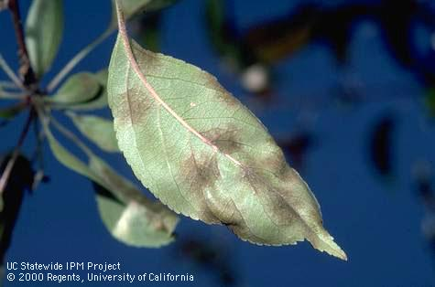
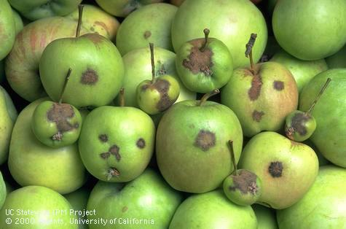
Apple Scab
http://ipm.ucanr.edu/PMG/V/D-AP-VINA-FO.007.html
http://ipm.ucanr.edu/PMG/V/D-AP-VINA-FR.014.html

Slide 12
Apple Scab
Prevention/Treatment
Prevention:
Certain species of trees are more susceptible than others. By researching which trees are more resistant and using them, the need to prevent the disease could become unnecessary.
Treatment:
Chemically — Fungicide is only necessary if leaves are going to be wet for longer than nine hours.
Culturally — Removal of fallen leaves and applying zinc and urea to leaves can help prevent the development and spread of apple scab.

Slide 13
Botrytis – Gray Mold
Overview
This fungus can thrive everywhere plants are grown and survives particularly well in humid areas, especially greenhouses.
Botrytis requires a food source and will often times be found on wounded or dying plant parts that are leaking nutrients.
Once the food source is established, the fungus will expand as it attacks the healthy plant tissue.

Slide 14
Botrytis – Gray Mold
Symptoms
Initially appearing as a white spot, Botrytis will turn a dark gray color.
The gray mold will grow spores that give it a dusty appearance and will spread easily.
It can be found on any part of the plant: leaves, stem, flower, fruit, etc.

Slide 15
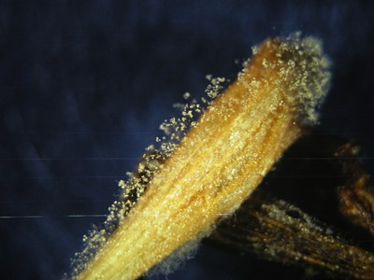
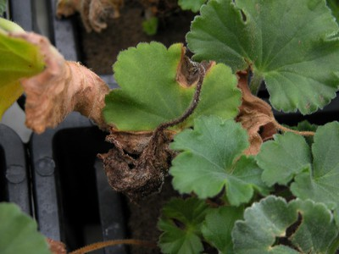
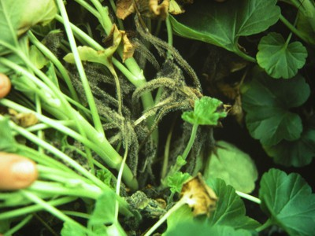
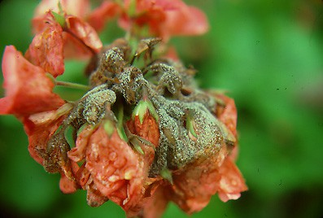
Botrytis – Gray Mold
http://extension.psu.edu/pests/plant-diseases/all-fact-sheets/botrytis-or-gray-mold

Slide 16
Botrytis – Gray Mold
Prevention/Treatment
Prevention:
Avoid injuring plants
Clean up plant debris
Properly ventilate greenhouses
Treatment:
Chemically — Fungicide
Culturally — Reduce relative humidity

Slide 17
Canker
Overview
Cankers are dead spots in a tree’s bark and trunk that are caused by a variety of fungi and bacteria.
They also can form from open wounds that are caused from physical damage while mowing or pruning.

Slide 18
Canker
Symptoms
Cankers appear as big open wounds on the sides of tree trunks or branches.
Girdling can form above the canker. This is when all parts above the canker lose their nutrient and water supply and die off.
If a canker becomes large enough on the trunk of a tree, it may kill the entire plant.

Slide 19
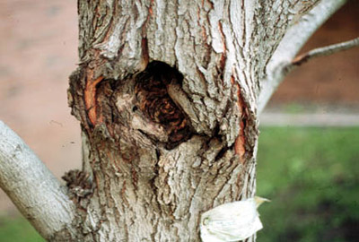
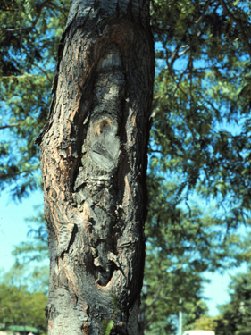
Canker
https://www.extension.umn.edu/garden/yard-garden/trees-shrubs/canker-on-trees/img/fig1.jpg
http://hort.uwex.edu/files/2014/11/canker.png

Slide 20
Canker
Prevention/Treatment
Prevention:
Cankers are hard to form on vigorous trees. Through proper irrigation and fertilization, mitigation of cankers is maximized. Research which trees are most likely to be affected by cankers and avoid them.
Treatment:
Chemically — There are no chemical options to effectively control or prevent cankers.
Culturally — If cankers form on branches, quickly remove the affected areas.

Slide 21
Cedar – Apple Rust
Overview
Cedar – apple rust affects the juniper (cedar) and apple families of trees.
This form of rust is rarely harmful to its host plant. It is simply a cosmetic problem.
To complete it’s life cycle, it requires both a cedar and apple host.

Slide 22
Cedar – Apple Rust
Symptoms
On apple trees, leaf spots that range from yellow to red will form. Very short (less than a tenth of an inch) tubes will form on the opposite side of the leaf from the spots.
On apple trees, it is rare for bright orange fungi blisters to from on flowers.
On cedar trees, small greenish-brown galls will form on small twigs and branches. In the spring, these will turn into bright orange tentacles that are less than an inch long.

Slide 23
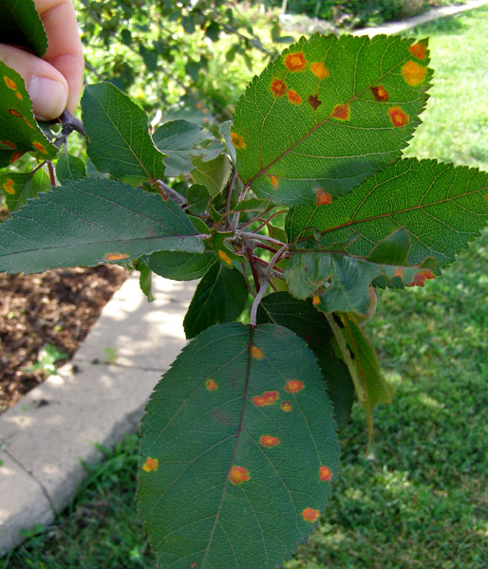
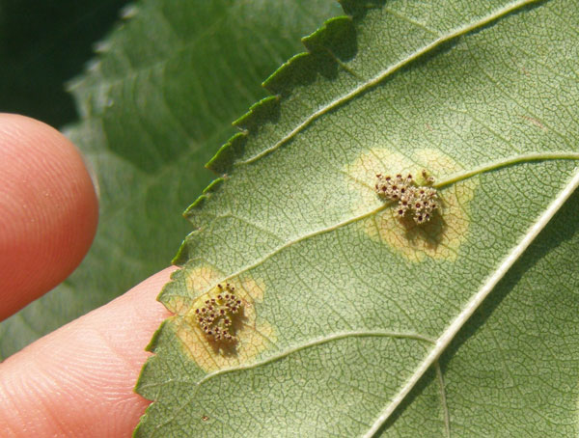
Cedar – Apple Rust
Apple Tree
https://www.extension.umn.edu/garden/yard-garden/trees-shrubs/cedar-apple-rust-and-gymnosporangium-rusts/#seven

Slide 24
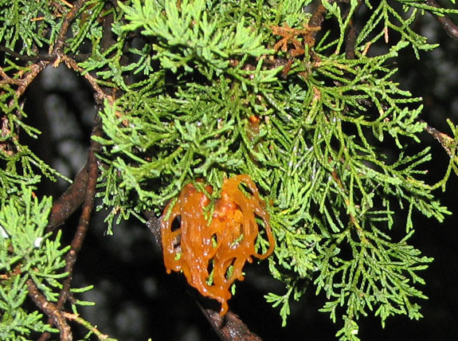
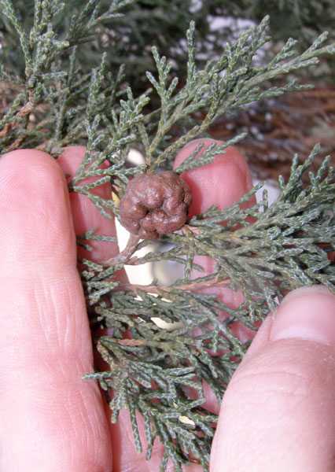
Cedar – Apple Rust
Cedar Tree
https://www.extension.umn.edu/garden/yard-garden/trees-shrubs/cedar-apple-rust-and-gymnosporangium-rusts/#seven

Slide 25
Cedar – Apple Rust
Prevention/Treatment
Prevention:
Do not plant apple and cedar trees within a few hundred yards of one another. Certain types of apple trees are less susceptible to the rust, so plant them when possible.
Treatment:
Chemically — Certain fungicides can be used as a pre-emptive measure to reduce to chance of initial infection.
Culturally — Remove the galls before they turn orange to reduce spreading to apple trees. Remove infected leaves and branches from apple trees.

Slide 26
Crown Gall
Overview
Crown gall is a bacteria-based infection that causes growths that can affect water and nutrient flow.
Just like any bacteria, sanitization helps prevent infections, which includes disinfecting pruning tools and dipping bare roots in Agrobacterium tumefaciens K-84.
  This is another bacteria the prevents crown gall from infecting plants through their roots.

Slide 27
Crown Gall
Symptoms
Tumor-like growths can be found anywhere on the plant: the main stem of a plant, branches or root system.
They can range in size from less than an inch up to a foot in diameter.
New galls are round, rough in texture, light in color and spongy. Old galls are hard, dry and dark in color with cracks.

Slide 28
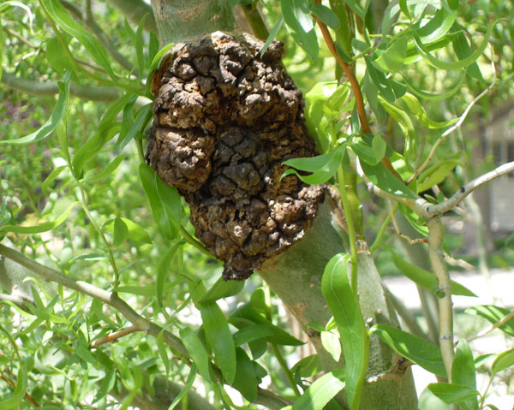
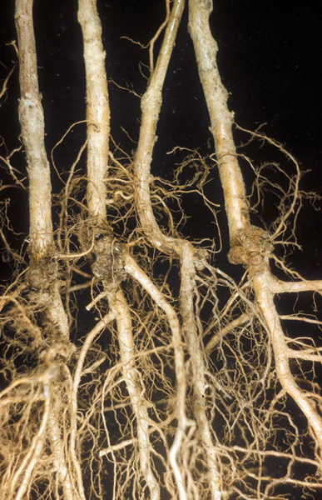
Crown Gall
https://www.extension.umn.edu/garden/yard-garden/trees-shrubs/crown-gall/
https://www.extension.umn.edu/garden/yard-garden/trees-shrubs/crown-gall/

Slide 29
Crown Gall
Prevention/Treatment
Prevention:
Never purchase plants with signs of crown gall.
Treatment:
Chemically — Gallex can be safely applied to a gall to reduce growth.
Culturally — Young plants that show signs of crown gall should be removed along with the soil around the roots. Well-established plants can typically handle crown galls.

Slide 30
Fire Blight
Overview
This bacteria is especially destructive to fruit but can damage and kill off entire trees.
Tree vigor plays a major part in the spreading of this bacteria. Fire blight likes to target rapidly growing shoots.
This means younger trees that are growing quickly are affected more than aged trees.

Slide 31
Fire Blight
Symptoms
In early spring, once growth starts, canker symptoms will form, and a light tan ooze will form around the cankers. The ooze will turn dark brown and may leave streaks on bark.
Flowers are the most common point of infection. Discoloration (black or brown) will occur. Infection may be localized and will only affect a cluster of flowers.
The infection can spread to the wood but will be underneath the bark causing pink-red-orange streaks.

Slide 32
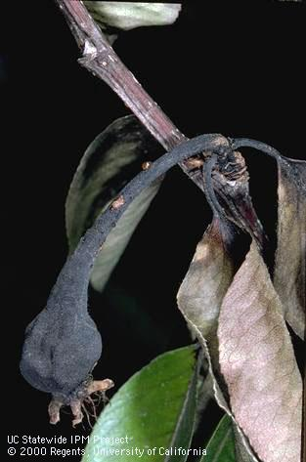
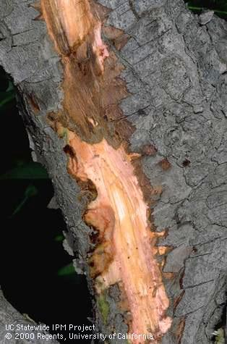
Fire Blight
http://ipm.ucanr.edu/PMG/E/D-PE-EAMY-BA.014.html
http://ipm.ucanr.edu/PMG/E/D-PE-EAMY-BT.027.html

Slide 33
Fire Blight
Prevention/Treatment
Prevention:
Certain ornamental trees are more susceptible than others.
Treatment:
Chemically — The products available to homeowners will not cure fire blight but can help reduce infections with multiple applications.
Culturally — Removal of diseased wood in summer and winter seasons will slow or stop the spread of fire blight.

Slide 34
Powdery Mildew
Overview
Powdery mildew can be especially destructive since it can infect new and old foliage and is airborne.
Attacking new growth is when it causes the most harm. Buds, new shoots, leaves and flowers can all be affected.
This fungus prefers temperate climates and moderate humidity. If temperatures reach above 95 degrees or there is water on the leaves powdery, mildew will not grow.

Slide 35
Powdery Mildew
Symptoms
Powdery mildew is recognizable by its white and powdery spore growth that most commonly happens on leaves but can target shoots and flowers.
Typically, infected parts will die off early, putting extra stress on the plant.

Slide 36
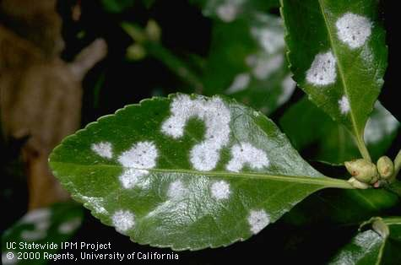
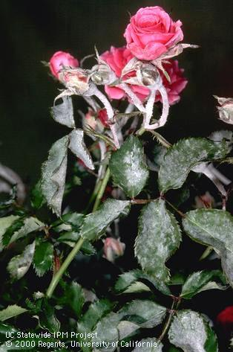
Powdery Mildew
http://ipm.ucanr.edu/PMG/M/D-WO-MEUO-FU.007.html
http://ipm.ucanr.edu/PMG/S/D-WO-SPAN-FO.001.html

Slide 37
Powdery Mildew
Prevention/Treatment
Prevention:
Research which plants are less susceptible and use those when possible.
Plant specimens in direct sunlight.
Treatment:
Chemically — Fungicides can be extremely effective at preventing and removing powdery mildew.
Culturally — Overhead irrigation will stop the spread and wash spores off leaves. Once spores are in contact with water, they die.

Slide 38
Root Rot
Overview
Root rot happens when soils remain saturated for extended periods of time due to poor drainage or over irrigation.
Root rot is caused by various fungi and can target and kill the plant; however, some are more susceptible than others.

Slide 39
Root Rot
Symptoms
Younger plants affected by root rot can have stunted growth, lesions at the soil line, wilting and collapse.
Established plants can have poor growth, discoloration and dropping of leaves, wilting or even death.
Roots can appear brown, soft and decayed. Depending on the fungi, cankers can form on the lower portion of the stem.

Slide 40
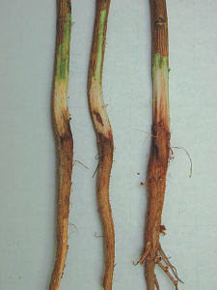
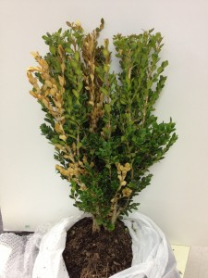
Root Rot
http://bexar-tx.tamu.edu/files/2011/12/CottonRootRot.jpg
https://agrilife.org/plantclinic/files/2012/10/TPDDL2012-1328_05-225x300.jpg

Slide 41
Root Rot
Prevention/Treatment
Prevention:
Inspect plant’s roots before purchase for symptoms.
Ensure soil has proper drainage.
Treatment:
Chemically — Only a handful of fungicides can help with root rot and are difficult for homeowners to purchase.
Culturally — Make sure the proper amount of water is being applied to the soil.

