Slide 1
Nursery/Landscape Unit One
Lesson Four
Pest and Beneficial Insects

Slide 2
Unit One: Identification
Resources
University of California Agricultural and Natural Resources — Pest Management Program
  http://ipm.ucanr.edu/PMG/invertebratelist.html#W
  http://ipm.ucanr.edu/PMG/NE/index.html
  http://ipm.ucanr.edu/PMG/PESTNOTES/pn7450.html
PennState College of Agricultural Sciences — Department of Entomology
  http://ento.psu.edu/extension/factsheets/bagworm

Slide 3
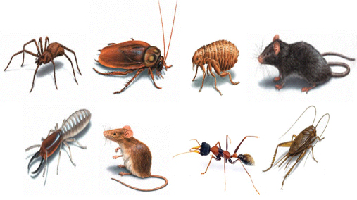
Introduction
What is a Pest?
Create a classroom definition for the term “Pest.”
http://www.jpcdubai.com/Images/general_pests.jpg

Slide 4
Identification
Pests
Aphids
Bagworm
Borer
Leafhopper
Leaf miner
Scale
Spider mite
Snail/Slug
Whitefly
White grub

Slide 5
Aphids
Overview
Aphids are small, pear-shaped insects with soft bodies that use their mouth to pierce the plant and suck out nutrients. They range in color from green to black, depending on the species. A pair of tube-like structures protrude out of its hindquarters, called a cornicle, and this helps distinguish an aphid from other pests.

Slide 6
Aphids
Symptoms
Aphids typically congregate and feed around the stem and leaves, leaving their skin casts on the underside of leaves. Unlike other pests, they do not rapidly disperse when disturbed. They excrete a sticky substance called honeydew that will eventually turn black and moldy. Leaf curling and distortion are also a symptom of an aphid infestation.

Slide 7
Aphids
Prevention/Treatment
Prevention
  Check plants regularly.
  Hose or prune off sections that show signs of infestation.
Treatment
  Chemically — Insecticide
  Culturally — Parasitic wasps

Slide 8
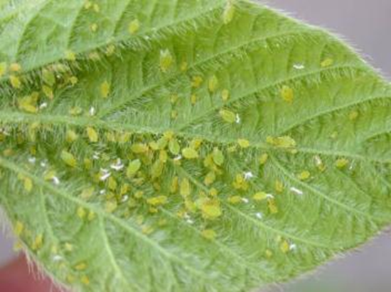
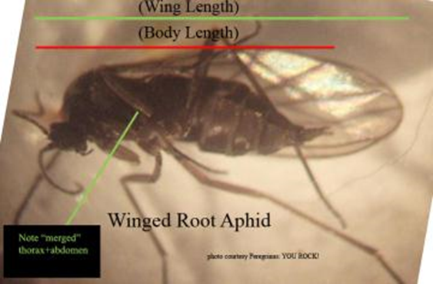
Aphids
Resources:
University of California
http://ipm.ucanr.edu/PMG/PESTNOTES/pn7404.html

Slide 9
Bagworm
Overview
The bagworm is a perennial pest whose primary targets are certain coniferous and deciduous trees. This pest is most easily identified by its “bag” woven from silk in which the bagworm lives. The bagworm only partially leaves its home to eat. The adult female lays her eggs in the bag where the eggs winter and hatch in the spring.

Slide 10
Bagworm
Symptoms
Bagworm larvae feed on the needles and leaves of trees, which can lead to holes in the foliage. Deciduous trees typically recover from an infestation. However, damage to evergreens from mature larvae can be especially devastating. Typically, an infestation isn’t detected until damage is significant.

Slide 11
Bagworm
Prevention/Treatment
Prevention
  Picking bags off of plants in the late fall or early spring
Treatment
  Chemical — Pesticide applied early to late June

Slide 12
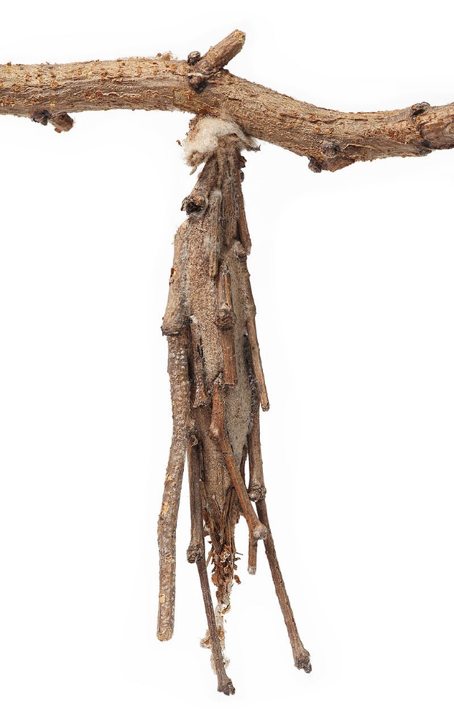
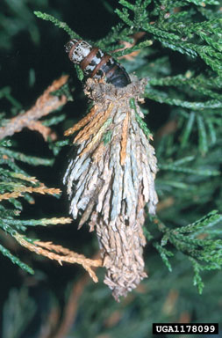
Bagworm
https://en.wikipedia.org/wiki/Bagworm_moth#/media/File:Meture-Elongatus.jpg
https://en.wikipedia.org/wiki/Evergreen_bagworm#/media/File:Thyridopteryx.ephemeraeformis.caterpillar.jpg

Slide 13
Borer
Overview
Borers can be some of the most destructive pests to trees and shrubs. Most borers are in their larvae stage. They will feed on tissue underneath the bark that conducts water and sap. This leads to die back and structural weakness.

Slide 14
Borer
Symptoms
Common signs of borer damage are holes in the bark, oozing liquids from branches, foliage may wilt or discolor, branches or the entire tree may die off. While borer damage can be devastating, they typically target damaged or dying trees. Rarely are healthy tree affected.

Slide 15
Borer
Prevention/Treatment
Prevention
  Remove any dead or damaged trees and limbs; do not store freshly cut wood next to trees as they may emerge and infect surrounding trees.
Treatment
  Pesticides applied to damaged bark are usually not effective.

Slide 16
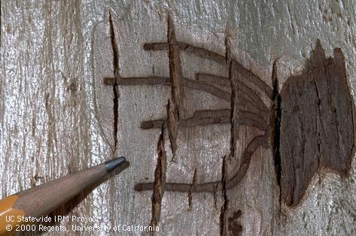
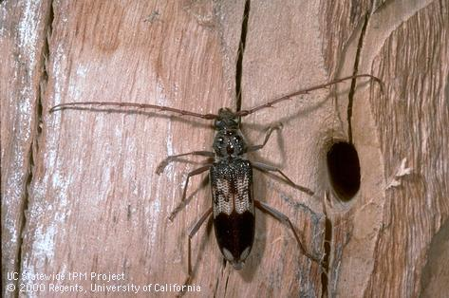
Borer
Resources:
University of California
http://ipm.ucanr.edu/PMG/GARDEN/PLANTS/INVERT/roundheadbore.html

Slide 17
Leafhopper
Overview
Growing to almost a quarter inch in length, leafhoppers are very fast moving and jump when disturbed. The females lay their eggs inside the plant tissue, which causes pimple-like sores to form. Once the eggs hatch, the nymphs will molt several times, leaving skin castings on the underside of the leaf until fully grown.

Slide 18
Leafhopper
Symptoms
Leaf hoppers leave speckled white marks on the leaves from their feeding. Eventually, too much feeding will cause the leaves to curl and brown. Once leaf hoppers are adults, they become very hard to control due to their quick movement.

Slide 19
Leafhopper
Prevention/Treatment
Prevention
  Check plants regularly for castings.
  Keep area free of weeds.
Treatment
  Chemically — Insecticide
  Culturally — Predatory wasps or lady beetles

Slide 20
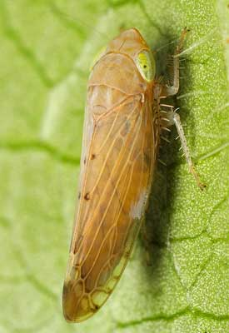
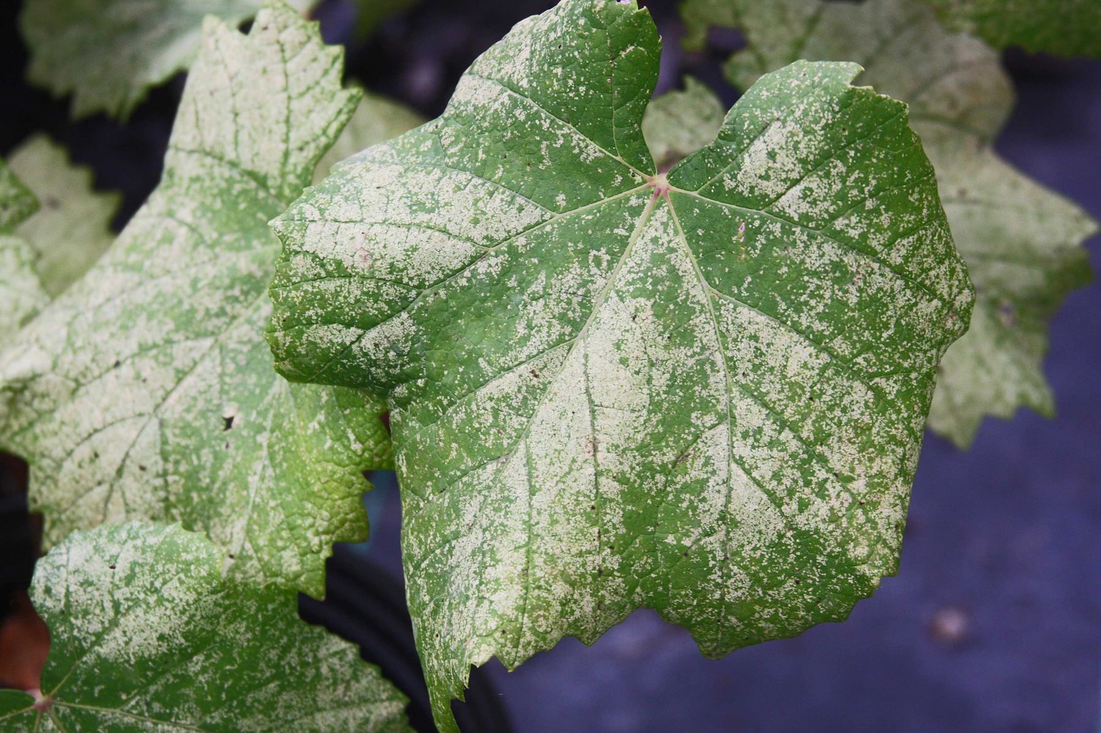
Leafhopper
Resources:
University of California
http://ipm.ucanr.edu/PMG/GARDEN/VEGES/PESTS/leafhopper.html
http://ipm.ucanr.edu/PMG/C302/m302splfhprenemy.html

Slide 21
Leaf Miner
Overview
Measuring 1.8 mm, adult leaf miners are brightly colored and have clear wings. The females puncture the leaves and lay their eggs inside the tissue. Once the eggs hatch, the larvae feed on the leaf until they drop to the soil to pupate. During an infestation, the punctures from egg laying and larvae mines will damage the plant and take away from the aesthetic value.

Slide 22
Leaf Miner
Symptoms
The larvae form mines inside the leaf during their feeding, usually following the veining pattern. Depending on the species of leaf miner, the mines can be visible from either the top or bottom of the leaf.

Slide 23
Leaf Miner
Prevention/Treatment
Prevention
  Use sticky pads to capture adults.
  Check plants regularly.
  Keep area free of weeds.
Treatment
  Chemically — Insecticide
  Culturally — Predatory mites

Slide 24
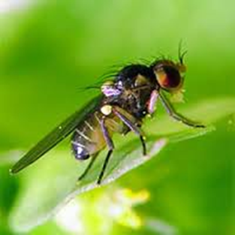
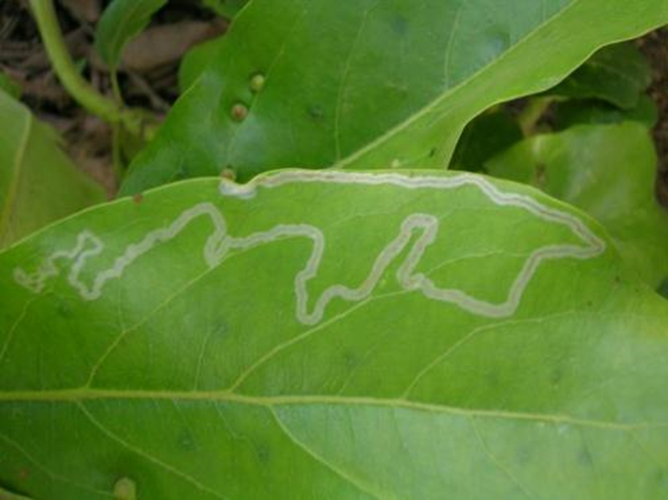
Leaf Miner
Resources:
University of California
http://ipm.ucanr.edu/PMG/r280300911.html

Slide 25
Scale
Overview
Scales vary in species, but the females are round and wingless with no recognizable body parts. They stick their mouthparts into the plant and suck the nutrients out. The males are very rarely seen. They are small yellow- or white-winged flies with an antenna. Female scales are either armored or soft.

Slide 26
Scale
Symptoms
An infestation will cause the plant’s growth to slow and leaves to appear dehydrated. Some scales produce a sticky substance called honeydew that will eventually turn black and moldy. A few scales, and even high concentrations of certain species, will not harm plants.

Slide 27
Scale
Prevention/Treatment
Prevention
  Monitor the plants for signs of honeydew.
  Set tape traps.
Treatment
  Chemically — Insecticide
  Culturally — Lady beetles

Slide 28
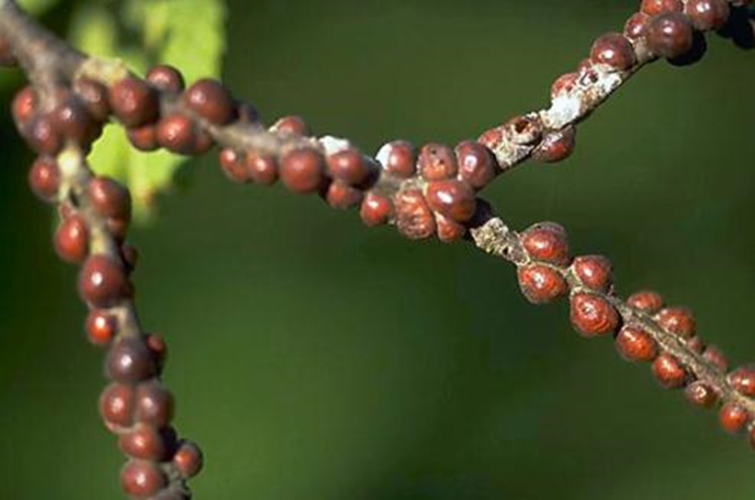
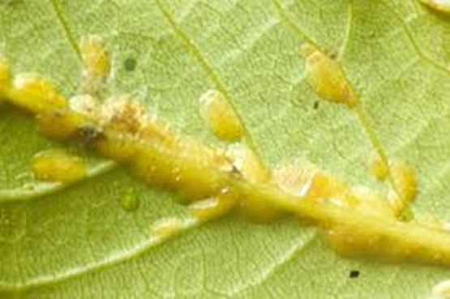
Scale
Resources:
University of California
http://ipm.ucanr.edu/PMG/PESTNOTES/pn7408.html

Slide 29
Spider Mites
Overview
Spider mites live in colonies and usually move on the underside of leaves. The webs they spin help distinguish a spider mite infestation from other pests. Adults are oval shaped with 8 legs and red eye dots near their head.

Slide 30
Spider Mites
Symptoms
The spider mite sucks the nutrients from the leaves, and in high concentrations, they can severely damage the plant. The first sign is white speckles or a stippling effect on the leaves and then webbing will begin to appear. The plant can show signs of dehydration, causing leaves to yellow and drop off.

Slide 31
Spider Mites
Prevention/Treatment
Prevention
  Prevent dust from accumulating by sweeping or spraying.
  Routinely check the undersides of leaves.
Treatment
  Chemically — Miticide
  Culturally — Predatory mites

Slide 32
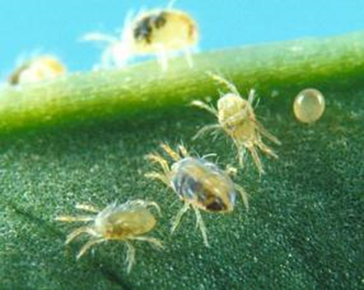
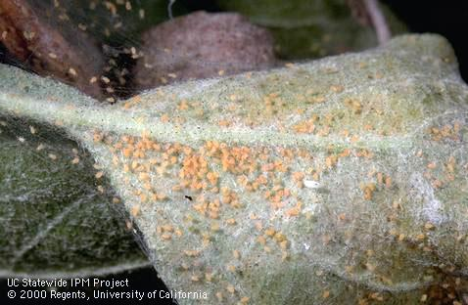
Spider Mites
Resources:
University of California
http://ipm.ucanr.edu/PMG/PESTNOTES/pn7427.html

Slide 33
Snails/Slugs
Overview
Both these pests belong to the Mollusca phylum and share similar characteristics. A major distinguishing factor between the two is that a snail has a spiral shell on its back. Both secrete mucus, which helps them move along, and as it dries, it creates a slime trail. They are both sensitive to the sun, so they typically only come out at night or on cloudy days.

Slide 34
Snails/Slugs
Symptoms
Snails and slugs chew on all types of plants and will leave holes with smooth edges in the plants. They also like to eat decaying plants, fruit and flowers. To tell if the bite marks where made by a mollusk and not another kind of pest, look for a slime trail left by their mucus.

Slide 35
Snails/Slugs
Prevention/Treatment
Prevention
  Check in cool, moist areas for hiding snails/slugs.
  Routinely check plants and pick snails/slugs off by hand when necessary.
  Create a copper barrier.
        This can be done by using copper tape to create a line that slugs will not cross.
Treatment
  Chemically — Molluscicide
  Culturally — No treatment listed

Slide 36
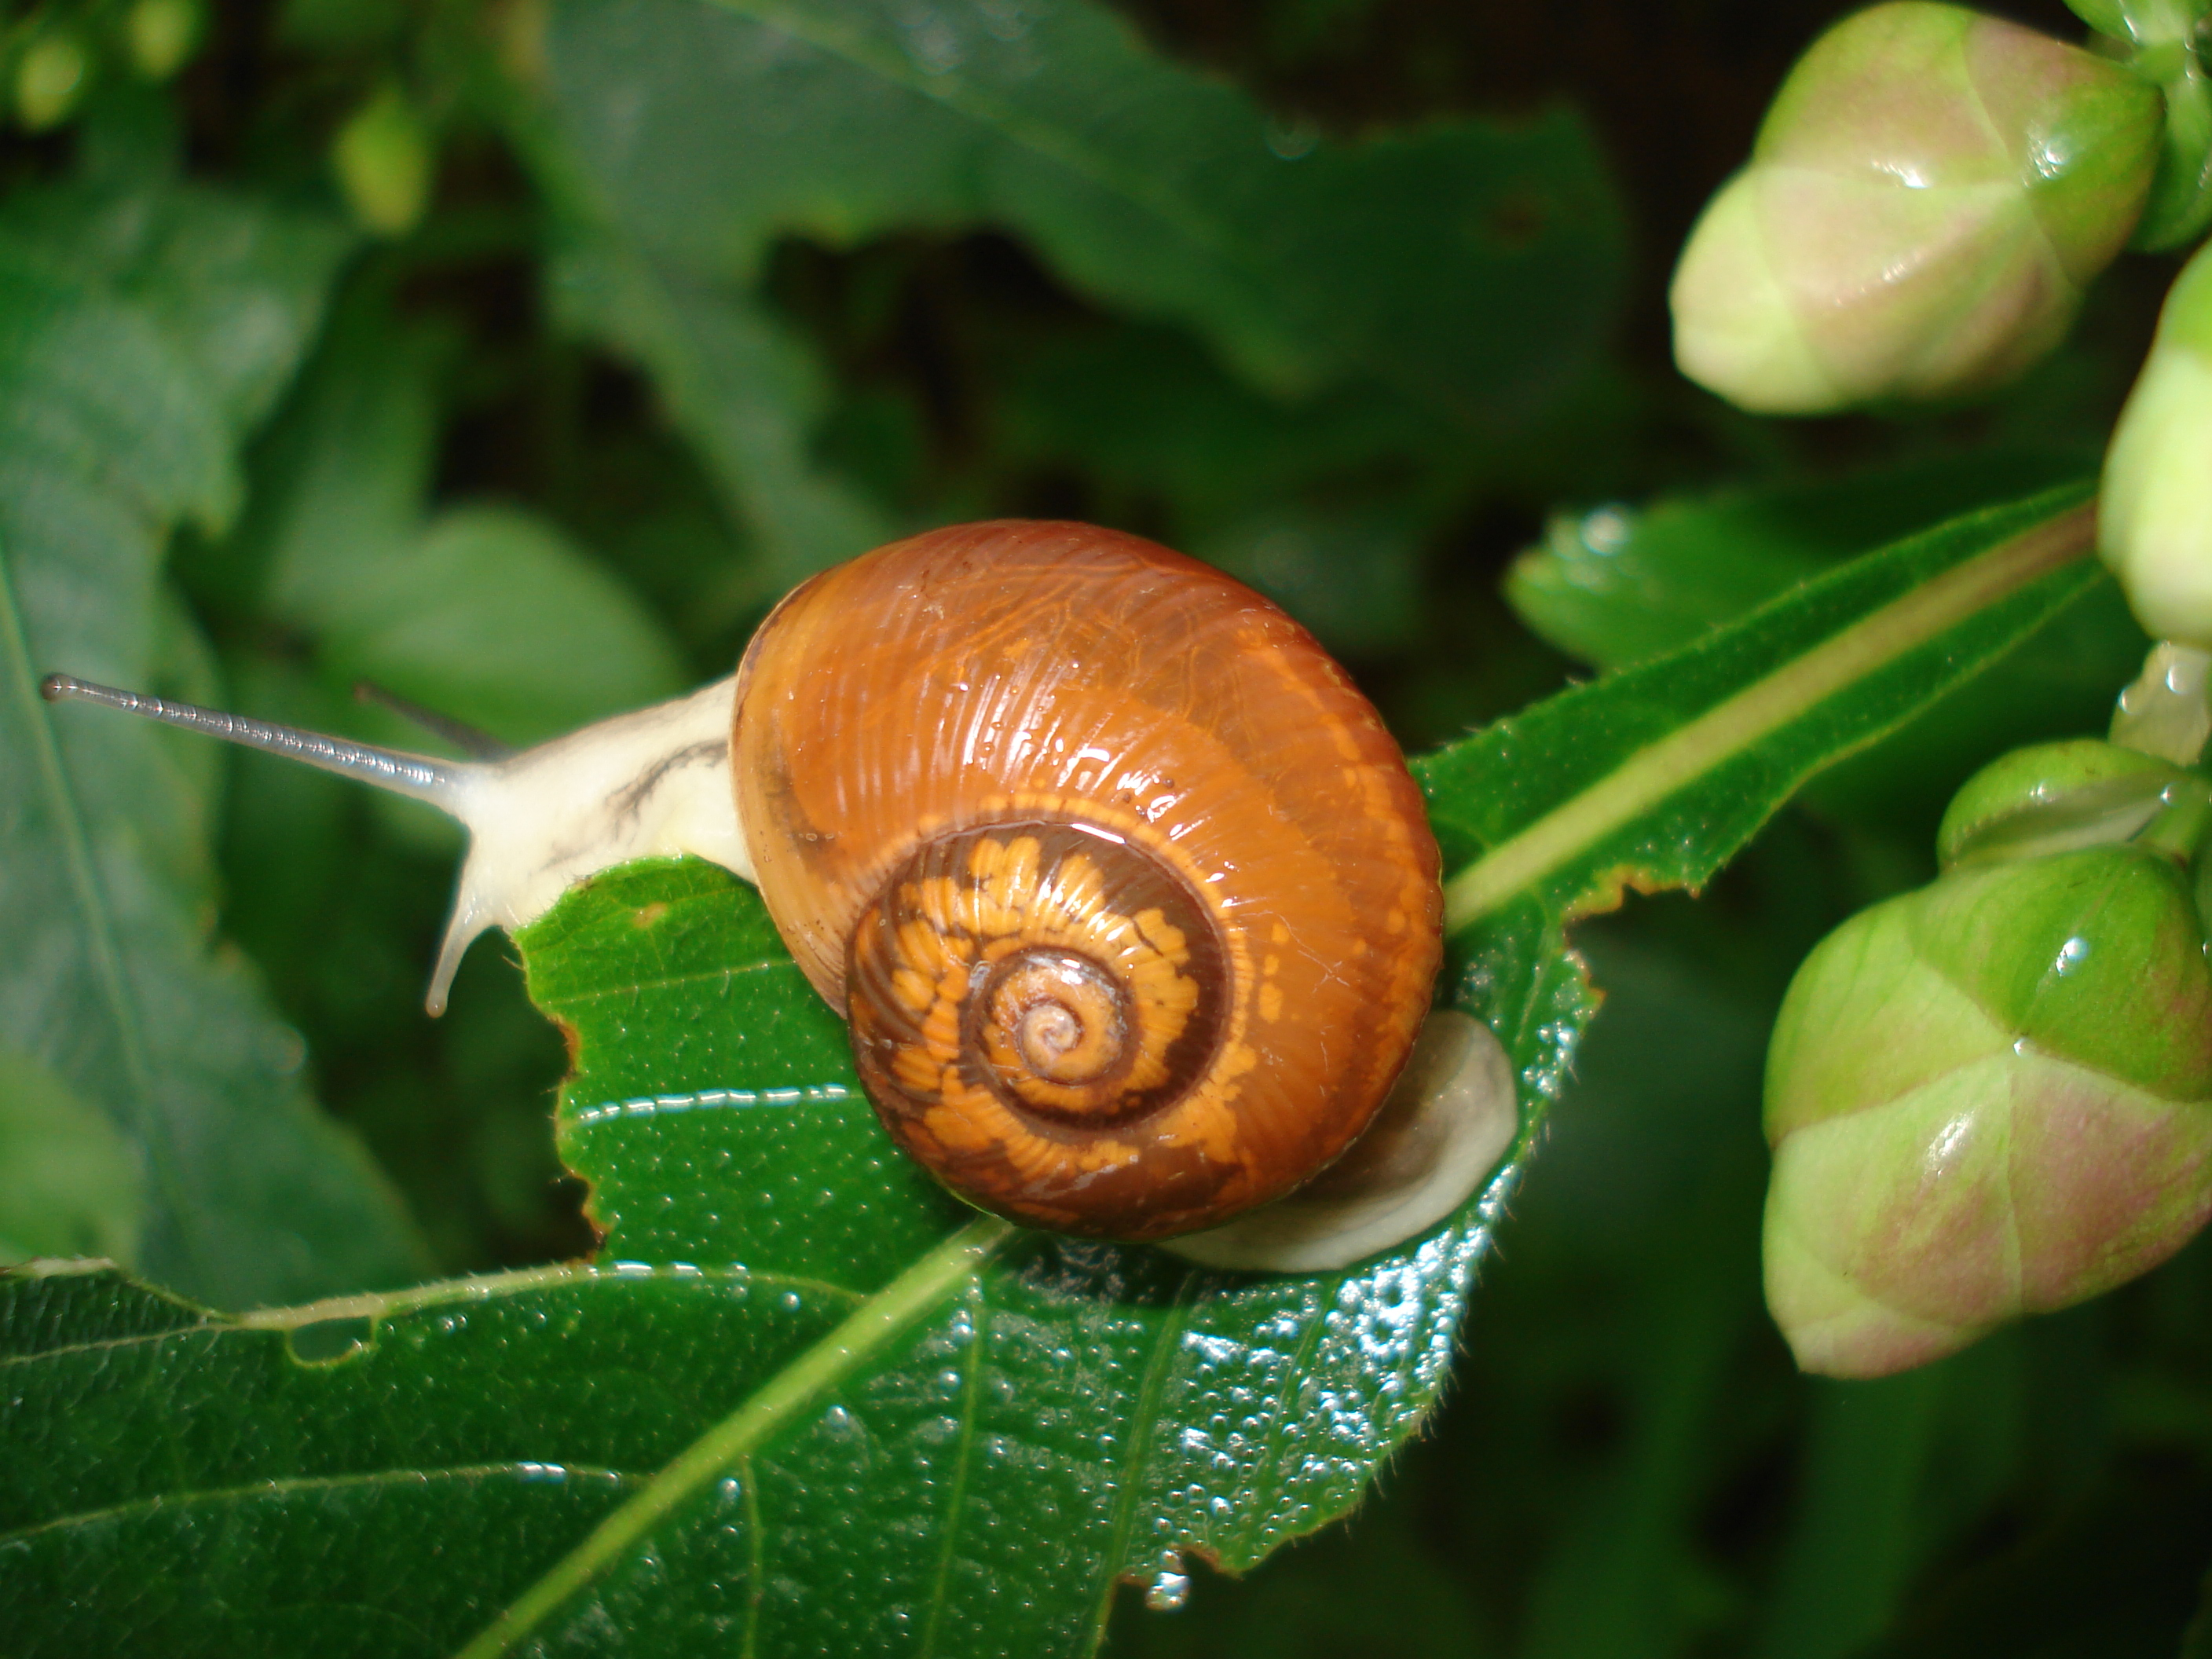
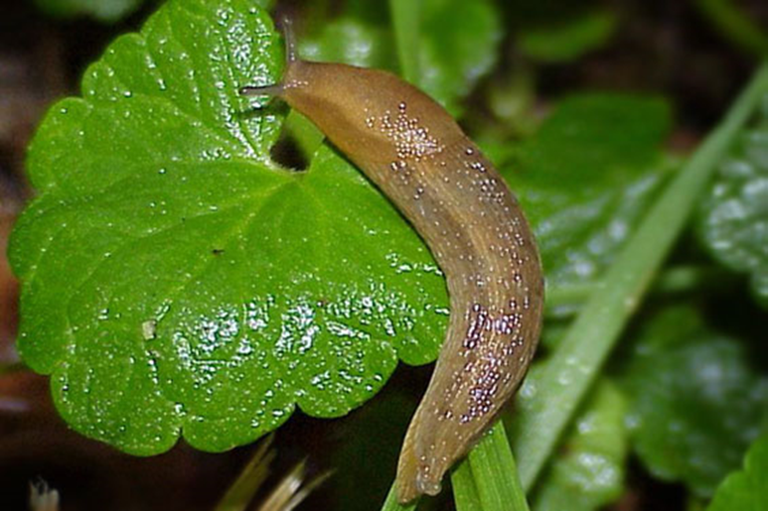
Snails/Slugs
Resources:
University of California
http://ipm.ucanr.edu/PMG/PESTNOTES/pn7405.html

Slide 37
Whiteflies
Overview
Whiteflies are not actually flies. The are winged insects that have a waxy white covering on their bodies. Their wings are held up in a roof-like manner. They reproduce rapidly in warm weather and little can be done once a large colony has been established. They suck the sap out of plants and secrete a sticky substance called honeydew that will eventually turn black and cause leaves to yellow.

Slide 38
Whiteflies
Symptoms
Whiteflies tend to congregate on the underside of leaves. They will cause symptoms similar to dehydration in plants. They also cause plant discoloration and distortion.

Slide 39
Whiteflies
Prevention/Treatment
Prevention
  Prevent dust from accumulating by sweeping or spraying.
  Use sticky pads.
  Hose or remove any sections of a plant that show signs of infestation.
Treatment
  Chemically — Insecticides
  Culturally — Lady beetles

Slide 40
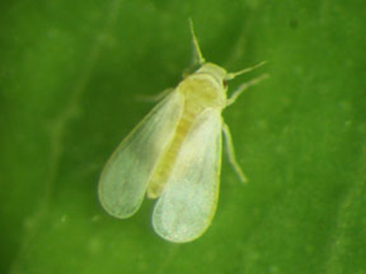
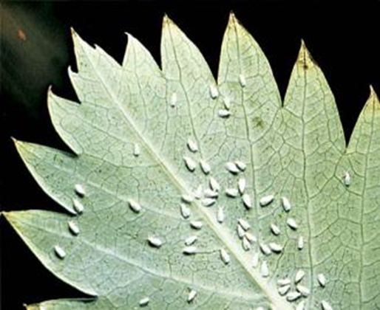
Whiteflies
Resources:
University of California
http://ipm.ucanr.edu/PMG/PESTNOTES/pn7401.html

Slide 41
White Grub
Overview
White grubs are white, C-shaped grubs with dark stripes on their backs and brown head capsules and legs. On the posterior end of their abdomen, there is a unique pattern of bristles. When fully grown, white grubs are around an inch long. White grubs are most commonly round in turfgrasses.

Slide 42
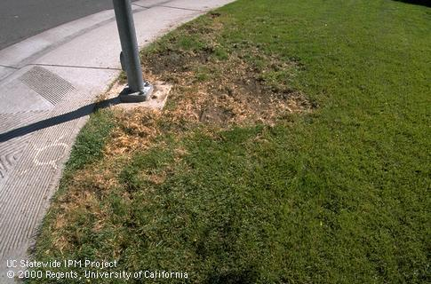
White Grub
Symptoms
White grub larvae feed on the root system of turfgrass. Damage appears in late summer or fall as irregular patches of brown, dying grass. The ground often feels soft, and in cases of severe infestation, the lawn can be rolled back.
http://ipm.ucanr.edu/PMG/C/I-CO-CYCL-CD.007.html

Slide 43
White Grub
Prevention/Treatment
Prevention
  Aerating lawns before and after infestation.
  Irrigation and fertilization with proper timing.
Treatment
  Chemically — Insecticides (Imidacloprid)

Slide 44
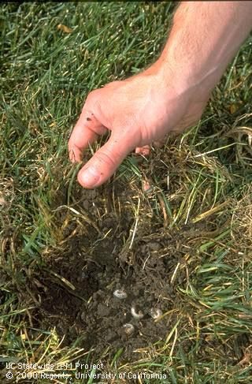
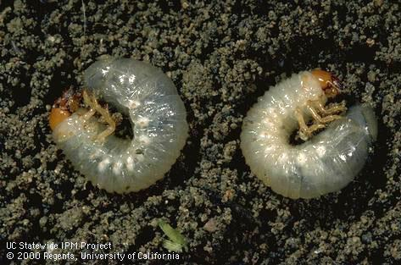
White Grub
http://ipm.ucanr.edu/PMG/C/I-CO-CBOR-LV.001.html
http://ipm.ucanr.edu/PMG/C/I-CO-CYCL-IF.009.html

Slide 45
Beneficial Insects
Enemy of My Enemy
Natural enemies are organisms that kill pest insects. Natural enemies help to regulate populations of pest in a natural way. A natural enemy can be another insect, a parasite or pathogen. To have a successful integrated pest management program, natural enemies are a must.

Slide 46
Identification
Beneficial insects
Praying Mantis
Lady Beetle
Paper Wasp
Lacewing
Spider

Slide 47
Praying Mantis
Overview
Adult praying mantis comes in an array of colors from yellowish green to brown. Typically waiting by flowers, praying mantis use their spiny forelegs to grasp prey and hold on to them while eating. Despite praying mantises being extremely effective hunters, they are hard to control and use as a reliable biological control.

Slide 48
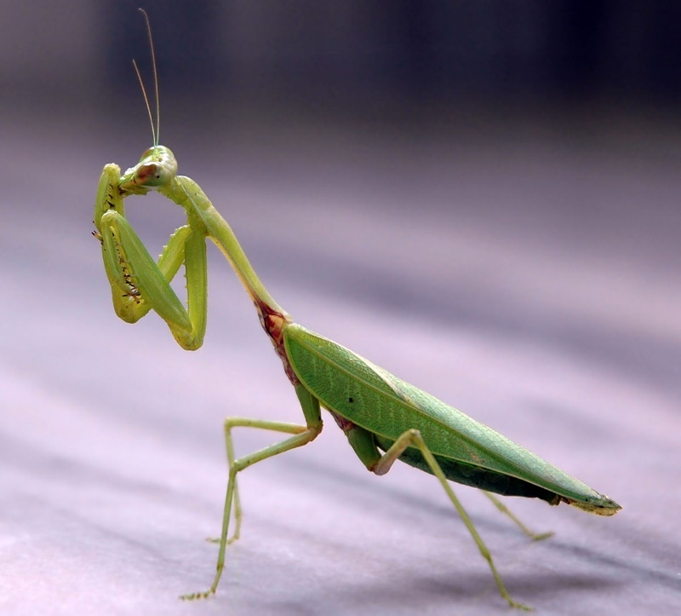
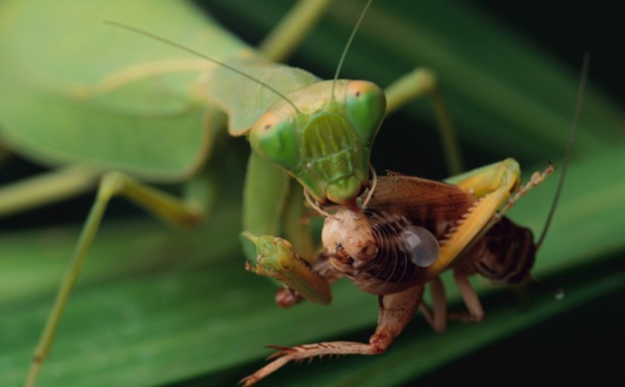
Praying Mantis
Prey
Nectar and pollen feeding insects, other beneficial insects and other praying mantis
https://upload.wikimedia.org/wikipedia/commons/thumb/2/22/Praying_mantis_india.jpg/1200px-Praying_mantis_india.jpg
http://dingo.care2.com/pictures/greenliving/uploads/2015/11/Mantis-eating-sized.jpg

Slide 49
Lady Beetle
Overview
Lady beetles are some of the most recognized insects, but it takes a professional to differentiate species. Lady beetles are predacious throughout their entire life cycle. During the winter months, lady beetles congregate together. This is when commercially sold lady beetles are collected. While lady beetles are crucial predators of aphids, they tend to disperse. Even with an ample food supply, lady beetles disperse, making it hard to inoculate an area.

Slide 50
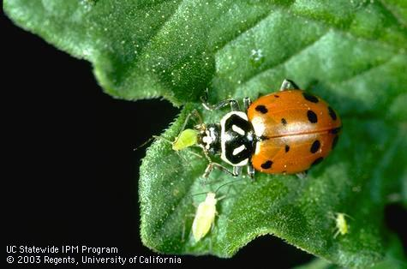
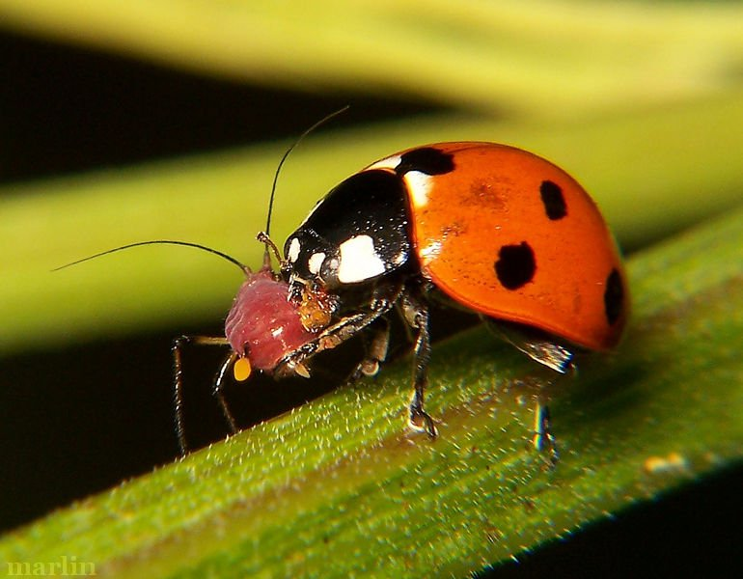
Lady Beetle
Prey
Aphids, whiteflies, other soft body insects
http://ipm.ucanr.edu/PMG/H/I-CO-HCON-AD.024.html
http://www.cirrusimage.com/Beetles/seven-spotted_ladybug_77.JPG

Slide 51
Paper Wasp
Overview
While many perceive paper wasps as pests, they serve an important role in pest management. The only time one should remove a paper wasp nest is when it is a direct threat to the safety of individuals or pets. Paper wasps prey on pests and feed them to their larvae.

Slide 52
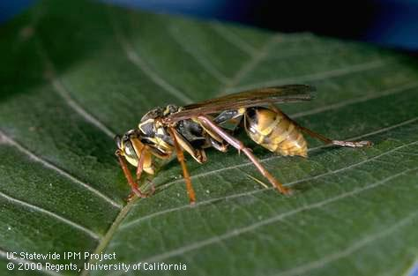
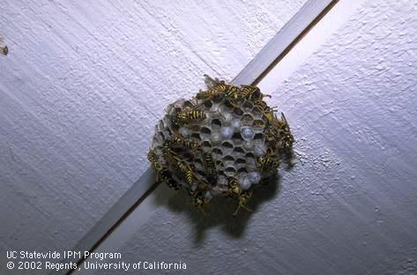
Paper Wasp
Prey
Mainly different types of caterpillars along with other small pests
http://ipm.ucanr.edu/PMG/M/I-HY-MFLA-AD.003.html
http://ipm.ucanr.edu/PMG/P/I-HY-POSP-CO.001.html

Slide 53
Lacewing
Overview
Lacewings are soft-bodied insects with four membrane wings, green bodies and golden eyes. All species of lacewings can survive mild winters and are found in most agricultural areas. Some lacewing species are predacious while others only consume nectar. Lacewings are available for commercial purchase and are the most commonly released predator.

Slide 54
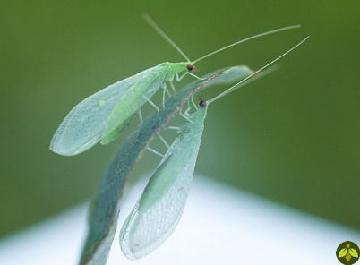
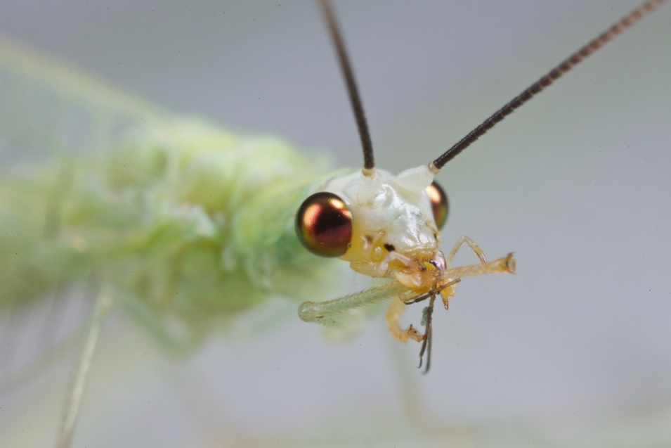
Lacewing
Prey
Aphids, leafhoppers, whiteflies and other small-bodied insects.
http://insectary.com/wp-content/uploads/2014/10/Green-lacewing-adults.jpg
https://c1.staticflickr.com/7/6177/6135156964_d33864ac3f_b.jpg

Slide 55
Spider
Overview
All spider species are predacious and mainly eat insects. There are up to 50 different spider families in the US, and each hunt in their own unique way. Many spin different types of webs, some hunt in broad daylight and others pounce on insects while hidden within burrows or silk pockets. The vast majority of garden spiders are harmless to humans.

Slide 56
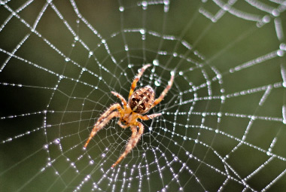
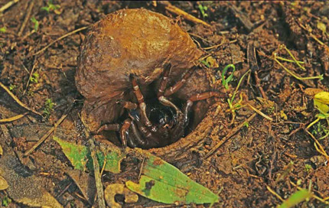
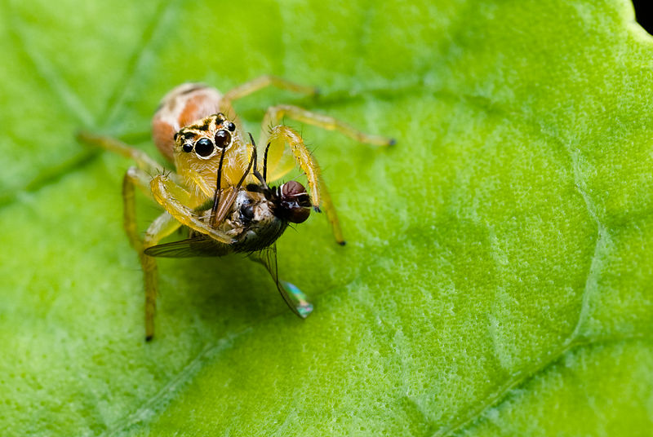
Spider
Prey
All insects and other spiders
https://www.rottler.com/images/common-spider.jpg
http://www.samuseum.sa.gov.au/Upload/Files-Biological-Sciences
/S-S-and-T-images/Blak-aurea-Adel-430W.jpg
https://upload.wikimedia.org/wikipedia/commons/thumb/9/9b/Female_
Salticidae_with_a_prey-Northeast_Region%2C_Brazil_a.jpg/800px-Female
_Salticidae_with_a_prey-Northeast_Region%2C_Brazil_a.jpg

