Slide 1
Unit One: Identification
Lesson Five:
Cultural Practices

Slide 2
Resources
Ingels, J. (2009). Landscaping: principles and practices (7th ed.). Clifton Park, NY: Thomson/Delmar Learning. Equipment and Supplies.
  Chapter 27 — Maintaining Landscape Plants
  Chapter 28 — Plant Injuries: Identification and Care
Footer description area.

Slide 3
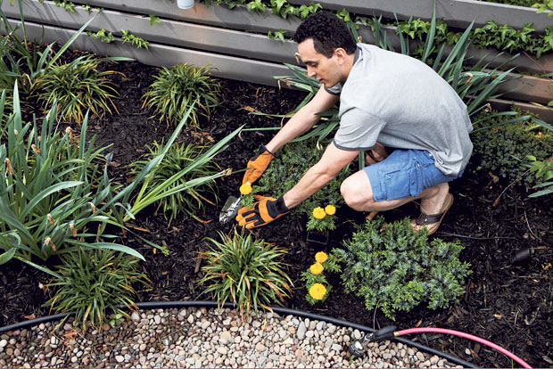
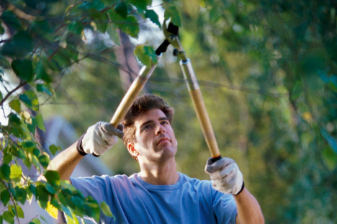
Cultural Practices
Cultural practices are activities that involve caring for plants and the landscape to maintain the health of the environment and promote proper nutrient balance, beneficial insects and water levels.
http://hawaiirenovation.staradvertiser.com/wp-content/uploads/2013/05/garden_20130512_03.jpg
http://greenliving101.com/files/includes/images/wp-content-uploads-2014-10-pruning.jpg

Slide 4
Watering
Frequency and amount of watering depends entirely on the climate and type of plants.
At first, watering helps plants establish a strong root system. Later, watering keeps the plant healthy and growing during the spring and summer.
Not all plants require the same amount of water nor do their roots systems grow to the same depth. However, all plants will be adversely affected by too much or not enough watering.
Infrequent deep watering is preferred over frequent, shallow watering.

Slide 5
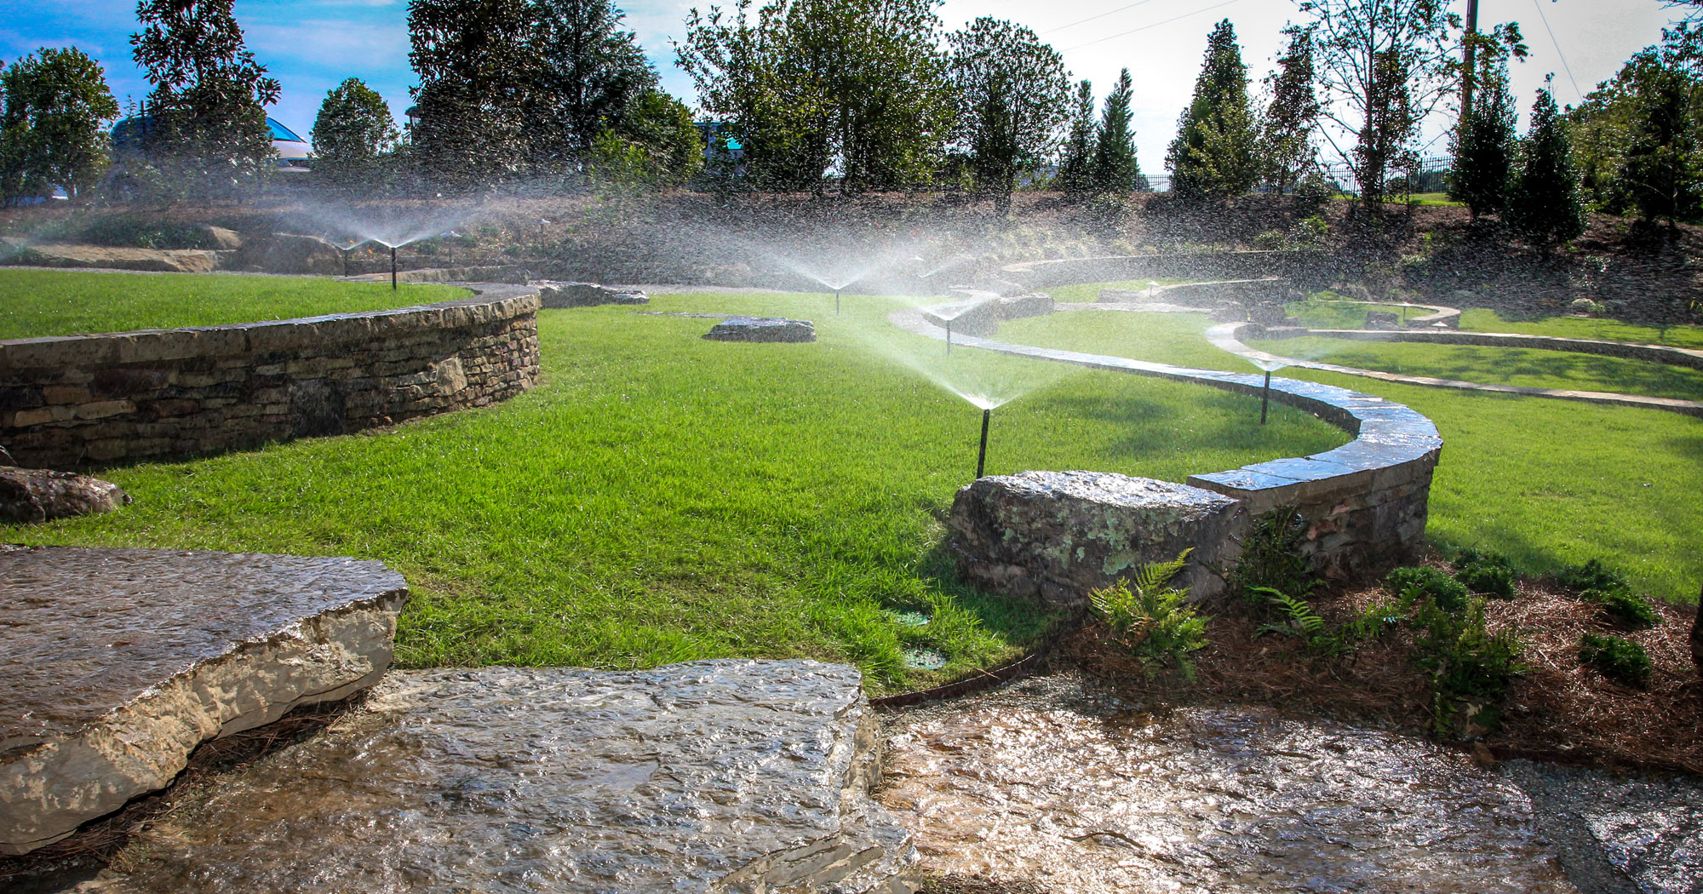
Watering
http://www.jallandscaping.com/wp-content/uploads/2015/07/popular-landscaping-landscape-irrigation-backflow-devices-landscape
-irrigation-in-williamsport-pa-landscape-irrigation-installers-plano-tx-landscape-irrigation-houston-landscape-irriga.jpg

Slide 6
Fertilization
Trees can grow without fertilizer once established but will grow with more vigor if fertilized annually. This can be done by spreading the fertilizer on the surface of the soil or working it into the soil.
It is important to apply fertilizer at the correct time in the growing season. If applied too late, the tree will continue to grow lush vegetation too long and will not be properly prepared for the winter season.
Annual flowers should be fertilized midsummer to maintain health. Bulbs should be fertilized right after flowering. Summer or fall fertilization can harm plants by not preparing them for winter.

Slide 7
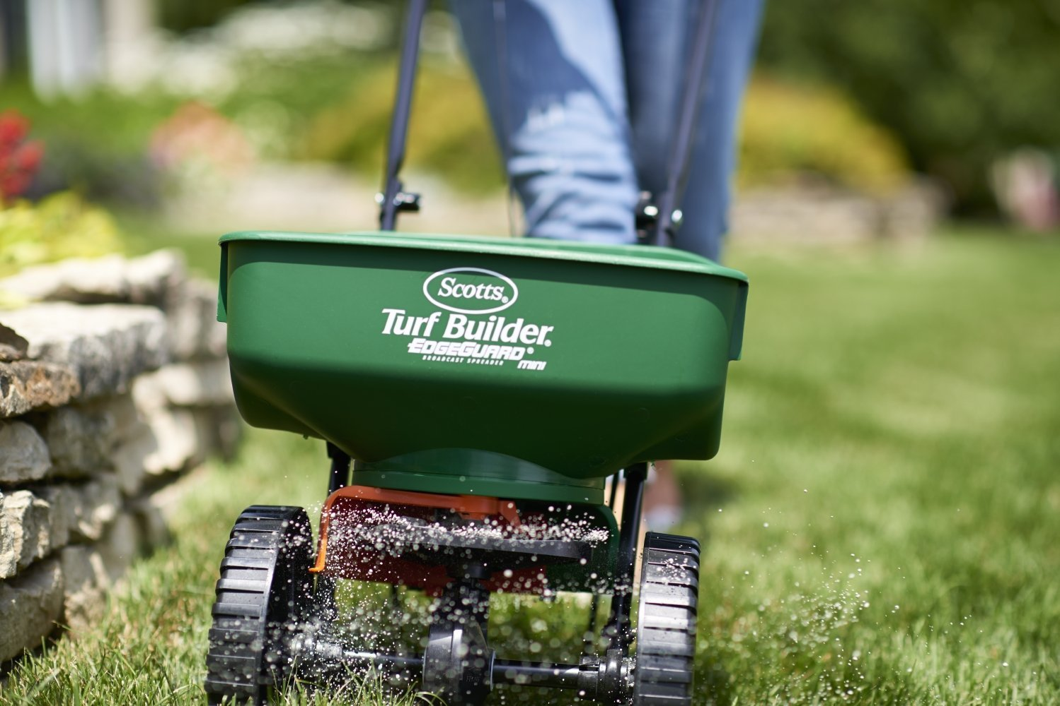
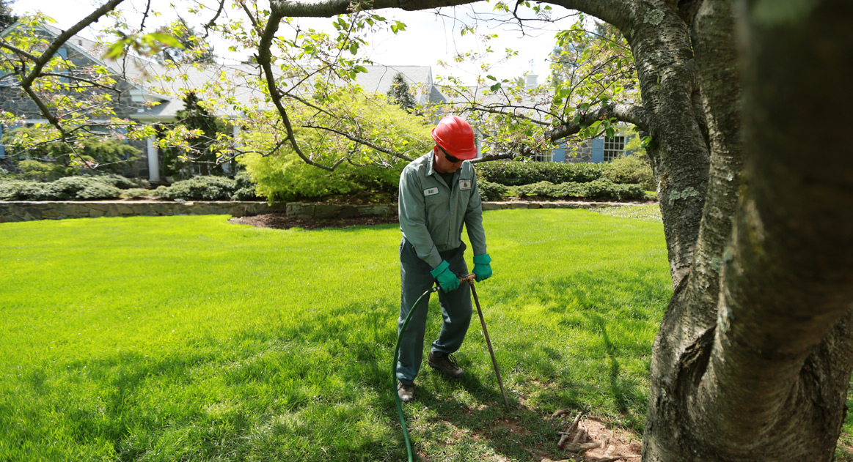
Fertilization
https://images-na.ssl-images-amazon.com/images/I/71DRfodznqL._SL1498_.jpg
http://www.johnbward.com/sites/default/files/featured_images/fertilizing.jpg

Slide 8
Aeration
Over time, soil around trees and shrubs can become compacted and push the air out of the soil. This can prevent water from reaching the roots or cause root rot to start.
One option is to use an air spade. This tool is inserted into the ground around roots and injects pressurized air into the soil creating free space for water to permeate.
Another technique is vertical mulching and radial trenching. Vertical mulching drills holes 12 inches deep that are then filled will sand/pea gravel.
Radial trenching cuts narrow strips outward from the trunk of the tree. These are also 12 inches deep.

Slide 9
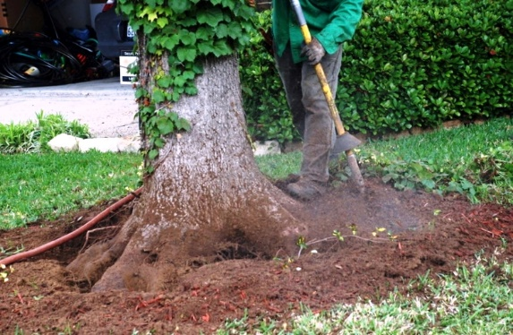
Aeration
https://preservationtree.com/assets/images/Arborists%20Technical%20Training%20-%20Prill%20residence%204.28.09%20025.jpg

Slide 10
Mulching
Mulch provides a protective barrier around trees and other plants.
  When mowing lawns, people try to get as close to a tree as possible; however, this can cause physical damage to a tree over the years. A mulch ring around a tree eliminates the need to mow close to the tree trunk.
Mulch also helps suppress the growth of weeds. However, organic mulches must be replaced periodically, or it will decompose into a humus, which is ideal for weed growth.
It is important to remove the old mulch before adding new mulch. When placing mulch, do not place directly onto the tree trunk. This can cause fungal infections to form.

Slide 11
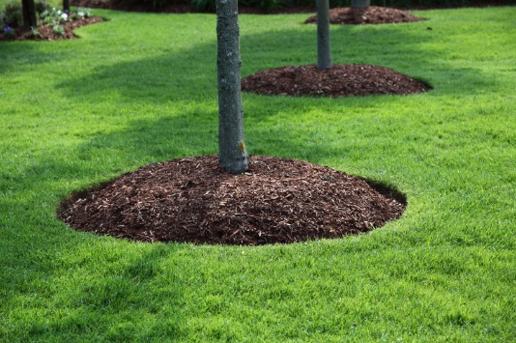
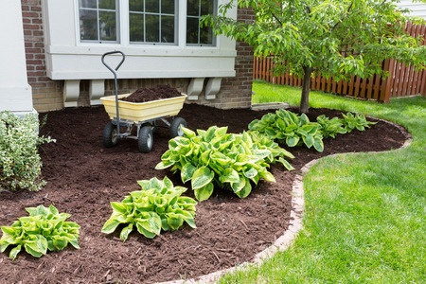
Mulching
https://s-media-cache-ak0.pinimg.com/originals/03/36/5d/03365dc98ffa637103706933d877de8f.jpg
http://www.manselllandscape.com/blog/wp-content/uploads/2015/08/mulch-1.jpg

Slide 12
Pest/Disease Control
Controlling pests and diseases before they enter a landscape can save time and money.
Most of the time when a population is infected or infested it becomes extremely hard or impossible to remove the intruder.
Following these guidelines will lead to a well-protected landscape free from potential threats to plant health or unappealing aesthetics.

Slide 13
Pest/Disease Control
Exclusion
Exclusion is the first line of defense. When purchasing plants for a landscape, make sure to inspect them for any signs of infestation or infection.
If any purchased plants show signs of infestation or infection, immediately return them to the grower.
Purchasing high quality materials that come from certified nurseries helps reduce the chance of infestation. Using free or extremely cheap mulches, seeds or straw runs the risk of bringing a potential threat into the landscape.

Slide 14
Pest/Disease Control
Eradication
Eradication works to remove any pests or diseases that have entered the landscape. There are a number of ways to eradicate theses intruders.
    Isolating individually infected plants
    Hand pulling weeds that have yet to produce seeds
    Removal of alternative hosts to diseases or pest
    Plant rotation
    Destroying parts of the plants that host the pest or disease
Using these methods helps reduce the options pests and diseases have to spread to other hosts within the landscape.

Slide 15
Pest/Disease Control
Protection
By manipulating the environment, certain plants that are susceptible to infection can be protected.
Plant species that are affected by the same pests or diseases away from each other, and put other plants in between them to create a physical barrier.
To create more obstacles for threats, water in the morning, apply fertilizer at the correct times throughout the year and promote soil pH levels that favor plants.

Slide 16
Pest/Disease Control
Resistance
Different plant species have varying levels of resistance to pests and diseases, and this can also vary depending on the area.
To help prevent pests and diseases from becoming established, conduct research to determine the most common threats in the area and then select plants that have a natural resistance to them.
Over time, a plant’s resistance can change. It is crucial to know when other prevention methods should be incorporated because natural resistance may no longer work.

Slide 17
Pruning
Removing certain parts of a plant can improve the overall appearance, health and growth.
The geography and species of plant can impact the best season for pruning the plant. Make sure to research what is best for the plant’s health.

Slide 18
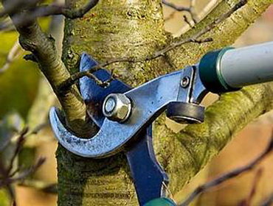
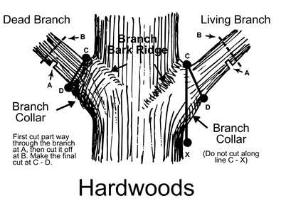
Pruning
http://integritylandscapeservice.com/wp-content/uploads/2016/05/tree-and-palm-service-2132202.jpg?quality=100.3016041119500
http://www.grahamforestry.com/Assets/images/arborday-illustrations/properpruning.gif

Slide 19
Weed Control
Weeds within a landscape not only look unappealing but pose a threat to the health of other plants.
A weed population can grow rapidly out of control once established. Hand pulling single weeds before they start to seed drastically decreases the chance of this happening.
Just like any other plant, weeds can be annuals or perennials. Perennials can produce millions of seeds throughout their lifetime.
The seeds can stay dormant for years and will begin to germinate once brought to the surface.

Slide 20
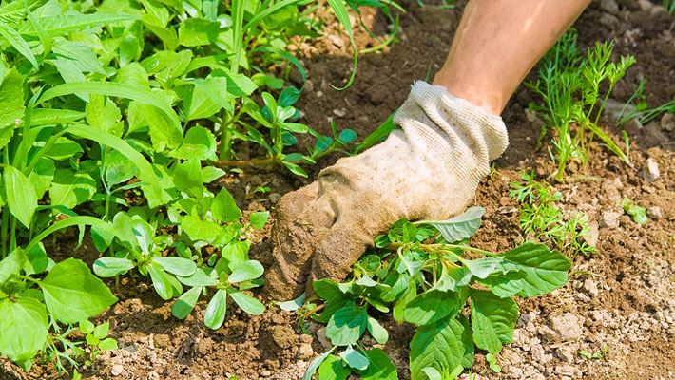
Weed Control
http://www.gardenstylesanantonio.com/images/PullingWeeds-710x4001.jpg

Slide 21
Dead Heading
Most summer annuals and many perennials must be continually tended by removing the dead or faded flower heads.
By removing the old flower heads, the plant will not put energy into creating seeds. This puts more energy into flowers that are just blooming.
While this is labor intensive, it allows for more healthily, vigorous flowers and adds an aesthetic value to the landscape.

Slide 22
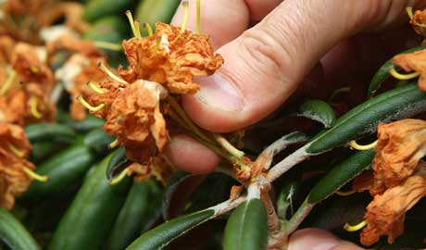
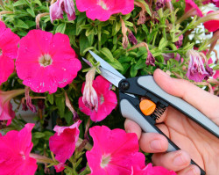
Dead Heading
http://www.treeandlandscapecompany.com/wp-content/uploads/2015/02/deadheading.jpg
http://www.treeandlandscapecompany.com/wp-content/uploads/2013/08/Extending-the-Season-Through-Deadheading-and-Pruning-250x199.jpg

Slide 23
Pinching
Annuals benefit most from pinching back, but there are some perennials that look better if pinched.
Soft pinching is done with the thumb and forefinger to remove the terminal bud. Hard pinching may shorten each stem by a third or more.
Most flowers benefit from a hard pinch after being set out along with one or two soft pinches through the growing season.

Slide 24
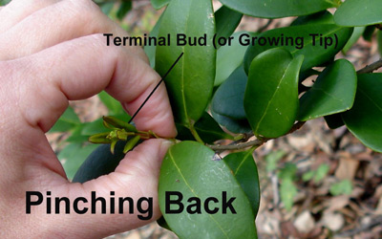
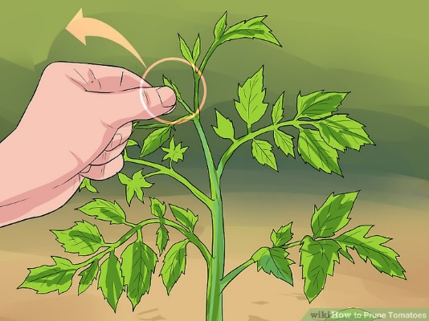
Pinching
https://www.todayshomeowner.com/images/article/basic-shrub-pruning-5.jpg
http://pad2.whstatic.com/images/thumb/1/12/Prune-Tomatoes-Step-9.jpg/aid335182-v4-728px-Prune-Tomatoes-Step-9.jpg

