Slide 1
Nursery/Landscape Unit One
Lesson Six
Equipment Identification

Slide 2
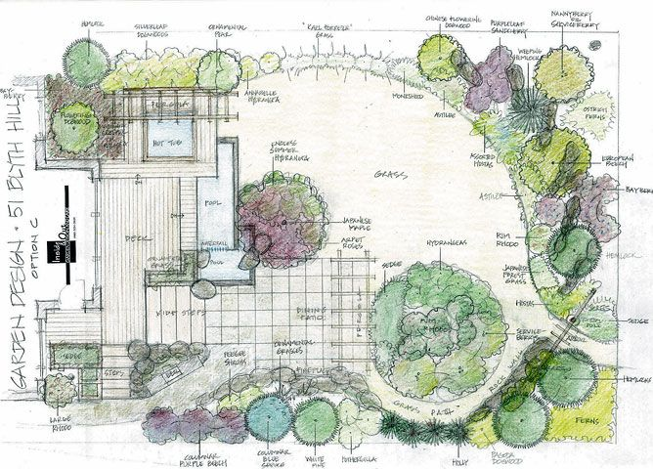
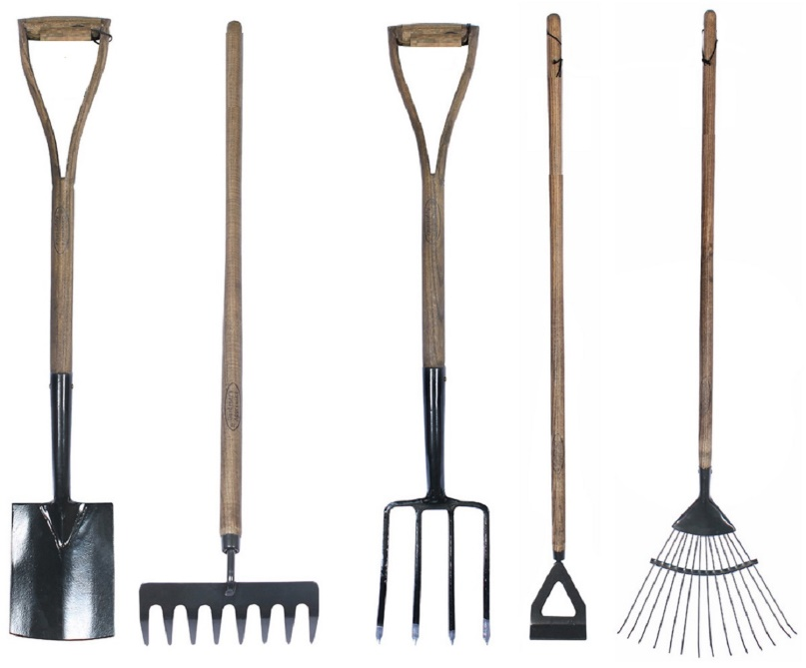
Introduction
Start Up Business
https://s-media-cache-ak0.pinimg.com/736x/6b/a8/1d/6ba81d91ca48444dabbf2f0163cc8241.jpg
https://www.spottygreenfrog.co.uk/uploads/images_products_extralarge/lg_393.jpg
In your assigned groups, think of all the equipment you will need to start your own landscaping business.

Slide 3
Nursery/Landscape Equipment Identification
Tools – Hand and Power
Anvil-and-blade pruner
Bow Saw
Bulb Planter
Bunker rake
Core Aerifier
Chain saw
Cut-off machine
Edger (power or hand)
Garden (spading) fork
Garden (bow) rake
Hedge shears
Hoe
Hook-and-blade pruners
Leaf rake
Loppers
Mattock
Pick axe
Planting/earth/soil auger
Pole pruner
Post-hole digger
Power blower
Power hedge trimmer
Pruning saw
Reel mower
Rototiller
Round point shovel
Scoop shovel
Spade
Square point (flat) shovel
String trimmer
Thatch rake
Trowel
Vertical mower

Slide 4
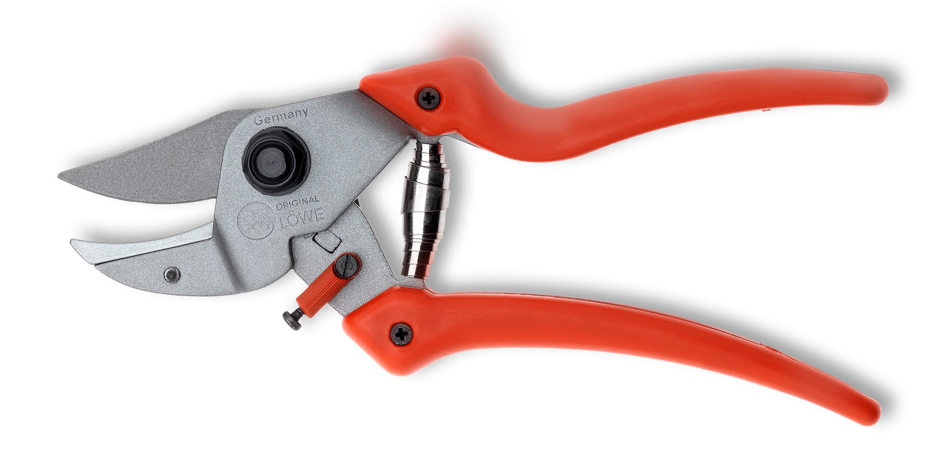
Anvil-and-Blade Pruner
Anvil pruners cut by pushing a blade through a material.
At the end of the cut, the blade's cutting edge meets the anvil.
http://www.original-lowe.com/uploads/tx_loeweproducts/7.107_offen.jpg

Slide 5
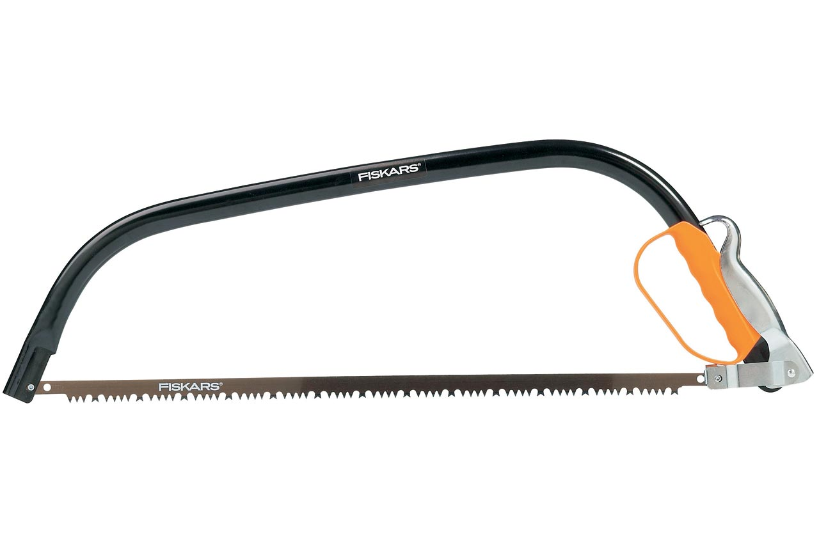
Bow Saw
Used for cutting trees or branches up to 10–12 inches in diameter
Can be quicker and easier than using a chainsaw if workload is small
http://static.fiskars.eu/var/fiskars_emea/storage/images/frontpage2/gardening-yard-care/products/wood-branches/saws/124810-fiskars-24-bow-saw-sw31/8530-64-eng-EU/124810-24-Bow-Saw.jpg

Slide 6
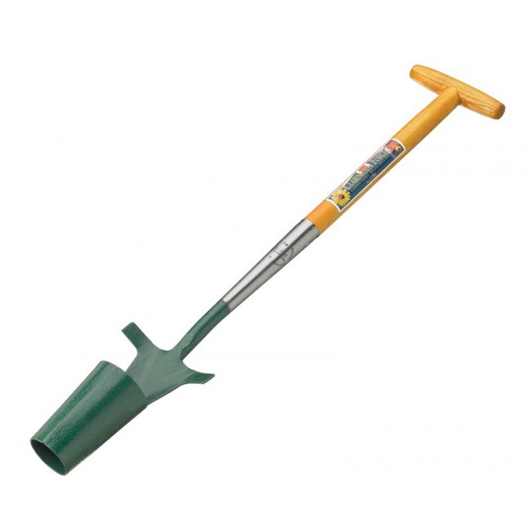
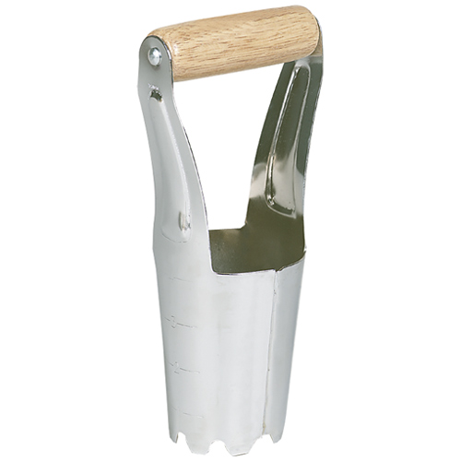
Bulb Planter
A bulb planter is a hand tool that has an open-ended cone sharpened on its bottom edge
Used to dig holes 2–3 inches deep to then place a bulb in
http://www.claringtonforge.com/media/catalog/product/cache/1/image/650x/9df78eab33525d08d6e5fb8d27136e95/i/m/image_65.jpg
http://ace.imageg.net/graphics/product_images/pACE-959626dt.jpg

Slide 7
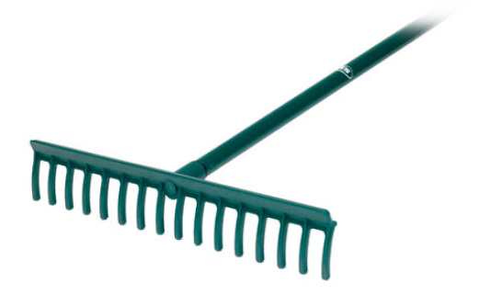
Bunker Rake
Bunker rakes are most commonly used on golf courses to tend to sand bunkers.
http://www.daylinks.co.uk/uploads/4/2/4/8/42485717/s107721051795777303_p244_i1_w320.jpeg

Slide 8
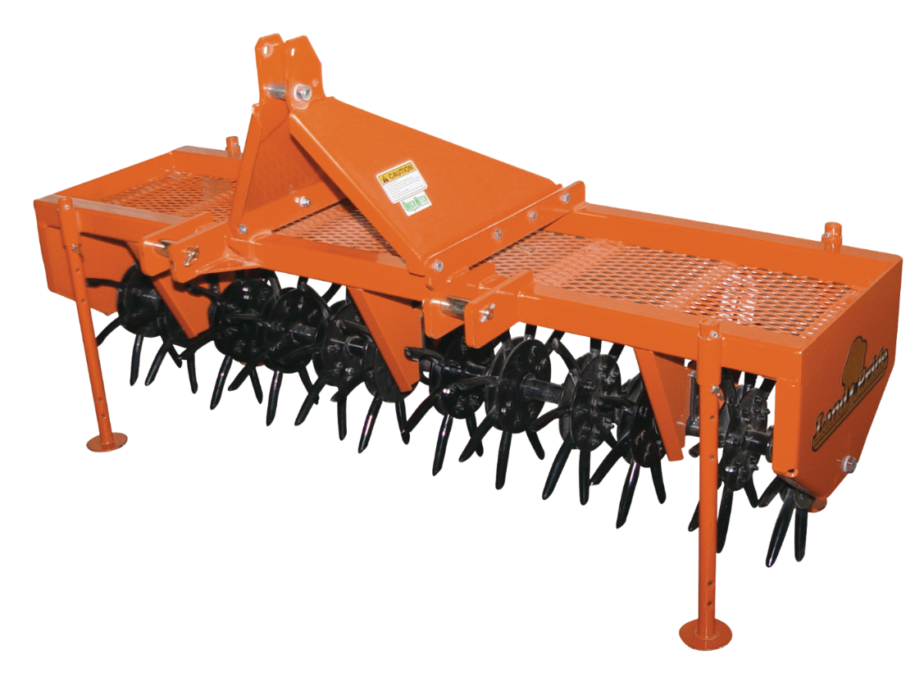
Core Aerifier
Aeration involves penetrating the soil with small holes allowing air, water and nutrients to reach roots and create a deeper, stronger root system.
Often used on heavily used turf or where the thatch has become too thick
(Thatch is roots and grass stems that build up and have yet to decompose.)
http://cdn-lp.greatplainsmfg.com/cdn/farfuture/Zw-AjwLwAOMO37TXIS5L2npMQoFScy_Jl88az6AMoQ8/mtime:1331815864/sites/default/files/lp_ca25.png

Slide 9
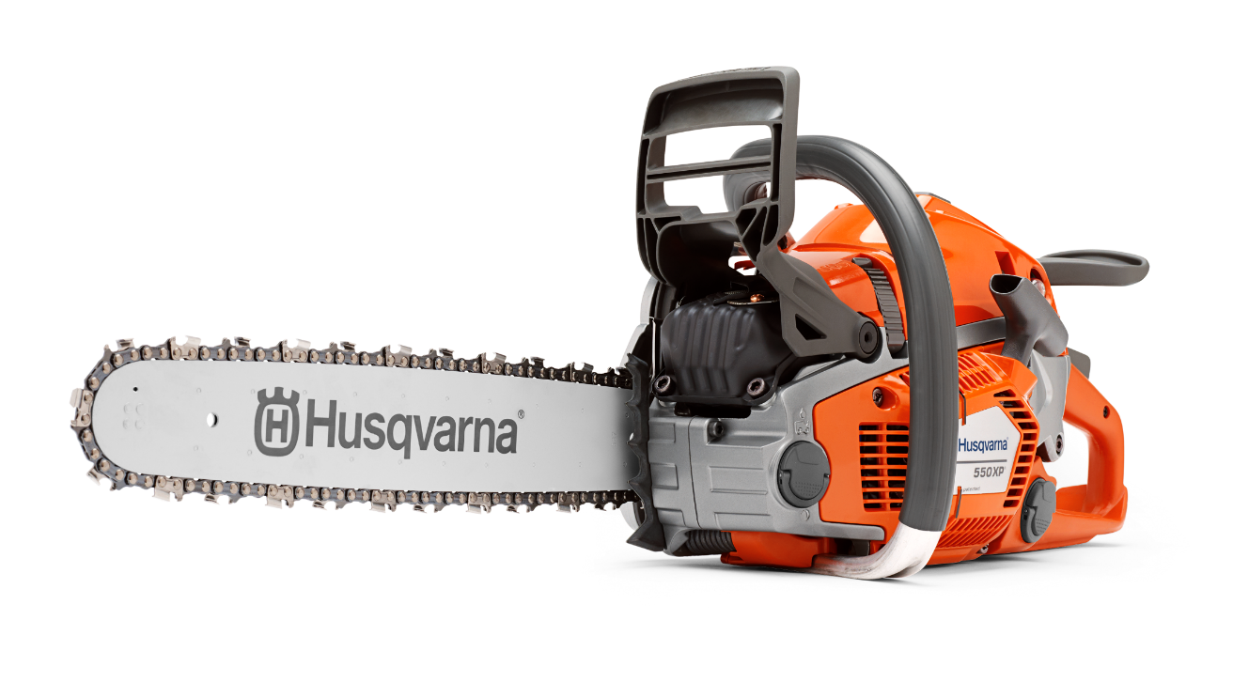
Chain Saw
Chain saws are incredibly versatile tool used to fell trees, remove limbs and prune.
http://husqvarnacdn.azureedge.net//qs_ver=00000000T000000/_$$_/media/dam/husqvarna/forest%20chain%20saws%20electric%20saws%20power%20cutters%20and%20saw%20mills/chain%20saws/2014/12/03/05/01/h110-0273.ashx

Slide 10
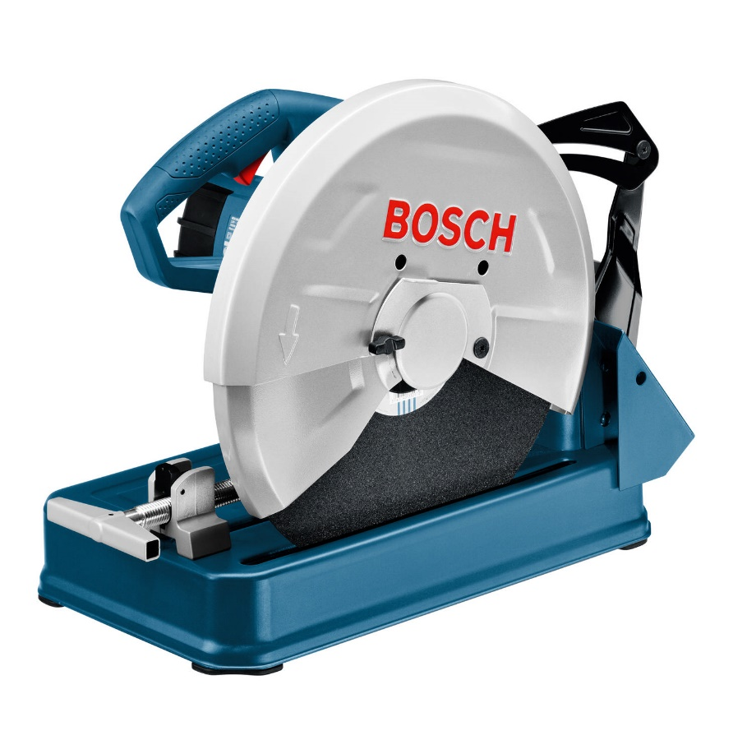
Cut-Off Machine
Cut-off machines are used to cut tougher materials such as metal piping or concrete stones.
Essential to use a diamond wheel when cutting paver stones or retaining wall bricks
https://www.makro.co.za/Images/Products/Large/MIN_197489_EAA.jpg?v=20160306

Slide 11
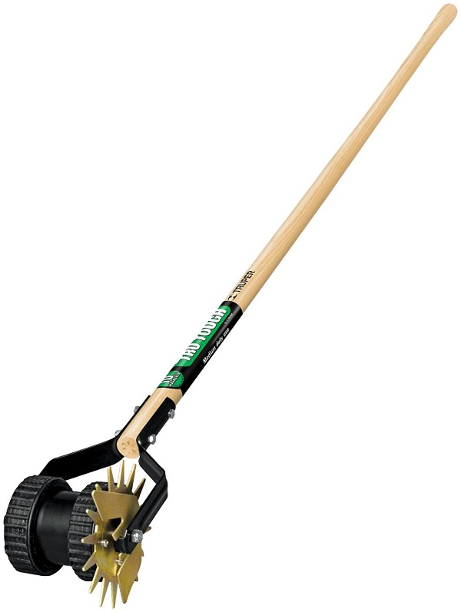
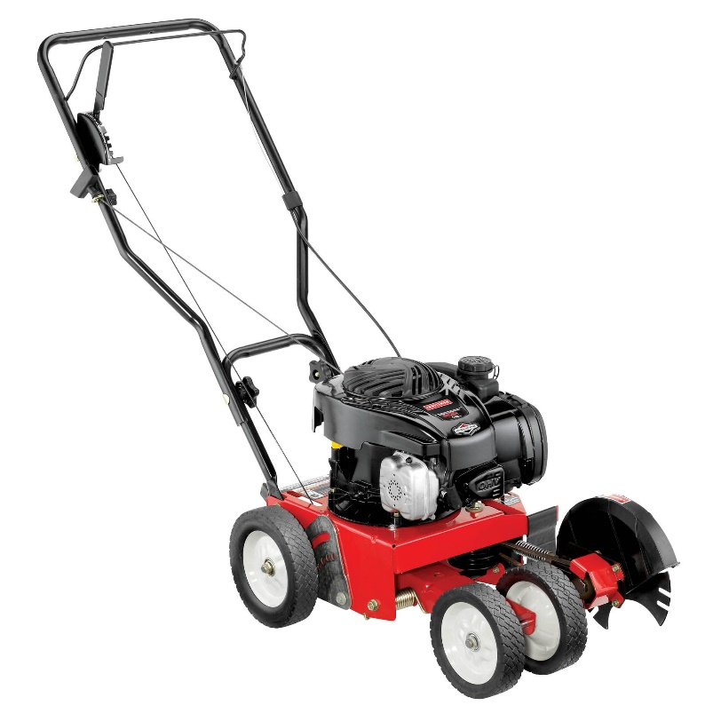
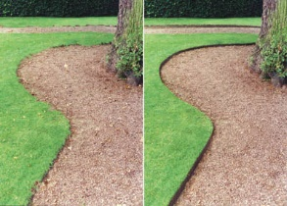
Edger (Power or Hand)
Edgers are used to create distinct separation between two boundaries.
Can be used to separate turf and a mulched area or create a clean edge against a paved surface
https://images-na.ssl-images-amazon.com/images/I/61np42XA54L._SL1500_.jpg
http://c.shld.net/rpx/i/s/i/spin/image/spin_prod_776923612
https://s3.amazonaws.com/cdn.kinsmangarden.com/images/BefAfterPath.jpg

Slide 12
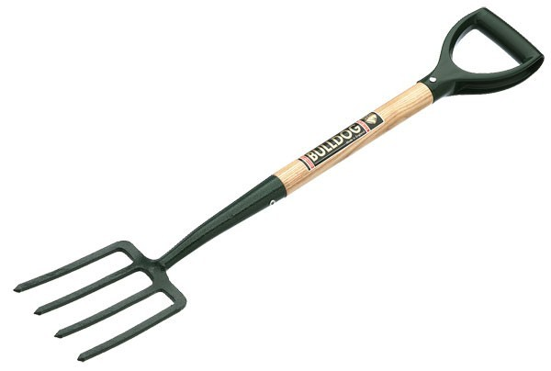
Garden (Spading) Fork
Gardening forks are used for breaking up clumps of soil, cleaning up weeds or removing rocks from the ground.
Can be more advantageous in certain situations instead of a shovel
Should not be mistaken for a pitchfork
https://s-media-cache-ak0.pinimg.com/originals/7f/51/56/7f5156f24f2567f23a2549ac999d8ac7.jpg

Slide 13
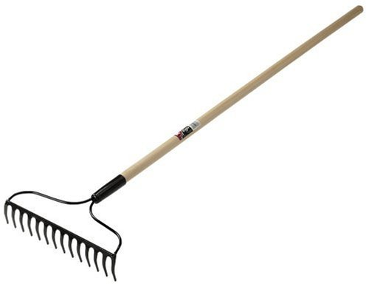
Garden (Bow) Rake
Used mainly for working with heavier materials such as soil, mulch or sand.
Its short, wider and stronger tines make it ideal for leveling out materials and raking rocks from soil.
https://images-na.ssl-images-amazon.com/images/I/31y4cNmYnEL.jpg

Slide 14
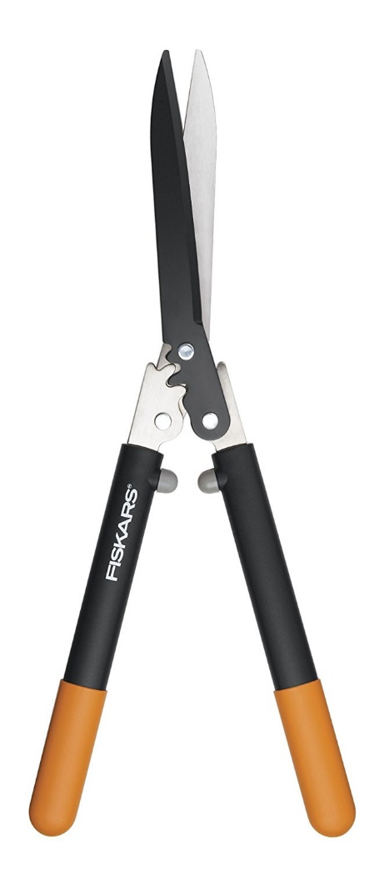
Hedge Shears
Hedge shears are used to trim and prune hedges or shrubs.
With its longer blades, it covers a much larger area compared to typical hand held shears.
https://images-na.ssl-images-amazon.com/images/I/61e7EZucm6L._SL1500_.jpg

Slide 15
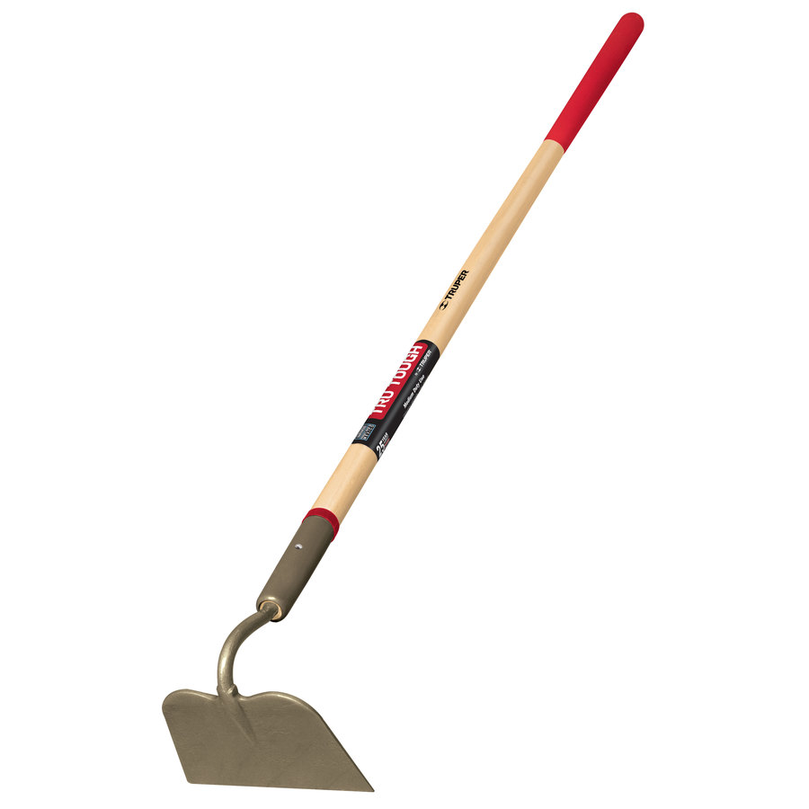
Hoe
A garden hoe is used to shape soil by either drawing soil around the base of a plant or drawing trenches for planting.
Removal of weeds is another common use of a garden hoe.
https://mobileimages.lowes.com/product/converted/755625/755625038678.jpg

Slide 16
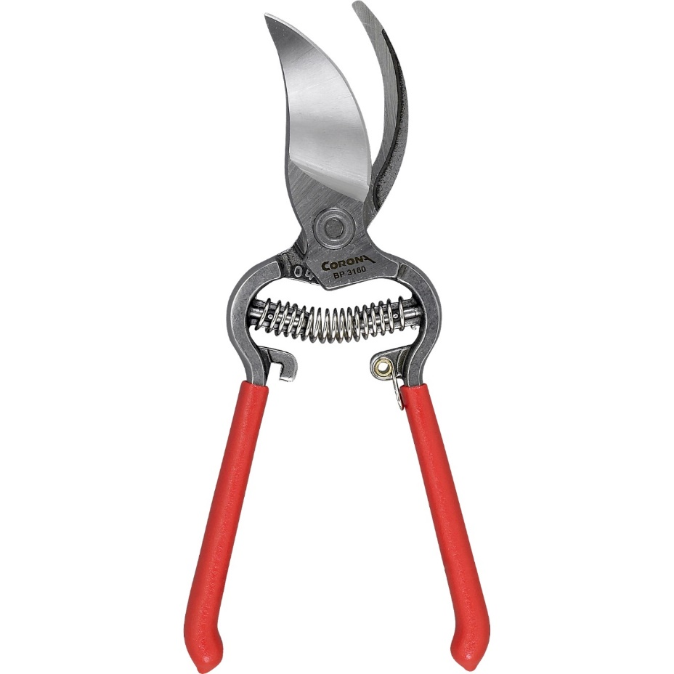
Hook-and-Blade Pruners
Hook-and-blade pruners are used for very detailed trimming of hedges or shrubs, cutting, at most, branches a half inch in diameter.
Different from an anvil pruner since the two cutting parts pass each other like traditional scissors
https://midwesternplants.files.wordpress.com/2014/11/bypass-pruners.jpg

Slide 17
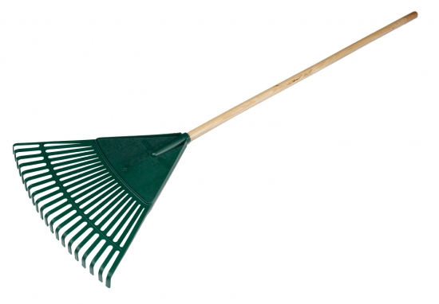
Leaf Rake
Leaf rakes move around light materials such as leaves or grass clippings.
https://www.nature-watch.com/images/products/large/279k%20new.jpg

Slide 18
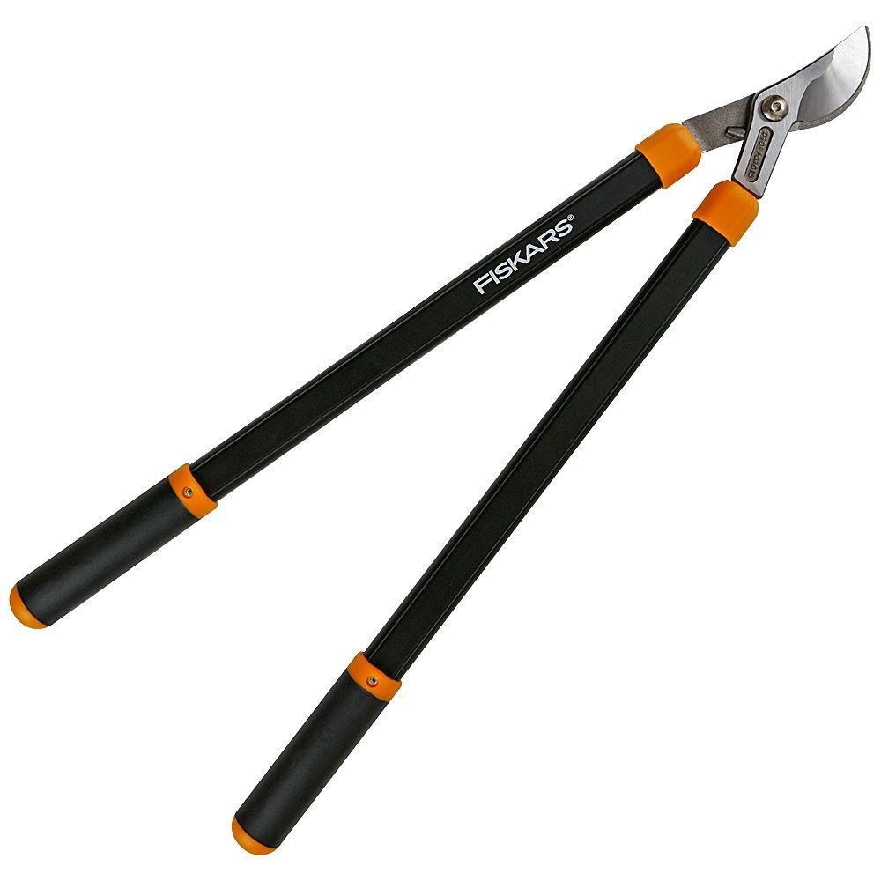
Loppers
Loppers are used to trim smaller tree branches less than two inches.
http://www.homedepot.com/catalog/productImages/1000/1f/1fbda3b4-d09a-4c80-8de7-bdfede4afd10_1000.jpg

Slide 19
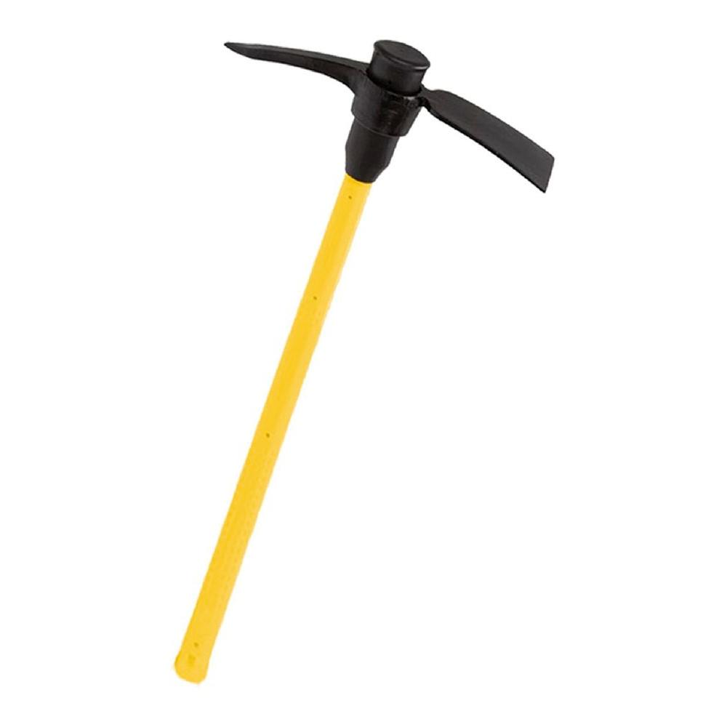
Mattock
A mattock typically has a cutting edge and an axe edge. The two flat edges are perpendicular to one another.
Mattocks are useful for breaking up dirt and cutting through roots.
http://www.homedepot.com/catalog/productImages/1000/ac/ac8b5efb-bee8-41ef-b557-dd9464bf85f0_1000.jpg

Slide 20
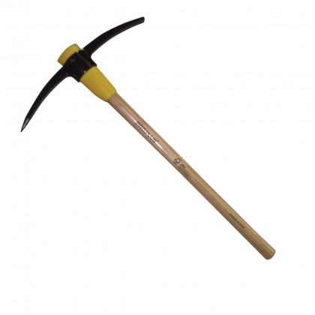
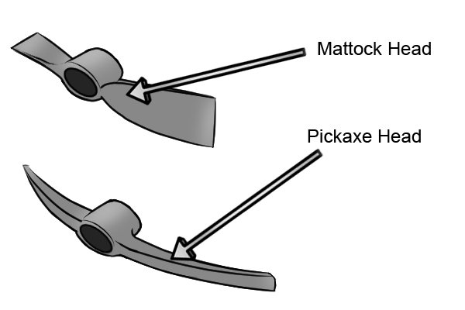
Pick
With smaller and sharper points than a mattock, a pick is most effective at breaking up tough soils.
It is important to note that the pick is different than the mattock shown earlier.
http://www.woodies.ie/media/catalog/product/cache/1/image/420x420/9df78eab33525d08d6e5fb8d27136e95/1/0/1072372_proplus_7lb_pick_axe.jpg
https://www.wonkeedonkeetools.co.uk/mattocks/what-is-a-mattock/

Slide 21
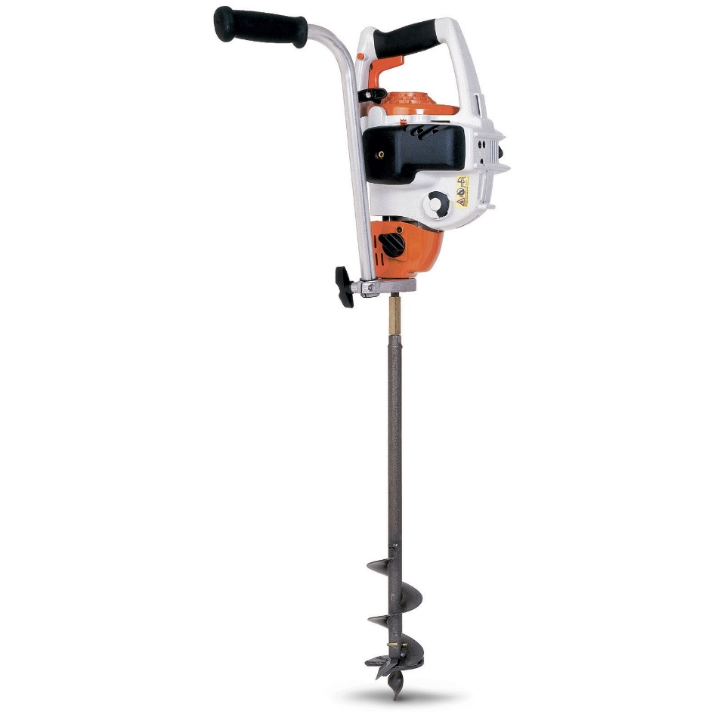
Planting/Earth/Soil Auger
When needing to dig holes for planting trees or for installing fences or other scenery, an auger is the easiest option out there.
http://www.barrysgravely.com/wp-content/uploads/images/BT45A.jpg

Slide 22
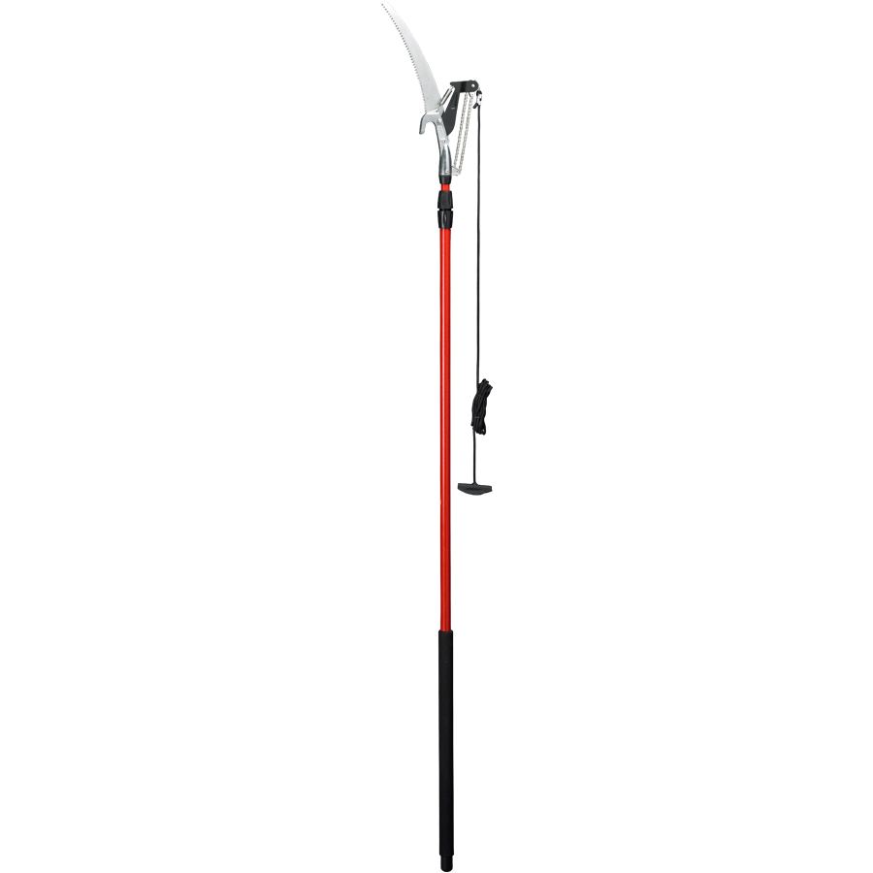
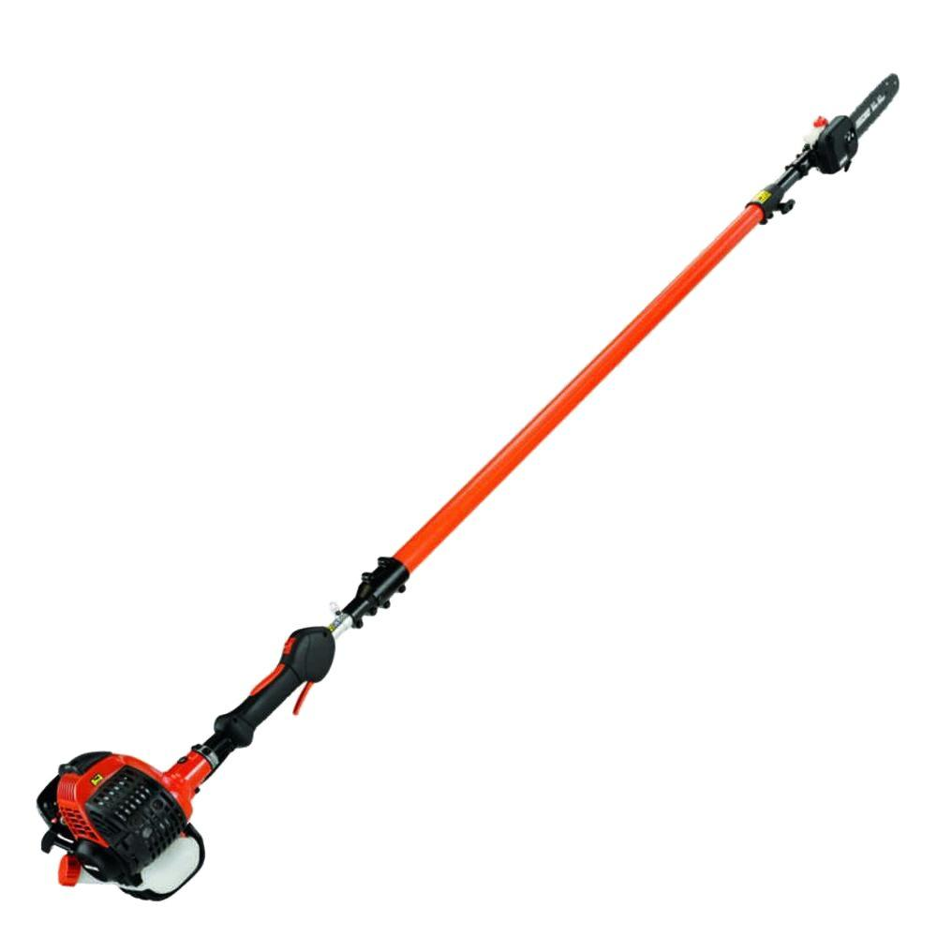
Pole Pruner
A pole pruner is a very selective tool. Its only purpose is to trim very thin tree branches that can’t be reached from the ground.
https://mobileimages.lowes.com/product/converted/038313/038313067809.jpg
http://www.homedepot.com/catalog/productImages/1000/96/96d07095-36cb-43cd-bdec-82429ff4d855_1000.jpg

Slide 23
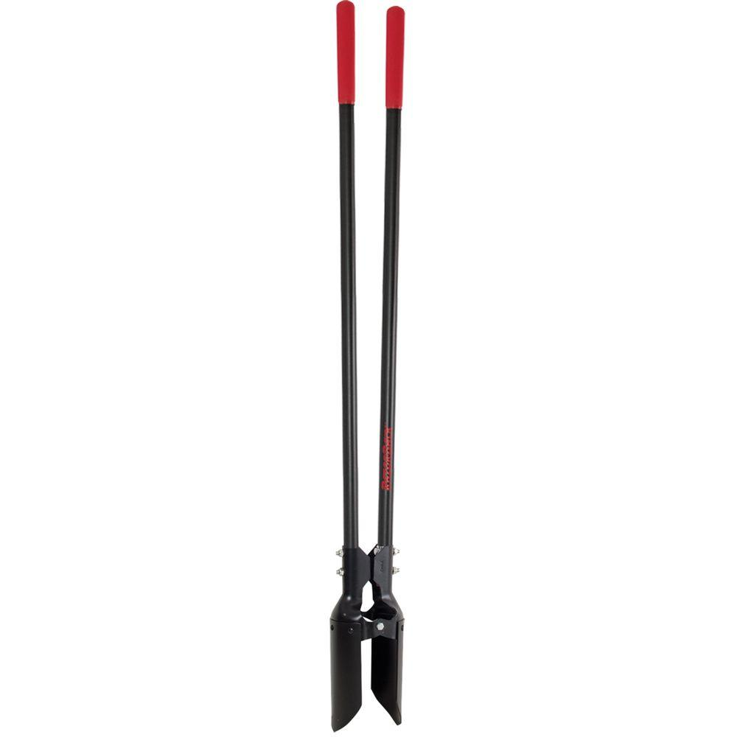
Post-Hole Digger
Post hole diggers are used to create holes for fences or signs.
While more labor intensive than using an auger, a post hole digger allows the user to have complete control over the depth and width of the hole.
http://www.homedepot.com/catalog/productImages/1000/2a/2ab25ec1-cb9d-48b8-bdc9-f3a167b585f2_1000.jpg

Slide 24
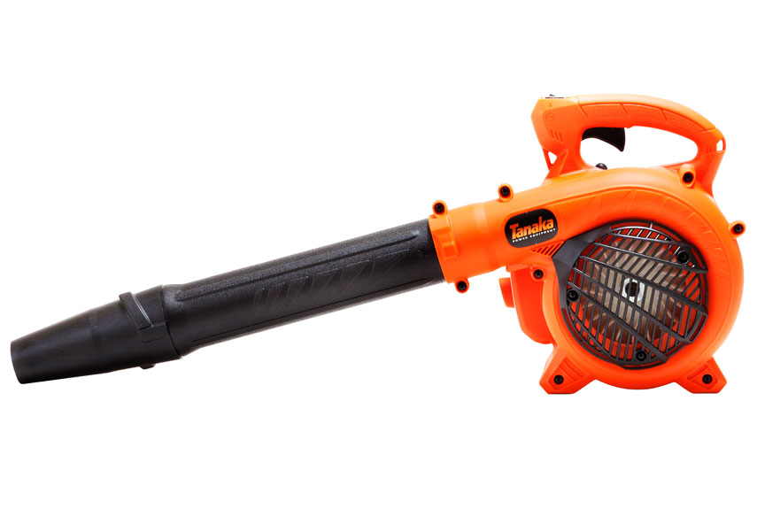
Power Blower
Power blowers can have either electric or gasoline powered motors.
They are used to easily move light debris such as leaves or grass clippings.
http://pop.h-cdn.co/assets/cm/15/05/54ca6572daee6_-_leaf-blowers-07-0911-xln.jpg

Slide 25
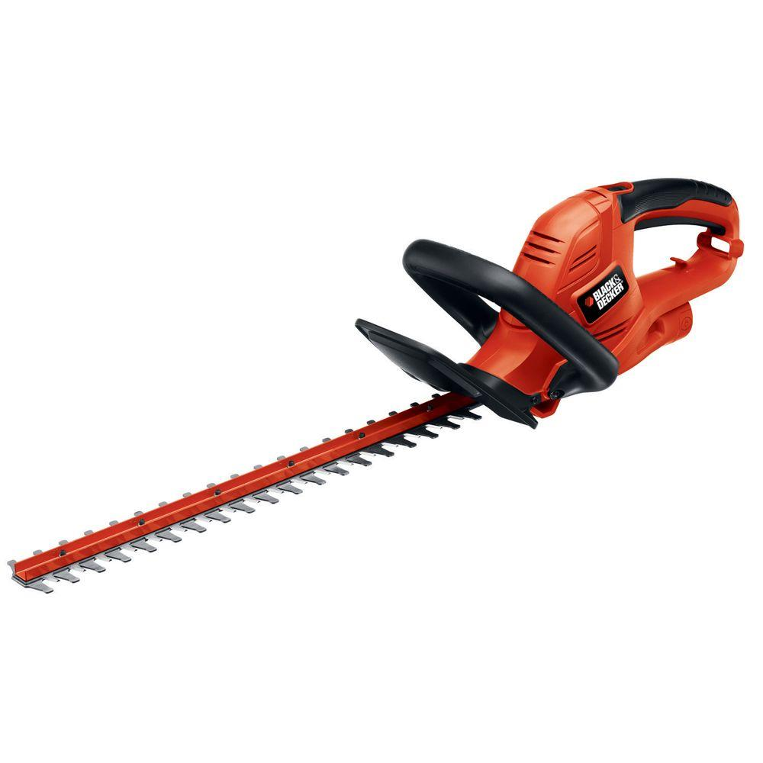
Power Hedge Trimmer
Power hedge trimmers offer a quick and easy solution to unruly hedges.
Come with either electric or gasoline motors
http://www.homedepot.com/catalog/productImages/1000/0d/0d2b814e-b442-4ea8-ba21-f5c2d51dd2ae_1000.jpg

Slide 26
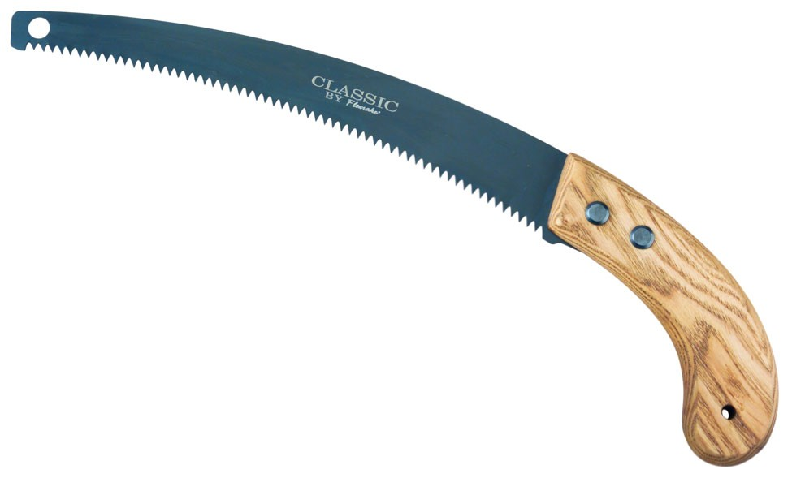
Pruning Saw
A pruning saw is used to remove smaller branches from trees.
Best used in tight or hard to reach places where a bow saw or chainsaw wouldn’t work
http://flexrake.com/media/catalog/product//1/image/9df78eab33525d08d6e5fb8d27136e95/c/l/cla320-lg.jpg

Slide 27
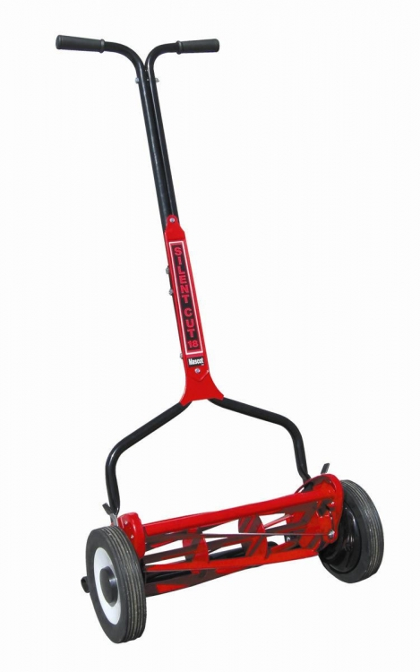
Reel Mower
Typically used on smaller residential lawns, a reel mower cuts grass like scissors while a gasoline mower “chops” the grass blades.
Reel mowers are cheaper, require less maintenance, hand powered and less noisy than gasoline mowers.
http://www.reelmowersetc.com/Merchant2/graphics/00000002/mascot-reel-mower-18_469x750.jpg

Slide 28
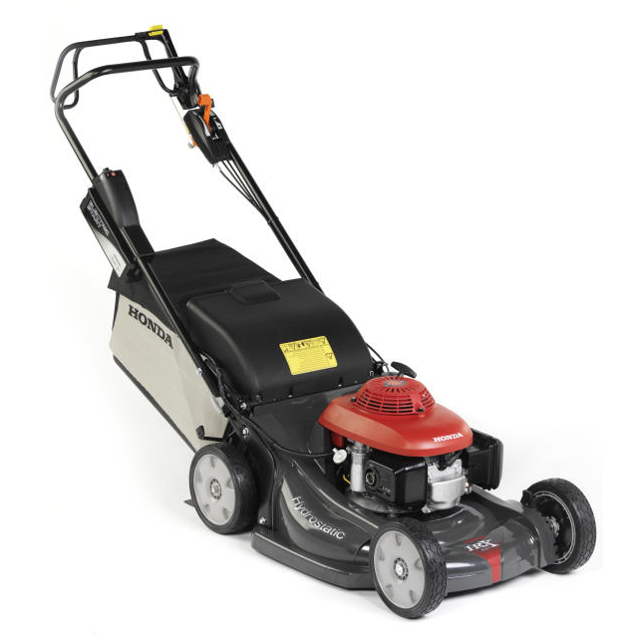
Rotary Mower
Rotary mowers are motor powered blades used to cut grass.
The mowers range in size from a hand-pushed mower to one pulled behind a tractor.
These are the most time efficient mowers typically used for larger residential lawns and commercial purposes.
https://www.lawnmowersdirect.co.uk/wp-content/uploads/2016/11/HRX537HZ.png

Slide 29
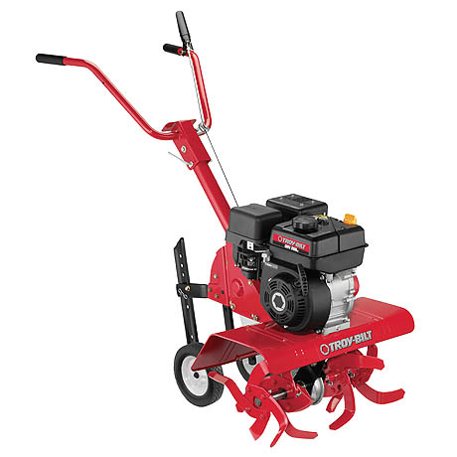
Rototiller
Rototillers are used to work the top 6–8 inches of topsoil. This helps loosen soil creating air pockets and allowing roots to grow more easily.
This also helps work in any compost, grass clippings, weeds and other organic material into the soil.
http://www.troybilt.com/wcpics/TroyBiltUS/en_US/products/21B-34M8711_product_medium.jpg

Slide 30
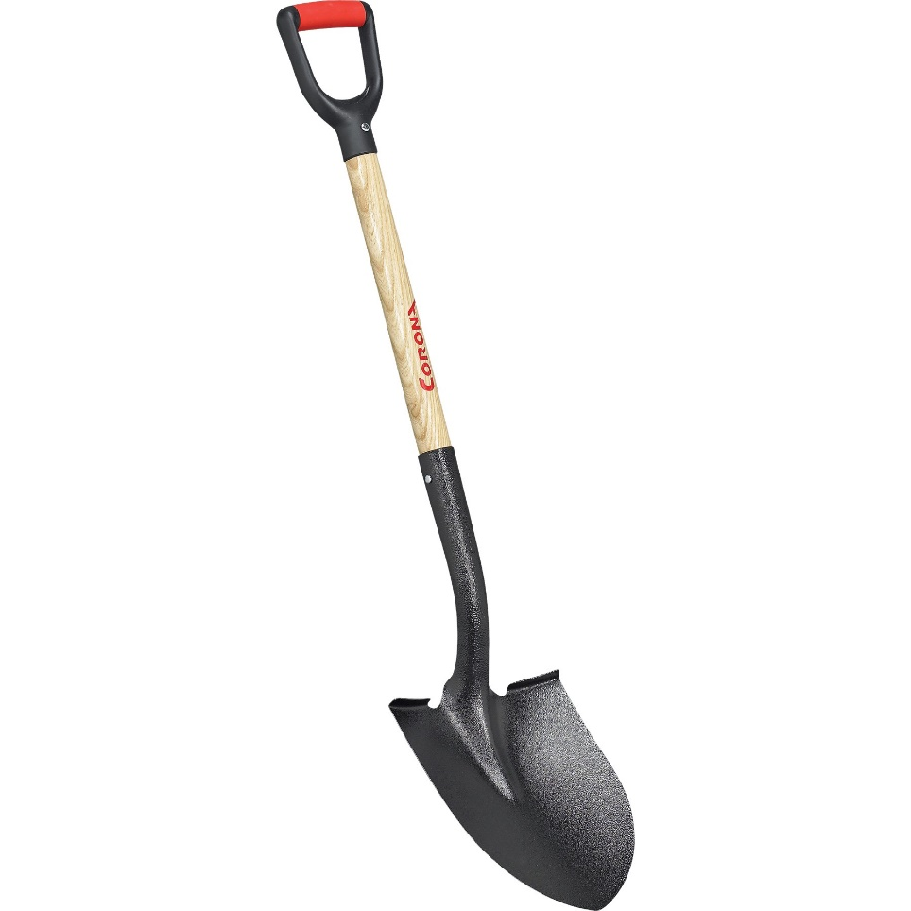
Round Point Shovel
With a pointed edge, the shovel is ideal for digging and lifting heavier materials like soil.
https://media.qcsupply.com/catalog/product/cache/1/image/9df78eab33525d08d6e5fb8d27136e95/3/4/340074_1.jpg

Slide 31
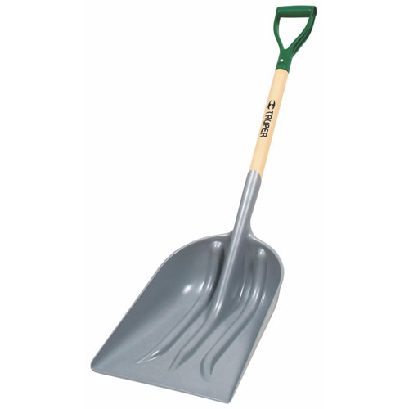
Scoop Shovel
A scoop shovel it used to move larger amounts of lighter materials like mulch and grass clipping.
http://gensonash.com//images/catalog/Truper%20Scoop%20Shovel-17232.jpg

Slide 32
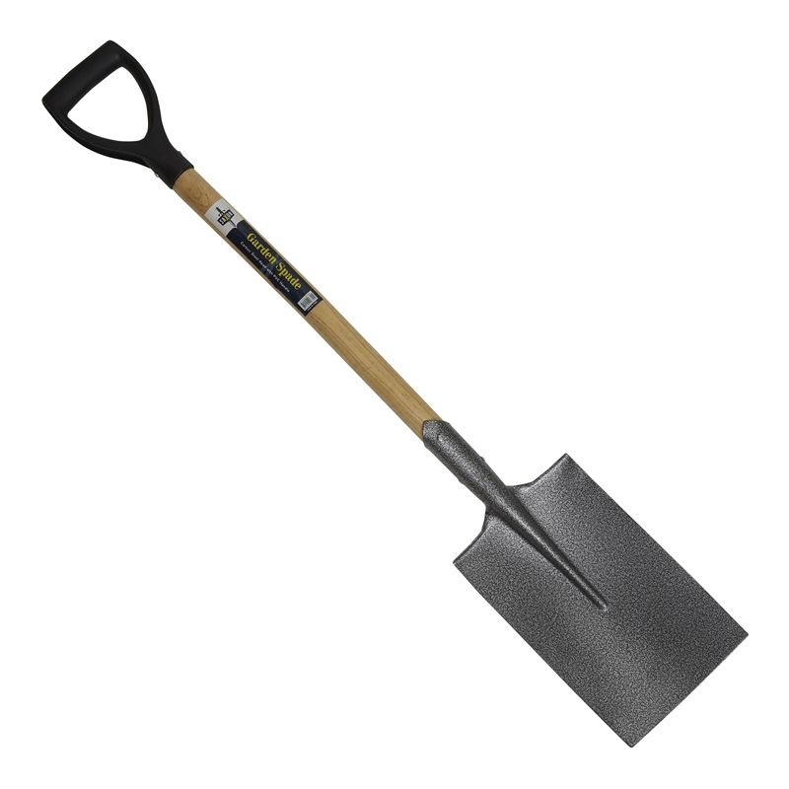
Spade
A spade can be use as a regular shovel to dig holes or move materials like soil or mulch.
Spades can also be used to edge in the absence of an edger.
https://2ecffd01e1ab3e9383f0-07db7b9624bbdf022e3b5395236d5cf8.ssl.cf4.rackcdn.com/Product-800x800/374f090d-bb5b-438c-82f3-9f099e2dd6a5.jpg

Slide 33
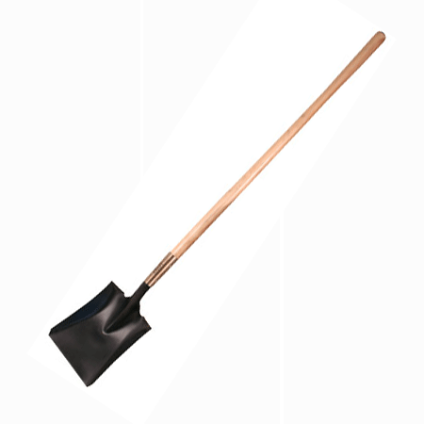
Square Point (Flat) Shovel
A square point shovel is commonly used for scooping and moving lighter materials.
Can be used to edge along sidewalks or flowerbeds
http://www.locatorsandsupplies.com/images/KRA-GG861_lg.gif

Slide 34
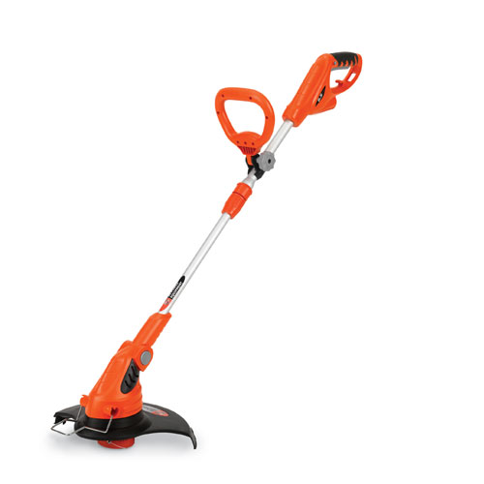
String Trimmer
String trimmers are used to get left over weeds or grass in areas that a mower couldn’t get close enough to, such as nears posts, rocks or garden edges.
Since this is a free-hand tool, it is important to never cut grass too short or down to the soil and cause permanent damage to the turf.
http://www.drpower.com/productimages/image.axd/i.30076/a.1/w.1000/h.1000/dr+13in+corded+string+trimmer_l.jpg

Slide 35
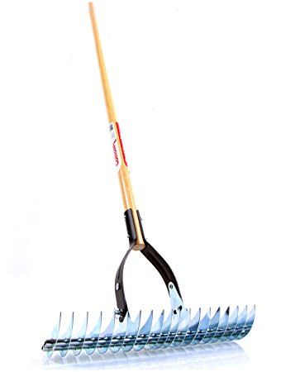
Thatch Rake
A thatch rake is used to remove the thatch in turf. This helps remove dead roots and grass that has built up.
With the thatch removed, it allows the roots to better receive water and nutrients.
https://images-na.ssl-images-amazon.com/images/I/71pM7-Nh8HL._SY450_.jpg

Slide 36
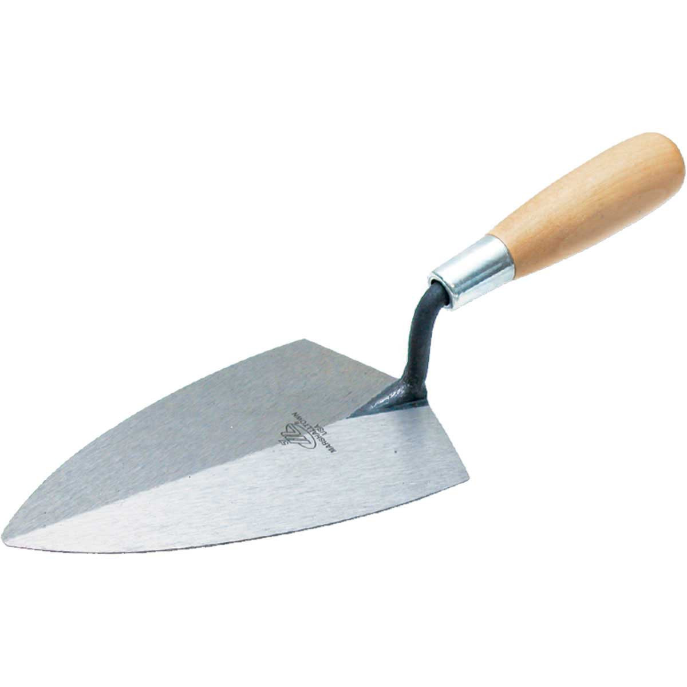
Trowel
A trowel is used to move and smooth out small amounts of a material.
This could be used when planting individual plants or as a masonry tool when setting a retaining wall.
http://www.contractorsdirect.com/images/products/2597_01.jpg?resizeid=3&resizeh=1200&resizew=1200

Slide 37
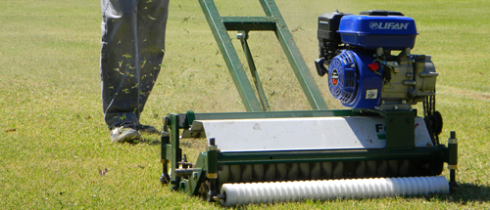
Vertical Mower
Vertical mowers are motor-driven machines used to dethatch larger lawns.
Through dethatching, grass can grow better since dead plant material is no longer blocking water and nutrients from the roots.
http://fullgrassweb.com.ar/wp-content/uploads/banner.jpg

Slide 38
Nursery/Landscape Equipment Identification
Irrigation and Fertilization
Broadcast (cyclone) spreader
Bubbler head, irrigation
Compressed air sprayer
Drip emitter, irrigation
Fertilizer injector
Fertilizer tablet
Granular fertilizer
Gravity (drop) spreader
Ground/pelleted limestone
Hose-end repair fitting
Hose-end sprayer
Hose-end washer
Hose repair coupling
Impact sprinkler
Irrigation ring tool
Mist nozzle (mist bed)
Oscillating sprinkler
Polyethylene pipe
Pop-up irrigation head
Pump sprayer
Quick coupler
Quick coupler head adapter
Resin-coated fertilizer
Siphon proportioner
Soaker hose
Solenoid valve
Water breaker

Slide 39
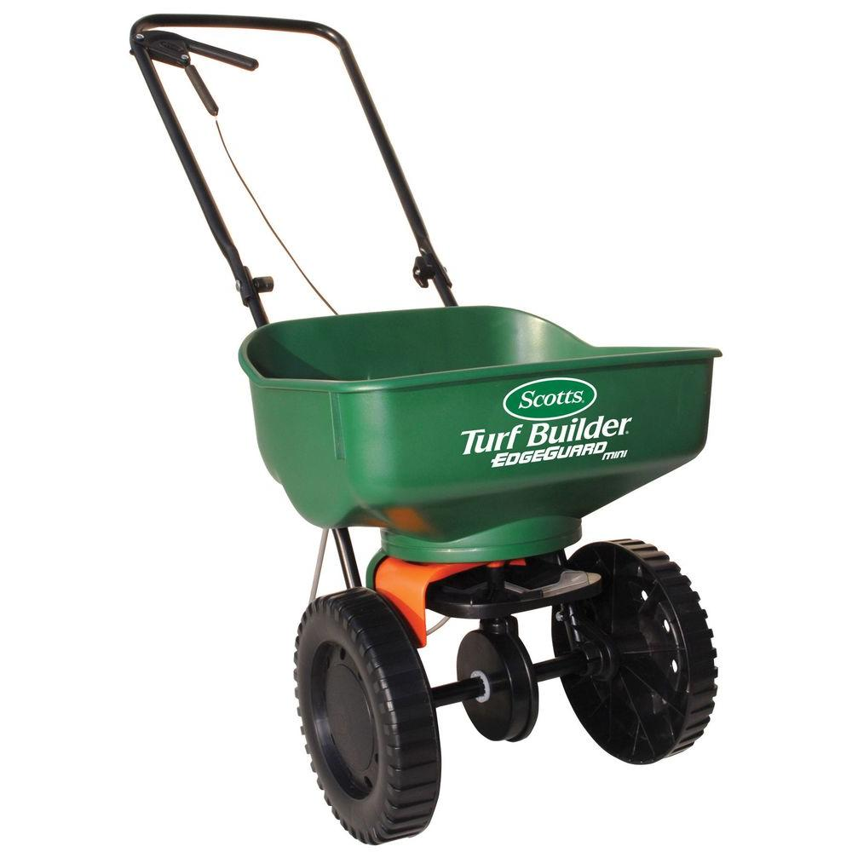
Broadcast (Cyclone) Spreader
Used to spread fertilizer or seed easily across smaller properties.
Varies in size; larger models can be towed behind mowers or ATVs.
http://www.homedepot.com/catalog/productImages/1000/ee/eee31612-fc6c-4b83-8e01-2874180f94a4_1000.jpg

Slide 40
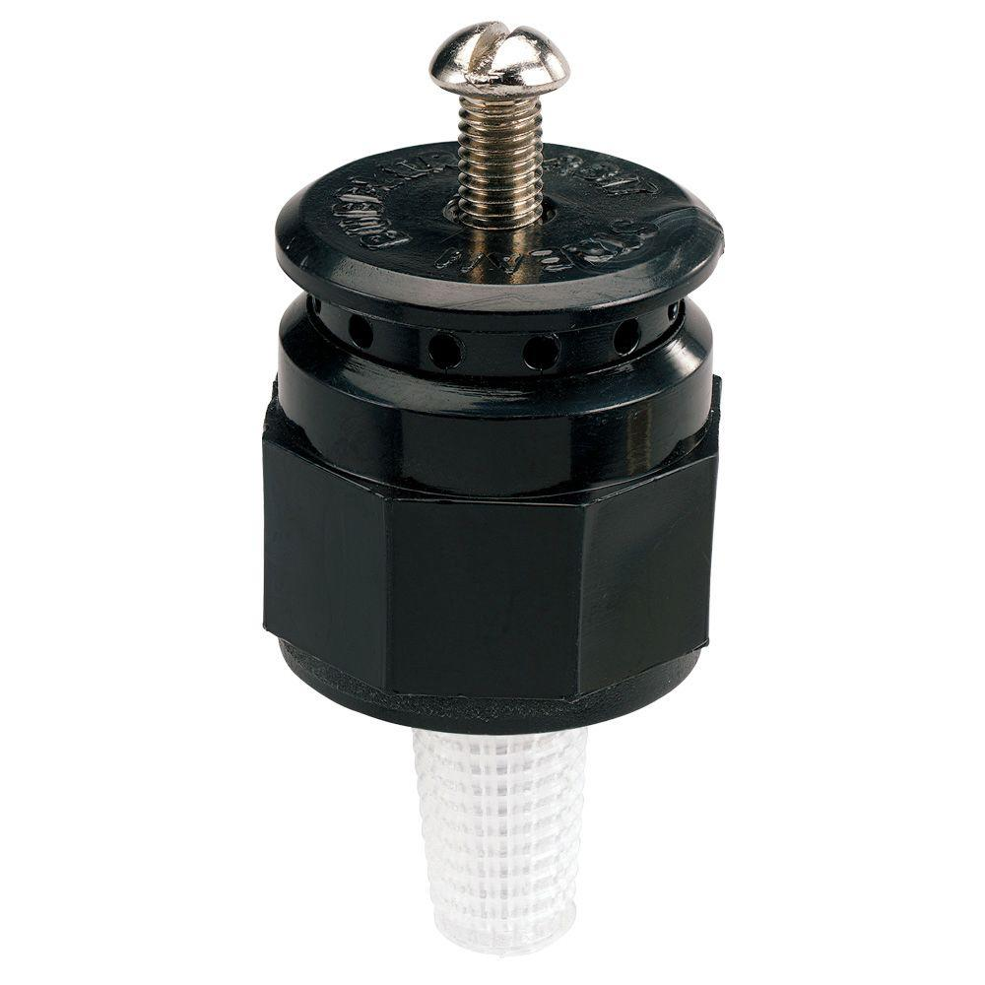
Bubbler Head, Irrigation
Can be more water efficient than other sprinkler options
Typically used to cover smaller areas around shrubs or trees
Not ideal for turf irrigation
http://www.homedepot.com/catalog/productImages/1000/6c/6cbf734b-e033-4c04-bab0-46b1bb8be878_1000.jpg

Slide 41
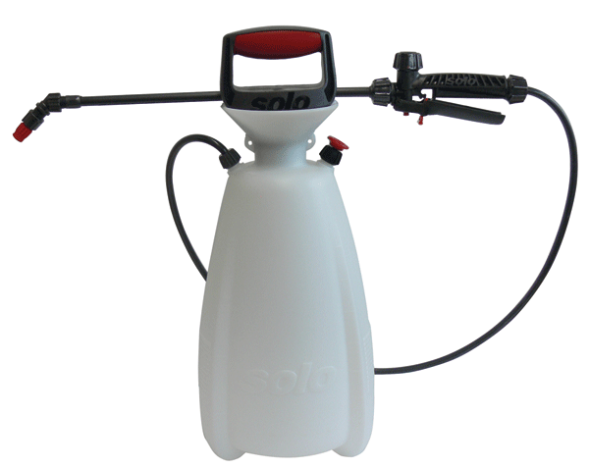
Compressed Air Sprayer
Light weight and cost effective, compressed air sprayers can be used for applying fertilizer and herbicides.
Being completely in control of the spray ensures there are minimal amounts of run off.
http://solousa.com/store/shop_image/product/f5936a9dbc16eb3dd5ceab8b5463cb97.gif

Slide 42
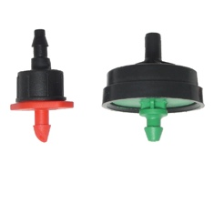
Drip Emitter, Irrigation
Drip irrigation is a precise way to irrigate landscapes or nursery plants.
Water loss is controlled through how much water is in the soil and reducing the amount lost to evaporation.
https://www.dripworks.com/media/catalog/category/pressure-compensating-emitters_1.jpg

Slide 43
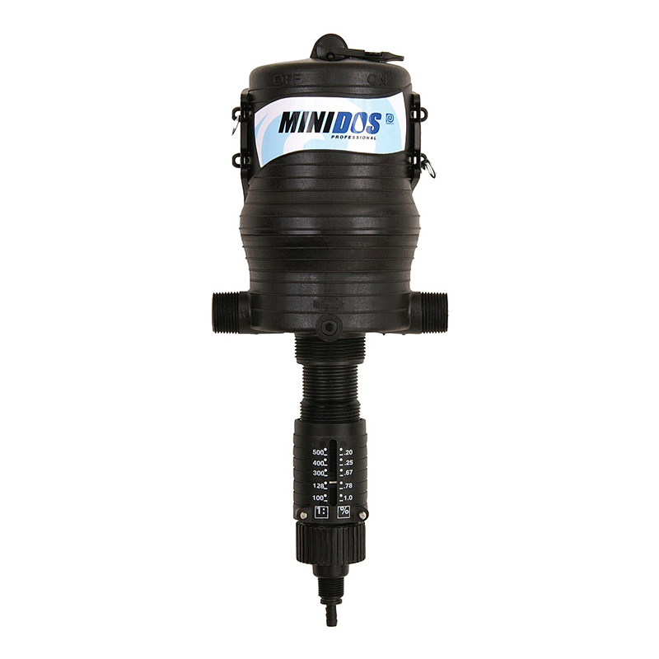
Fertilizer Injector
Fertilizer injectors are an effective way to deliver liquid fertilizer and nutrients directly to the roots of a plant.
An injector is used with an already existing drip irrigation system and adds the nutrients to the system when necessary.
http://cdn.greenhousemegastore.com/images/uploads/2098_5473_popup.jpg

Slide 44
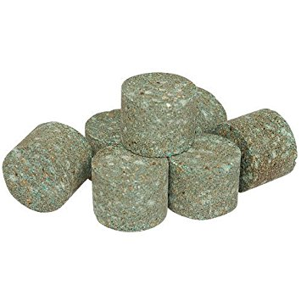
Fertilizer Tablet
The tablets are planted along with a new shrub or tree.
Helps start healthy growth
Doesn’t require any measuring of loose fertilizer and can supply nutrients for up to two years
https://images-na.ssl-images-amazon.com/images/I/51gO738b9vL._SY355_.jpg

Slide 45
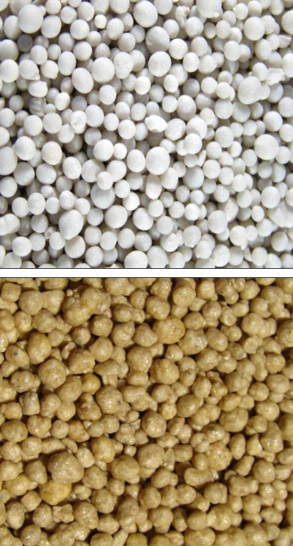
Granular Fertilizer
Granular fertilizer should be worked into or spread on top of soil.
It first must break down before a plant can take up the nutrients.
Depending on the type of fertilizer, it can last anywhere from a month to nine months.
http://continentalrollomixer.com/sites/default/files/sample/13-13-13_Un-Coated_Granular_Fertilizer-13-13-13_Fertilizer_with_12%2B_Polymer_Coating.jpg

Slide 46
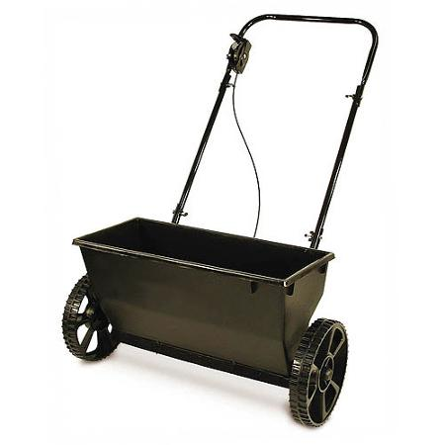
Gravity (Drop) Spreader
While similar to a cyclone spreader, gravity spreaders allow for a more accurate application and control of fertilizers or herbicides.
https://www.seedsuperstore.com/content/images/Ask%20the%20expert%20artwork/drop%20spreader.jpg

Slide 47
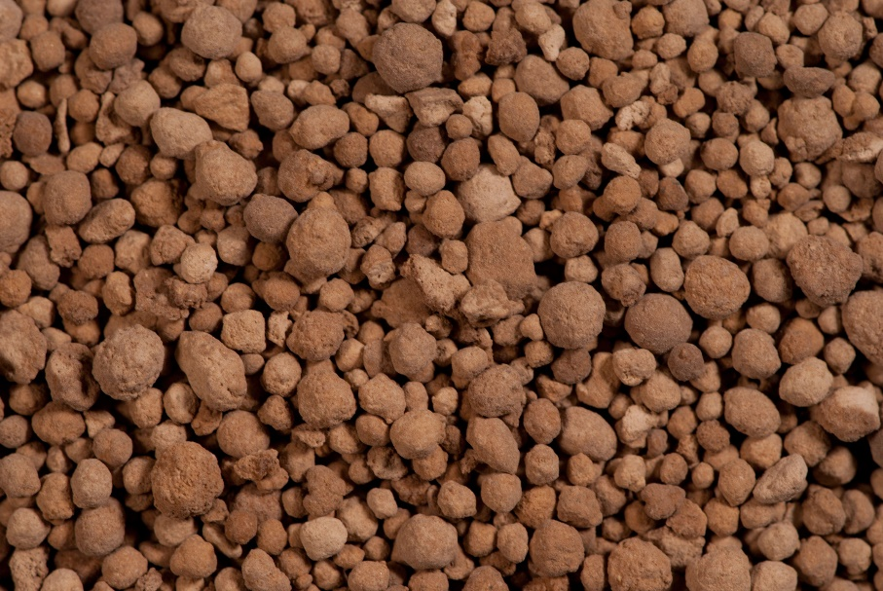
Ground/Pelleted Limestone
If a lawn’s pH levels are too low, pelleted limestone can be applied to help raise it.
Limestone can also add other nutrients such as magnesium and calcium.
http://www.omahaorganicslawncare.com/wp-content/uploads/2014/02/Lime.jpg

Slide 48

Hose-End Repair Fitting
Over time, hose ends easily become damaged leading to leaky hose coupling or some that will not connect.
Hose-end repair fittings offer a fix to that problem without having to replace the entire hose.
https://mobileimages.lowes.com/product/converted/847259/847259088126.jpg

Slide 49

Hose-End Sprayer
Hose-end sprayers allow for customized application of liquid fertilizer by adjusting the fertilizer concentration and flow rate.
The liquid fertilizer is put in the plastic container and is then drawn out as the water flows through the handle.
http://www.chainsawjournal.com/wp-content/uploads/2015/03/HD-Hudson-60000GT-hose-end-sprayer.jpg

Slide 50


Hose-End Washer
This washer helps seal the coupling to make sure water doesn’t leak out.
Sometimes, a faulty rubber hose-end washer is the reason for a leaky hose end and an entire repair fitting isn’t necessary.
http://gilmour.com/wordpress/wp-content/uploads/2016/02/rubber-hose-washers-01RW.jpg
https://images-na.ssl-images-amazon.com/images/I/71Gd4WZJGlL._AC_UL320_SR302,320_.jpg

Slide 51

Hose Repair Coupling
If a hole punctures a garden hose, it can be patched with a hose repair coupling.
By cutting the hose where the hole is and applying the coupling, it will save the hose, and there is no need to buy a new one.
http://gilmour.com/repair/hose-repair

Slide 52

Impact Sprinkler
Impact sprinklers are popular due to their effective irrigation, simple use and set up.
The head of the sprinkler is driven by the force of water spraying out pushing the extended arm, which helps direct the water to create an even irrigation pattern.
http://www.rainbird.com/images/products/diy/impacts/25PJDAC.jpg

Slide 53

Irrigation Ring Tool
Irrigation ring tools are used to couple water distribution tubing for a sprinkler or irrigation systems.
http://www.homedepot.com/catalog/productImages/1000/34/340fa873-d64c-43a0-9b0f-b4c8a1ae3151_1000.jpg

Slide 54

Mist Nozzle (Mist Bed)
Mist nozzles are typically used in nurseries with newly propagated plants.
Through misting, it offers a lightly applied water source that does not damage the plant but provides adequate moisture.
https://www.easy-irrigation.co.uk/bmz_cache/c/ccf1eab71e2606a32f5ecf0c521d7980.image.400x400.jpg

Slide 55

Oscillating Sprinkler
Oscillating sprinklers are attached to the end of a hose and placed on a lawn.
The head of the sprinkler moves back and forth to cover large sections at a time.
http://www.homedepot.com/catalog/productImages/1000/f6/f6eb994a-2ee6-41c6-92a1-63a207995029_1000.jpg

Slide 56

Polyethylene Pipe
Polyethylene pipes are used in irrigation systems. They will run from the water source to the sprinkler or irrigation head.
Polyethylene pipes have become increasing popular over the years due to their cost and ease of installation.
http://www.onewater.com.au/images/1379653297_bluelinePEPipe-halfcropped.jpg

Slide 57


Pop-Up Irrigation Head
Pop-up irrigation heads are extremely common due to their simplistic design.
Heights range from 2–20 inches.
The most common height for residential areas is 4 inches, and each head typically covers a radius of 3–15 feet.
http://www.homedepot.com/catalog/productImages/1000/bb/bbd89146-dbcb-4df0-b0de-5416b8522f43_1000.jpg
http://www.rainbird.com/images/products/diy/sprays/1804Q_Action.jpg

Slide 58

Pump Sprayer
Pump sprayers are large tanks with a gasoline pump attached to create pressure.
They can either be in the back of a pickup truck or on a separate cart and are used with commercial operation.
Can be used to apply liquid fertilizer of herbicides
https://www.amleo.com/solo-backpack-sprayer-4gal-with-piston-pump/p/425-101/

Slide 59

Quick Coupler
A quick coupler is an easy way to swap sprinkler heads.
These are attached at the end of the irrigation line and stick out at ground level.
http://www.rainbird.com/images/products/turf/valves/quickcoupling_cutaway.jpg

Slide 60

Quick Coupler Head Adapter
A quick coupler head adapter is attached to the base of a sprinkler allowing it to properly fit into a quick coupler.
This sprinkler head can now be easily swapped out instead of being permanently installed.
http://www.vyrsa.com/us/catalogo/productos/racordaje-maguera/

Slide 61

Resin-Coated Fertilizer
Coated fertilizer controls the release rate of the nutrients into the soil.
Controlling how much fertilizer is released over time helps reduce the amount lost to leeching.
http://www.hortidaily.com/images/2014/0910/fertilizer2.jpg

Slide 62


Siphon Proportioner
Siphon proportioners allow for concentrated fertilizer or herbicide to be directly mixed into water coming out of a hose.
It is important to know the ratio at which the siphon draws concentrate to ensure the correct rate is applied.
https://images-na.ssl-images-amazon.com/images/I/31s3G0y5FKL.jpg
https://images-na.ssl-images-amazon.com/images/I/512w90FBxqL.jpg

Slide 63

Soaker Hose
A soaker hose is perforated with many small holes that allow for water to slowly drip out and into the root zones of plants.
Similar to other drip irrigation systems, a soaker hose loses very little water to run off or evaporation and is simple to use.
http://3.bp.blogspot.com/-Ijes0DbUopY/TiYblC9yVcI/AAAAAAAAANg/gHzDq9z8ZXE/s1600/_DSC0045.JPG

Slide 64

Solenoid Valve
A solenoid valve is an electronically controlled valve. It allows for remote activation to release water for an irrigation system.
https://www.stcvalve.com/Process%20Valve/Slow-Closing-Solenoid-Valve.gif

Slide 65

Water Breaker
Water breakers are attached to the end of a hose and used to water plants.
Breaking up the water helps soften the impact of water hitting the plant and soil.
A water breaker can also be used to control the flow of water with its multiple settings.
https://www.todayshomeowner.com/images/article/water-saving-gadgets-for-the-garden-3.jpg

Slide 66
Nursery/Landscape Equipment Identification
Others
Ball cart (B&B truck)
Bark mulch
Burlap
Dry-lock wall block
Edging
Erosion netting
Grafting band
Grafting knife
Landscape fabric
Measuring wheel
Mower blade balancer
Nursery container
Peat moss
Pot-in-pot units
Propagation mat
Shade fabric
Sharpening stone
Soil sampling tube
Sphagnum moss
Tree caliper
Tree wrap
Wire tree basket

Slide 67

Ball Cart (B&B Truck)
Used to move heavy trees that are “balled” up
Use of this cart helps ensure the root ball does not slip and cause damage to the young tree.
http://www.handtrucksrus.com/trucks/vc/lg/6086lg%20[zoom].jpg

Slide 68

Bark Mulch
Used to retain soil moisture, regulate soil temperature, suppress weed growth and for aesthetics
Best used around trees or shrubs where digging is minimal
Decomposes over time increasing soil fertility
https://previews.123rf.com/images/pilens/pilens1101/pilens110100051/8579058-Pine-bark-mulch-background-texture-pattern-in-outdoor-garden--Stock-Photo.jpg

Slide 69

Burlap
Burlap can be used as mulch to help cover soil, reducing weed growth.
Can replace bark mulch as it is easy to find for a low price
http://www.homedepot.com/catalog/productImages/1000/6f/6f3da0e5-df98-4240-9595-e020e66d21b0_1000.jpg

Slide 70


Dry-Lock Wall Block
Dry-lock retaining wall blocks create walls that are harder for water to permeate and hold soil back to prevent a collapse in the landscape. These blocks have a special “lock” on the back of the block that help keep them in place.

Slide 71

Edging
Used to establish boundaries between turf and garden beds
Helps prevent soil and mulch from spilling onto turf
Creates crisp lines within a landscape
http://cdnll.amleo.com/images/500/452CE.jpg

Slide 72


Erosion Netting
Erosion netting is used to slow water flow on steep inclines, which, in turn, reduces the amount of sediment swept away.
To ensure water runs over the top of the netting, a key trench is dug at the top of the slope.
http://www.homedepot.com/catalog/productImages/300/3a/3a2bd99b-f014-4143-89b2-7b7f73ac9d06_300.jpg
http://www.co.forest.wi.gov/docview.asp?docid=19315&locid=145

Slide 73

Grafting Band
Grafting bands are used to apply pressure to the grafting point.
Added pressure encourages the tissues to grow together faster making sure the vascular system is able to supply nutrients and water to the whole plant.
http://curbstonevalley.com/wp-content/uploads/2011/03/elastic.jpg

Slide 74

Grafting Knife
Used to cut both plants at the point of grafting
It is important to have a sharp and clean grafting knife to reduce damage to plants and minimize chance of infection.
http://cdnll.amleo.com/images/500/A5017_1.jpg

Slide 75

Landscape Fabric
Landscaping fabric is used to help suppress weeds and retain more water in the soil.
Typically the fabric is used with mulch.
First the soil is leveled, the fabric placed down, holes cut where plants will be placed and then mulch covers the entire fabric.
http://www.bluemaize.net/im/arts-crafts-sewing/landscaping-fabric-7.jpg

Slide 76

Measuring Wheel
A measuring wheel is used to measure the ground distance between two points.
The wheel can be fairly accurate on flat solid terrain. However, when measuring an incline or on loose materials, the measurement may be off.
http://www.homedepot.com/catalog/productImages/1000/29/291698da-9af7-4308-86c1-ee336c72ca29_1000.jpg

Slide 77

Mower Blade Balancer
A mower blade balancer is used while sharpening mower blades. Placing the blade on top of the balancer will show if one side is heavier than the other.
If it is unbalanced, the heavier side should be filed down until balanced. Unbalanced blades can cause vibrations while mowing that increase wear and tear.
http://images.oreillyauto.com/parts/img/large/pri/pri705975-1.jpg

Slide 78

Nursery Container
Nursery containers are used for plants to grow and establish a root system before planting in the ground.
They also make transportation of plants easier.
http://cdn.greenhousemegastore.com/images/uploads/1920_249_popup.jpg

Slide 79

Peat Moss
Peat moss is used as an additive to soil to help slow nutrients leeching from the soil and add acidity and texture to the soil.
Peat moss breaks down extremely slowly so one application can last several years.
https://smhttp-ssl-17653.nexcesscdn.net/media/catalog/product/cache/1/thumbnail/9df78eab33525d08d6e5fb8d27136e95/p/s/pso100a.jpg

Slide 80

Pot-in-Pot Units
Pot-in-pot units are a technique that has nursery containers set inside of permanent pots in the ground.
This has the added benefits of root protection from changing temperatures, trees can be removed any time of year and greater stability.
http://aggie-horticulture.tamu.edu/newsletters/hortupdate/hortupdate_archives/2003/jan03/cancan1.jpg
Resource:
http://www.uky.edu/Ag/CCD/introsheets/potinpot.pdf

Slide 81

Propagation Mat
A propagation mat is used to regulate the temperature of soil with germinating seeds.
Should only be used indoors and for germinating seeds
Once germinated, plants should be moved off the mat and into sunlight.
https://cdn.shopify.com/s/files/1/1498/9506/t/8/assets/germination.jpg?18087462922295774271

Slide 82

Shade Fabric
Shade fabric is used to keep plants out of direct sunlight so they do not over heat and wilt as easily, and it also slows water loss due to evaporation.
Shade fabric can also help seeds germinate in areas with exceptionally warm summers.
http://obcnw.com/images/products/detail/616.nico_shade_fabric.jpg

Slide 83

Sharpening Stone
Sharpening stones are used to re-sharpen dull tools such as a grafting knife.
https://images-na.ssl-images-amazon.com/images/I/41eC4CGczRL.jpg

Slide 84

Soil Sampling Tube
Soil sampling tubes draw out cores of soil that can then be tested to identify deficiencies of important nutrients.
If deficiencies are found, decisions about what fertilizers to apply can be backed up with data.
http://static.gemplers.com/img/lamotte-soil-sampling-72840-lrg.jpg

Slide 85


Sphagnum Moss
Unlike peat moss, which has been dead for centuries before it is harvested and dried, sphagnum moss is harvested while the plant is still alive, and then it is dried.
Sphagnum moss is found in almost all potting soils and is added to natural soil to add texture and as a natural fertilizer.
https://images-na.ssl-images-amazon.com/images/I/81bhiIhCvhL._AC_UL320_SR176,320_.jpg
https://us.123rf.com/450wm/kaowenhua/kaowenhua1405/kaowenhua140501756/28182118-dried-sphagnum-plant.jpg?ver=6

Slide 86

Tree Caliper
A tree caliper is used to measure the diameter of a tree trunk.
It is important to account for the lean of a tree and if the tree is oval shaped.
http://static.stihl.com/upload/assetmanager/modell_imagefilename/scaled/zoom/05bf5e17f2564b548c806511afc20d51.jpg

Slide 87

Tree Wrap
Tree wrap is applied to newly planted or thin-barked trees. The wrap keeps the sun off the tree to prevent scalding of the bark.
It is recommended to cover trees from November to April if needed.
http://extension.illinois.edu/gardenerscorner/images/winter_05_13.jpg

Slide 88

Wire Tree Basket
Wire tree baskets are used to help transport balled trees and are planted with the tree in the ground.
The wire tree basket offers added support to the tree root system and has no negative effect on growth.
http://www.cherokeemfg.com/wp-content/uploads/2015/02/cbt.jpg

Slide 89
Quizet Review
We will split into two evenly numbered teams and review the equipment with a Quizlet flash card challenge!
https://quizlet.com/214068568/nurserylandscape-equipment-id-flash-cards/?new

