Slide 1
Poultry Processing

Slide 2
Processing Steps
1. Shackling
  Poultry meat processing is initiated by hanging, or shackling, the birds to a processing line.
  Birds are transferred from coops or transport cages to a dark room where they are hung upside down from shackles attached to an automated line.
2. Stunning
  Electrical stunning delivers a current through a water bath to immediately create a state of unconsciousness.
    An effective stun will cause the bird to arch the neck, hold the wings tightly to the body and sometimes have body tremors.
    The current should be compliant with minimum recommended current per bird and may vary for broilers, turkeys and other types of poultry.
  Controlled Atmosphere Stunning: Gas stunning is another form of stunning. Birds are immersed in an approved gas or mixture of gases (i.e., CO₂) in order to displace oxygen and render the bird unconscious.

Slide 3
Processing Steps, continued
3. Bleeding
  After stunning, the birds are passed through an automated knife that makes an incision on the neck to cut the major blood vessels.
  With the carcass hanging upside down and the major blood vessels cut, the majority of the blood is drained from the carcass.
4. Scalding
  Scalding loosens the feathers to facilitate their removal.
  Carcasses are submerged in the scalder that contains water heated to 125 to 150°F, depending upon type and age of bird.
  This high water temperature serves to loosen the connection of feathers to the skin.

Slide 4
Processing Steps, continued
5. Picking
  Picking is a term that refers to feather removal.
  The picker removes the feathers on the carcass.
  The picker is an automated machine that contains rubber finger-like projections that rotate in a circular motion to remove feathers without damaging the carcass.
6. Removal of feet, head, neck and oil glands
  Feet are removed at the ankle joints.
  The head is cut and removed.
  The neck is cut by machine and esophagus is exposed.

Slide 5
Processing Steps, continued
7. Evisceration
  Evisceration refers to the removal of internal organs.
  The inedible viscera consist of the spleen, esophagus, lungs, intestines and reproductive organs.
  The intestines (viscera) are federally inspected for signs of disease or other problems.
  Identified disease or other problems results in the removal, or condemnation, of the carcass from the processing line.
  The edible viscera, or giblets, consist of the heart, liver and gizzard.
  The giblets are packaged in the carcass or sold separately.

Slide 6
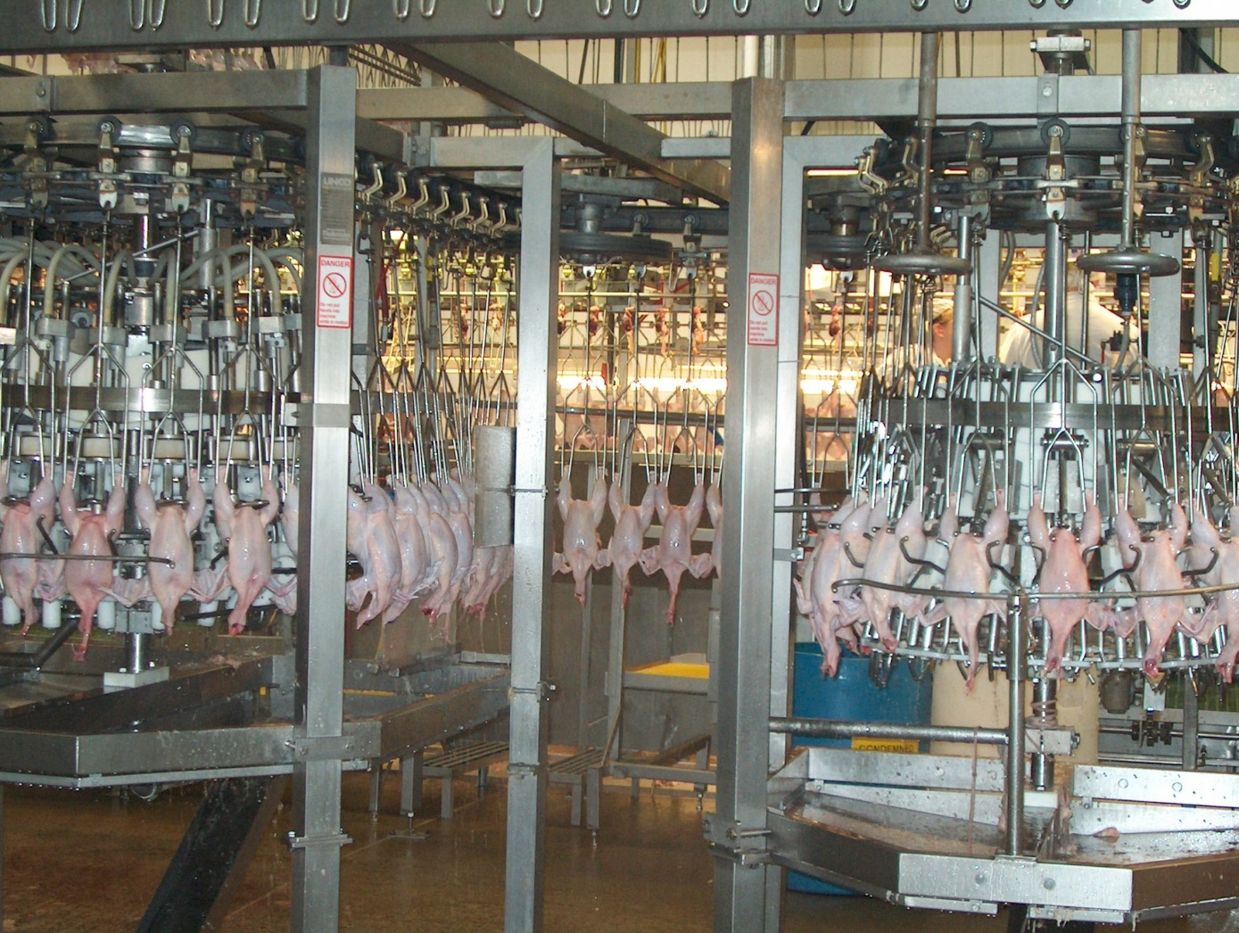
Poultry Processing

Slide 7
Processing Steps, continued
8. Washing the carcass
  The carcasses are cleaned for microbial and visible concerns.
  When processing chicken, microbial bacteria such as E. coli and salmonella are analyzed.
9. Chilling
  The carcass temperature must be reduced to prevent microbial growth.
  The USDA specifies the amount of chilling for specific bird sizes.
  4-pound broiler: 40°F within 4 hours
  4- to 8-pound broiler: 40°F within 6 hours
  Greater than 8-pound broiler: 40°F within 8 hours
  Submerging the carcass in an ice (chilled water) bath is the most common method of carcass chilling.
  Carcass can also be chilled by air chilling.
  Air chilling occurs by passing cold air over the carcass. This is a more expensive process but some consumers are willing to pay more for air chilling.

Slide 8
Processing Steps, continued
10. Cut-up and deboning
  On average, 75 to 80% of the live animal weight is retained in the carcass.
  This amount of live weight retained in the carcass is known as the dressing percentage or yield.
  The carcass can be sold whole or individual components of carcass can be cut-up for individual sale.
  Cut-up often includes removal of the breast, thigh, drumsticks and wings.
  Deboning refers to the removal of bone from the cut-up meat.
  Breasts and thighs are commonly deboned.

Slide 9
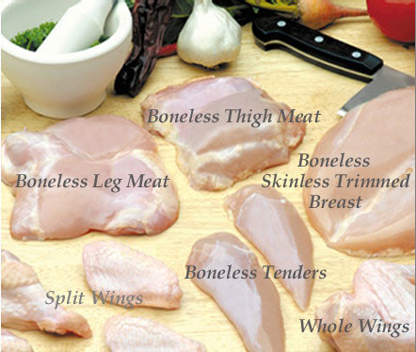
Processing Steps, continued

Slide 10
Processing Steps, continued
11. Further processing
  The whole carcass or cut-up and deboned pieces may be further processed for added value.
  Further processing may include forming, curing, smoking and cooking of products.
  Forming product requires a change in particle size and often includes the addition of nutrients to add flavor.
  Forming product also requires the use of a mold to obtain desired shape.
  Formed products include hot dogs, chicken nuggets, or sausage.
  Curing involves the addition of preservatives, often nitrates, to the meat to improve flavor and product shelf-life.
  Smoking also acts as a preservative while providing additional flavor to the product.
  Some product may be prepared in a form that is edible without additional preparation and is known as “ready-to-eat.”

Slide 11
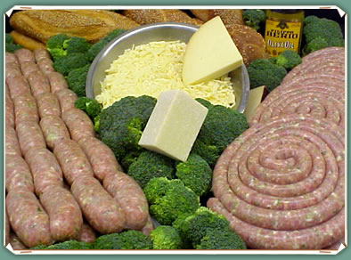
Processing Steps, continued

Slide 12

Processing Steps, continued
12. Storage
  Poultry meat should be refrigerated around 30°F. Keeping the poultry below 40°F reduces the risk of microbial growth.
  Refrigeration and freezing does not kill all microbes.

Slide 13
Processing Steps, continued

Slide 14
Equipment Used in Plant
Stunning cabinet
  Electrical circuit passes through the whole body. The amount of current required depends upon the type of bird, i.e., chickens, turkeys, ducks, etc.
Automated knife blade
  Cuts the neck and major blood vessels allowing the blood to flow out of the bird. All birds are stunned and insensible to pain prior to entering the automated knife machine.
Scalding tank
  The purpose is to loosen the feather follicles of the bird so that the picker can remove the feathers.
Picker
  Soft, rubber projections are installed throughout the inside and the purpose is to remove all of the feathers so the bird is ready for processing.
Pneumatic shears
  An air-powered device to remove the neck and head.

Slide 15
Layout of Processing Plant
Flow of operations
  Poultry processing plants are highly organized and mechanized facilities that contain state-of-the-art technology to ensure the safe preparation of poultry meat products.
  Processed product should travel from the area of highest potential contamination to the lowest potential contamination.
Personnel traffic flow
  Personnel traffic flow should be restricted to prevent potential contamination of product.
  Personnel should be restricted to their routine work area.
Separation of raw and ready-to-eat product
  Ready-to-eat products must be located in a separate facility from raw product in order to prevent potential contamination.
  Ventilation systems should direct airflow away from cooked products.

Slide 16
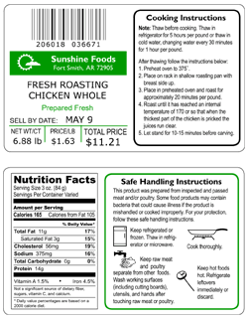
Requirements of a Packaging Label
1. Sell-by date
  Preferred by stores
  Date used for quality assurance
  Food can still be consumed if meat is frozen and the sell-by date is expired.

Slide 17
Requirements of a Packaging Label
2. Plant Code
  All product inspected at retail stores.
  Used for bacteria outbreak and recalls

Slide 18
Requirements of a Packaging Label
3. Grade of Chicken
  Grade A is the best quality.
  Includes plump, bruise free and no broken bones

Slide 19
Requirements of a Packaging Label
4. Keep refrigerated.
5. Follow label instructions.
6. Nutrition Facts
  Serving sizes
  Fat, sugar, sodium, and carbohydrate quantities

