Slide 1
Niche Poultry Markets

Slide 2
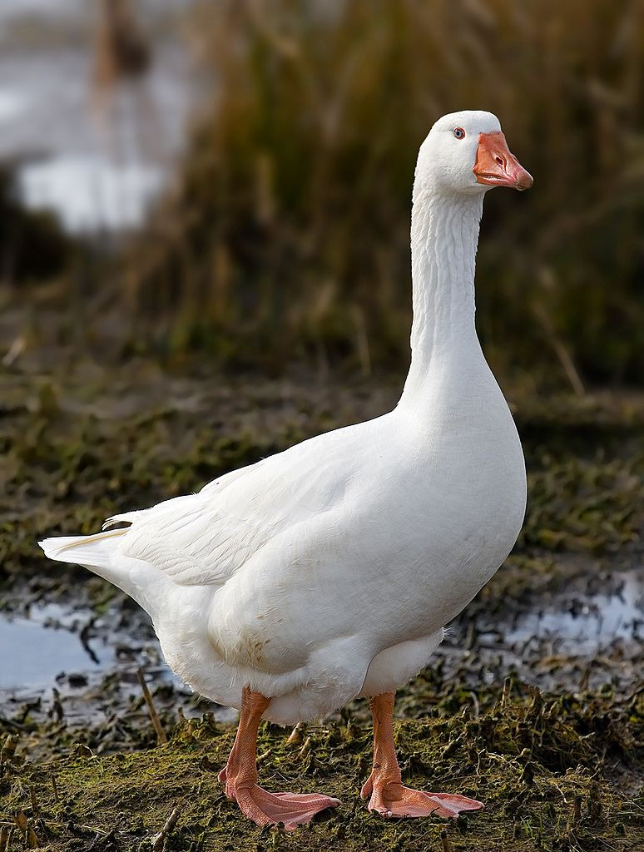
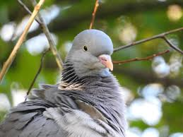
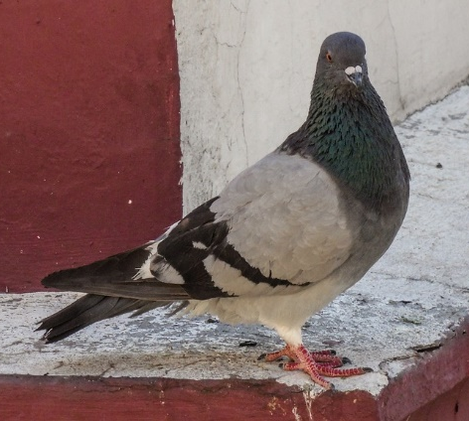
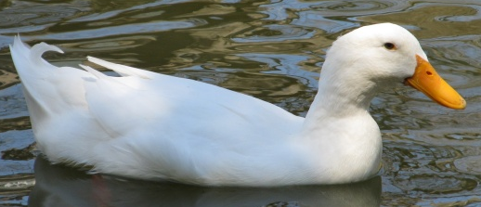
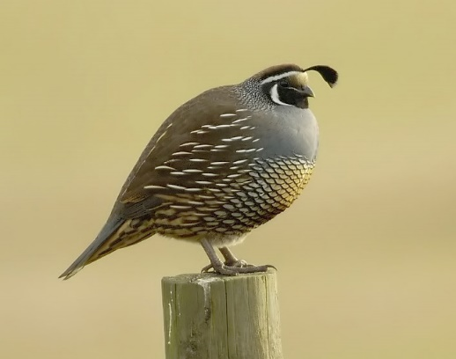

Slide 3
Niche Poultry Markets
Live Bird Markets
Squab Production
Duck Production
Upland Game Birds

Slide 4
Live Bird Markets
Chickens, ducks, geese and other fowl are often sold at live bird markets.
  Some suppliers are partially integrated.
    It is normal for a supplier to own breeder farms, grow-out facilities, trucking and transportation. However, most of the suppliers will not own their own feed mill or hatchery. This is mainly because of the smaller size of the company.
    Relatively few suppliers and many markets.

Slide 5
Live Bird Market Consumers
Many consumers at live bird markets are from various Asian ethnicities.
  Consumers may choose to inspect the bird live to make sure that it does not have any noticeable illnesses or defects.
  The traditional Asian consumers prefer to process their own birds at home for cultural reasons and to guarantee freshness.
  Younger generations may prefer their bird processed professionally.

Slide 6
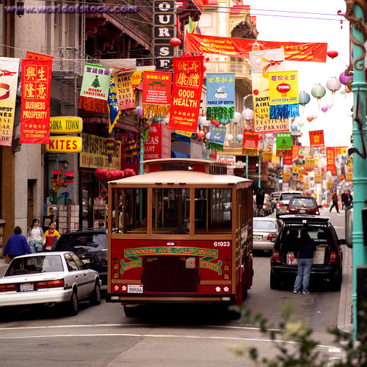
Live Bird Markets in Chinatown

Slide 7
Live Bird Market Suppliers (Chickens)
Breed Differences from Commercial Broilers
  Brown Leghorn Pullet
    The first brown chickens raised for meat in the U.S. in the early 1980s.
    Used for egg production prior to 1980
  Companies make regular deliveries but some also offer on-farm pick up for birds to be brought to the market.
  Due to the manner in which the bird is raised, the meat may be tougher than traditional broiler birds.
    Most birds are either boiled or barbequed.

Slide 8
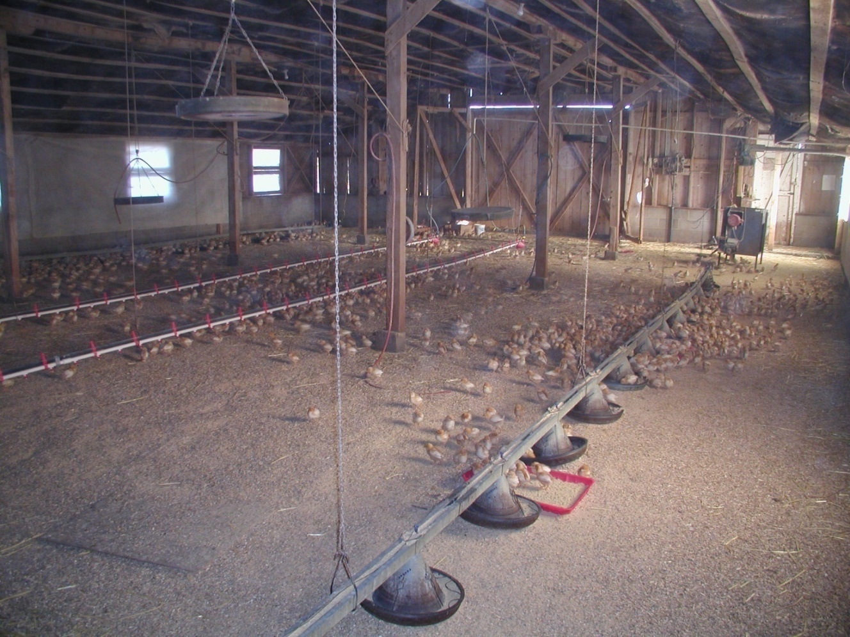
Brown Leghorn Chicks

Slide 9
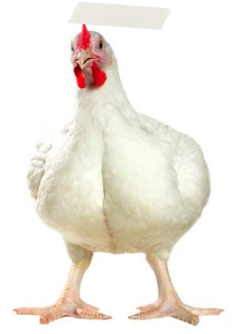
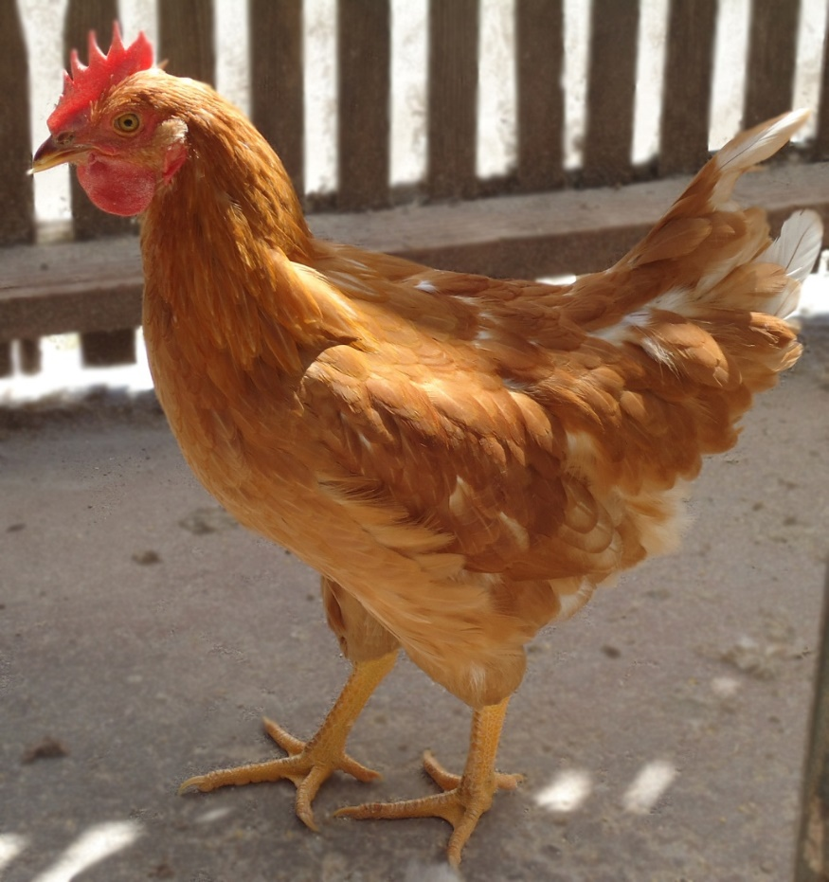
Brown Leghorn vs. Broiler Chicken

Slide 10
Live Bird Market Chicken Flock Lifespan
Age of bird varies with time of year and breed.
  Most common age a bird is sold is 16 to 20 weeks old.
  The bird maturity plays a part in the time of the sale.

Slide 11
Diet Differences
Because birds are raised longer than broilers, they are fed a different diet.
  Feed formulas vary by the individual supplier but usually include a chick starter, grower and a developer.

Slide 12
Processing
Processing can be done by the consumer at home.
Processing is also done at commercial processing plants that offer custom processing.
  Birds that are processed must be sold and consumed within seven days in order to maintain freshness.
  Birds are never frozen and then sold in the markets as fresh.
Whether the birds are professionally or personally processed, the bird is left whole with the head and feet attached.
  This is called a Buddhist-style process.
  The consumer can also tell the age of the bird by the size of the comb.
A “Hot Plant” is offered for consumers to pick out the live bird they want and have it processed in a state-inspected processing facility.
  All other processing is done at USDA-inspected facilities.
  The birds are packaged with custom labels or packed directly on ice for transport.

Slide 13
Marketing
Birds are sold in grocery stores, restaurants and live bird markets.
  Most live markets offer both live and processed product.
  The store is divided in two by a panel to separate the live from the processed cold storage.

Slide 14
Duck Producers
Market Structure: Similar to the commercial poultry industry but a much smaller market.
Some duck companies are fully integrated — owning all major aspects of production.
Processors typically own their own farms or contract with duck growers and market under their own brand.

Slide 15

Market Outlets for Duck
Marketed to high-end restaurants and grocery stores

Slide 16

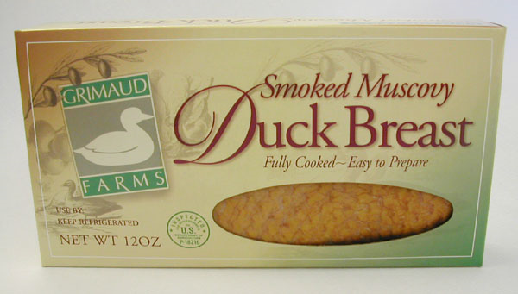
Duck Processing
Whole birds
Some duck processors offer further processed products.
  Cut-up products
  Cooked products

Slide 17
Duck Producers
Terms
  Drake – male duck
  Hen – female duck
  Ducklings – adolescent ducks

Slide 18
Major Meat Breeds of Duck
Aylesbury
Muscovy
White Pekin

Slide 19
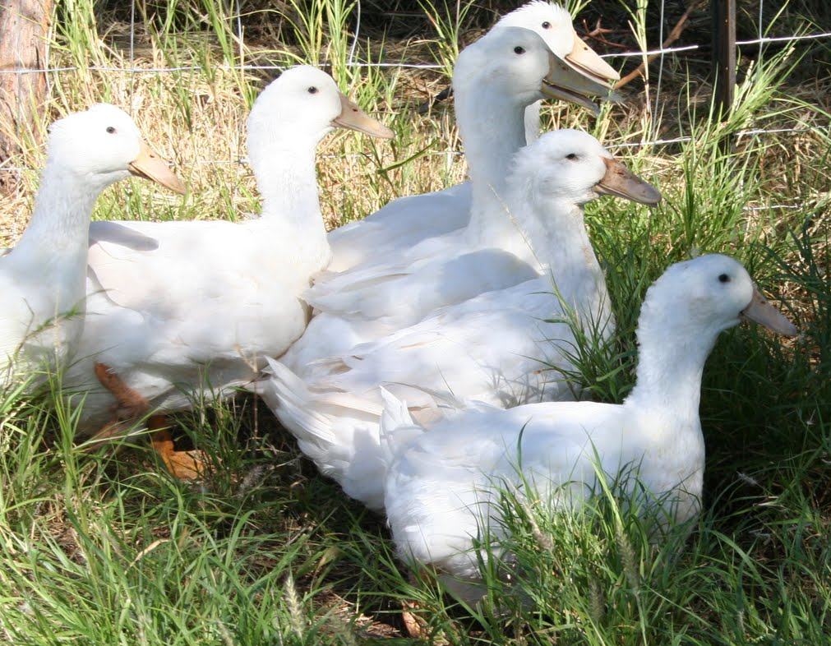
Aylesbury
Popular in England where the breed originated
Appearance: white feathered, white skin, flesh-colored bills, light orange legs and feet.
Adult drakes: up to 9 pounds
adult hens: up to 8 pounds

Slide 20
Muscovy
Unrelated to other meat breeds
Wild Muscovy originated in South America; however, the French domesticated the Muscovy duck for commercial production and brought it to the United States. This is a major commercial breed in California.
Appearance: many varieties; white is most desirable for markets
Drakes weigh up to 11 pounds and hens weigh up to 6 pounds.
Non-migratory bird
Still considered a waterfowl; however, it is more comfortable on the ground than water. Enjoys scavenging in the mud and dirt.
Muscovy ducks are indigenous of South America. Wild populations are found in Florida and Texas today because they were relocated by people to those areas.

Slide 21
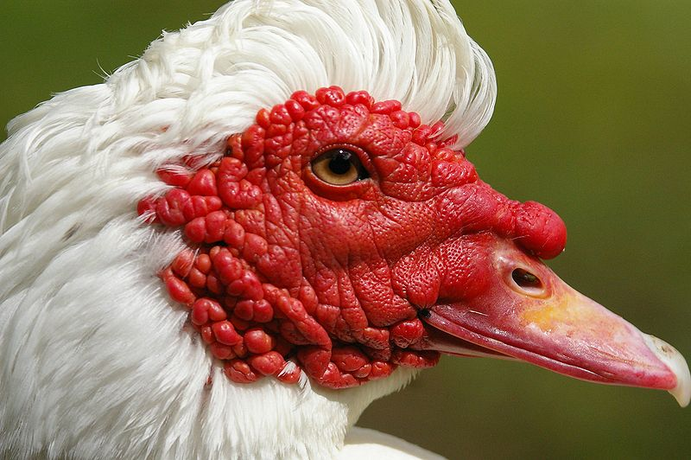
Muscovy

Slide 22
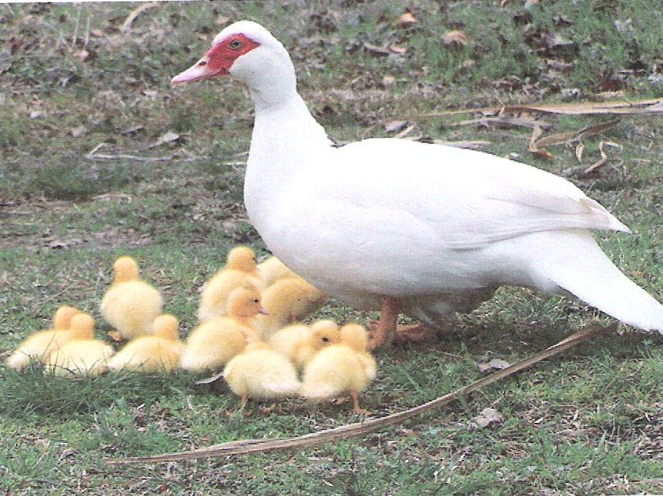
Muscovy Hen with Ducklings

Slide 23
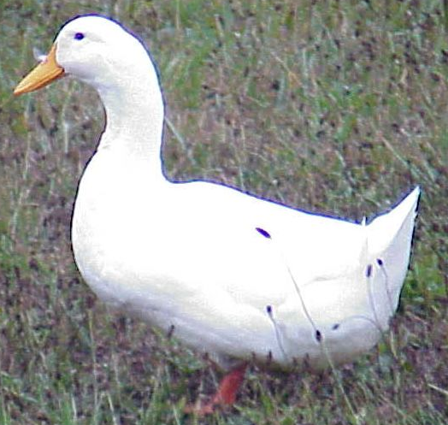
White Pekin
Major commercial breed in the United States
Originated in China and introduced in the U.S. in 1870s
Appearance: white feathered, orange-yellow bills, reddish orange legs and feet.
Can reach market weight of approximately 6.25 pounds in 8 weeks.
Migratory bird
Indiana is where the majority of Pekin duck producers are located.
Pekin Duck in the Wild

Slide 24
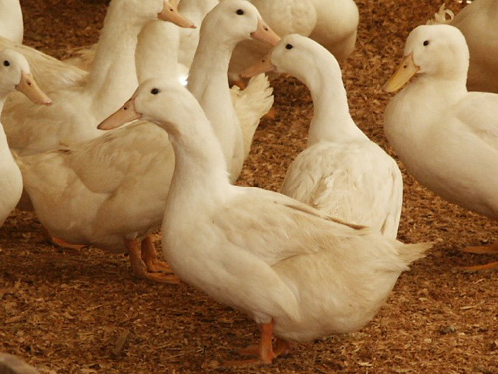
Pekin Ducks in Production

Slide 25
Duck Flock Lifespan
Muscovy vs. Pekin
  Muscovy ducks take 10 (hens) to 12 (drakes) weeks to reach market weight.
Pekin ducks can reach market weight in 5.5 to 6 weeks.

Slide 26
Breeding and Reproduction
Male and Female “Lines”
  Male lines are bred for structural correctness, breeding productivity, efficient feed conversion ratios and desirable carcass characteristics.
  Female lines are bred to lay an optimal amount of eggs.
  Crossing these two lines produces a superior terminal product (hybrid vigor).
Incubation period
  Muscovy – 35 days
  All other breeds – 28 days

Slide 27
Grow-out
Brood/Grow-out (very similar to chicken/turkey production).
  Heat source
    For the first week, ducklings need an extra heat source. The first week the temperature should be about 90 degrees Fahrenheit. Duck growers use brood stoves similar to the commercial poultry industry.
  Litter
    Mold resistant materials must be used for the floor cover. i.e., rice hulls, peat moss, straw or shavings.
  Feeding
    All feed mixes are designed by an animal nutritionist with the health and welfare of the birds in mind.
        Starter – high percentage of protein (about 22%)
        Grower – about 18% protein
        Finisher – about 16% protein

Slide 28
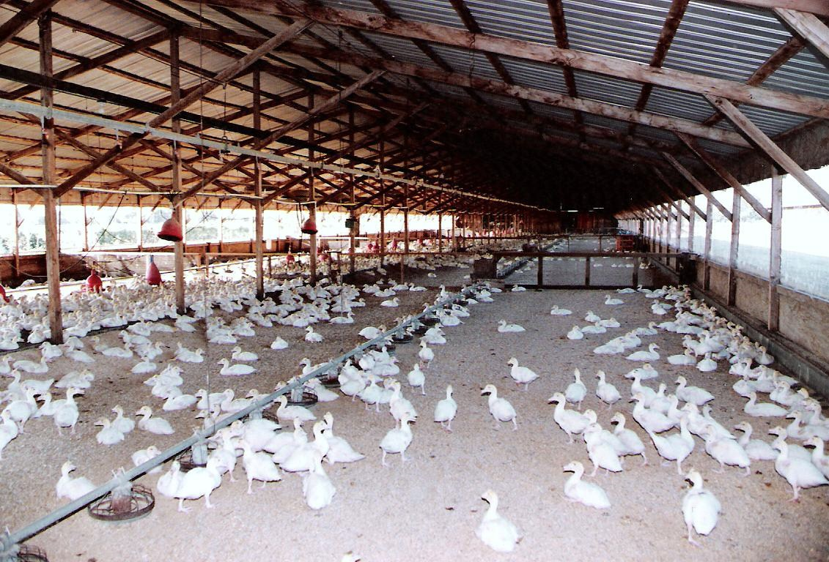
Muscovy Ducks in Production

Slide 29
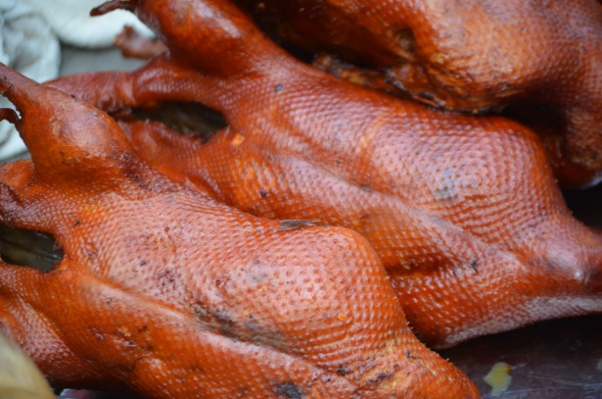
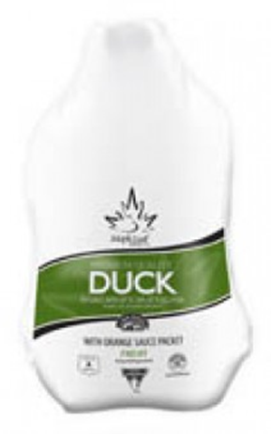

Slide 30
Squab Producers
A squab is a young pigeon.
There is a high demand in the Asian (principally Chinese) community for squab, and it is also marketed to high-end restaurants and retail markets.

Slide 31
Squab Growers
Uniqueness of Squab
  Pigeon breeders are monogamous and mate for life.
  Squab are processed at about one month of age, before the bird can fly.
  Squab meat is dark, moist and flavorful.

Slide 32
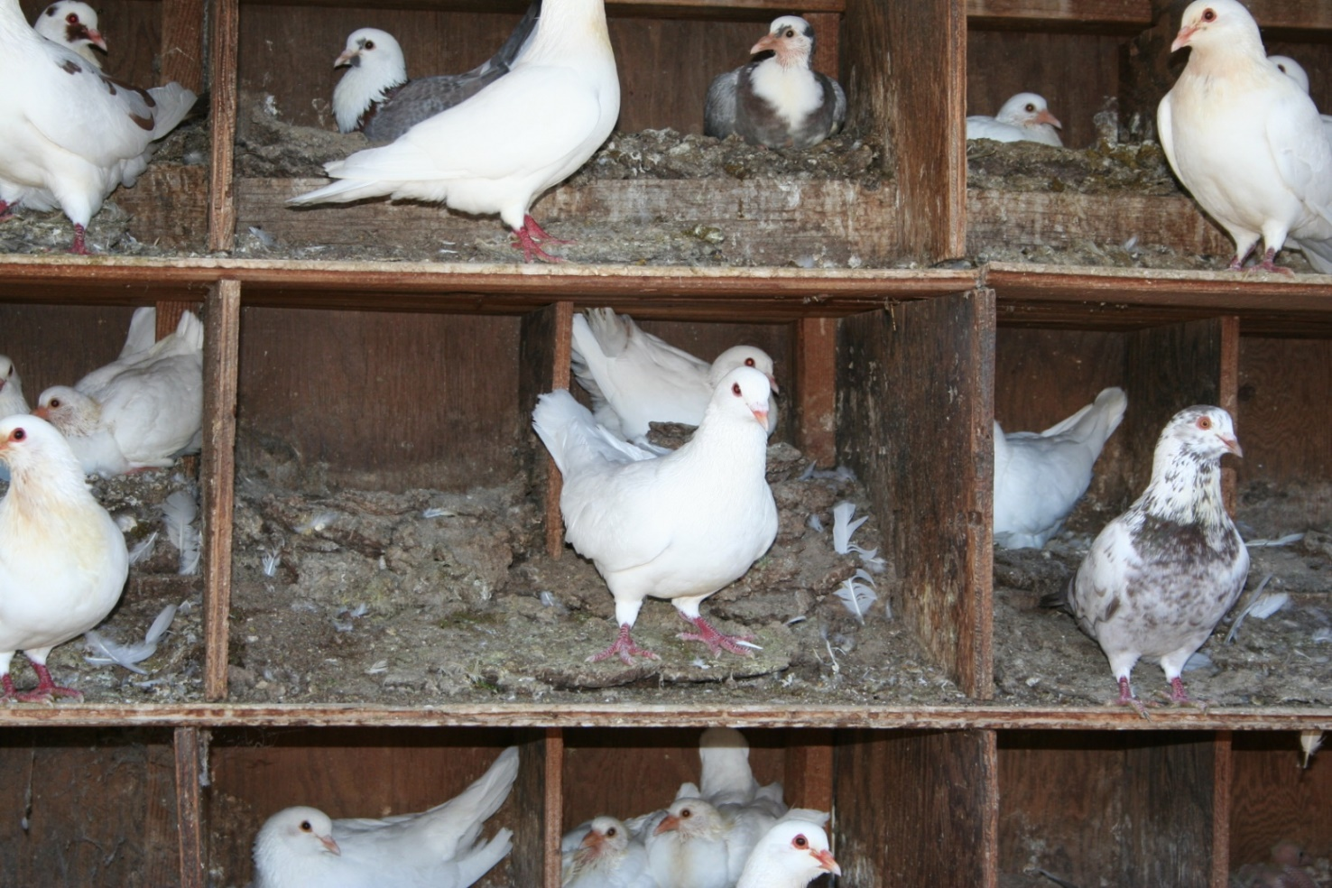
Pigeon Nests

Slide 33
Reproduction and Production
Pigeon Pair: mated male and a female pigeon. Since pigeons mate for life they are referred to as a pair.
Nest: each pair has their own nest. This is where the eggs are laid and the squab are raised.
Controlled mating: a pair of birds are manually placed in a nest together. Common practice for widowed pigeons.
Natural mating is when the grower places the young birds in a pen and lets the pigeons choose their own mate. This is the most common industry practice.
Clutch: a set of eggs (usually two for pigeons) laid during the mating period.

Slide 34
Reproduction and Production
Pigeon breeders are often given an identification band on their leg to help the producer keep production records.
Once the squab reach about three weeks of age, the hen will lay another clutch of eggs. The female will be responsible for incubating the new eggs and the male will take charge of feeding the squab.
Pigeon’s egg production peaks at about 3 years of age.
A pair can produce about 22 squab per year at their production peak. However, they average about 14 squab per year over their average 5 year economically viable breeding lifespan.
The grower collects the squab for processing at about 26 to 28 days of age.

Slide 35
Squab Marketing
Most squab are sold in metropolitan areas such as San Francisco, Los Angeles and New York city.
They are marketed to high-end restaurants, grocery stores and other Asian (principally Chinese) markets.

Slide 36
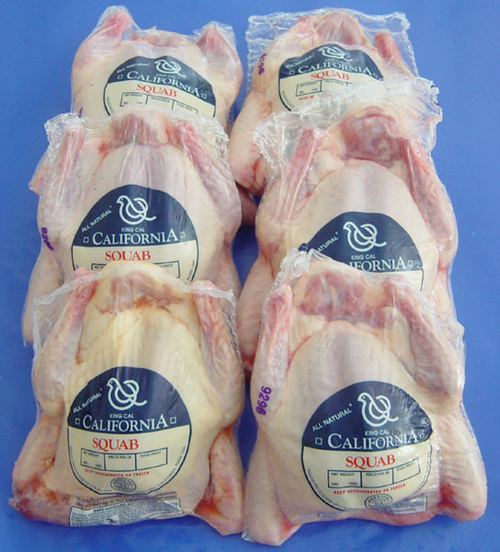
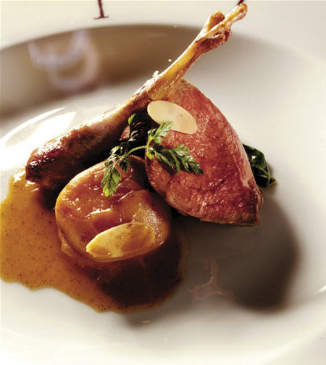

Slide 37
Squab Producers of California
SPOC is an agricultural cooperative.
  Members pool their resources and work together to process and market their squab.
  Squab Producers of California operates the largest squab processing plant outside of Asia.
  Growers own their farms and their birds. Collectively, the members own and control the cooperative.
  By joining together, the squab growers can have more control over the supply, demand and, consequently, the price of squab.
    Members also benefit from a more efficient processing plant. Instead of having many small processors, a single state-of-the-art processing plant is utilized by all members.

Slide 38
Upland Game Bird Growers
Upland game birds include pheasants, chukars and quail.
These birds are raised for the specific purpose of hunting at hunt clubs.
Some growers breed, hatch and grow-out their birds.
Some larger growers might even have their own hunt clubs.

Slide 39
Importance of Niche Markets
Although the niche poultry markets are much smaller than the commercial poultry industry, they still are very valuable to the economy.
Because of niche markets, consumers have a choice between different products.
Many Asian American and Asian immigrants in the United States take advantage of the niche markets for traditional cultural reasons.

