Slide 1
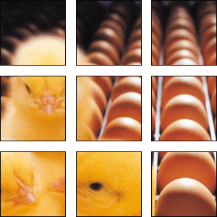
Poultry Health and Welfare

Slide 2
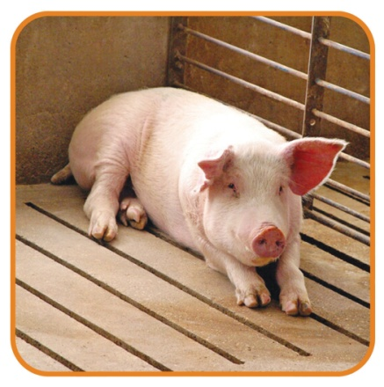
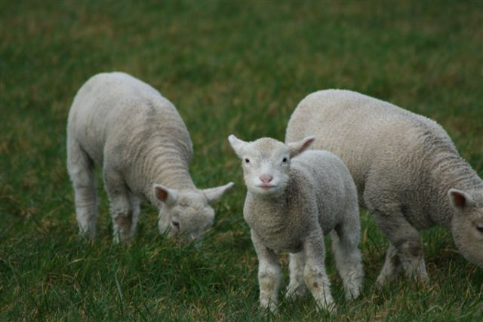
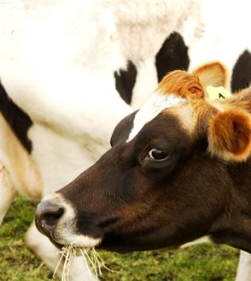
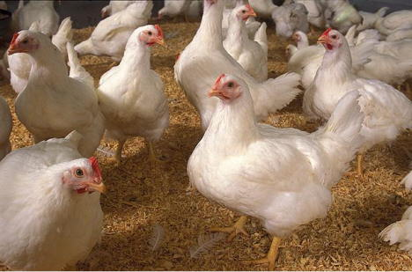
What is animal welfare?
Defined as providing animals with environments and management to meet their intrinsic physiological and behavioral needs.
The avoidance of abuse and exploitation of animals by humans by maintaining appropriate standards of accommodation, feeding and general care, the prevention and treatment of disease, and the assurance of freedom from harassment and unnecessary discomfort and pain. (Saunders Comprehensive Veterinary Dictionary, 2007)

Slide 3

What is animal welfare?
Decisions regarding animal care, use and welfare shall be made by balancing scientific knowledge and professional judgment with consideration of ethical and societal values.
Animals must be provided water, food, proper handling, health care and an environment appropriate to their care and use, with thoughtful consideration for their species-typical biology and behavior.
Animals should be cared for in ways that minimize fear, pain, stress and suffering.
Procedures related to animal housing, management, care and use should be continuously evaluated, and when indicated, refined or replaced.

Slide 4
Animal Welfare
Conservation and management of animal populations should be humane, socially responsible and scientifically prudent.
Animals shall be treated with respect and dignity throughout their lives and, when necessary, provided a humane death.
American Veterinary Medical Association (AVMA) Animal Welfare Principles (Approved by AVMA Executive Board November 2006)

Slide 5
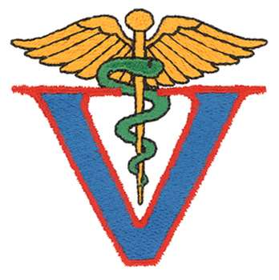

Who is responsible for health and welfare?
3 main parties involved:
  Owner (individual or multiple parties)
    Includes manager/operator of facility
Veterinarian
  Additional health care and disease prevention
Government/Professional Association or Organization
  State/National
    State poultry associations, Farm Bureau Federation, National Poultry Improvement Plan, U.S. Poultry & Egg Association, National Chicken Council, National Turkey Federation, United Egg Producers
  Federal
    U. S. Department of Agriculture

Slide 6
Who is responsible for health and welfare?
Qualified animal agriculture professionals are those educated and trained to be the best caretakers of the animals.
  Veterinarians
  Farmers and ranchers
  Animal scientists
  United States Department of Agriculture
    All work together to provide for the well-being of the animals.

Slide 7
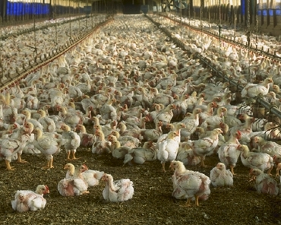
Current Issues in the Poultry Industry
Trends and technique issues
  Induced molting
    Physically causing birds to start molting
  Bird density and spacing
  Availability of food and water
  Ventilation of housing
  Types of housing
  Health care
    Antibiotics
    Vaccinations
    Biosecurity
  Beak and toe conditioning
  Handling and treatment during transportation and harvesting

Slide 8
National Regulations

Slide 9
National Poultry Improvement Plan
The objective of the NPIP is to provide a cooperative industry-state-federal program through which new diagnostic technology can be effectively applied to the improvement of poultry and poultry products throughout the country.
The NPIP examines the health status of all commercial flocks through monitoring of primary breeding and multiplier flocks and establishes the regulatory standard in sample collection, diagnostic tests performed and laboratory protocols for conducting tests.

Slide 10
On July 1, 1935 the National Poultry Improvement Plan became operational and was subsequently adopted by all 50 states and one U.S. territory.
The 51 member states and territories are responsible for various disease control programs of over 3 billion breeding chickens and 250 million breeding turkeys during the 83 years since the founding of the NPIP.

Slide 11
The NPIP surveillance and control program certifies that poultry companies and producers are clean or monitored for Plan diseases (Salmonella, Avian Mycoplasmas and Avian Influenza) by utilizing the following disease certifications:
  U.S. Pullorum Typhoid Clean
  U.S. Mycoplasma Gallisepticum Clean
  U.S. Mycoplasma Synoviea Clean
  U.S. Mycoplasma Meleagridis Clean
  U.S. Salmonella Enteritidis Clean
  U.S. Salmonella Enteritidis Monitored
  U.S. Salmonella Monitored
  U.S. Avian Influenza Clean
  U.S. Avian Influenza Clean Compartment
  U.S. H5/H7 Avian Influenza Clean
  U.S. H5/H7 Avian Influenza Clean Compartment
  U.S. Sanitation Monitored
  U.S. Mycoplasma Gallisepticum Monitored
  U.S. Mycoplasma Synoviae Monitored
  U.S. H5/H7 Avian Influenza Monitored

Slide 12
The NPIP oversees and authorizes 100 laboratories located across 39 U.S. states, consisting of state, private, industry, university and biologic laboratories to perform the poultry testing for NPIP participants.
The NPIP established the first federal biosecurity principles program for all commercial poultry operations in the U.S. in 2017.

Slide 13

National Regulations
United States Department of Agriculture (USDA)
  No federal laws or acts establish guidelines for animal welfare in the poultry industry.
  USDA recommends Critical Control Points for Animal Welfare.
    Hatcheries - mechanical chick handling devices
    Poultry Grower Farms
      Ammonia level not over 25ppm
      Backup available for mechanical ventilation systems
      Birds should be able to move at least 1 meter away as a person walks through them.
      Birds must be able to lie down in cages without having to be below or on top of another bird.
    General Care
      No throwing or stepping on birds
      No disposal of live birds in the trash

Slide 14
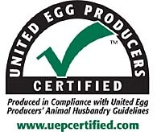
National Plans/Guidelines
Egg Laying Hens
  In 2006, the first UEP Certified cage-free guidelines were established, following the conventional housing guidelines initiated in 2002.
    Developed by an independent third party scientific advisory committee
    Animal Husbandry Guidelines for Egg Laying Flocks provides science-based guidelines for all aspects of egg production, including the following:
      Cage configuration
      Handling
      Beak trimming
      Transportation and slaughter
      Cage space per bird
      Molting
      Cage-free guidelines

Slide 15
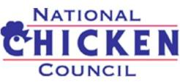
National Plans/Guidelines
Broiler Chickens
  The National Chicken Council (NCC) developed the
  NCC Animal Welfare Guidelines and Audit Checklist.
    Assists companies in ensuring and verifying a high level of welfare exists
      Has been widely adopted within the industry
    The physical well-being of animals is very important to the broiler chicken industry.
      Only healthy animals can be utilized for human food.
    Science-based guidelines cover every phase of the chicken's life and offers recommendations for proper treatment. Among other things, it includes chapters on:
      Education, training and planning
      Best practices on the farm
      Appropriate comfort and shelter
      Proper nutrition and feeding
      Catching and transportation
      Health care
      Processing

Slide 16
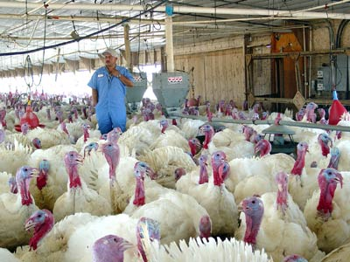
National Plans/Guidelines
Turkeys
  The National Turkey Federation (NTF) developed Humane Production Guidelines, which have been used by the industry since the late 1980s.
    The most recent guidelines identify control points in turkey production and processing and provide recommendations to ensure animal welfare standards in the following areas:
    - Farm safety and security
    - Hatching
    - Facilities and equipment
    - Feed and water supply
    - Maintenance
    - Bird comfort
    - Training

Slide 17
U.S. Poultry & Egg Association
The world's largest and most active poultry organization.
  Formed in 1947, the association has affiliations in 27 states and member companies worldwide.
  Represent the entire industry as an “All Feather” association
    Membership includes producers and processors of broilers, turkeys, ducks, eggs and breeding stock, as well as allied companies.
    Provide assistance and guidance with all aspects of raising and processing poultry and eggs
    Industry resource for research related to all segments of broiler, turkey and commercial egg operation

