Slide 1
Poultry Biosecurity

Slide 2
What Is Biosecurity?
Biosecurity:
  Addresses measures that should be taken to keep any diseases from a farm.
  Reduces the transmission of diseases to neighboring farms.
  Biosecurity reduces the risk of pathogens from forming, which prevents the spread of diseases from one flock to another.

Slide 3
What are Pathogens?
Pathogens may be characterized as:
  Bacteria: single-celled organisms that are known to cause infections
  Viruses: tiny microscopic infectious agents that replicate within the cells of a living host
  Fungi: organisms that live by breaking down and absorbing the organic material in which they grow
  Parasites: organisms that live on or within a host from which it obtains the nutrients it needs to survive

Slide 4
What are Diseases?
A disease is
  any abnormal condition that impairs bodily functions in an organism.
    Diseases can be characterized by specific symptoms and signs.
    A disease may be caused by
      external factors (infectious disease).
      internal dysfunctions (autoimmune disease).

Slide 5
Why Does the Industry Use Biosecurity?
Biosecurity’s purpose in the industry is to:
  Reduce the exposure of diseases and pathogens to birds within a particular flock.
  Reduce transmission of diseases and pathogens to a neighboring farm.
  Reduce the transmission of zoonotic diseases:
    Infectious diseases that can be transmitted from animals to humans or humans to animals

Slide 6
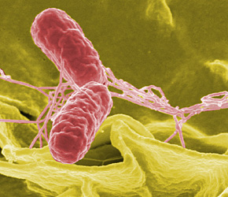
Zoonotic Diseases
Common Zoonotic Diseases:
  Salmonella
    A bacteria transmitted between birds primarily through the air.
      The bacteria is shed from the infected bird through feces, feather dust and secretions made from both the eyes and nose.
  E. coli
    A bacteria commonly found in the intestine of birds.
      The bacteria is harmless as long as it is kept in check by other bacteria in the intestine.

Slide 7

What Are the Economic Benefits of Biosecurity?
By reducing diseases and pathogens:
  The producer saves money by not having to euthanize (kill painlessly) all the birds in the infected flock.
    Depending on the size of the flock, the economic loss could be worth millions of dollars.

Slide 8
How Is Biosecurity Achieved?
Tire Baths
  Reduces opportunity for incoming traffic, such as feed and delivery trucks, to bring in pathogens from outside the perimeter of the farm.

Slide 9
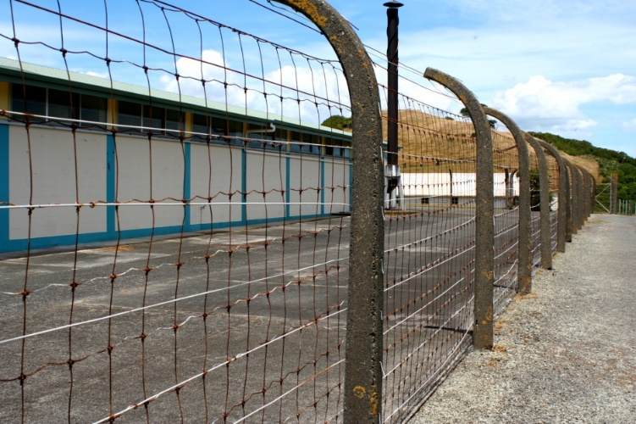
How Is Biosecurity Achieved?
Outside Perimeter
  High fences prevent intruders such as animals and people from entering the premises and possibly transmitting diseases to the flock.

Slide 10
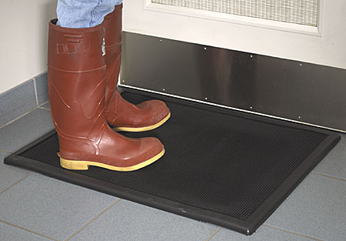
How Is Biosecurity Achieved?
Footbaths
  Footbaths are placed outside the door of all facilities and contain disinfectants, reducing the risk of bringing pathogens inside the buildings.

Slide 11

How Is Biosecurity Achieved?
Sanitation of Equipment and Supplies
  The purpose of sanitizing equipment, surfaces and supplies is to reduce pathogens.
    This is especially important in preventing the spread of diseases between neighboring flocks.

Slide 12
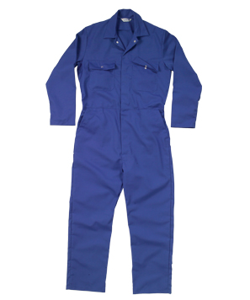
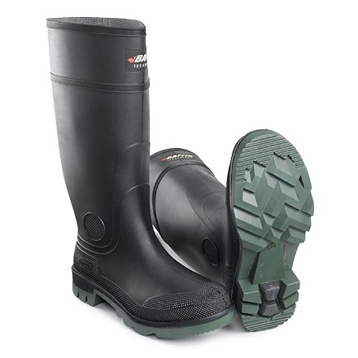
How Is Biosecurity Achieved?
Good Hygiene
  Prior to entering the facility, employees and visitors should demonstrate good hygiene by showering and wearing clean designated clothing such as boot covers, hairnets and coveralls.

Slide 13
How Is Biosecurity Achieved?
Entrance Order
  The order of entering facilities depends on the age of the birds.
    For example, you want to enter the hatchery first (where the youngest birds are), before entering the grower house (where the older birds live.)
      Older birds have stronger immune systems, making them more resilient to any pathogens that may be present.

Slide 14
How Is Biosecurity Achieved?
Hostile Environment
  Creating an environment that is non-desirable will reduce the risk of transferring pathogens from infected wild life.
    Eliminating any trees, grass and ponds from the property will deter wildlife from trying to enter.

Slide 15
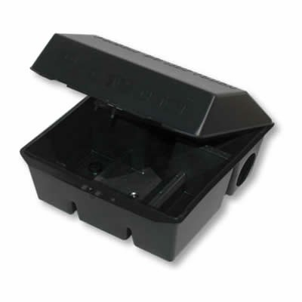
How Is Biosecurity Achieved?
Bait Stations
  Reduces the risk of rodents, which are small enough to easily get into facilities and carry many pathogens, from infecting the flock.

Slide 16
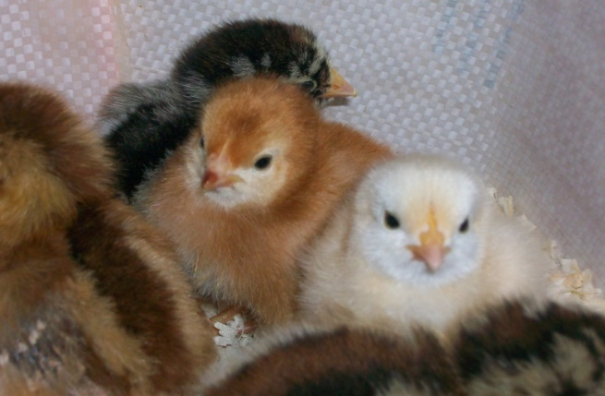
How Is Biosecurity Achieved?
No contact with outside birds
  Since most avian diseases are transmitted through the air, it is highly important to have no contact with outside birds within 72 hours of entering a facility.
    This includes pets as well as birds from other flocks.

