Slide 1
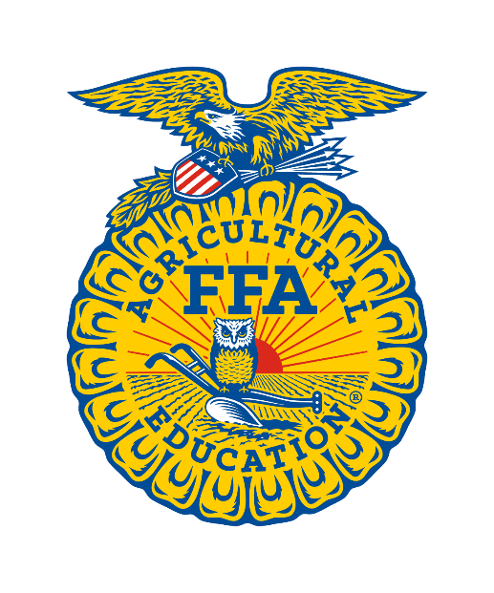
Careers with Animals
Production

Slide 2
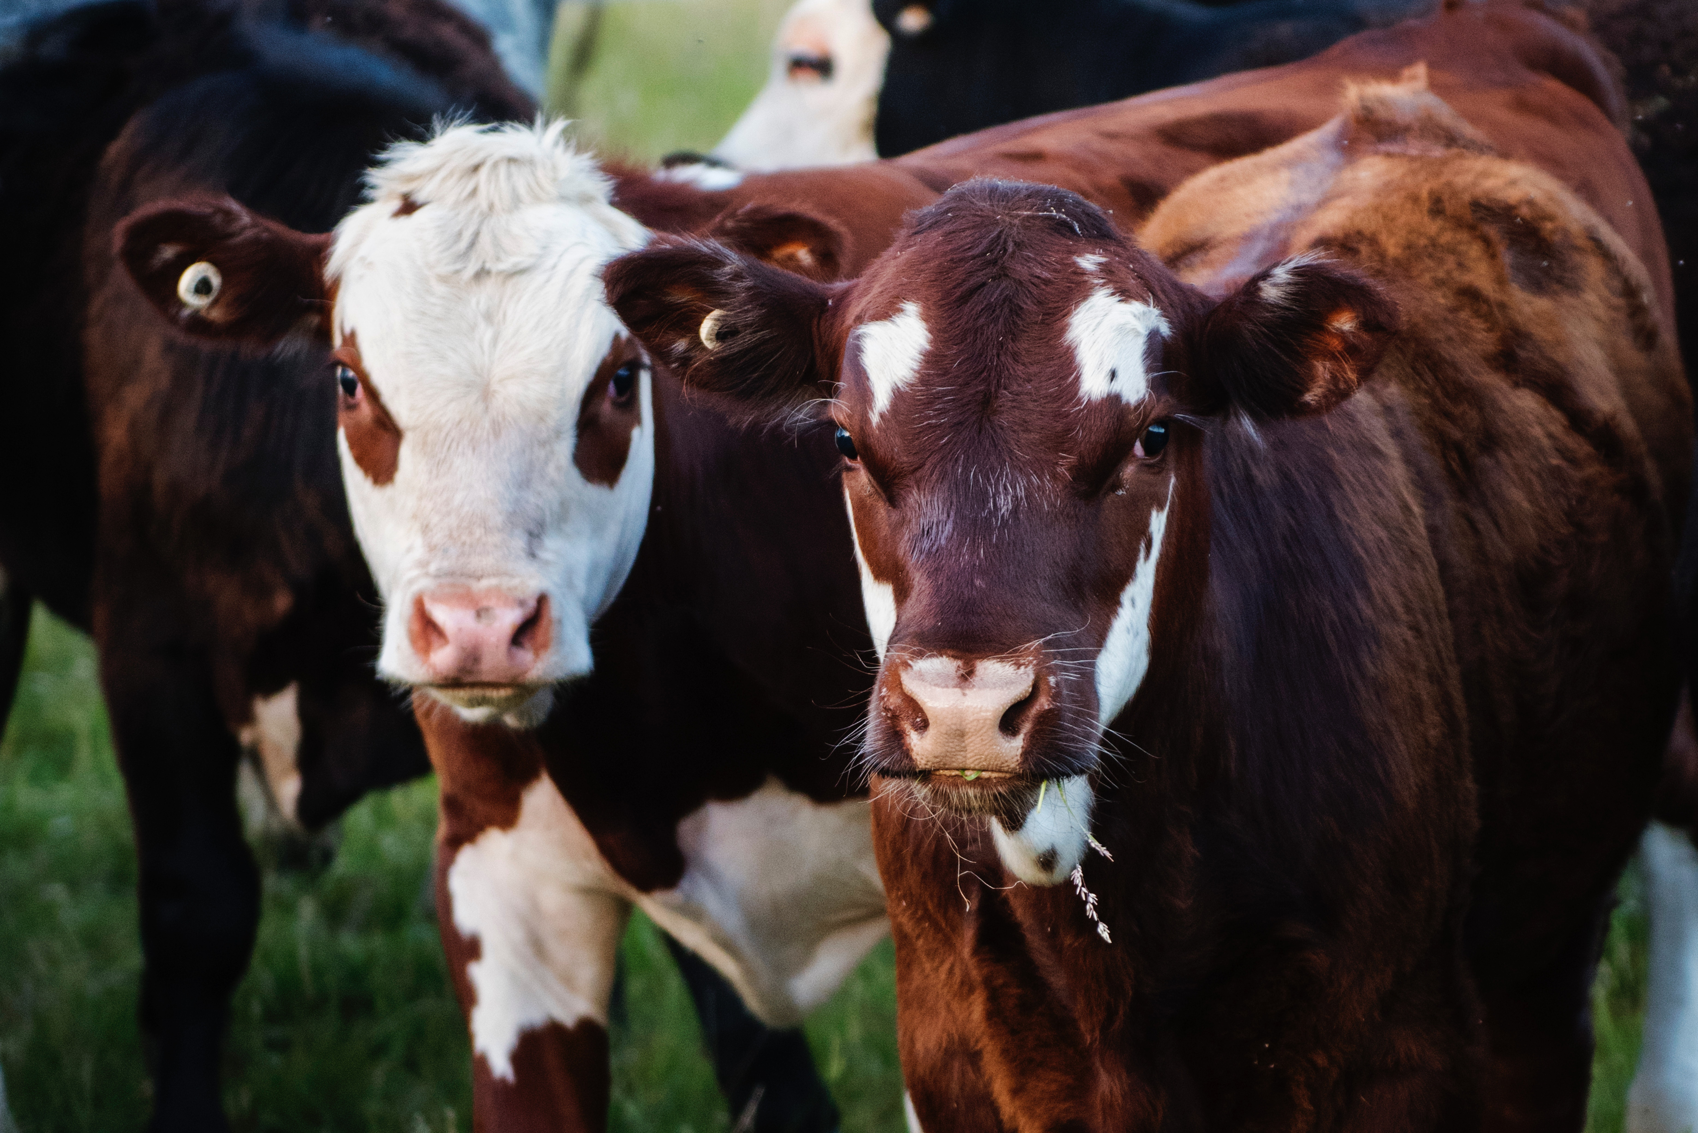
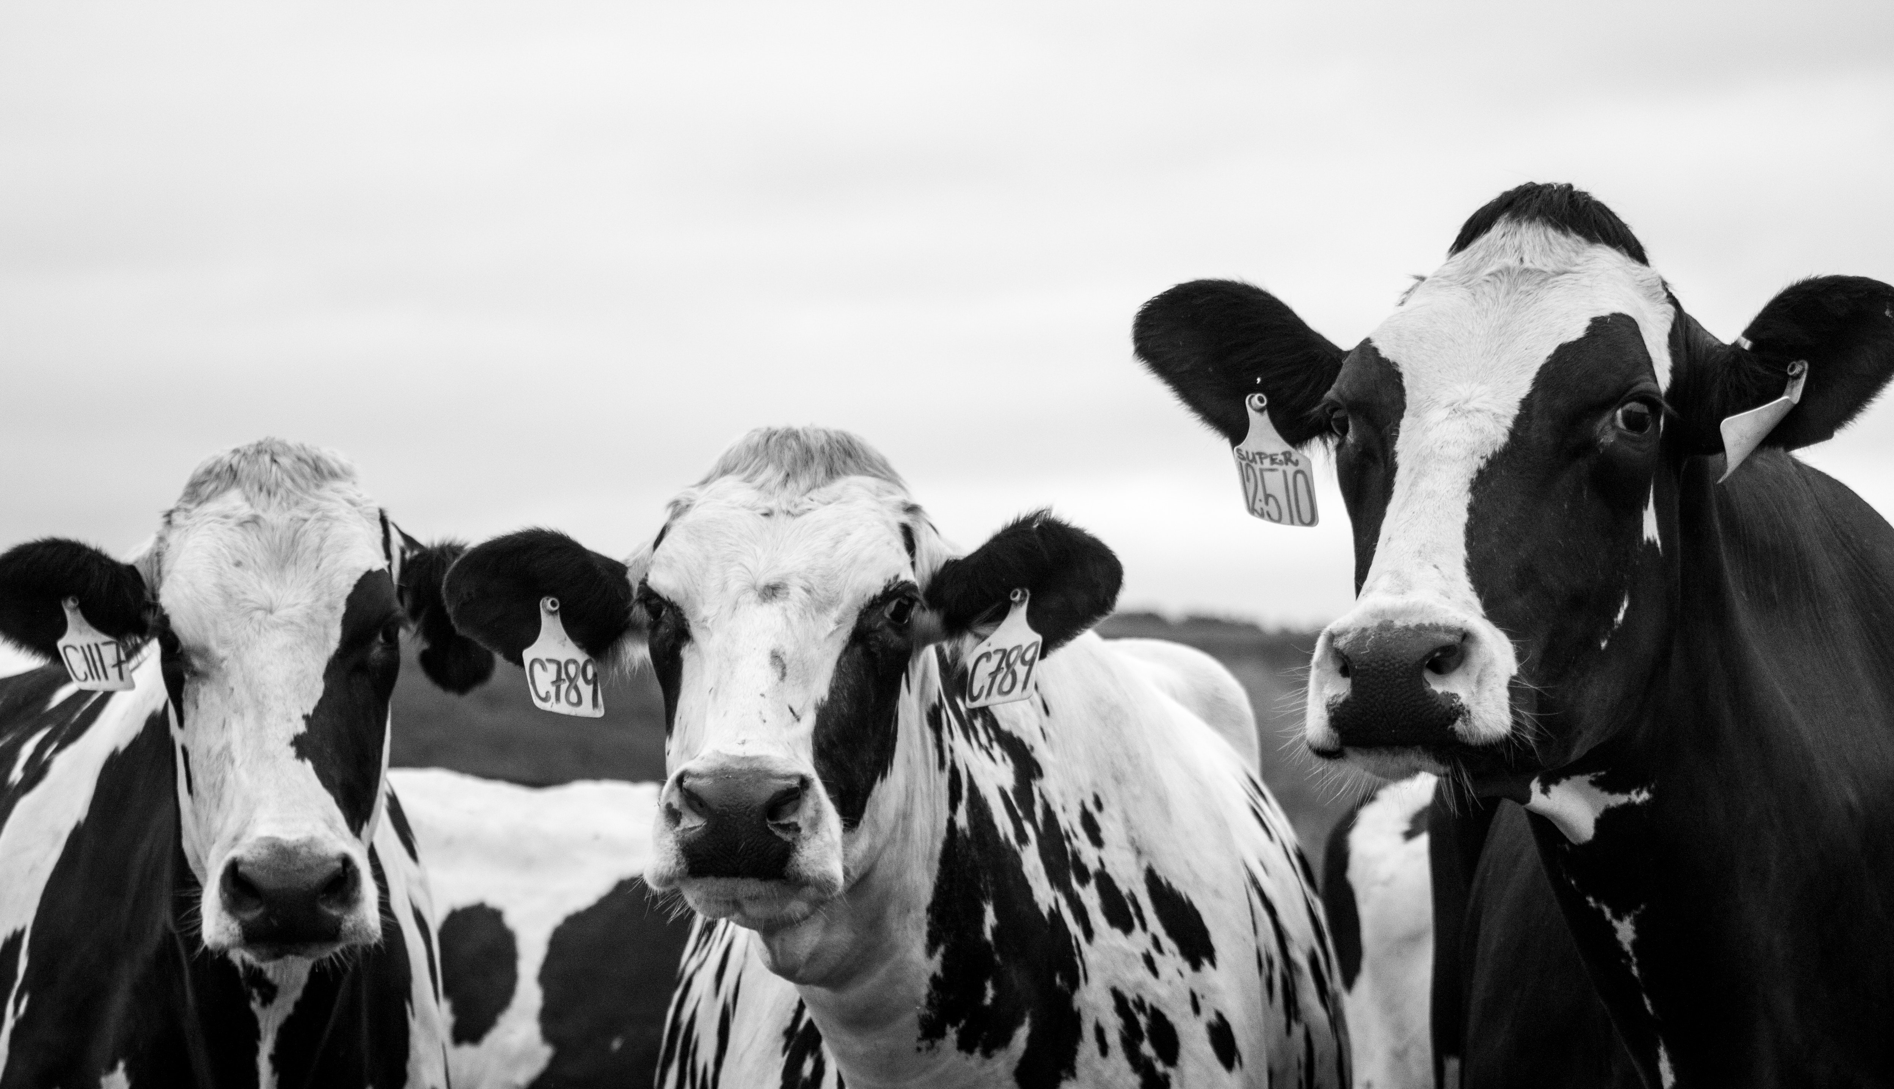
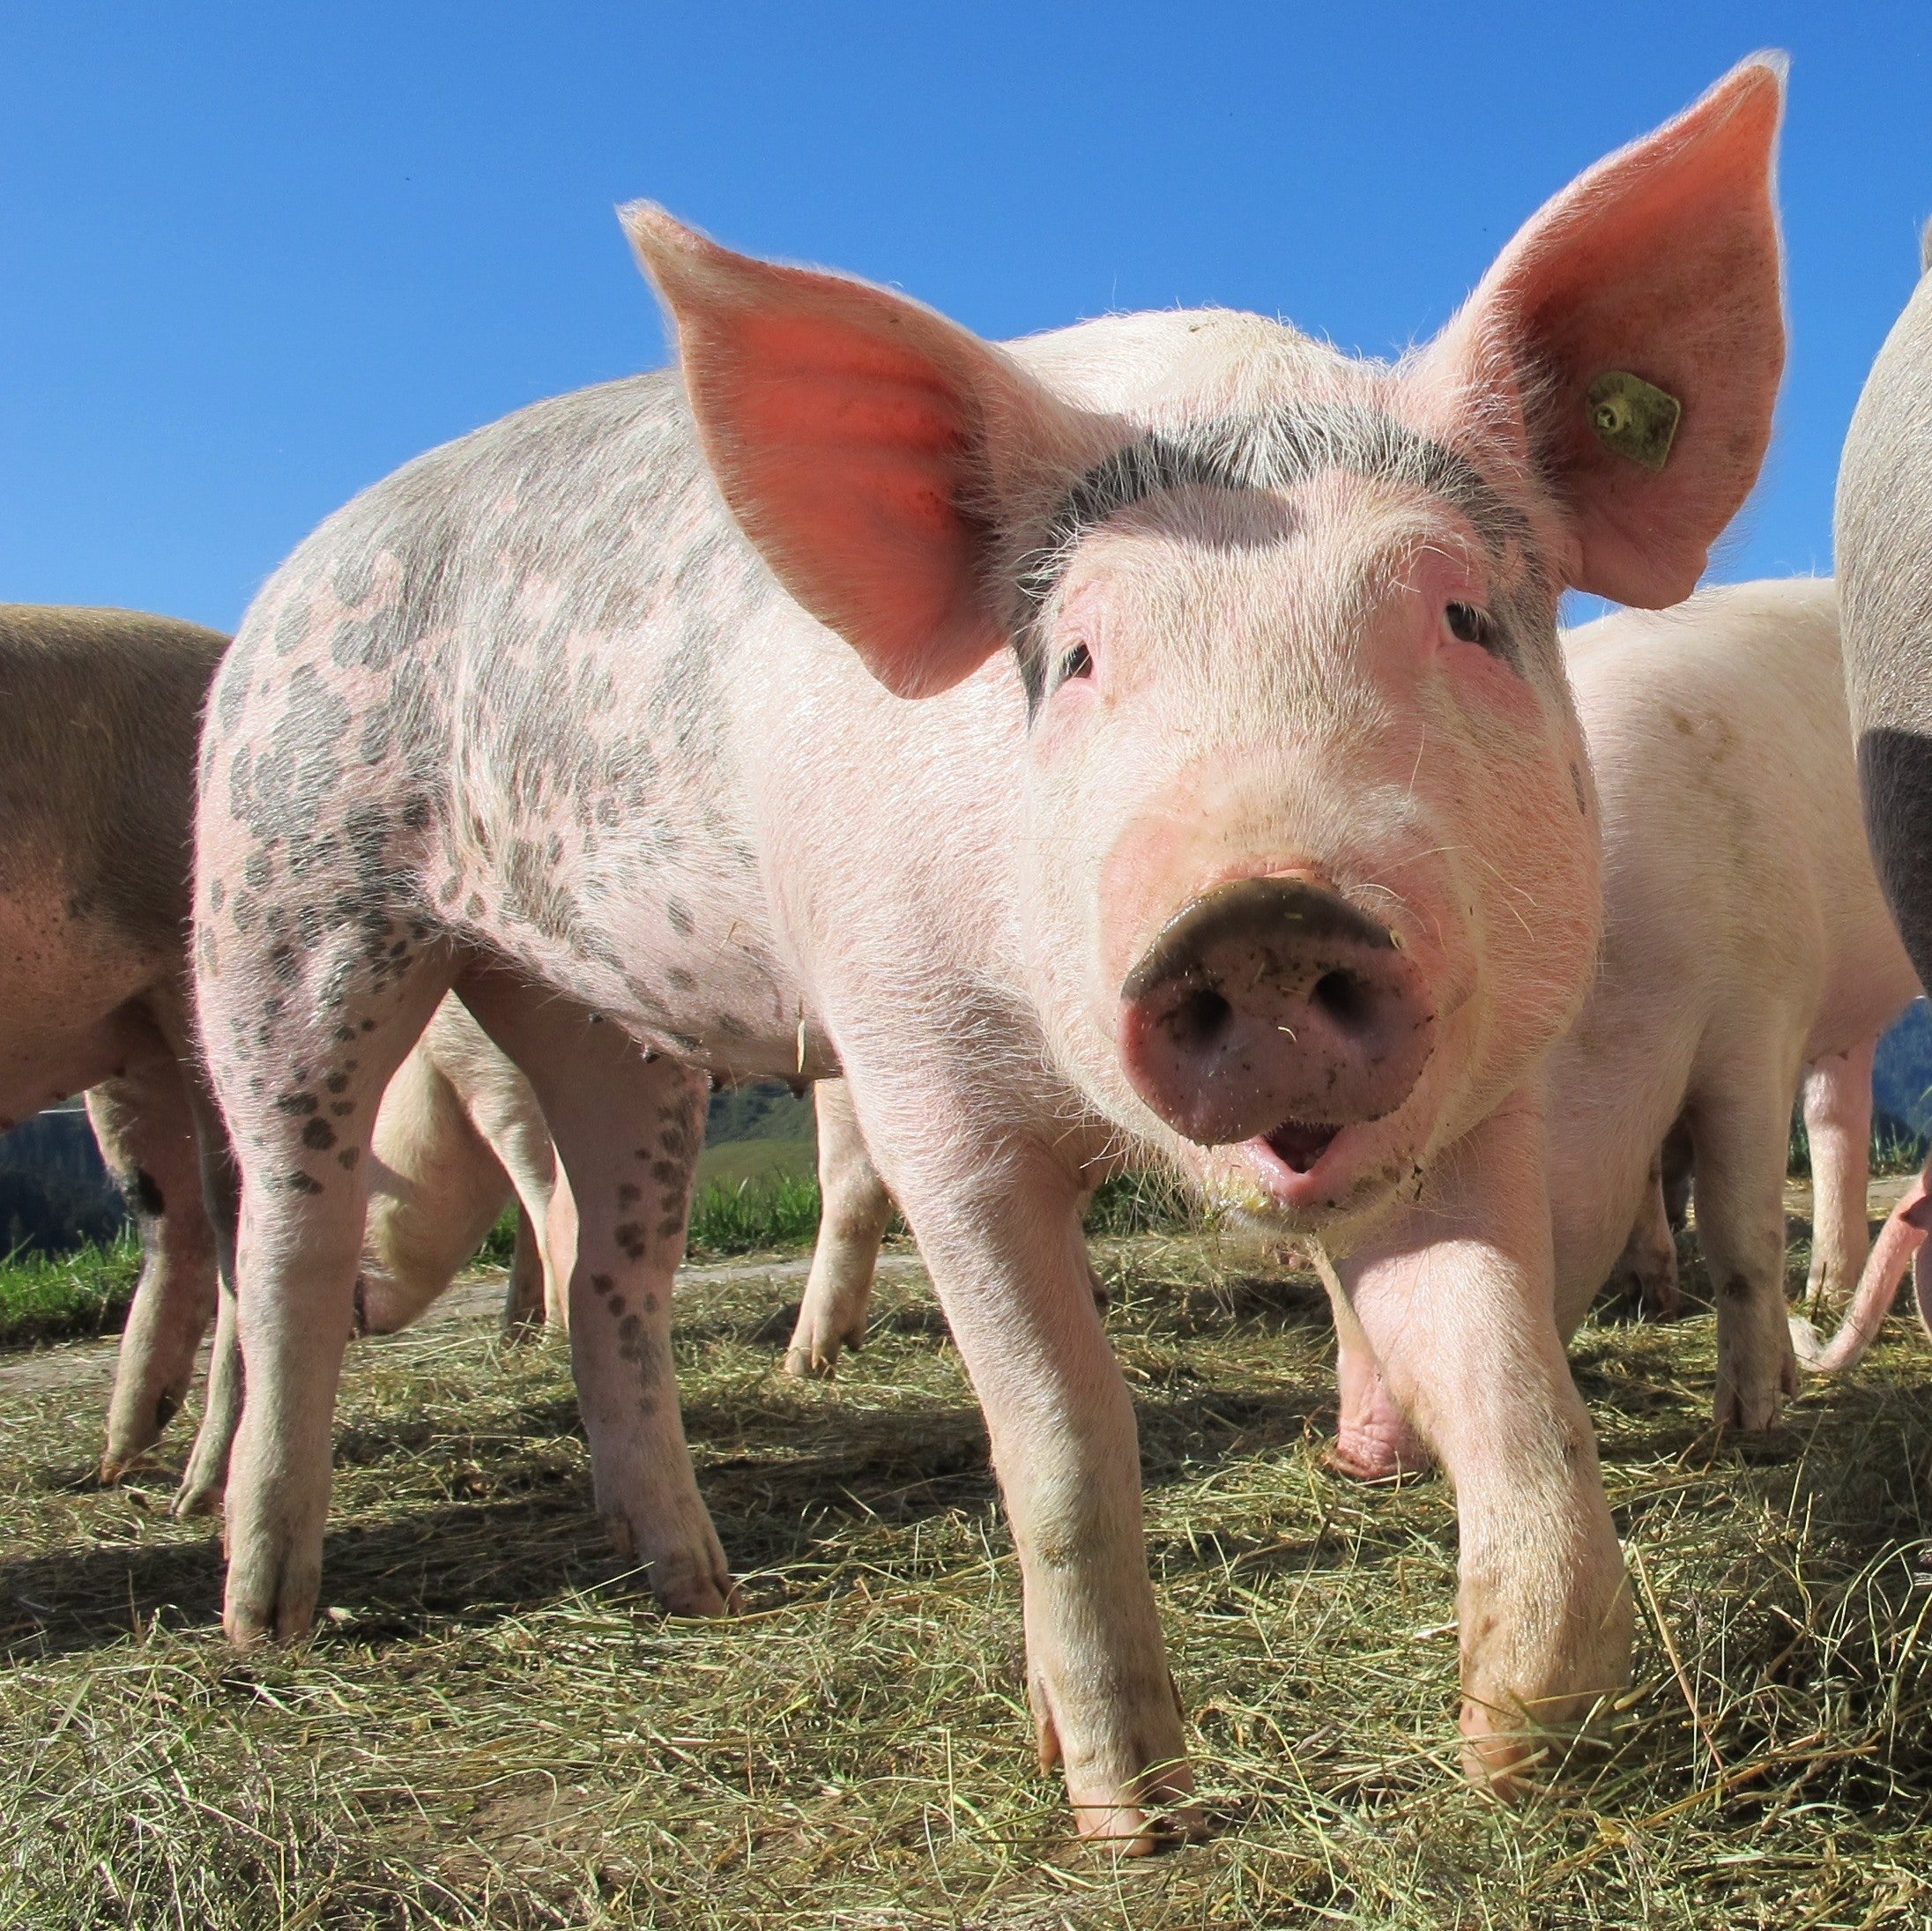
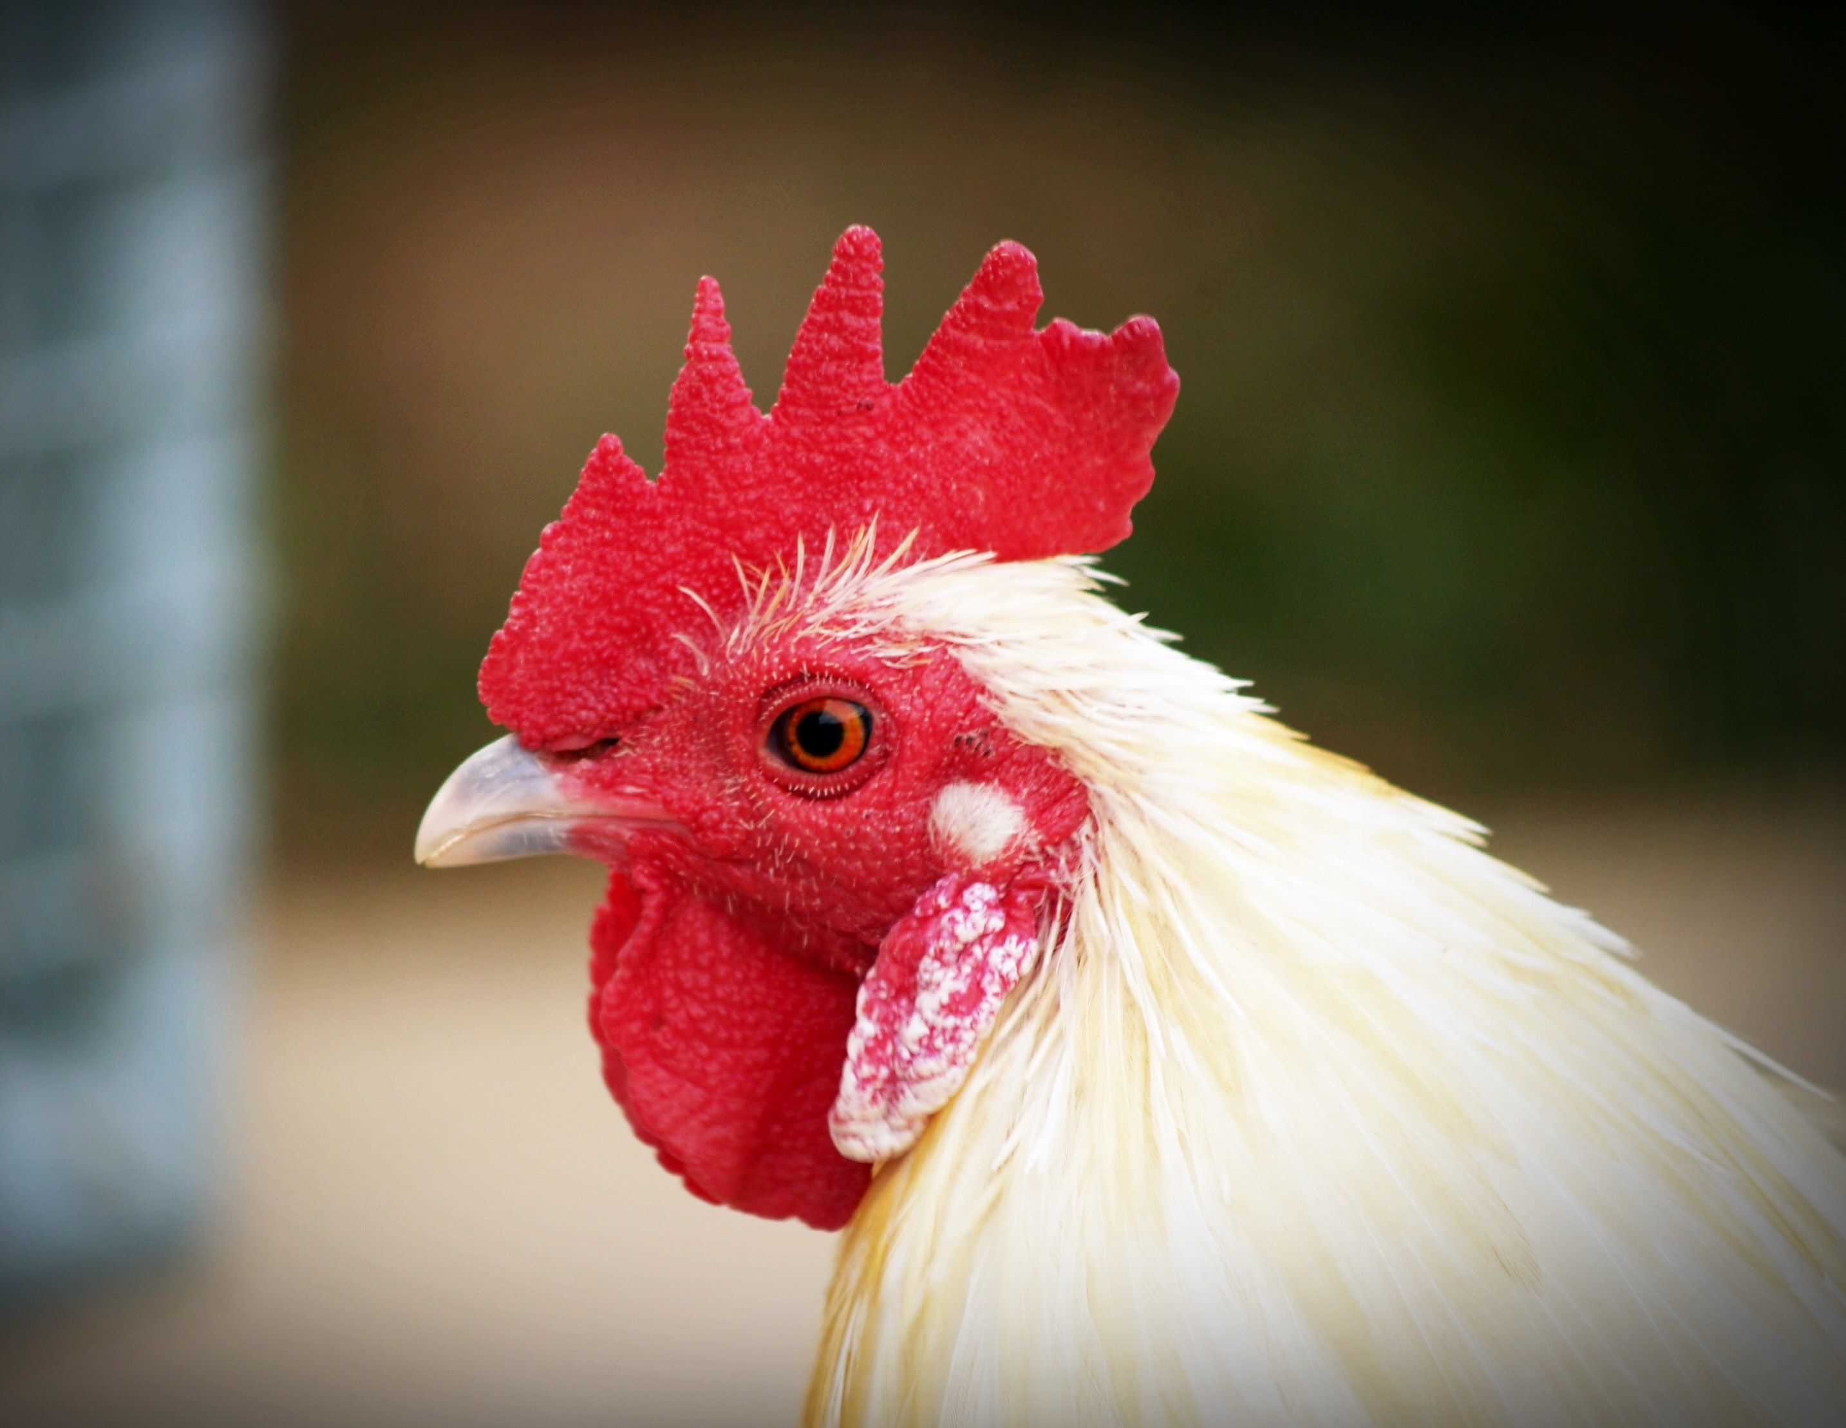
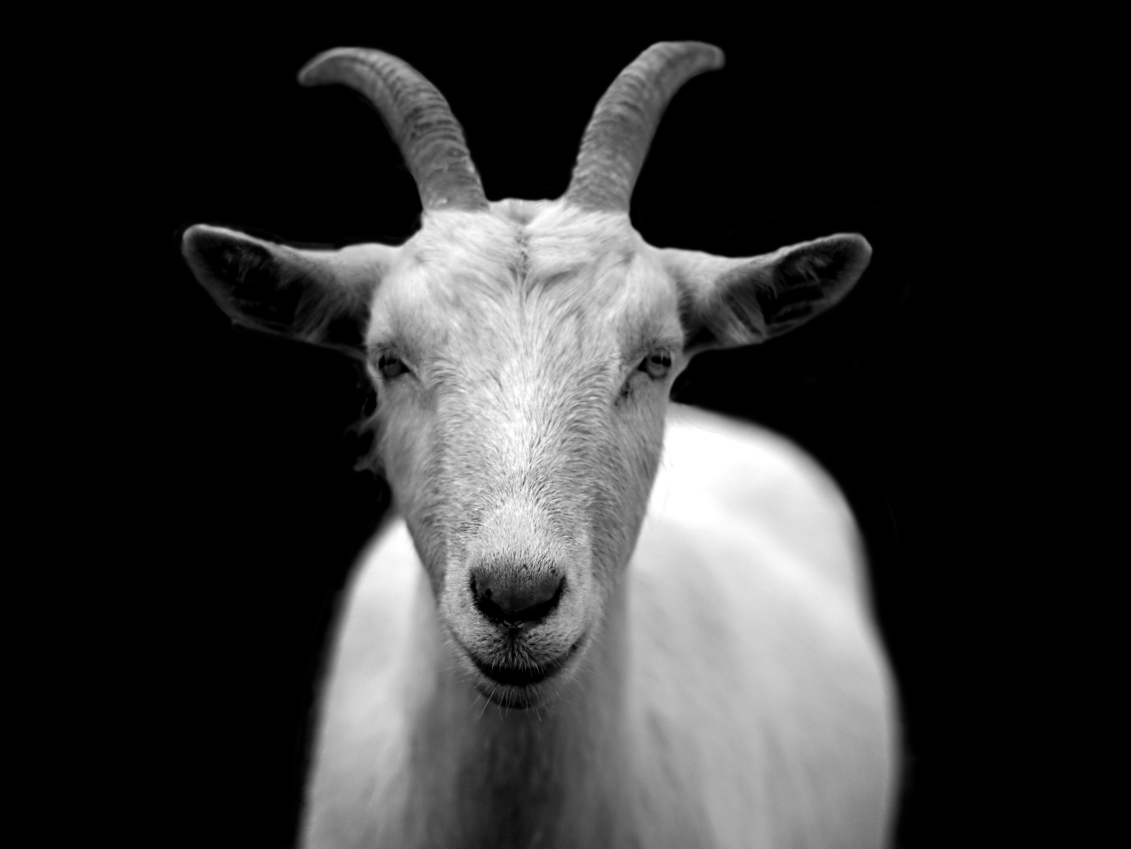
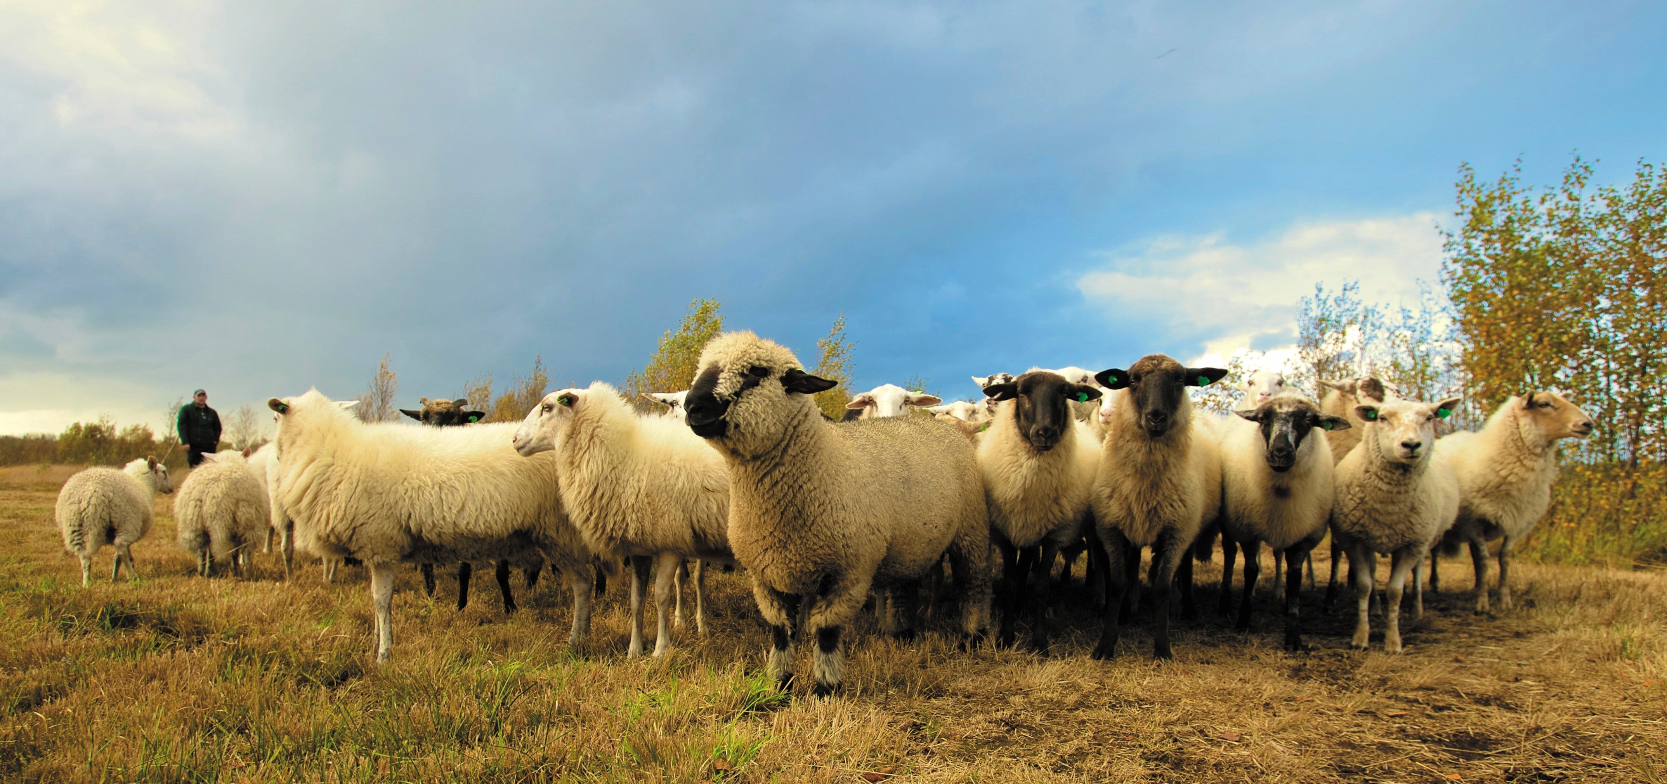
Careers with Animals: Production
Beef
Dairy
Swine
Species
Poultry
Goats
Sheep

Slide 3

Careers with Animals: Production
Beef
Dairy
Dairy Production
  Raised in all 50 states
  Top producing states are CA, WI, ID, NY and PA
  Total number of dairies down
  Dairies trending to have more head and more milk produced per cow
  U.S. dairy exports on the rise
  Producer-owned cooperatives
  Hot topics: hormone usage and government programs
Swine
Species
Poultry
Goats
Sheep

Slide 4
Careers with Animals: Production
Beef
Dairy
Poultry Production
  Includes broilers (meat), eggs, turkey and ducks
  Health, disease and cost of inputs all impact market and trade
  Hot topics: poultry welfare, antibiotics and hormones, education and labeling, avian influenza, global trade
Swine
Species
Poultry
Goats
Sheep

Slide 5
Careers with Animals: Production
Beef
Dairy
Sheep Production
  Produced for meat (lamb and mutton) and wool
  Raised in all 50 states
  U.S. imports lamb and mutton to meet consumer demands
  Hot topics: consumer preferences, competition from other meats and fiber sources, predators
Swine
Species
Poultry
Goats
Sheep

Slide 6
Careers with Animals: Production
Beef
Dairy
Goat Production
  Produced for meat, milk, and mohair
  U.S. shifted from a net-exporter to a net-importer of goat meat
  Demand for goat milk increasing to make products like goat cheese
  Hot topics: animal health and internal parasite control management, predators, goat meat marketing and education, animal identification
Swine
Species
Poultry
Goats
Sheep

Slide 7
Careers with Animals: Production
Beef
Dairy
Swine Production
  8 major breeds
  16 to 17 weeks from farm to fork
  U.S. pork production has nearly doubled in the last 50 years to meet demand
  Hot topics: animal welfare, immigration, product labeling, federal funding, responsible antibiotic use, animal identification
Swine
Species
Poultry
Goats
Sheep

Slide 8
Careers with Animals: Production
Beef
Dairy
Beef Production
  Cow/calf or feedlot operations
  Raised in every state
  Export to many countries including Japan, Mexico, South Korea, Canada, and Hong Kong
  Input costs (grain and feed), weather, tariffs and laws all impact markets and trade
  Hot topics: responsible antibiotic use, traceability
Swine
Species
Poultry
Goats
Sheep

Slide 9
Careers with Animals: Production
Career Skills
Safety/Handling
Observation
Keeping yourself and animals safe throughout the production process
Proper techniques and knowledge
Watch, record and note animal health and well-being
Proper animal nutrition
Environment, behavior and management
Ability to evaluate challenges and find solutions
Evaluate and identify best genetic practices
Establish, maintain and function with co-workers and/or family for production goals and outcomes
Team Player
Problem Solving

