Slide 1
Unit Two: Plant Disease and Pest Management
Lesson One:
Nutrition Deficiencies and Environmental Disorders
Lesson Objectives:
Identify major nutrient deficiencies and environmental disorders of floriculture crops.
Evaluate the causes and effects of these disorders in floriculture plants.
Discuss cure and prevention strategies for these disorders in floriculture plants.
Footer description area.

Slide 2
Introduction
What do these three things have in common?
Scurvy
Rickets
Anemia
How about these three things?
Hypothermia
Dehydration
Frostbite

Slide 3
Identification
Disorders and Deficiencies
Cold temperature (freeze)
Cold water damage
Ethylene damage
Insufficient water damage
Iron deficiency
Nitrogen deficiency
Phosphorous deficiency

Slide 4
Cold Temperature (Freeze)
Overview:
Occurs when temperatures drop below 32˚F.
Frost does not have to form for freeze damage to occur.
  Damage takes place at the cellular level as the subfreezing temperatures cause the plant tissues to freeze.
  If the cells making up the tissue remain frozen too long, they will burst the cell wall and cause cellular death.
  The severity of the damage depends on how quickly the temperature drops and how long it stays below freezing, as well as the health and maturity of the plant.
  Young plants, leaves and shoots are more susceptible to the effects of cold temperature than mature plants.

Slide 5
Cold Temperature (Freeze)
Symptoms:
Leaves becoming limp and dry are usually the first signs of cold temperature damage, but symptoms don’t occur overnight.
In some cases, damage may not become evident for months.

Slide 6
Cold Temperature (Freeze)
Prevention: (If not in a temperature controlled environment)
Eliminate nitrogen fertilizer use.
Ensure all plants are healthy and mature by the end of fall.
Reduce water frequency when approaching winter.
Cover young plants with a blanket when temperatures drop.
Treatment:
Chemically – No treatment listed
Culturally – Correct/Adjust temperature
Notes:
Resources:

Slide 7
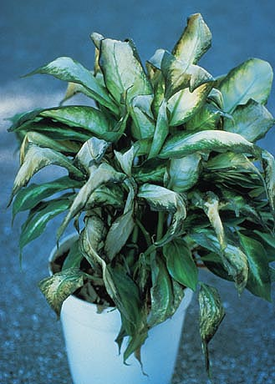
Cold Temperature (Freeze)
http://www.apsnet.org/publications/apsnetfeatures/Article%20Images/HouseplantsTemp_Fig07.jpg
Resources:
Michigan State University
https://www.oakgov.com/msu/Documents/publications/e2996_abiotic.pdf
University of Arizona
http://cals.arizona.edu/mohave/master_gardeners/kingman/articles/frostorfreeze.pdf

Slide 8
Cold Water Damage
Overview:
Watering your plants is important, but make sure the water you are using is not too cold! Cold water temperatures can harm the plant, causing stress and chilling injury. Water below 41˚F or 5˚C is too cold.
Symptoms:
Signs of cold water damage can be seen on the leaves as lesions or ring spots. The effected leaves turn white and necrotic, and the cause can be easily mistaken as a viral disease.

Slide 9
Cold Water Damage
Prevention:
Use water that is at room temperature.
Avoid watering the leaves, just the growing media will do!
Treatment:
Chemically – No treatment listed
Culturally – Correct/adjust watering

Slide 10
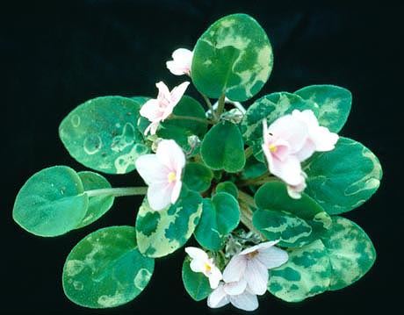
Cold Water Damage
http://www.apsnet.org/publications/apsnetfeatures/Article%20Images/HouseplantsWater_Fig04.jpg
Resources:
American Phytopathological Society
http://www.apsnet.org/publications/apsnetfeatures/Pages/Water.aspx
Purdue University
https://www.ppdl.purdue.edu/PPDL/weeklypics/12-5-11.html

Slide 11
Ethylene Damage
Overview:
Ethylene is a hormone found in plants that initiates flowering, fruit ripening and seed germination. The hormone is commonly used in greenhouse production, but if not properly ventilated, it can be harmful to plants. It is also a product of combustion and decomposition. Overexposure to the gas has damaging effects on flowers and flower buds.
Symptoms:
The extent of ethylene damage depends on the sensitivity of the plant. Flowers and flower buds that have been overexposed will abscise (fall off), and the leaves and nodes will show epinasty (drooping).
Notes:
Ohio State University
http://www.oardc.ohio-state.edu/joneslab/images/ethylene_extension.pdf

Slide 12
Ethylene Damage
Prevention:
Proper use and maintenance of heating units.
If you have equipment that uses propane or has a combustion engine, make sure the area is well ventilated.
Clean up all dying or damaged plant material.
Treatment:
Chemically – No listed treatment
Culturally – Reduce relative humidity

Slide 13
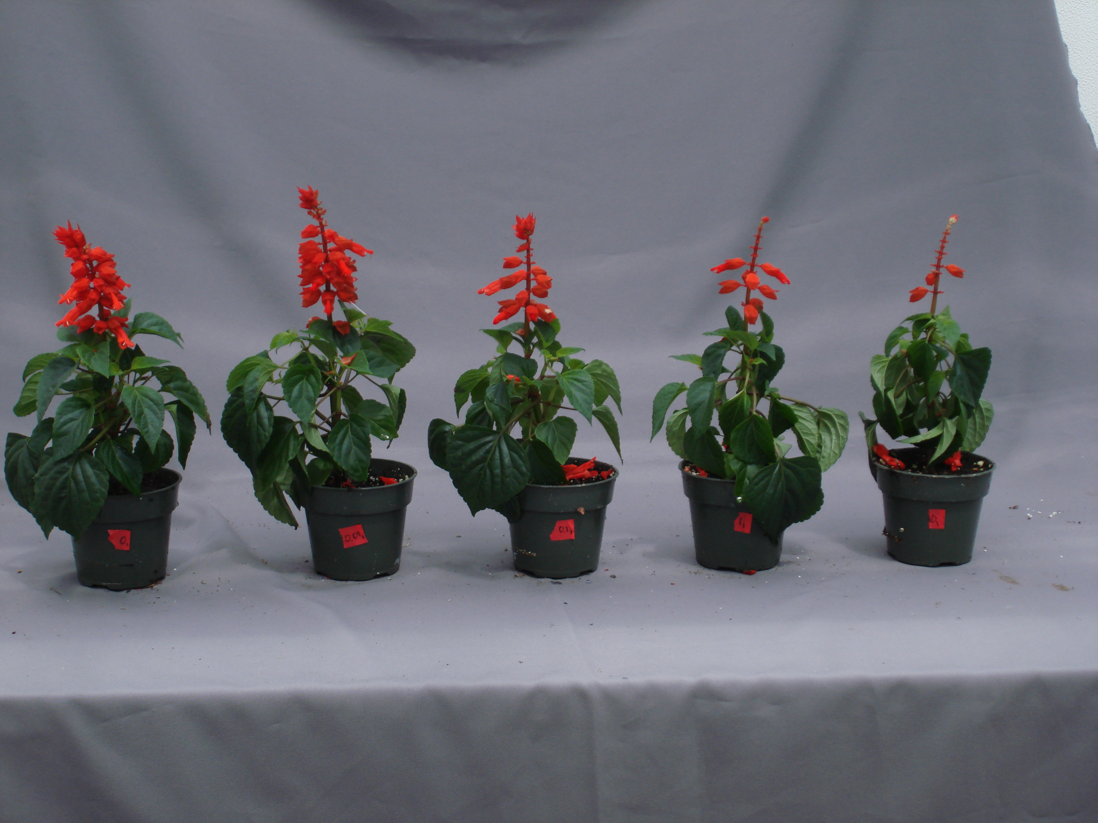
Ethylene Damage
http://u.osu.edu/greenhouse/files/2014/04/Figure-3-photos-3.jpg
Resources:
Ohio State University
http://www.oardc.ohio-state.edu/joneslab/images/ethylene_extension.pdf

Slide 14
Insufficient Water Damage
Overview:
Watering is important. However, giving a plant too much or not enough water can be damaging. When plants are given too much water, the plant’s can drown because it can’t receive any oxygen. Too little water causes dehydration. Both extremes are stressful for the plant and can be seen in the leaves of the plant.
Notes:
Colorado State University
http://www.coopext.colostate.edu/4dmg/Garden/drought6.htm

Slide 15
Insufficient Water Damage
Symptoms:
Insufficient water damage causes the leaves to wilt and discolor, turning yellow or brown. Overwatering causes water pressure to build up in the cells, which creates edema (blisters), and the leaves will feel soft and limp. Insufficient water causes the outer edges of the leaves to curl inward, and they will feel dry and crispy.
Notes:
Colorado State University
http://www.coopext.colostate.edu/4dmg/Garden/drought6.htm

Slide 16
Insufficient Water Damage
Prevention:
Use a moisture meter to prevent over/under watering.
Treatment:
Chemically – No treatment listed
Culturally – Adjust/correct watering

Slide 17
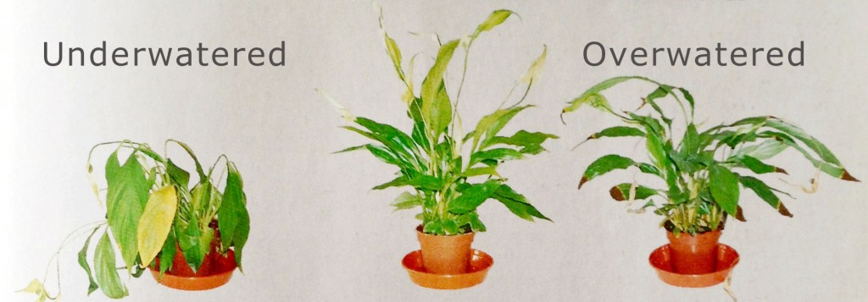
Insufficient Water Damage
http://gardeningunlimited.com/wp-content/uploads/2013/07/underwatering-overwatering-plants-1024x357.jpg
Resources:
Colorado State University
http://www.coopext.colostate.edu/4dmg/Plants/guidline.htm
Valley Crest
http://valleycresttakeson.com/watermanagement/resources/four-signs-you-are-overwatering-your-plants/

Slide 18
Iron Deficiency
Overview:
Iron is the most important of the micronutrients required in plant growth. Although it is needed in smaller amounts than macronutrients, too little iron can lead to an iron deficiency. Iron can be found in growing media with a pH below 6; the more alkaline, the less iron. Iron is used by the plant for the formation of enzymes and chlorophyll, which helps gives the plant its green color.
Notes:
Utah State University
http://forestry.usu.edu/htm/city-and-town/tree-care/what-is-iron-chlorosis-and-what-causes-it

Slide 19
Iron Deficiency
Symptoms:
The main symptom of an iron deficiency is yellowing of the leaves. This result is called iron chlorosis and makes the younger leaves appear yellow with green veins. Symptoms will also be visible on the roots. Medium that is over-watered can damage the roots and make it hard to asborb the iron in the soil.
Notes:
Utah State University
http://forestry.usu.edu/htm/city-and-town/tree-care/what-is-iron-chlorosis-and-what-causes-it

Slide 20
Iron Deficiency
Prevention:
Allow time between watering for the soil to dry out, preventing root stress and damage.
Test the pH of your soil; if it is 6.5 or over, the iron is unavailable to the plant.
Treatment:
Chemically – No treatment listed
Chemically – Apply complete fertilizer. Use acidic fertilizer to lower the pH of the medium.

Slide 21
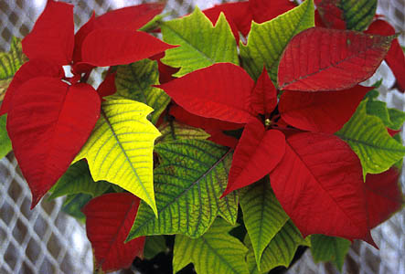
Iron Deficiency
https://www.ces.ncsu.edu/depts/hort/poinsettia/corrective/imgs/0019.jpg
Resources:
ProMix
http://www.pthorticulture.com/en/training-center/role-of-iron-in-plant-culture/
Utah State University
http://forestry.usu.edu/htm/city-and-town/tree-care/what-is-iron-chlorosis-and-what-causes-it

Slide 22
Nitrogen Deficiency
Overview:
Nitrogen is the most important macronutrient and required in large amounts by plants. It is an essential element in amino acids and is a component of nucleic acid, which helps make DNA. When nitrogen levels are deficient, it affects the development of chlorophyll and the photosynthesis process.
Notes:
University of Arizona
http://extension.arizona.edu/sites/extension.arizona.edu/files/pubs/az1106.pdf

Slide 23
Nitrogen Deficiency
Symptoms:
Because nitrogen is absorbed through the roots as ammonium or nitrate, the growing medium will have a lot to do with a plant’s nitrogen levels. Leached or volatile soils are signs of low nitrogen content. The plant itself shows a yellowing of the older leaves and an overall lightening of color in the rest of the plant.
Notes:
University of Arizona
http://extension.arizona.edu/sites/extension.arizona.edu/files/pubs/az1106.pdf

Slide 24
Nitrogen Deficiency
Prevention:
Use slow-release fertilizer to prevent leaching.
Inject water-soluble nitrogen into the irrigation water.
Send in soil samples for nutrient analysis.
Treatment:
Chemically – No treatment listed
Culturally – Apply complete fertilizer. Use fertilizer with high levels of nitrogen (ammonium, nitrate or urea).

Slide 25
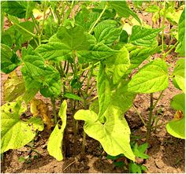
Nitrogen Deficiency
https://s-media-cache-ak0.pinimg.com/236x/02/3d/96/023d960eab9d0a55b581ad3f7cb14e2b.jpg
Resources:
University of Hawaii at Manoa
http://www.ctahr.hawaii.edu/mauisoil/c_nutrients01.aspx
University of Arizona
http://extension.arizona.edu/sites/extension.arizona.edu/files/pubs/az1106.pdf

Slide 26
Phosphorous Deficiency
Overview:
Phosphorus is a unique and important macronutrient. This nutrient helps regulate growth by being involved in the process of respiration, photosynthesis and reproduction. Because the function of phosphorous can not be replicated by other nutrients, a deficiency can be very damaging to the plant.
Symptoms:
Phosphorous deficiency can be seen in the leaves. They are unable to grow to their normal size. The leaves turn a dark green and the edges will discolor, turning a dark purple/red color. This is brought on by the build up of carbohydrates not being utilized by phosphorous. Root mass is also decreased, which leads to less nutrients and water being absorbed by the plant.
Notes:
University of Arizona
http://extension.arizona.edu/sites/extension.arizona.edu/files/pubs/az1106.pdf

Slide 27
Phosphorous Deficiency
Prevention:
Send in soil samples for nutrient analysis.
Test pH level in soil. phosphorus is most available in the 6-7 range.
Treatment:
Chemically – No treatment listed
Culturally – Apply complete fertilizer. Use fertilizer with high levels of phosphorus (phosphate).

Slide 28
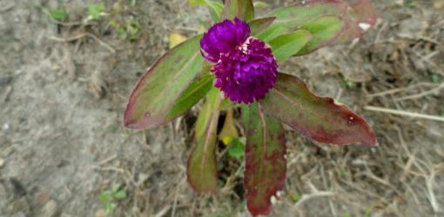
Phosphorous Deficiency
http://www.todayshomeowner.com/wp-content/uploads/2011/05/purple-leaves-phosphorus-deficiency-1.jpg
Resources:
Crop Nutrition
http://www.cropnutrition.com/efu-phosphorus#phosphorus-in-soils
International Plant Nutrition Institute
https://www.ipni.net/ppiweb/bcrops.nsf/$webindex/ECBABED567ABDCDD852568EF0063C9F4/$file/99-1p06.pdf
University of Arizona
http://extension.arizona.edu/sites/extension.arizona.edu/files/pubs/az1106.pdf

Slide 29
Review
Exit Ticket
Answer the following questions and turn your answers in before you head out the door!
What is something about plant disorders and deficiencies you found surprising?
Do you think it would be difficult for you to identify a disorder or deficiency just by looking at a plant? Why or why not?

