Slide 1
Unit Two: Plant Disease and Pest Management
Lesson Two:
Plant Diseases
Lesson Objectives:
Identify common diseases found in floriculture plants.
Evaluate the causes and effects of diseases in floriculture plants.
Discuss cure and prevention strategies for diseases in floriculture plants.

Slide 2


Introduction
Think, Pair, Share
How can you tell if a person is sick?
How can you tell if a plant is sick?

Slide 3
Identification
Diseases
Botrytis – Gray mold
Damping-off
Downy mildew
Leaf spot (Black)
Powdery mildew
Root rot
Rust
Stem rot
Tospovirus (INSV & TSWV)

Slide 4
Botrytis – Gray Mold
Overview:
This fungus can thrive everywhere plants are grown and survives particularly well in humid areas, especially greenhouses. Botrytis requires a food source and will often times be found on wounded or dying plant parts that are leaking nutrients. Once the food source is established, the fungus will expand as it attacks the healthy plant tissue.

Slide 5
Botrytis – Gray Mold
Symptoms:
Initially appearing as a white spot, Botrytis will turn a dark gray color. The gray mold will grow spores that give it a dusty appearance and will spread easily. It can be found on any part of the plant: leaves, stem, flower, fruit, etc.

Slide 6
Botrytis – Gray Mold
Prevention:
Avoid injuring plants.
Clean up plant debris.
Properly ventilate greenhouses.
Treatment:
Chemically – Fungicide
Culturally – Reduce relative humidity

Slide 7
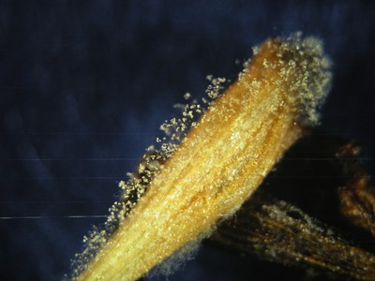
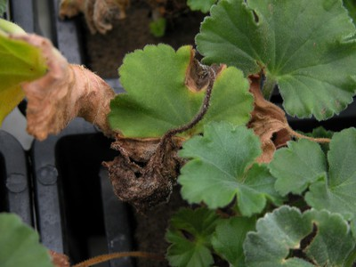
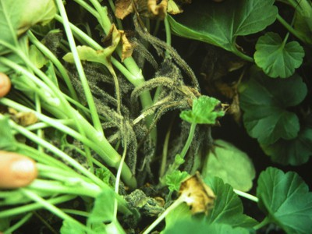
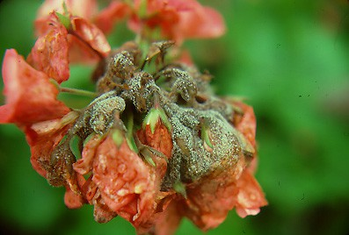
Botrytis – Gray Mold
Resources:
Pennsylvania State University
http://extension.psu.edu/pests/plant-diseases/all-fact-sheets/botrytis-or-gray-mold

Slide 8
Damping-off
Overview:
Damping-off is generally caused by soil inhabiting fungus (Pythium, Rhizoctonia, Fusarium and Phytophthora). They affect the seeds causing them not to grow, and the shoots, stems and leaves will decay.

Slide 9
Damping-off
Symptoms:
Seeds that are attacked before they germinate will become dark brown and turn soft. Seedlings that make it above the soil will shrivel and darken. If damping-off doesn’t occur until after the plant has germinated, it will be seen on the stem and leaves near the soil line as they weaken and decay. Eventually the decay will cause the plant to fall over and die.

Slide 10
Damping-off
Prevention:
Sanitize all your containers, equipment and growing medium to prevent the spread of pathogens.
Make sure growing medium is well drained, not compacted and not too cold.
Plant when conditions encourage rapid growth.
Treatment:
Chemically – No treatment listed
Culturally – No treatment listed

Slide 11
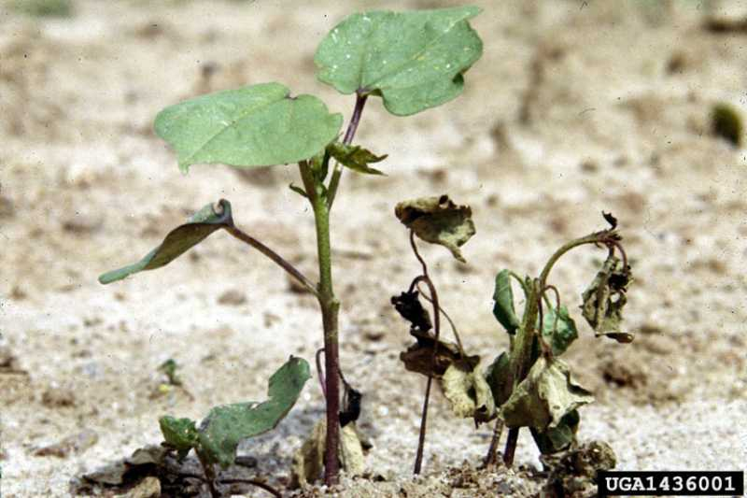
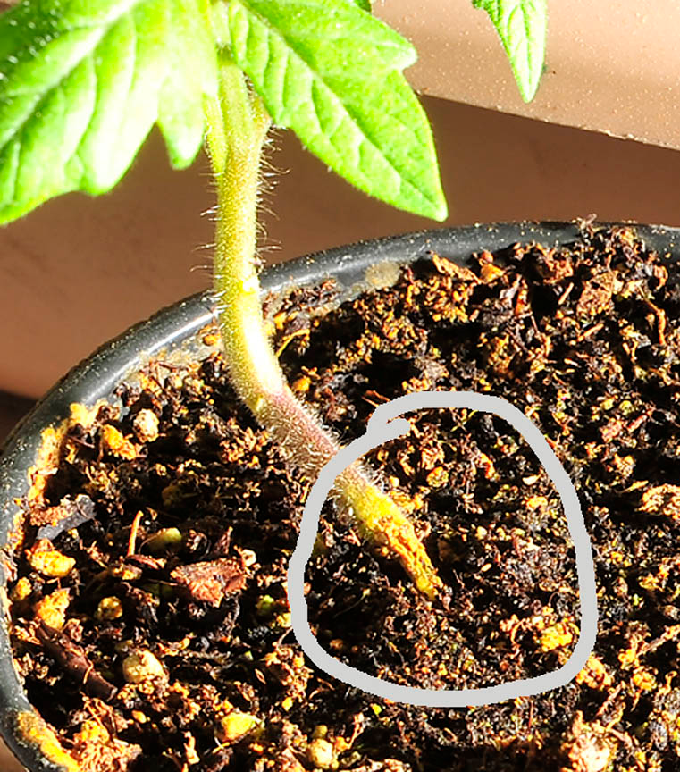
Damping Off
http://www.missouribotanicalgarden.org/Portals/0/Gardening/Gardening%20Help/images/Pests/Dampingoff2121.jpg
http://www.tomatodirt.com/images/damping-off.jpg
Resources:
University of California
http://ipm.ucanr.edu/PMG/PESTNOTES/pn74132.html

Slide 12
Downy Mildew
Overview:
Fungus (related to Phythium and Phytophthora) causes downy mildew and favors cool temperatures and high humidity. As the downy mildew spreads on the leaves and branches, it can distort and kill the plant. With the naked eye, it may appear very similar to botrytis or powdery mildew.

Slide 13
Downy Mildew
Symptoms:
The fungus first appears on the underside of leaves as a fluffy growth and is bluish-white in color. Then, small yellow spots form on the top side of the leaf. As the leaf spots die, the growth on the bottom of the leaf will turn dark gray.

Slide 14
Downy Mildew
Prevention:
Clean up plant debris.
Make sure plants are not overcrowded and have good air circulation.
Carefully monitor plants during spring time when the weather is cool and damp (especially pansies, impatiens and roses).
Treatment:
Chemically – Fungicide
Culturally – Reduce relative humidity

Slide 15
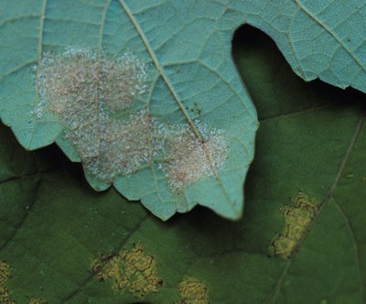
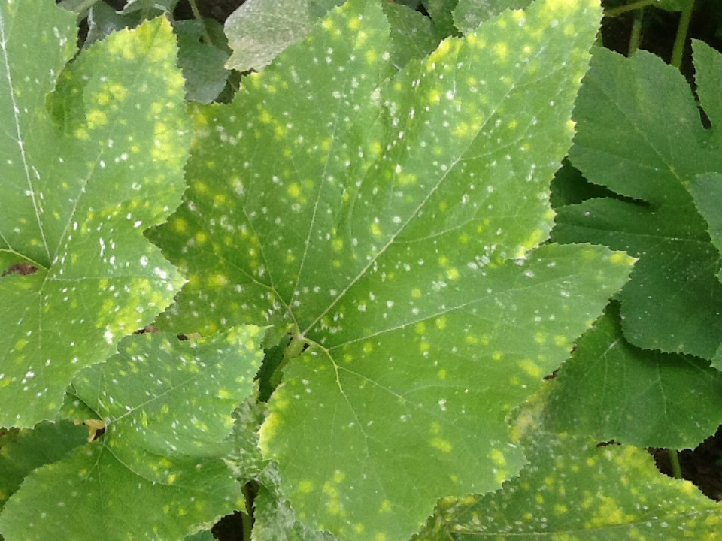
Downy Mildew
http://extension.psu.edu/images/factsheets/ppath/downy-mildew0.jpg/image_preview
http://walterreeves.code18interactiv.netdna-cdn.com/wp-content/uploads/2013/07/squash-downy-mildew.jpg
Resources:
Pennsylvania State University
http://extension.psu.edu/pests/plant-diseases/all-fact-sheets/downy-mildew

Slide 16
Leaf Spot (Black)
Overview:
This disease is caused by the fungus Diplocarpon rosae and is very common in roses. It causes black spots to appear on the leaves and can result in weakening of the plant and lack of blooms.

Slide 17
Leaf Spot (Black)
Symptoms:
Black spots form on the top side of leaves with no powdery growth found on the underside. The black spots have feathery fibers and are not fluffy like mildew. Yellowing typically occurs around the edges of the spots and causes the leaf to drop off.

Slide 18
Leaf Spot (Black)
Prevention:
Make sure plants are not overcrowded and have good air circulation.
Do not allow leaves to be wet for more then seven hours.
Clean up infected plant debris.
Treatment:
Chemically – Fungicide
Culturally – No treatment listed

Slide 19
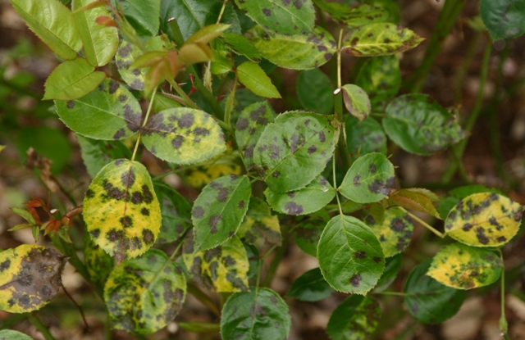
Leaf Spot (Black)
http://www.olyrose.org/images/Black%20spot-01%20-%20Copy.JPG
Resources:
University of Maine
https://extension.umaine.edu/ipm/ipddl/publications/5097e/
University of California
http://ipm.ucanr.edu/PMG/GARDEN/PLANTS/DISEASES/blackspot.html

Slide 20
Powdery Mildew
Overview:
Powdery mildew refers to a group of diseases that are caused by related fungi. The powder growth can affect the plants’ leaves, stems and flower petals. While water does not affect this fungus as much as other mildews, high humidity helps it spread.

Slide 21
Powdery Mildew
Symptoms:
Small round spots develop on the plant’s surface and grow into a powdery white-gray growth. As the fungus grows, it extracts nutrients from the plant and causes a decline in health and vigor.

Slide 22
Powdery Mildew
Prevention:
Properly ventilate greenhouse.
Make sure plants are not overcrowded and have good air circulation.
If you notice an onset of powdery mildew, remove the leaves immediately and prune the infected stem at the end of the growing season.
Treatment:
Chemically – Fungicide
Culturally – Reduce relative humidity

Slide 23
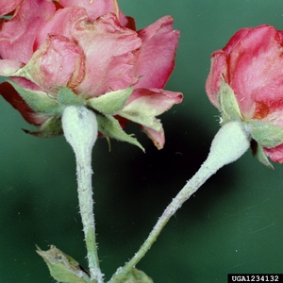
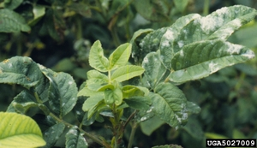
Powdery Mildew
Resources:
Clemson University
http://www.clemson.edu/extension/hgic/pests/plant_pests/flowers/hgic2049.html

Slide 24
Root Rot
Overview:
This disease can happen in both indoor and outdoor plants that are affected by poor drainage. The fungus that results from the lack of drainage can cause symptoms that are very common to other diseases and disorders.

Slide 25
Root Rot
Symptoms:
Above the soil, the overall growth of the plant is decreased, and they may appear smaller and flower less then healthy plants. The leaves of infected plants will yellow, curl and die. The roots of the plant will turn black and become limp. When the plant is removed from the growing medium, the root’s outer cell layer will be stripped off and the tissue exposed.

Slide 26
Root Rot
Prevention:
Sanitize all your containers, equipment and growing medium to prevent the spread of pathogens.
Make sure growing medium is well drained.
Avoid overwatering and overcrowding.
Treatment:
Chemically – Fungicide
Culturally – Correct/adjust watering

Slide 27
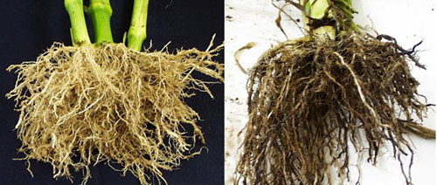
Root Rot
Healthy Root Infected Root
http://pnwhandbooks.org/plantdisease/sites/default/files/images/Corn_root_rot.jpg
Resources:
Pennsylvania State University
http://extension.psu.edu/pests/plant-diseases/all-fact-sheets/fungal-root-rots-and-chemical-fungicide-use

Slide 28
Rust
Overview:
Rust is a very common disease found in all types of plants. It is an unsightly fungus and can cause death in extreme cases. Rust tends to be more prominent in the late-summer to mid-autumn months. Typically, the leaves show signs of rust, but it can also form on the stem and flowers in some cases. In severe cases, it can cause leaves to yellow and fall off.

Slide 29
Rust
Symptoms:
Small round structures called pustules form on the underside of the leaf. Dozens of pustules can form on a single leaf. The rust name comes from the color of the pustules that can be yellow-orange to dark brown.

Slide 30
Rust
Prevention:
Make sure plants are not overcrowded and have good air circulation.
Do not allow leaves to be wet for more then seven hours.
If you notice an onset of rust, remove the leaves immediately and dispose of them.
Dust plants with sulfur to prevent fungus from spreading.
Treatment:
Chemically – Fungicide
Culturally – No treatment listed

Slide 31
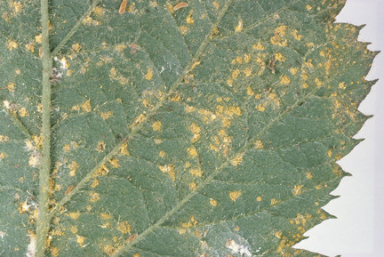
Rust
http://apps.rhs.org.uk/Advice/ACEImages//RHS_SCN0000059rust_429507.JPG
Resources:
Royal Horticulture Society
https://www.rhs.org.uk/advice/profile?pid=756
Farmer’s Almanac
http://www.almanac.com/content/rust

Slide 32
Stem Rot
Overview:
This fungal disease (Rhizoctonia, Fusarium and Pythium) is caused by poor drainage, overwatering and crowding. Typically, plants with stem rot are predisposed to root rot. Nematodes can cause similar symptoms in plants.

Slide 33
Stem Rot
Symptoms:
Stains will appear on the affected area of the stem and vary in color from black to red. The infection will cause the stems to wilt, losing their structure and vigor.

Slide 34
Stem Rot
Prevention:
Sanitize all your containers, equipment and growing medium to prevent the spread of pathogens.
Make sure growing medium is well drained.
Avoid overwatering and overcrowding.
Treatment:
Chemically – Fungicide
Culturally – Correct/adjust watering

Slide 35
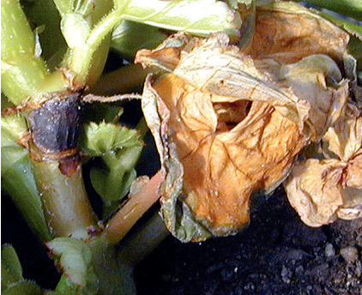
Stem Rot
http://www.armstronggrowers.com/wp/files/2012/04/Typical-symptoms-of-botrytis-on-Begonia.png
Resources:
Texas A&M University
http://plantdiseasehandbook.tamu.edu/problems-treatments/problems-affecting-multiple-crops/stem-and-root-rot/

Slide 36
Tospovirus (INSV and TSWV)
Overview:
Viruses like Impatiens Necrotic Spot Virus (INSV) and the Tomato Spotted Wilt Virus (TSWV) created the tospovirus. This virus is commonly seen in the greenhouse industry and can be transmitted by thrips from plant to plant.

Slide 37
Tospovirus (INSV & TSWV)
Symptoms:
The leaves or stems will develop brown or yellow rings that eventually lead to wilting. The symptoms alone are not enough to diagnose the problem and testing should be used to positively identify the virus.

Slide 38
Tospovirus (INSV & TSWV)
Prevention:
Isolate and inspect any new plants for symptoms and test as needed.
Destroy any plants found positive for tospovirus.
Treatment:
Chemically – No treatment found
Culturally – No treatment found

Slide 39
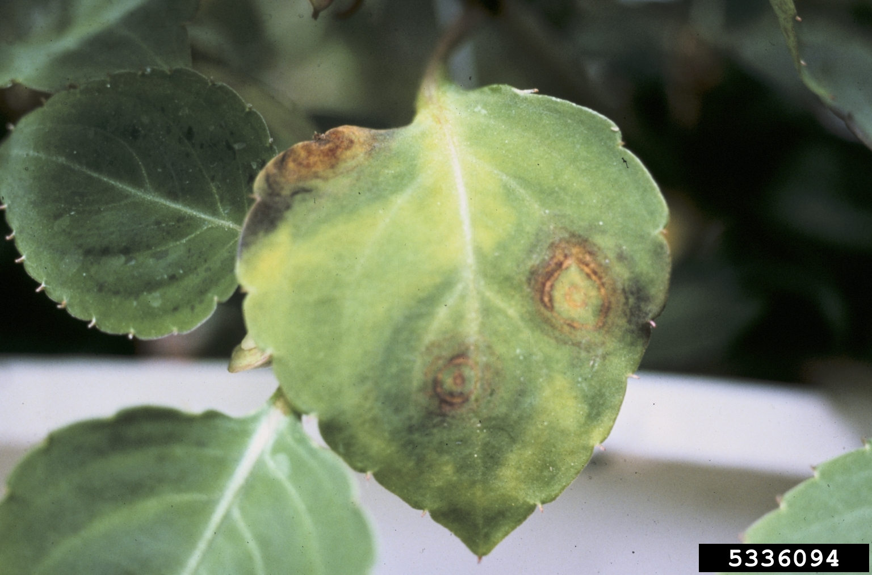
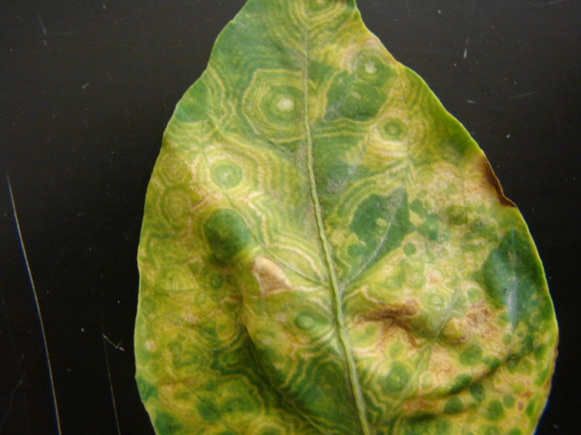
Tospovirus (INSV & TSWV)
http://www.gardeningknowhow.com/wp-content/uploads/2014/12/insv.jpg
http://aces.nmsu.edu/ces/plantclinic/documents/pepperleaf.jpg
Resources:
University of Florida
http://edis.ifas.ufl.edu/pp134
Pennsylvania State University
http://extension.psu.edu/pests/plant-diseases/all-fact-sheets/impatiens-necrotic-spot-virus

Slide 40
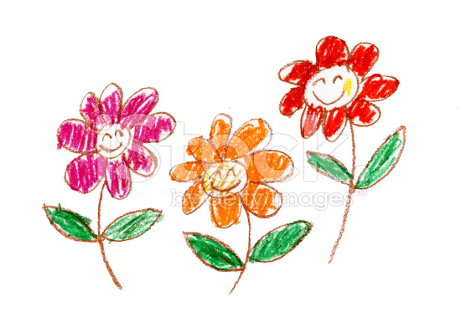
Review
What is That?!
Illustrate the symptoms of the diseases we discussed on the plant diagrams.
Where is it located?
What does it look like?
What color is it?

