Slide 1
Lesson 8: Plant Propagation and Planting

Slide 2
What is Propagation?
Propagation is the process of creating a new plant either sexually or asexually.
Sexual Method
  Seed
  Spore
Asexual Method
  Cuttings (multiple methods)
  Layering (multiple methods)
  Division
  Separation
  Grafting

Slide 3
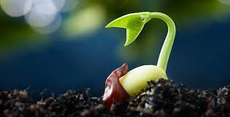
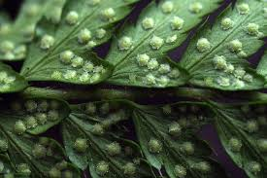
Sexual Methods
Seed
Spore

Slide 4
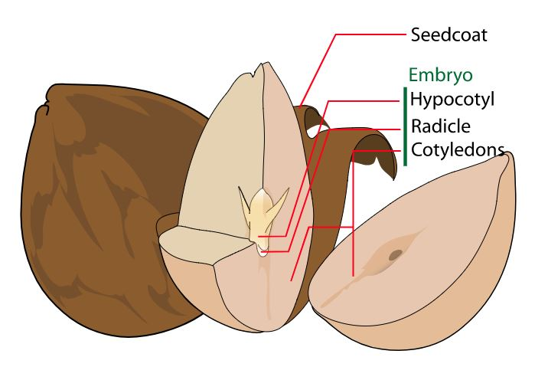
Sexual Propagation with a Seed
Union of the pollen (male) and the egg (female) to produce a seed.
The seed is made of three parts:
  Outer seed coat — protection
  Endosperm — food reserve
  Embryo — young plant
When a seed is mature and put in favorable conditions, it will germinate and grow a plant.

Slide 5
Seed Propagation
Germination
  The seed must meet the following requirements for germination to occur:
      Mature embryo
      Large enough endosperm to sustain growth
      Sufficient hormones to initiate the process

Slide 6



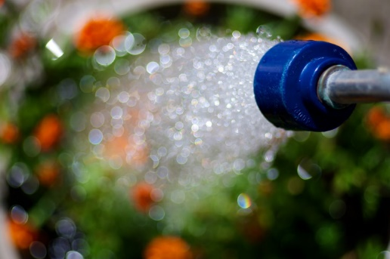
Seed Propagation
Germination Elements
  Absorption of water
  Light (the proper amount varies per seed)
  Access to oxygen
  Temperature (temp desired varies per seed)

Slide 7
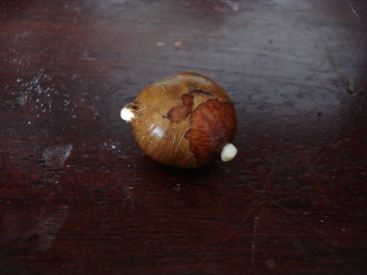
Seed Dormancy
Seeds go into dormancy to prevent germination before the ideal time.
Some seeds, like those of trees and shrubs, are hard to get out of dormancy.
  Treatments can be done to get these seeds out of dormancy.
      Scarification involves breaking, scratching or softening the seed coat so that water can enter and start the germination process.
          There are many methods of scarification:
            Acid
            Mechanical
            Hot water
            Warm moist
      Stratification involves keeping the seed in a moist medium in the refrigerator for 10 to 12 weeks.

Slide 8
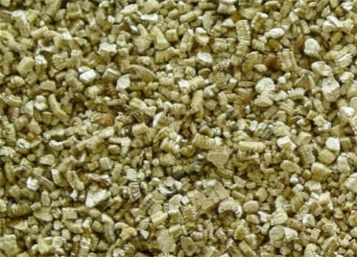
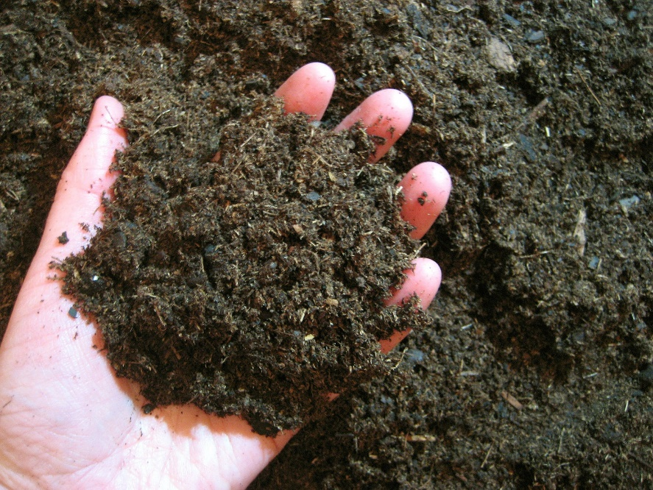
Starting Seeds — Media
Media is the substance that the seed is placed in.
  Types:
    Vermiculite
    Sphagnum peat moss
    Pearlite
    Sterilized soil
Placing the seed in one of these media types should allow the seed to grow easily.
The media should be
  Fine and uniform
  Well aerated and loose
  Free of insects, disease and weeds
  Capable of holding and moving moisture

Slide 9
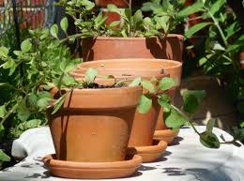
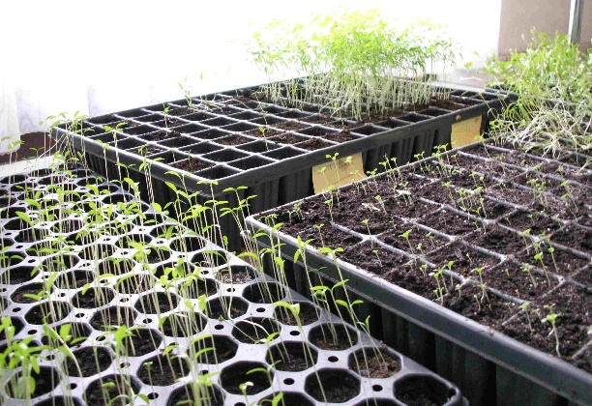
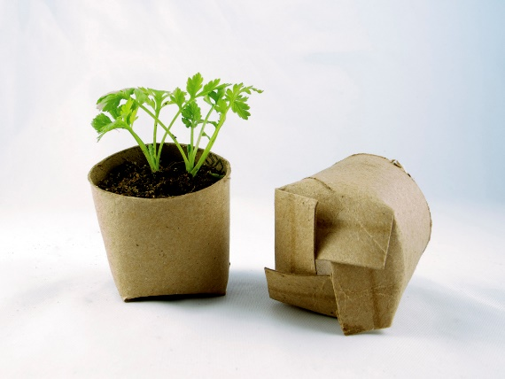
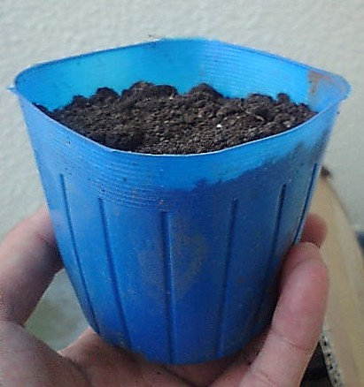
Starting Seeds — Containers
Many items can be used as containers for starting seeds.
Some examples are
  Flats
  Trays
  Recycled takeout containers
  Recycled plastic containers
  Pie pans
  Plastic pots
  Clay pots
  Wood
  Newspaper
Whatever the container, good drainage is key.
Seeds can be started together or in individual containers.

Slide 10

Starting Seeds — Timing
Knowing when the plants are needed is essential to knowing when to start the seeds.
The range for germination to occur can take 5–21 days prior to the time of transplanting.

Slide 11

Starting Seeds — Seeding
Seeding is the process of putting the seeds into the growing medium to start the growing process.
Steps
  Select a container and fill it with the medium of choice.
  Plant seeds on top of the growing medium (depth will vary on seed size). Large/medium seeds should be planted 1–2 inches apart.
  Place the seeds in rows for easier growth.
  Once the seeds are planted, water the seeds with a fine mist to start the germination process.
  Wait for the seeds to grow, and then transplant them so they have more room to grow.

Slide 12
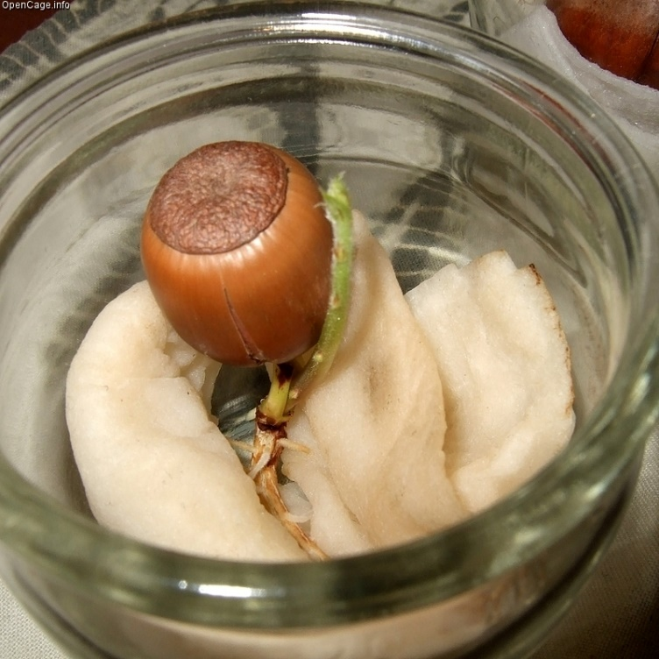
Pregermination
Seeds can also be pregerminated. This process can be done in many ways, but the purpose is for the seed to start germination without a media.
Examples
    Placing a seed within a moist paper towel or cloth in a warm environment
    Suspending a seed within gel

Slide 13
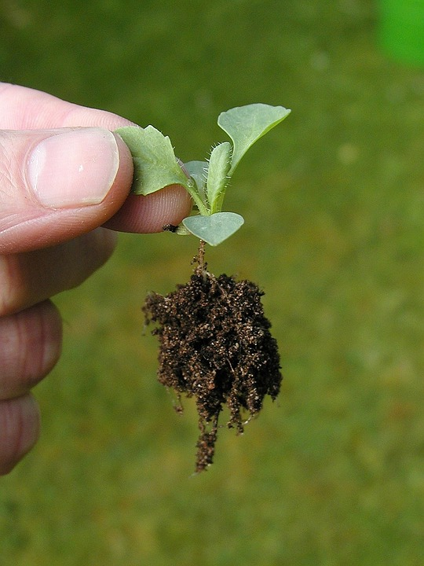
Transplanting
Once seeds are germinated, they need to be placed in their own containers to maximize growth space.
Transplant once the true leaves appear above or between the cotyledon leaves.
    Cotyledon leaves are the first leaves that a seedling produces.

Slide 14
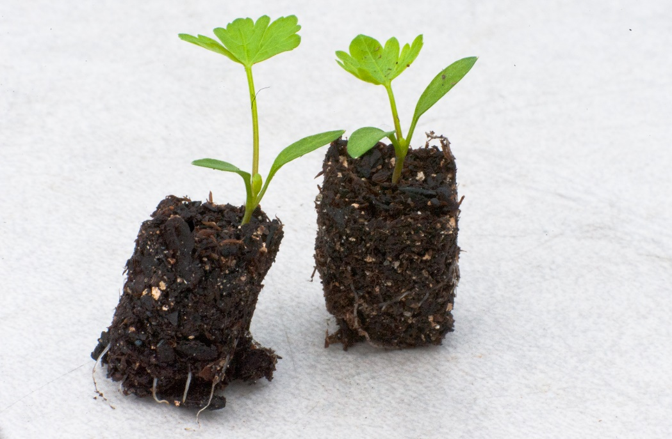
Transplanting
To transplant
    Carefully dig up the small plants with a knife or wooden plant label.
    Let the seedlings fall apart and pick out individual plants.
    Handle small seedlings by their leaves and avoid tearing roots.
    Punch a small hole in the growing medium you are transplanting to and plant the seedling at the same depth as it was in the flat.
    Firm the soil and water the seedlings once moved.
    Keep freshly transplanted seedlings in the shade and away from direct heat sources for a few days.

Slide 15
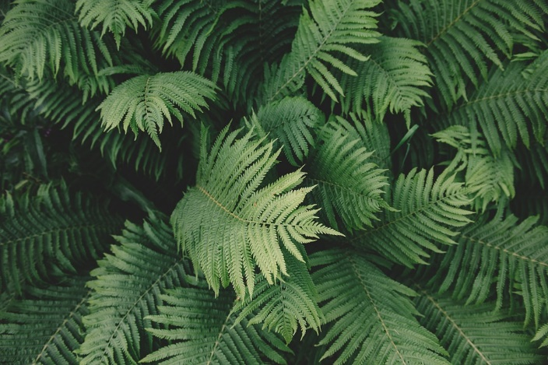
Sexual Propagation with a Spore
Ferns reproduce with spores.
Use the spores from the underside of the fern frond to propagate this way.
Place the spores onto a brick covered in moss and soil, cover the brick with plastic and keep the brick in a moist place with indirect light.
After about three weeks, fertilization should have occurred. Separate the mat that has grown with tweezers, cover with plastic and keep moist.
When fern fronds appear and become crowded, transplant to small pots, gradually reduce humidity and increase light exposure.

Slide 16
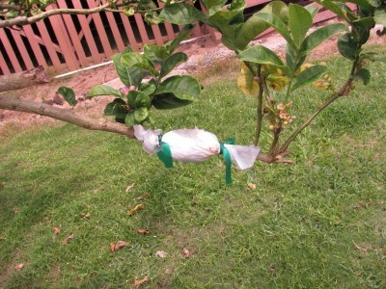
Asexual Methods
Cuttings (multiple methods)
Layering (multiple methods)
Division
Separation
Grafting

Slide 17
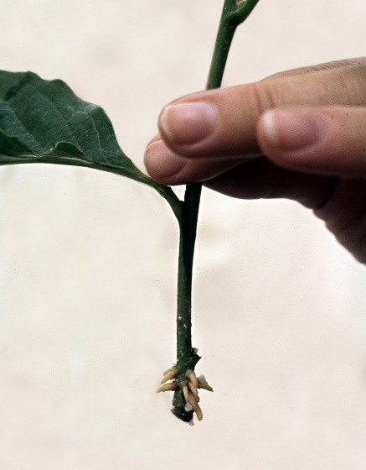
Cuttings — Stem
Cut off a section of the stem.
    Select healthy growth that is 3–6 inches long and make a sharp cut that doesn’t mash the stems.
Remove the lower leaves.
    Clip off the leaves on the lower half of the shoot, leaving the bare stem to insert into your potting mix.
Dip the end of your stem in rooting hormone.
    This helps many cuttings root more quickly.
Pot your cutting.
    Immediately place the cutting into the growing media of your choice.
    Keep your cutting humid by loosely wrapping it in clear plastic.

Slide 18
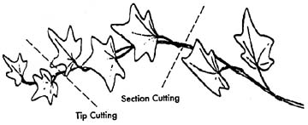
Cuttings — Stem Tip
Cut off a section of the stem, including the terminal bud.
    Select healthy growth that is 2–6 inches long and make a sharp cut that doesn’t mash the stems.
    Make the cut just below a node.
Remove the lower leaves.
    Clip off the leaves on the lower half of the shoot, leaving the bare stem to insert into your potting mix.
Dip the end of your stem in rooting hormone.
    This helps many cuttings root more quickly.
Pot your cutting.
    Immediately place the cutting into the growing media of your choice.
    Keep your cutting humid by loosely wrapping it in clear plastic.
    At least one node must be below the surface.
https://aggie-horticulture.tamu.edu/ornamental/a-reference-guide-to-plant-care-handling-and-merchandising/propagating-foliage-flowering-plants/

Slide 19
Cuttings — Stem Medial
Cut off a section of the stem.
    Make the first cut just above a node, and the second cut just above a node 2–6 inches down the stem.
Remove the leaves.
    Clip off the leaves on the shoot, leaving the bare stem to insert into your potting mix.
Dip the end of your stem in rooting hormone.
    This helps many cuttings root more quickly.
Pot your cutting.
    Immediately place the cutting into the growing media of your choice.
    Keep your cutting humid by loosely wrapping it in clear plastic.
    Be sure to position the right side up, axial buds are always above the leaves.
https://aggie-horticulture.tamu.edu/ornamental/a-reference-guide-to-plant-care-handling-and-merchandising/propagating-foliage-flowering-plants/

Slide 20
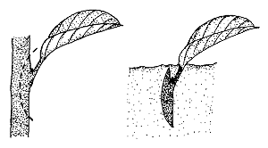
Cuttings — Leaf
Cut a leaf from the parent plant.
    Snip as close to the leaf stalk as possible.
Dip the cut end of your leaf in rooting hormone.
    This helps many cuttings root more quickly.
Pot your cutting.
    Immediately place the cutting into the growing media of your choice.
    Keep your cutting humid by loosely wrapping it in clear plastic.
    Be sure to place the cut portion into the growing media.
https://content.ces.ncsu.edu/plant-propagation-by-leaf-cane-and-root-cuttings-instructions-for-the-home-gardener

Slide 21
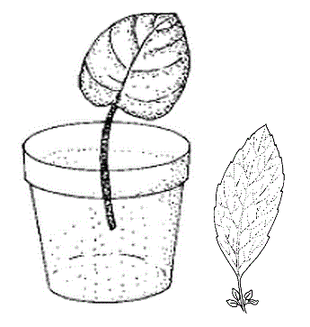
Cuttings — Leaf with Petiole
Cut a leaf from the parent plant.
    Ensure that you have the petiole of the leaf.
Dip the cut end of your leaf in rooting hormone.
    This helps many cuttings root more quickly.
Pot your cutting.
    Immediately place the cutting into the growing media of your choice.
    Keep your cutting humid by loosely wrapping it in clear plastic.
    Be sure to place the cut portion into the growing media.
https://content.ces.ncsu.edu/plant-propagation-by-leaf-cane-and-root-cuttings-instructions-for-the-home-gardener

Slide 22
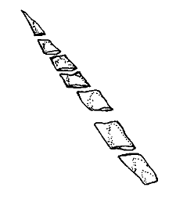
Cuttings — Leaf without Petiole
Cut a leaf from the parent plant.
    This method is used on plants with sessile leaves.
Dip the cut end of your leaf in rooting hormone.
    This helps many cuttings root more quickly.
Pot your cutting.
    Immediately place the cutting into the growing media of your choice.
    Keep your cutting humid by loosely wrapping it in clear plastic.
    Be sure to place the cut portion into the growing media.
https://content.ces.ncsu.edu/plant-propagation-by-leaf-cane-and-root-cuttings-instructions-for-the-home-gardener

Slide 23
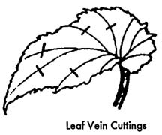
Cuttings — Split Vein
Detach a leaf from the parent plant.
Slit the veins of the leaf on the underside of the leaf surface.
Lay the cutting, lower side down, on the growing medium.
New plants will form at each cut.
https://aggie-horticulture.tamu.edu/ornamental/a-reference-guide-to-plant-care-handling-and-merchandising/propagating-foliage-flowering-plants/

Slide 24
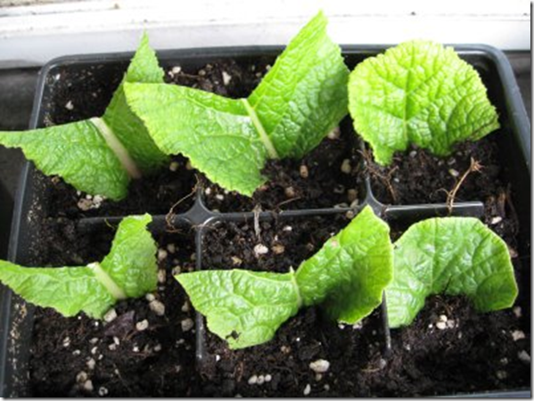
Cuttings — Leaf Sections
Cut leaves into wedges with at least one vein.
Lay leaves flat on the medium.
A new plant will arise at the vein.

Slide 25
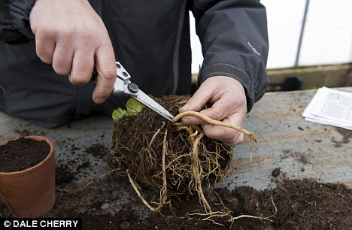
Cuttings — Root
Root cuttings are usually taken from 2- to 3-year-old plants during their dormant season when they have a large carbohydrate supply.

Slide 26
Layering
Stems still attached to the parent plant may form roots where they touch a rooting medium.
This method has a high success rate because it prevents the water stress and carbohydrate shortage that occurs with cuttings.
Some plants do this naturally.

Slide 27
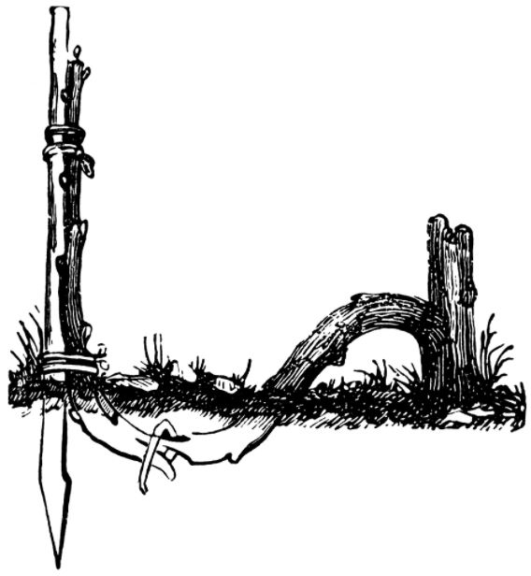
Layering — Simple
Bend the stem to the ground.
Cover part of it with soil, leaving the last 6–12 inches exposed.
Bend the tip to a vertical position and stake in place.
The sharp bend will induce rooting.
    Wounding the lower side of the branch or loosening the bark by twisting the stem may help.

Slide 28
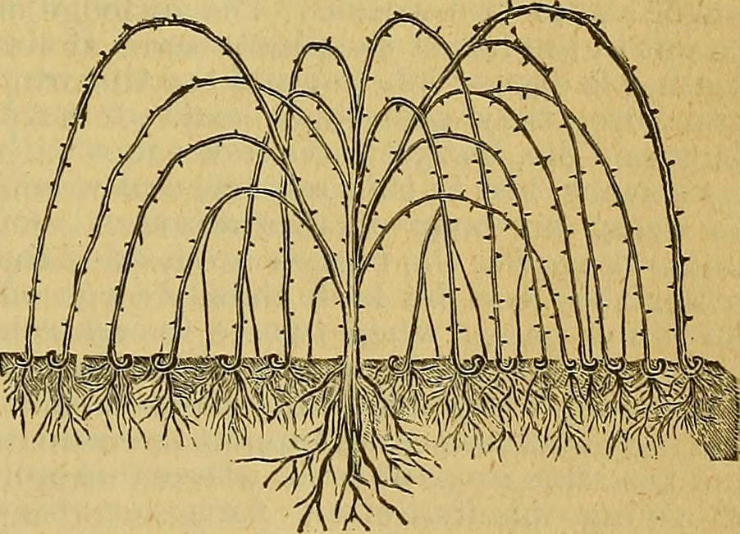
Layering — Tip
Dig a hole 3–4 inches deep.
Insert the shoot tip, and cover it with soil.
The tip will grow downward first and then bend sharply and grow upward.
Roots form at the bend.
Remove the new plant, and replant where desired.

Slide 29
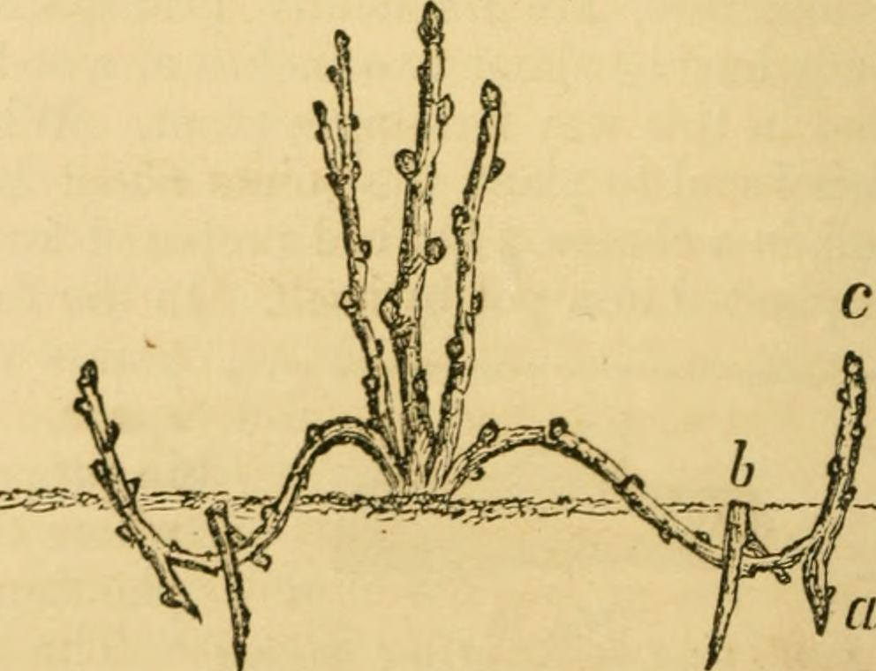
Layering — Compound
Cut the plant back to 1 inch above the ground in the dormant season.
Mound soil over the emerging shoots in the spring to enhance rooting.
Replant new plants where desired.

Slide 30
Layering — Air
Slit the stem just below a node.
Pry the slit open with a toothpick.
Surround the wound with wet, unmilled sphagnum moss.
Wrap plastic or foil around the sphagnum moss and tie in place.
When roots come through the moss, cut the plant off below the root ball.
Replant the new plant where desired.

Slide 31
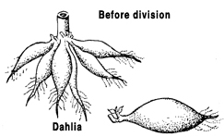
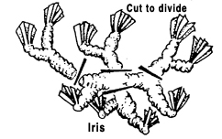
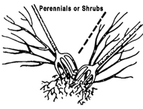
Division
If stems are not joined, gently pull the plants apart.
If the crowns are united by horizontal stems, cut the stems and roots with a sharp knife to minimize injury.
Dust with fungicide before replanting.
https://extension.umaine.edu/gardening/manual/propagation/plant-propagation/

Slide 32
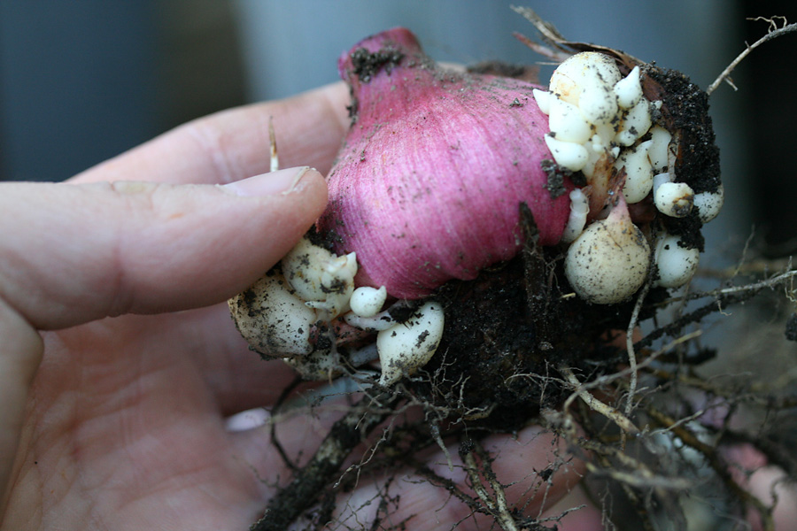
Separation
Bulbs: New bulbs form beside the original bulb.
    Separate the bulb clumps every 3 to 5 years.
    Replant the bulbs immediately.
Corms: New corms form on top of the old corms and cormels form around the new corm.
    After the leaves wither, dig up the corms and allow them to dry in indirect light for 2 to 3 weeks.
    Remove the cormels, and gently separate the new corm from the old corm.
    Dust all new corms with fungicide and store in a cool place until planting time.

Slide 33
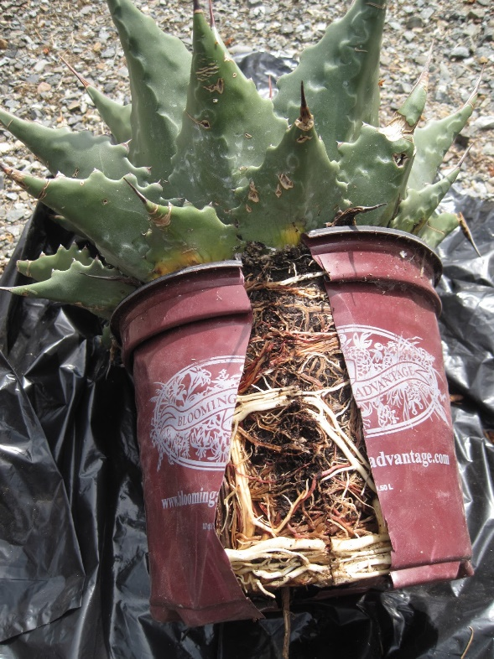
Potting a Plant
Sometimes, after significant growth has occurred, a plant needs to be potted or repotted.
All propagated plants need to be repotted.
Signs potting or repotting is needed:
    Plant looks too big for its pot.
    Roots are growing out of the drainage holes.
    Water is sitting on the top of the soil and is not absorbing.
    The plant has been in the same pot for a long time.

Slide 34
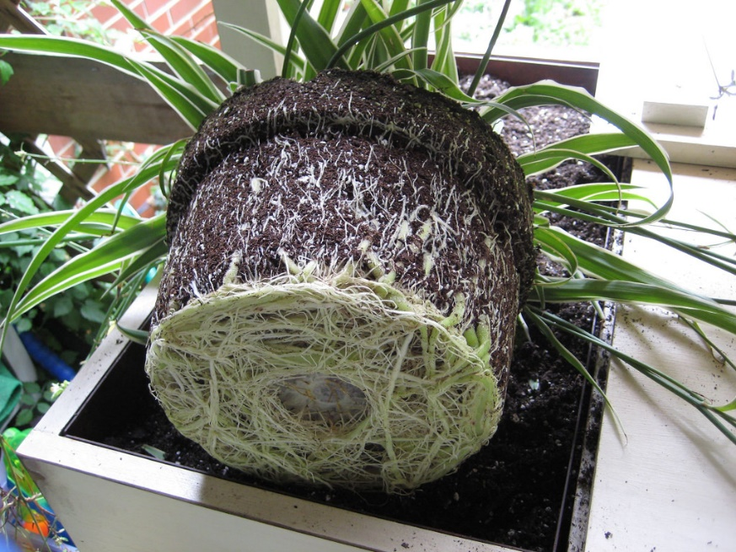
Potting a Plant — Steps
Inspect the plant for damage.
Prepare the new pot or container.
    Add a base layer of soil so the roots have space to grow. Add enough that the plant will have room without spilling over the top of the container.
Water the plant in the original container.
Remove the plant from the original container.
    Do not pull the plant out. Turn the plant upside down while placing your hand over the top of the pot.
    Rotate the plant, loosen it and allow it to fall out into your hand.

Slide 35
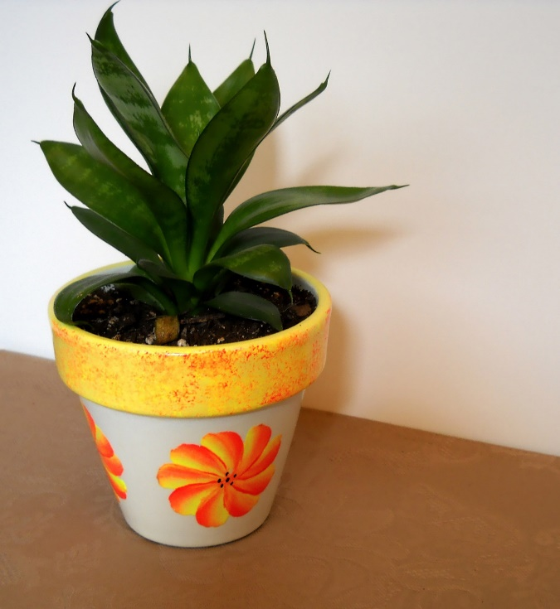
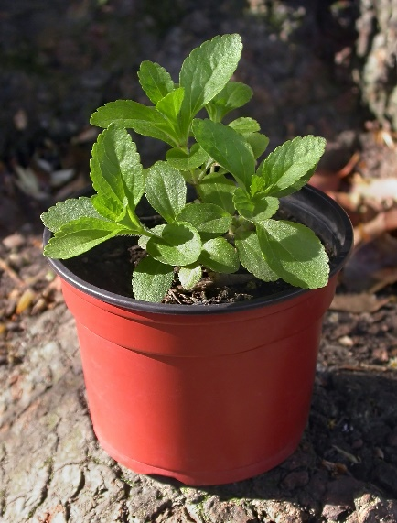
Potting a Plant — Steps
Prune the root ball and untangle old roots,
    This allows for the root ball to stop growing inward.
    Prune excess root length off.
Place the plant in the new container.
    Make sure the plant is centered and upright then press firmly into the new soil.
    Add soil around the plant to stabilize it.
Water the plant in the new container.
Properly label the plant with
    Variety
    Name
    Date

