Slide 1
Nursery/Landscape Unit Two
Lesson Three:
Design Concepts

Slide 2
Design Concepts
Each of the next three slides shows two different landscape designs.
Write down which one you think is better and why.
At the end of class, we will review these pictures and apply the design concepts we learned.

Slide 3
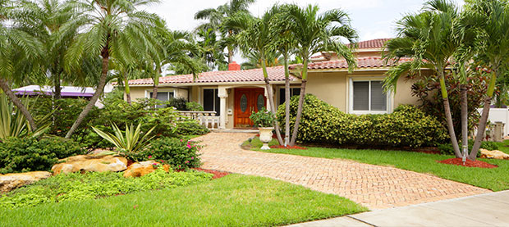
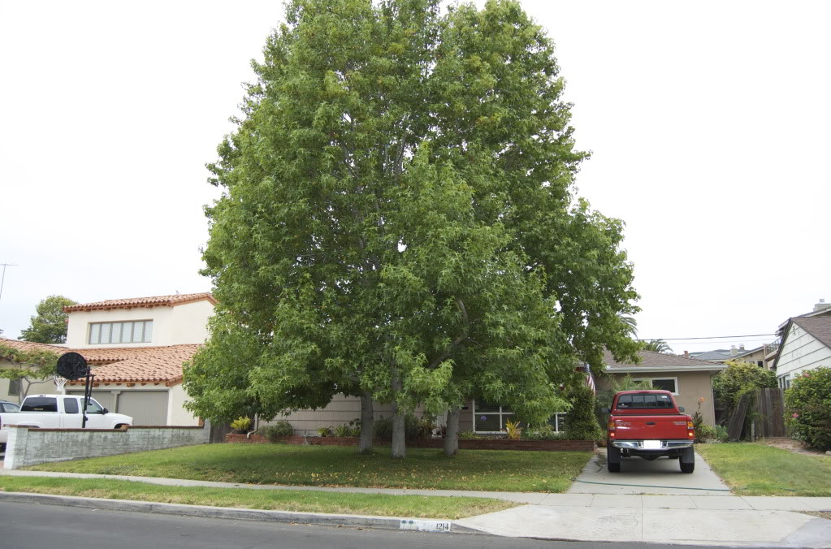
Design Concepts
Which is better?
http://www.executivelandscapingswfl.com/images/cape-coral-lawn-maintenance/Landscaping.jpg
http://photobucket.com/gallery/user/KiminPL/media/cGF0aDpGcm9udCBsYW5kc2NhcGUvRFNDXzAwMDktMi5qcGc=/?ref=
Notes:
The picture on the right is a better landscape. The left picture fails because the tree is much larger than the house (proportion), and there is nothing else to balance it out. The tree is completely blocking the house.

Slide 4
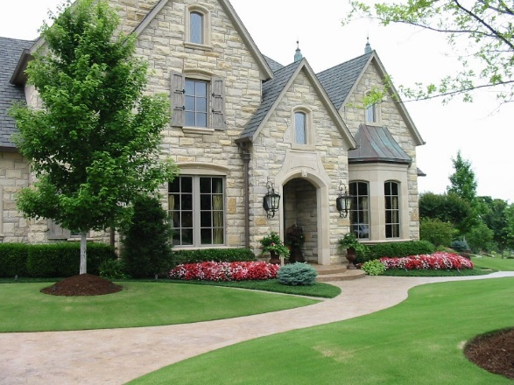
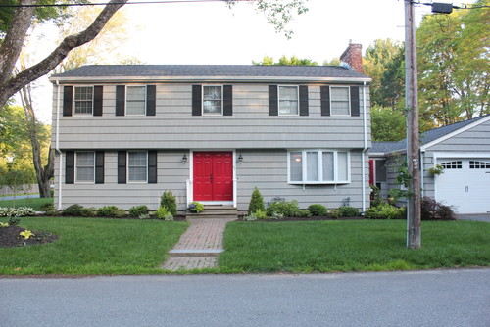
Concept Designs
Which is better?
http://www.coachuoz.com.au/wp-content/uploads/2016/07/landscapers.jpeg
https://st.hzcdn.com/simgs/3dc2611b058ded3e_8-4773/home-design.jpg
Notes:
This house on the right fails because its landscaping is too small for the house. It has balance and good lines. Creates focus on the front door, but the plants are way too small.

Slide 5
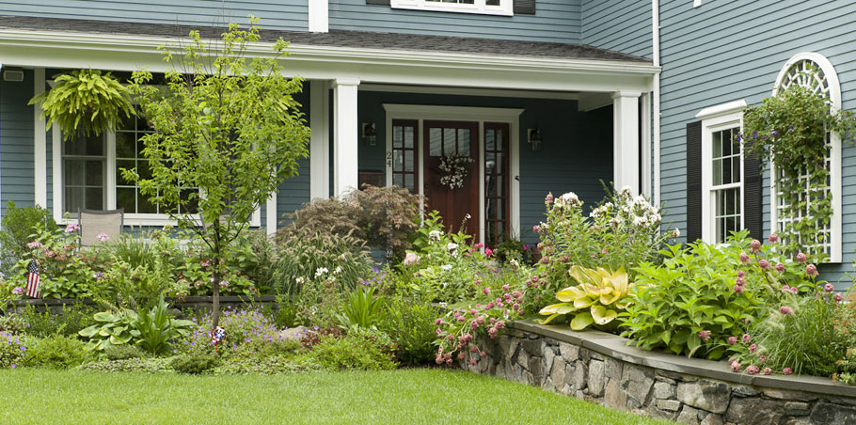
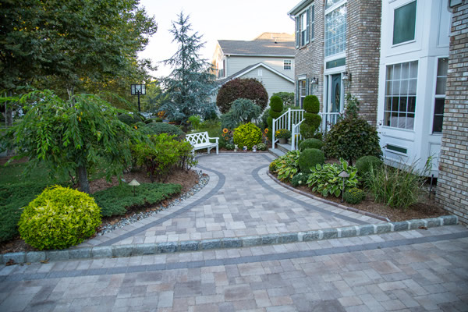
Concept Designs
Which is better?
https://lakelandlandscaping.com/wp-content/uploads/2016/03/paver-driveway-and-walkway-install.jpg
http://www.terrascapeslandscapedesign.com/wp-content/uploads/2013/01/Young-front-for-site.jpg
Notes:
The house on the left fails because it is too complex. There are no defined lines and many different plants, and it is unbalanced. The landscape on the right has nice lines and great proportion and proximal balance.

Slide 6
Lesson Overview
The six different principles and concepts used within landscape design are the same for all fine arts.
Since landscape design is considered an art form, there may be differences in how these concepts are applied and interpreted.
While many people may not consider themselves artists, these principles stem from a natural visual sense most people possess.

Slide 7
Balance
A lack of visual balance can create a sense of uneasiness.
There are three different types of balance:
  Symmetric
  Asymmetric
  Proximal/Distal

Slide 8
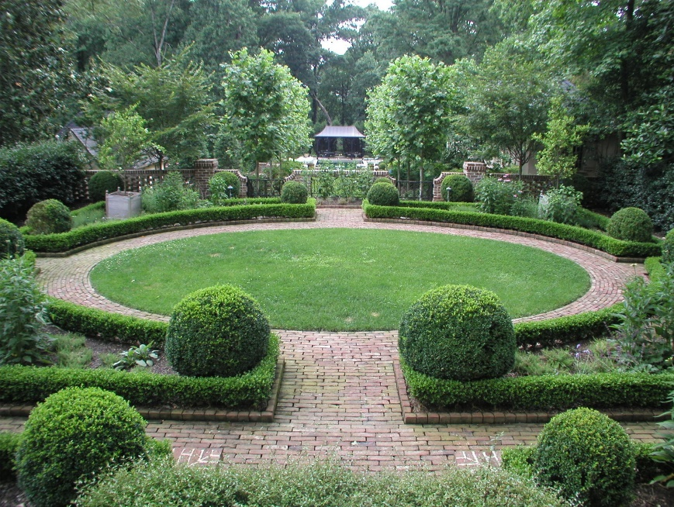
Balance
Symmetric
Symmetrical balance is a mirror image from one side to another.
This style creates a very formal and stiff appearance.
Symmetric is the simplest and
easiest form of balance to use.
https://georgelduncan48.files.wordpress.com/2013/05/landscape-design-principles-5.jpg

Slide 9
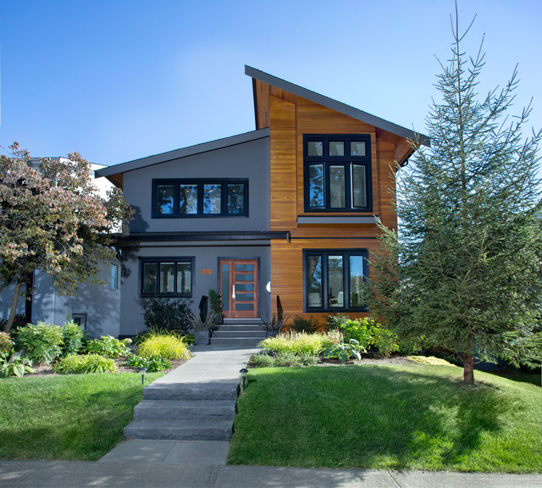
Balance
Asymmetrical
Asymmetrical balance is more informal and can be more
intriguing to the viewer.
The balance is created by the
weight on both sides of the
landscape rather than
mirroring.
Plants and materials on either
side may vary.
https://st.hzcdn.com/simgs/65d1fc910112ec81_4-2743/contemporary-exterior.jpg

Slide 10
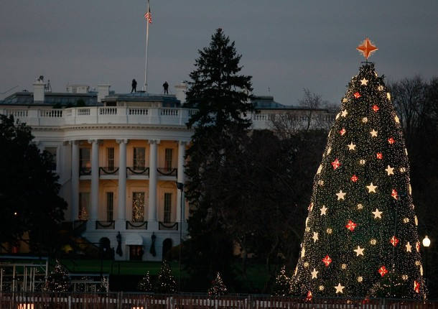
Balance
Proximal/Distal
Proximal and distal balance use the distance and proximity of a landscape to balance it out.
Any large structures, mountains or trees in the background must be considered to maintain
balance.
Notice how the Christmas tree
and the White House are even
because their difference in
distance make them balanced.
http://raredelights.com/wp-content/uploads/2011/12/History-in-Pictures-of-the-Christmas-Tree-in-the-White-House-15.jpg

Slide 11
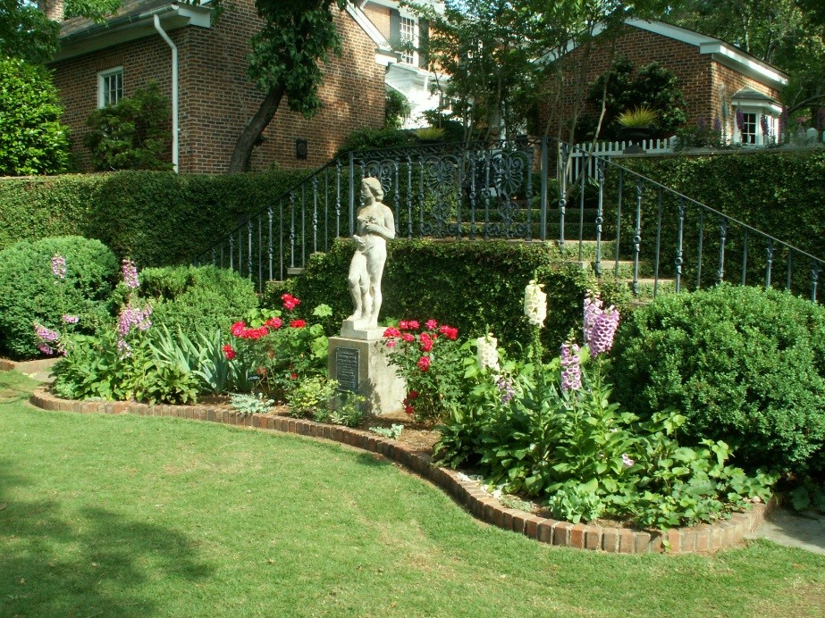
Focalization of Interest
A well-designed landscape will have a focal point that captures the viewer’s attention.
The focal point can be predetermined, such as an entrance to a house, or set by the designer, like a statue.
It is important not to
overuse focal points;
otherwise, the landscape
may become confusing
to the viewer.
http://www.ced.uga.edu/wp-content/uploads/2015/03/FMG.statue.DN_.jpg

Slide 12
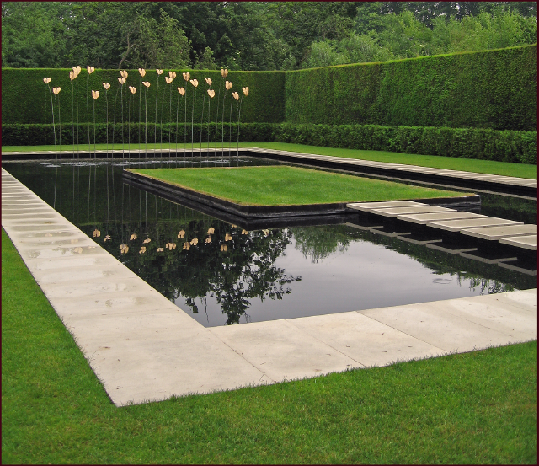
Simplicity
Simplicity aims to put the viewer at ease within a landscape.
Landscape designs become overbearing when too many different shapes, colors or species are used.
Simplicity does not mean
simplistic or boring. This
principle focuses more on
the ease of understanding the
design.
https://notanothergardeningblog.files.wordpress.com/2013/11/formal-structure1.png?w=640&h=553

Slide 13
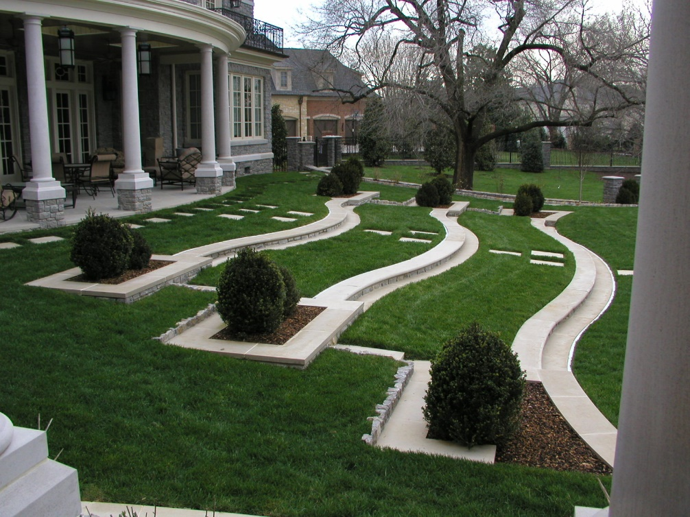
Rhythm and Line
Rhythm within landscape design is similar to music. It is a repeating theme throughout.
Line is just as it sounds. It could be hard and straight lines or soft and curvy lines.
Repeated lines, arcs and
shapes can create
engaging yet simple
landscape designs.
http://dargan.com/about/images/TUrnersidestepsbest.JPG

Slide 14
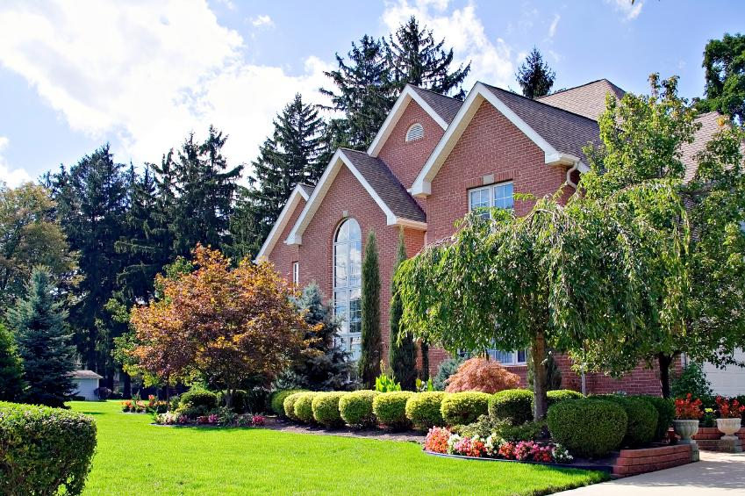
Proportion
Proportion focuses on the relationship of perceived size and placement within a landscape.
Vertical, horizontal and spatial differences must be taken into consideration.
Landscapes can look
different while sitting,
standing or from a
distance.
http://cf.ltkcdn.net/garden/images/slide/178879-849x565-formal-hedge-trees.jpg

Slide 15
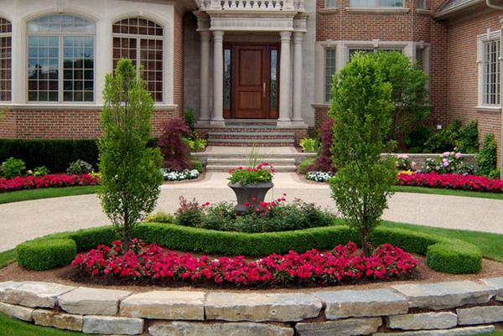
Unity
Unity is achieved if all of the other five principles have been applied.
A unified landscape design has everything come together and create a whole visual for the viewer.
If parts of a landscape
seem out of place due to
differences in species,
color or shape then
unity is not achieved.
https://articles.extension.org//sites/default/files/styles/large/public/6423714165_3bd5a2733e_z.jpg

