Slide 1
Unit Two: Plant Disease and Pest Management
Lesson Three:
Insects and Pests
Lesson Objectives:
Identify common insects and pests found in floriculture plants.
Evaluate the causes and effects of insects and pests in floriculture plants.
Discuss pest management strategies for floriculture plants.
Footer description area.

Slide 2
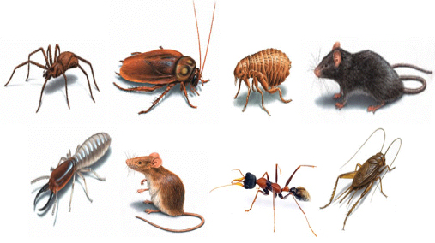
Introduction
What is a Pest?
Create a classroom definition for the term “Pest.”
http://www.jpcdubai.com/Images/general_pests.jpg

Slide 3
Identification
Pests
Aphids
Fungus gnats
Leaf miner
Leaf hopper
Mealy bugs
Scale
Shore flies
Snails/Slugs
Spider mites
Thrips
Whiteflies

Slide 4
Aphids
Overview:
Aphids are small, pear-shaped insects with soft bodies that use their mouth to pierce the plant and suck out nutrients. They range in color from green to black, depending on the species. A pair of tube-like structures protrude out of its hindquarters, called a cornicle, and this helps distinguish an aphid from other pests.

Slide 5
Aphids
Symptoms:
Aphids typically congregate and feed around the stem and leaves, leaving their skin casts on the underside of leaves. Unlike other pests, they do not rapidly disperse when disturbed. They excrete a sticky substance called honeydew that will eventually turn black and moldy. Leaf curling and distortion is also a symptom of an aphid infestation.

Slide 6
Aphids
Prevention:
Check plants regularly.
Hose or prune off sections that show signs of infestation.
Treatment:
Chemically – Insecticide
Culturally – Parasitic wasps

Slide 7
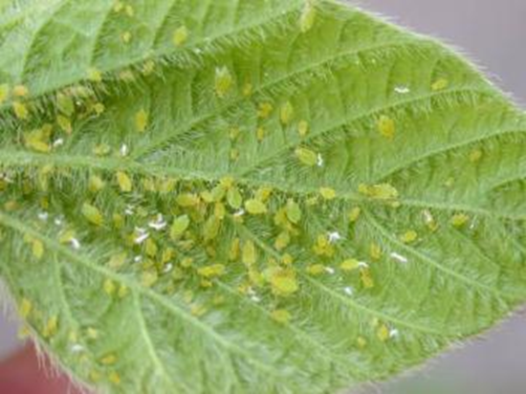
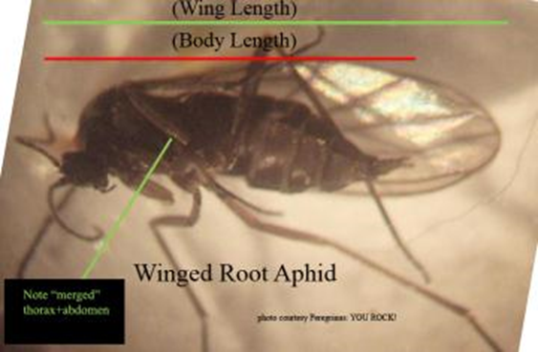
Aphids
Resources:
University of California
http://ipm.ucanr.edu/PMG/PESTNOTES/pn7404.html

Slide 8
Fungus Gnats
Overview:
The full-grown fungus gnat is a small black pest that resembles a mosquito. They are a nuisance but do not pose a threat to humans or plants. The larvae, however, is laid in the soil and will damage the roots and prevent growth.

Slide 9
Fungus Gnats
Symptoms:
Fungus gnats are not strong fliers; they tend to hover or crawl around growing media, foliage or wet mulch. The larva thrive in moist soil and other growing media and leave shiny trails from their excretion.

Slide 10
Fungus Gnats
Prevention:
Use sticky pads to capture adults.
Reduce soil moisture.
Clean up plant debris.
Treatment:
Chemically – Insecticides
Culturally – Nematodes

Slide 11
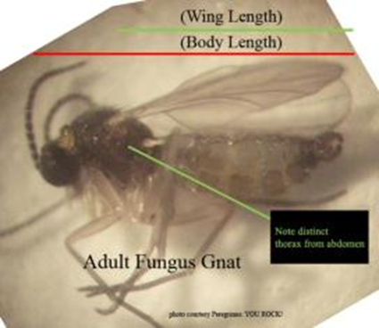
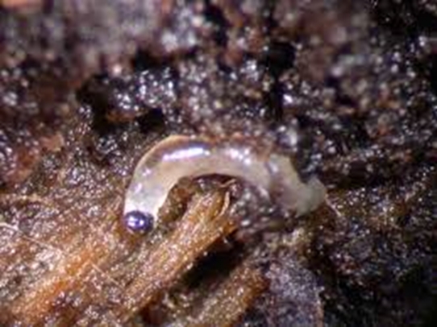
Fungus Gnats
Resources:
University of California
http://ipm.ucanr.edu/PMG/PESTNOTES/pn7448.html

Slide 12
Leaf Miner
Overview:
At 1.8 mm, adult leaf miners are brightly colored and have clear wings. The females puncture the leaves and lay their eggs inside the tissue. Once the eggs hatch, the larvae feed on the leaf until they drop to the soil to pupate. During an infestation, the punctures from egg laying and larvae mines will damage the plant and take away from the aesthetic value.

Slide 13
Leaf Miner
Symptoms:
The larvae form mines inside the leaf during their feeding, usually following the veining pattern. Depending on the species of leaf miner, the mines can be visible from either the top or bottom of the leaf.

Slide 14
Leaf Miner
Prevention:
Use sticky pads to capture adults.
Check plants regularly.
Keep area free of weeds.
Treatment:
Chemically – Insecticide
Culturally – Predatory mites

Slide 15
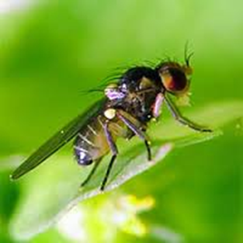
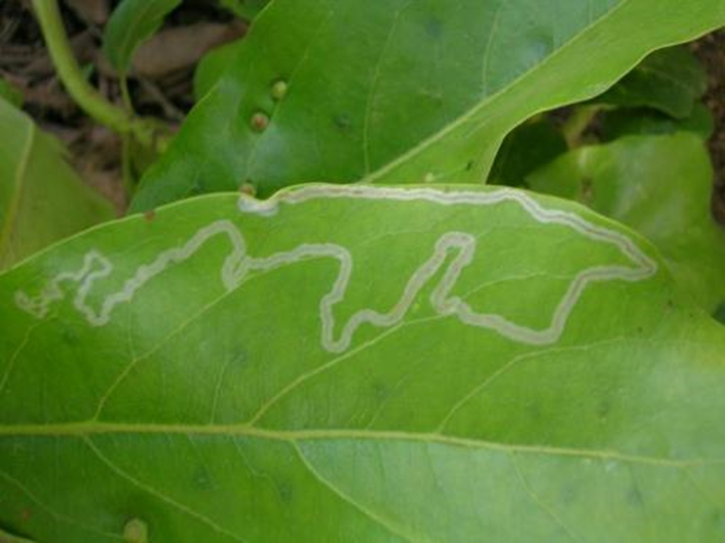
Leaf Miner
Resources:
University of California
http://ipm.ucanr.edu/PMG/r280300911.html

Slide 16
Leaf Hopper
Overview:
Growing to almost a quarter inch in length, leaf hoppers are very fast moving and jump when disturbed. The females lay their eggs inside the plant tissue, which causes pimple-like sores to form. Once the eggs hatch, the nymphs will molt several times, leaving skin castings on the underside of the leaf until fully grown.

Slide 17
Leaf Hopper
Symptoms:
Leaf hoppers leave speckled white marks on the leaves from their feeding. Eventually, too much feeding will cause the leaves to curl and brown. Once leaf hoppers are adults, they become very hard to control due to their quick movement.

Slide 18
Leaf Hopper
Prevention:
Check plants regularly for castings.
Keep area free of weeds.
Treatment:
Chemically – Insecticide
Culturally – Predatory wasps or ladybird beetles

Slide 19
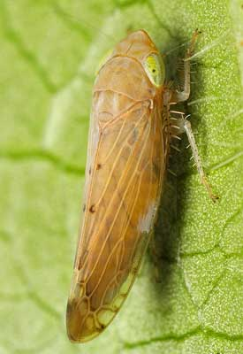
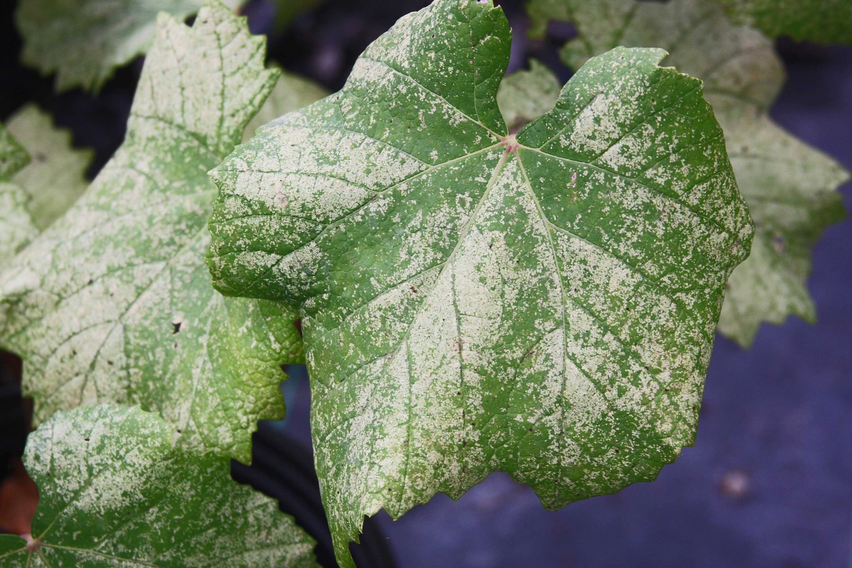
Leaf Hopper
Resources:
University of California
http://ipm.ucanr.edu/PMG/GARDEN/VEGES/PESTS/leafhopper.html
http://ipm.ucanr.edu/PMG/C302/m302splfhprenemy.html

Slide 20
Mealy Bugs
Overview:
Mealy bugs are tiny, wingless, soft-bodied insects that measure only 1/20 to 1/5 inch in size. They are oval shape and covered in a mealy or cottony wax, making them easily mistaken for wooly aphids.

Slide 21
Mealy Bugs
Symptoms:
When mealy bugs congregate on a plant, they cover it in a white cottony mass as they feed on the plant’s stems and leaves. In some cases, they produce a sticky substance called honeydew that will eventually turn black and moldy. Overtime, an infestation will slow the growth of the plant.

Slide 22
Mealy Bugs
Prevention:
Check plants regularly.
Hose or prune off sections that show signs of infestation.
Treatment:
Chemically – Insecticide
Culturally – Parasitic wasps

Slide 23
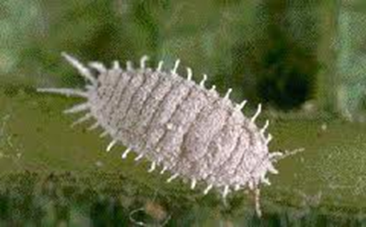
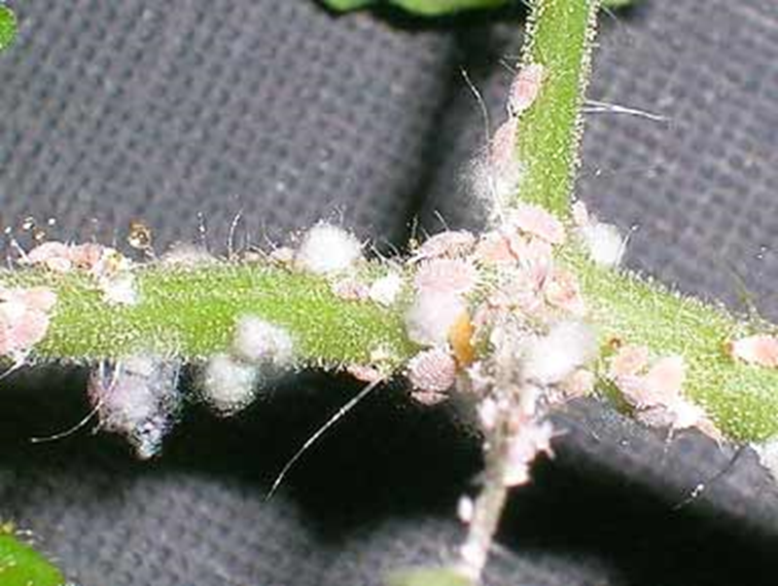
Mealy Bugs
Resources:
University of California
http://ipm.ucanr.edu/PMG/GARDEN/PLANTS/INVERT/mealybugs.html

Slide 24
Scale
Overview:
Scales vary in species, but the females are round and wingless with no recognizable body parts. They stick their mouthparts into the plant and suck the nutrients out. The males are very rarely seen. They are small yellow- or white-winged flies with an antenna. Female scales are either armored or soft.

Slide 25
Scale
Symptoms:
An infestation will cause the plant’s growth to slow and leaves to appear dehydrated. Some scales produce a sticky substance called honeydew that will eventually turn black and moldy. A few scales, and even high concentrations of certain species, will not harm plants.

Slide 26
Scale
Prevention:
Monitor the plants for signs of honeydew.
Set tape traps.
Treatment:
Chemically – Insecticide
Culturally – Ladybird beetle

Slide 27
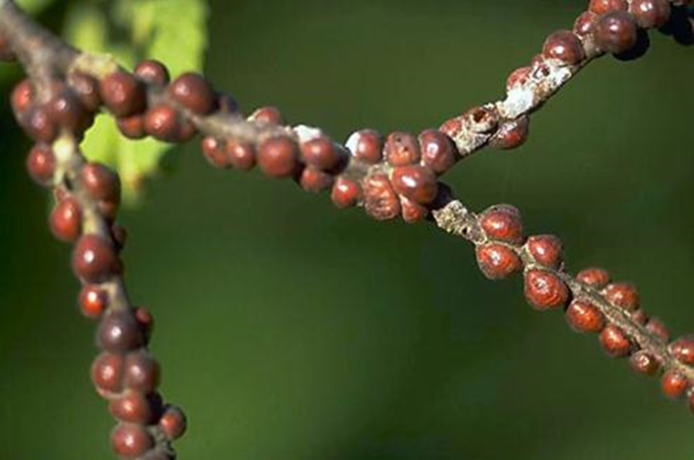
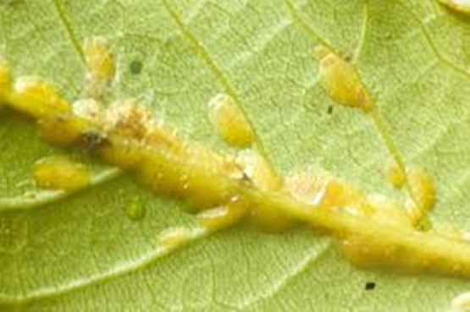
Scale
Resources:
University of California
http://ipm.ucanr.edu/PMG/PESTNOTES/pn7408.html

Slide 28
Shore Flies
Overview:
Smaller then the typical house fly, shore flies have short legs, an antenna and their wings have white circles on them. They breed in overwatered areas that have a good source of algae.

Slide 29
Shore Flies
Symptoms:
Shore flies are annoying but not harmful to plants. Their excrement will form small specs on the leaves, lowering the aesthetic value. They can also spread fungal diseases inside the greenhouse. Typically, shore flies tend to congregate near irrigation equipment and under benches where algae can grow.

Slide 30
Shore Flies
Prevention:
Avoid overwatering.
Use sticky pads.
Treatment:
Chemically – Insecticide
Culturally – Correct/adjust watering

Slide 31
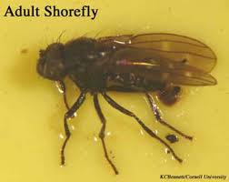
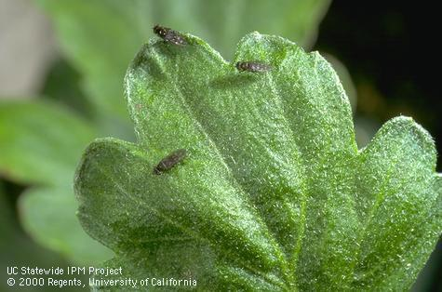
Shore Flies
Resources:
University of California
http://ipm.ucanr.edu/PMG/r280301111.html

Slide 32
Snails/Slugs
Overview:
Both these pests belong to the Mollusca phylum and share similar characteristics. A major distinguishing factor between the two is that a snail has a spiral shell on its back. Both secrete mucus, which helps them move along, and as it dries it creates a slime trail. They are both sensitive to the sun, so they typically only come out at night or on cloudy days.

Slide 33
Snails/Slugs
Symptoms:
Snails and slugs chew on all types of plants and will leave holes with smooth edges in the plants. They also like to eat decaying plants, fruit and flowers. To tell if the bite marks where made by a mollusk and not another kind of pest, look for a slime trail left by their mucus.

Slide 34
Snails/Slugs
Prevention:
Check in cool, moist areas for hiding snails/slugs.
Routinely check plants and pick snails/slugs off by hand when necessary.
Create a copper barrier.
Treatment:
Chemically – Molluscicide
Culturally – No treatment listed

Slide 35
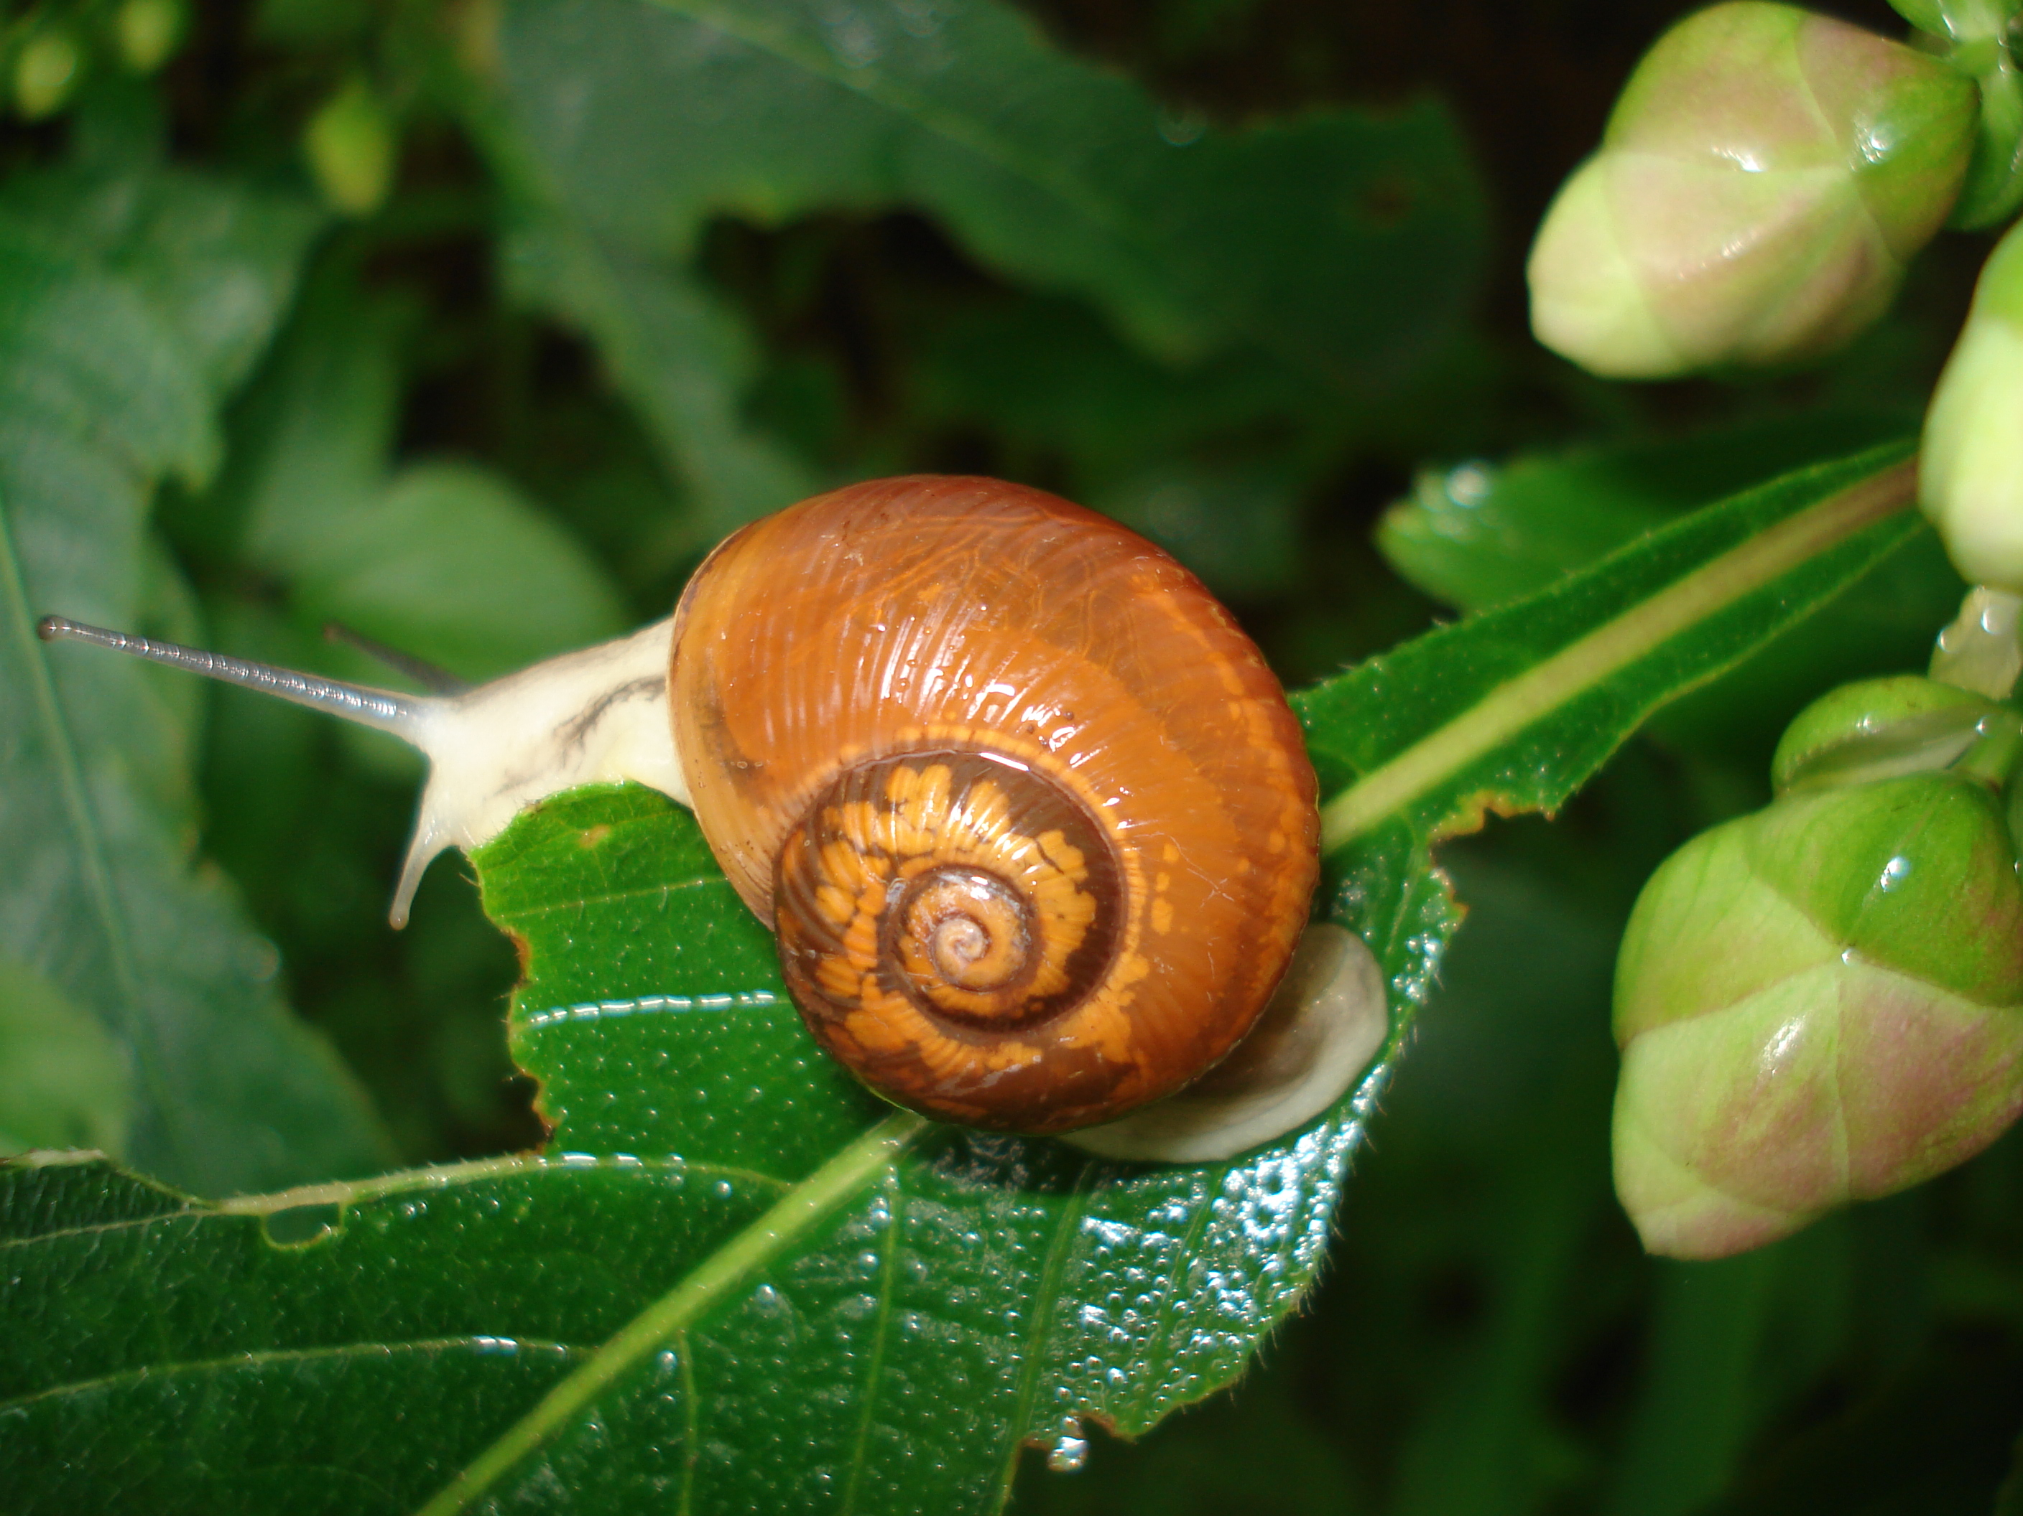
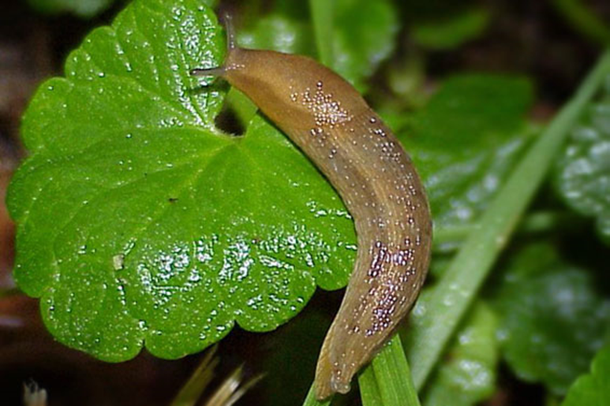
Snails/Slugs
Resources:
University of California
http://ipm.ucanr.edu/PMG/PESTNOTES/pn7405.html

Slide 36
Spider Mites
Overview:
Spider mites live in colonies and usually move on the underside of leaves. The webs that they spin help distinguish a spider mite infestation from other pests. Adults are oval shaped with 8 legs and red eye dots near their head.

Slide 37
Spider Mites
Symptoms:
The spider mite sucks the nutrients from the leaves and in high concentrations, they can severely damage the plant. The first sign is white speckles or a stippling effect on the leaves and then webbing will begin to appear. The plant can show signs of dehydration, causing leaves to yellow and drop off.

Slide 38
Spider Mites
Prevention:
Prevent dust from accumulating by sweeping or spraying.
Routinely check the undersides of leaves.
Treatment:
Chemically – Miticide
Culturally – Predatory mites

Slide 39
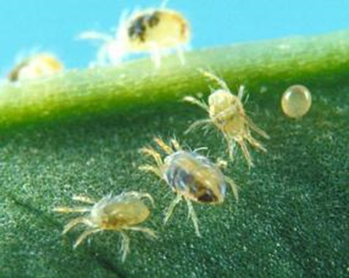
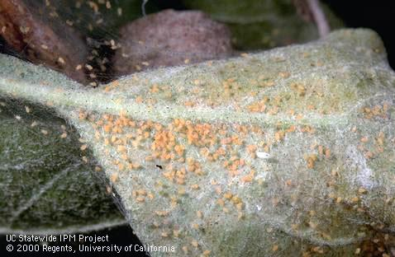
Spider Mites
Resources:
University of California
http://ipm.ucanr.edu/PMG/PESTNOTES/pn7427.html

Slide 40
Thrips
Overview:
Another sucking insect that measures 1 mm in length and has fringed wings. Thrips feed on plant tissue, fungal spores and pollen. They range from bright red or yellow to a dark brown or black. Some thrips are purposefully introduced because they help control other pests, but once those pests have been managed, they will begin eating the plant. They also transfer diseases among plants.

Slide 41
Thrips
Symptoms:
Thrips cause white speckles or stippling, which gives the leaves a silver look. They also leave black dots from their excrement. Plants suffering from tospovirus will typically have western flower thrips present. An infestation will lead to scaring, distorted growth and lower aesthetic value.

Slide 42
Thrips
Prevention:
Gently shake the plants that you suspect to be affected.
Use sticky pads.
Prune off sections that show signs of infestation.
Keep area free of weeds.
Treatment:
Chemically – Insecticides
Culturally – Parasitic wasps

Slide 43
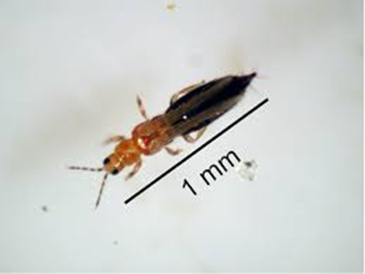
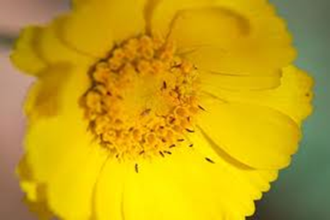
Thrips
Resources:
University of California
http://ipm.ucanr.edu/PMG/PESTNOTES/pn7429.html

Slide 44
Whiteflies
Overview:
Whiteflies are not actually flies. The are winged insects that have a waxy white covering on their bodies. Their wings are held up in a roof-like manner. They reproduce rapidly in warm weather and little can be done once a large colony has been established. They suck the sap out of plants and secrete a sticky substance called honeydew that will eventually turn black and cause leaves to yellow.

Slide 45
Whiteflies
Symptoms:
Whiteflies tend to congregate on the underside of leaves. They will cause symptoms similar to dehydration in plants. They also cause plant discoloration and distortion.

Slide 46
Whiteflies
Prevention:
Prevent dust from accumulating by sweeping or spraying.
Use sticky pads.
Hose or remove any sections of a plant that show signs of infestation.
Treatment:
Chemically – Insecticides
Culturally – Ladybird beetles

Slide 47
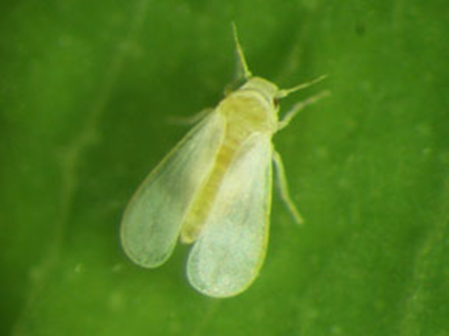
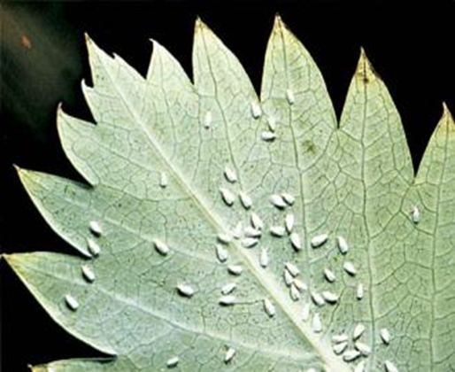
Whiteflies
Resources:
University of California
http://ipm.ucanr.edu/PMG/PESTNOTES/pn7401.html

Slide 48
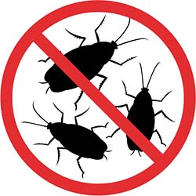
Review
Think, Pair, Share
What are three prevention techniques you would suggest as something to practice for good plant production (beyond techniques used only in the case of an infestation).
To ensure great plants, do these three things…
1.
2.
3.
http://www.mercurytermiteandpest.com/no_cockroaches.jpg

