Slide 1
Lesson Four: Pricing a Landscape Design

Slide 2
The Price is Right
The next five slides will have items commonly used throughout a landscape.
Try to guess the price of each item without going over. Write down each guess on a piece of paper before the answer is shown.
Whoever is the closest without going over the price is the winner.

Slide 3
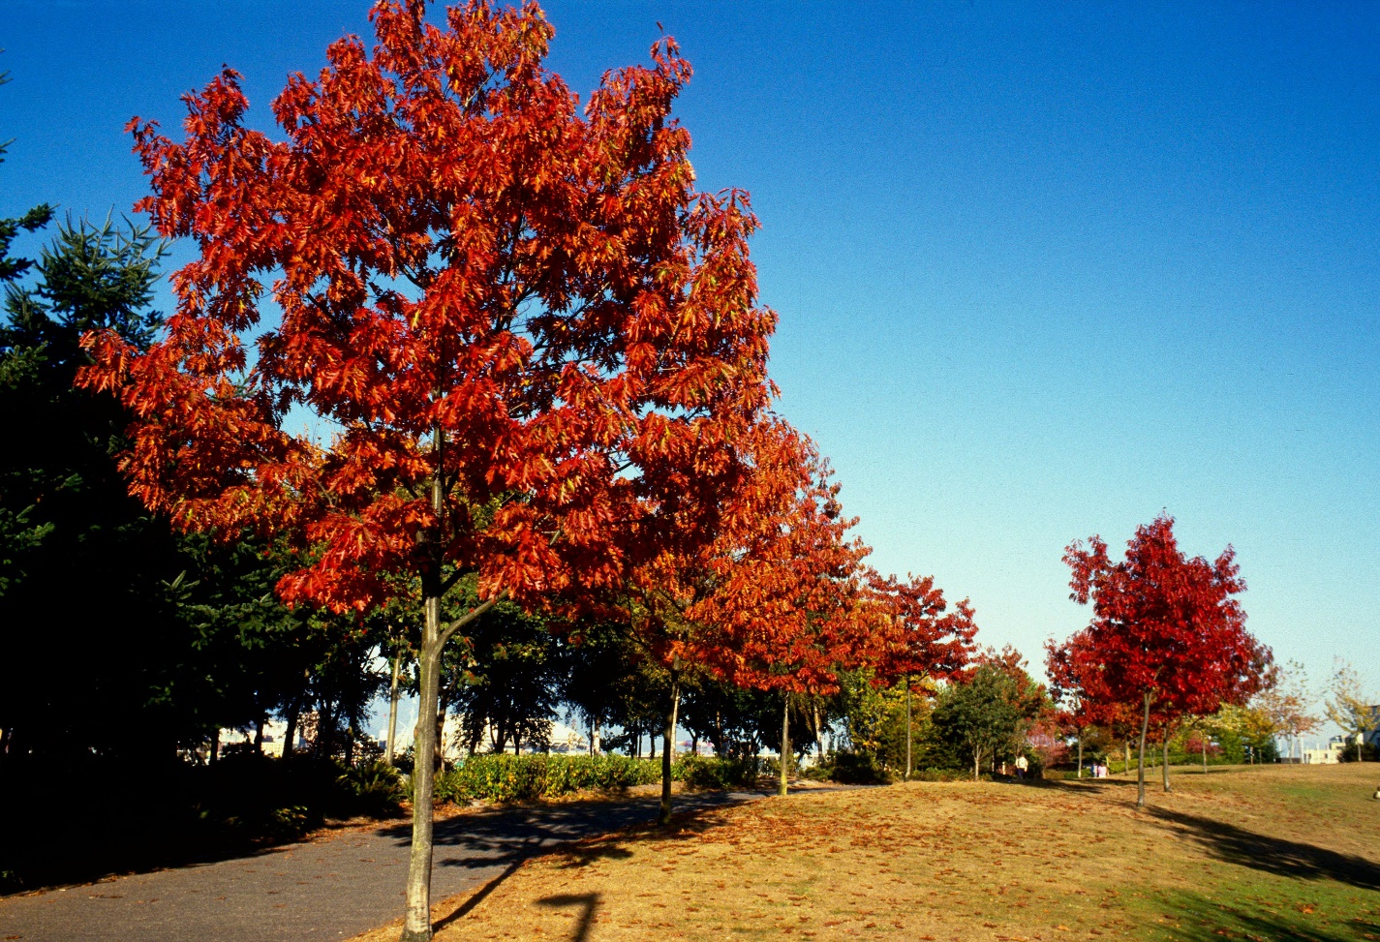
The Price is Right
6–7ft Northern Red Oak
~$120
https://i.ytimg.com/vi/C5PY0e9q2WM/maxresdefault.jpg

Slide 4
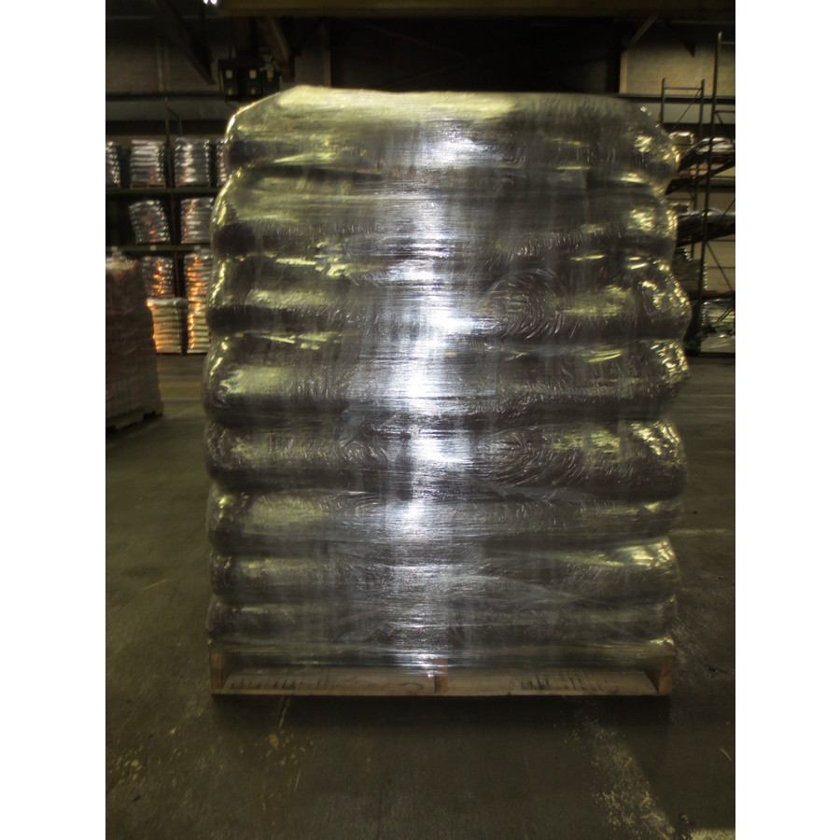
The Price is Right
80 cubic feet of mulch
~$1,000
https://www.lowes.com/pd/Rubberific-80-cu-ft-Brown-Shredded-Bulk-Mulch/4746673

Slide 5
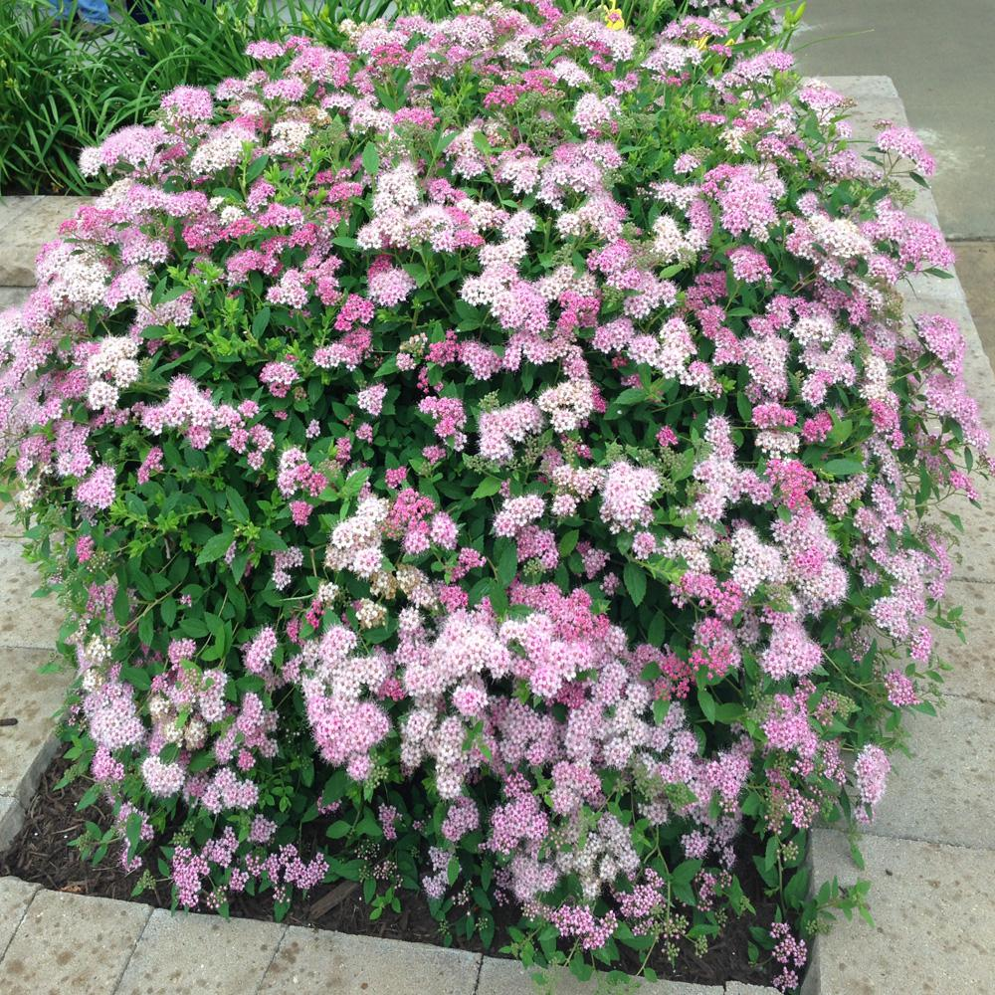
The Price is Right
3 gal. Princess Spirea Shrub
~$40
http://www.homedepot.com/p/OnlinePlantCenter-3-Gal-Little-Princess-Spirea-Shrub-S6018G3/301765808

Slide 6
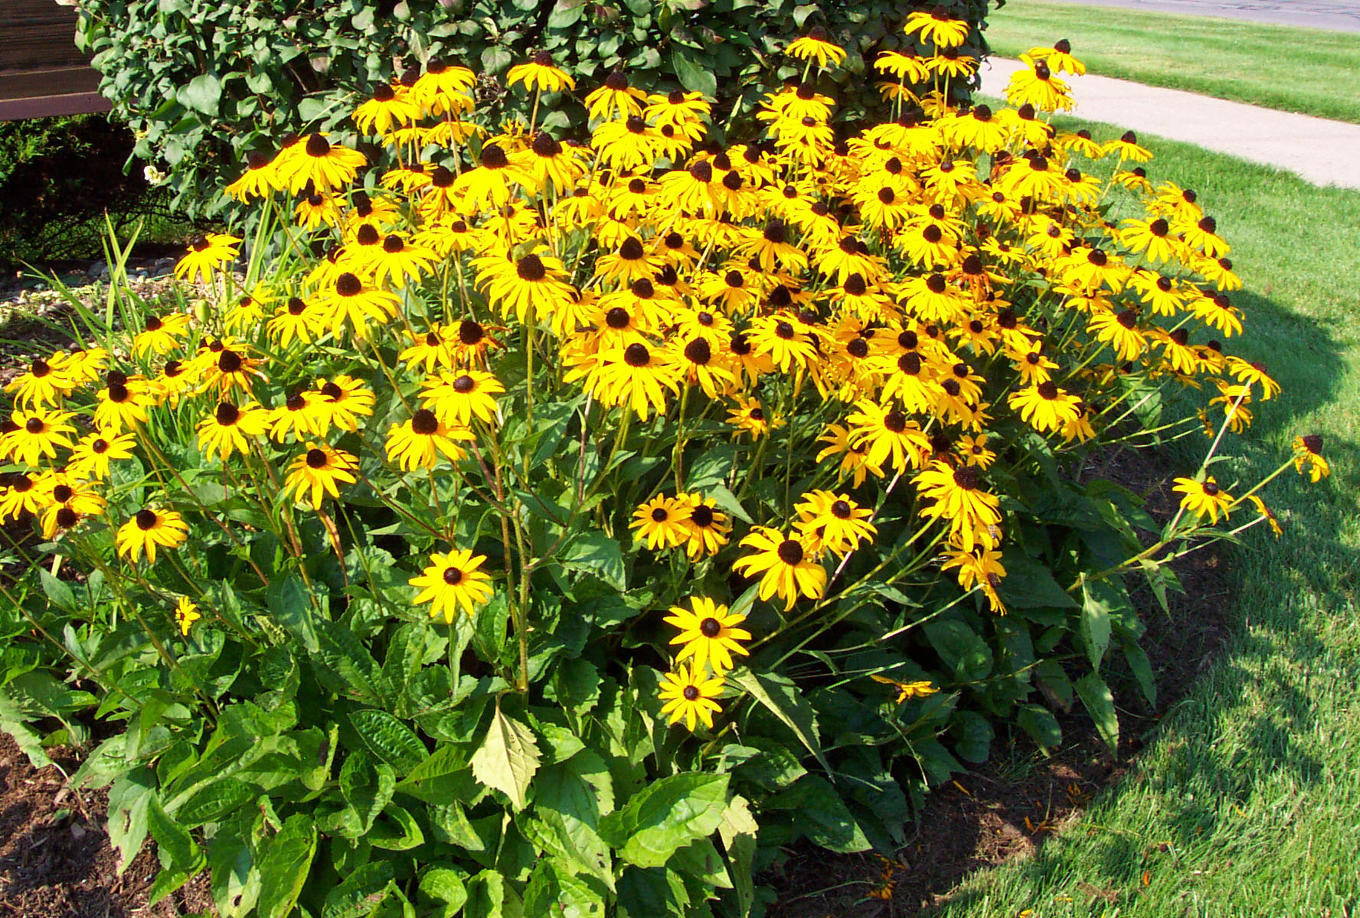
The Price is Right
100 Black-eyed Susans
~$70
http://gardenhobbies.com/flower/pictures/besusan001.jpg

Slide 7
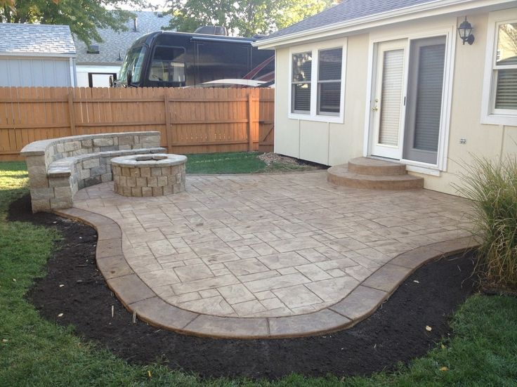
The Price is Right
250 square feet of pavers
~$625
https://s-media-cache-ak0.pinimg.com/originals/a2/68/74/a26874753f150624dd403a46e0212acc.jpg

Slide 8
Cost vs. Price
Cost
Costs refer to the recovery of expenditures.
Cost = Materials + labor + equipment use + subcontractors + overhead
These are all expenses assumed by the landscape contractor during the construction of a landscape. If they are not recovered through payment by the client, the landscaper will lose money on the project.

Slide 9
Cost vs. Price
Price
The price is what the client pays to the landscape contractor.
Price = Landscape design services + contingency + profit + cost
Contingency acts as an insurance for the contractor. Throughout the project, there may be unforeseen costs due to weather delays, labor issues and varying materials cost.

Slide 10
Estimates and Bids
Estimates
An estimate is a landscape contractor or architect’s best approximation of the price a customer will be charged for a landscape project.
The time required to prepare an estimate may take minutes or hours depending on the detail, accuracy and size of the project.
An estimate is not a firm price, however. Certain costs are subject to change but should not stray far from the estimate.

Slide 11
Estimates and Bids
Bids
A bid is a definite price offered to a client to put a number on the services and materials that would be provided.
Once a bid is signed by all parties, that is the agreed upon price for the services that will be provided. If changes are made to the design, the price of the bid may be renegotiated.
Should unforeseen conditions that are not the fault of the client increase costs, the bid remains the same. This cuts into the profits of the landscaper.

Slide 12
Specifications
For large projects, specifications are listing of the materials, quality standards and time schedules for a project.
These specifications are given to landscape contractors so they can prepare a bid for the project. Specifications must be extremely accurate to ensure all parties know what is expected and to receive accurate bids.
The creation of specifications can be tedious. Every plant, brick, light fixture, every cubic yard of concrete or mulch must be counted.

