Slide 1
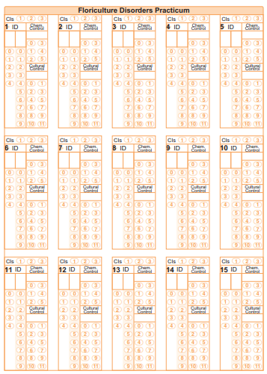
National FFA Floriculture CDE
Disorders Practicum
Please locate the section labelled Floriculture Disorders Practicum on your E-rubric scan sheet to mark your answers. Check to make sure that the sample number matches the question number.

Slide 2
It is necessary that students have a printed copy of the Disorders Student Handout or the Disorder Practicum Scorecard (page 23 of the handbook) with them while they complete this section

Slide 3
Students will need to identify 4 components for each disorder:
A. The classification
1. Diseases
2. Insects, Pests, Mites
3. Nutritional/ Environmental
B. Identification of the disorder – be sure to include a Zero (0) in the front of single digit numbers – such as 1 for aphids should be entered at 01
C. Chemical Control
D. Cultural Control

Slide 4
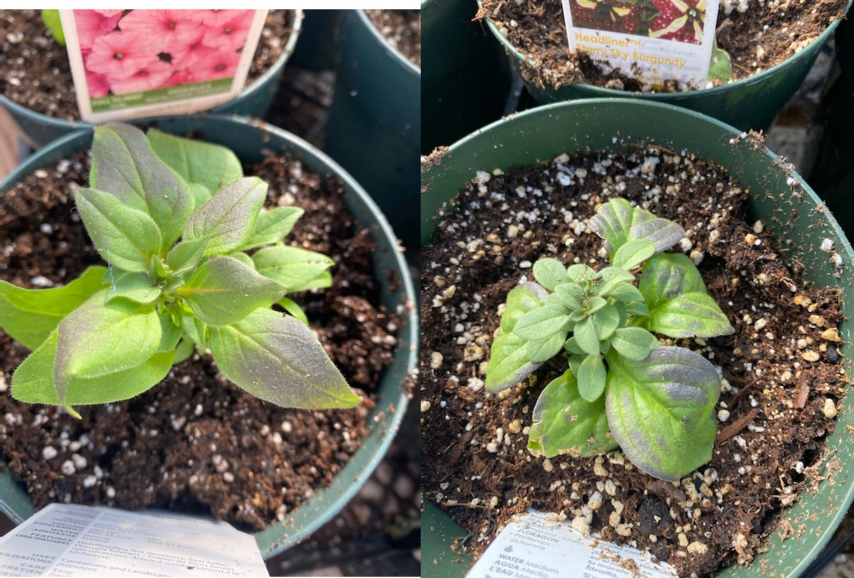
2021 National FFA Floriculture CDE –Identification
Sample 1

Slide 5
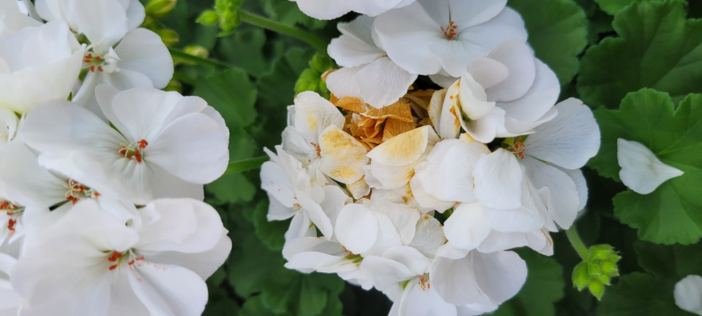
2021 National FFA Floriculture CDE –Identification
Sample 2

Slide 6
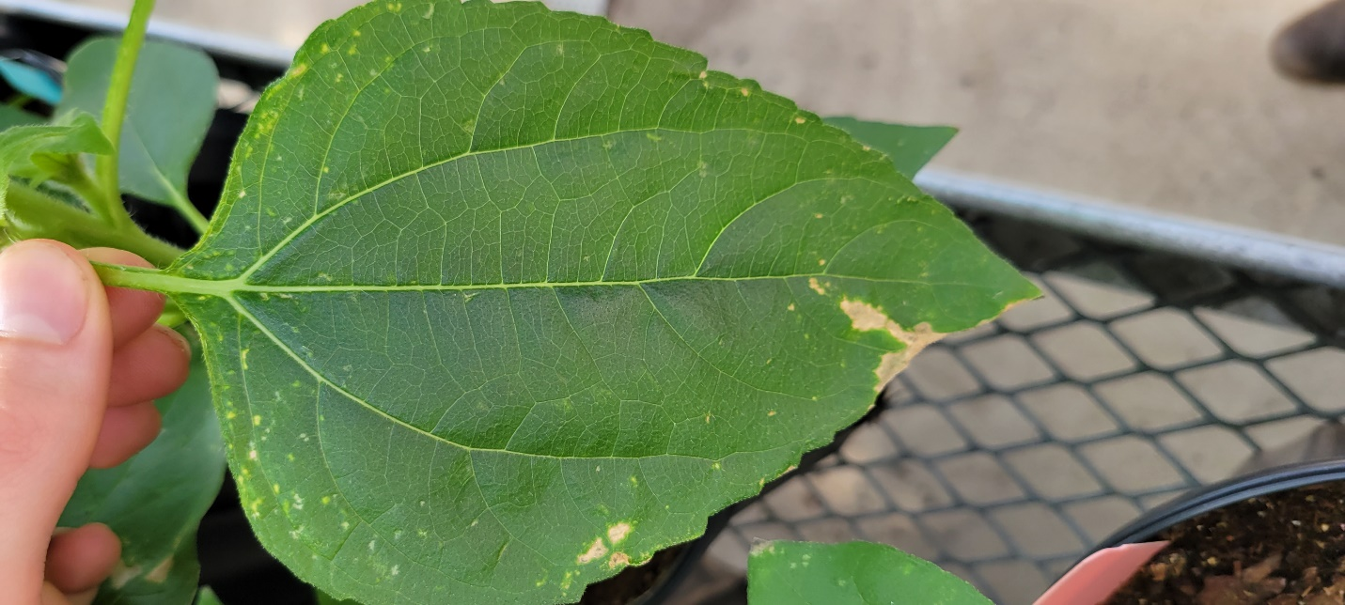
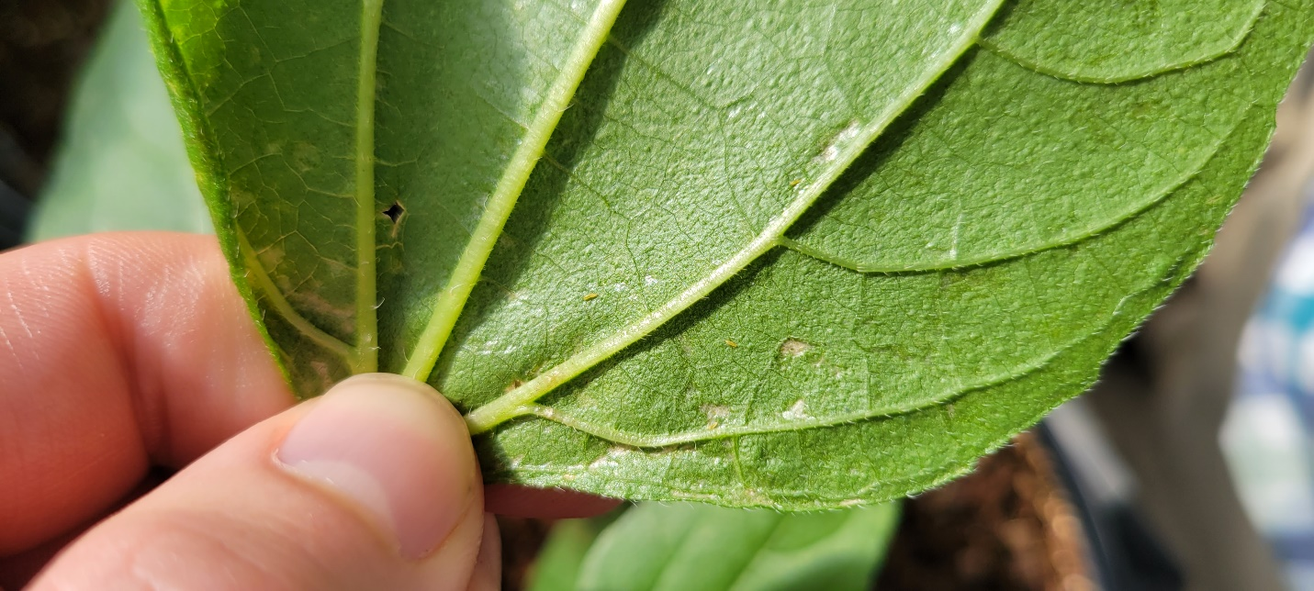
2021 National FFA Floriculture CDE –Identification
Sample 3

Slide 7
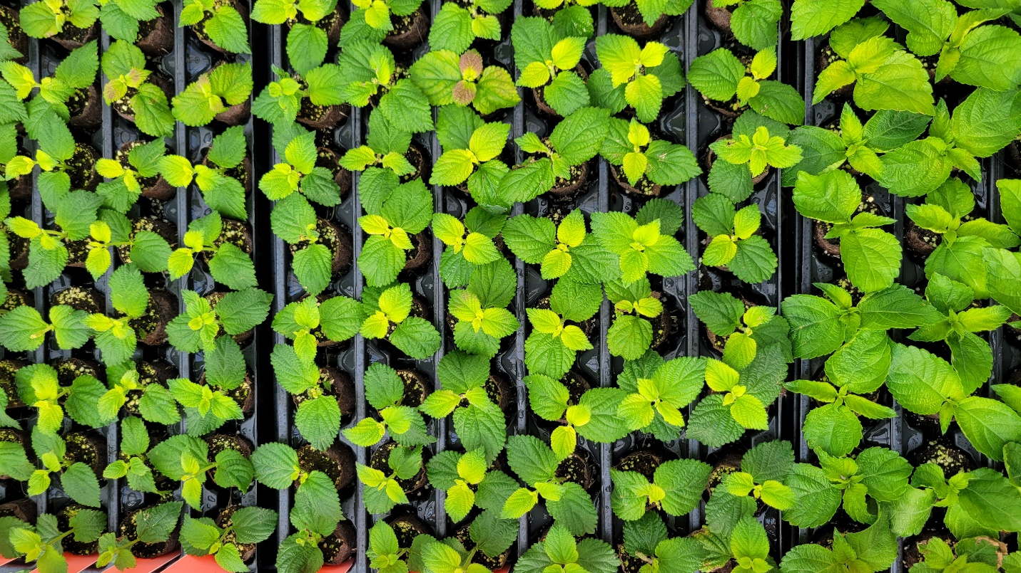
2021 National FFA Floriculture CDE –Identification
Sample 4

Slide 8
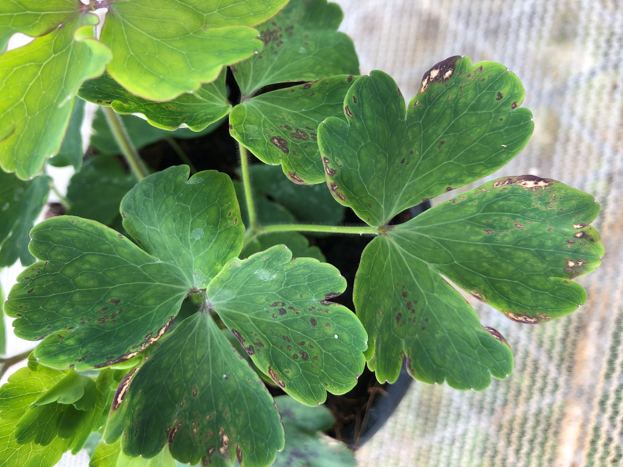
2021 National FFA Floriculture CDE –Identification
Sample 5

Slide 9
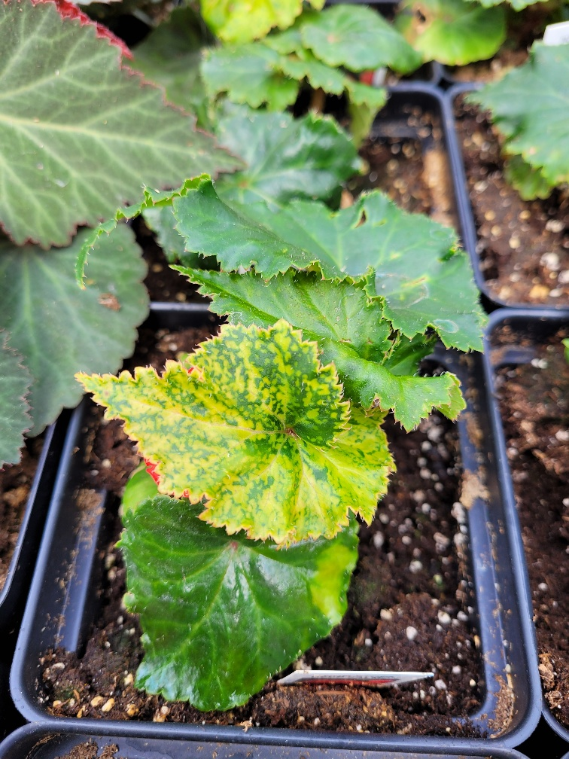
2021 National FFA Floriculture CDE –Identification
Sample 6

Slide 10
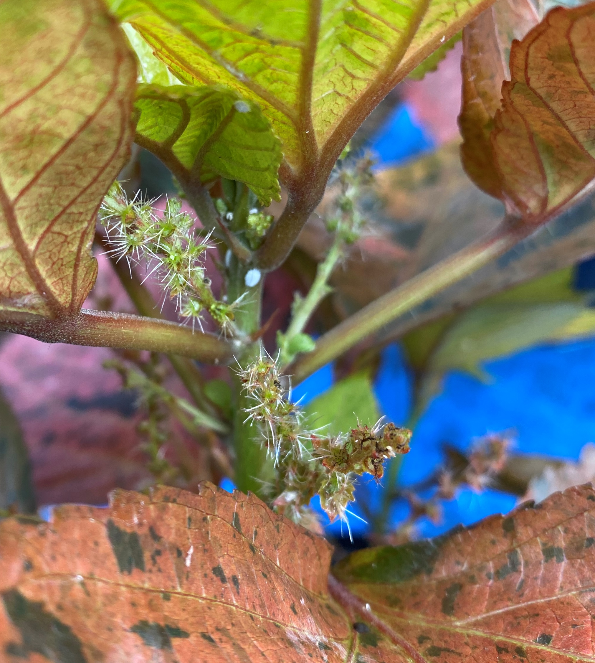
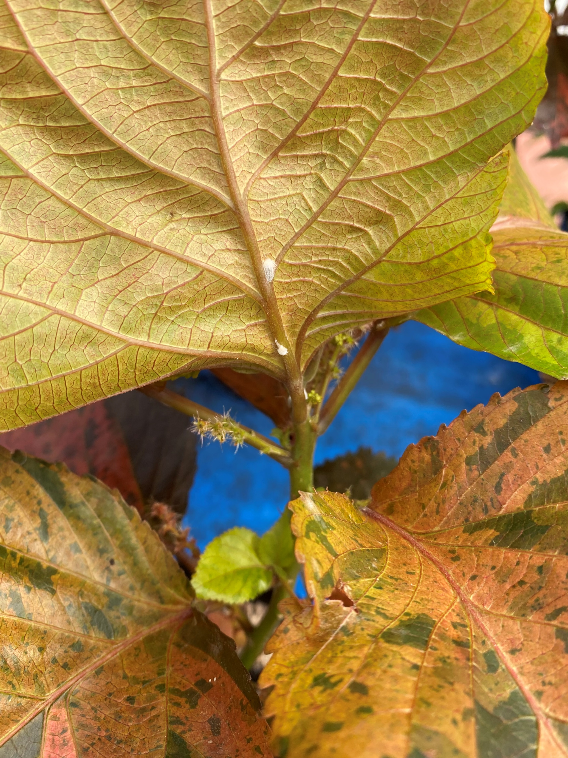
2021 National FFA Floriculture CDE –Identification
Sample 7

Slide 11
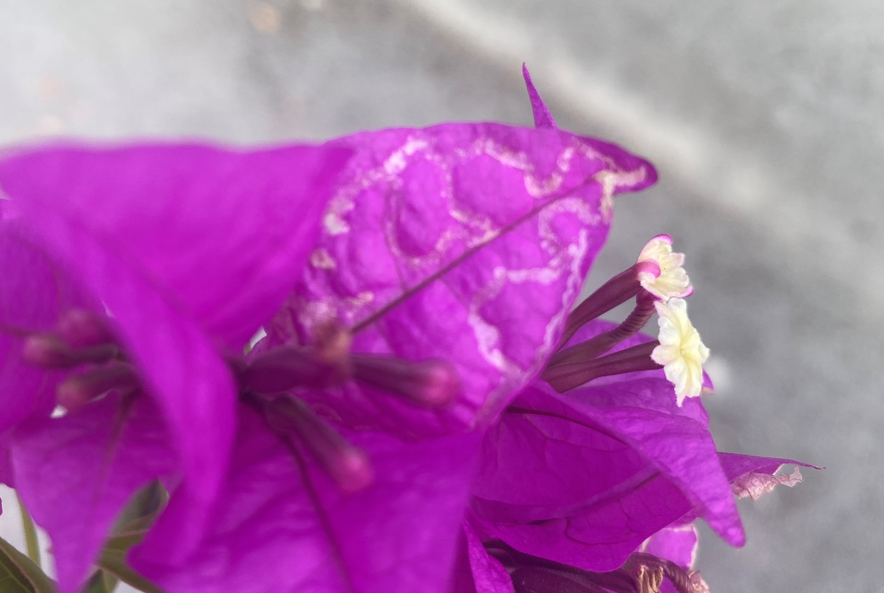
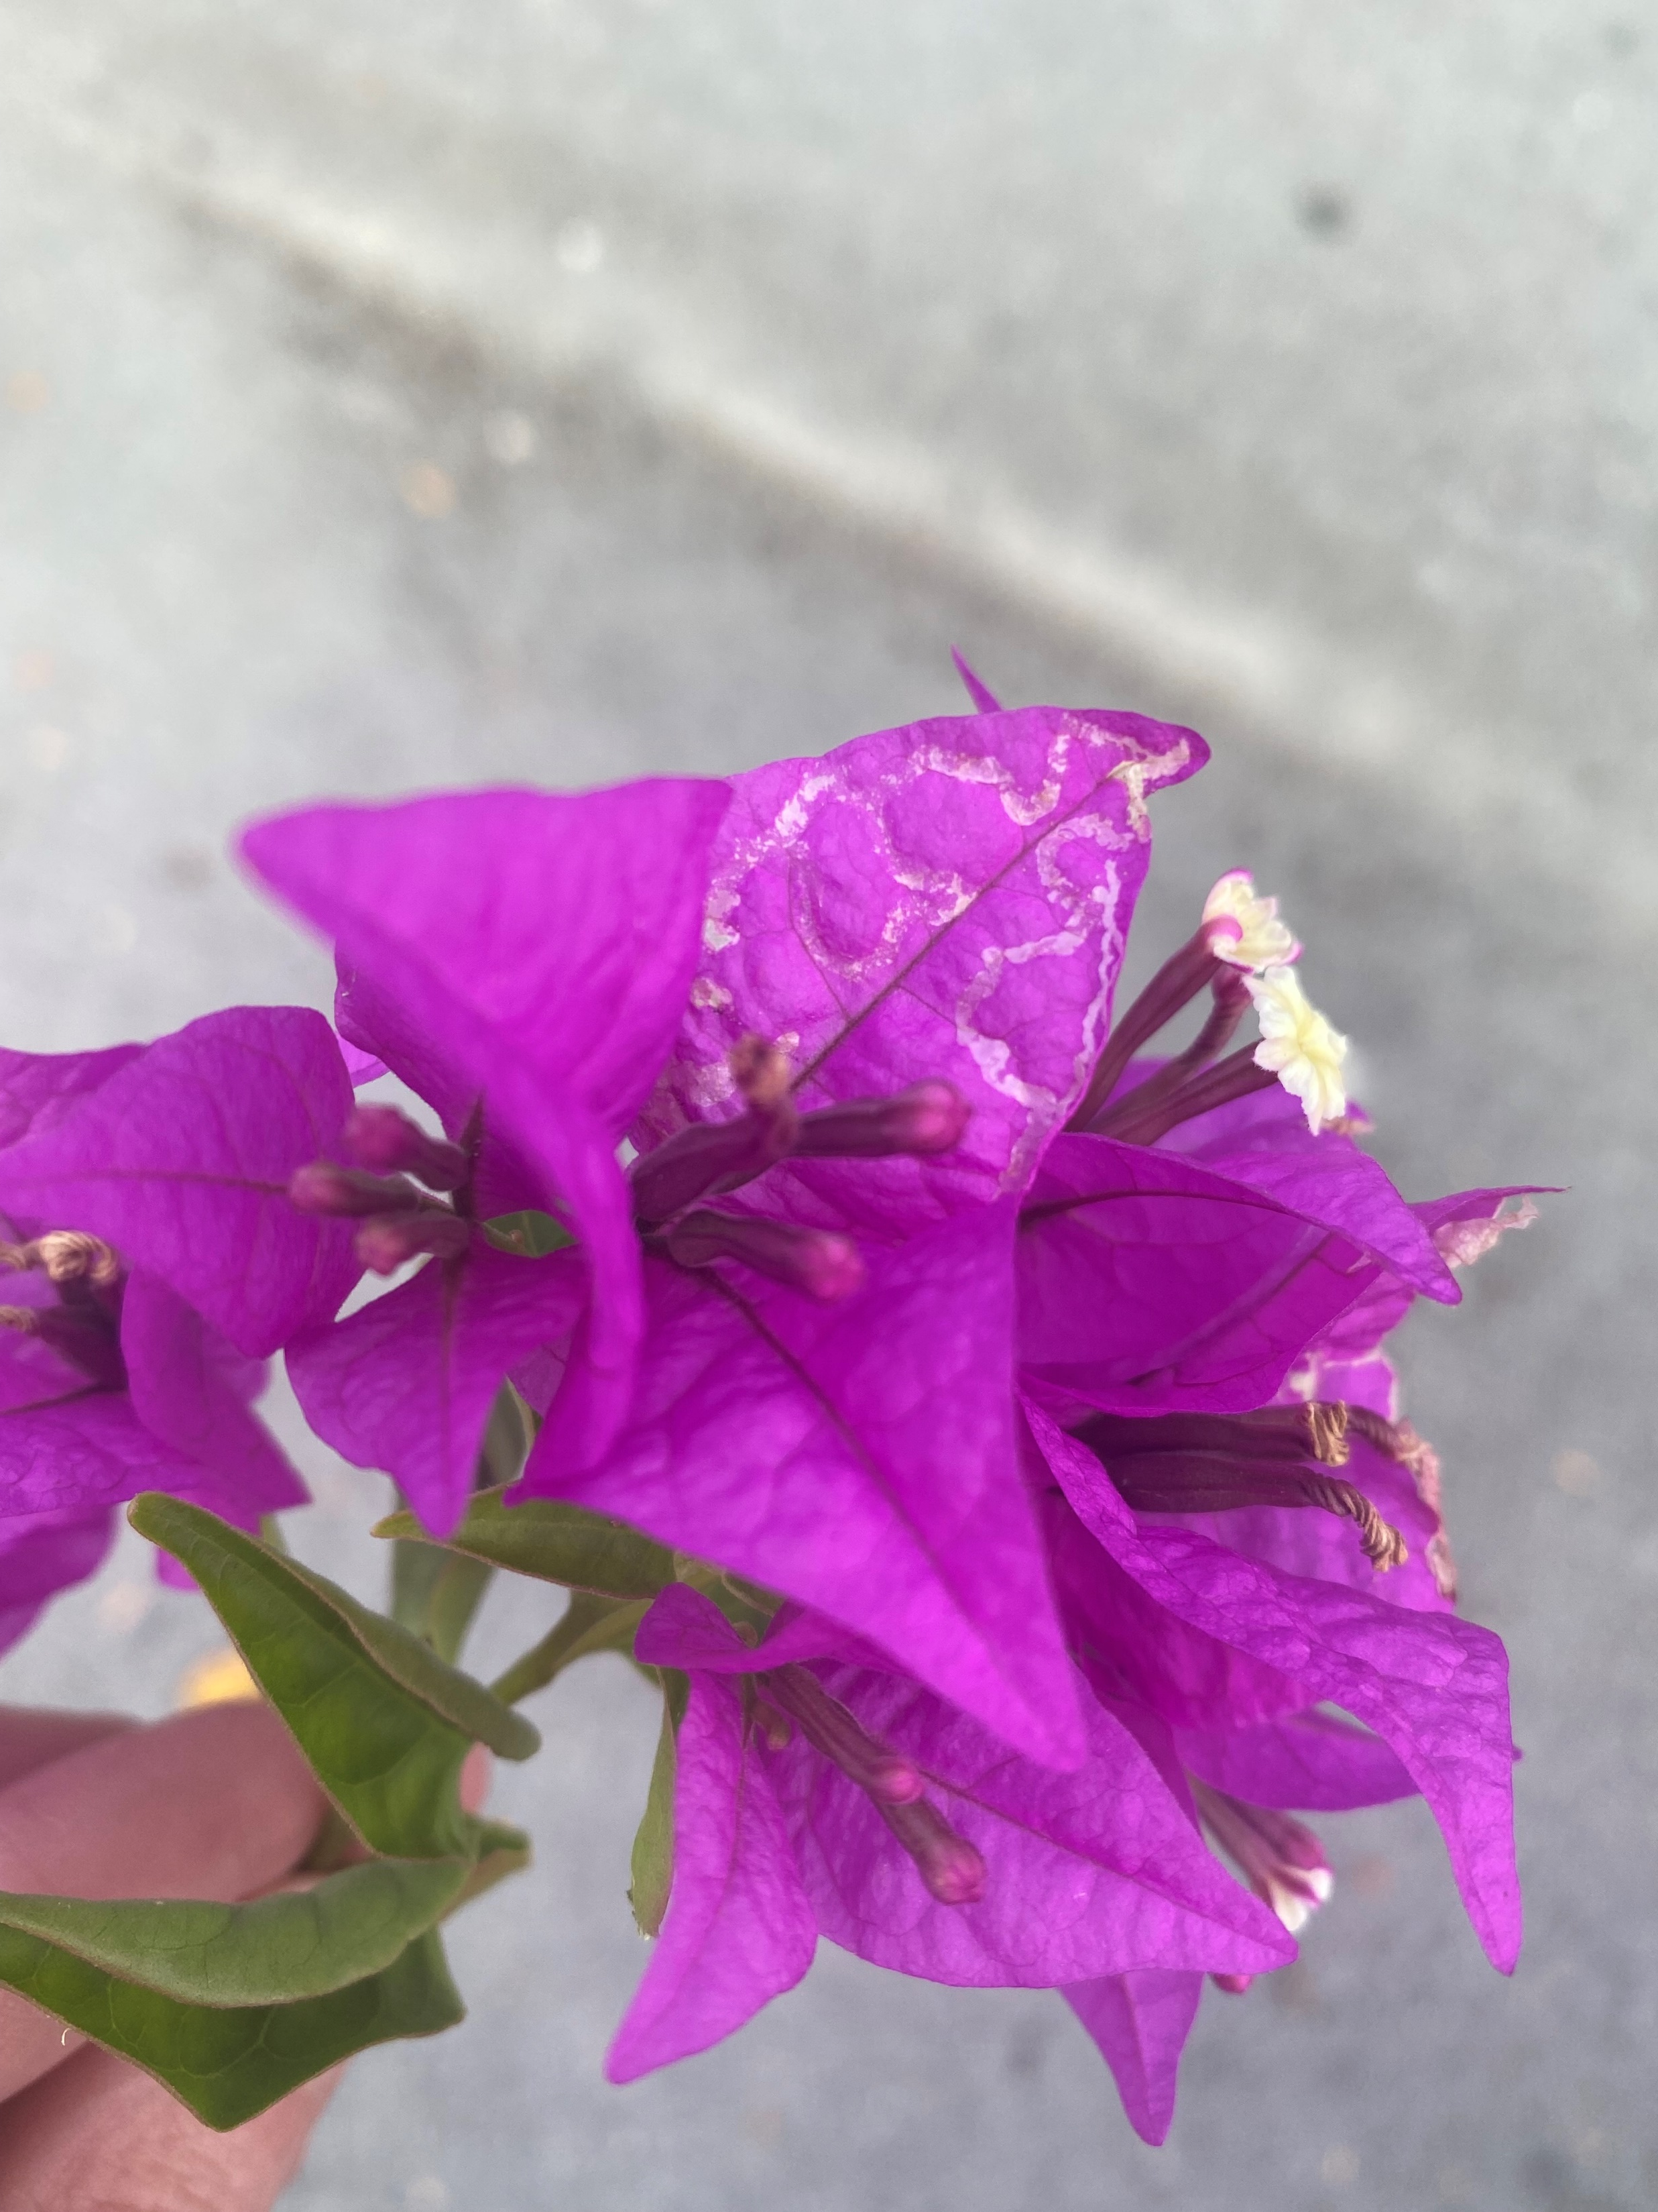
2021 National FFA Floriculture CDE –Identification
Sample 8

Slide 12
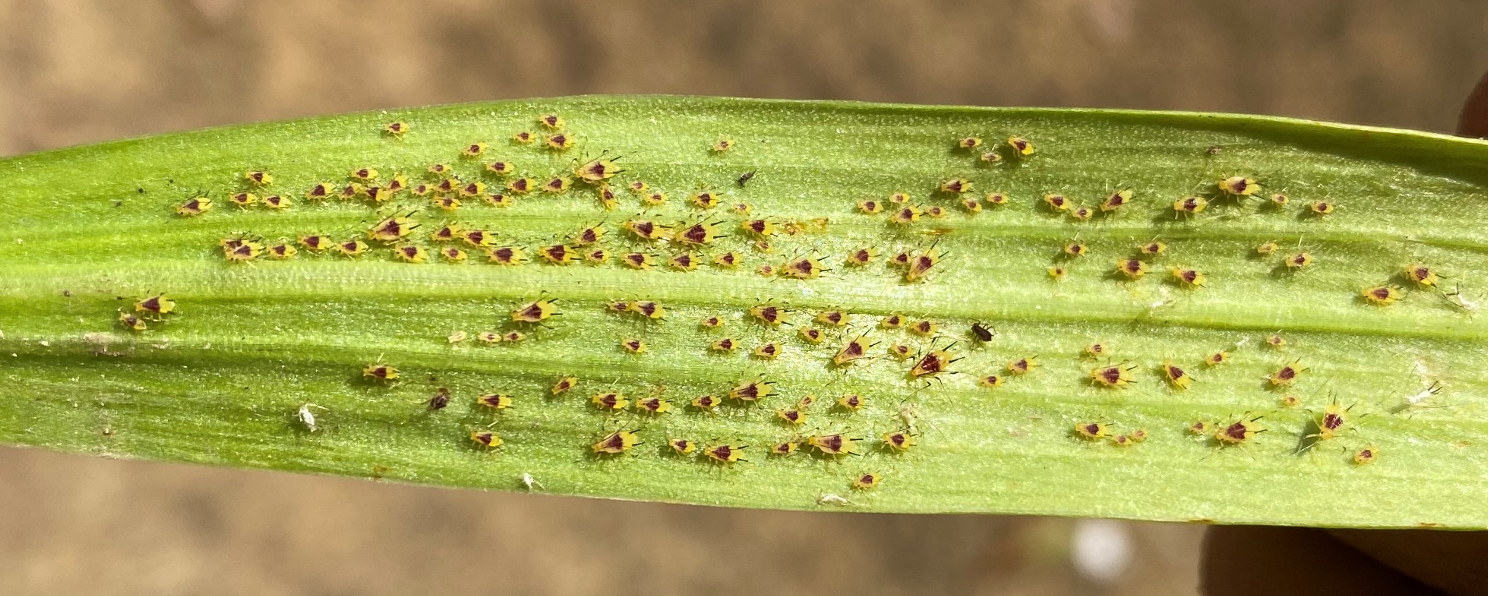
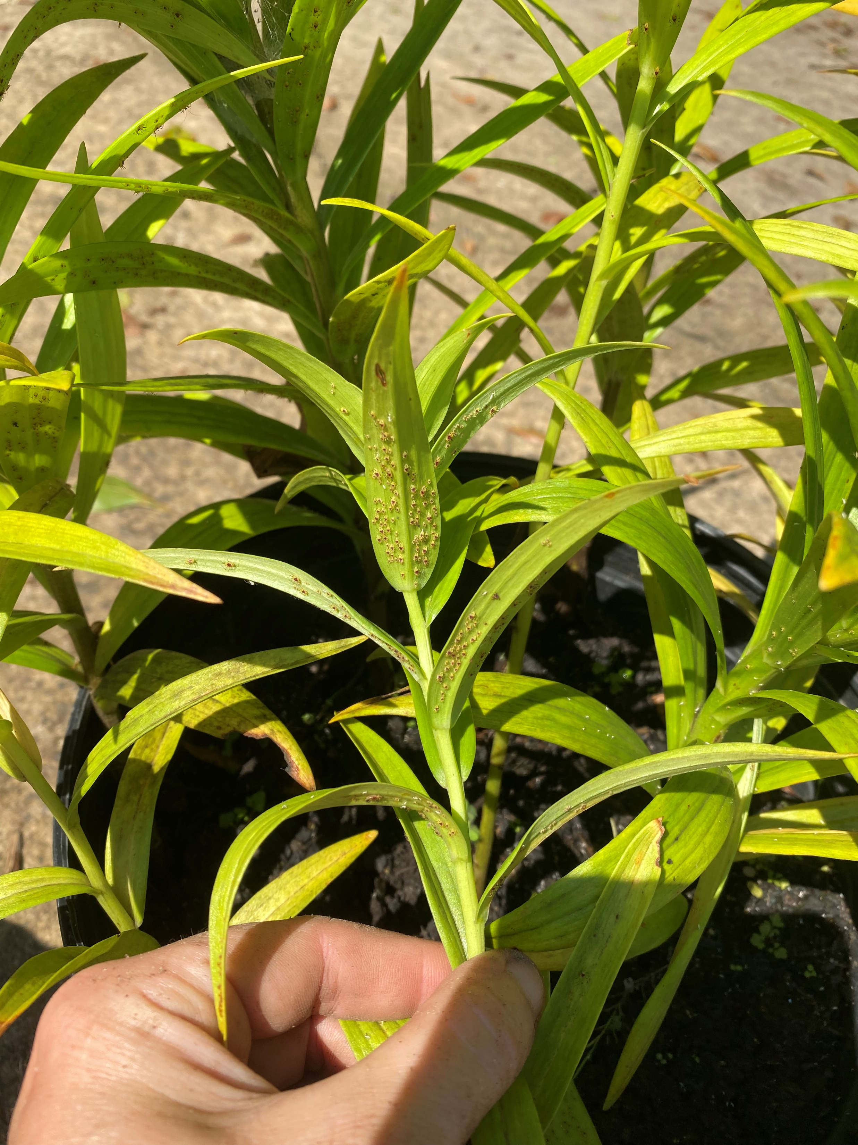
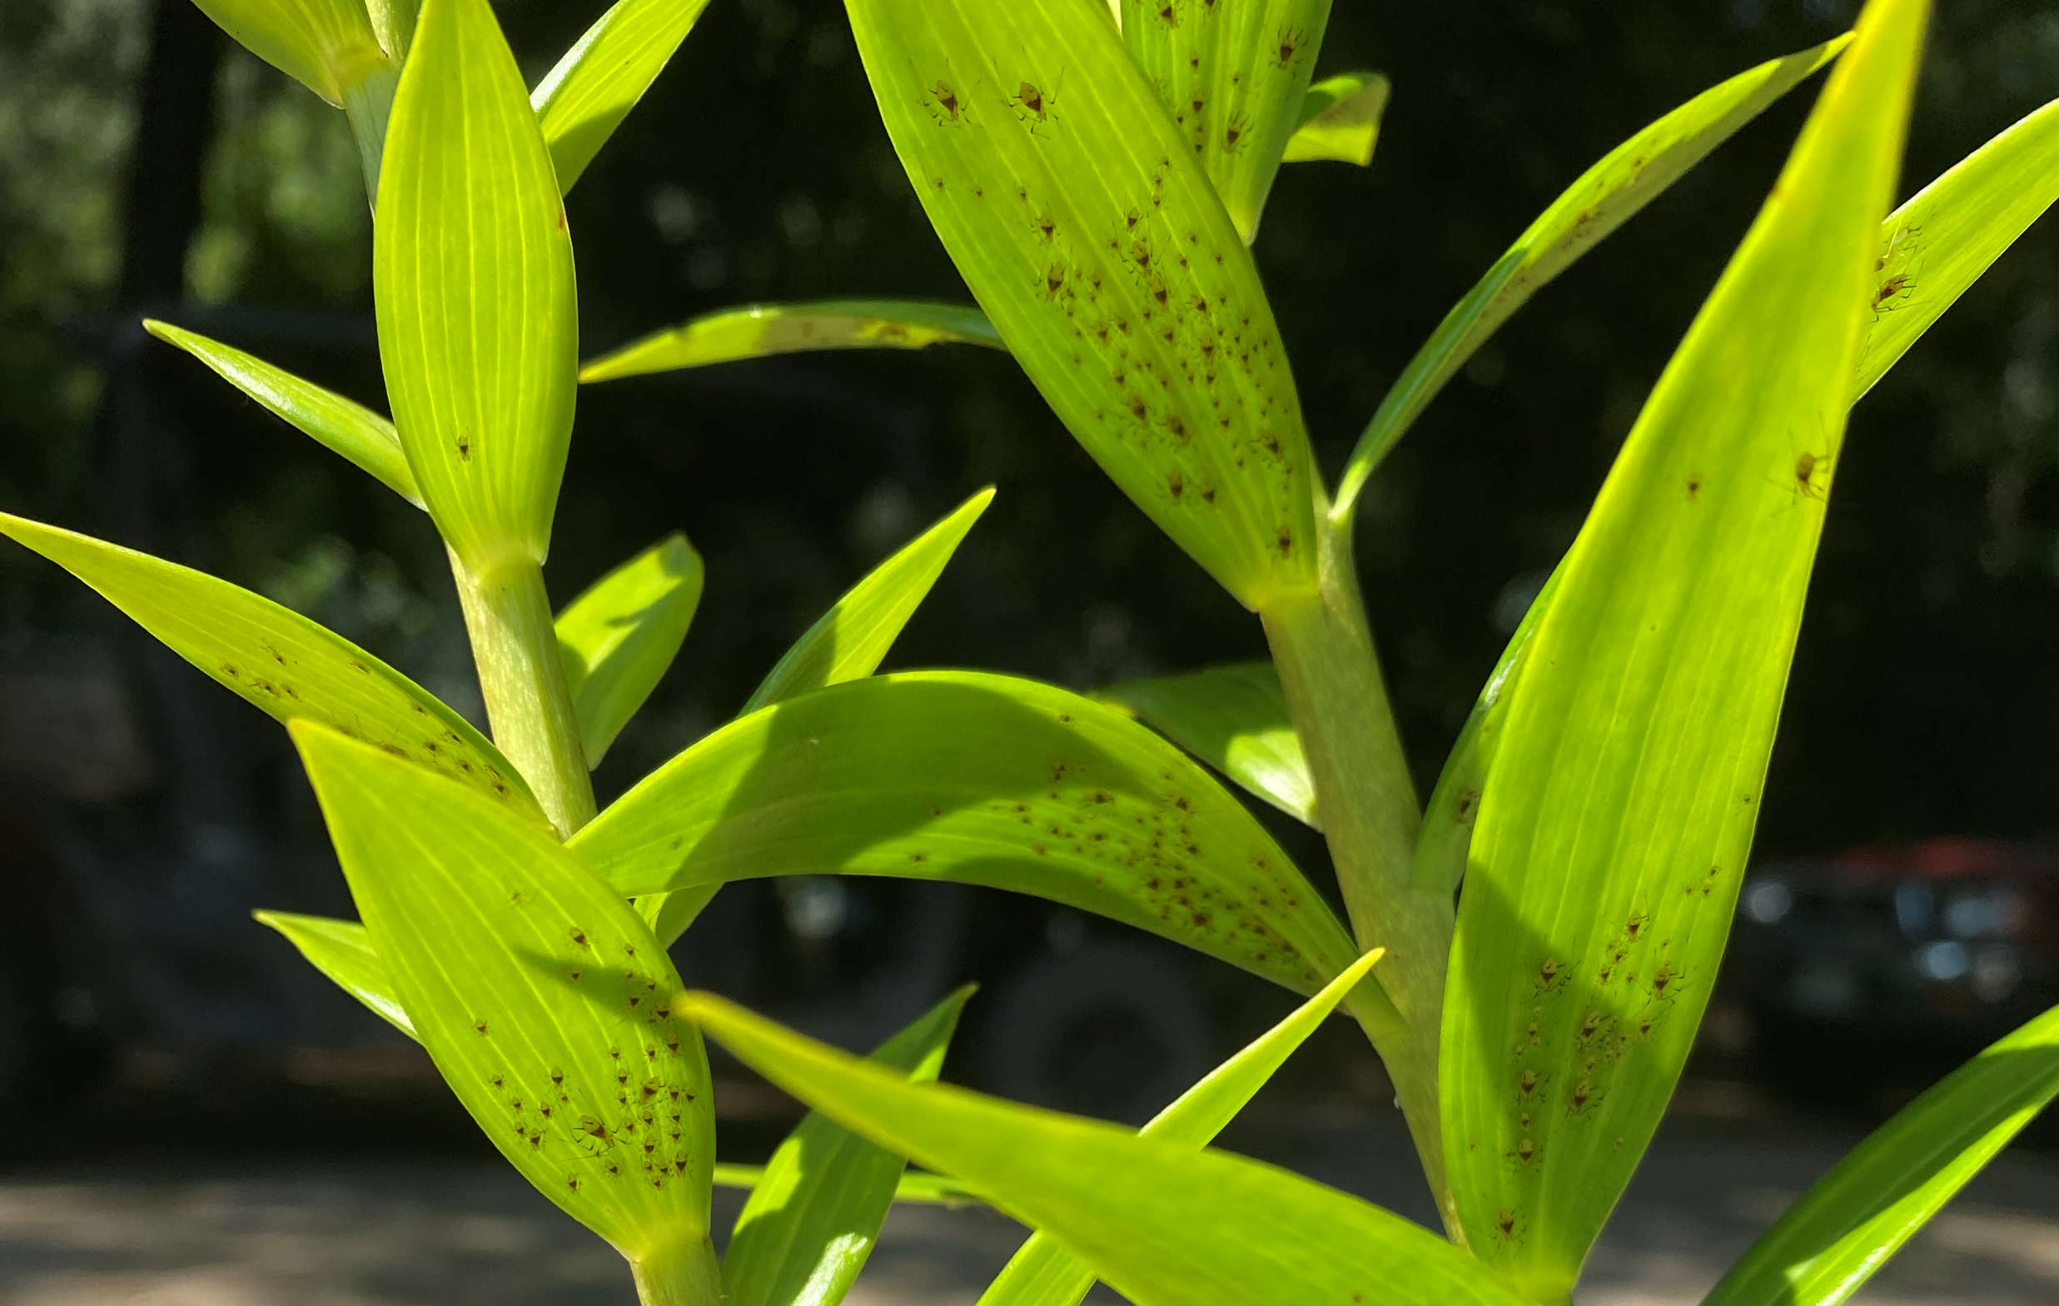
2021 National FFA Floriculture CDE –Identification
Sample 9

Slide 13
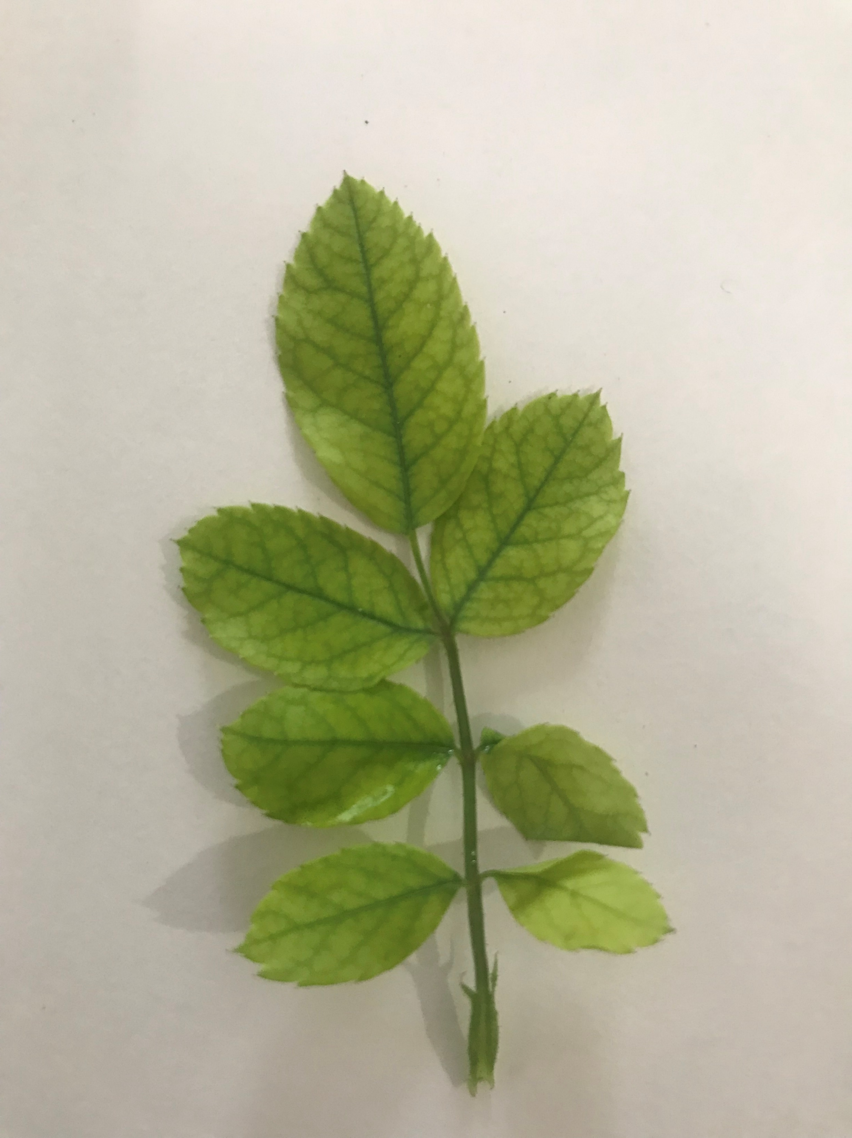
2021 National FFA Floriculture CDE –Identification
Sample 10

Slide 14
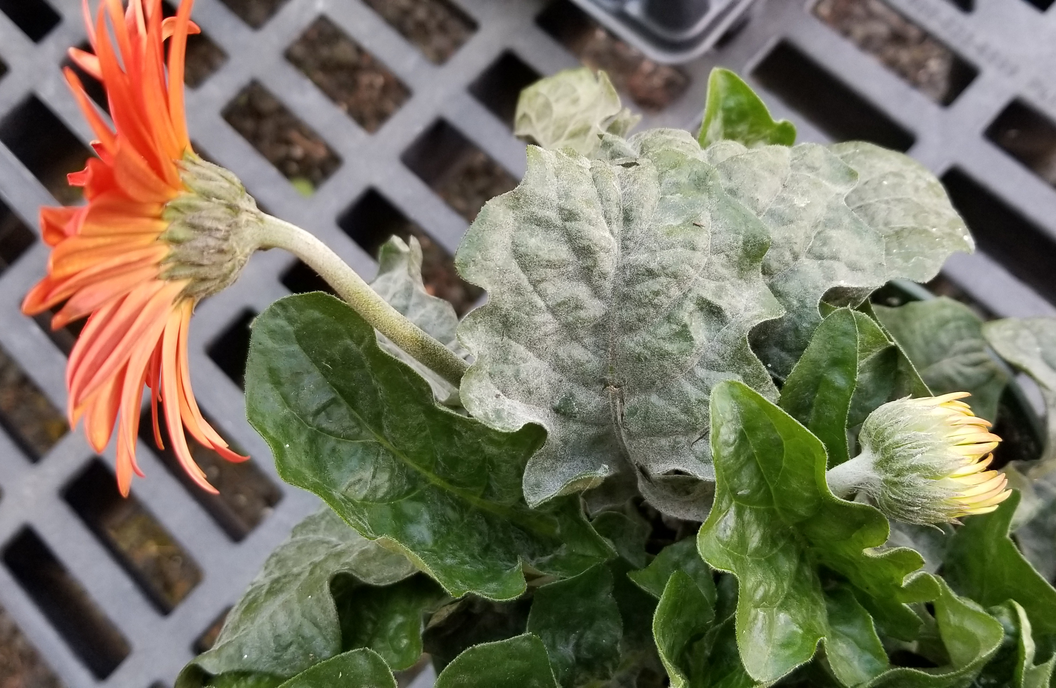
2021 National FFA Floriculture CDE –Identification
Sample 11

Slide 15
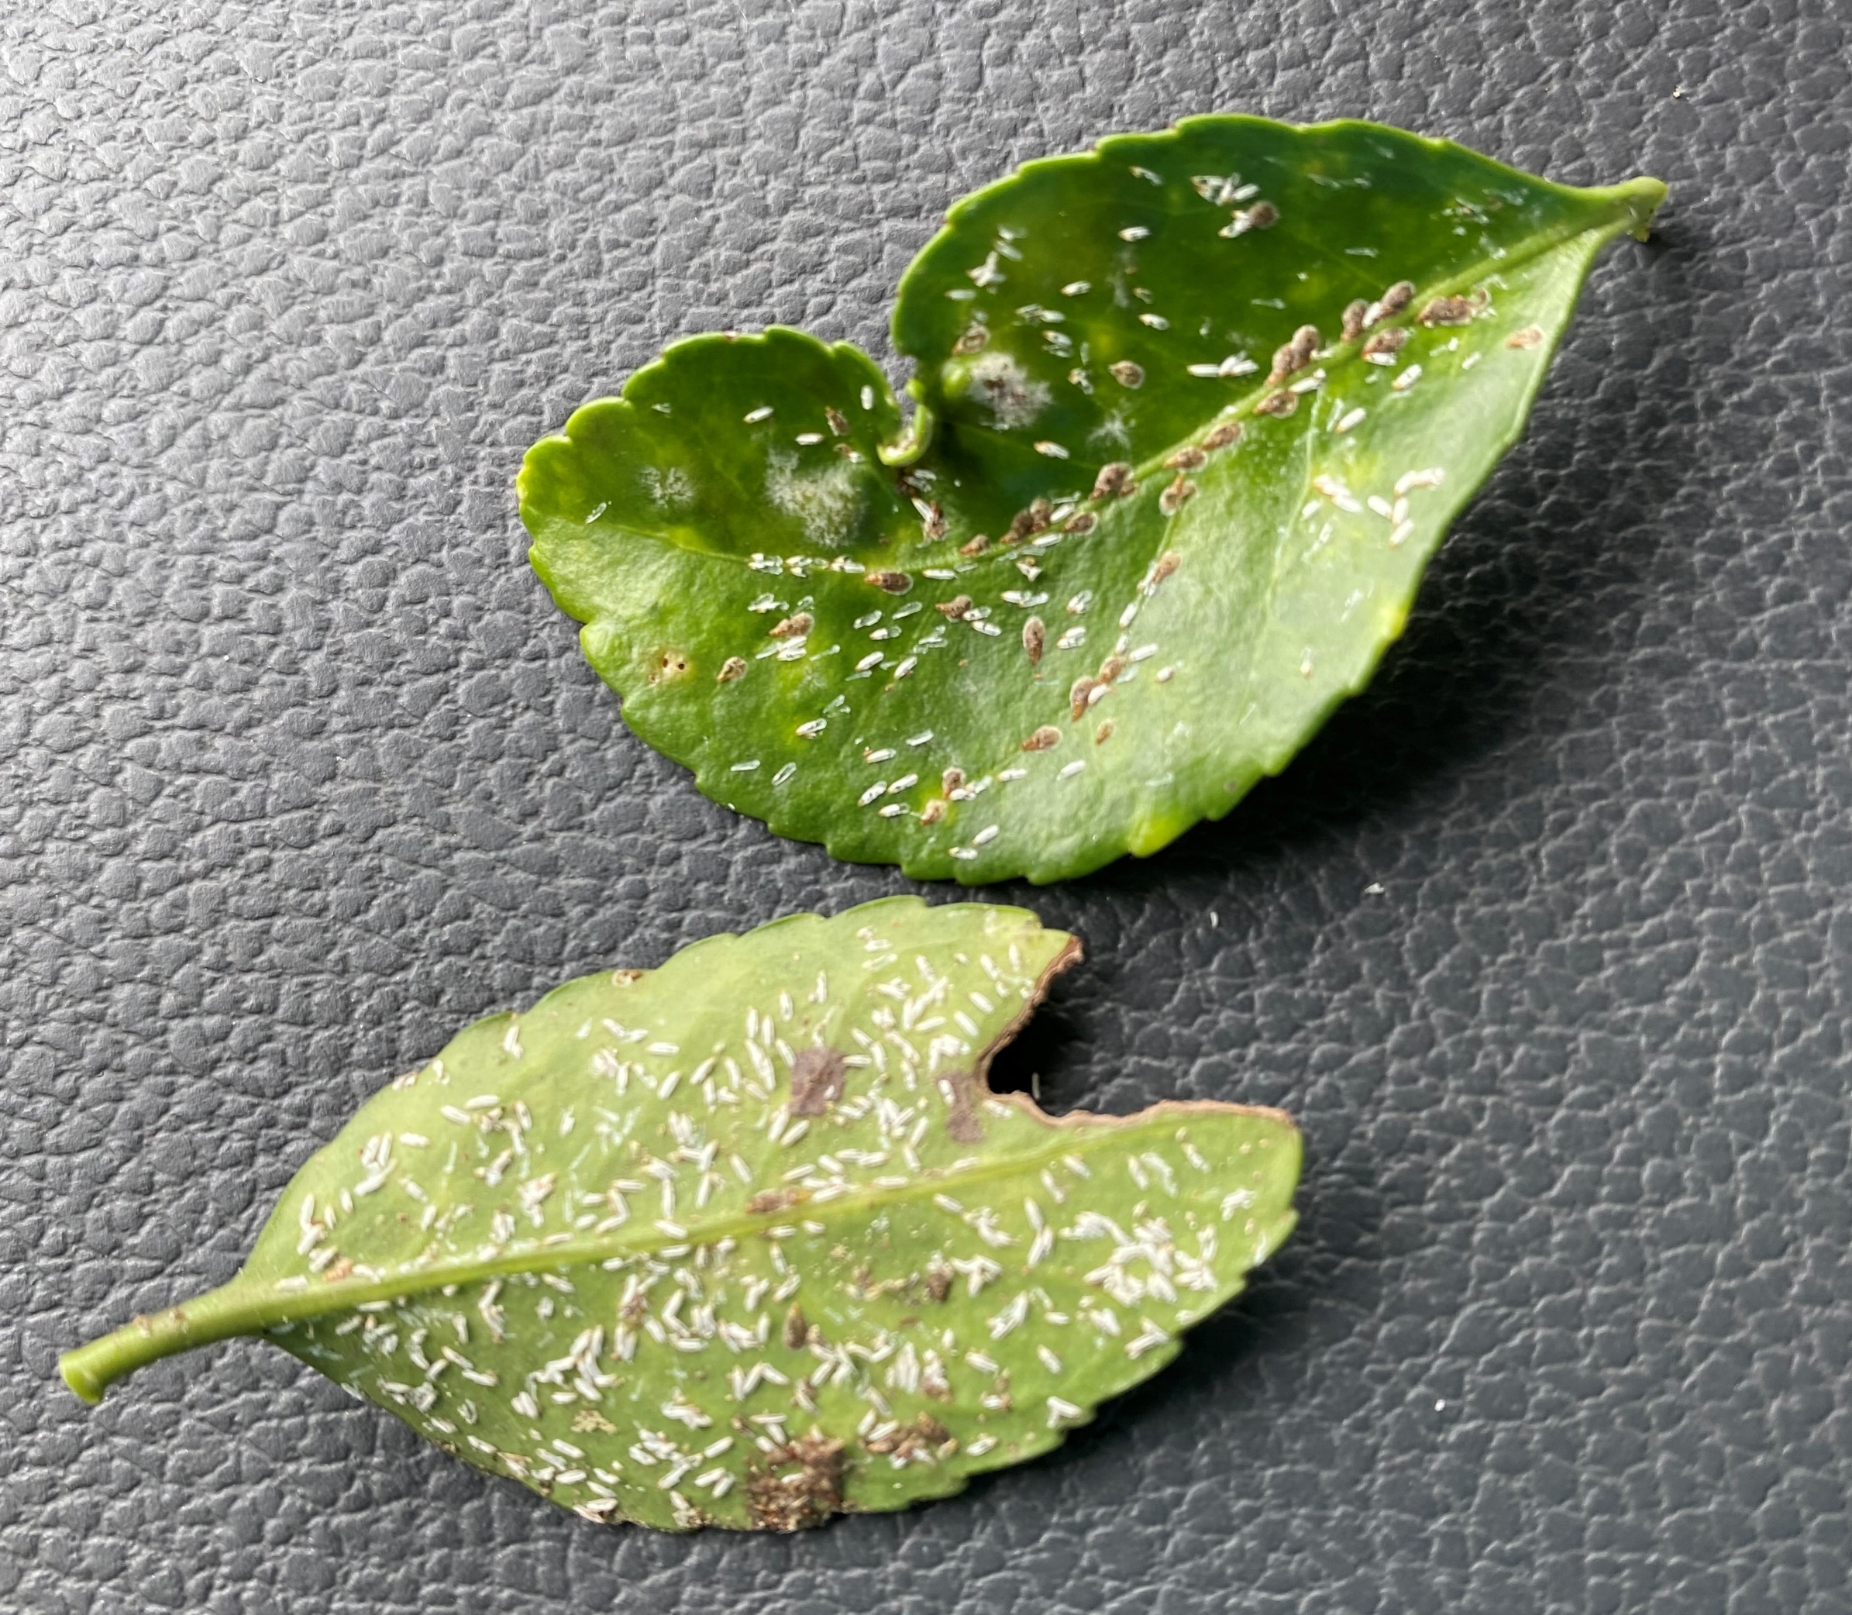
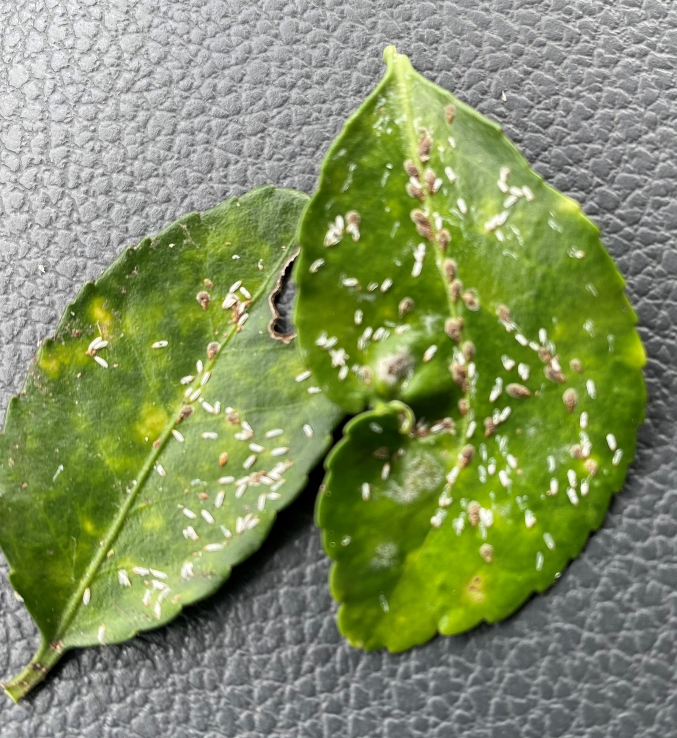
2021 National FFA Floriculture CDE –Identification
Sample 12

Slide 16
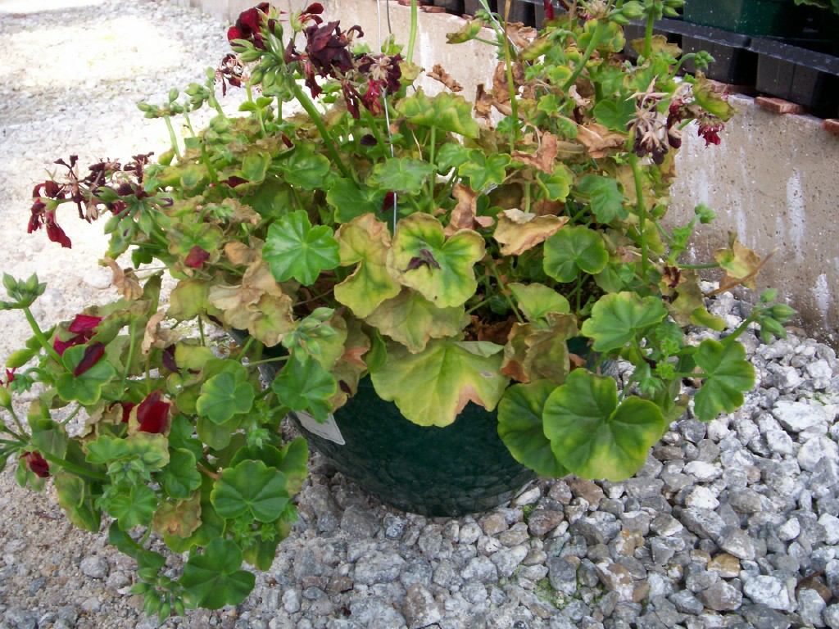
2021 National FFA Floriculture CDE –Identification
Sample 13

Slide 17
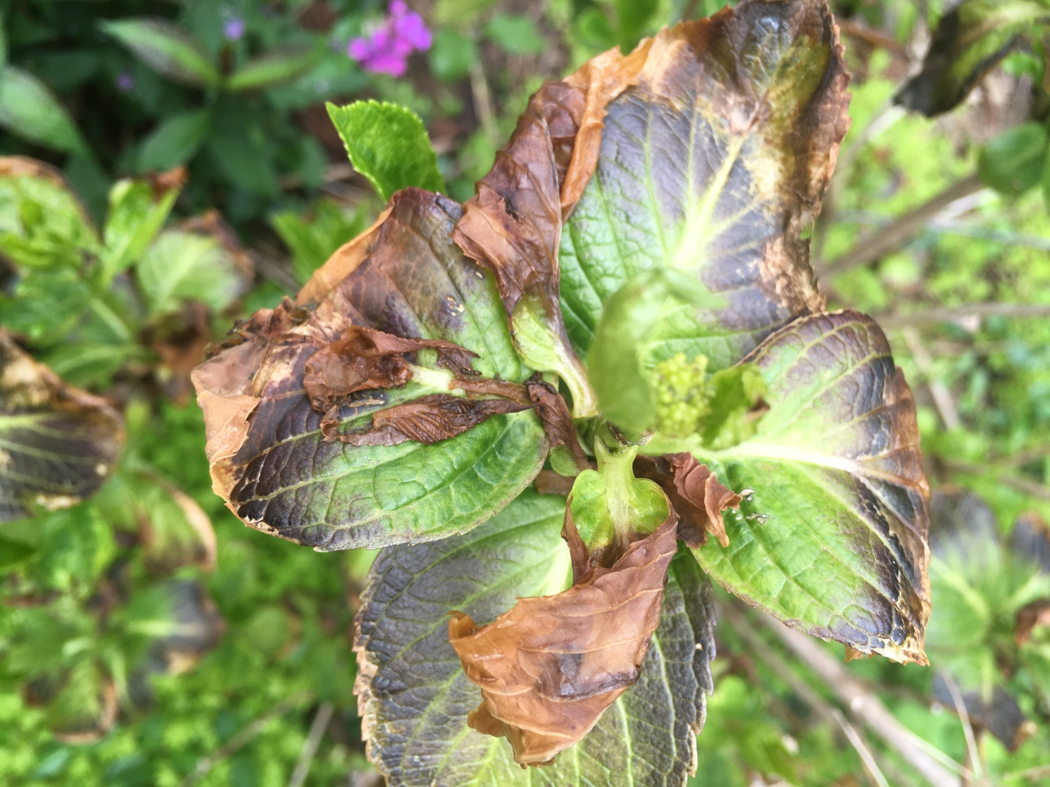
2021 National FFA Floriculture CDE –Identification
Sample 14

Slide 18
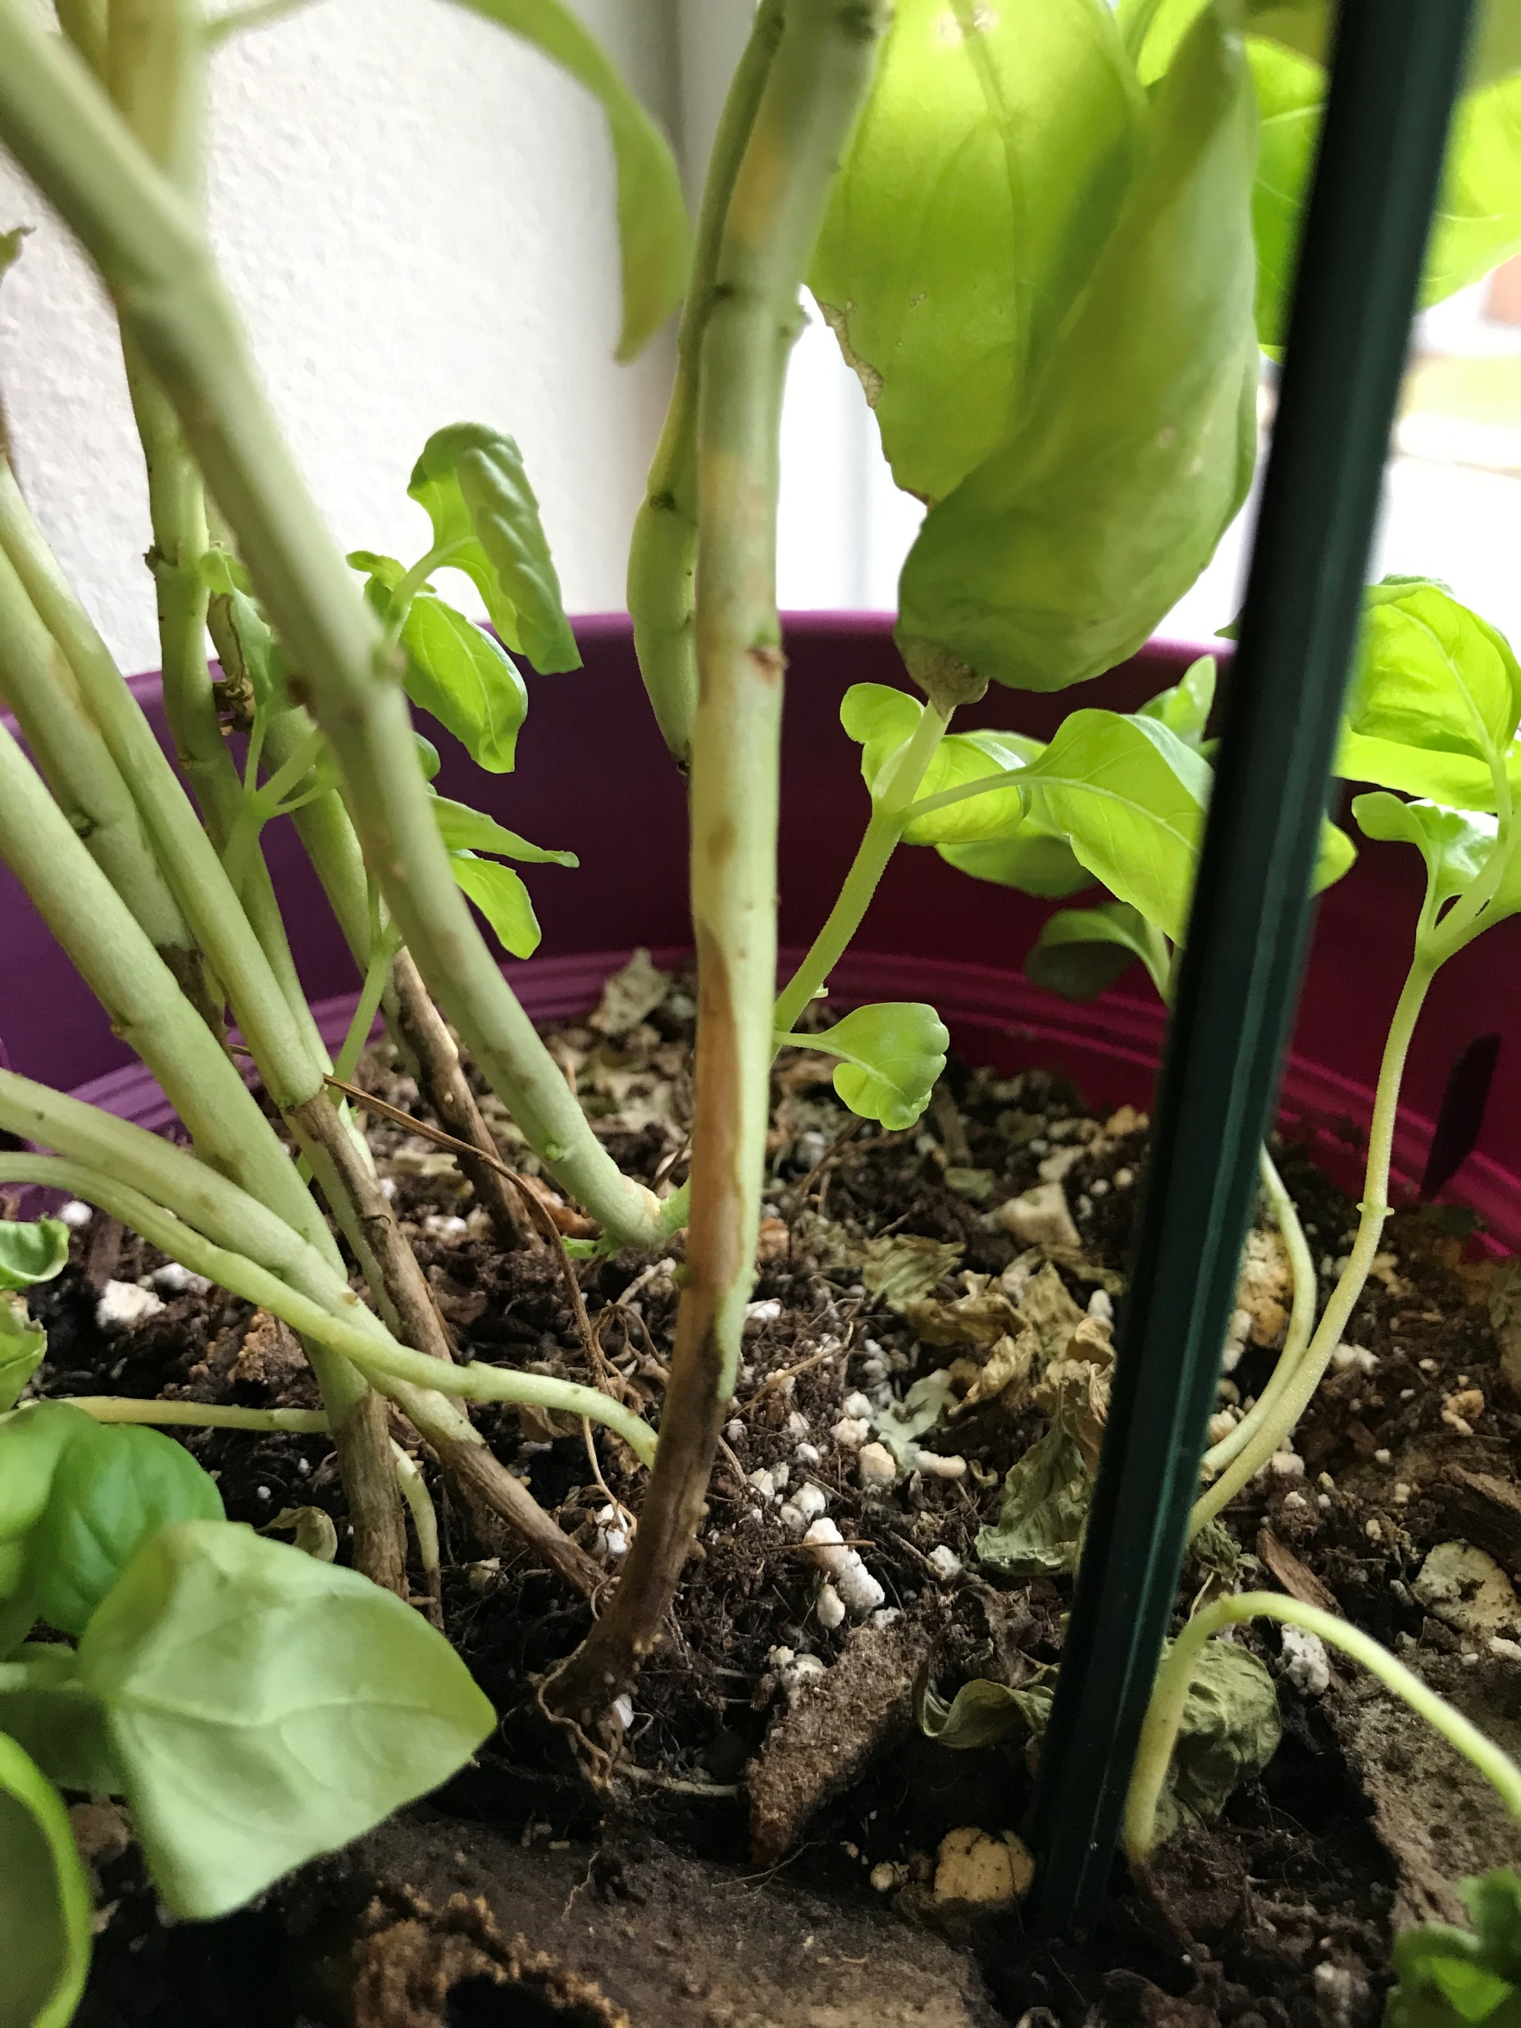
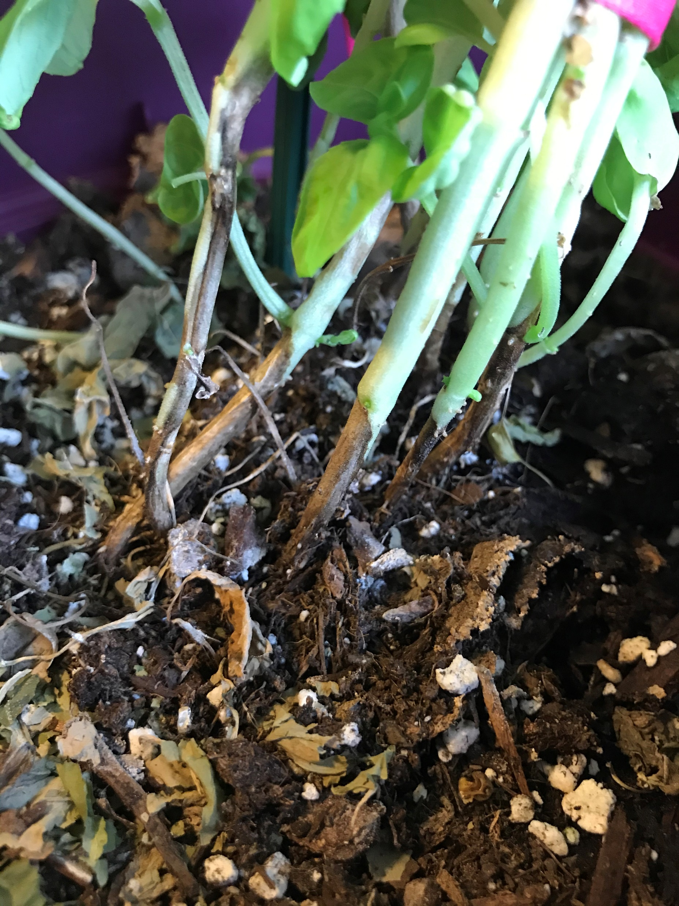
2021 National FFA Floriculture CDE –Identification
Sample 15

