Slide 1
National FFA Veterinary Science CDE
Please locate the section labelled Identification on your scan sheet to mark your answers.
Check to make sure that the sample number matches the question number.

Slide 2
Equipment & Materials Identification

Slide 3
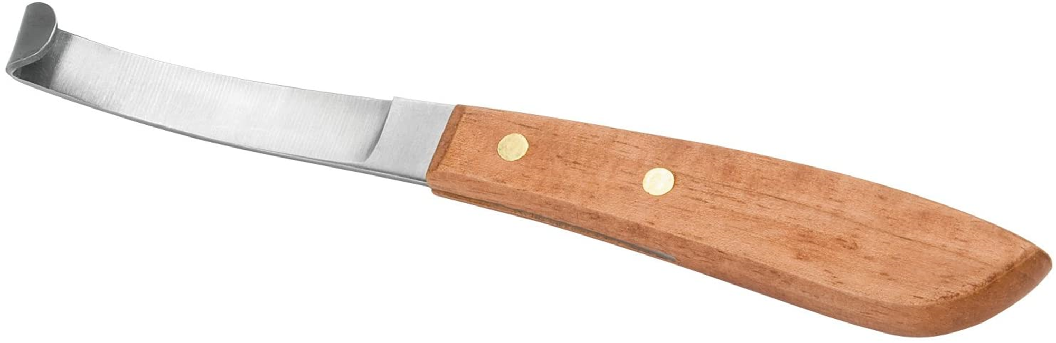
Answer the question NOT the equipment and mark the number on the answer sheet
Equipment 1
Which part of the anatomy do you use this piece of equipment?
001 Ear
002 Hoof
003 Abdomen
004 Tail

Slide 4
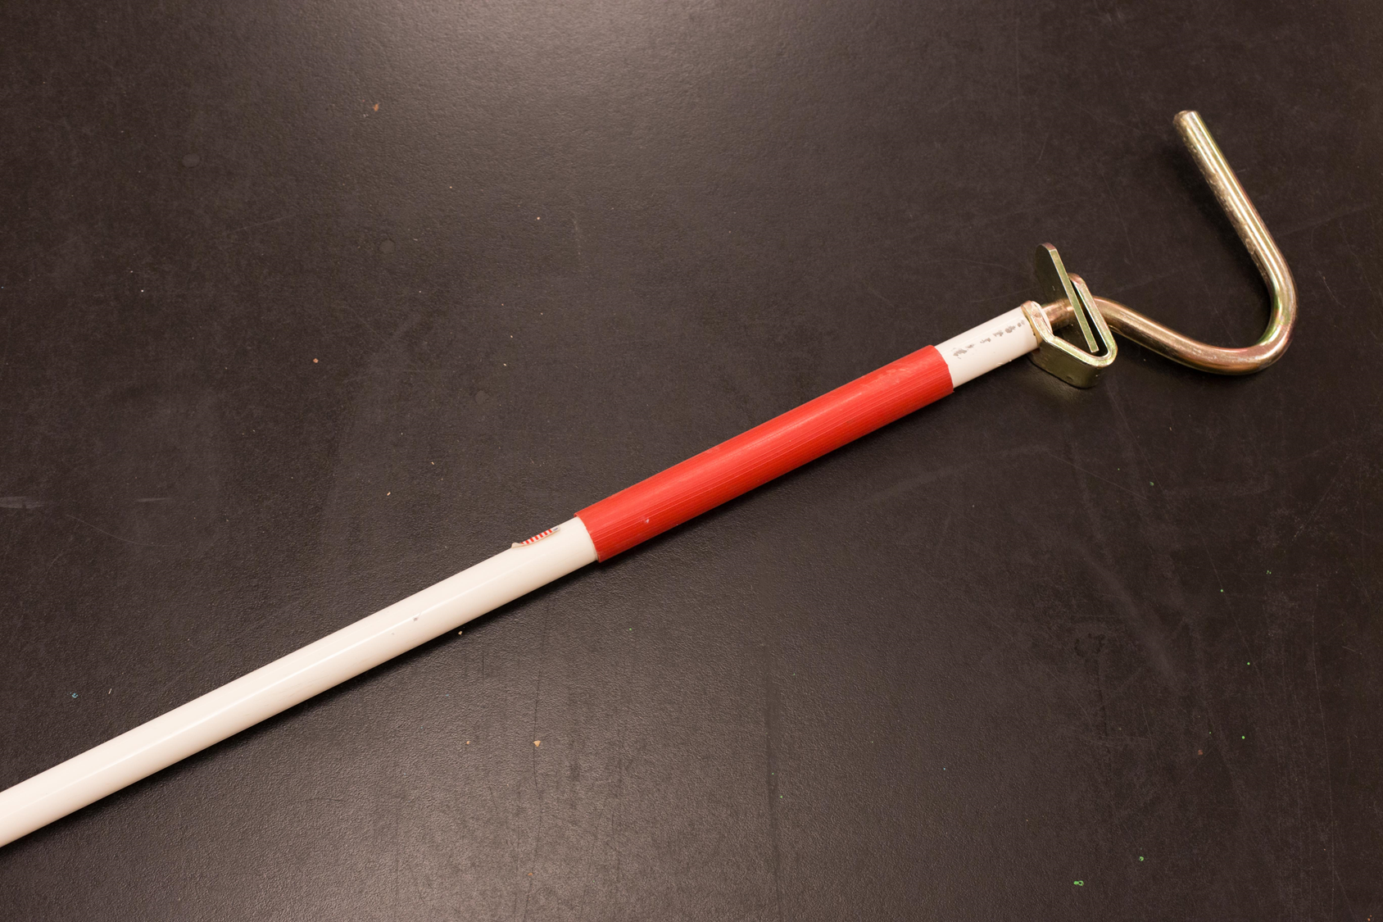
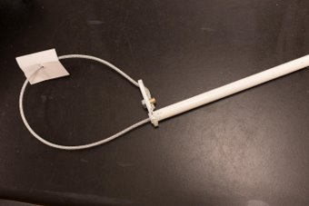
Equipment 2

Slide 5
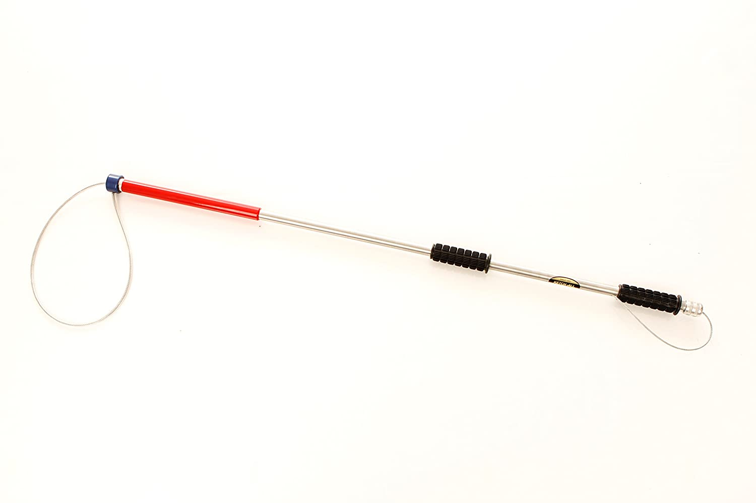
Equipment 3

Slide 6
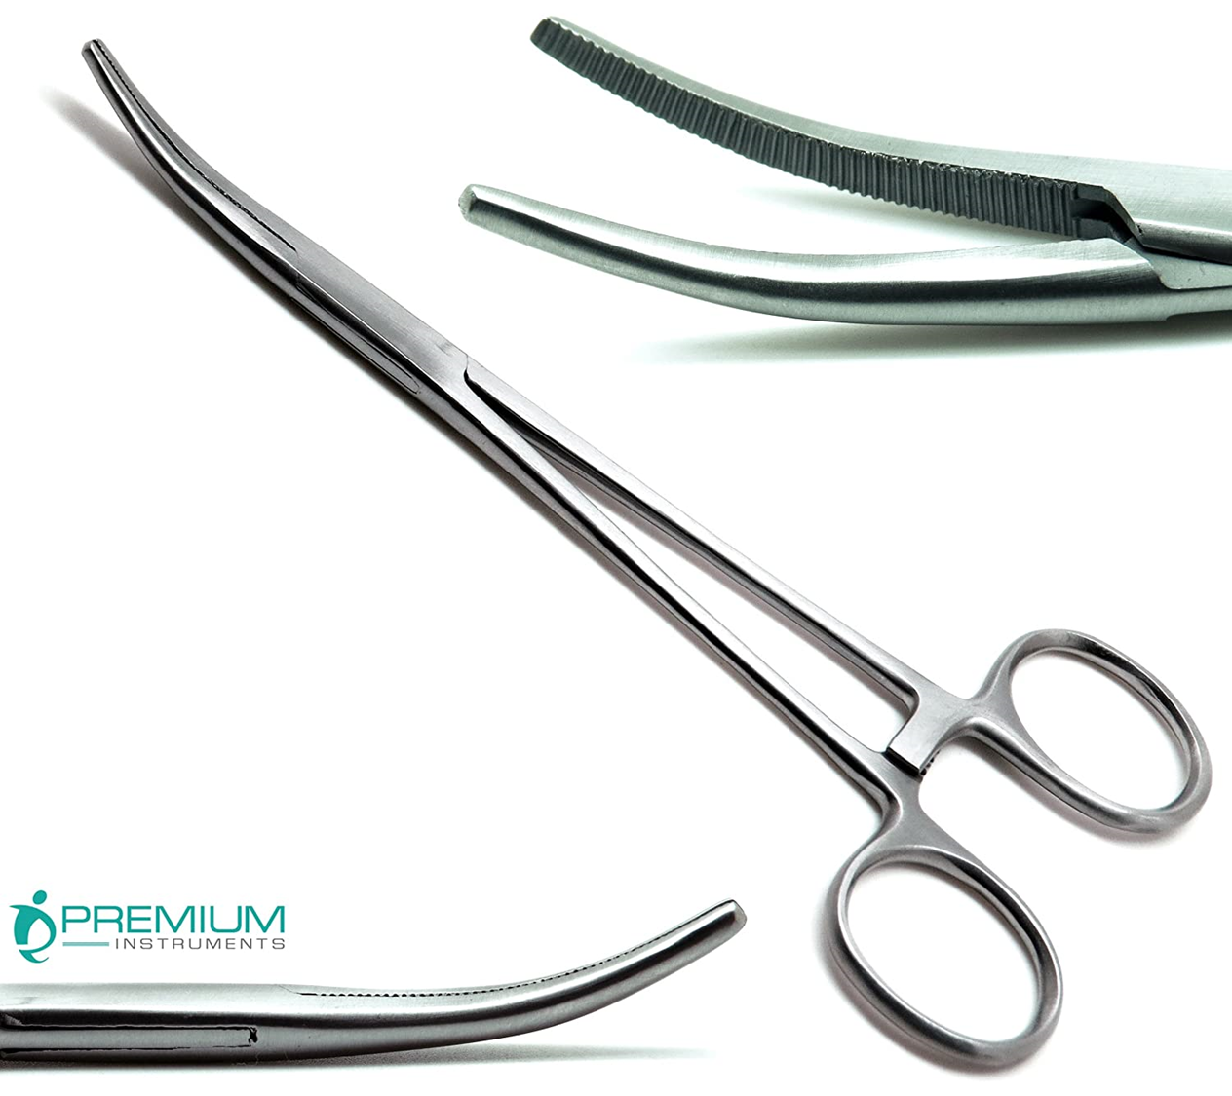
Equipment 4

Slide 7
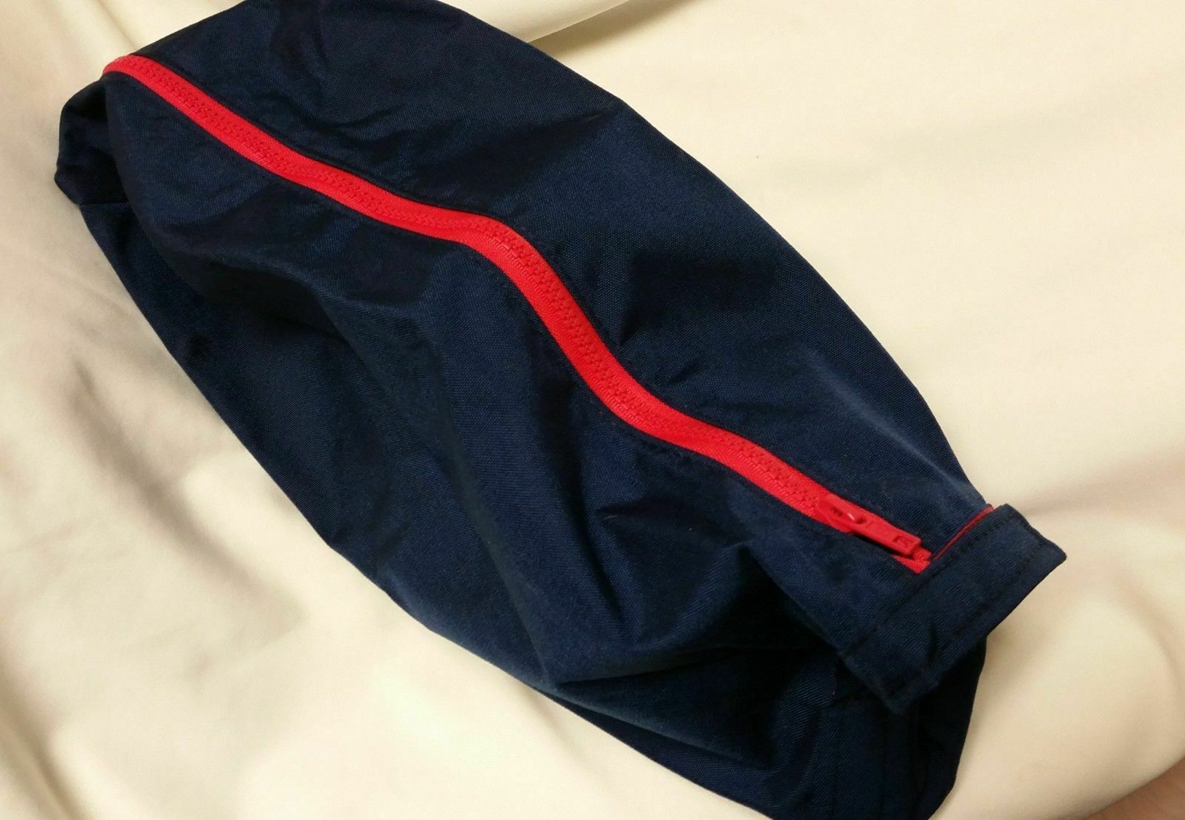
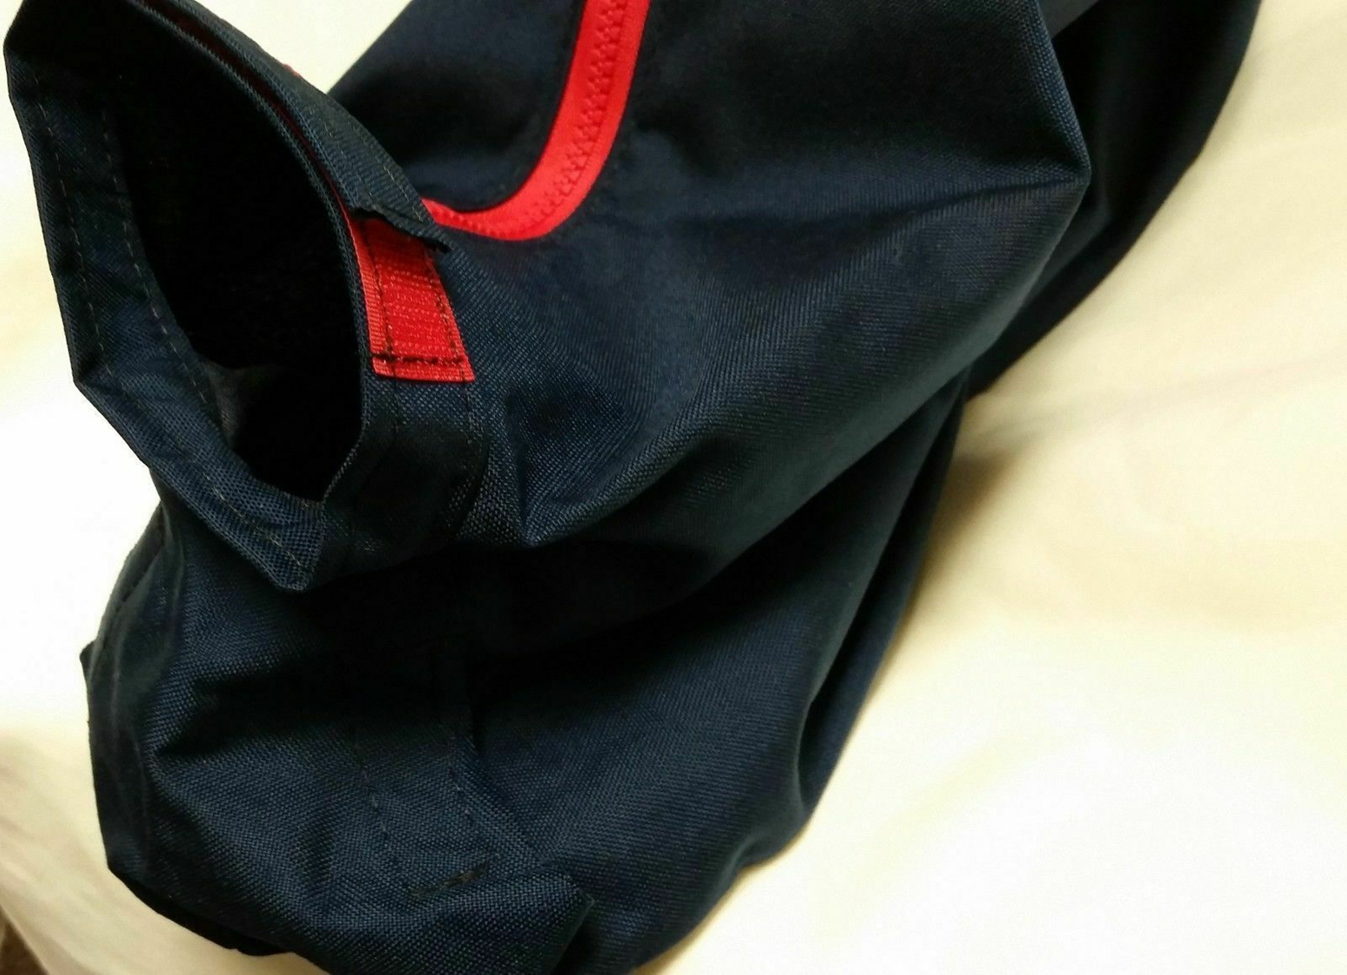
Equipment 5

Slide 8
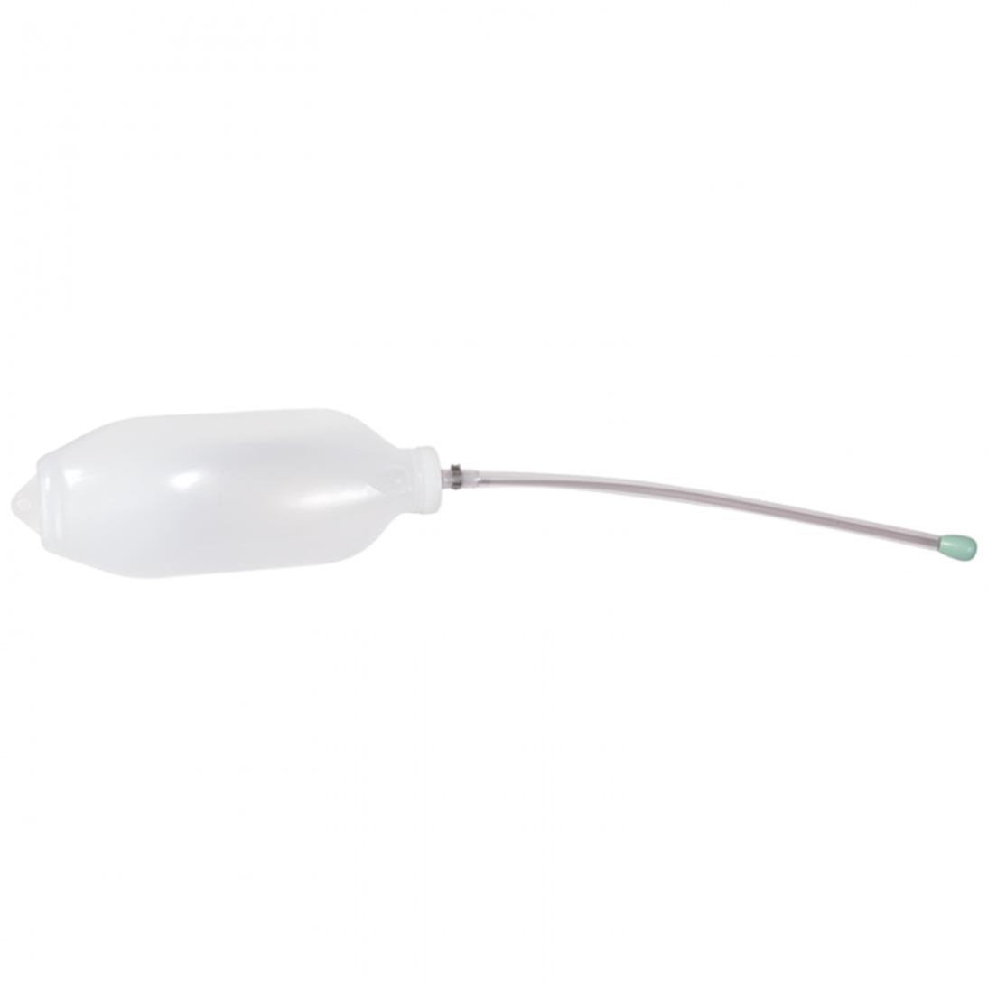
Equipment 6

Slide 9
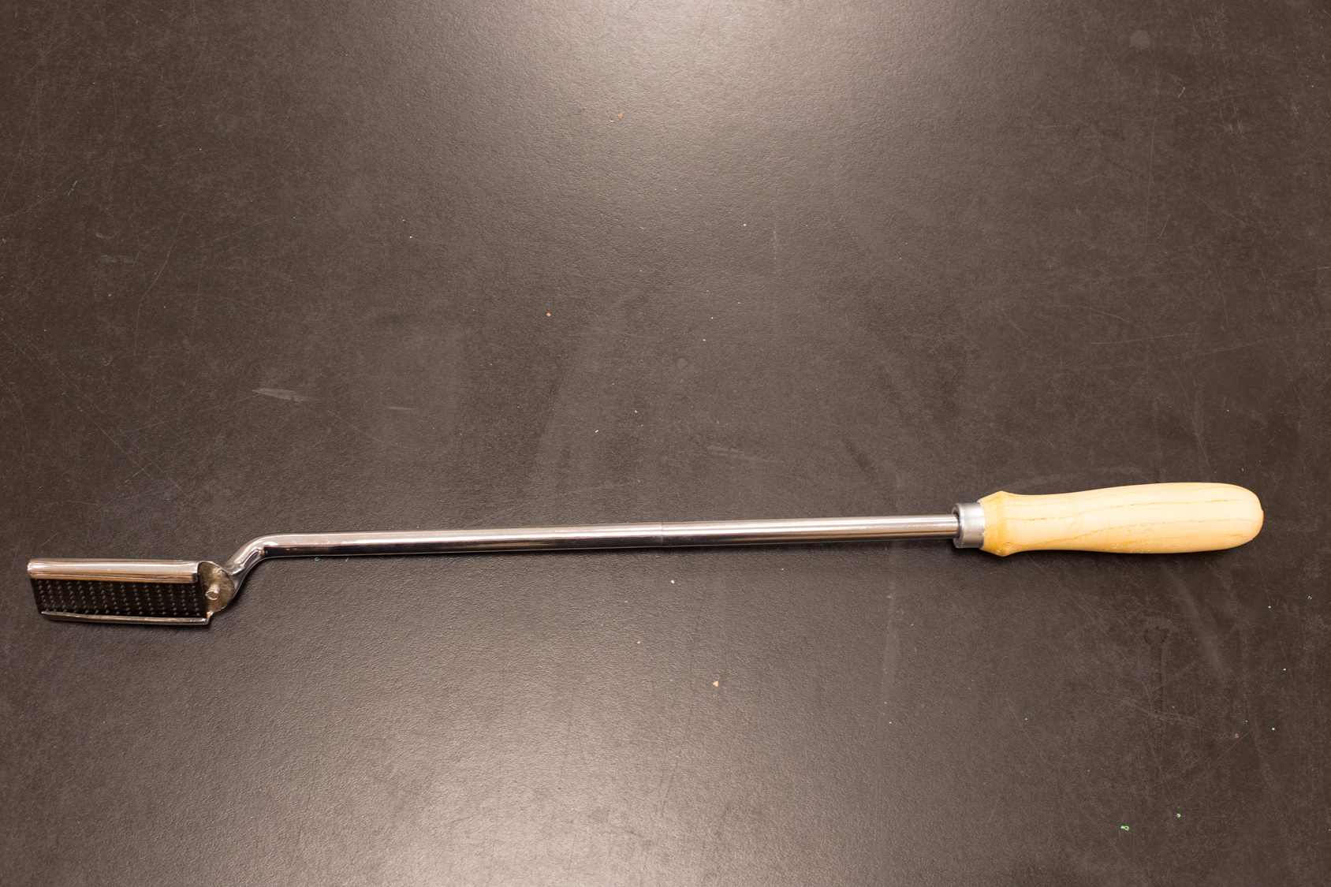
Equipment 7

Slide 10
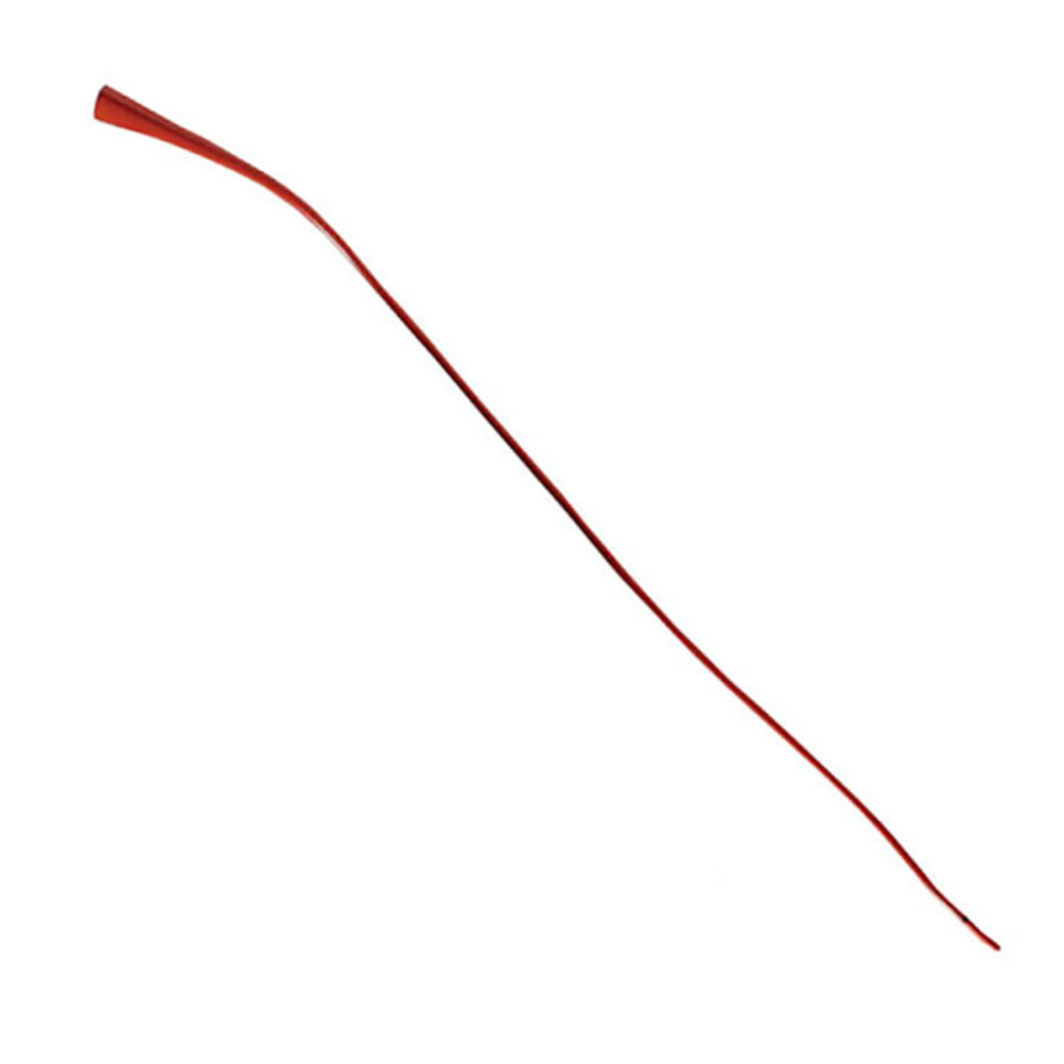
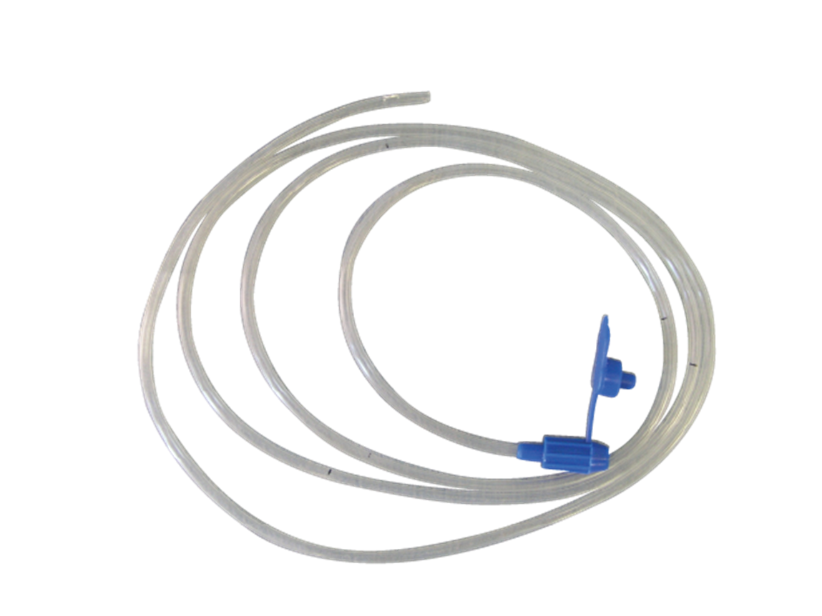
Equipment 8

Slide 11

Answer the question NOT the equipment and mark the number on the answer sheet
Equipment 9
What is this equipment typically constructed of?
001 Lead
002 Copper
003 PVC
004 Aluminum

Slide 12
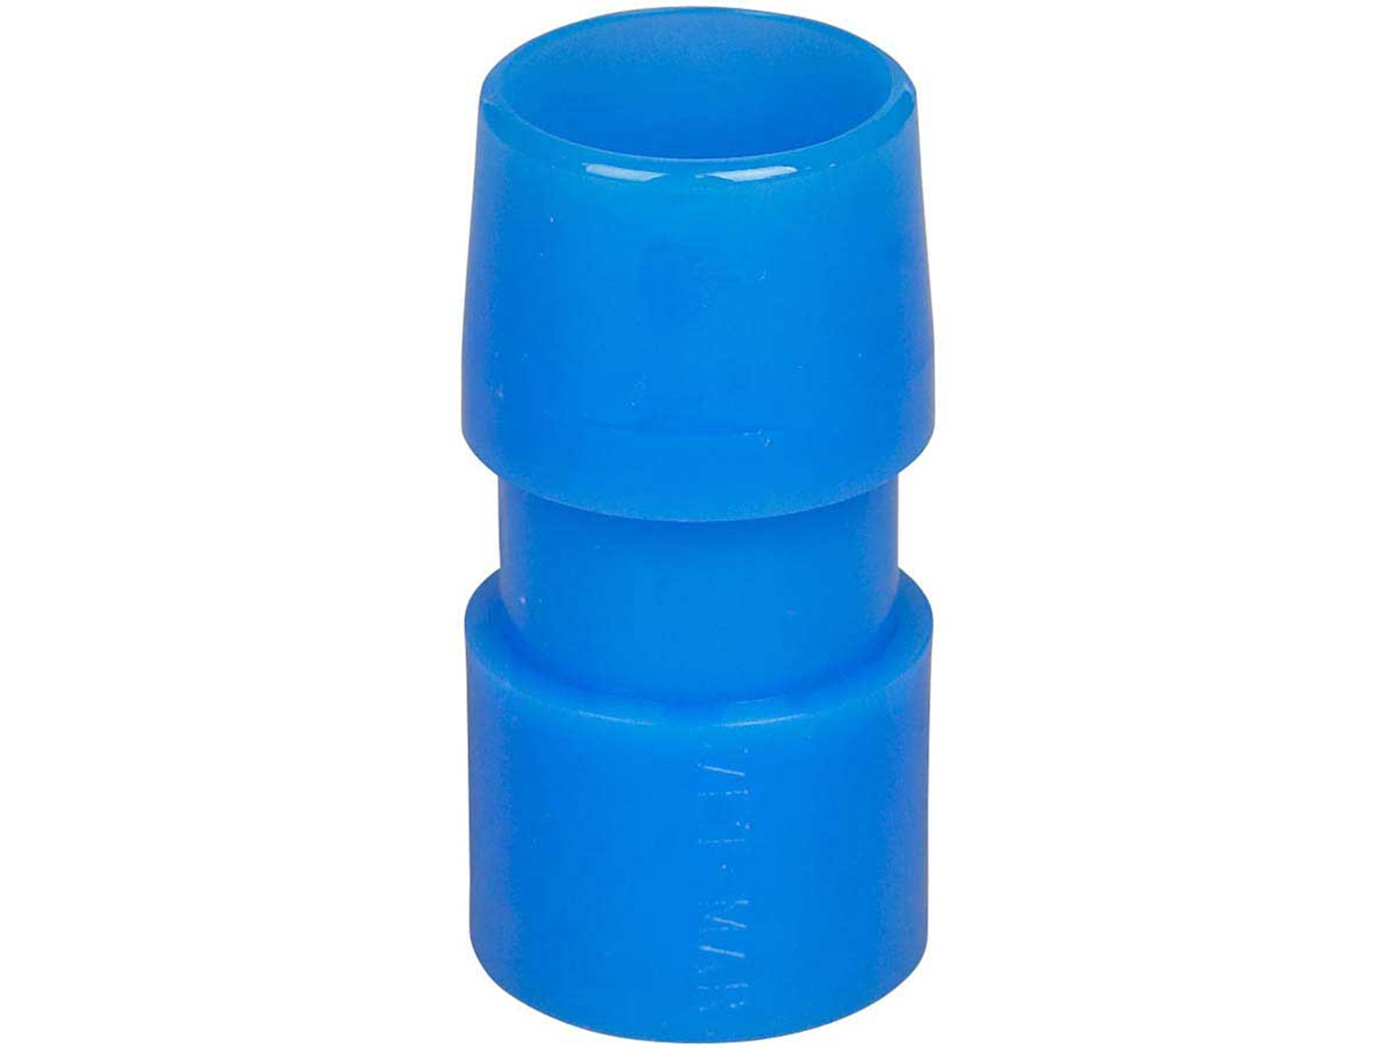
Equipment 10

Slide 13
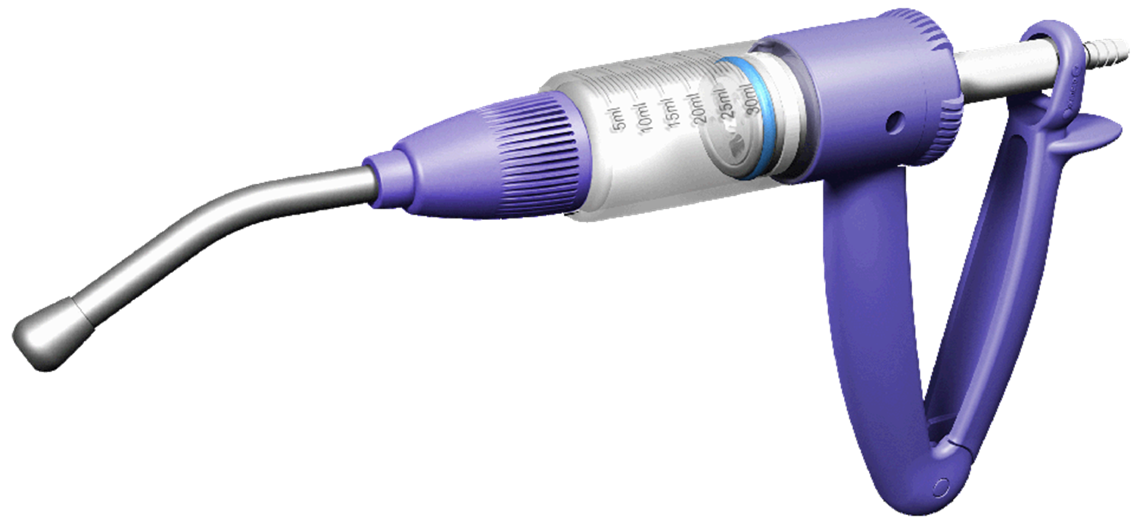
Answer the question NOT the equipment and mark the number on the answer sheet
Equipment 11
Which species is this piece of equipment typically used?
001 Tiger
002 Gerbil
003 Sheep
004 Swine

Slide 14
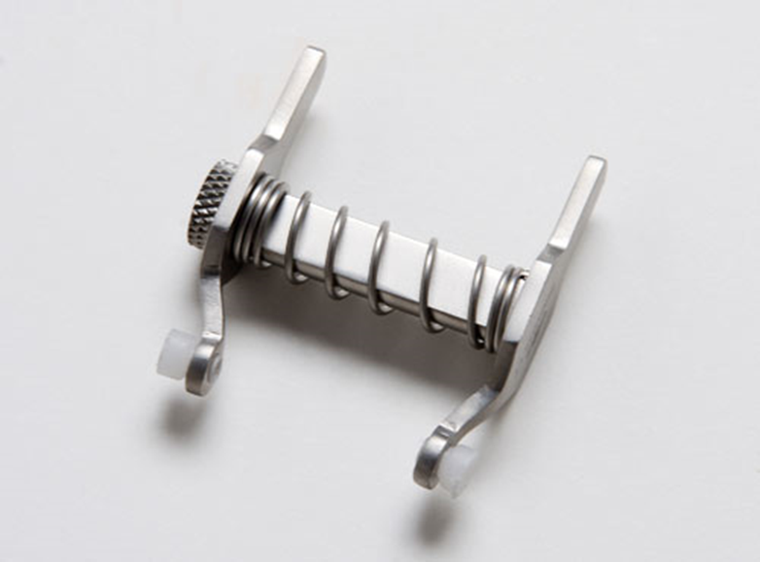
Equipment 12

Slide 15
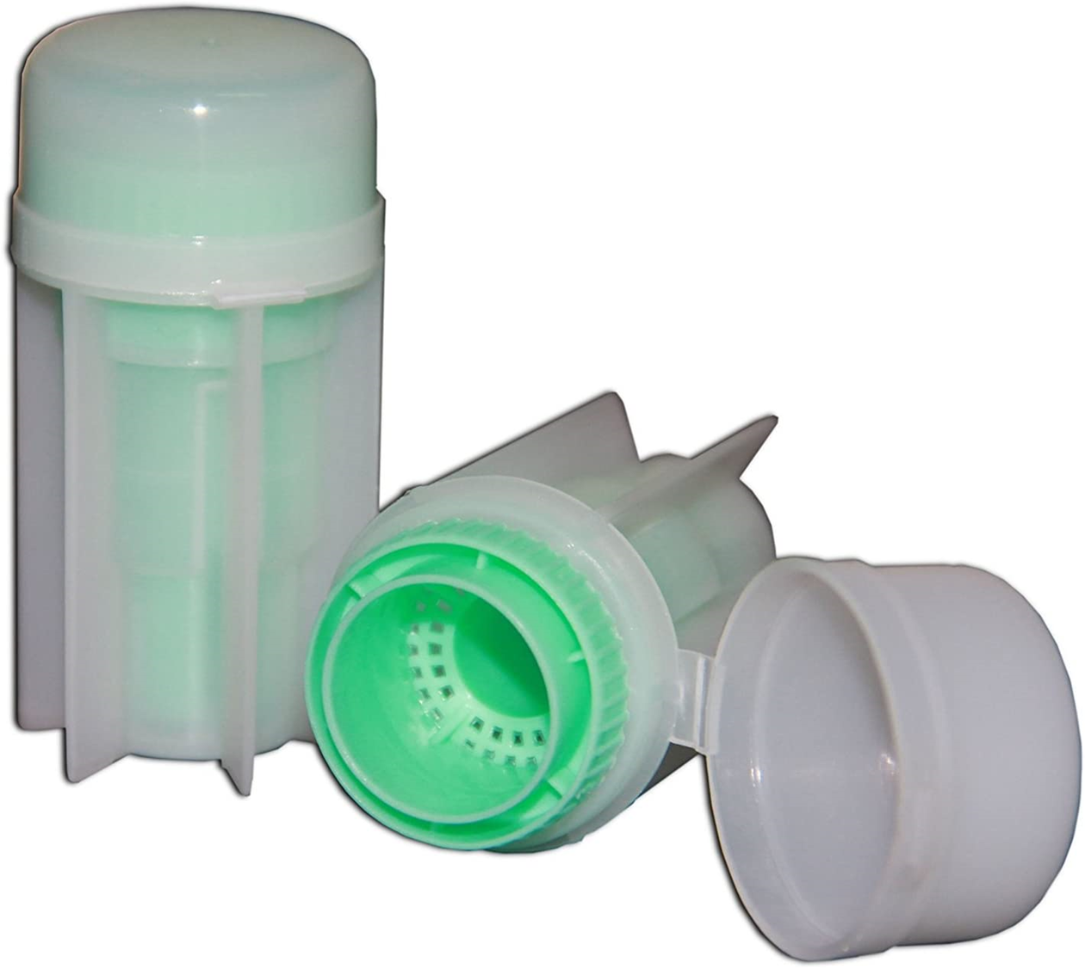
Equipment 13

Slide 16
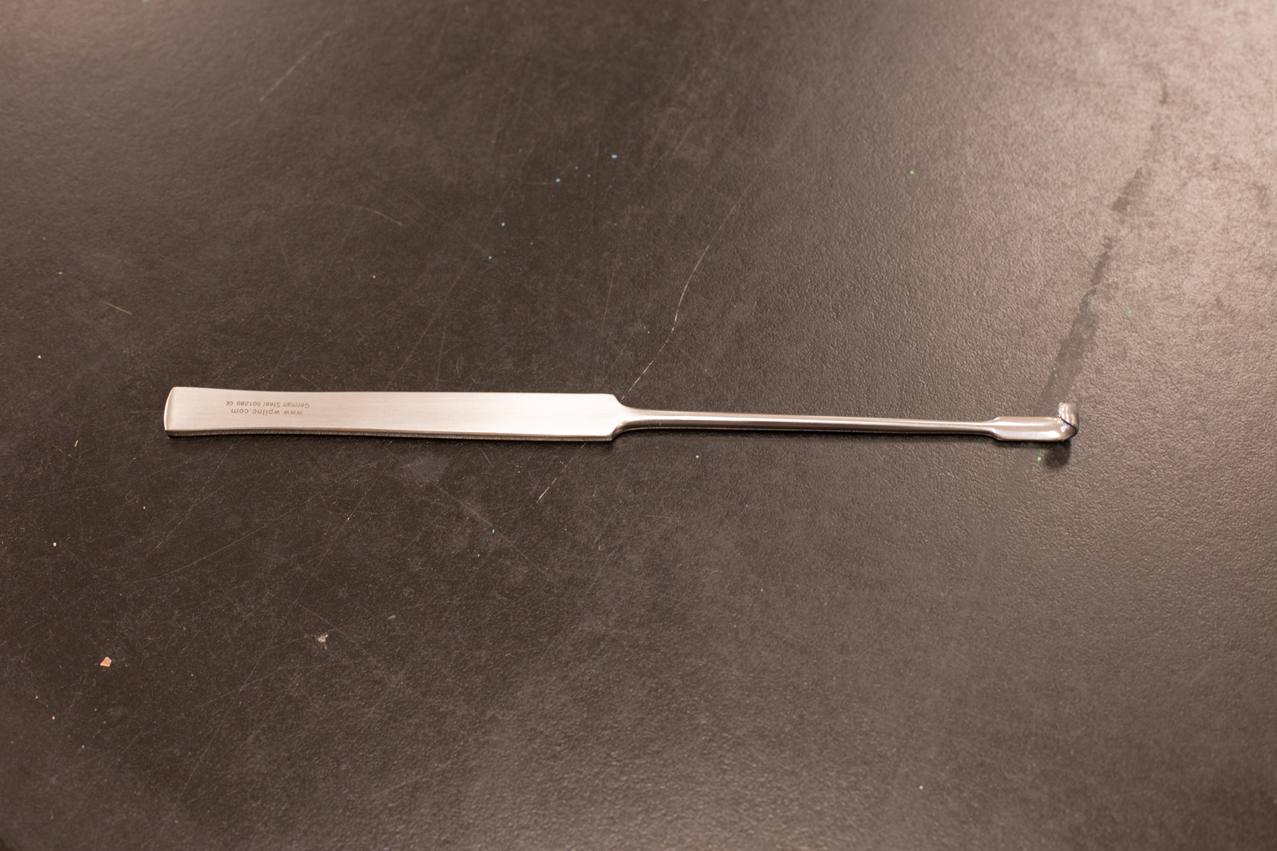
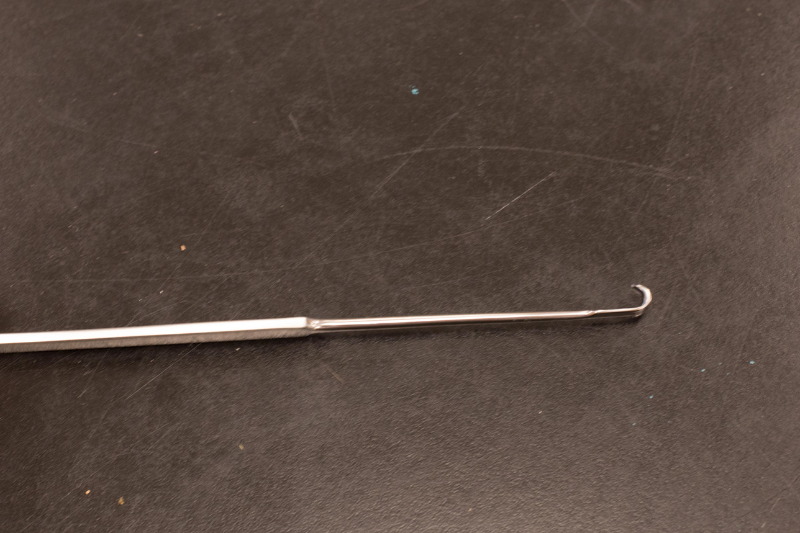
Equipment 14

Slide 17
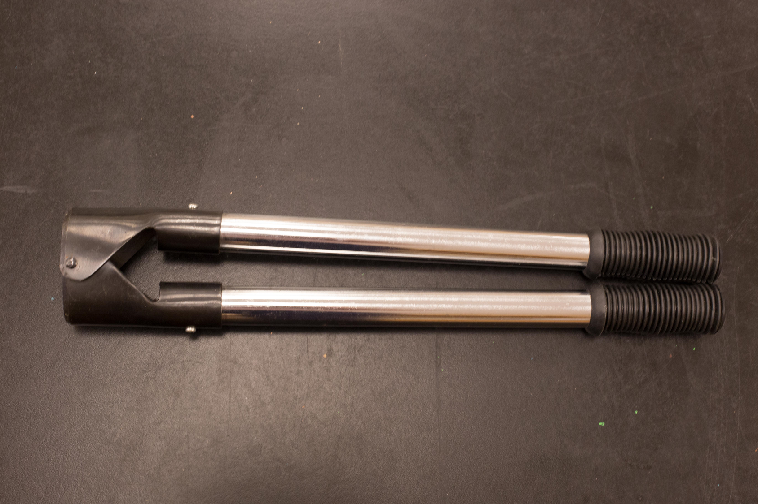
Equipment 15

Slide 18
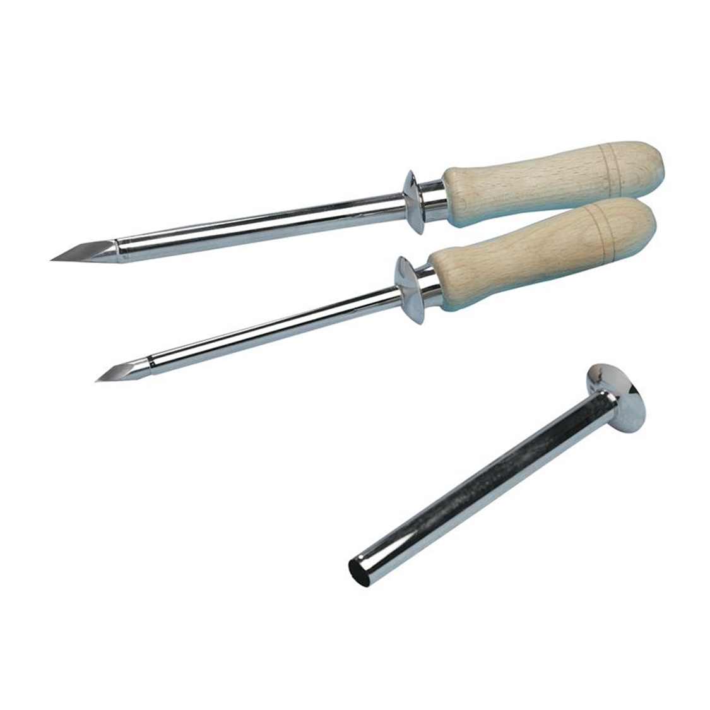
Equipment 16

Slide 19
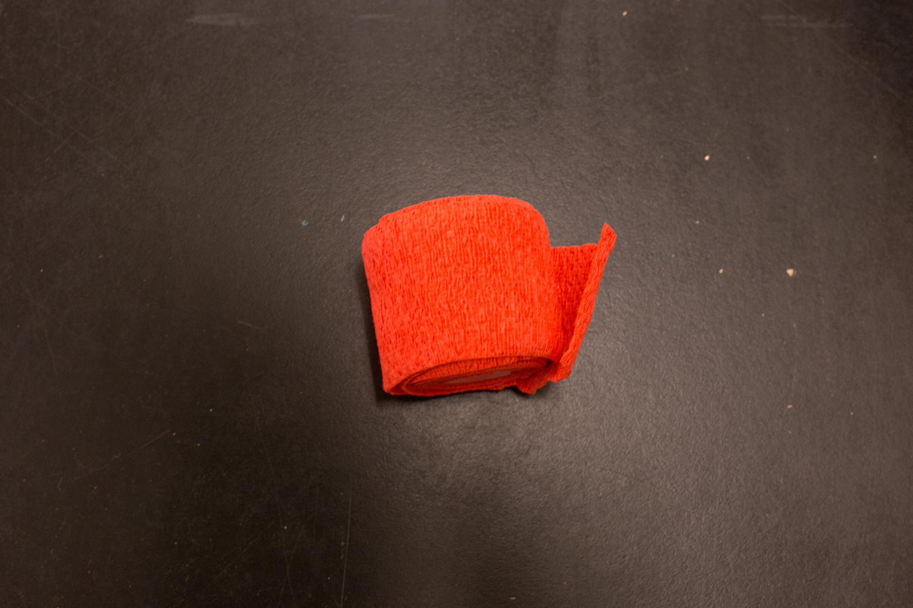
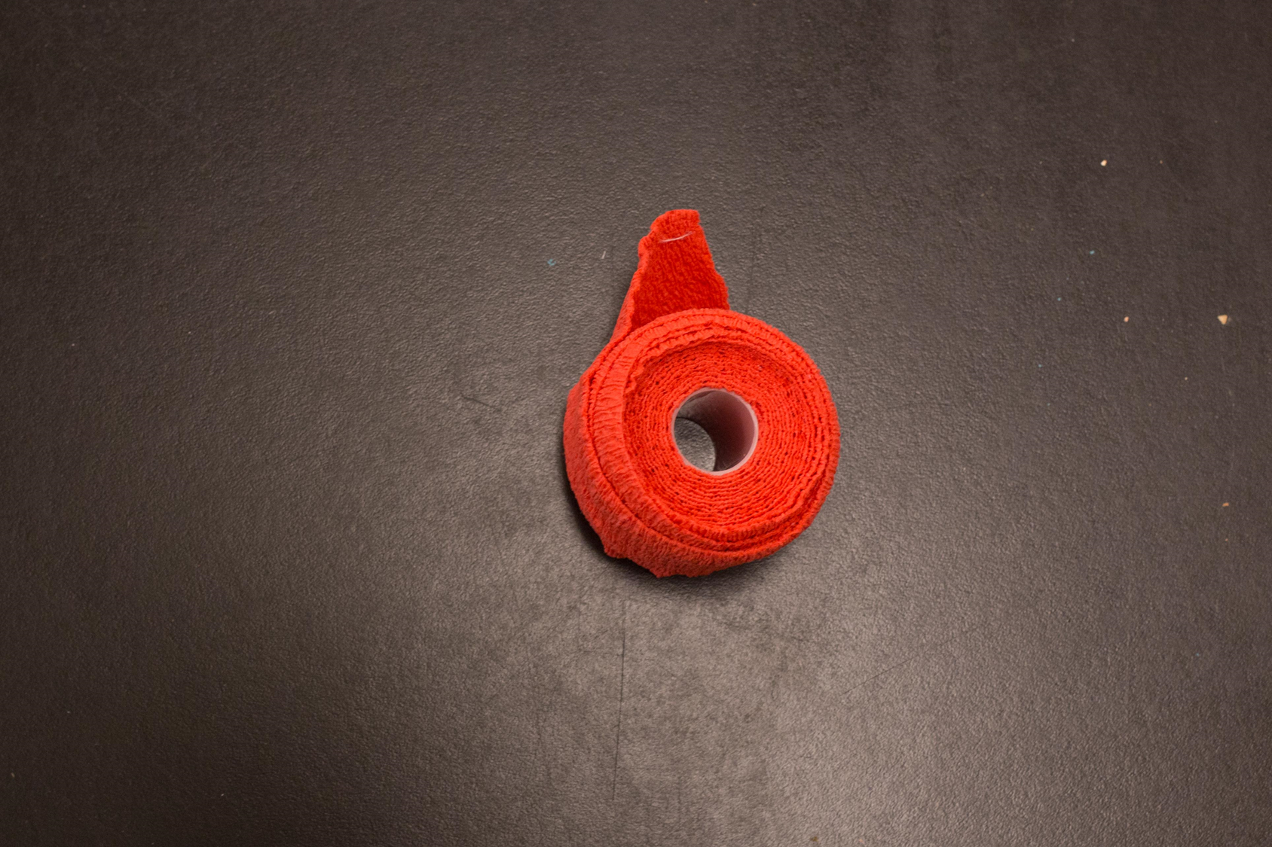
Equipment 17

Slide 20
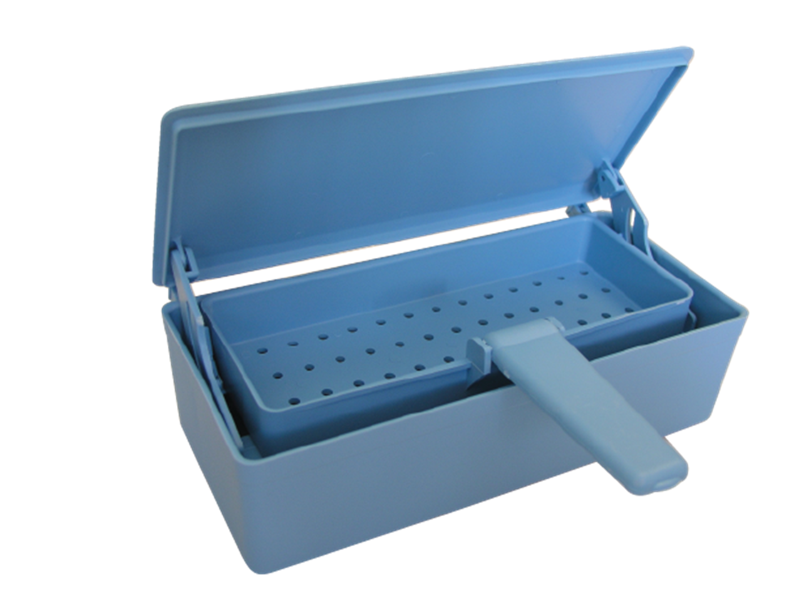
Equipment 18

Slide 21
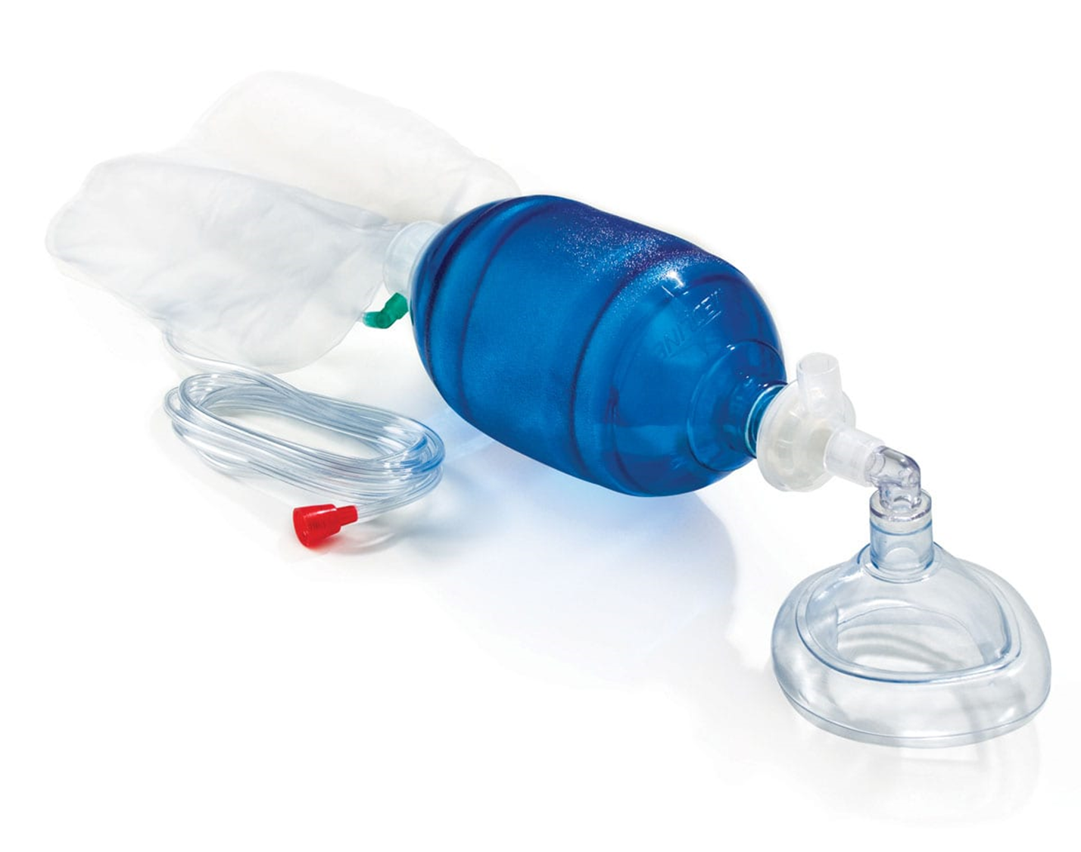
Equipment 19

Slide 22
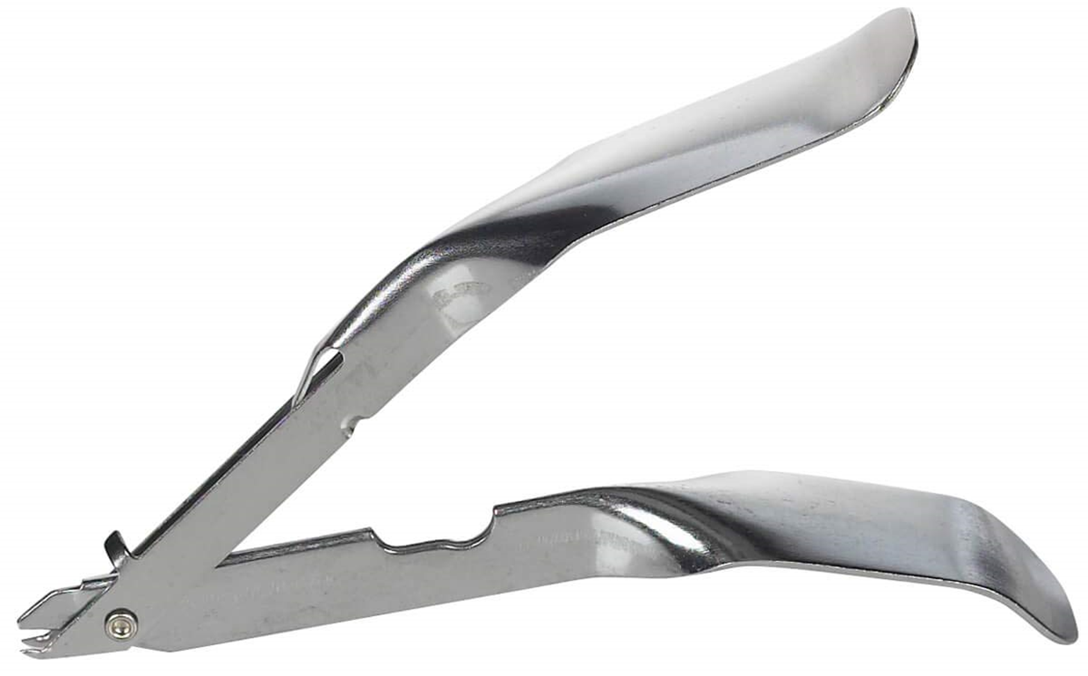
Equipment 20

Slide 23
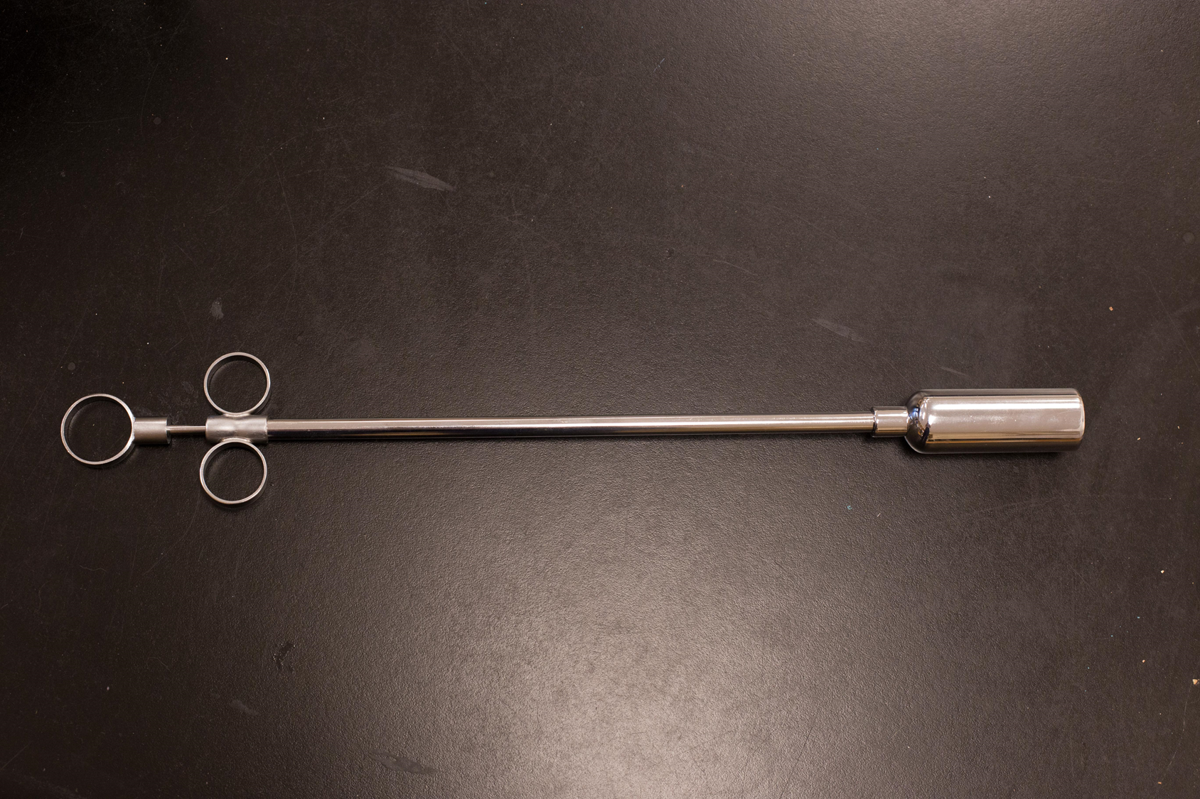
Equipment 21

Slide 24
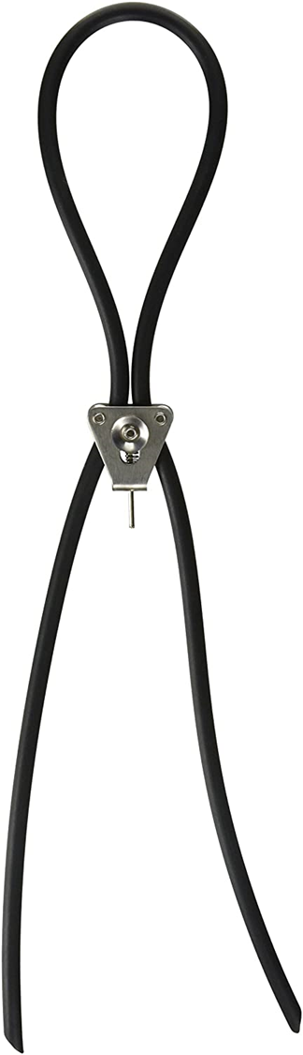
Equipment 22

Slide 25
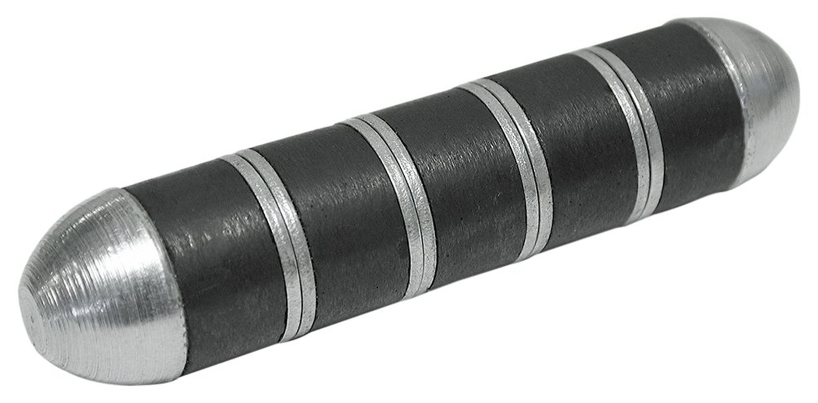
Equipment 23

Slide 26
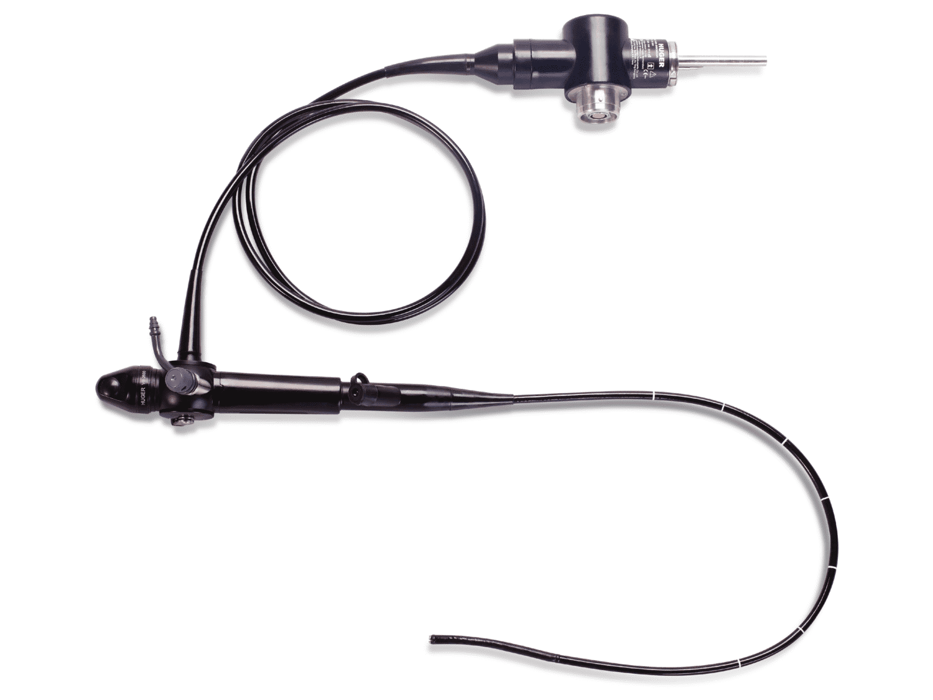
Equipment 24

Slide 27
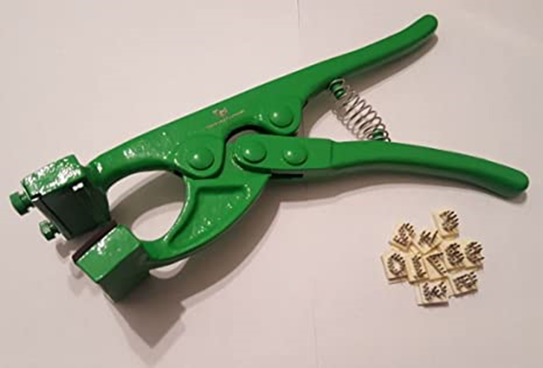
Equipment 25

Slide 28
Parasite/Microscope
Identification

Slide 29
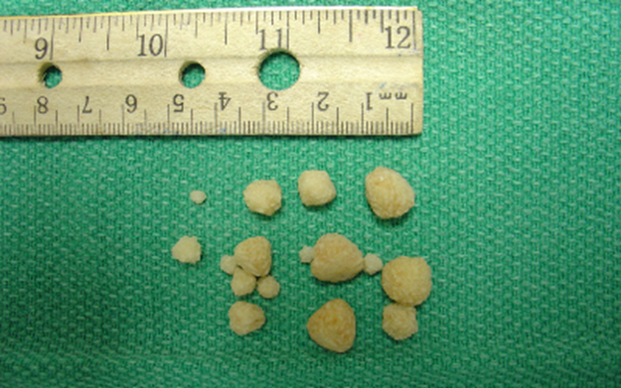

Parasite/Microscopic 26

Slide 30
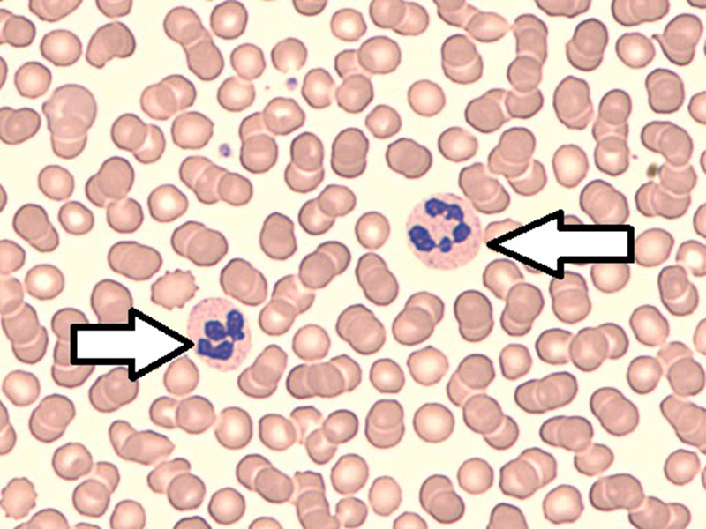
Parasite/Microscopic 27

Slide 31
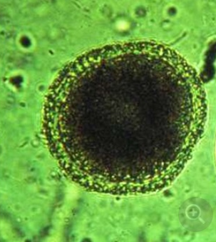
Parasite/Microscopic 28

Slide 32
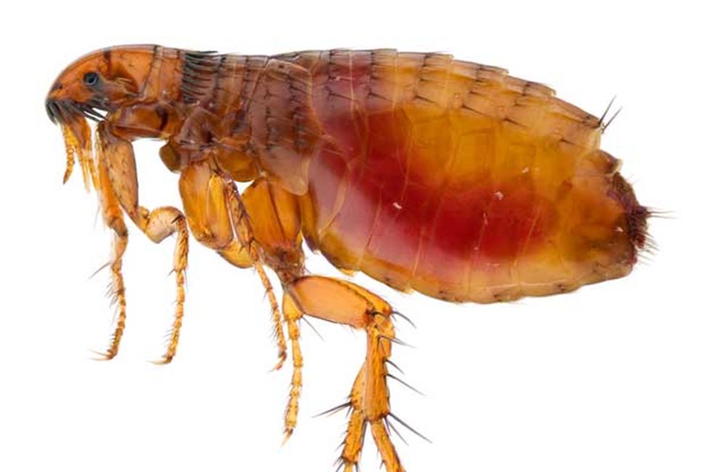
Parasite/Microscopic 29
What is the last stage of the life cycle of this parasite?
001 Adult
002 Ovum
003 Pupae
004 Larva

Slide 33
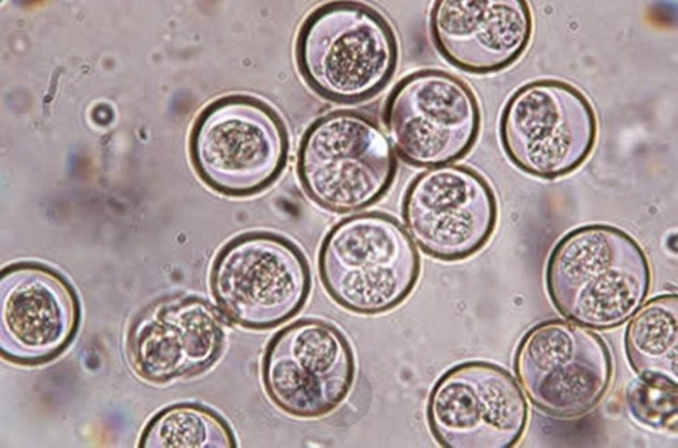
Parasite/Microscopic 30

Slide 34
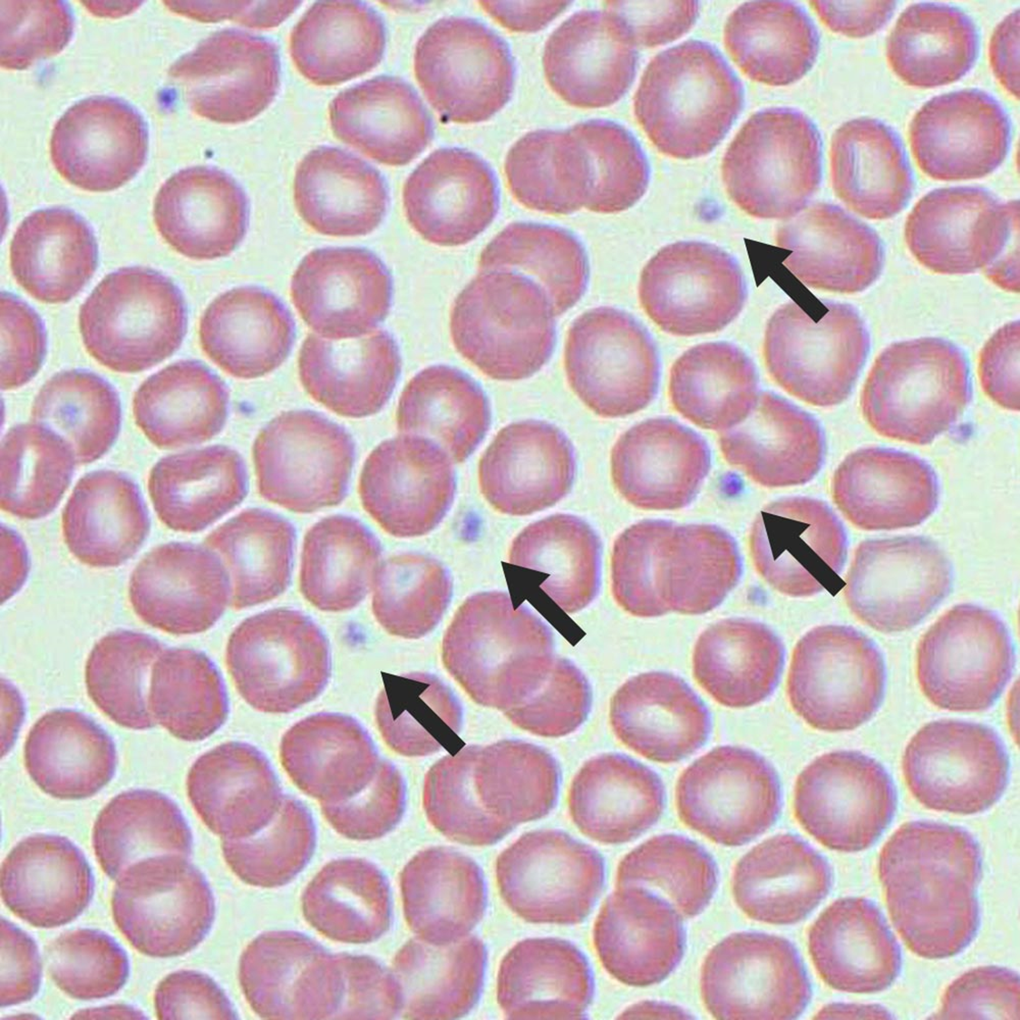
Parasite/Microscopic 31

Slide 35
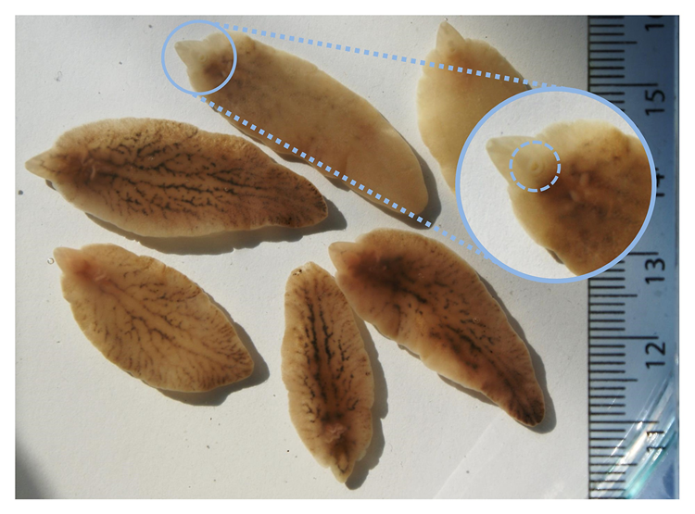
Parasite/Microscopic 32

Slide 36
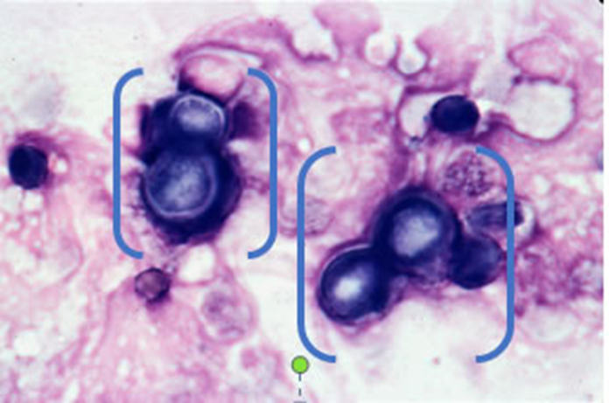
Parasite/Microscopic 33

Slide 37
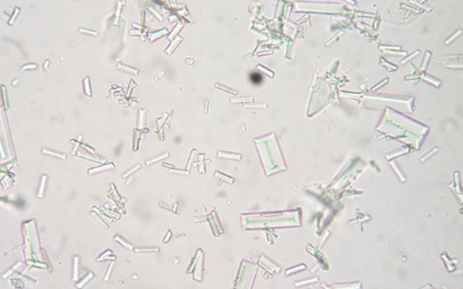
Parasite/Microscopic 34

Slide 38
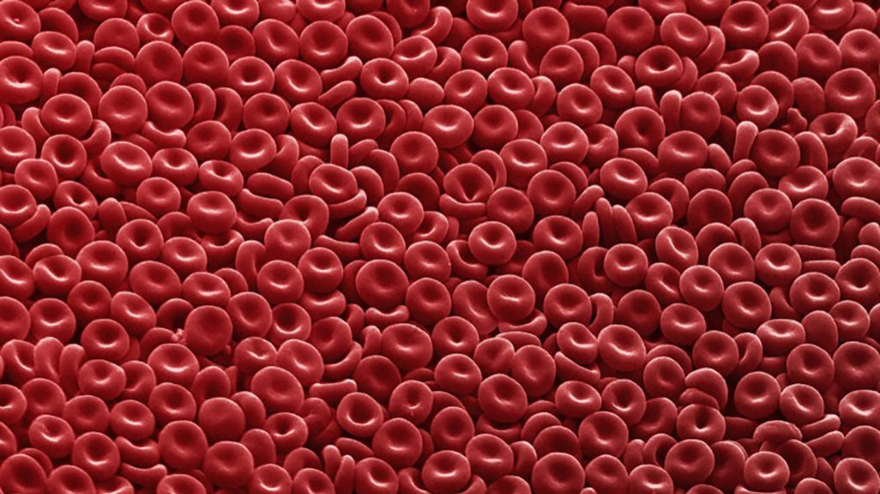
Parasite/Microscopic 35

Slide 39
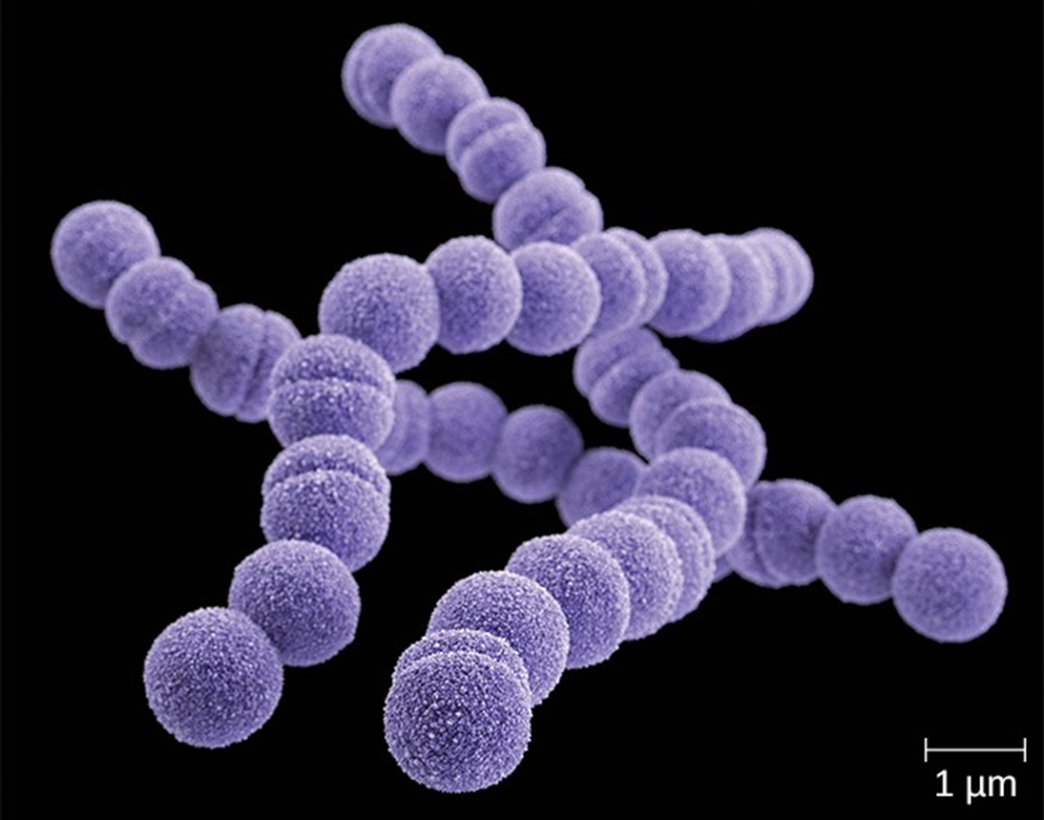
Parasite/Microscopic 36

Slide 40
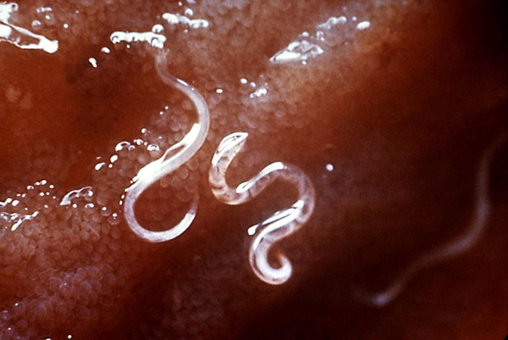
Parasite/Microscopic 37

Slide 41
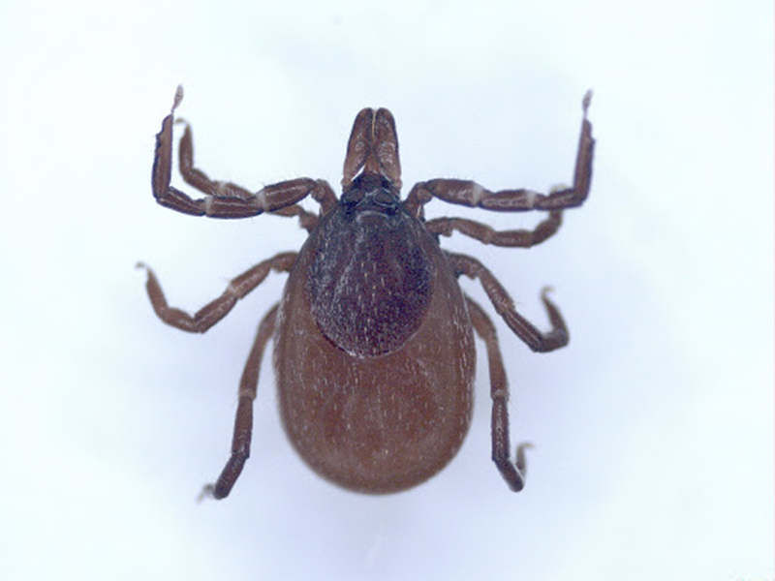
Parasite/Microscopic 38

Slide 42
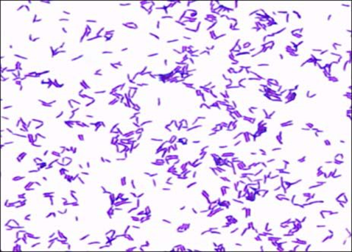
Parasite/Microscopic 39

Slide 43
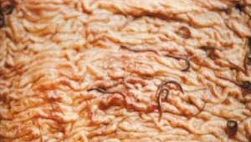
Parasite/Microscopic 40

Slide 44
Breed/Species Identification

Slide 45
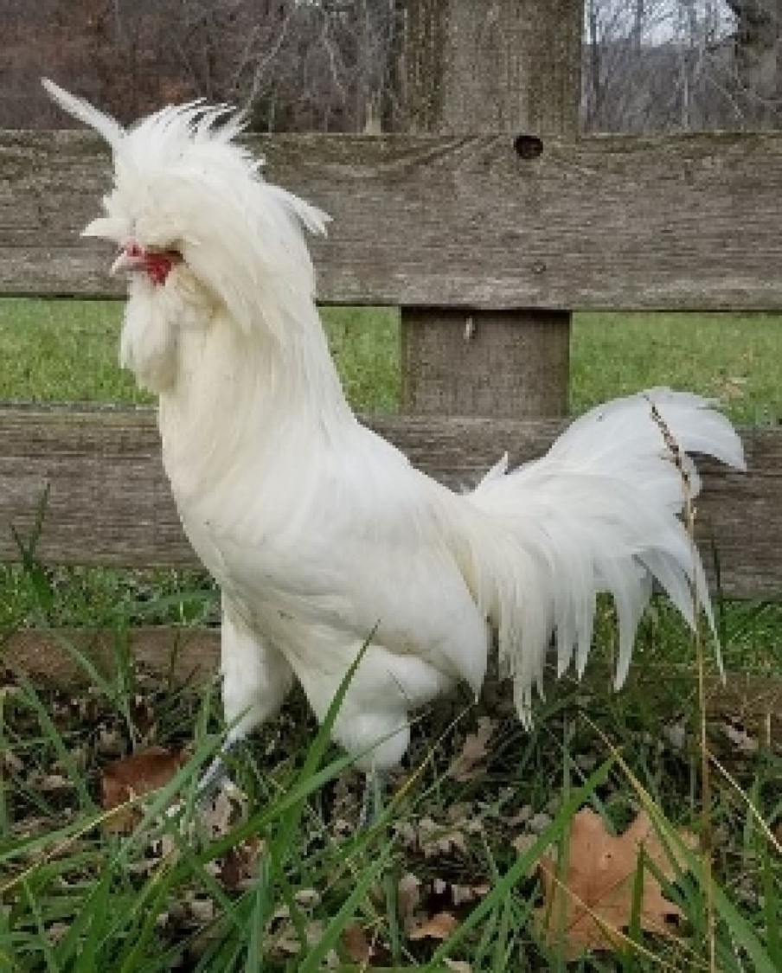
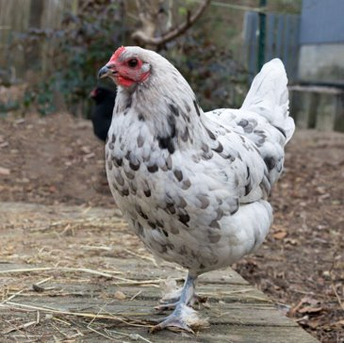
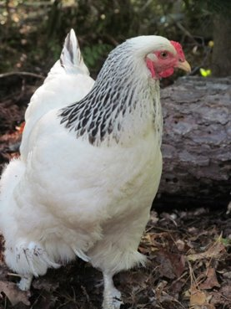
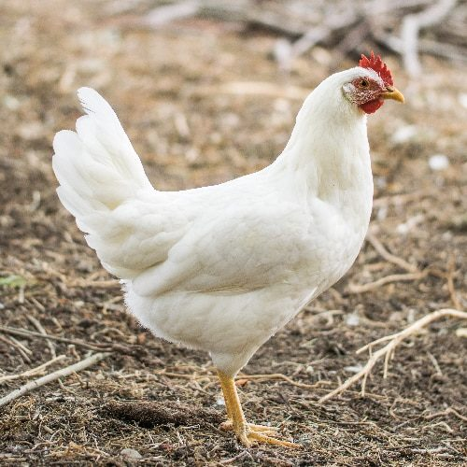
Which of the following is a Leghorn? (place the correct number for the question)
Breed/Species 41
001
002
003
004

Slide 46
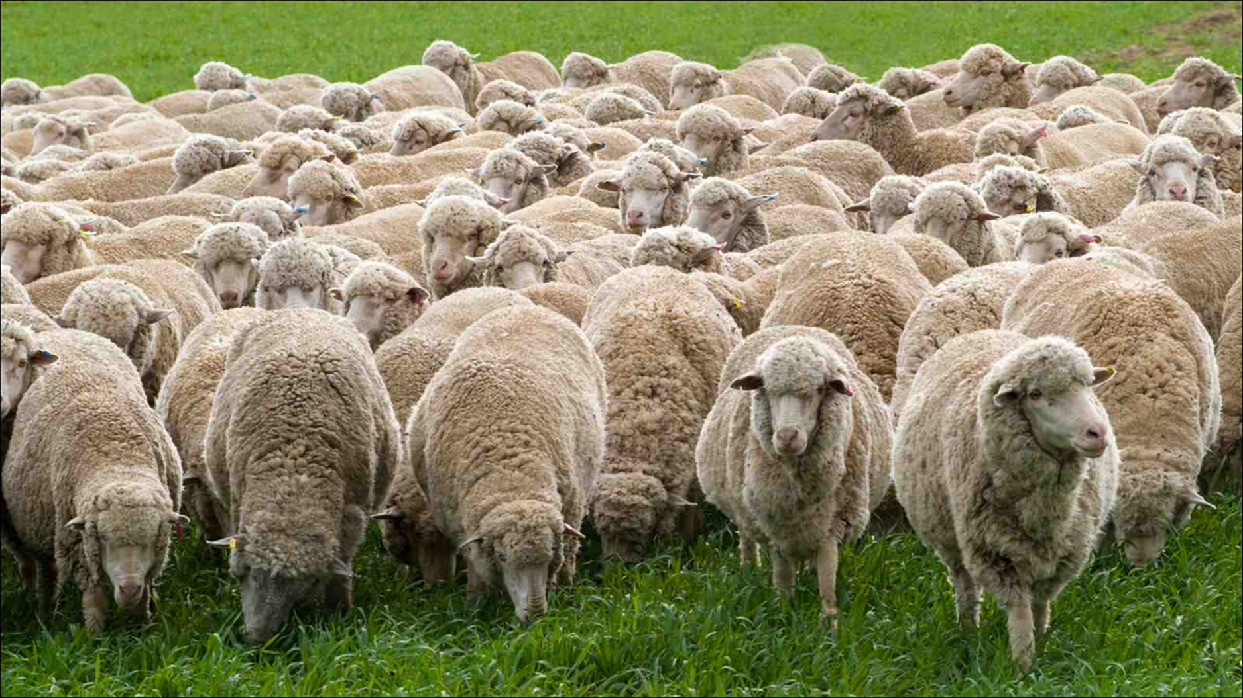
Breed/Species 42

Slide 47
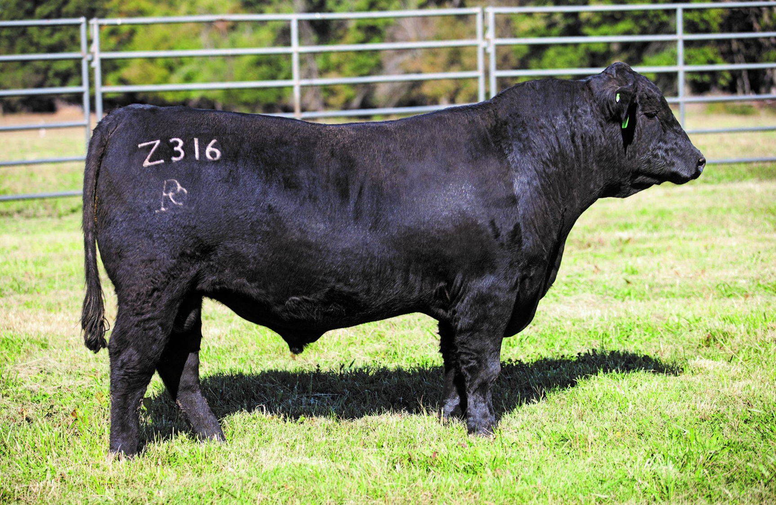
Breed/Species 43

Slide 48

Breed/Species 44

Slide 49

Breed/Species 45

Slide 50

Breed/Species 46

Slide 51

Breed/Species 47

Slide 52

Breed/Species 48

Slide 53

Breed/Species 49

Slide 54



Breed/Species 50

