Slide 1
Unit 3: Floral Design
Lesson Two:
Floral Design Concepts
Lesson Objectives:
Identify the principles used in floral design.
Examine the elements used in floral design.
Critique the use of lines in floral arrangements.
Analyze how color creates a theme in floral arrangements.
Footer description area.

Slide 2
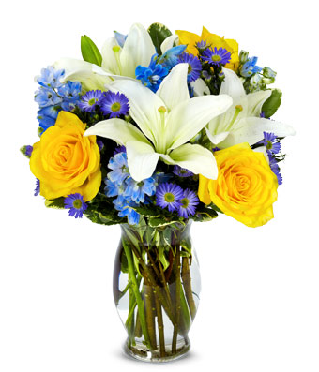
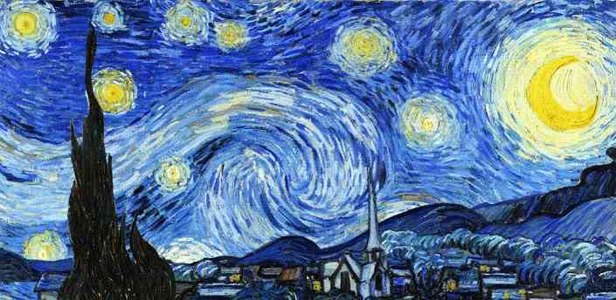
Introduction
Understanding Art
Can you describe the following concepts in the two works of art:
Color
Balance
Texture
Any similarities?

Slide 3

Concepts of Floral Design
These concepts apply to all art forms.
Principles are how the elements fit together.
Elements are what make up the design.
Principles are the recipe:
Balance
Proportion
Emphasis
Rhythm
Harmony
Unity
Elements are the ingredients:
Line
Form
Depth
Texture
Color

Slide 4
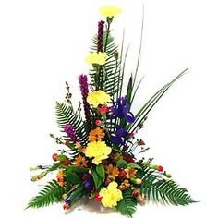
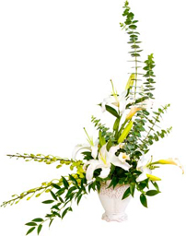
Principles
Balance
Balance gives a sense of equilibrium to a floral arrangement.
An arrangement or composition should have both visual and physical balance.
Physical balance means it is structurally and mechanically sound.
Visual balance means that both sides have equal weight or eye attraction.
Symmetrical Balance
Asymmetrical Balance
https://s-media-cache-ak0.pinimg.com/236x/45/22/67/452267c89930c40947931e5c9b2dc489.jpg
http://www.bloomsbythebox.com/img/example-of-balance-in-a-floral-arrangement.jpg

Slide 5
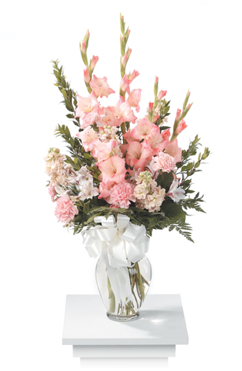

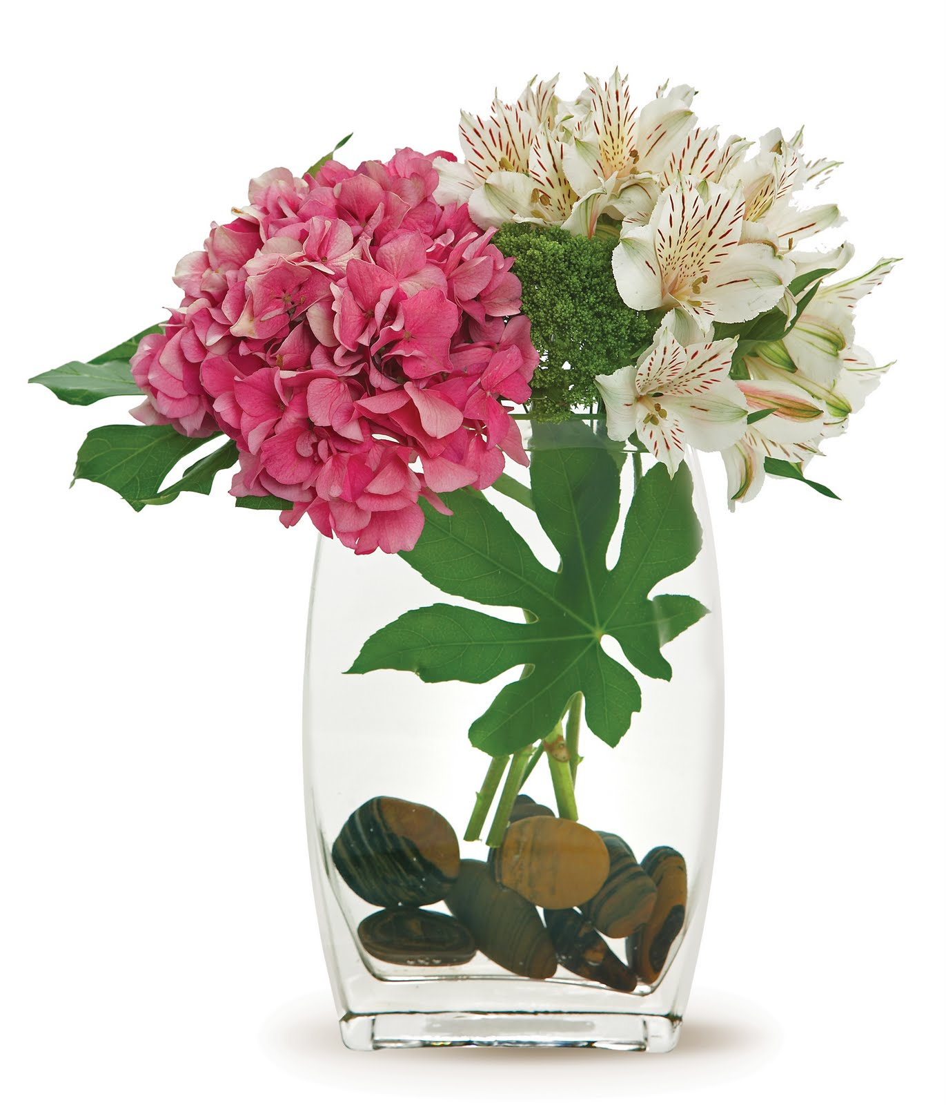
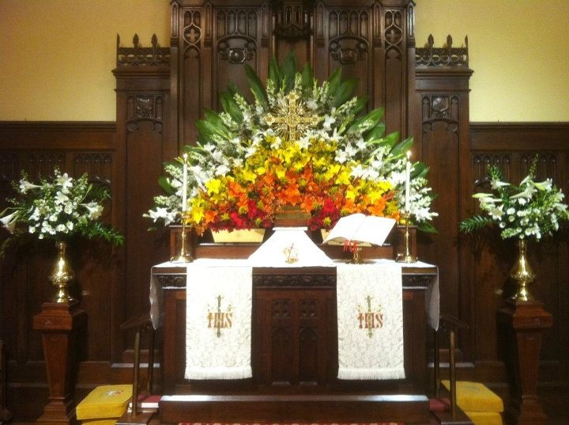
Principles
Proportion
Proportion or scale ties in with the idea of balance.
Proportion controls the size of the materials being used in the floral arrangement
The arrangement height should be proportionate to the container (1½ to 2 times the size of the container).
The arrangement must be proportionate to its surroundings.
http://d13jmf4ukq7yn1.cloudfront.net/jshop/images/0_CTT73-21_TFS211.jpg
http://1.bp.blogspot.com/-FrTGleM8wxM/TmWLaCm0sBI/AAAAAAAAAAc/rj4zesNSotk/s1600/FLO-00402_high.jpg
http://www.growerdirect.com/uploads/files/Images/Stock%20Pictures/sleepingpatientwithflowers.jpg
The one on the left is more proportionate.
https://s-media-cache-ak0.pinimg.com/736x/20/60/eb/2060ebf9535b96b2e85a4ce7daaeee09.jpg
Both arrangements are proportionate to the room.

Slide 6
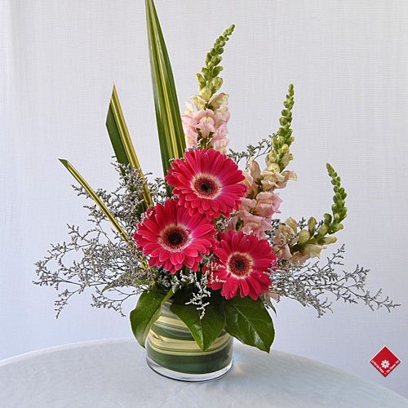
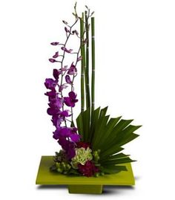
Principles
Emphasis
The center of interest in a floral arrangement is the emphasis or focal point.
The emphasis is where the viewer looks first in the design (multiple focal points are called accents).
Emphasis can be done strategically through location, framing and contrast.
Emphasis?
https://s-media-cache-ak0.pinimg.com/564x/9e/d5/a6/9ed5a657b977388e0566b47944b846cd.jpg
https://s-media-cache-ak0.pinimg.com/236x/7c/29/c8/7c29c872e4aa8294a4fe900309890c6e.jpg

Slide 7
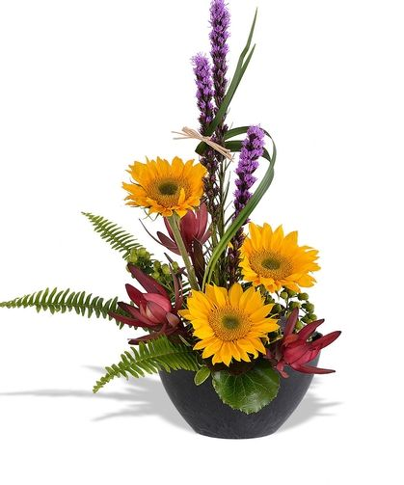
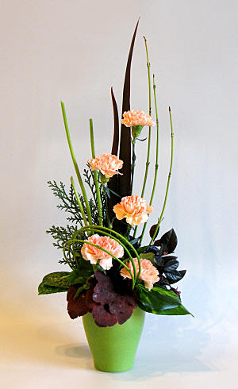
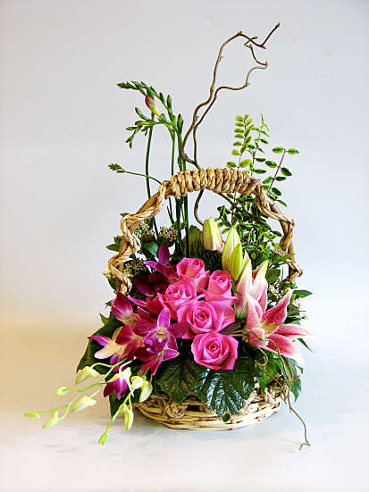
Principles
Rhythm
Rhythm refers to the movement of your eyes from the emphasis out to the rest of the arrangement.
Rhythm is established by repetition, radiating lines and transition.
http://www.flowerarranging.me.uk/images/takefiveflowers2.jpg
http://www.wowfloraldesignstudio.com/e/images/design309.jpg
https://s-media-cache-ak0.pinimg.com/564x/e8/ec/60/e8ec6011ac642d8c704a91692f3703e9.jpg

Slide 8
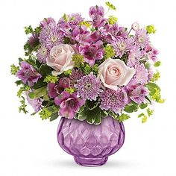
Principles
Harmony
Harmony is how the individual parts of the design come together in an aesthetically pleasing arrangement.
Like harmony in music, different instruments come together to make one pleasant song.
Having a predetermined theme or style is important to a harmonious design.
Repeating color, shape and texture emphasizes harmony.
https://s-media-cache-ak0.pinimg.com/236x/af/cd/d0/afcdd0992f34431143d5472c9930ead8.jpg

Slide 9
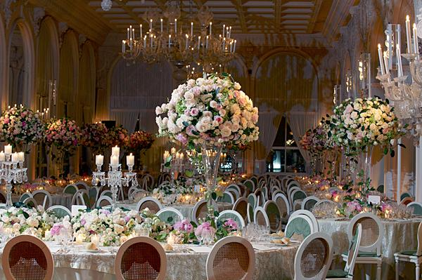
Principles
Unity
Unity is how the finished floral arrangement is viewed as a whole composition.
Different from harmony, which focuses on the individual components
All principles of floral design must be correct to achieve unity in a floral arrangement.
http://cf.ltkcdn.net/weddings/images/slide/149000-600x399-Vintage-Room.jpg

Slide 10
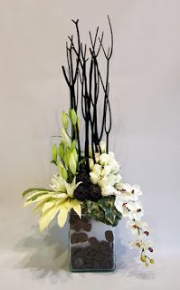
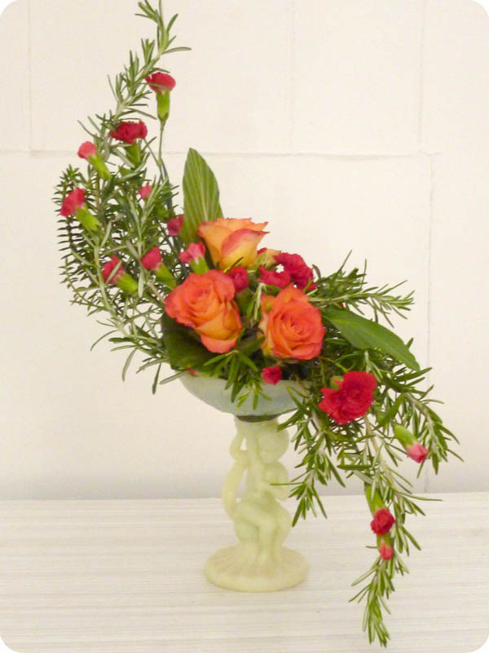
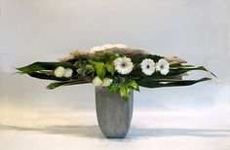
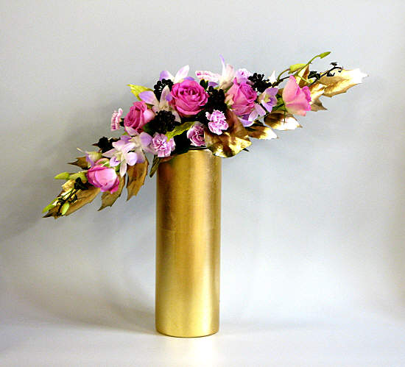
Elements
Line
Lines in floral design give distinction and importance to an arrangement.
Rhythm is greatly influenced by the lines of a composition.
Directional lines can be vertical, horizontal, diagonal or curved.
Arrangements can have actual, implied and psychic lines.
https://s-media-cache-ak0.pinimg.com/236x/bf/30/bb/bf30bb4d6ccc3c1052bf5dace07c4614.jpg
http://www.flowerarranging.me.uk/images/design314.jpg
https://s-media-cache-ak0.pinimg.com/236x/49/5b/21/495b215c328d9e0fe87506442b006667.jpg
http://www.juliescreativeflowers.com/images/Dayschool5Jly11/5Jly11_003.jpg

Slide 11
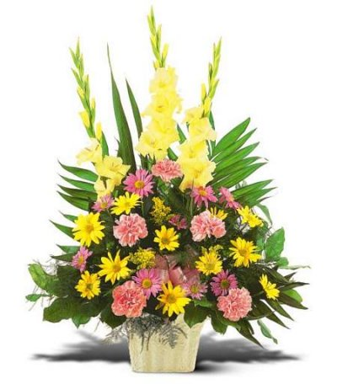
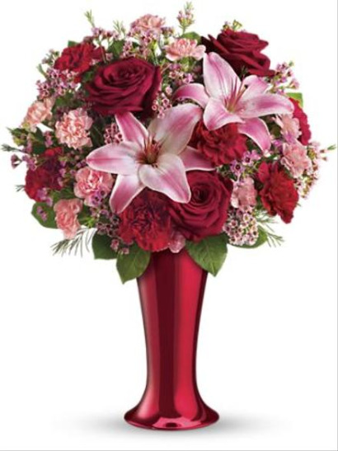
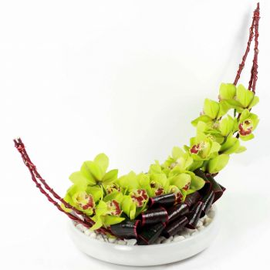
Elements
Form
Form refers to the shape of the arrangement. The shape of the flowers, foliage and container helps create the overall form of the composition.
The form is made up of positive and negative space.
http://www.flowers24hours.co.uk/flowers/images/images4/Cymbidium-Orchids-IMG3050-350.jpg
http://ladanmoshiri.com/multimedia/flower_website/assets/images/templatemo_thumb_52_big.jpg
http://www.englishgardenraleigh.com/bmz_cache/1/1eaf6e00b274dd5806d19c59d3932485.image.400x456.JPG
Crescent Round/Circular Triangular/Fan-shaped

Slide 12
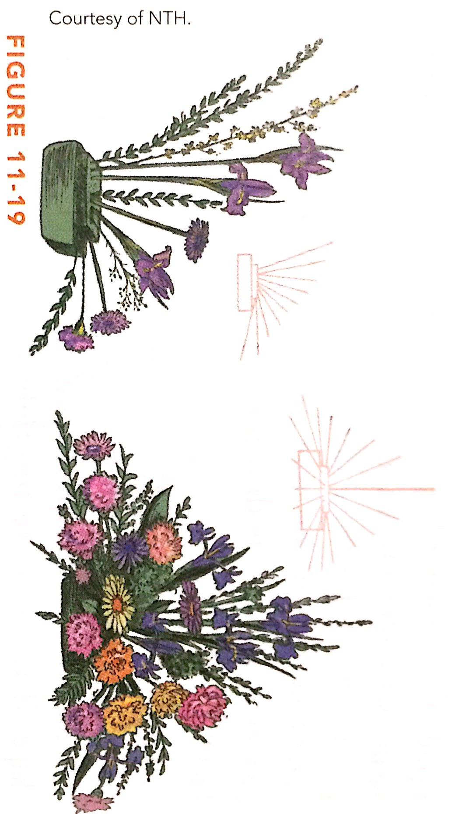
Elements
Depth
Arrangements with depth avoid looking flat and two-dimensional.
Angled lines and overlapping are both techniques that help portray depth in an arrangement.
Angling the tallest stems slightly backward and the foreground stems slightly forward enhances depth.
Viewed from the front (left) the arrangement has depth. Viewed from the side (right), we see how that depth was created- through angling and over lapping.

Slide 13
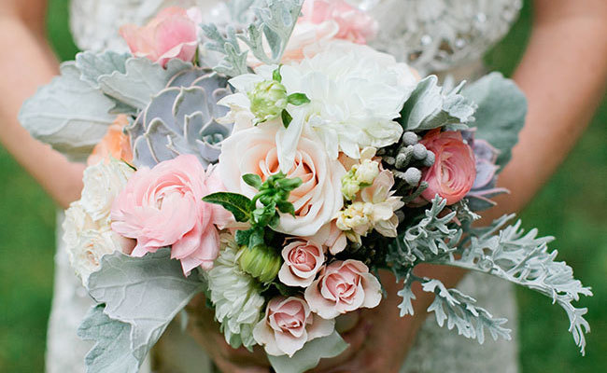
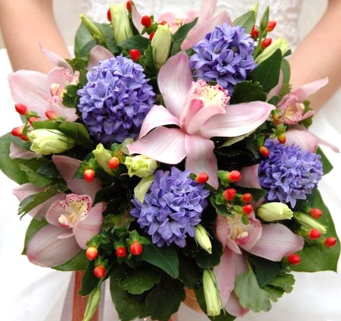
Elements
Texture
Texture refers to the exterior physical characteristics of objects in an arrangement.
Flowers and foliage vary in texture (smooth, rough, glossy).
Successful floral arrangements combine textures while still maintaining harmony and unity.
https://apis.xogrp.com/media-api/images/ae408f1c-765e-473a-9838-0eb3c7f5e936~rs_768.h
http://www.bloomsbythebox.com/blog/wp-content/uploads/2011/07/mult-textured-bouquet.jpg

Slide 14
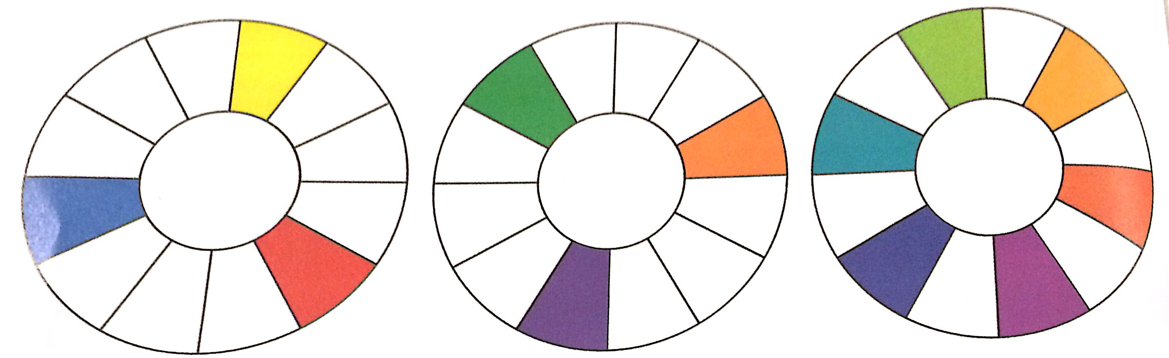
Elements
Color
Hue is the proper term for color.
The basic color wheel has 12 hues.
3 Primary
3 Secondary
6 Tertiary

Slide 15
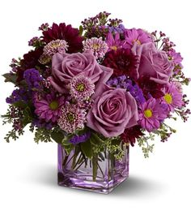
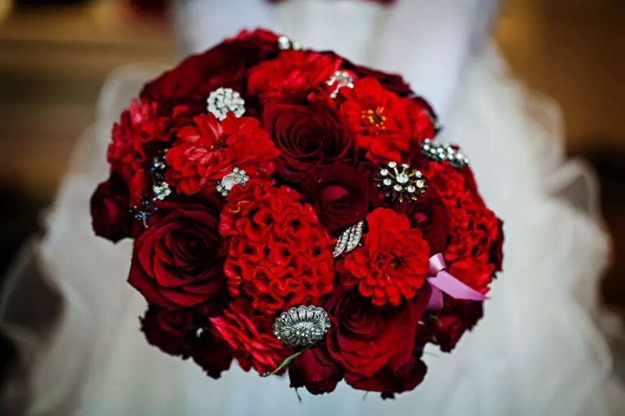
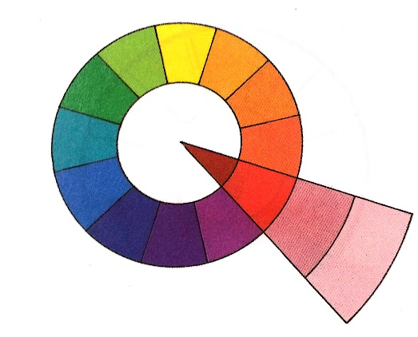
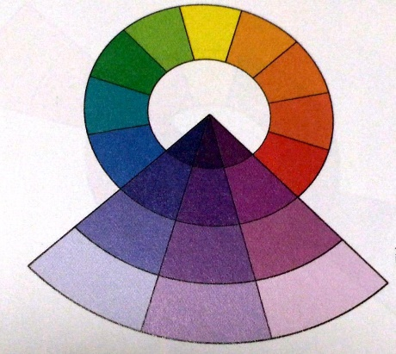
Elements
Color, Continued
Floral design themes revolve around a color scheme.
Related color schemes can be monochromatic or analogous.
http://images.mywedding.com/dims3/manipulate/quality/60/resize/800x533/;http://mediastore001.mywedding.com/media/1c6e3c5e-6e8c-11e3-83c1-deadcafe8df2/content
https://s-media-cache-ak0.pinimg.com/236x/0f/a7/29/0fa7297ded983c6c44fffb1299662d1b.jpg

Slide 16
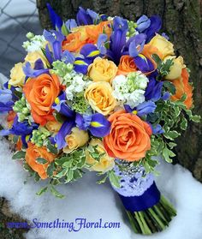
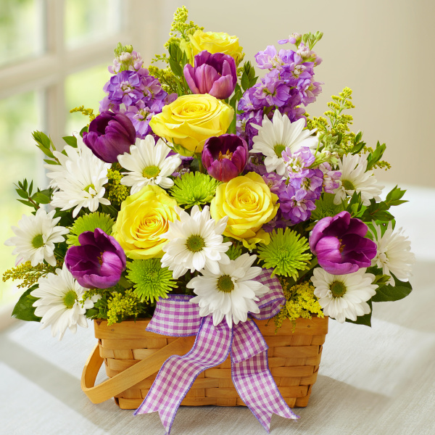
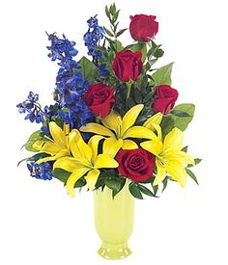
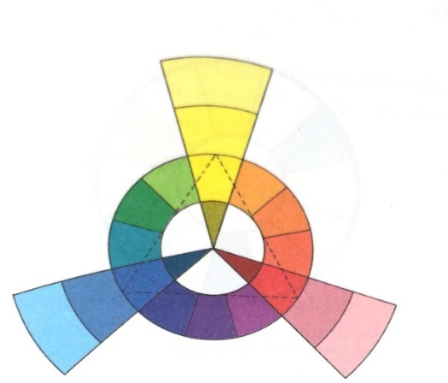
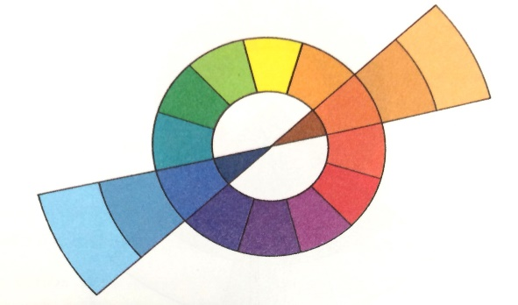
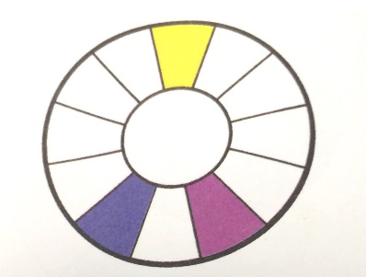
Elements
Color, Continued
Colors across from each other on the color wheel are referred to as complementary colors.
Contrasting colors themes are considered complementary, split-complementary or triadic.
https://s-media-cache-ak0.pinimg.com/236x/64/2b/40/642b406e8ea9281487185dc8ed4cc13d.jpg
http://res.cloudinary.com/picasso/image/upload/c_lpad,f_jpg,fl_progressive,h_600,q_95,w_600/gm3vyg923g60udgngca1.jpg
https://s-media-cache-ak0.pinimg.com/236x/61/c9/36/61c93667f9dfe5dfda4a90823847e247.jpg

Slide 17
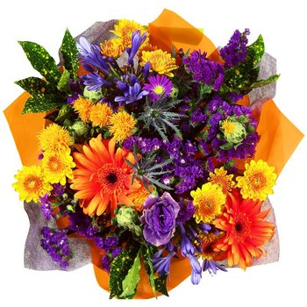
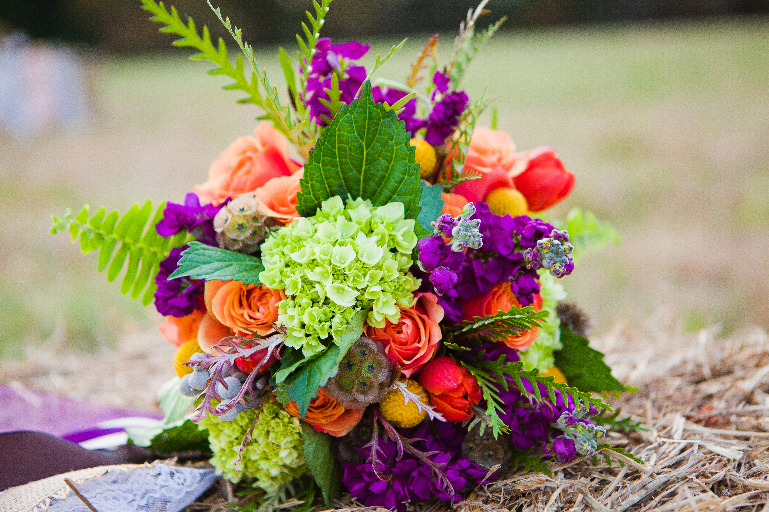
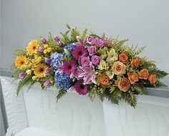
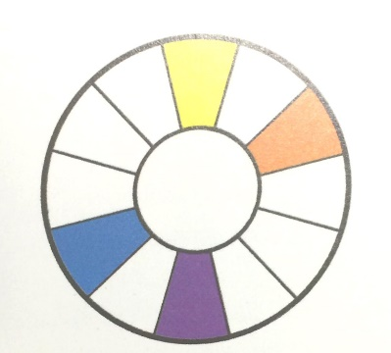
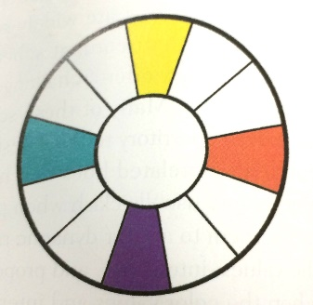
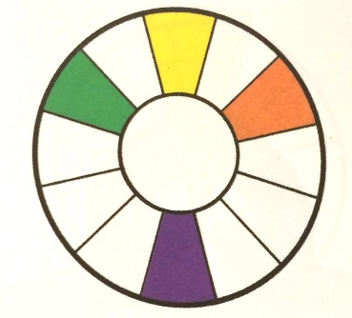
Elements
Color, Continued
Some floral arrangements will spread farther out on the color wheel, utilizing four hues.
Discordant color themes are considered double-complement, alternate-complement and tetrad.
http://www.fiftyflowers.com/site_files/FiftyFlowers/Image/Product/Bridal_Centerpieces_Orange_and_Purple_Flowers_350.jpg
https://myurbanpetals.files.wordpress.com/2012/11/urban-petals-177.jpg
https://s-media-cache-ak0.pinimg.com/236x/3a/e5/bf/3ae5bfce4a4d9a58f6255a38fe92e533.jpg

Slide 18

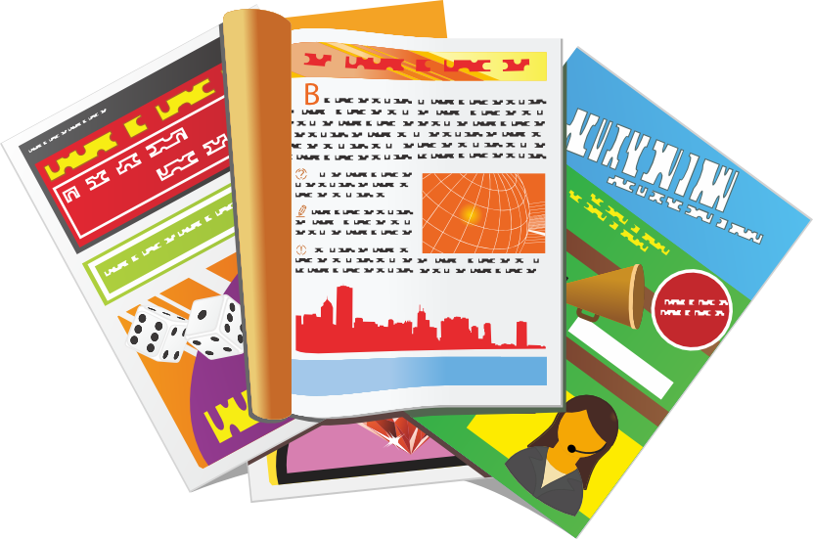
Activity
Design Concepts Examples
Using floral magazines, find example of the concepts we discussed today and paste them into your “Design Concepts” packet.
Make sure you have answered all other questions using information from the PowerPoint.
http://images.clipartpanda.com/magazine-clipart-magazines.png
https://conceptdraw.com/a2996c3/p94/preview/640/pict--scissors-and-a-bottle-of-glue-education-pictograms-vector-stencils-library

Slide 19
Review
Ticket out the Door
Name a concept you found new or interesting.
Name a concept you had heard of before and explain where it was mentioned (art, music, fashion, etc.)
All the concepts are important, but when you look at a flower arrangement what stands out the most to you?

