Slide 1
Unit 3: Floral Design
Lesson Three:
Equipment Identification and Floral Crops
Lesson Objectives:
1. Identify equipment used in the retail floriculture industry.
2. Categorize floral crops commonly used in floral design.
Footer description area.

Slide 2
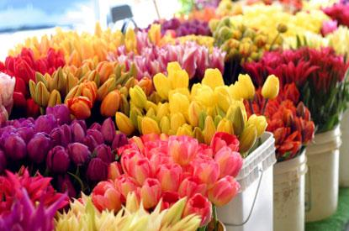
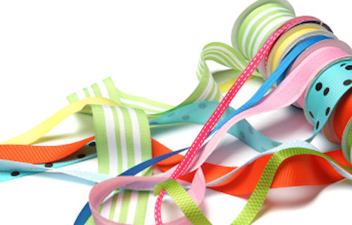
Introduction
Shopping List
http://the-flower-shoppe.com/images/415_Colorful-Wholesale-flowers.jpg
http://quiltcraftsewmall.com/images/slide04.jpg
Think, Pair, Share:
Think of a floral arrangement you would like to create and make a list of material you would need to create it (price is not a factor)!

Slide 3
Floriculture Tool Identification
Bouquet sleeve
Cardette
Ceramic container
Chenille stem
Corsage box
Corsage pins
Corsage snips
Dry foam
Enclosure card
Fern greening pins
Floral adhesive
Floral foam
Floral knife
Floral preservative
Floral stem tape
Floral wire
Glass vase
Glue gun
Glue pan
Glue sticks
Nosegay holder
Pot cover
Ribbon
Ribbon shears
Rose and stem flower stripper
Sheet moss
Spanish moss
Styrofoam
Sure-stik cling
Tulle
Water picks
Water tubes
Waterproof container tape
Wire cutter
Wooden pick
Wrist corsage holder

Slide 4
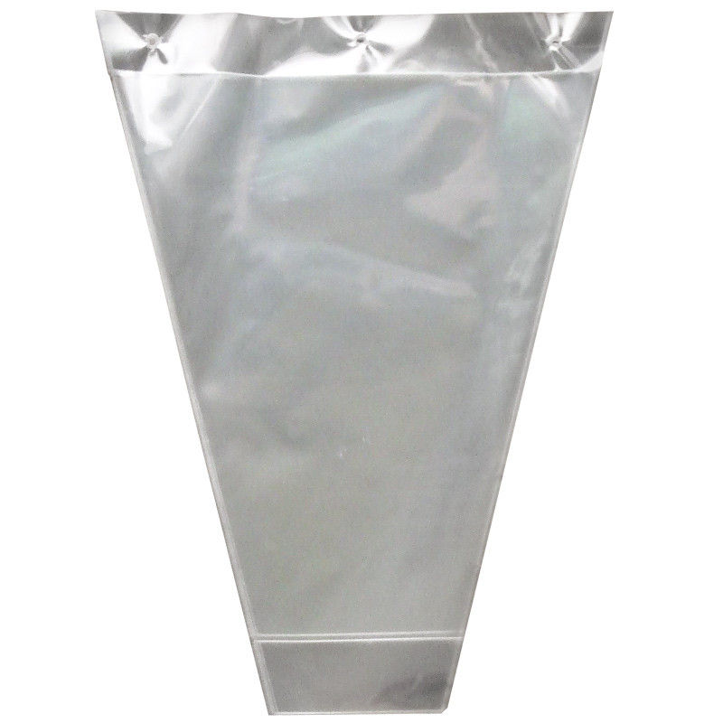
Bouquet Sleeve
Protective cover for flowers or foliage
Made of clear or colored cellophane
http://www.flowerwrappingsleeves.com/photo/pl5938526-transparent_floral_sleeves_plastic_flower_wrapping_sleeve_with_bopp_cpp_pp_hdpe.jpg

Slide 5
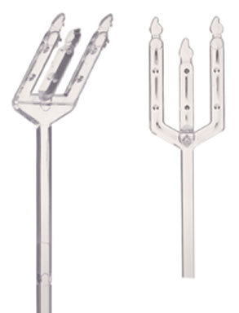
Cardette
Used to hold enclosure cards in floral arrangements
Vary in size, shape and color
http://www.floradec.com/prodimg/SYN-47%2048.jpg

Slide 6
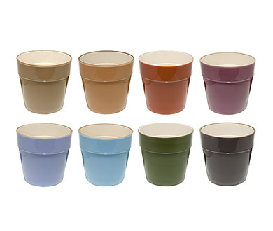
Ceramic Container
Ceramic containers are used to hold mixed flower arrangements.
Containers can be simple or ornate, big or small, and in various colors and shapes.
https://posts.mode.com/wp-content/uploads/2008/06/glazedceramic.jpg

Slide 7
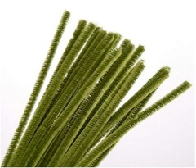
Chenille Stem
Also known as a pipe cleaner
Comes in assorted colors and lengths
Used to secure ribbon and other decorations in floral work where the chenille stem can be hidden in the arrangement or wreath based on its color
https://o.quizlet.com/i/z5pbJsAoFMhB3ms1nI0ECw_m.jpg

Slide 8
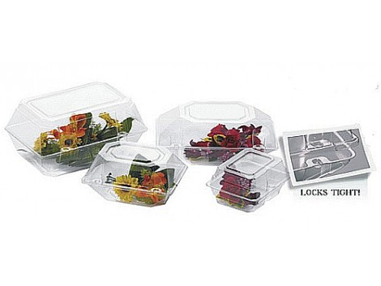
Corsage Box
Protects corsage after purchase and during travel.
Varies in size
http://www.floralsupply.com/media/catalog/product/cache/1/image/470x353/9df78eab33525d08d6e5fb8d27136e95/c/o/corsage_2.jpg

Slide 9
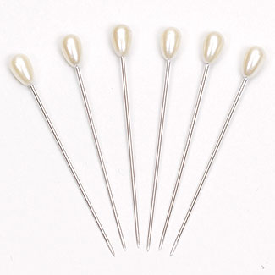
Corsage Pins
Used to fasten corsage
Top is decorative, usually pearled or jeweled
Decorative end is typically larger and more ornate than a boutonniere pin
http://www.fss.com/images/products/K2.jpg

Slide 10
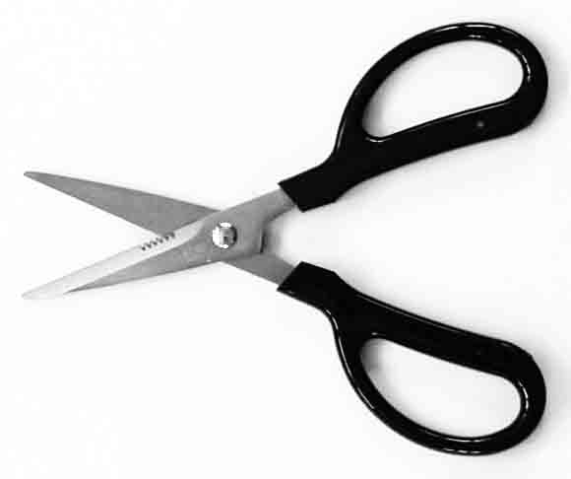
Corsage Snips
Smaller blades than typical shears
Used to make cuts in smaller pieces or in tight areas
https://sproulefloristsupply.ca/resources/products/gallery/p_NDY2/main/3213ap15.jpg

Slide 11
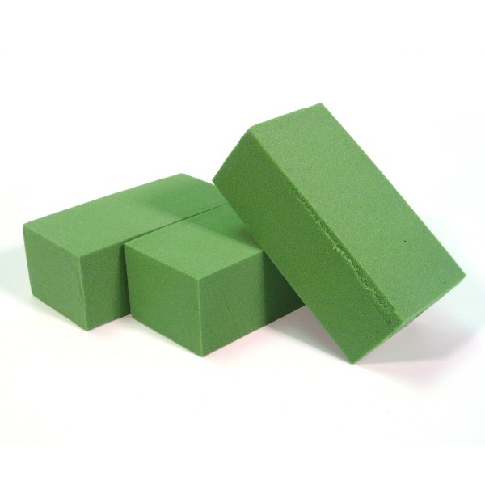
Dry Foam
Used to anchor flowers and foliage in an arrangement
Unlike floral or oasis foam, it doesn’t need to be soaked in water prior to use.
Because this foam doesn’t hold water, only use with silk and artificial plants.
http://www.theuniversityflorist.com/supplies/dry-foam

Slide 12
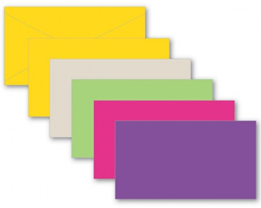
Enclosure Card
Used to deliver a message on a floral arrangement
Printed on durable cardstock and can be decorated for any holiday or special occasion
http://www.marlowfloral.com/productimages/products/Everyday/EN6305_120.jpg

Slide 13
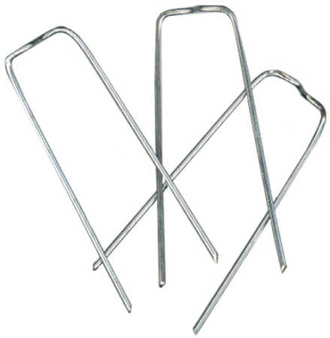
Fern Greening Pins
Greening pins are used for securing moss or foliage to floral foam.
http://factorydirectcraft.com/pimages/20060412092738-741540/silver_metal_greening_pins.jpg

Slide 14
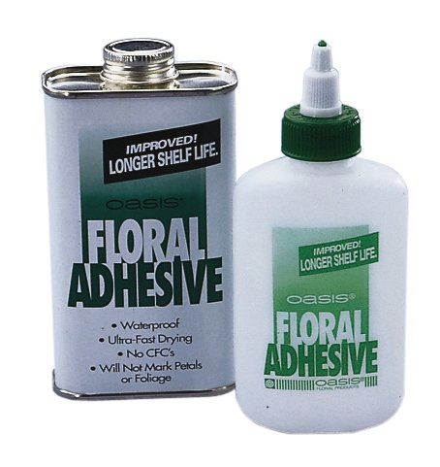
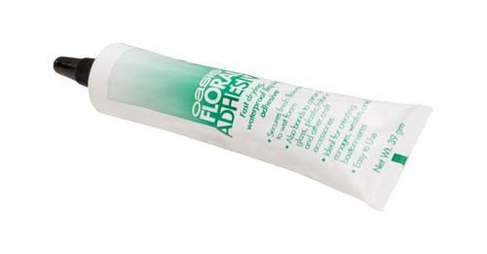
Floral Adhesive
Also known as cold glue
Floral adhesive allows you to glue fresh flowers directly to ribbon or tulle as well as foliage and garland.
http://nebula.wsimg.com/obj/RTRENURGREQzQjM3RUJEMDU2MkQ6MjdhNTY1MzcxMjVhYjFjZjg0YjkwMTcxZmRjYzE3NjE6Ojo6OjA=

Slide 15
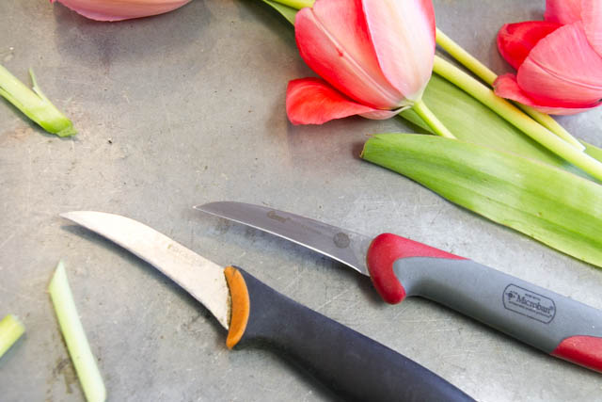
Floral Knife
Most commonly used tool by florists
Looks similar to a kitchen paring knife
Used to cut flowers before they are inserted into a design
http://livingfresh.ca/blog/wp-content/uploads/2014/03/MG_3517.jpg

Slide 16
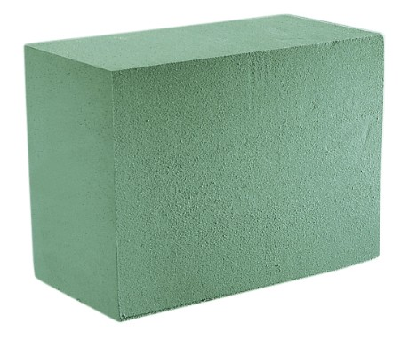
Floral Foam
Used to anchor flowers and foliage in an arrangement
Unlike dry foam, this foam needs to be soaked in water prior to use.
Use with fresh-cut plants
http://www.marshallfloralproducts.com/assets/images/designerblocks.jpg

Slide 17
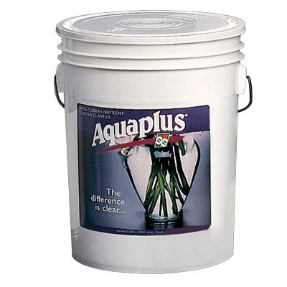
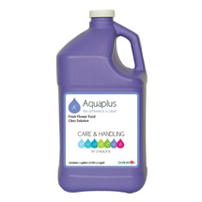
Floral Preservative
Preservatives help extend the life of fresh cut flowers in floral arrangements.
Can be sprayed in a liquid form or sprinkled into water as a powder form
http://www.swflorist.com/categories/floral-preservative.html

Slide 18
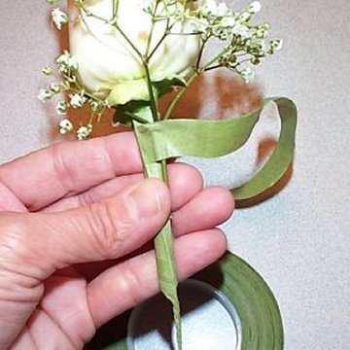
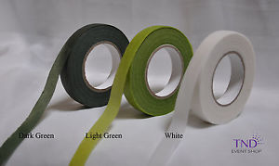
Floral Stem Tape
Paraffin-coated stretchy paper
Used mechanically to help combine wires and multiple stems in a corsages, boutonnieres and hand-held bouquets
Comes in different shades of green and white
http://www.wedding-flowers-and-reception-ideas.com/images/florist-tape-02.jpg
http://i.ebayimg.com/images/g/1kwAAMXQydtTN2zi/s-l300.jpg

Slide 19
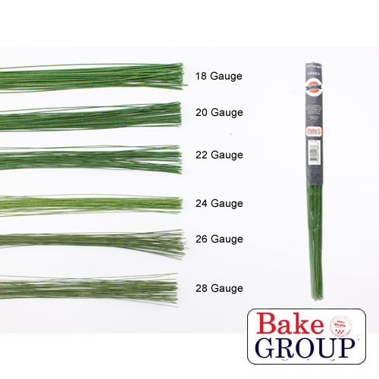
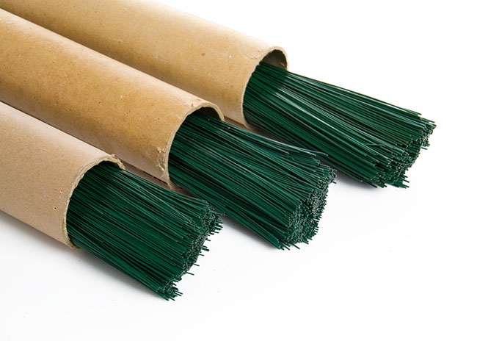
Floral Wire
Thin, long wire used to strengthen and combine stem.
Sold based on diameter size or gauge.
18- and 28-gauge are commonly used
http://cdn1.bigcommerce.com/server5200/4m7zoyl/products/469/images/818/Green_Floral_Wires__59867.1375234001.1280.1280.jpg?c=2
http://www.koch.com.au/blog/wp-content/uploads/2013/04/florist_wire.jpg

Slide 20
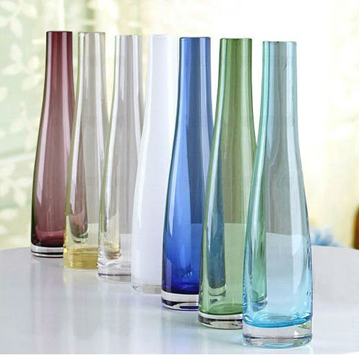
Glass Vase
Glass vases are used to hold single flower or mixed flower arrangements, depending on the size.
Vases can be simple or ornate, big or small, and in various colors and shapes.
http://i01.i.aliimg.com/img/pb/011/768/485/485768011_883.jpg

Slide 21
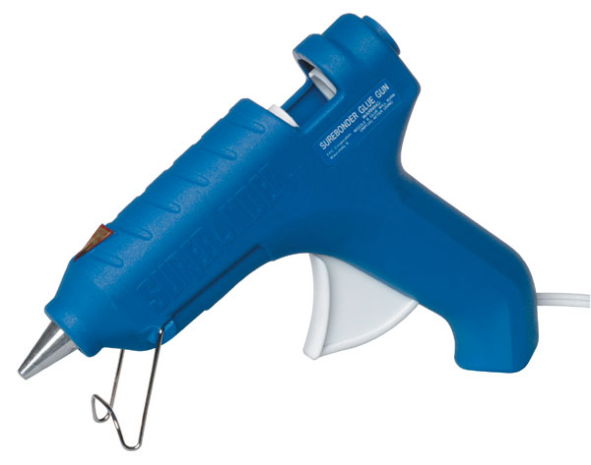
Glue Gun
Used to administer hot glue when working with flower arrangements
When plugged in, the machine heats up the glue sticks and allows it to be applied precisely as a liquid.
http://d28xhcgddm1buq.cloudfront.net/product-images/bevfabriccrafts_2269_775864018_260.jpg

Slide 22
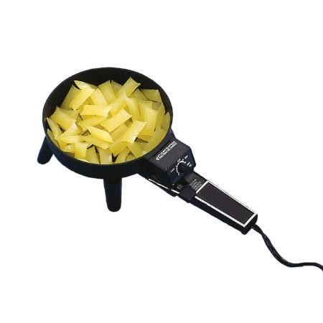
Glue Pan
Melts glue in the pan
Stems and foam can be dipped directly into the glue pan.
http://www.marshallfloralproducts.com/thumbnail.asp?file=assets/images/hotmeltgluepan1.jpg&maxx=500&maxy=0

Slide 23
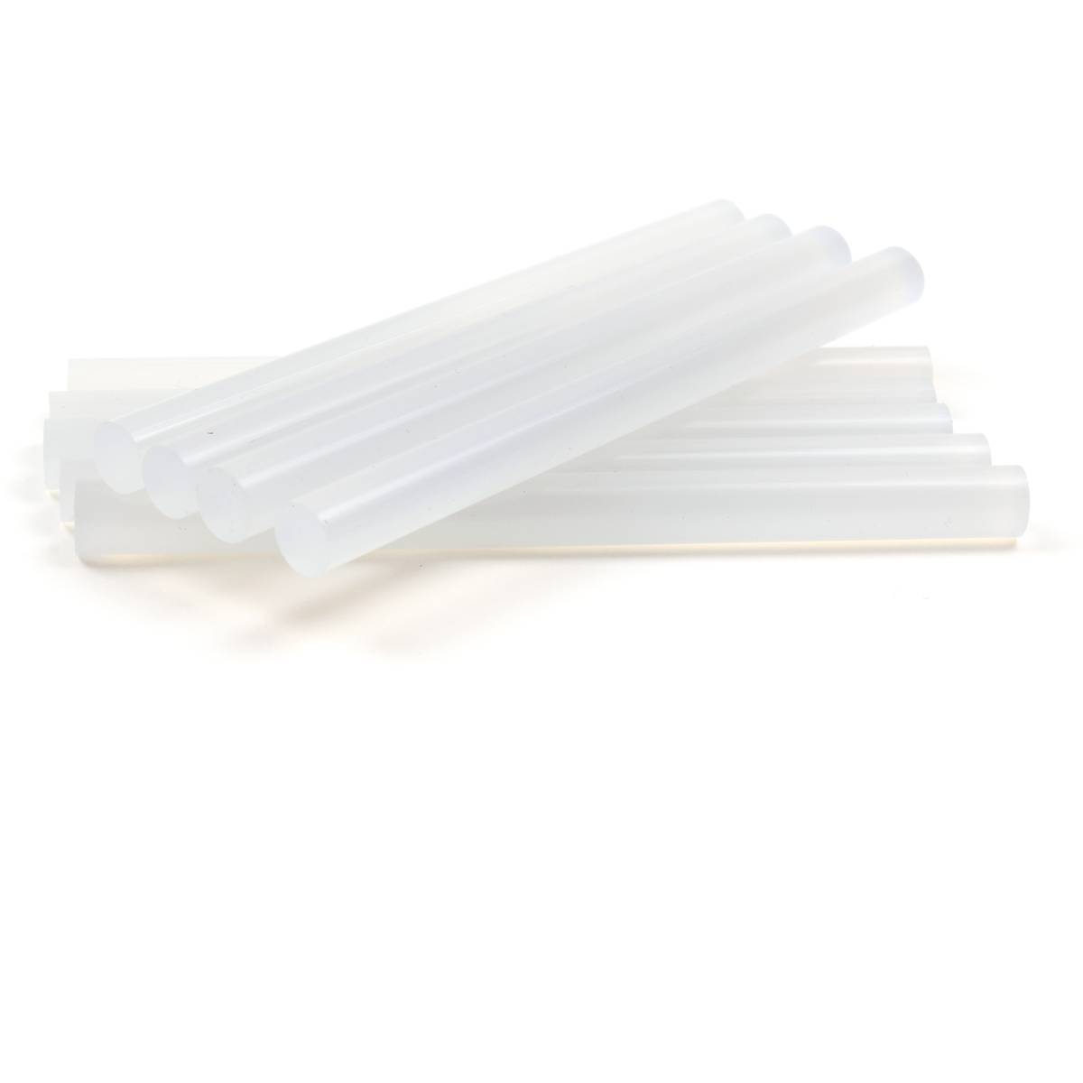
Glue Stick
Starts as solid cylinder sticks of glue
Once inserted into a glue gun, the sticks are heated up and turned into a hot, liquid glue.
http://www.hobbycraft.co.uk/supplyimages/567347_1000_1_800.jpg

Slide 24
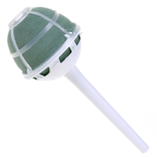
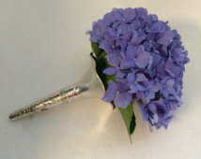
Nosegay Holder
Ornate holders for tuzzie-muzzies or hand-held bouquets
Made popular in European floral design
Can be metal or plastic
https://o.quizlet.com/DR757YvmlND.NssRd341Og_m.png
https://img1.etsystatic.com/129/0/11669397/il_214x170.1049825417_ps1x.jpg

Slide 25
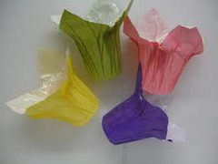
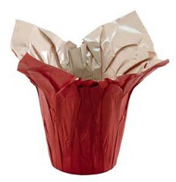
Pot Cover
Polyfoil material used to cover containers
Comes in a variety of colors
https://o.quizlet.com/1CaGCDjArxivuVYHkAw4Cw_m.jpg
https://quizlet.com/113856139/floriculture-cde-tool-id-flashcards-flash-cards/

Slide 26
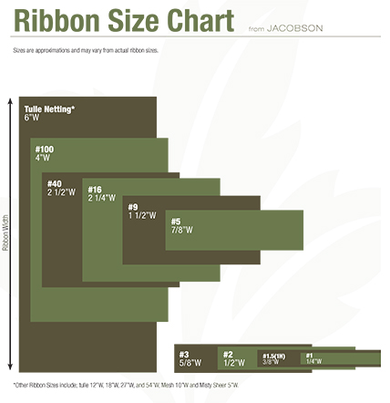
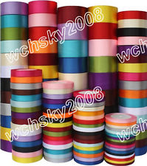
Ribbon
Ribbon can be satin, sheer and/or wired.
Used for decoration and for holding together arrangements
Commonly used sizes are #3, #9, #40 and #100.
http://www.jacobsonfloral.com/public/_assets/media/2015/JFS.RibbonSizeChart2015_web.jpg
http://thumbs.ebaystatic.com/images/m/mRuN7402S7nxftiFBEXJjvA/s-l225.jpg

Slide 27
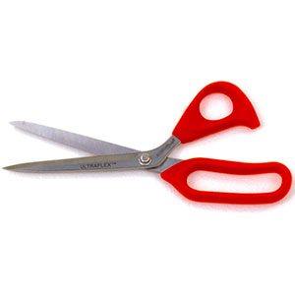
Ribbon Shears
Around 8.5 inches in length
Used specifically for cutting ribbon and nothing else
Sharp blade to cut ribbon without causing the ribbon to unravel or fringe

Slide 28
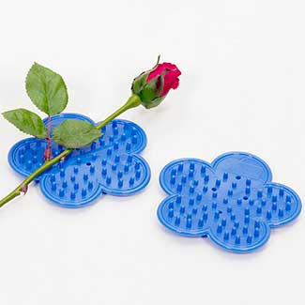
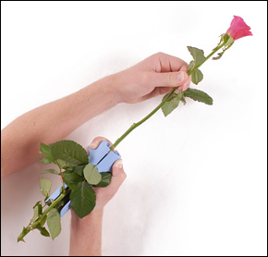
Rose and Stem Flower Stripper
Strips the leaves and thorns of roses and other flowers
Can be a hand held machine, pad or glove
http://www.fss.com/images/products/T5.jpg
http://www.leevalley.com/us/images/item/gardening/db312s1.jpg

Slide 29
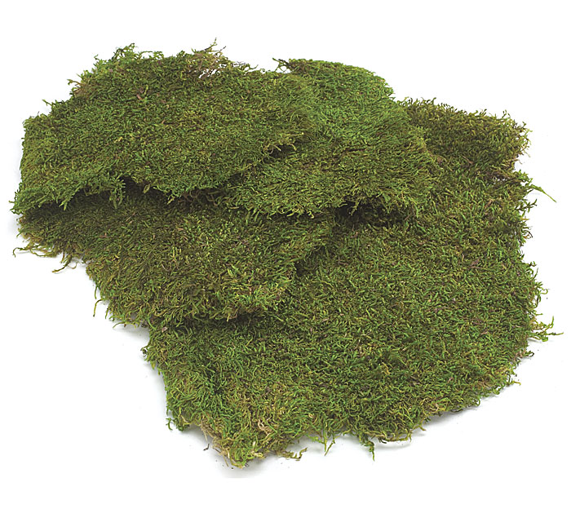
Sheet Moss
Sheet moss is harvested and kept intact in whole-sheet pieces.
Used to cover foam and soil media in planting containers or cut flower arrangements
https://www.burtonandburton.com/images/catalog/F4141_L.jpg

Slide 30
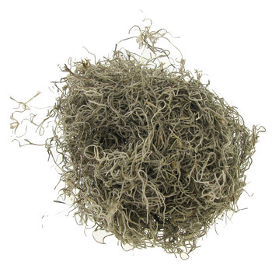
Spanish Moss
Shredded moss is used to cover soil media in mixed planter and container arrangements.
Also used in some cutting propagation methods
http://img.hobbylobby.com/sys-master/root/h86/h8d/h00/8944380215326/601526[5].jpg

Slide 31
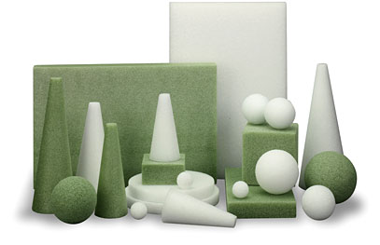
Styrofoam
Styrofoam is more porous than both dry and floral foam.
Typically used in decorative work that does not require flowers.
http://www.floracraft.com/wp-content/themes/floracraft/images/home-styrofoam.jpg

Slide 32
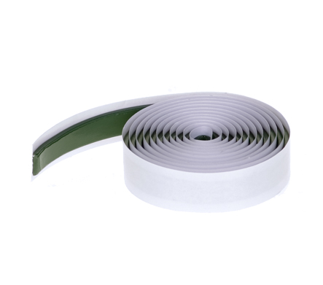
Sure-stik Cling
Commonly called stickum, floral clay or cling
This material is a sticky, clay-like material used to adhere anchors into floral containers.
For a secure bond between the anchor and the container, roll a small piece of clay between your hands to warm it and create a thin "snake" of clay.
Form the clay into a circle on the bottom of the anchor. Then press the anchor into place with a twisting motion.
https://www.floraldesigninstitute.com

Slide 33
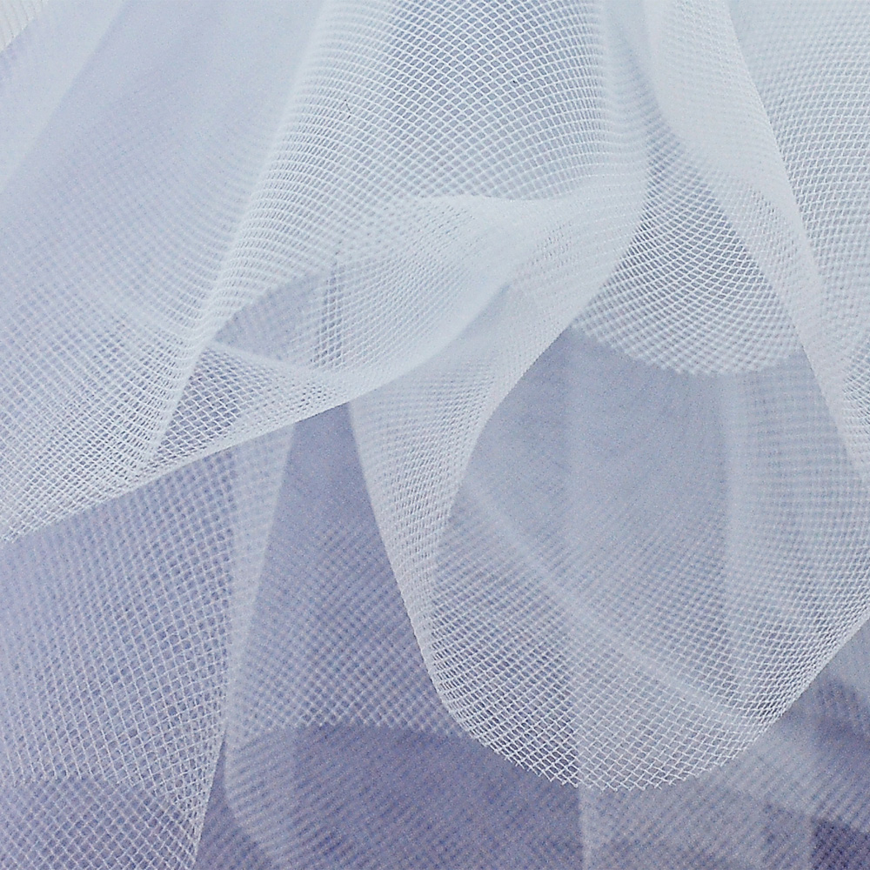
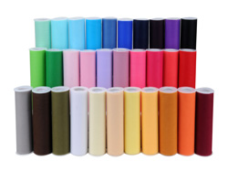
Tulle
Sheer, brittle fabric used to make bows and other decorative accents
6-inch width and comes in a variety of colors
http://www.tutunetoandnotions.com/wp-content/uploads/2013/07/soft-tulle-010-bianco-white.jpg
http://www.fuzzyfabric.com/upload_images/products/3-6-9-12-18-inch-tulle--25-yards-.jpg

Slide 34
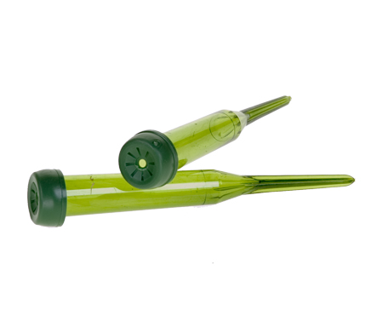
Water Picks
Water picks are very similar to water tubes except they are typically green in color.
They come with a spike on the end to allow them to be inserted into Styrofoam or dry floral foam or wreaths when using fresh flowers.
http://thumbs3.ebaystatic.com/d/l225/m/mTzSvgFE1BelUjeJej38IUg.jpg

Slide 35
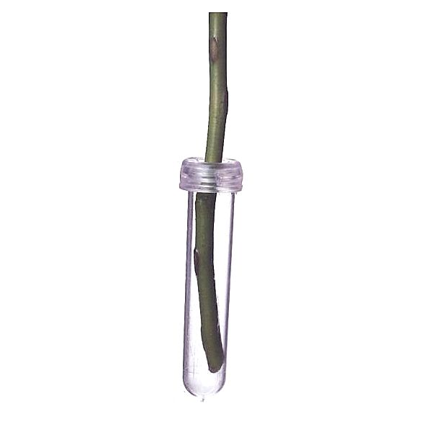
Water Tubes
Small plastic tubes that holds water to keep flowers fresh
Tube is rounded with a lid that allows a stem to be inserted
http://www.rjcarbone.com/Photos/saqc5497.jpg

Slide 36
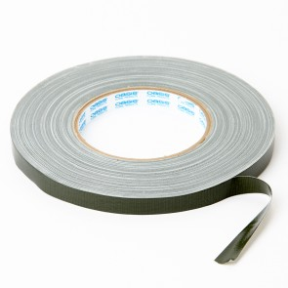
Waterproof Container Tape
Also called anchor tape, helps secure wet floral foam to containers
Available in green or white in widths of ¼- or ½-inch
http://www.oasishomeandhobby.co.uk/media/catalog/product/cache/1/small_image/295x295/9df78eab33525d08d6e5fb8d27136e95/6/0/6020-_a_.jpg

Slide 37
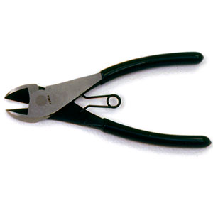
Wire Cutter
Used to cut through floral wire
Sharp blades and spring handle allow it to cut through thick gauges with ease
http://www.fss.com/images/products/T487.jpg

Slide 38
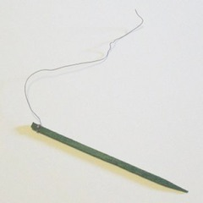
Wooden Picks
Wooden picks can be used when working with fresh flowers.
  Example: to cluster grasses together for a single insertion into floral foam
They can also be used when working with heavy or bulky stems to give greater stability.
Wooden picks can be used to secure a bow in an arrangement and are great for securing fruits, vegetables, pine cones and pods in a floral design.
https://o.quizlet.com/NhlQ3kzgNNGzSAYyf0okPg_m.jpg

Slide 39
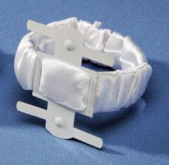
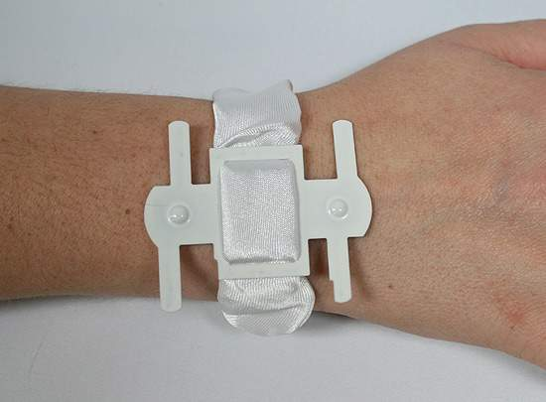
Wrist Corsage Holder
Used to anchor the corsage arrangement
Fabric wristlet comes in different colors and materials
http://d28xhcgddm1buq.cloudfront.net/product-images/wrist-corsage-holder-white-satin-3.jpg
http://factorydirectcraft.com/pimages/20100911094924-183190/white_satin_corsage_bracelet_1.jpg

Slide 40
Floriculture Crop Identification
Flower crops have blooms that vary in size and color.
Foliage crops are classified as greenery, lacking blooms.
In floral arrangements, flowers and foliage are grouped based on their function:
Line: long and straight, creates height and width.
Form: large and unique in size, usually a focal point.
Mass: draw attention to focal area, add depth.
Filler: small sprays that help fill in space.

Slide 41
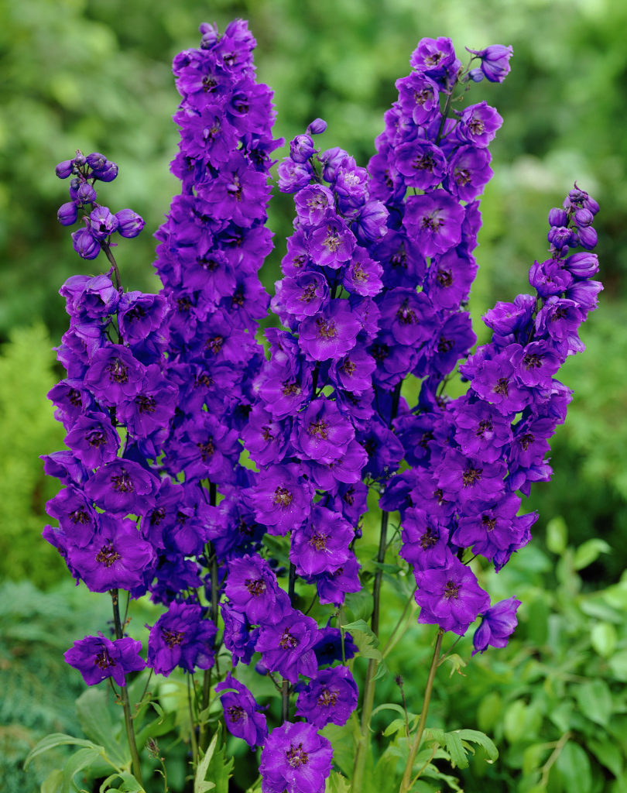
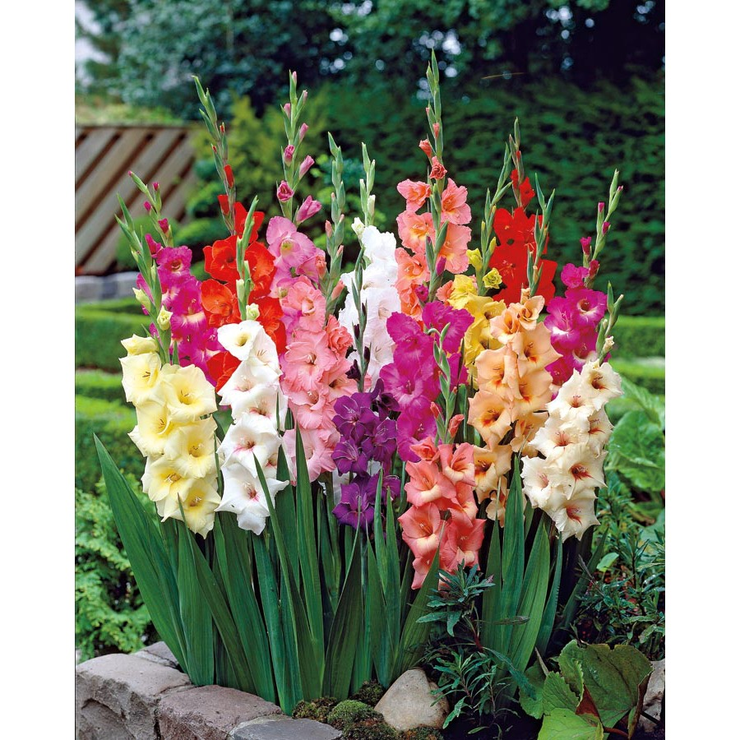

Line Flowers
Delphinium consolida (Larkspur)
Gladiolus x hortulanus cv. (Garden Gladiolus)
Liatris spicata (Liatris)
http://whatcomflowers.net/wp-content/uploads/2014/10/Blue-Larkspur-Flowers-in-Garden.jpg
http://mobileimages.lowes.com/product/converted/685229/685229008350.jpg
http://www.eattheweeds.com/wp-content/uploads/2013/02/liatris-spicata-D790-1013091wg.jpg

Slide 42



Line Foliage
Eucalyptus polyanthemos (Silver Dollar Eucalyptus)
Salix matsudana (Curly Willow)
Myrtus (Myrtle)
http://www.flowermuse.com/media/catalog/product/cache/1/image/1200x1200/9df78eab33525d08d6e5fb8d27136e95/s/i/silver-dollar-eucalyptus-2.jpg
http://www.nettletonhollow.com/v/vspfiles/photos/110201-3.jpg
http://images.fiftyflowers.com/site_files/FiftyFlowers/Image/Product/Univ-Myrtle-350.jpg

Slide 43



Form Flowers
Anthurium x andraeanum cv. (Flamingo Plant)
Steriltzia reginae (Bird of Paradise)
Zantedeschia hybrid cv. (Calla Lily)
http://www.healingpeak.com/wp-content/uploads/2014/03/flamingo-lily.jpg
http://img09.deviantart.net/575a/i/2007/214/e/0/blue_bird_of_paradise_by_massano.png
http://typesofflower.com/wp-content/uploads/2015/01/calla-lily-flower-season.jpg

Slide 44



Form Foliage
Caladium x hortulanum cv. (Caladium)
Codiaeum variegatum pictum (Croton)
Monstera deliciosa (Split Leaf Philodendron)
https://s-media-cache-ak0.pinimg.com/736x/08/cf/36/08cf36d649780e320e761ed68446fbc4.jpg
https://badger.uvm.edu/xmlui/bitstream/handle/2051/4869/Croton2.JPG?sequence=1
http://fcit.usf.edu/florida/flassets/content/6200/fa6227/fa6227.jpg

Slide 45



Mass Flowers
Chrysanthemum x morifolium (Florist’s Chrysanthemum)
Dianthus caryophyllus cv. (Carnation)
Rosa hybrid cv. (Hybrid Tea Rose)
http://siteforeverything.com/wp-content/uploads/2015/08/Chrysanthemum.jpg
http://www.buffalo-niagaragardening.com/wp-content/uploads/2012/12/pink-carnations-from-Mischlers-in-Amherst-NY.jpg
http://image.brands-list.com/articleimg/20150609/20150609152100_36210.jpg

Slide 46


Mass Foliage
Rumohra adiantformis (Leatherleaf Fern)
Chamaedorea elegans (Parlor Palm)
http://ep.yimg.com/ca/I/yhst-89672727041557_2250_14899213
http://indoor-air-quality-plants.com/uploads/images/parlor-palm-cleans-air-house-plant.jpg

Slide 47



Filler Flowers
Erica carnea cv. (Spring Heather)
Gypsophila elegans cv. (Baby’s Breath)
Limonium sinuatum (Statice)
http://previews.123rf.com/images/cascoly2/cascoly21106/cascoly2110600315/9746659-Detail-purple-heather-in-bloom-spring-in-Seattle--Stock-Photo.jpg
http://www.miseagrant.umich.edu/wp-content/blogs.dir/1/files/2013/03/Babys-Breath-Gypsophylia-Hubert-Steed.jpg
http://www.thegardenhelper.com/psd/limonium_sinuatum.jpg

Slide 48



Filler Foliage
Asparagus densiflorus (Sperngeri Fern)
Asparagus setaceus (Plumosa Asparagus)
Anethum graveolens (Dill)
http://www.boulevardflst.com/images/PLUMOSA_STEMxg.jpg
http://www.freshfromflorida.com/var/ezdemo_site/storage/images/media/images/marketing-development-images/fern_sprengeri/264492-1-eng-US/fern_sprengeri.jpg
http://previews.123rf.com/images/fablok/fablok1406/fablok140600026/29304608-bunch-of-fresh-dill-on-white-background-Stock-Photo.jpg

Slide 49



Review
Pick an Arrangement
http://shop.flowerno5.com/images/1800_16733.jpg
http://res.cloudinary.com/picasso/image/upload/c_lpad,f_jpg,fl_progressive,h_300,q_95,w_300/l65qafnerzh4t1muq70l.jpg
http://images.costco-static.com/image/media/500-100101172-847__1.jpg
List what kind of equipment and floral crops you would need to recreate the arrangement.

