Slide 1
Unit 3: Floral Design
Lesson Four:
Pricing Floral Arrangements
Lesson Objectives:
Calculate individual unit prices from bulk quantities.
Identify the difference in wholesale and retail prices.
Solve problems using both ratio and percentage retail markups.
Demonstrate understanding of pricing a floral arrangement using an itemized cost sheet.
Footer description area.

Slide 2
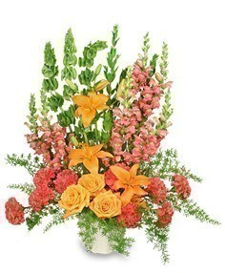
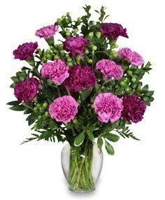
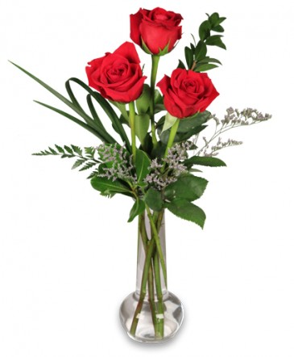
Introduction
The Price is Right!
$ 5 0
$ 2 0
$ 1 2 5
Prices and images are from http://www.indianapaflowers.com/

Slide 3
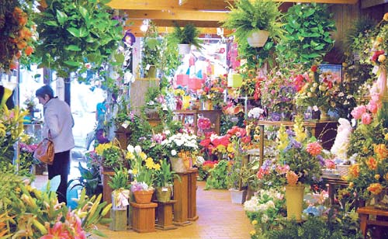
Pricing Arrangements
A floral shop, just like any business, needs to make money to stay in operation.
Determining the right price for an arrangement is important for earning a profit while not overcharging customers.
Material, labor, holidays and flower seasons causes prices to fluctuate throughout the year.
http://www.800florals.com/images/hinsdale.jpg

Slide 4
Determining a Price
To determine the price of a floral arrangement, you must first look at all the individual items used.
Hard goods are your non-perishable items.
Examples: ribbon, container, foam, tape, etc.
These items are usually purchased in bulk and need to be broken down into individual unit cost.
This is done by dividing the total cost by the number of units (always round up!)

Slide 5
Problem 1 and 2
1) How much does it cost to use a yard of ribbon?
#9 satin ribbon
Cost $4.99 per roll
100 yards per roll
Do the Math:
Total cost/yards per roll
4.99/100=0.0499
Answer (round up):
$0.05 for a yard of ribbon
2) How much does a glass vase cost?
4-inch glass vase
Cost $19.95 per case
24 containers per case
Do the Math:
Total cost/number of vases
19.95/24=$0.831
Answer:
$0.83 for a glass vase

Slide 6
Determining a Price
Plants must also be identified and priced individually to determine an accurate price.
Fresh goods include the perishable flowers and foliage used in an arrangement.
Examples: Roses, leatherleaf, baby’s breath, etc.
Flowers and foliage are usually priced by the stem or in a bunch.
If using material from a bunch, you must divide the price of the bunch by the number of stems used to get a single unit cost.

Slide 7
Problem 4 and 5
4) How much does it cost to use a stem of leatherleaf?
Leatherleaf fern
$2.95 per bunch
20 stems per bunch
Do the Math:
Total cost/stems per bunch
$2.95/20=$0.147
Answer (round up):
$0.15 for a stem
5) How much is a quarter bunch of baby’s breath?
Baby’s breath
$3.49 per bunch
Determine by weight
Do the Math:
Total cost X 0.25 (or ¼)
$3.49X0.25=$0.872
Answer:
$0.87 for a quarter bunch

Slide 8
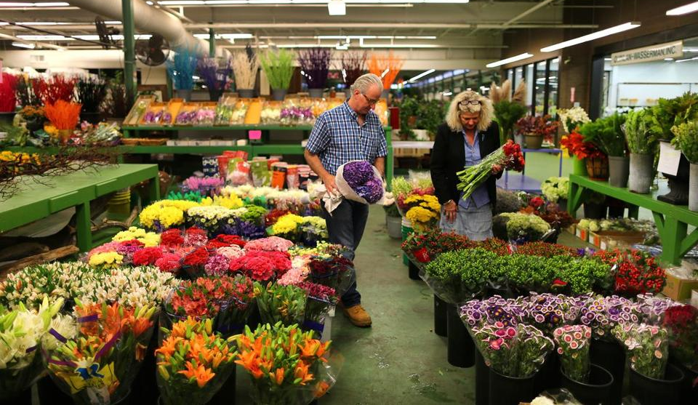
Buying Wholesale
Most florists purchase products from wholesalers.
Wholesale items are sold in large quantities to retail businesses.
To make a profit from their wholesale purchases, florist companies include a markup in their retail prices.
https://c.o0bg.com/rf/image_960w/Boston/2011-2020/2014/09/11/BostonGlobe.com/Metro/Advance/Images/tlumacki-bostonflowerexchange_metro392%7D.jpg

Slide 9

Retail Prices
Retail prices are more then wholesale prices.
Retail stores make their profit by marking up prices.
Markups can be done through ratios or percentages.
Markups allow the florist to cover expenses for labor, overhead and operating costs.
http://www.dailynews.lk/sites/default/files/news/2015/11/18/price.600.jpg

Slide 10
Ratio Markup
Ratio markups are a simple way to price merchandise.
Predetermined ratios are established in the retail floriculture industry.
2:1 markup – used on hard goods
3:1 markup – used on fresh goods
4:1 markup – used on specialty arrangements that are more labor intensive.
The problem with ratio markups is that it doesn't allow control over the profits.

Slide 11
Problem 7
7) What is the retail price on a dozen roses in a bouquet sleeve?
Sweetheart roses $16.99 per bunch (25 stems)
Bouquet sleeve $9.95 per pack (100 sleeves)
Do the Math:
Step One: Find the individual unit cost of materials.
$16.99/25= $0.68 per stem
$9.95/100= $0.10 per sleeve
Step Two: Find the subtotal for the quantity of materials being used.
$0.68X12=$8.16 subtotal for a dozen
$0.10X1= $0.10 subtotal for a sleeve

Slide 12


Problem 7, Continued
Step Three: Decide what kind of ratio to use for the roses.
Fresh Goods – 3:1
Step Four: Markup the fresh goods subtotal cost.
$8.16X3= $24.48
Step Five: decide what kind of ratio to use for the sleeve.
Hard Goods – 2:1
Step Six: Markup the hard goods subtotal cost.
$0.10X2= $0.20
Step Seven: Add the markup subtotals for both fresh and hard goods for a final retail price.
$24.48+$0.20= $24.68
$24.68
Retail Price

Slide 13
Percentage Markup
Percentage markups allow you to create a more accurate price and control the profit margin.
A percentage mark up can range anywhere from 20% to 100% depending on the size of the arrangement and what items are being used.
This preferred method can be used to cover the cost of labor, operational expenses and profit in addition to the cost of goods.

Slide 14
Problem 9
9) A glass vase arrangement uses 12 Carnations, 8 Leatherleaf stems, and half a bunch of Baby’s Breath. How much is the retail price at a 40% markup?
Carnations $13.99 per bunch (15 stems)
Leatherleaf fern $2.95 per bunch (20 stems)
Baby’s breath $3.49 per bunch (determine by weight)
Glass vase $19.95 per case (24 vases)

Slide 15
Problem 9, Continued
Do the Math:
Step One: Find the individual unit cost of each item and multiply by the quantity being used:
Carnations $13.99/15= $0.93 per stem 0.93X12= $11.16 for 12
Leatherleaf $2.95/20= $0.15 per stem 0.15X8= $1.20 for 8
Baby’s breath $3.49X0.5(or ½) = $1.75 for half a bunch
Glass vase $19.95/24= $0.83 for a glass vase
Step Two: Find the subtotal of all the items used.
$11.16 (12 Carnations)
$1.20 (8 Leatherleaf)
$1.75 (½ Baby’s breath)
$0.83 (1 Glass Vase)
$14.94 subtotal

Slide 16
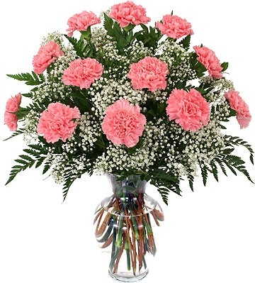

Problem 9, Continued
Step Three: Calculate the 40% markup cost from the subtotal.
$14.94X0.40= $5.98
Step Four: Add the markup to the subtotal for the final retail price.
$5.98+14.94= $20.92
$20.92
Retail Price

Slide 17

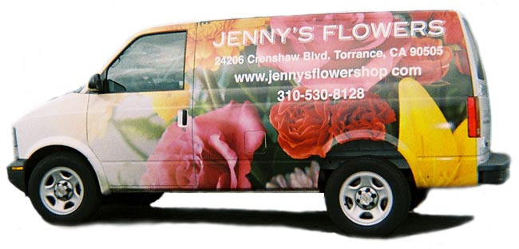
Preplan Your Prices
Most floral shops sell at a predetermined price point
Examples: $25, $35, $50
Florist should always list out the items and calculate the cost before they begin composing the arrangement.
Your itemized list of costs should be within 50 cents of the price point you were given.
http://www.jennys-flowers.com/images/van-lg.jpg

Slide 18


Itemized List of Costs
Create a $30 arrangement using the material listed in your “Floral Retail Catalog.”
The material is already at retail price, so no markups need to be added.
Individual unit prices will have to be calculated from the bulk price.
Calculate the material you will use within 50 cents of the $30 price point.
Once you have meet the price point, include a rough sketch of what the arrangement will look like.

Slide 19
Review Activity
Thumbs Up or Thumbs Down
Flower arrangement prices only account for the flowers used in the design.
Hard goods refer to the ribbon, container and tape used in a floral arrangement.
You can calculate the individual price of a stem out of a bunch if you know the price of the bunch.
The 2:1 markup ratio is used on hard good materials.
Percentage markups do not account for things like labor and operating expenses.

