Slide 1
Unit 3: Floral Design
Lesson Five:
Mechanics of Floral Design
Lesson Objectives:
Identify how mechanics are used in floral arrangements.
Evaluate the use of wire, ribbons, pins and tape in floral design.
Demonstrate mechanical skills needed to construct a corsage/boutonniere.
Footer description area.

Slide 2
Introduction
Questions to Ponder…
When are corsages and boutonnieres typically worn?
What skills would help you create one?
Do you know the tools you would need to create an arrangement?
What elements and principles should you keep in mind while composing your design?
Watch the video and keep these questions in mind:
https://www.youtube.com/watch?v=7Txenjo59ts

Slide 3
Mechanics of Floral Design
Mechanics refer to the methods used to create a stable, high-quality floral arrangement.
Developing your mechanical skills includes practicing methods and techniques in the following:
Foam
Ribbons
Gluing
Taping
Wiring
Pinning
Packaging

Slide 4
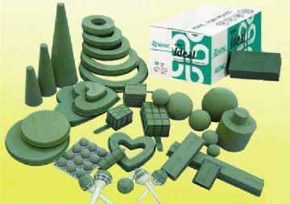
Foam
Some arrangements require more stability in their foundations.
Stems can be placed into foam to help them maintain their structure and design.
Foam used in floral arrangements can include dry foam, floral (wet) foam and Styrofoam.
The type of foam you use depends on what kind of container and floral crops you will be working with.
http://i.cantonfair.org.cn/fileserver/exhibitor/exp_product/270/2007-12/27005189_1182551_b1.JPG

Slide 5
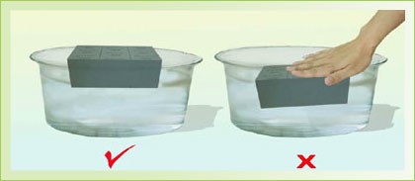
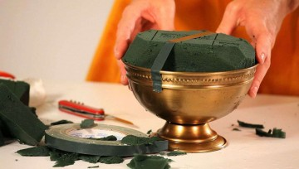
Floral Foam
Florists usually use floral foam when working with fresh cut flowers.
The foam block should be soaked in water fortified with flower food for a few minutes before it is placed in the container.
Wait for the block to sink; do not force it under the water.
When the block has submersed itself and no more bubble are coming out, it is ready to be used.
Floral foam can be anchored to the container using waterproof container tape.
http://static1.squarespace.com/static/53e5670ee4b08470e143c902/t/546a712ee4b0bfa4a7032578/1416261934864/
http://assets.howcast.com/crop.php?src=http://98441.cdx.c.ooyala.com/FnYXJhczqscqNF858Q0yzLm6N1_RpzYs/promo251742509&w=360&h=204

Slide 6
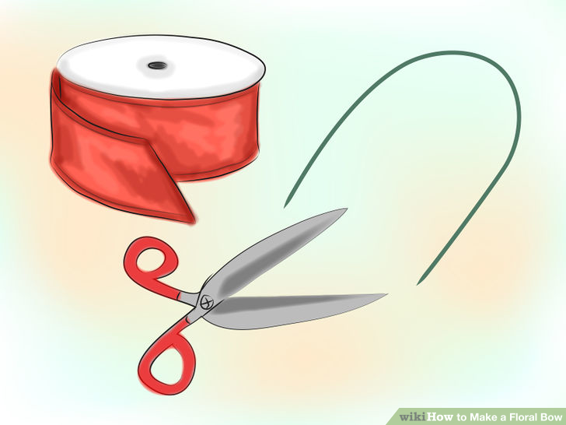
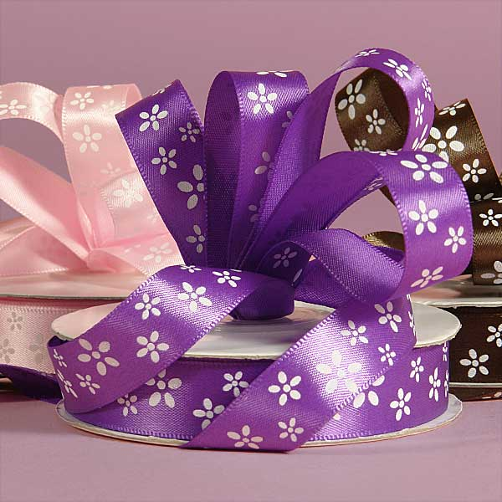
Ribbons
Ribbons are used for function and decoration.
They can hold together many stems.
They can be used to create bows, loops and streamers.
Ribbon is sold according to width.
Florists commonly work with #3 or #9.
http://ribbons.com/wp-content/uploads/2013/04/Dainty-Daisy-Floral-Ribbon-2.jpg
http://pad1.whstatic.com/images/thumb/c/c6/Make-a-Floral-Bow-Step-1-Version-2.jpg/aid256045-728px-Make-a-Floral-Bow-Step-1-Version-2.jpg

Slide 7
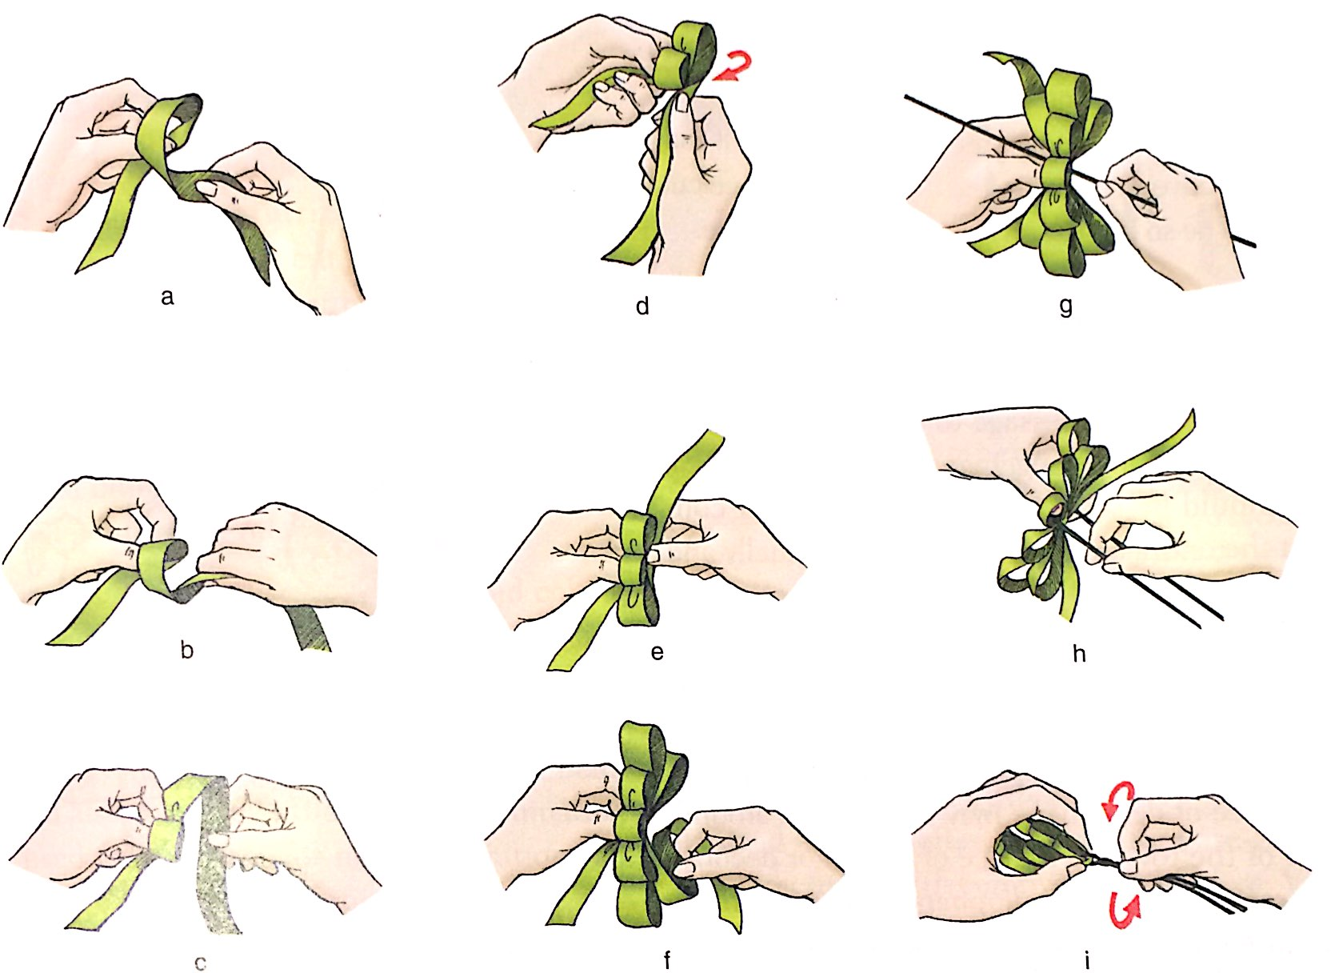
Making a Bow
Watch the video for a visual demonstration:
https://youtu.be/qUYG8ri4cxA?t=2m20s
Practice making a bow by yourself.

Slide 8
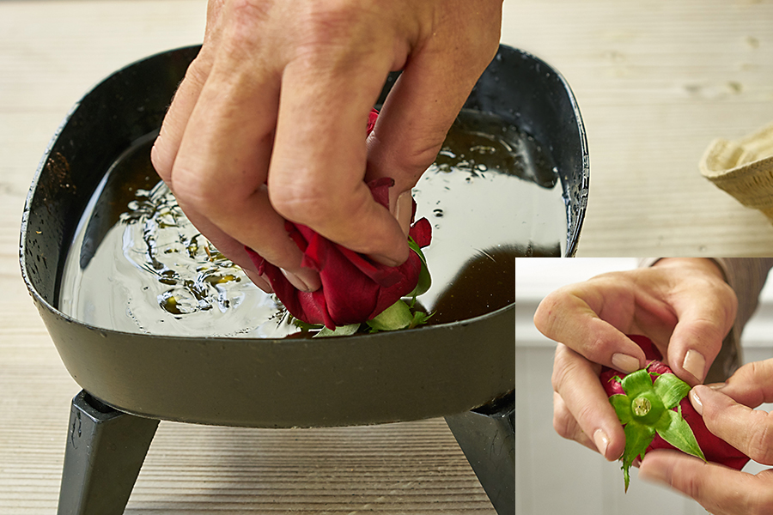
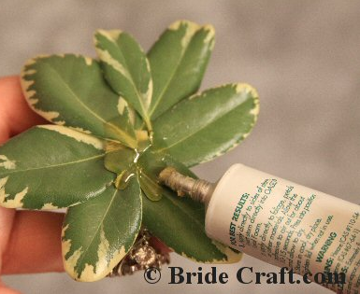
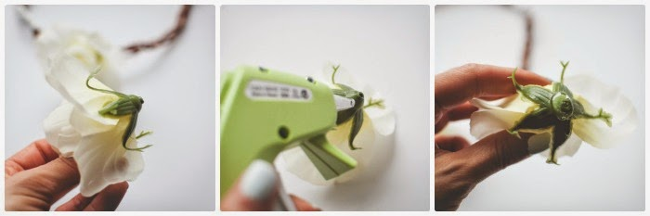
Gluing
Glue adhesives are very useful in floral arrangements.
Glue can come in a variety of forms: hot glue, pan-melt glue and liquid or spray adhesives.
When choosing a gluing adhesive, you should consider what you want to attach (fresh flowers, silk flowers, ribbon, etc.)
Make sure that the glue applied is concealed when the arrangement is finished.
http://giffysnap.com/thewonderforest/wp-content/uploads/2014/05/diy-flower-crown-tutorial10.jpg
https://www.1800flowers.com/blog/wp-content/uploads/2016/03/hot-glue-dipping-flowers.jpg
http://www.bridecraft.com/images/orchid-corsage-step-7.jpg

Slide 9
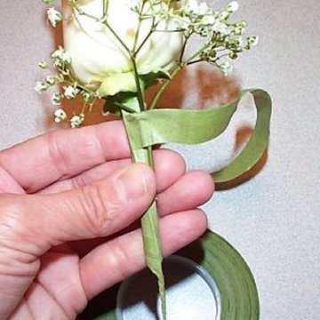
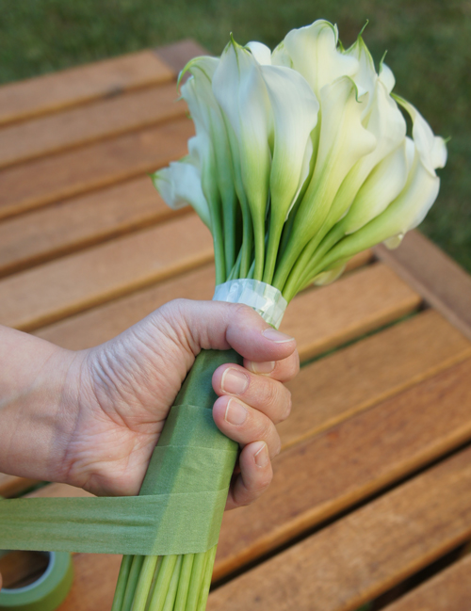
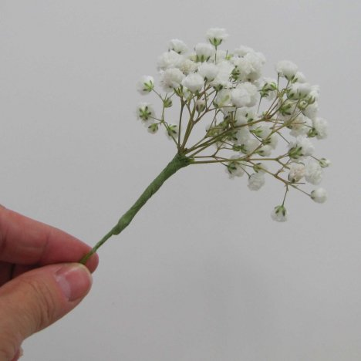
Taping
Floral tape is a paraffin-coated paper used to bind stems and is commonly used in corsages, boutonnieres and bouquets.
Floral tape typically comes in white or shades of green.
When floral tape is exposed in an arrangement, it must be wrapped tightly and uniformly.
http://www.wedding-flowers-and-reception-ideas.com/images/florist-tape-02.jpg
http://www.flowermuse.com/blog/wp-content/uploads/2013/09/wrapping-stems-with-floral-tape.jpg
http://www.wedding-flowers-and-reception-ideas.com/images/babies-breath-filler-02.jpg

Slide 10
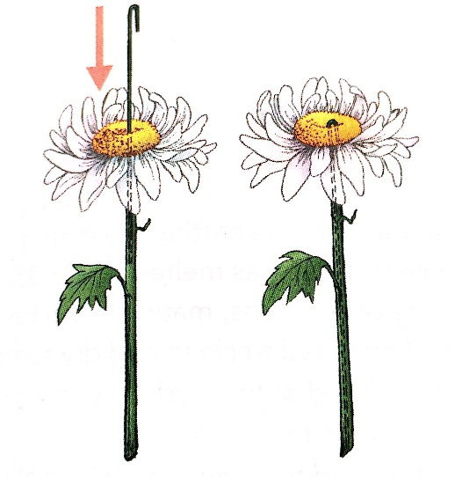
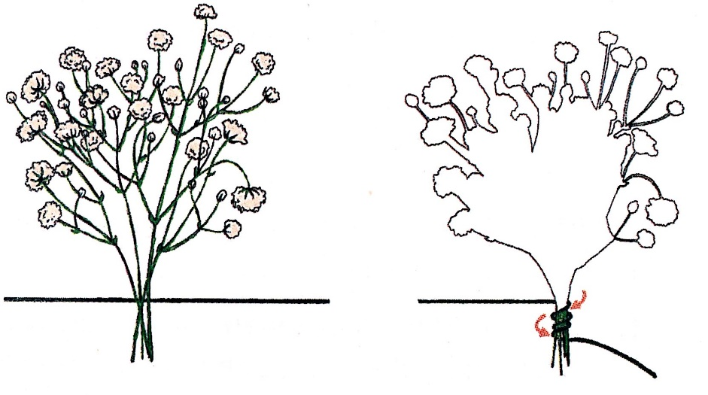
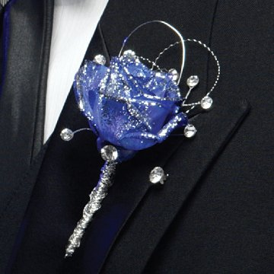
Wiring
Wire is used to help add structure and bind materials.
Wire comes in a variety of gauges and usually in green or silver.
Florists typically use heavy wire (18 gauge) or more delicate wire (28 gauge) depending on the desired result.
Decorative wire can come in a variety of colors and be used for decoration.
Wire not used for decoration should always be hidden in the arrangement.

Slide 11
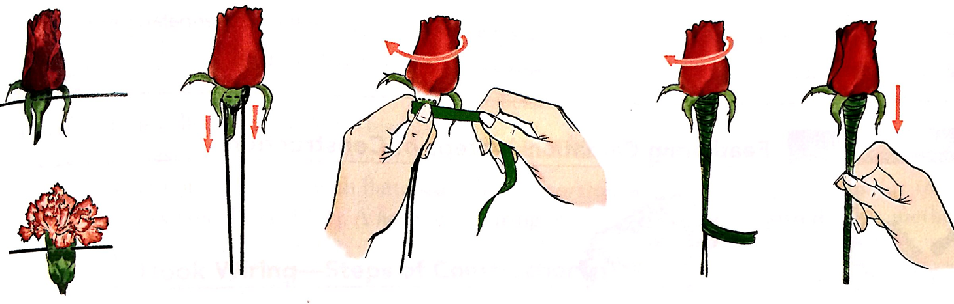
Making an Artificial Stem
Watch the video for a visual demonstration:
https://youtu.be/suwZs0nho9c
Practice making an artificial stem on the flowers you have available.

Slide 12
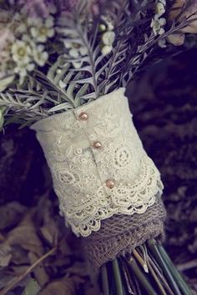
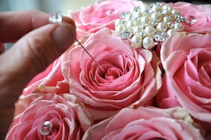
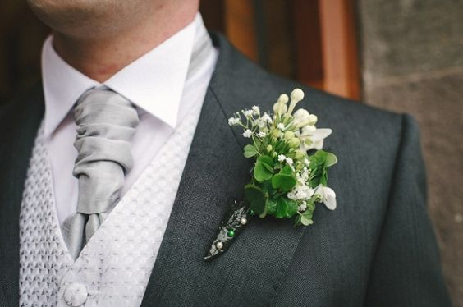
Pinning
Pins and picks are functional and decorative.
They can be used to fasten ribbon or arrangements to clothing.
They can have decorative heads that complement the design.
Pins should be placed in such a way that the needle can’t be seen or felt when the arrangement is handled.
http://www.flowerduet.com/large_flower_pictures/bling-inserting-pin.jpg
https://s-media-cache-ak0.pinimg.com/564x/6c/bb/6d/6cbb6dabb9095439a31c76f5eb0d0390.jpg
https://s-media-cache-ak0.pinimg.com/236x/91/d2/20/91d220b31ac605ec767c2321f5198d7f.jpg

Slide 13
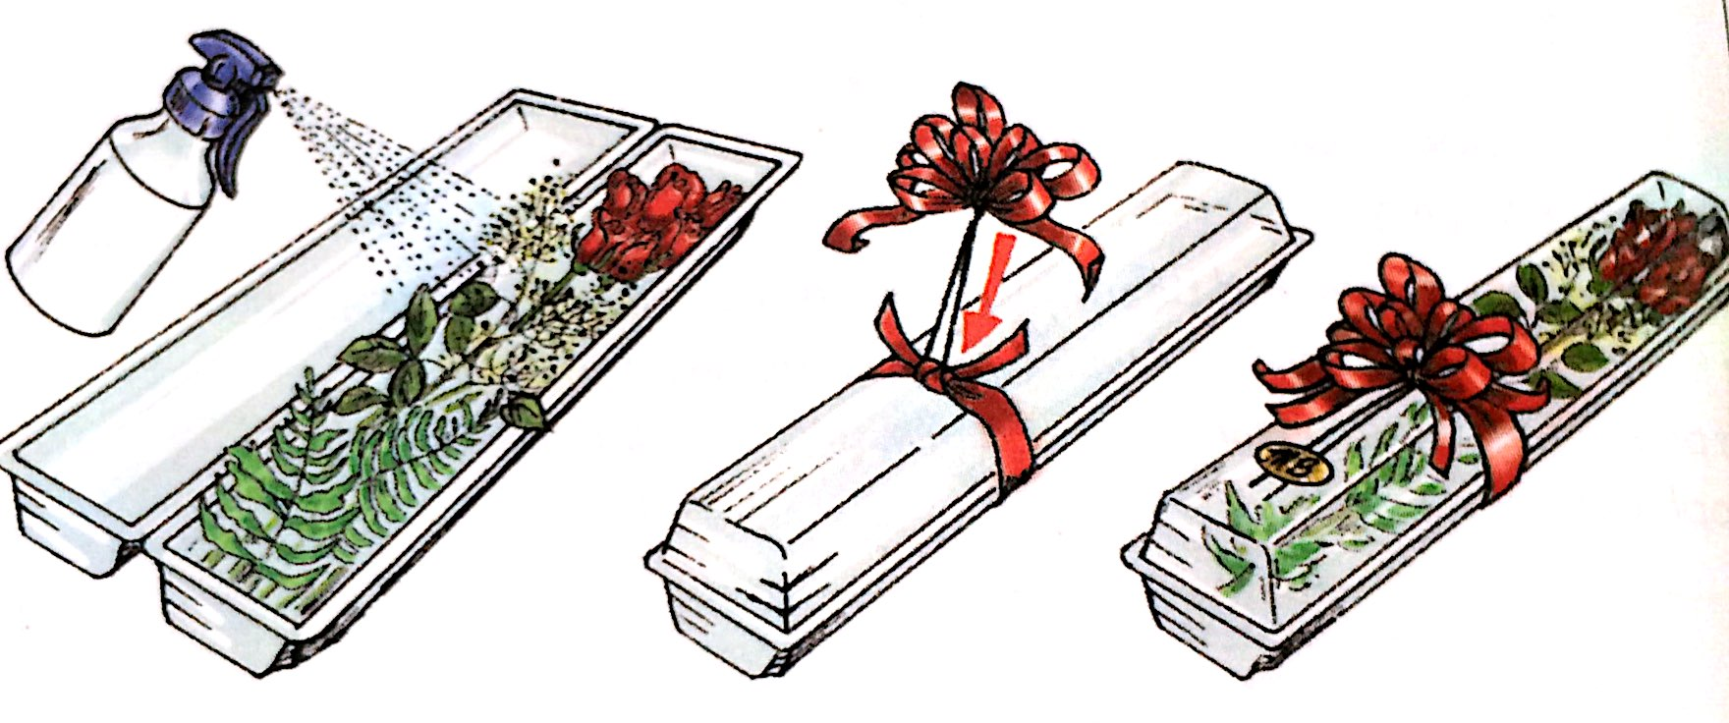
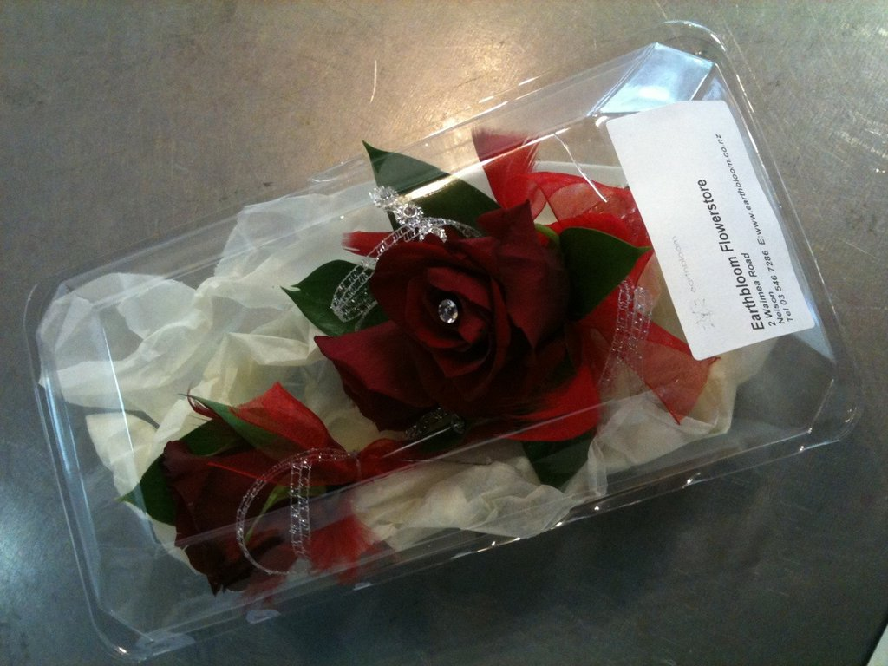
Packaging
All arrangements should be sprayed with a preservative when completed.
Packaging methods depend on the arrangement.
Corsages and boutonnieres can be placed in small clear boxes.
Fresh cut flowers can be wrapped or placed in long clear boxes.
http://cdn.shopify.com/s/files/1/0134/0942/products/Corsage_1024x1024.JPG?v=1401774539

Slide 14
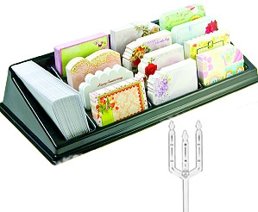
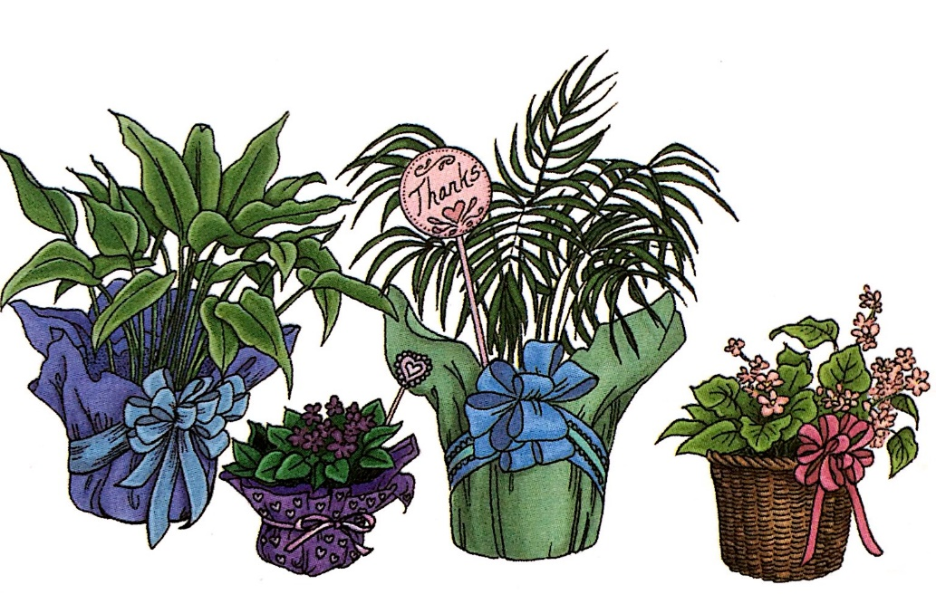
Packaging, Continued
Arrangements in clear packages should be backed by foliage or tissue paper.
Some arrangements include enclosure cards presented on cardettes.
Potted plants can be placed in a pot cover or woven basket.
http://cdn3.volusion.com/g6es4.zr6ck/v/vspfiles/photos/categories/350-T.jpg?1469007036

Slide 15
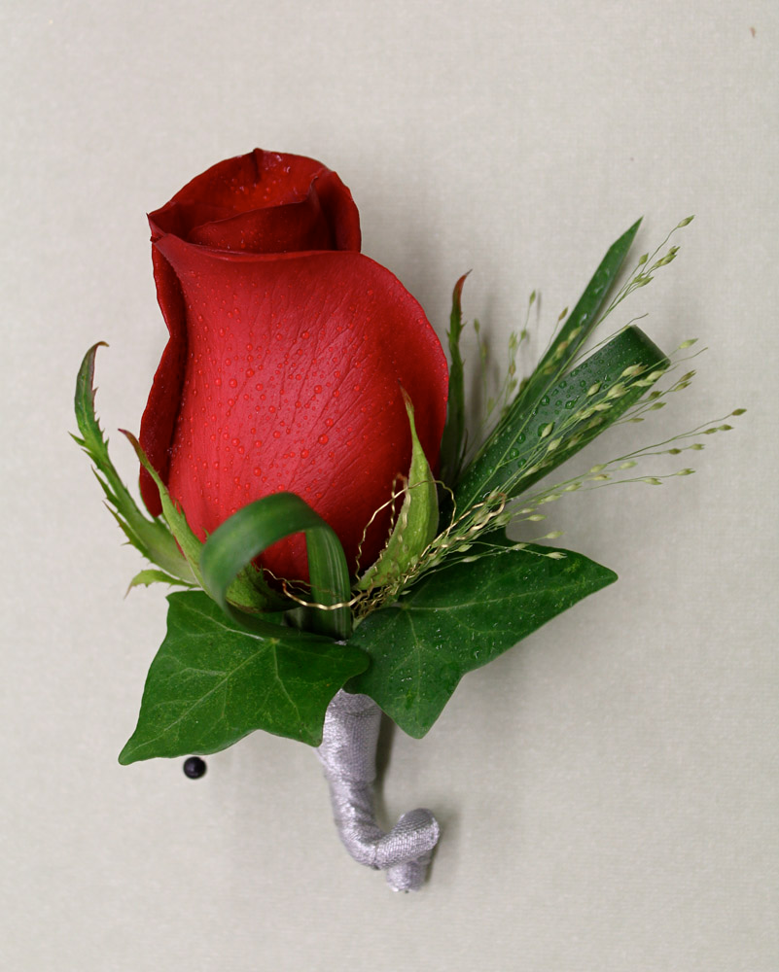
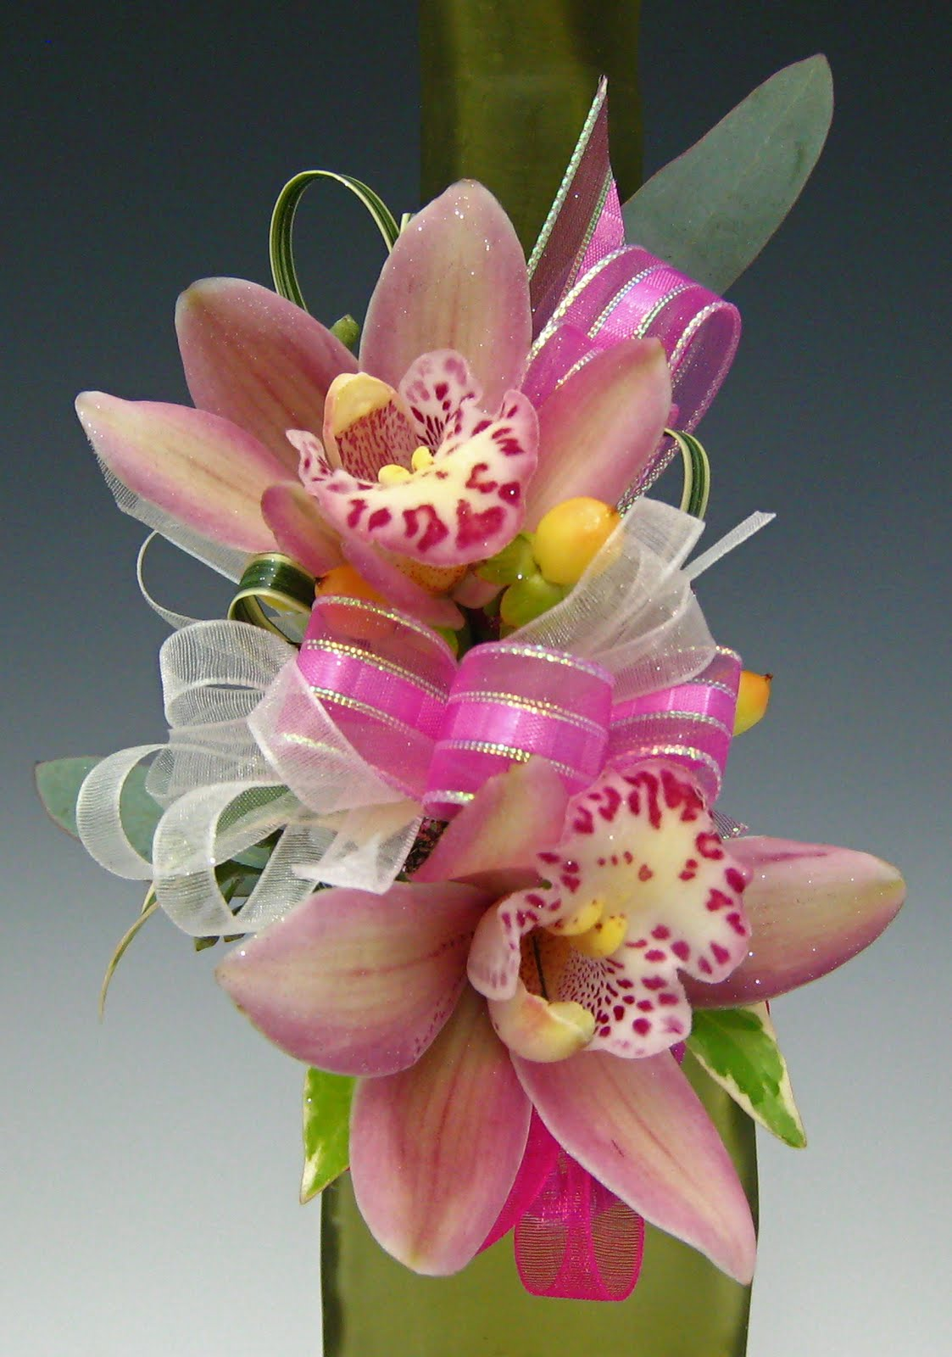
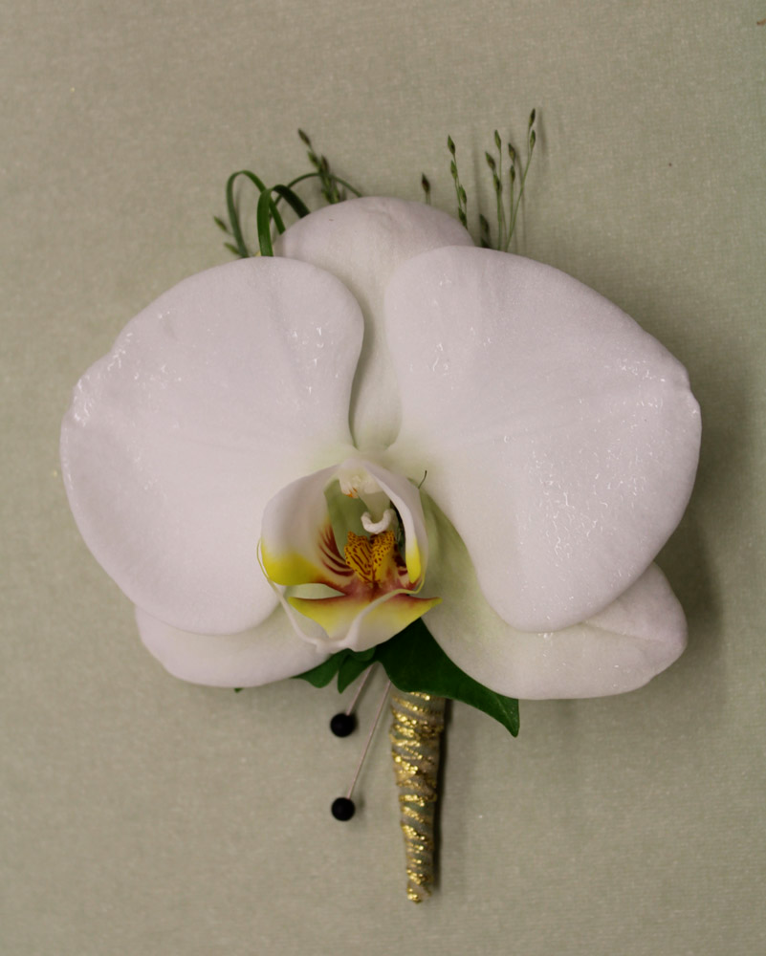
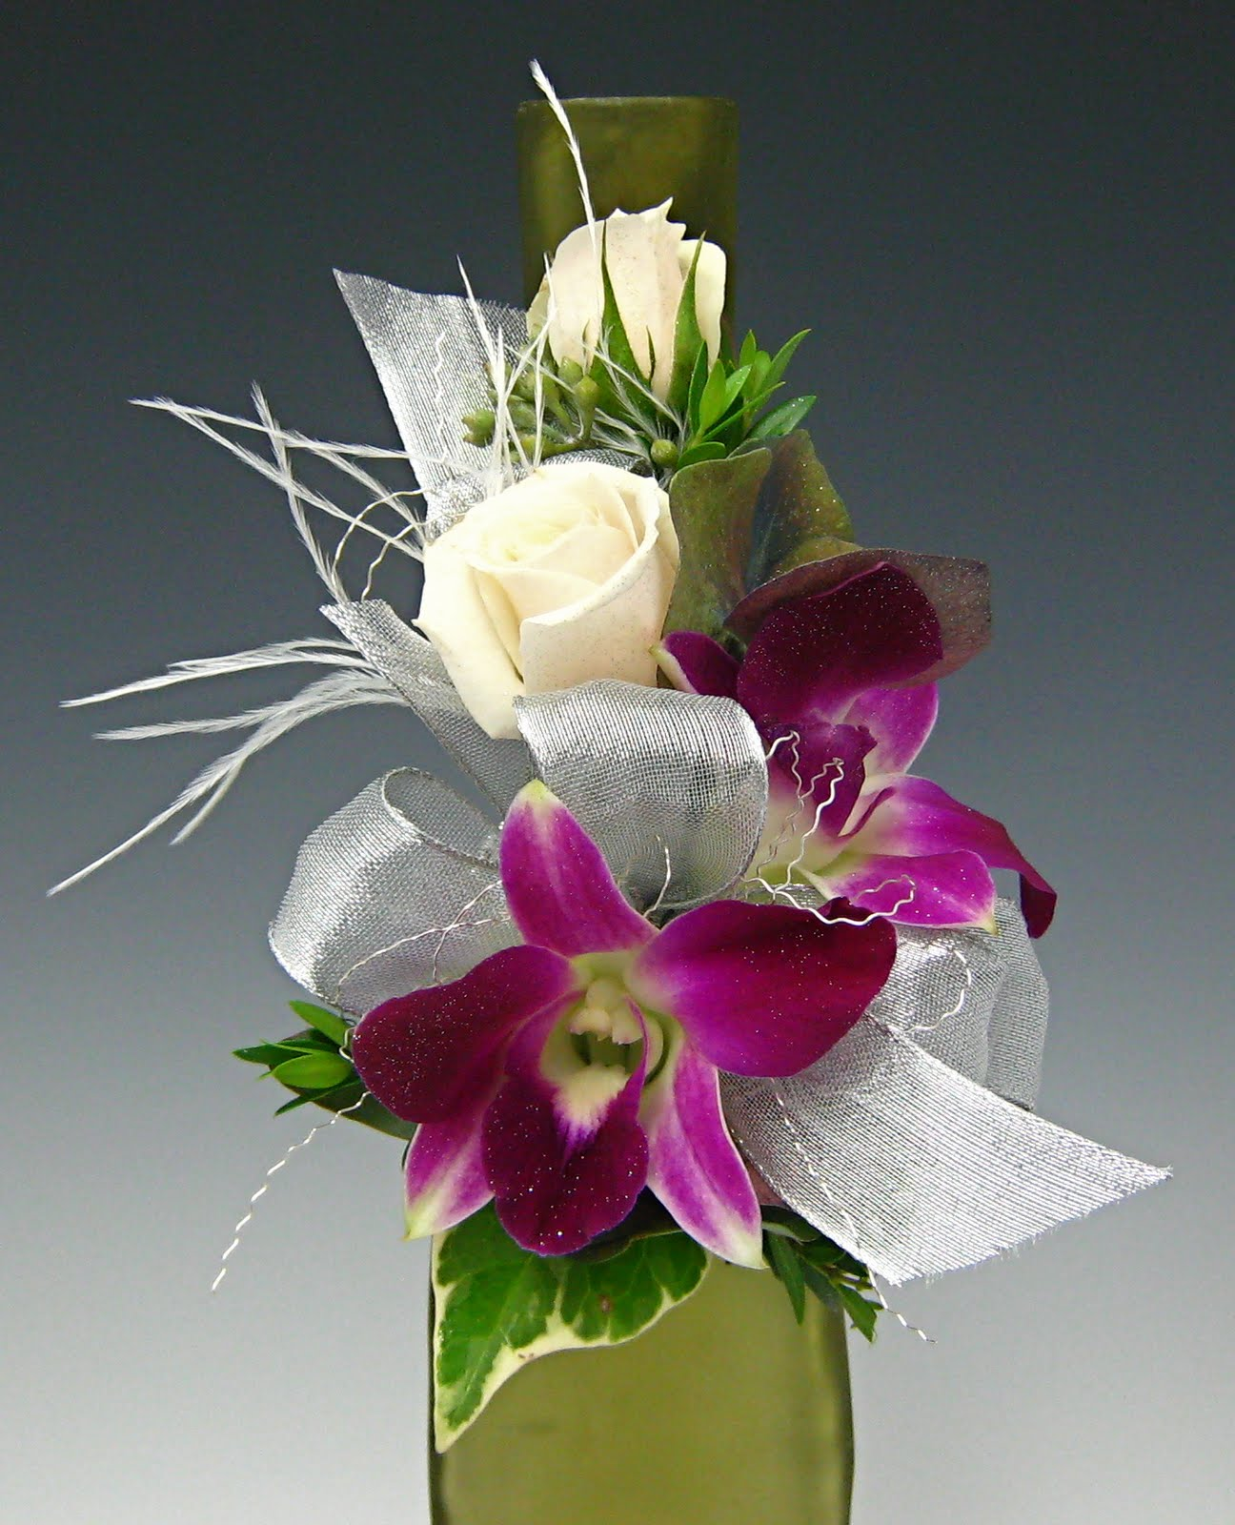
Activity
Create a Boutonniere or Corsage
Using the mechanical skills we discussed and practiced in this lesson, create your own boutonniere or corsage using tools and floral crops supplied by the teacher.
http://fenaflowers.blogspot.com/2012/10/corsages-and-boutonnieres.html

Slide 16
Review
Self-evaluation
What do you love about your arrangement?
What is something you wish was better?
What mechanical technique can you practice to improve the look of your arrangement?

