Slide 1
Unit Four: Business Practices
Lesson One:
Customer Service and Sales
Lesson Objectives:
Discuss aspects of effective communication.
Evaluate different kinds of customers and sales methods.
Demonstrate customer service and product knowledge.
Footer description area.

Slide 2

Introduction
What makes a good sales experience?
Think about a great sales experience that you had.
      What happened to make it great?
Think about a poor sales experience that you had.
      What happened to make it poor?

Slide 3
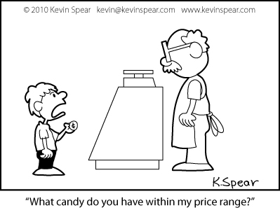
Buying Behavior
The successful salesperson needs to understand buyer behavior.
People do not simply buy a product; they decide to buy a product.
Few purchases are impulsive, except at the retail level.
Generally, sales representatives involve the sale of
non-impulse items.
http://ibrandstudio.com/wp-content/uploads/2011/10/blogging-brand-3.jpg

Slide 4
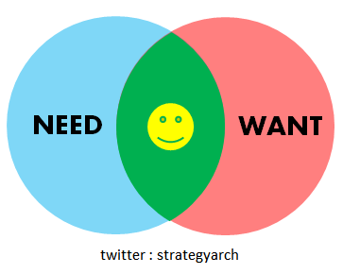
Steps of Buyer Behavior
Need Identity – Purchases are made because the buyer has a need for the product or wants the product. Advertising and merchandising may assist the buyer in identifying and expressing the need or want. A salesperson may assist in identifying a need for a customer.

Slide 5

Steps of Buyer Behavior
2. Information Search – Once an interest has awakened in a buyer, he or she begins to gather information about the product to satisfy the need or want. This information is basic: price, availability, suitability, dependability, etc.

Slide 6
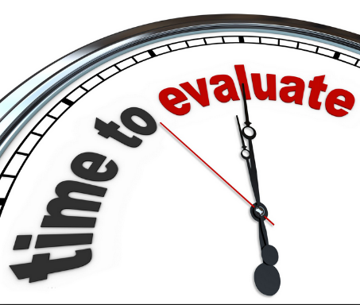
Steps of Buyer Behavior
3. Information Evaluation – Information gathering tends to be an overwhelming experience.
The information needs to be filtered if a buying decision is to be made. Buyers use many types of filters: opinions of friends, opinions of current product users, family members and even sales people.

Slide 7
Steps of Buyer Behavior
4. Purchase Decision – After filters have been applied to the information, it is altered into “personal knowledge.” At this point, the buyer has a general idea of what he or she needs or wants. Now it is a matter of seeking a “comfort level,” which means,
Buyer need/want + Product match + Perceived Affordability = Purchase

Slide 8
Steps of Buyer Behavior
5. Post-Purchase Behavior –After the purchase has been made, it is very natural for the buyer to wonder if the decision was too hasty, if a better price could have been found, etc. This is called “buyer’s remorse.”
It is essential for the salesperson to follow up on a sale to answer any questions the buyer may have to assist the buyer through this phase.

Slide 9
Act It Out Activity
Reflect on the steps of the buying process, and act them out with a partner or small group.

Slide 10
Sales Process
Understanding buyer behavior is essential for all successful salespeople.
Identifying what stage the buyer has reached provides a signal for the salesperson to assist.
The only way to discover what stage a buyer is in is to ask questions to see if you can assist with the search.

Slide 11

Steps in the Sales Process
1. Pre-Approach – This step may also be called prospecting. It involves characterizing and/or qualifying your potential customer. It involves matching buyer behavior to the sales process.

Slide 12
Steps in the Sales Process
Characterizing the buyer – What stage of the buying process is the buyer in? Is the buyer pursuing a need or a want? (A need is essential; a want is a desire.)
Is the buyer acting alone or with someone else (family, friends, colleague)?
Is the buyer prepared to make a decision or still searching for information?

Slide 13
Steps in the Sales Process
b. Qualifying the buyer – Is the buyer able to make a purchase decision or acting on someone’s behalf?
Is the buyer able to afford the product?
Is the buyer willing to make a decision?

Slide 14
Steps in the Sales Process
2. Approach – Establishing an opportunity to present your product to the buyer or to present the buyer with information useful to the buying decision.
Where is the buyer in the new product adoption spectrum? (Adoption spectrum is like buyer behavior.)

Slide 15
Product Adoption Spectrum
Awareness of product
Interest in product
Evaluate suitability of product
Inclination toward product and sale
Adopt or reject product
A successful sales person never talks “down” to a customer.

Slide 16
Steps in the Sales Process
3. Presentation – An industry standard is a presentation format known as the “FAB presentation.” FAB presentation means
Features+Advantages+Benefits

Slide 17
Steps in the Sales Process
4. Questions/Objections – A good sales presentation should generate questions.
If no questions occur then the sales representative should generate one or two to reinforce the FABs.
Silence after a presentation is rarely a good sign. It is not a sign of acceptance.

Slide 18
Steps in the Sales Process
5. Trial Close/Close – The purpose of the sales presentation and all the knowledge gained about a customer is to gain the sale.

Slide 19
Damage Control
Potential Errors
Talked too much
Did not classify or qualify buyer adequately
Lack of product knowledge
Lack of industry knowledge
Out sold
Forgot to sell/close
Forgot business basics
Lost sale

Slide 20

Sales Activity
Grab your favorite school supply!
Take 5 minutes to come up with a plan to sell this school supply to a classmate.
What questions are there?

Slide 21
Sales Debrief
How did you build rapport?
How could you tell what the buyer’s mindset was?
How did your sales experience go?
How many of you successfully sold the item you were trying to sell?
Buyers, what ultimately made you purchase the item?
How did you feel as a buyer?

Slide 22
Reflection Activity
Putting It All Together
Think about both the good and bad experiences that were shared at the beginning of this lesson.
How do you think that those experiences influenced the methods that were used to sell the school supplies today in class?
What are some takeaways from today’s lesson?

