Slide 1

Program of Activities

Slide 2
Program of Activities
The POA is…
A document that serves to:
  Define chapter goals
  Outline steps needed to meet those goals
  Act as a written guide to provide a calendar of events the chapter will follow in the year ahead for:
    Administrators
    Advisory committees
    Alumni
    Other stakeholders

Slide 3
Program of Activities
The POA will…
Ensure chapter activities meet the needs of its members
Provide direction from year to year
Lead to a workable budget
Give ownership to the students
Provide experience in planning
Develop leadership skills
Encourage the development of problem solving skills
Foster a sense of community involvement and pride
Serve as a reference point throughout the year

Slide 4
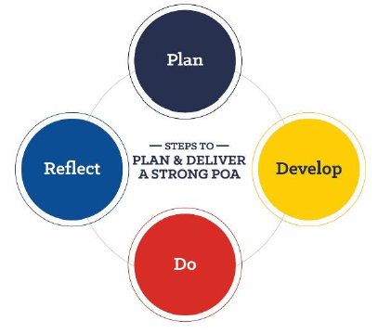
Program of Activities
Development & Implementation
The steps to develop and implement a successful Program of Activities include:

Slide 5
Program of Activities
Organizing A POA
Divisions
  Each chapter builds its POA around 3 major areas called divisions. The 3 divisions include:
    Growing Leaders
    Building Communities
    Strengthening Agriculture
Each division has 5 quality standards that typically function as student committees within the chapter.
  Quality standards and dedicated student committees guide the planning, preparation and delivery of activities in each quality standard area.

Slide 6
Program of Activities
Quality Standards
Growing Leaders | Building Communities | Strengthening Agriculture
Leadership | Environmental | Support Group
Healthy Lifestyle | Human Resources | Chapter Recruitment
Scholarship | Citizenship | Safety
Personal Growth | Stakeholder Engagement | Agricultural Advocacy
Career Success | Economic Development | Agricultural Literacy
For quality standard definitions and example activities, see the
Program of Activities Resource Guide.

Slide 7
Program of Activities
Chapter Activities
Every chapter activity should provide:
  A balance of experiences inside and outside the classroom
  Opportunities for developing self-confidence, responsibility, citizenship, cooperation and leadership skills
  Authentic, engaging activities
  Relevant, educational experiences
  Accessibility for all students
  Flexibility that will allow chapters from various environments and with various levels of resources to be successful
  Multiple levels of participation and experiences
  Appropriate recognition for all participants
  Exposure to opportunities and educational experiences for food, agriculture and natural resources

Slide 8
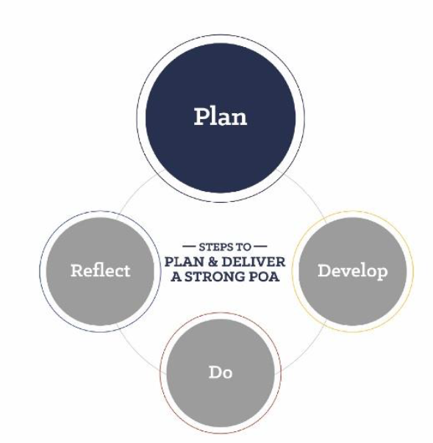
Program of Activities
Step 1: Plan
Organizing Student Committees:
  The POA should be organized by using student committees.
  The vice president has the responsibility of coordinating all standing committee work
  Chapter officers have the responsibility of coordinating chapter activities, but need not serve as committee chairs
  Every chapter member should actively serve on at least one committee
  Committee structure will depend on:
    Size of chapter
    Involvement of members
    Number of activities to complete
    School and community support
    Number of advisors

Slide 9
Program of Activities
Step 1: Plan
Types of Committees:
  Standing committees
    Committees that serve a function from year to year
  Executive committee
    Usually consists of the chapter officers and changes each year
  Special committees
    Committees that may meet to plan events that do not occur every year or are not part of a standing committee.

Slide 10
Program of Activities
Step 1: Plan
Committee Structure
  Number of committees
    Three committees – one committee per division
    Fifteen committees – one committee per quality standard
  Student participation in committees should be based on:
    Member interest
    Member talent
    Suitable meeting times
    Desired representation by agriculture course, grade level,
    experience, etc

Slide 11
Program of Activities
Step 1: Plan
Chapters should establish a timeline for POA development. A chapter may organize the timeline by date or by calendar schedule.
Examples are available in the POA Resource Guide

Slide 12
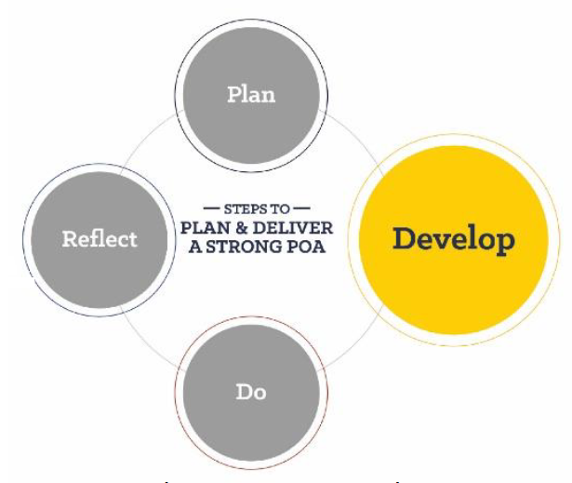
Program of Activities
Step 2: Develop
Each committee should meet and discuss activities that relate to the purpose of the committee.
Once the committee selects an activity, use POA Form 1 to plan.
  Pay attention to special notes when completing the form
  For a sample draft, see the POA Resource Guide
Once planning is complete, the chapter membership must approve at a chapter meeting.

Slide 13
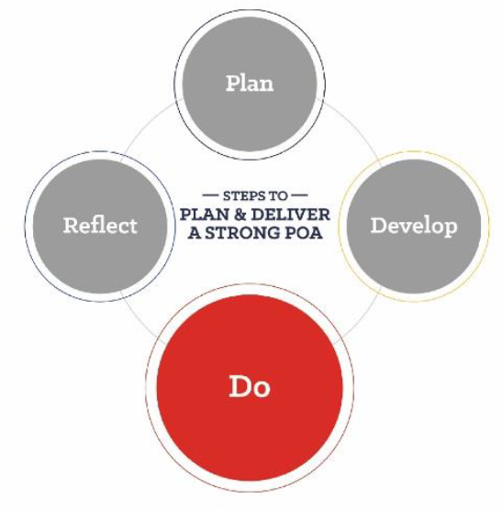
Program of Activities
Step 3: Do
Once approved, the committee will plan each activity using POA Form 2. This includes planning goals, steps to accomplish each goal, target dates and estimated financial impact.
The committee should complete a POA Form 2 sheet for each approved activity.
  For a sample draft, see the POA Resource Guide

Slide 14

Program of Activities
Step 3: Do
SMART Goals, Plans of Action
  SMART Goals should be:
      S – Specific
      M – Measurable
      A – Attainable
      R – Realistic
      T – Timely
  What is necessary to meet the goal?
      Step by step processes
      Listed in order
      Clear and detailed
      Who, what, why, where, when, how, how much?

Slide 15
Program of Activities
Step 3: Do
Making the POA work:
  When planning is finished, smooth delivery is key. Successful chapters:
    Give every member a copy of the POA and/or chapter handbook
    Give a copy of the POA to support groups and stakeholders
    Give each committee a copy of the national chapter award application
    Hold regularly scheduled committee meetings
    Report committees’ actions to the executive committee
    Report committee’s actions to the chapter membership at chapter meetings
    Evaluate each activity

Slide 16
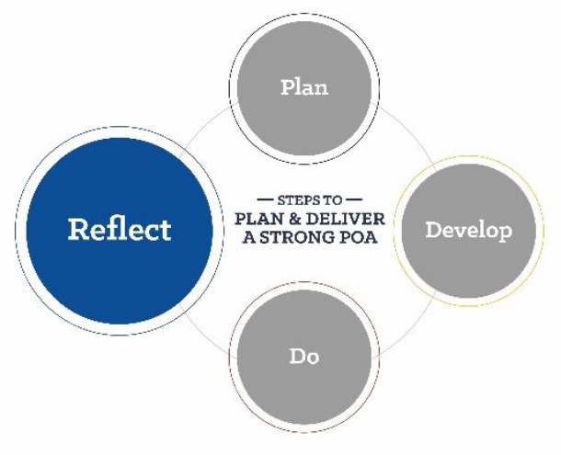
Program of Activities
Step 4: Reflect
Reflecting on the POA involves looking at each activity after implementation and deciding if the event was successful in completing its goals
Reflection is an ongoing process. To save time and effort, the POA should be reviewed and reflected upon regularly.
Committee members should:
  Fill out the ‘Results/Notes’ section on POA Form 2 as each step of the activity takes place.
  Use POA Form 3 and POA Form 4 to help reflect on and
  evaluate the results.
    See the POA Resource Guide for sample
    reflection questions

Slide 17
Program of Activities
Step 4: Reflect
Each committee may use POA Form 3 to summarize actions. This assists in preparing a report for the officers and chapter members.
  For a sample draft, see the POA Resource Guide
After each activity is implemented, reflect on accomplishments and make recommendations for the future. Use POA Form 4 for this purpose.
  For a sample draft, see the POA Resource Guide

Slide 18

Program of Activities
Brainstorming Tools
Review previous year’s POA
Review other chapters’ POAs
Chapter Success Guides (available on FFA.org)
Chapter needs
Community needs
Student interests

Slide 19
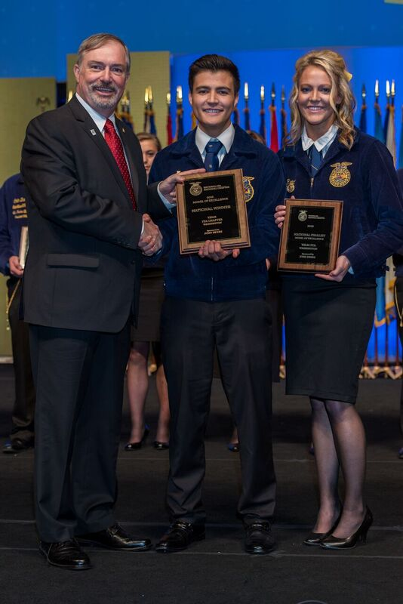
Program of Activities
Next Steps?
After completing a successful Program of Activities, the chapter should consider participating in the National Chapter Award Program! This program is designed to recognize FFA chapters that actively implement the mission and strategies of the organization.
To learn more, visit: www.FFA.org/nationalchapter

Slide 20
Program of Activities
Resources
All POA Resources: www.FFA.org/POA
  POA Resource Guide
  POA Divisions, Quality Standards and activity ideas
  POA Planning Forms (in Word and PDF)
All National Chapter Award Program Resources: www.FFA.org/nationalchapter
  Chapter Success Guides

Slide 21
Program of Activities
Questions?
Contact the National Chapter Award Program
Education Specialist
317-802-4402
nationalchapter@ffa.org

