Slide 1

Showing Compassion to Others
How do we build high performing teams?
AHS 24
Stage Two of Development
WE

Slide 2
Compassion
Acting kindly towards others because you want to help, not for the material rewards.
Objective 1
AHS 24 TM A

Slide 3
Compassionate Actions
Being honest
Accepting others
Thinking kind thoughts
Giving a loving gesture
Praying for others
Complimenting others
Listening
Giving a shoulder to cry on
Hugging
Being a Friend
Loving others
Forgiving others
Objective 2
AHS 24 TM B

Slide 4
How can I benefit from leading a compassionate life?
Generates pride
Accomplishment
Creates acts of kindness
  Holding the door for someone
  Saying thank you
  Putting coins in another person’s
  parking meter
  Picking up litter
Objective 3
AHS 24 TM C

Slide 5
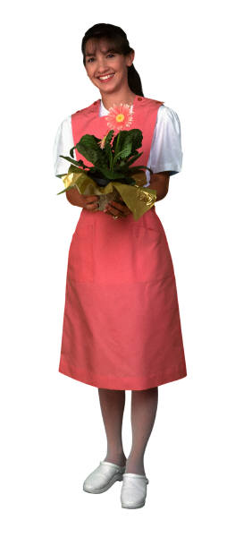
Community Outreach
Places in which I can make a difference:
- Chamber of Commerce
- Volunteer Connection
- Salvation Army
- Hospital
- Zoo
- Children’s Organizations
Objective 3

