Slide 1

Using Evaluation and Reflection
How do we create and accomplish our vision?
Stage Three of Development
DO
AHS 31

Slide 2
Think About It!
What is the most perfect thing in the world?
Is this thing the most perfect thing in the world? What could make it better?
Interest Approach

Slide 3
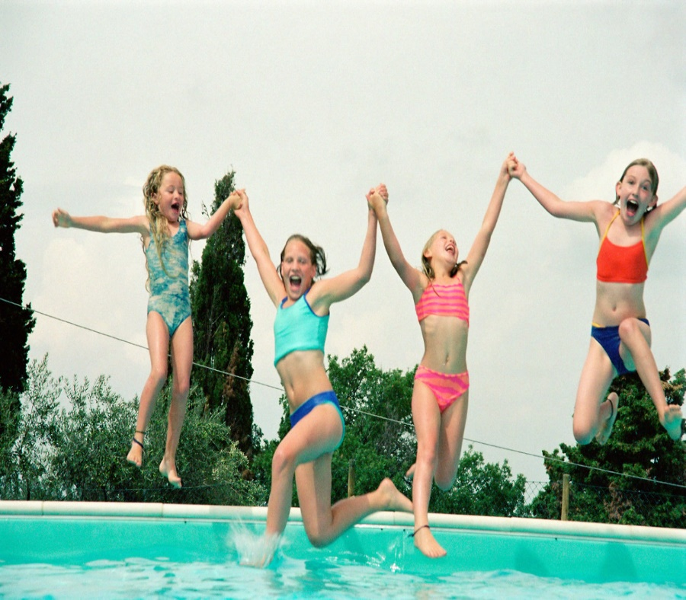
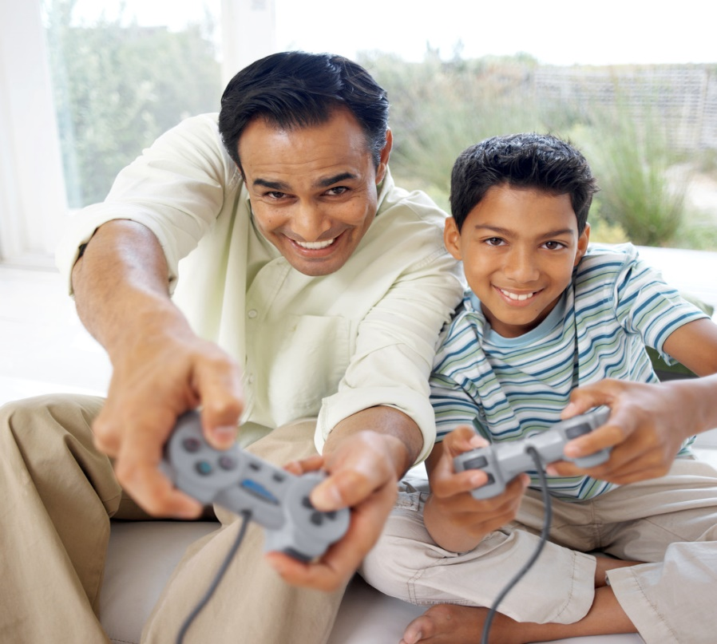


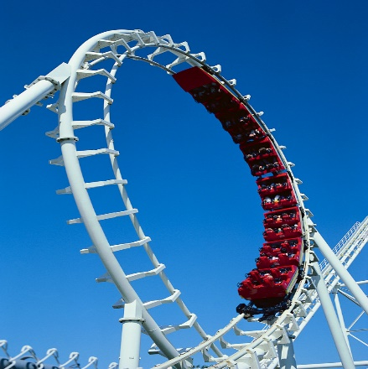

My Perfect Day…
Sunshine
Spending Time On the Farm
Roller Coasters
Hanging out with Friends
The Beach
Playing Video Games
Objective 1

Slide 4
Self-Evaluation & Self-Reflection
Self-reflection is the process in which a person recalls past actions, thoughts, and feelings in order to consider future decisions, activities, and goals.
Self-evaluation is the process whereby a person analyzes his or her reflections to consider their successes or shortcomings.
Objective 1
AHS 31 TM A

Slide 5
Self-Evaluation & Self-Reflection
Both self-reflection and self-evaluation are important for a person’s future growth and development. One must understand the past in order to develop success in the future.
In order to make a difference or a change in an organization or in the world, the first step is to make a difference or a change in oneself.
Objective 1
AHS 31 TM A

Slide 6
Confidence
Confidence comes from knowing the limits of current skills, knowledge, and abilities, and from the assurance of growth and improvement in the future.
Objective 2

Slide 7
Reflection & Evaluation
Reflection on and evaluation of past performance is the one true method of transforming a personal “good” into a “better” and eventually into a personal “best.”
Objective 2

Slide 8
Methods of Self-Reflection & Self-Evaluation
Often involve quiet, peaceful times where a person can think and carry on a dialogue with his or her inner self
Keep a journal in which you collect your thoughts and reminisce the day
Objective 3
AHS 31 TM B1

Slide 9
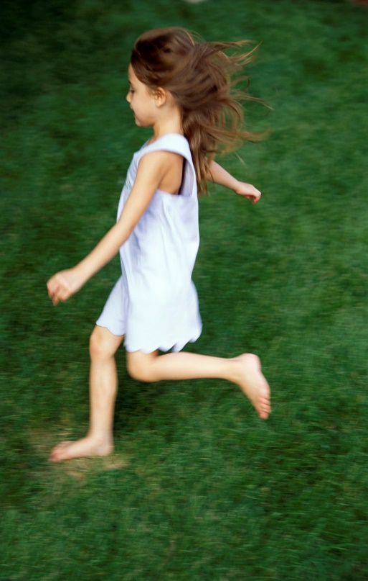
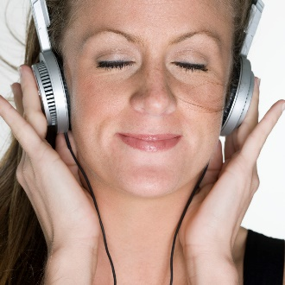
Methods of Self-Reflection & Self-Evaluation
Physical activity, such as running or walking in the woods, provides an escape from the hectic world
    Listening to music, especially classical or relaxing music tends to expand the mind and relax tensions, allowing a person to reflect more deeply
Objective 3
AHS 31 TM B1

Slide 10
Methods of Self-Reflection & Self-Evaluation
Immediately reviewing an action or thought allows the person to catalog the result quickly
Intimate discussions with close friends allow a person to express their feelings, fears, goals, aims, and intents
Objective 3
AHS 31 TM B2

Slide 11
Methods of Self-Reflection & Self-Evaluation
Reading relaxes the mind and often provides new ideas and perceptions with which to view the world
Evaluating performance against goals allows a person to assess his or her progress toward the goals and aims
Objective 3
AHS 31 TM B2

