Slide 1

Building Mutual Interest
How do I build relationships with others?
HS 57
Stage Two of Development
WE

Slide 2
Mutual Interest
the common belief, interest, or involvement two or more people share.
    Agriculture and FFA is our mutual interest in this class!
Objective 1
HS 57 TM A1

Slide 3

What are some reasons that we may want to build relationships?
1. Friendship and companions
  School friends, church friends, club friends or teammates
Objective 1
HS 57 TM A2

Slide 4
What are some reasons that we may want to build relationships?
2. Work or professional
  Boss, supervisors, co-workers
Objective 1
HS 57 TM A3

Slide 5
What are some reasons that we may want to build relationships?
3. Community activities and involvement
  4-H, grange, youth groups, volunteer opportunities
Objective 1
HS 57 TM A4

Slide 6
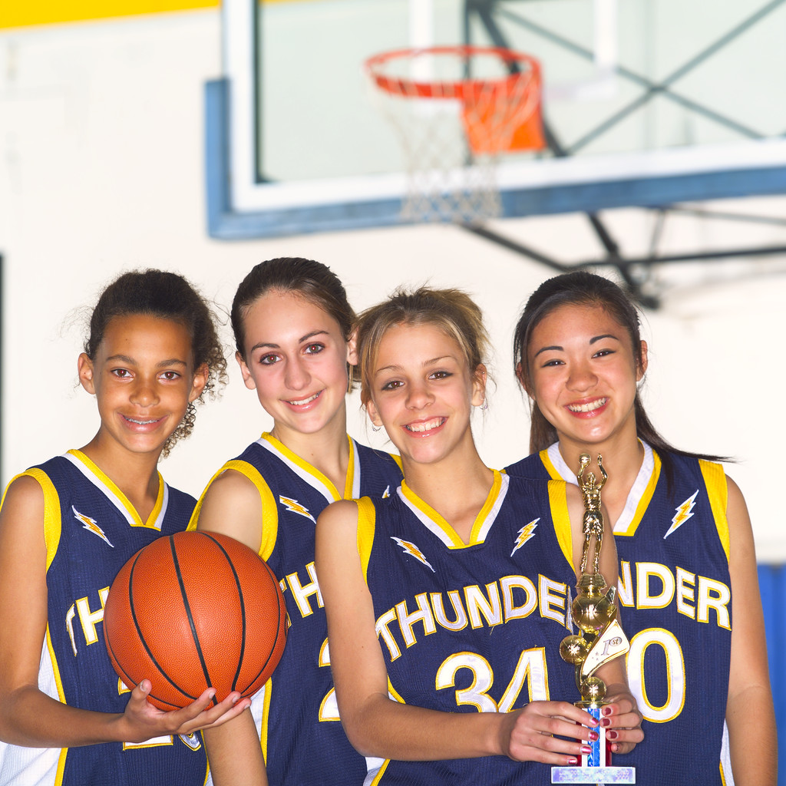
What are some reasons that we may want to build relationships?
4. Mutual interests between two people
  Someone with a common interest or hobby
  (Dance team, choir, athletics)
Objective 1
HS 57 TM A5

Slide 7
Building Mutual Interests
1. Connect with others on a personal level
  Get to know people
  Be interested in listening and learning
Objective 1
HS 57 TM B1

Slide 8
Building Mutual Interests
2. Develop new interests
  Try a new hobby
  Encourage your friends to try new activities -like FFA!-
Objective 1
HS 57 TM B2

Slide 9
Building Mutual Interests
3. Respect differences
Objective 1
HS 57 TM B3

Slide 10
Building Mutual Interests
4. Continue building the relationship
Objective 1
HS 57 TM B4

Slide 11
Ways to strengthen and maintain relationships
1. Take time out.
  Make time for the people that matter most to you. Share your time with others who may need someone to care about them.
Objective 1
HS 57 TM B5

Slide 12
Ways to strengthen and maintain relationships
2. Do the little things that matter most.
  Send notes, make phone calls, and stay in touch with friends and family.
Objective 1
HS 57 TM B6

Slide 13

Ways to strengthen and maintain relationships
3. Attend activities and events together.
  Spend time doing mutual hobbies with someone you consider a friend.
  Movies, music, sports, youth groups, traveling, FFA
Objective 1
HS 57 TM B7

Slide 14
Ways to strengthen and maintain relationships
4. Have meaningful conversations.
  World issues, religion, traveling.
Objective 1
HS 57 TM B8

