Slide 1


Local FFA Chapter Name
Name of group presenting to | Date
Notes:
[Slide opens with video and FFA emblem continuously looping until you click to bring up the text to get your presentation started.]

Slide 2


AGRICULTURAL EDUCATION
THREE-COMPONENT MODEL
CLASSROOM/LABORATORY
Contextual, inquiry-based learning through instructor-led classroom and laboratory.
School-based
Agricultural
Education
SUPERVISED AGRICULTURAL EXPERIENCES (SAE)
Experiential learning through implementation in a real-world setting.
FFA
Premier leadership, personal growth and career success through
FFA experiences and activities.
Notes:
FFA delivers our mission through a unique three-component model for school-based agricultural education:
[Classroom/Lab] Students gain knowledge in the classroom.
[SAE] They apply that knowledge through hands-on learning and experience.
[FFA] They develop leadership skills and receive recognition in FFA.

Slide 3
FFA Is Intra-curricular
In order to have an FFA chapter, schools are required to have an agricultural education program and teacher.
Only intra-curricular student organization focused exclusively on agriculture and leadership.
More than 11,000 FFA advisors and agriculture teachers.
Agriculture, food and natural resources (AFNR) career pathways:
AGRIBUSINESS SYSTEMS • ANIMAL SYSTEMS • BIOTECHNOLOGY SYSTEMS
ENVIRONMENTAL SERVICE SYSTEMS • FOOD PRODUCTS AND PROCESSING SYSTEMS
NATURAL RESOURCES SYSTEMS • PLANT SYSTEMS
POWER, STRUCTURAL AND TECHNICAL SYSTEMS
Notes:
FFA is unique in that it is in the classroom and not simply an extracurricular activity.
In order to have an FFA chapter, schools are required to have an agricultural education program and teacher.
Only intra-curricular student organization focused exclusively on agriculture and leadership.
More than 11,000 FFA advisors and agriculture teachers.
Additionally:
The AFNR Career Cluster Content Standards provide state agricultural education leaders and educators with a high-quality, rigorous set of standards to guide what students should know and be able to do after completing a program of study in each of the following AFNR career pathways: 1. Agribusiness Systems 2. Animal Systems 3. Biotechnology Systems 4. Environmental Service Systems 5. Food Products and Processing Systems 6. Natural Resource Systems 7. Plant Systems 8. Power, Structural and Technical Systems

Slide 4

FFA is the premier school-based, member-led youth organization.
Strong values, service to others and global purpose
Transformational and
life-changing experiences
Next generation of leaders
We Are FFA.
Notes:
[FFA positioning statement – what sets us apart]
FFA is the premier school-based, member-led youth organization.
We provide transformational and life-changing experiences to future generations of agricultural, food and natural resources advocates who are driven by strong values, service to others and global purpose.
Our members represent the next generation of leaders in industry, government and local communities. We are FFA!

Slide 5
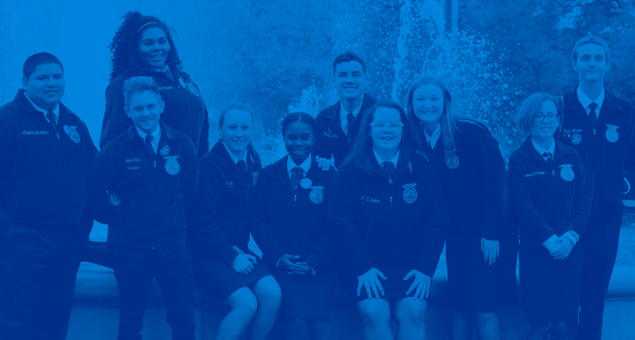
FFA HAS IMPACT
65,000
National FFA Convention & Expo attendees
+
649,000
FFA members
We are the future of agriculture.
7,859
Active FFA Alumni members
Of 20 largest
U.S. cities have
FFA chapters
FFA chapters in all 50 states, Puerto Rico
and Virgin Islands
19
62,705
+
11,000
FFA advisors and agriculture teachers
Notes:
[This slide gives a big picture view of FFA. We have additional data available in the notes of the presentation so that they may also be brought up…data from the annual report such as average number of members per chapter, the total number of ag ed students, etc.]
649,000+ members
19 of 20 largest U.S.cities have FFA chapters
7,859 FFA Chapters in all 50 states, Puerto Rico & Virgin Islands
62,705 Active FFA alumni members
65,000 National FFA Convention & Expo attendees
11,000 FFA advisors and agriculture teachers

Slide 6
Chapter Information
# of FFA members
Ag Ed courses offered
State and National recognition received
Mentionable achievements

Slide 7
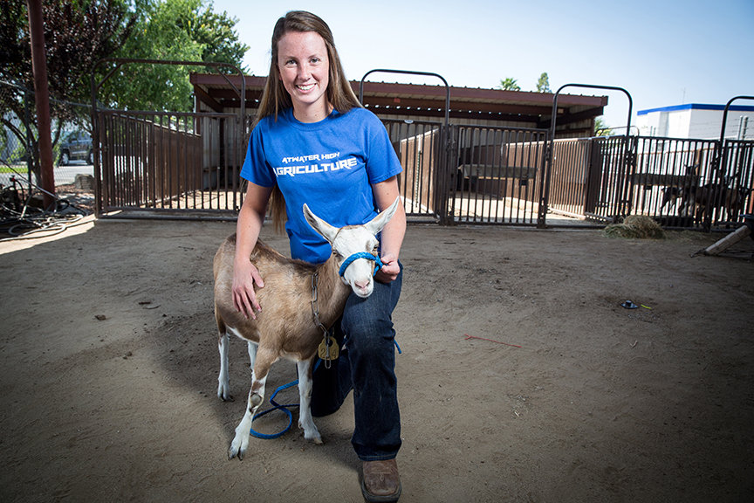
FFA DELIVERS
AGRICULTURAL KNOWLEDGE
Notes:
FFA Delivers Agricultural Knowledge.
[This slide is the title slide for this platform. The next slides will go into details about the platform.]

Slide 8
FFA Delivers Agricultural Knowledge
Agricultural Proficiency—Students compete for awards in 47 areas covering everything from agricultural communications to wildlife management.
National FFA Agriscience Fair—A competition for FFA members who are interested in the science and technology of agriculture.
FFA Degree and Star Awards—Rewards active FFA members for progress in all phases of leadership, skills and occupational development.
Notes:
FFA Delivers Agricultural Knowledge through:
Agricultural Proficiency Awards
National FFA Agriscience Fair
FFA Degrees and Star Awards

Slide 9
Agricultural Proficiency Awards
List proficiency awards and areas that members in your chapter have won (Examples below)
  Agricultural Communications
  Wildlife Management
  Dairy Production
  Diversified Crop Production
  Floriculture
  Agricultural Mechanics Design and Fabrication
Notes:
Agricultural proficiency awards recognize FFA members who, through their SAEs, have developed specialized skills that they can apply toward their future careers.
Students compete for awards in 47 areas covering everything from agricultural communications to wildlife management.
Proficiency awards are given out at the local, state and national levels to all members who qualify.

Slide 10
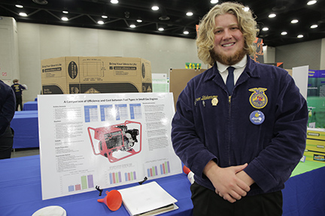
National FFA Agriscience Fair
A competition for FFA members who are interested in the science and technology of agriculture.
FFA members conduct a scientific research project about agriculture and food science and present their findings to a panel of judges.
Notes:
The National FFA Agriscience Fair is a competition for FFA members who are interested in the science and technology of agriculture. FFA members conduct a scientific research project pertaining to the agriculture and food science industries and present their findings to a panel of judges with a display and a report.
Students participated in a variety of research areas such as:
Animal systems
Environmental services/natural resource systems
Food products & processing systems
Plant systems
Power, structural & technical systems
Social systems

Slide 11
FFA Degree and Star Awards
Rewards active FFA members for progress in all phases of
leadership, skills and occupational development.
Chapter
State
National
Discovery FFA Degree
Greenhand FFA Degree
Chapter FFA Degree
State FFA Degree
American FFA Degree
>
>
Notes:
FFA is structured into a degree program which rewards active FFA members for progress in all phases of leadership, skills and occupational development.
Chapter level
The Discovery FFA Degree, the Greenhand FFA Degree and the Chapter FFA Degree are awarded at the chapter level.
State level
State associations award top members with the State FFA Degree.
National level
The highest degree, the American FFA Degree, is conferred upon an elite group of members at the national level. For the most up-to-date degree requirements, visit www.FFA.org.

Slide 12
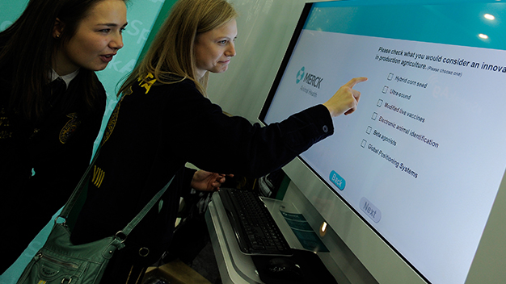
FFA DELIVERS
CAREER EXPLORATION
Notes:
FFA Delivers Career Exploration.
[This slide is the title slide for this platform. The next slides will go into details about the platform.]

Slide 13
FFA Delivers Career Exploration
Members learn advanced career skills in 47 national proficiency areas ranging from agricultural communications to turf grass management.
FFA members are challenged to real-life, hands-on skills tests in preparation for careers in agriculture.
CAREERS IN AGRICULTURE
+
200
Notes:
[this is additional info for the platform description]
FFA members are challenged to real-life, hands-on skills tests in preparation for 200+ careers in the agriculture industry

Slide 14
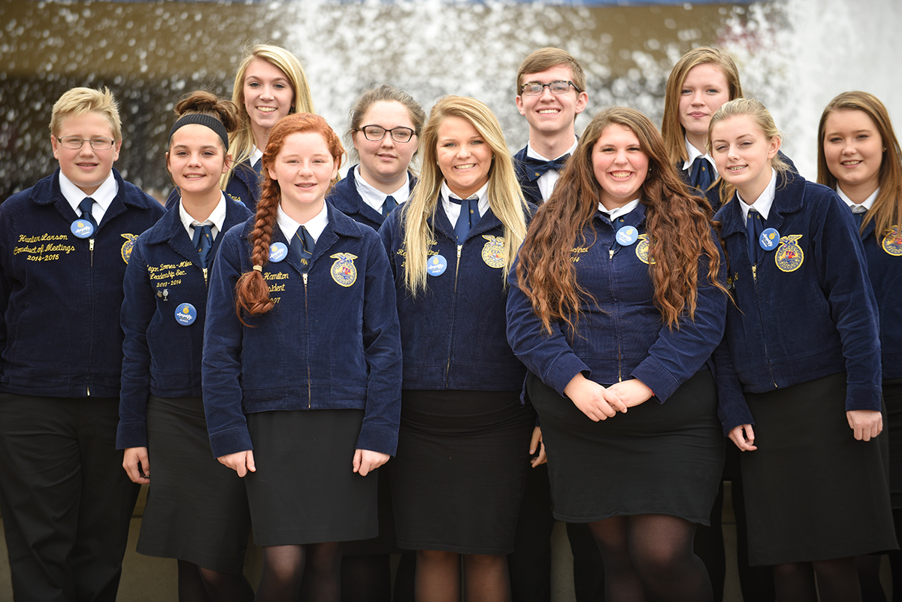
Career and Leadership Development Events
CDEs and LDEs are local, state and national competitions.
Compete in 25 different CDE and LDE areas in everything from forestry to mechanics.
Compete as individuals or in teams.
Notes:
CDEs are local, state-wide and national competitions.
Allows all FFA members to compete in 25 different CDE areas in everything from forestry to mechanics.
Some events allow students to compete as individuals, while others allow them to compete in teams.

Slide 15
Career and Leadership Development Events
List the Career and Leadership Development Events your chapter participated in (Examples below)
  Extemporaneous Speaking
  Veterinary Science
  Poultry Judging
  Agricultural Mechanics
  Parliamentary Procedure
  Food Science and Technology
  Agronomy
Notes:
Share stories of FFA members in the chapter who have competed in these events. What skills did they learn? How has it helped set their career path? What level of competition did they make it to?

Slide 16
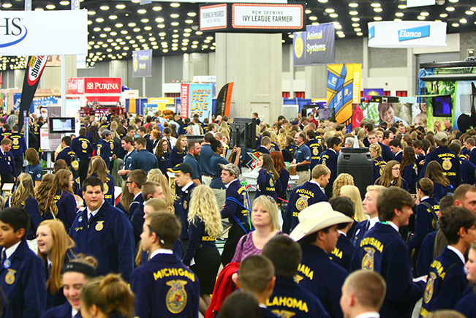
National FFA Convention & Expo
Largest annual student gathering in the nation, and in most recent years has maintained an attendance of more than 60,000.
Approved by the National Association of Secondary School Principals, which allows students an opportunity to experience education-filled programs outside of school.
1998 | Kansas City
2005 | Louisville
2012 | Indianapolis
2015 | Louisville
49,240
52,396
56,167
65,173
Notes:
The convention and expo is the largest student gathering in the nation, and in most recent years, has maintained an attendance of more than 60,000. National officers preside over business sessions conducted by 475 delegates representing their respective state associations. The national convention and expo has been approved by the National Association of Secondary School Principals, which allows students an opportunity to experience education-filled programs outside of school.
A wide variety of educational programs, events and activities are available at the national convention and expo:
• A national expo aligned to the eight career pathways.
• National career development events and award competitions.
• National band, chorus and talent programs.
• Leadership and career success workshops for high school members, middle school members and agriculture educators.
• Main arena sessions featuring motivational guest speakers, retiring addresses of the national officers, recognition and award presentations to student, teacher and chapter finalists, as well as honoring and recognizing FFA supporters and sponsors.
• National FFA Days of Service, a program that helps FFA members discover the value of community service and volunteering within their communities.
• Career Success Tours, which enable students to explore careers in fields as they relate to agriculture.
For many members, the National FFA Convention & Expo provides the inspiration and motivation that leads to further achievements in FFA.
[Infograph]
You can see the growth of the convention attendees has continued to substantially increase each year.

Slide 17
National FFA Convention & Expo
A wide variety of educational programs, events and activities:
A national expo aligned to the eight career pathways.
National award competitions.
National band, chorus and talent programs.
Leadership and career success workshops.
Sessions feature speakers, national officers, award presentations and recognize FFA supporters/sponsors.
Career Success Tours.
Notes:
A wide variety of educational programs, events and activities are available at the national convention and expo:
A national expo aligned to the eight career pathways.
National career development events and award competitions.
National band, chorus and talent programs.
Leadership and career success workshops for high school members, middle school members and agriculture educators.
Main arena sessions featuring motivational guest speakers, retiring addresses of the national officers, recognition and award presentations to student, teacher and chapter finalists, as well as honoring and recognizing FFA supporters and sponsors.
Career Success Tours, which enable students to explore careers in fields as they relate to agriculture.
For many members, the National FFA Convention & Expo provides the inspiration and motivation that leads to further achievements in FFA.

Slide 18
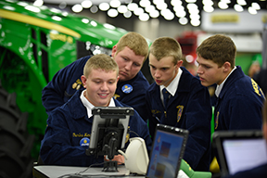
National FFA Convention & Expo
Several engagement opportunities are offered to more than 60,000 members.
Include meeting with industry experts to help participants learn how to secure their roles in the next generation of American agriculture.
Notes:
Several engagement opportunities are offered to more than 60,000 members at each annual National FFA Convention & Expo.
As career success is core to the FFA mission, these opportunities include meeting with industry experts to help participants learn how to secure their roles in the next generation of American agriculture.

Slide 19

FFA DELIVERS
LEADERSHIP CONCEPTS
Notes:
FFA Delivers Leadership Concepts.
[This slide is the title slide for this platform. The next slides will go into details about the platform.]

Slide 20
The 212° Leadership Conference
The series begins with a focus on individual development through the 212° Leadership Conference.
Designed to take 7th-10th grade students to the boiling point of personal leadership.
Notes:
Part I: The 212° Leadership Conference:
The series begins with a focus on individual development through the 212° Leadership Conference.
212 degrees is temperature at which water boils. The 212° conference takes students to the boiling point of leadership. Themes for the conference are virtues, growth and collaboration.

Slide 21
The 360° Leadership Conference
Once students show a firm grasp on individual development, they are encouraged to attend.
Part II of the series, designed specifically for 11th-12th grade students.
Challenges participants to expand their circle of influence and focus on leadership.
Notes:
Part II: The 360° Leadership Conference
Once students show a firm grasp on individual development, they are encouraged to attend Part II of the series – the 360° Leadership Conference, designed specifically for 11th-12th grade students.
360° takes students full circle through chapter leadership development. Attendees will learn how to develop action plans for their chapters from every angle. Themes for this conference are action and influence.

Slide 22
The Washington Leadership Conference (WLC)
Capstone conference in this series, hosted during the summer in Washington, D.C.
Designed primarily for experienced FFA members.
Dives into advanced leadership themes of authenticity and valuing diversity, as well as taking action through advocacy and service.
Notes:
Part III: The Washington Leadership Conference (WLC)
WLC, the capstone conference in this series, is hosted during the summer in Washington, D.C.
Designed primarily for experienced FFA members, this conference dives into advanced leadership themes of authenticity, valuing diversity, as well as taking action through advocacy and service.
WLC is the ultimate leadership experience for FFA members. It provides hands-on experiences that help attendees learn how to apply leadership skills to real-life situations. This conferences focuses on personal development, diversity, advocacy and service. There are seven, one-week sessions each summer.

Slide 23
State Leadership Conferences
Add information about any state and chapter leadership conferences

Slide 24
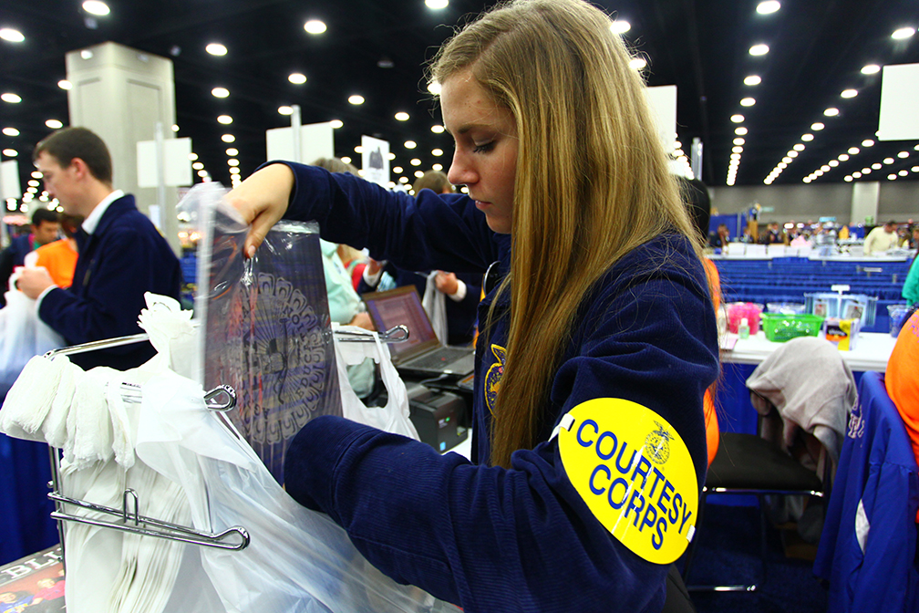
FFA DELIVERS
SERVICE-LEARNING
Notes:
FFA Delivers Service-learning.
[This slide is the title slide for this platform. The next slides will go into details about the platform.]

Slide 25
FFA Delivers Service-learning
List the different community service projects your chapter completes (Examples below)
  Meal packing event
  Roadside clean-up
  Farmer Appreciation Day
Notes:
Share stories of community service projects and add pictures.

Slide 26
Thank You!

