Slide 1
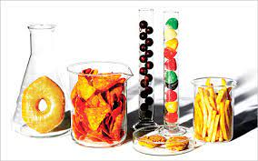


Unit 3 Assessment
Food Sanitation Report

Slide 2
DIRECTIONS: View each picture in the next slide and determine if there is a violation. With 1 partner, complete the Food Safety and Sanitation Scorecard, 1 card/team.
*Note: You may not have concerns in every area on the scorecard. Put N/A where there are no concerns.
Use the handout provided by your instructor to assign a number with each violation found in the following pictures.

Slide 3
