Slide 1

Bayer Products
Entering the Sales World

Slide 2
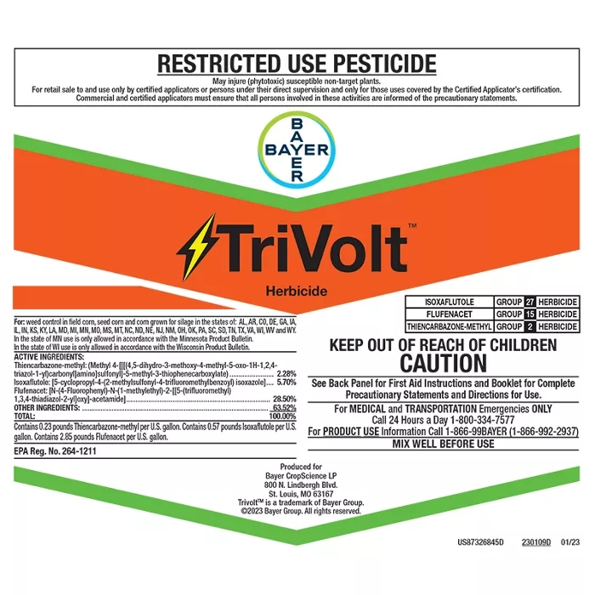
TriVolt Herbicide
Built with a proprietary formula, TriVolt Corn Herbicide provides burndown and residual activity in a variety of weather conditions.
Approved States: AL, AR, CO, DE, GA, IA, IL, IN, KS, KY, LA, MD, MI, MN, MO, MS, MT, NC, ND, NE, NJ, NM, OH, OK, PA, SC, SD, TN, TX, VA, WI, WV, WY
Key Benefits:
  Controls a broad spectrum of key grass and broadleaf weeds
  Keeps fields clean for up to eight weeks, in a variety of weather conditions
  Contains three different active ingredients: flufenacet, isoxaflutole and thiencarbazone-methyl
Product Details: Liquid
Effective Against: Barnyard Grass, Common Lambsquarters, Common Ragweed, Common Waterhemp, Crabgrass Species, Fall Panicum
Registered Crops: Corn
https://www.cropscience.bayer.us/d/trivolt-herbicide

Slide 3
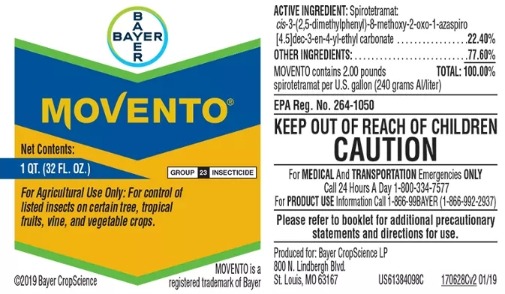
Movento Insecticide
Movento insecticide features powerful, two-way movement that moves within plants to protect them from a broad range of insects, mites and nematodes above and below the ground, creating highly pest-resistant plants and healthier crops.
Approved States: AK, AL, AR, AZ, CA, CO, CT, DC, DE, FL, GA, HI, IA, ID, IL, IN, KS, KY, LA, MA, MD, ME, MI, MN, MO, MS, MT, NC, ND, NE, NH, NJ, NM, NV, NY, OH, OK, OR, PA, RI, SC, SD, TN, TX, UT, VA, VT, WA, WI, WV, WY
Key Benefits:
  Moves leaf to leaf and leaf to root protecting the entire plant, including those in dense crop canopies, new shoots and roots systems
  Suppresses nematodes, including root-knot, ring, lesion, citrus, dagger, stubby and cyst species
  High level of residual efficacy and protection of new plant growth
  Provides minimal risk to natural predators when used as directed
  Lower spray volume can typically be utilized on certain crops for time and labor savings, as well as more timely application to the entire treatment area
  A unique mode of action that becomes active when ingested by insect, mite and nematode pests that feed on treated plants
Product Details: Liquid
Effective Against: Aphids, Mealybugs, Mites, Nematodes, Psyllids, Scale
Registered Crops: Citrus, Grapes, Potatoes, Tree Nuts, Vegetables
https://www.cropscience.bayer.us/d/movento-insecticide

Slide 4
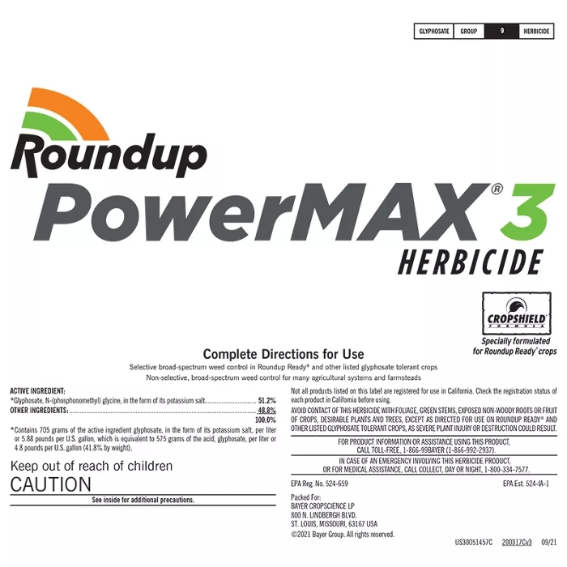
Roundup PowerMax 3 Herbicide
Roundup PowerMAX 3 Herbicide contains a unique surface blend with a higher concentration of glyphosate per gallon, allowing farmers to spray more acres per gallon.
Approved States: AK, AL, AR, AZ, CA, CO, CT, DC, DE, FL, GA, HI, IA, ID, IL, IN, KS, KY, LA, MA, MD, ME, MI, MN, MO, MS, MT, NC, ND, NE, NH, NJ, NM, NV, NY, OH, OK, OR, PA, RI, SC, SD, TN, TX, UT, VA, VT, WA, WI, WV, WY
Key Benefits:
  It is a postemergence, systemic herbicide with no soil residual activity.
  It’s nonselective and gives broad-spectrum control of many annual weeds, perennial weeds, woody brush, trees and vines.
  Covers more acres per gallon compared to competing products
  Provides consistent control over yield-robbing weeds, resulting in translocation throughout the plant, including the root system
Product Details: Liquid
Effective Against: Cheatgrass, Kochia, Marestail, Russian Thistle, Volunteer Wheat
Registered Crops: Corn field, Corn Production Seed, Corn Sweet, Grain Sorghum, Popcorn, Silage Corn
https://www.cropscience.bayer.us/d/roundup-powermax-3-herbicide

Slide 5
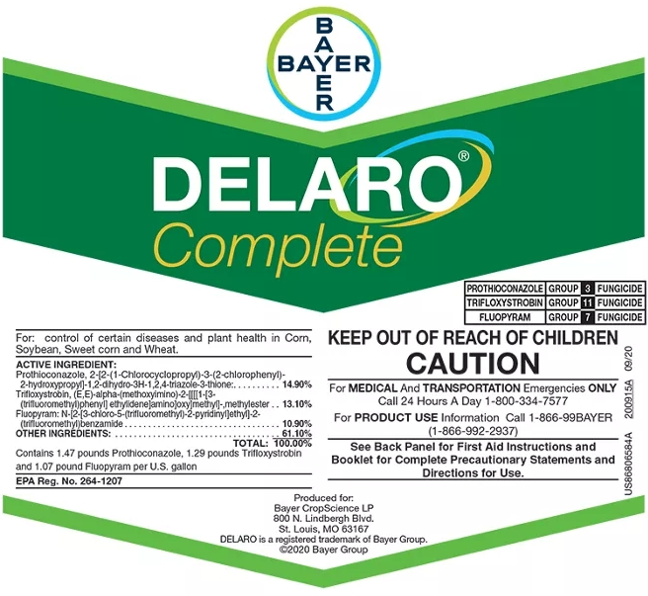
Delaro Complete Fungicide
Delaro Complete Fungicide offers unique chemistries in all three modes of action. These powerful ingredients work together to provide consistent control of most major corn and soybean diseases and increased plant health all season long.
Approved States: AL, AR, AZ, CO, CT, DE, FL, GA, IA, ID, IL, IN, KS, KY, LA, MA, MD, ME, MI, MN, MO, MS, MT, NC, ND, NE, NH, NJ, NM, NV, NY, OH, OK, OR, PA, RI, SC, SD, TN, TX, UT, VA, VT, WA, WI, WV, WY
Key Benefits:
  Three modes of action provide consistent control of major corn and soybean diseases under many different environmental conditions.
  A unique chemistry combination boosts photosynthesis and increases grain fill for consistently higher yield potential and resistance management.
  Strengthens corn stalks and invigorates the soybean canopy to withstand environmental pressures for robust growth
Product Details: Liquid
Effective Against: Frogeye Leaf Spot, Gray Leaf Spot, Northern Corn Leaf Blight, Rusts, Tar Spot, White Mold Suppression
Registered Crops: Cereals, Corn, Soybean
https://www.cropscience.bayer.us/d/delaro-complete-fungicide

Slide 6
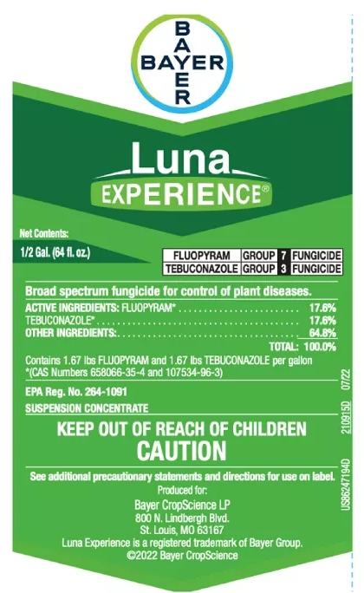
Luna Experience Fungicide
Luna Experience fungicide is a trusted, broad-spectrum solution from Bayer. It controls the most prevalent and challenging diseases in a wide range of crops, improves plant health and produce quality, and reduces crop losses at harvest and later in storage.
Approved States: AL, AR, AZ, CA, CO, CT, DE, FL, GA, HI, IA, ID, IL, IN, KS, KY, MA, MD, ME, MI, MN, MO, MS, MT, NC, ND, NE, NH, NJ, NM, NY, OH, OK, OR, PA, RI, SC, SD, TN, TX, UT, VA, VT, WA, WI, WV, WY
Key Benefits:
  Proven in more than 1,500 U.S. field trials to provide the broadest spectrum disease control equal or superior to all current leading fungicides
  Uniform uptake after application enables Luna to enter buds, blooms and new tissue where disease hides.
  Novel active ingredients in long-term tree health and on fruit quality and storability
  Luna fungicides provide the broadest options for preventing and managing fungicide resistance.
Product Details: Liquid
Effective Against: Alternaria, Botryosphaeria, Botrytis, Bunch Rots, Powdery Mildew, Scab
Registered Crops: Almonds, Cherries, Cucurbits, Pistachios, Potatoes, Wine Grapes
https://www.cropscience.bayer.us/d/luna-experience-fungicide

Slide 7

FieldView
FieldView helps farmers all around the world see what worked, what didn’t and how to improve their operation with data and digital tools.
FieldView is helping address one of our planet’s most pressing challenges, growing more with fewer natural resources. The power of machine learning, artificial intelligence and data science can help farmers bring a new level of precision to every seed, chemical, machine and decision.
FieldView Plus offers analysis of your field data, interactive field health maps, instant planting and harvest data and custom reports.
https://www.cropscience.bayer.us/tools/fieldview

Slide 8
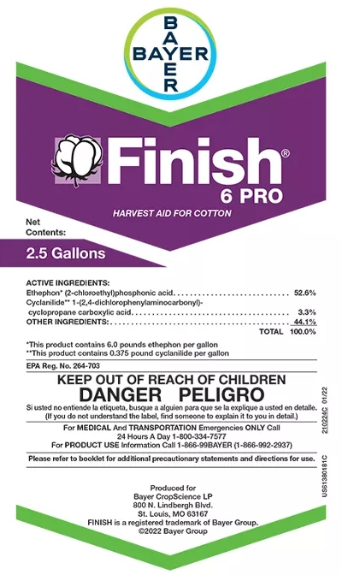
Finish 6 PRO Harvest Aid
Finish 6 PRO Harvest Aid is the only hormonal cotton defoliant and boll opener premix. Finish 6 PRO delivers superior boll opening while dropping green leaves and reducing terminal regrowth. It provides enhanced defoliation and opens bolls fast, so you can get your crop out of the field earlier, and accelerates defoliation and boll opening without the harsh side effects of desiccants.
Approved States: AL, AR, AZ, CA, FL, GA, KS, LA, MD, MO, MS, NC, NM, OK, SC, TN, TX, VA, WV
Key Benefits:
  Opens bolls fast without the harsh side effects of desiccants and PPO-type defoliants
  Faster opening reduces the amount of time lint is vulnerable to damage from wind and weather, preserving fiber quality and protecting profits
  Faster, more gentle opening reduces the risk of leaf grade and color discounts
Product Details: Liquid
Effective Against: N/A
Registered Crops: Cotton
https://www.cropscience.bayer.us/d/finish-6-pro-harvest-aid-for-cotton-plant-growth-regulator

Slide 9
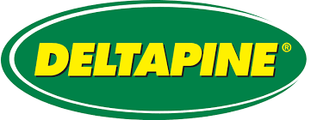
Deltapine 1829 B3XF
Early-Mid Bollgard 3 XtendFlex cotton variety with excellent fiber quality, Bacterial Blight resistance and excellent yield potential in West Texas
Maturity: Early-Mid
Region: West Texas
Strengths
  Widely adapted and excellent yield potential in West Texas
  Excellent fiber quality/staple length
  Bacterial blight resistant
  Very responsive to plant growth regulator management
Plant Height: Med-Tall
One of the most popular Deltapine varieties planted in 2020
https://www.cropscience.bayer.us/d/deltapine-dp-1820-b3xf-cotton
https://www.youtube.com/watch?v=eTAiSiUzbFQ

