Slide 1

Bell Ringers for the Agricultural Science Classroom
Animal Systems Career Focus Area

Slide 2
Animal Systems Career Focus Area
What kind of cheese is made backward?

Slide 3
Animal Systems Career Focus Area
Q: What kind of cheese is made backward?
A: Edam cheese (made spelled backward)

Slide 4
Animal Systems Career Focus Area
There are six eggs in the basket. Six people each take one of the eggs. How can it be that one egg is left in the basket?

Slide 5
Animal Systems Career Focus Area
Q: There are six eggs in the basket. Six people each take one of the eggs. How can it be that one egg is left in the basket?
A: The last person took the basket with the last egg still inside.

Slide 6
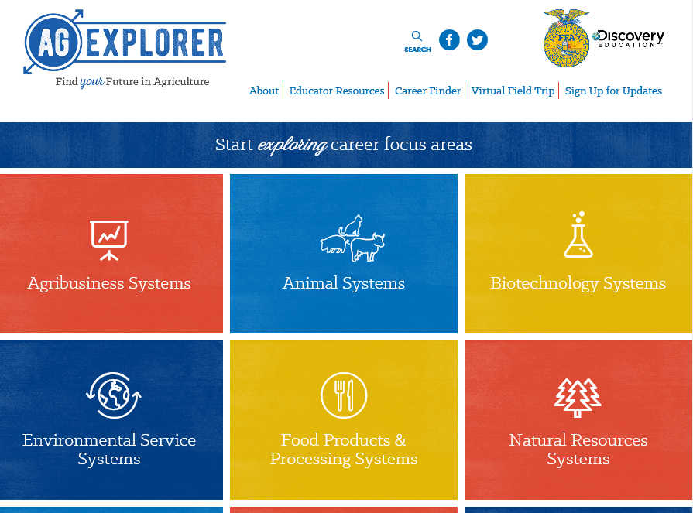
Animal Systems Career Focus Area
Go to AgExplorer.ffa.org and complete the Career Finder.

Slide 7
Animal Systems Career Focus Area
Video journaling: Watch this short video clip, reflect in writing and be ready to share responses with the class.
https://www.youtube.com/watch?v=sc4HxPxNrZ0

Slide 8
Animal Systems Career Focus Area
In which sport are the shoes made entirely of metal?

Slide 9
Animal Systems Career Focus Area
Q: In which sport are the shoes made entirely of metal?
A: Horse racing

Slide 10
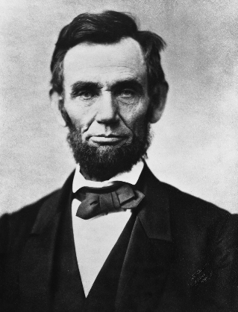
Animal Systems Career Focus Area
Which U.S. president (pictured below) was responsible for establishing the United States Department of Agriculture (USDA)?
a. Abraham Lincoln
b. Thomas Jefferson
c. Alexander Hamilton
d. Woodrow Wilson

Slide 11
Animal Systems Career Focus Area
Which U.S. president (pictured below) was responsible for establishing the United States Department of Agriculture (USDA)?
a. Abraham Lincoln
b. Thomas Jefferson
c. Alexander Hamilton
d. Woodrow Wilson

Slide 12
Animal Systems Career Focus Area
How many pounds of milk does a dairy cow, on average, produce in a day?
a. 100 lbs.
b. 105 lbs.
c. 175 lbs.
d. 200 lbs.

Slide 13
Animal Systems Career Focus Area
How many pounds of milk does a dairy cow, on average, produce in a day?
a. 100 lbs.
b. 105 lbs.
c. 175 lbs.
d. 200 lbs.

Slide 14
Animal Systems Career Focus Area
The farm value of 100lbs of milk (~12 gallons) is $18.90. How much of that price goes back to the farmer?
a. $5.07
b. $7.21
c. $12.10
d. $17.02

Slide 15
Animal Systems Career Focus Area
The farm value of 100lbs of milk (~12 gallons) is $18.90. How much of that price goes back to the farmer?
a. $5.07
b. $7.21
c. $12.10
d. $17.02

Slide 16
Animal Systems Career Focus Area
Develop a list of everyday items that are produced from animal and plant byproducts. You have two minutes.

Slide 17
Animal Systems Career Focus Area
Develop a list of everyday items that are produced from animal and plant byproducts. You have two minutes.
Examples include: Manufacturing: adhesives, lubricants, solvents
Construction: lumber, paint, brushes, tar paper, tool handles
Personal Care Items: shampoo, soap, cosmetics, lotions, toothpaste
Healthcare: pharmaceuticals, surgical sutures, X-ray film, latex gloves
Transportation: biofuels, lubricants, antifreeze, tires, upholstery
Sports: uniforms, baseball bats, leather equipment
Printing: ink, paper
Education: Crayons, textbooks, chalk, desks, pencils
Entertainment: strings for musical instruments

Slide 18
Animal Systems Career Focus Area
In what year was barbed wire invented and utilized for livestock?
a. 1791
b. 1802
c. 1837
d. 1867

Slide 19
Animal Systems Career Focus Area
In what year was barbed wire invented and utilized for livestock?
a. 1791
b. 1802
c. 1837
d. 1867

Slide 20
Animal Systems Career Focus Area
Unscramble the animal terminology:
ruarcigletu _____________________
frehie _____________________
osw _____________________
lubl _____________________
eestr _____________________
tigl _____________________
wrbaro _____________________
aobr _____________________
ocw _____________________
lionstal _____________________
dggleni _____________________
tclo _____________________
rame _____________________
lyfil _____________________
wrehte _____________________
mar _____________________
edo _____________________
ckbu _____________________
wee _____________________
mbal _____________________

Slide 21
Animal Systems Career Focus Area
A: Unscramble the animal terminology:
Agriculture
Heifer
Sow
Bull
Steer
Gilt
Barrow
Boar
Cow
Stallion
Gelding
Colt
Mare
Filly
Wether
Ram
Doe
Buck
Ewe
Lamb

Slide 22
Animal Systems Career Focus Area
Identify five colleges/universities that offer agriculture-related degrees.

Slide 23
Animal Systems Career Focus Area
Identify five colleges/universities that offer agriculture-related degrees.
Examples include: Purdue University, University of Illinois, Kansas State, Texas Tech, University of Maryland, etc.

Slide 24
Animal Systems Career Focus Area
What is the purpose and role of the United States Department of Agriculture (USDA)?

Slide 25
Animal Systems Career Focus Area
Q: What is the purpose and role of the United States Department of Agriculture (USDA)?
A: “To provide leadership on food, agriculture, natural resources, rural development, nutrition, and related issues based on public policy, the best available science, and effective management.”

Slide 26
Animal Systems Career Focus Area
A bear walks south for one kilometer, then it walks west for one kilometer, then it walks north for one kilometer and ends up at the same point from which it started. What color was the bear?

Slide 27
Animal Systems Career Focus Area
Q: A bear walks south for one kilometer, then it walks west for one kilometer, then it walks north for one kilometer and ends up at the same point from which it started. What color was the bear?
A: The bear was white because it was a polar bear. The only place on earth where a bear can go south, west and north equal distances and end up where it started is the North Pole.

Slide 28
Animal Systems Career Focus Area
The office manager at Catoctin Veterinary Clinic is ordering supplies for the clinic. She purchases a case of calf colostrum with 12 cartons for $135.00. How much would a customer pay per carton with a 45 percent markup?

Slide 29
Animal Systems Career Focus Area
The office manager at Catoctin Veterinary Clinic is ordering supplies for the clinic. She purchases a case of calf colostrum with 12 cartons for $135.00. How much would a customer pay per carton with a 45 percent markup?
$135.00/12 = $11.25
$11.25 x 0.45 = $5.06
$11.25 + $5.06 = $16.31 (final answer)

Slide 30
Animal Systems Career Focus Area
The office manager at Adobe Veterinary Clinic is ordering supplies for the clinic. He purchases a case of 12 slip-on leashes at $6.00 each. How much total profit on all leashes will the clinic make with a 50 percent mark-up?
a. $72.00
b. $108.00
c. $36.00
d. $3.00

Slide 31
Animal Systems Career Focus Area
The office manager at Adobe Veterinary Clinic is ordering supplies for the clinic. He purchases a case of 12 slip-on leashes at $6.00 each. How much total profit on all leashes will the clinic make with a 50 percent mark-up?
a. $72.00
b. $108.00
c. $36.00
d. $3.00
12 x $6.00 = $72.00
$72.00 x .50 = $36.00

Slide 32
Animal Systems Career Focus Area
He is trying to determine in which two hospitals he will continue working in 2018. Analyze the salaries to find who offers him the best two salaries.
a. A and B
b. A and D
c. B and C
d. B and D
Hospital | Hours | Salary
A | 68 | $1,938
B | 45 | $1,080
C | 72 | $1,872
D | 56 | $1,624

Slide 33
Animal Systems Career Focus Area
He is trying to determine in which two hospitals he will continue working in 2018. Analyze the salaries to find who offers him the best two salaries.
a. A and B
b. A and D
c. B and C
d. B and D
Hospital | Hours | Salary
A | 68 | $1,938
B | 45 | $1,080
C | 72 | $1,872
D | 56 | $1,624

Slide 34
Animal Systems Career Focus Area
Approximately how long does it take a hen to produce one egg?
a. 3 to 5 hours
b. 6 to 10 hours
c. 11 to 14 hours
d. 15 to 21 hours
e. 24 to 46 hours

Slide 35
Animal Systems Career Focus Area
Approximately how long does it take a hen to produce one egg?
a. 3 to 5 hours
b. 6 to 10 hours
c. 11 to 14 hours
d. 15 to 21 hours
e. 24 to 46 hours

Slide 36
Animal Systems Career Focus Area
On average, how many eggs does an average hen lay in a year?
a. 100 to 125
b. 200 to 225
c. 300 to 325
d. 400 to 425

Slide 37
Animal Systems Career Focus Area
On average, how many eggs does an average hen lay in a year?
a. 100 to 125
b. 200 to 225
c. 300 to 325
d. 400 to 425

Slide 38
Animal Systems Career Focus Area
True or False
There are antibiotics in meat, milk and eggs. Using one to two sentences, explain your reasoning.

Slide 39
Animal Systems Career Focus Area
True or False
There are antibiotics in meat, milk and eggs. Using one to two sentences, explain your reasoning.

Slide 40
Animal Systems Career Focus Area
What term is given to chickens raised for meat production?
a. Hens
b. Broilers
c. Rooster
d. Turkey

Slide 41
Animal Systems Career Focus Area
What term is given to chickens raised for meat production?
a. Hens
b. Broilers
c. Rooster
d. Turkey

Slide 42
Animal Systems Career Focus Area
What career area is the largest employer in the world?
a. Medicine
b. Manufacturing
c. Education
d. Agriculture

Slide 43
Animal Systems Career Focus Area
What career area is the largest employer in the world?
a. Medicine
b. Manufacturing
c. Education
d. Agriculture

Slide 44
Animal Systems Career Focus Area
What country consumes more eggs per capita each year?
a. Mexico
b. USA
c. France
d. Portugal
e. India

Slide 45
Animal Systems Career Focus Area
What country consumes more eggs per capita each year?
a. Mexico
b. USA
c. France
d. Portugal
e. India

Slide 46
Animal Systems Career Focus Area
According to the U.S. Pet Ownership & Demographics Sourcebook by the American Veterinary Medical Association (AVMA), what state has the highest percentage of households that have owned a dog?
a. Arkansas
b. New Mexico
c. Kentucky
d. Missouri
e. West Virginia

Slide 47
Animal Systems Career Focus Area
According to the U.S. Pet Ownership & Demographics Sourcebook by the American Veterinary Medical Association (AVMA), what state has the highest percentage of households that have owned a dog?
a. Arkansas
b. New Mexico
c. Kentucky
d. Missouri
e. West Virginia

Slide 48
Animal Systems Career Focus Area
How much protein does one eight-ounce glass of milk contain?
a. 2 grams
b. 4 grams
c. 6 grams
d. 8 grams
e. 10 grams

Slide 49
Animal Systems Career Focus Area
How much protein does one eight-ounce glass of milk contain?
a. 2 grams
b. 4 grams
c. 6 grams
d. 8 grams
e. 10 grams

Slide 50
Animal Systems Career Focus Area
Hunger in America is a large concern. Approximately how many people in America are affected by hunger?
a. 18 million
b. 28 million
c. 38 million
d. 48 million
e. 58 million

Slide 51
Animal Systems Career Focus Area
Hunger in America is a large concern. Approximately how many people in America are affected by hunger?
a. 18 million
b. 28 million
c. 38 million
d. 48 million
e. 58 million

Slide 52
Animal Systems Career Focus Area
When is National Pizza Day?
a. January 10
b. February 9
c. April 21
d. May 6

Slide 53
Animal Systems Career Focus Area
When is National Pizza Day?
a. January 10
b. February 9
c. April 21
d. May 6

Slide 54
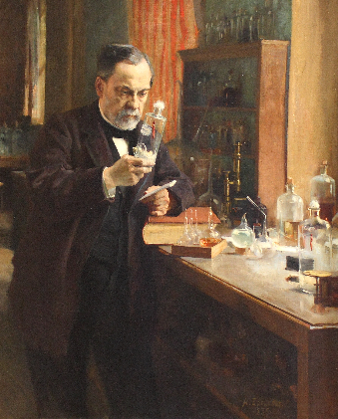
Animal Systems Career Focus Area
What well-known scientist (pictured below) discovered that when you heat liquids to high temperatures you can kill bacteria? HINT: This led to the process of pasteurization.
a. Marie Curie
b. Albert Einstein
c. Fanny Farmer
d. Louis Pasteur

Slide 55
Animal Systems Career Focus Area
What well-known scientist (pictured below) discovered that when you heat liquids to high temperatures you can kill bacteria? HINT: This led to the process of pasteurization.
a. Marie Curie
b. Albert Einstein
c. Fanny Farmer
d. Louis Pasteur

Slide 56
Animal Systems Career Focus Area
How do dogs get heartworm?
a. Bites
b. Scratches
c. Mosquitos
d. Ticks

Slide 57
Animal Systems Career Focus Area
How do dogs get heartworm?
a. Bites
b. Scratches
c. Mosquitos
d. Ticks

Slide 58
Animal Systems Career Focus Area
A house has four walls. All the walls are facing south, and a bear is circling the house. What color is the bear?

Slide 59
Animal Systems Career Focus Area
Q: A house has four walls. All the walls are facing south, and a bear is circling the house. What color is the bear?
A: The bear is white because the house is on the North Pole

Slide 60
Animal Systems Career Focus Area
Which weighs more, a pound of feathers or a pound of bricks?

Slide 61
Animal Systems Career Focus Area
Q: Which weighs more, a pound of feathers or a pound of bricks?
A: Neither, they both weigh one pound.

Slide 62
Animal Systems Career Focus Area
A cowboy rides into town on Friday, stays for three days and then leaves on Friday. How did he do it?

Slide 63
Animal Systems Career Focus Area
Q: A cowboy rides into town on Friday, stays for three days and then leaves on Friday. How did he do it?
A: Friday is the name of the horse.

Slide 64
Animal Systems Career Focus Area
My name is Rugar. I live on a farm. There are four other dogs on the farm with me. Their names are Snowy, Flash, Speedy and Brownie. What do you think the fifth dog’s name is?

Slide 65
Animal Systems Career Focus Area
Q: My name is Rugar. I live on a farm. There are four other dogs on the farm with me. Their names are Snowy, Flash, Speedy and Brownie. What do you think the fifth dog’s name is?
A: Rugar

Slide 66
Animal Systems Career Focus Area
How do dog catchers get paid?

Slide 67
Animal Systems Career Focus Area
Q: How do dog catchers get paid?
A: By the pound

Slide 68
Animal Systems Career Focus Area
What has to be broken before you can use it?

Slide 69
Animal Systems Career Focus Area
Q: What has to be broken before you can use it?
A: An egg

Slide 70
Animal Systems Career Focus Area
Draw a picture of what the word agriculture means to you. You have five minutes to complete the drawing.

Slide 71
Animal Systems Career Focus Area
An animal with a diet of plants only is called a(n) __.
a. Herbivore
b. Predator
c. Carnivore
d. Omnivore

Slide 72
Animal Systems Career Focus Area
An animal with a diet of plants only is called a(n) __.
a. Herbivore
b. Predator
c. Carnivore
d. Omnivore

Slide 73
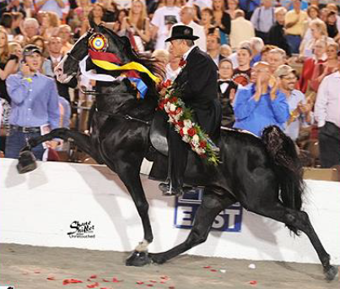
Animal Systems Career Focus Area
What breed of horse is this?
a. Morgan
b. American Saddlebred
c. Arabian
d. Tennessee Walking Horse

Slide 74
Animal Systems Career Focus Area
What breed of horse is this?
a. Morgan
b. American Saddlebred
c. Arabian
d. Tennessee Walking Horse

Slide 75
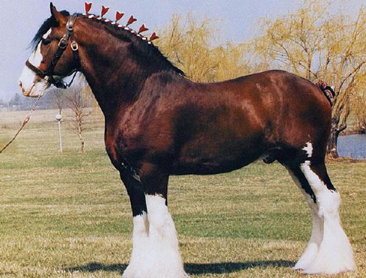
Animal Systems Career Focus Area
What breed of horse is this?
a. Clydesdale
b. Paint
c. Arabian
d. Morgan

Slide 76
Animal Systems Career Focus Area
What breed of horse is this?
a. Clydesdale
b. Paint
c. Arabian
d. Morgan

Slide 77
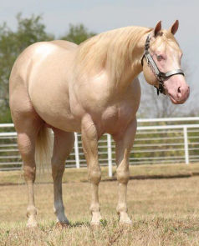
Animal Systems Career Focus Area
What is the coat color seen here?
a. Bay roan
b. Blue roan
c. Cremello
d. Dun

Slide 78
Animal Systems Career Focus Area
What is the coat color seen here?
a. Bay roan
b. Blue roan
c. Cremello
d. Dun

Slide 79
Animal Systems Career Focus Area
What animal system is responsible for producing hormones?
a. Lymphatic system
b. Endocrine system
c. Nervous system
d. Circulatory system

Slide 80
Animal Systems Career Focus Area
What animal system is responsible for producing hormones?
a. Lymphatic system
b. Endocrine system
c. Nervous system
d. Circulatory system

Slide 81
Animal Systems Career Focus Area
Boar goats originated in _____.
a. South Africa
b. South America
c. Kenya
d. Liberya

Slide 82
Animal Systems Career Focus Area
Boar goats originated in _____.
a. South Africa
b. South America
c. Kenya
d. Liberya

Slide 83
Animal Systems Career Focus Area
Chronic wasting disease in deer, ____ in sheep and Creutzfeldt-Jakob diseases are all similar to mad cow disease.
a. Enteritis
b. Scrapie
c. Spider-Lamb Syndrome
d. Trichomonias

Slide 84
Animal Systems Career Focus Area
Chronic wasting disease in deer, ____ in sheep and Creutzfeldt-Jakob diseases are all similar to mad cow disease.
a. Enteritis
b. Scrapie
c. Spider-Lamb Syndrome
d. Trichomonias

Slide 85
Animal Systems Career Focus Area
Most dairy cows are milked two to three times per day. On average, a cow will produce ___ gallons of milk each day.
a. 1 to 2
b. 8 to 9
c. 15 to 16
d. 20 to 21

Slide 86
Animal Systems Career Focus Area
Most dairy cows are milked two to three times per day. On average, a cow will produce ___ gallons of milk each day.
a. 1 to 2
b. 8 to 9
c. 15 to 16
d. 20 to 21

Slide 87
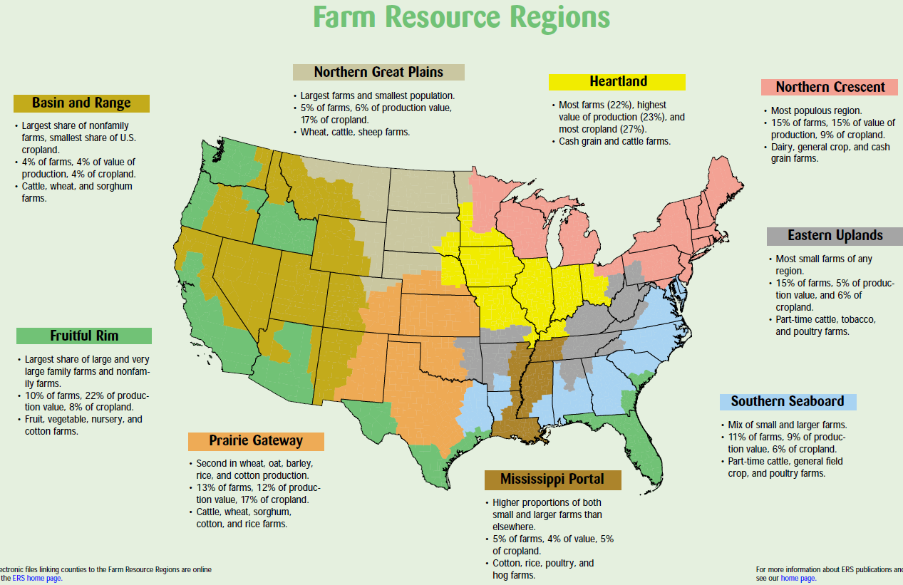
Animal Systems Career Focus Area
What region do we live in, and what are some of our greatest commodities according to the map from the USDA?

Slide 88
Animal Systems Career Focus Area
Utilizing the State Agricultural Facts map (https://www.agclassroom.org/teacher/ag_facts.cfm), identify and write down five interesting facts that you did not know about your state.

Slide 89

Animal Systems Career Focus Area
Write a tweet about how agriculture impacted you this weekend.

Slide 90
Animal Systems Career Focus Area
Watch this video: https://youtu.be/g7FuDeOpSUY.
1.What role does Zoetis play in the animal industry?
2.Why does Zoetis care so much?

Slide 91
Animal Systems Career Focus Area
Watch this video: https://youtu.be/0PU6BkSMUoA.
1.What careers exist in agriculture that are not production based?
2.What role do America’s farmers play in our economy?

Slide 92
Animal Systems Career Focus Area
Watch this video: https://youtu.be/B_WSLbw3ApA.
1.What benefits are there to being employed in agriculture? Identify three.

Slide 93
Animal Systems Career Focus Area
Watch this video: https://youtu.be/FxMHl5Gr2Yg.
1. What are scientists doing to help feed a growing population?

Slide 94
Animal Systems Career Focus Area
Current Event: Compassion fatigue, coupled with mental and emotional issues, in veterinary medicine is starting to define the profession. While practicing veterinary medicine brings joy to many in the field, there is a heavy emotional load on veterinary professionals. Share your thoughts, in three to five sentences, about why compassion fatigue is prevalent in veterinary medicine and how veterinary professionals can combat the issue.

Slide 95
Animal Systems Career Focus Area
Current Event: Obesity has rapidly become an epidemic for our pets. New research shows that 25 to 40 percent of dogs and cats who visit a veterinary clinic are overweight or obese. In addition, the incidence of overweight or obese pets appears to be on the rise. Acting as a vet technician, write a brief (three to five sentences) client education sheet on how you would explain the risks of an obese pet to a pet owner.

Slide 96
Animal Systems Career Focus Area
The main “greenhouse gases” (GHGs) associated with animal production are
a. Carbon monoxide, methane and nitrous oxide.
b. Carbon dioxide and ammonia.
c. Carbon dioxide, methane and nitrous oxide.
d. None of the gases listed above are major contributors to the “carbon footprint” of the food animal industry.

Slide 97
Animal Systems Career Focus Area
The main “greenhouse gases” (GHGs) associated with animal production are
a. Carbon monoxide, methane and nitrous oxide.
b. Carbon dioxide and ammonia.
c. Carbon dioxide, methane and nitrous oxide.
d. None of the gases listed above are major contributors to the “carbon footprint” of the food animal industry.

Slide 98
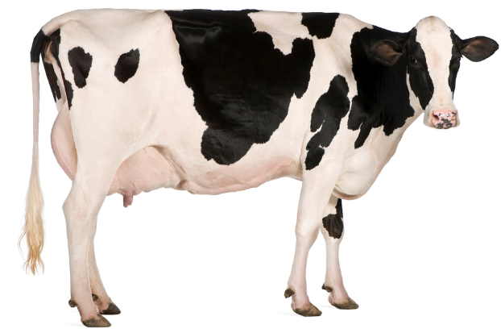
Animal Systems Career Focus Area
Which breed of dairy cattle is known for its high fluid milk production?
a. Brown Swiss
b. Milking Shorthorn
c. Jersey
d. Holstein

Slide 99
Animal Systems Career Focus Area
Which breed of dairy cattle is known for its high fluid milk production?
a. Brown Swiss
b. Milking Shorthorn
c. Jersey
d. Holstein

Slide 100
Animal Systems Career Focus Area
What relationship exists between science and agriculture? Give two examples to illustrate your response.

Slide 101
Animal Systems Career Focus Area
What is the purpose of a literature review in agriscience research?

Slide 102
Animal Systems Career Focus Area
Q: What is the purpose of a literature review in agriscience research?
A: To support and show previously completed research that directly relates to your research

Slide 103
Animal Systems Career Focus Area
What is the purpose of the materials and methods section in an agriscience report/research study?

Slide 104
Animal Systems Career Focus Area
Q: What is the purpose of the materials and methods section in an agriscience report/research study?
A: To give readers a clear understanding of the process and materials required to complete the research. Materials and methods also allow the reader to know how to replicate the study.

Slide 105
Animal Systems Career Focus Area
What is a hypothesis? Why is a hypothesis created when completing agricultural research?

Slide 106
Animal Systems Career Focus Area
Q: What is a hypothesis? Why is a hypothesis created when completing agricultural research?
A: A hypothesis is a brief statement of the anticipated results from a study being conducted. The hypothesis will be revisited in the results and conclusions section of the study write-up.

Slide 107
Animal Systems Career Focus Area
What is the role/purpose of an abstract when writing an agriscience research study?

Slide 108
Animal Systems Career Focus Area
Q: What is the role/purpose of an abstract when writing an agriscience research study?
A: The abstract is a brief summary of the purpose of the study, background information of the topic being studied, the materials/methods, the results and conclusions.

Slide 109
Animal Systems Career Focus Area
Head to the USDA website at https://www.fsis.usda.gov/wps/portal/informational/aboutfsis/state-fact-sheets.
Find your state and pull up the fact sheet.
1. What is the role of FSIS?
2. How many FSIS employees are in your state?
3. What agricultural commodity does your state excel in?

Slide 110
Animal Systems Career Focus Area
What is the role of the Center for Disease Control in our food supply?

Slide 111
Animal Systems Career Focus Area
Q: What is the role of the Center for Disease Control in our food supply?
A: “They work with state and local health departments and other federal agencies to investigate foodborne outbreaks.”

Slide 112
Animal Systems Career Focus Area
What is a zoonotic disease?
a. A disease found in a zoo.
b. A disease that zoo animals pass back and forth.
c. A disease that affects only humans.
d. A disease that can be passed from animals to
humans.

Slide 113
Animal Systems Career Focus Area
What is a zoonotic disease?
a. A disease found in a zoo.
b. A disease that zoo animals pass back and forth.
c. A disease that affects only humans.
d. A disease that can be passed from animals
humans.

Slide 114
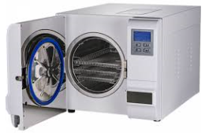
Animal Systems Career Focus Area
1.Which tool is pictured here?
a. Autoclave
b. Pressure cooker
c. Opthalmascope
d. Ambu-bag
2.What is the purpose of this tool?

Slide 115
Animal Systems Career Focus Area
1.Which tool is pictured here?
a. Autoclave
b. Pressure cooker
c. Opthalmascope
d. Ambu-bag
2.What is the purpose of this tool?
-An autoclave is utilized to sterilize materials (i.e. equipment).

Slide 116
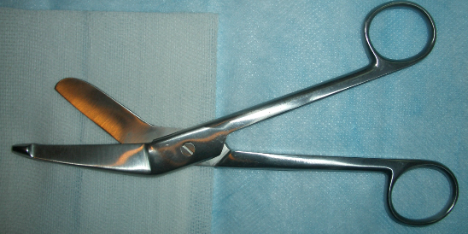
Animal Systems Career Focus Area
Which tool is pictured?
a. Scissors – Lister bandage
b. Scissors – Bandage
c. Scissors – Mayo dissecting
d. Scissors – Suture wire cutting

Slide 117
Animal Systems Career Focus Area
Which tool is pictured?
a. Scissors – Lister bandage
b. Scissors – Bandage
c. Scissors – Mayo dissecting
d. Scissors – Suture wire cutting

Slide 118
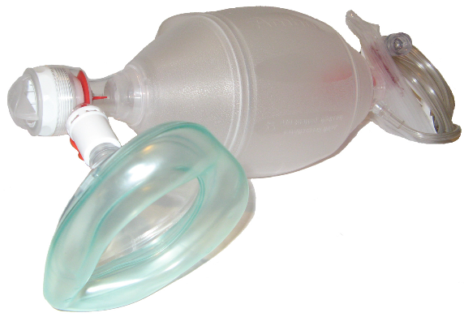
Animal Systems Career Focus Area
1.Which tool is pictured here?
a. Hoof knife
b. Elizabethan collar
c. Centrifuge
d. Ambu-bag
2.What is the purpose/role of this tool?

Slide 119
Animal Systems Career Focus Area
1.Which tool is pictured here?
a. Hoof knife
b. Elizabethan collar
c. Centrifuge
d. Ambu-bag
2.What is the purpose/role of this tool?
-An Ambu-bag is used to deliver oxygen to the lungs of an animal.

Slide 120
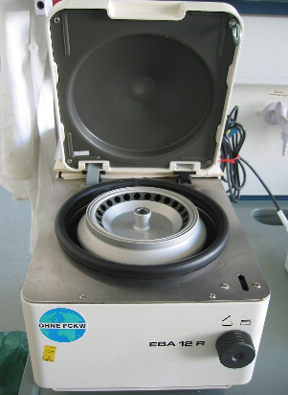
Animal Systems Career Focus Area
1.Which tool is pictured here?
a. Hoof knife
b. Elizabethan collar
c. Centrifuge
d. Ambu-bag
2.What is the purpose of this tool?

Slide 121
Animal Systems Career Focus Area
1.Which tool is pictured here?
a. Hoof knife
b. Elizabethan collar
c. Centrifuge
d. Ambu-bag
2.What is the purpose of this tool?
-The purpose of a centrifuge is to spin liquids to cause separation.

Slide 122
Animal Systems Career Focus Area
Find an impactful member of the agricultural community from history. Create a tweet about the impact that person had on the agriculture industry.

Slide 123
Animal Systems Career Focus Area
Read the article “Woman’s eye hosts more than a dozen cattle eyeworms,” https://www.sciencenewsforstudents.org/article/womans-eye-hosts-more-dozen-cattle-eyeworms.
Assume the role of a health professional. What types of precautions would you inform other patients to take regarding this nematode? (prevention, causes, etc.)

Slide 124
Animal Systems Career Focus Area
Read the article “Cool Jobs: Linking animal health to human health,” https://www.sciencenewsforstudents.org/article/cool-jobs-linking-animal-health-human-health.
Identify five careers you could potentially have in relation to what is discussed in the article.

Slide 125
Animal Systems Career Focus Area
Read the article “Fish get pooped living in polluted water,” https://www.sciencenewsforstudents.org/article/fish-get-pooped-living-polluted-water.
Create a numbered lab procedure to outline the research study that was performed in this article.
2. What implications will this research have for the future of our natural resources systems?

Slide 126
Animal Systems Career Focus Area
Rank ten dog breeds from best to worst. Explain why you ranked them as you did.

Slide 127
Animal Systems Career Focus Area
Write a two-minute elevator speech about what agriculture is/means. This elevator speech should be written for a student at the elementary level that has never taken an agriculture class.

Slide 128
Animal Systems Career Focus Area
Read the following farm-to-plate story of the American dairy supply: https://dairygood.org/content/2017/milks-food-safety-story.
Create an illustrated flow chart depicting the farm-to-plate process for dairy products.

Slide 129
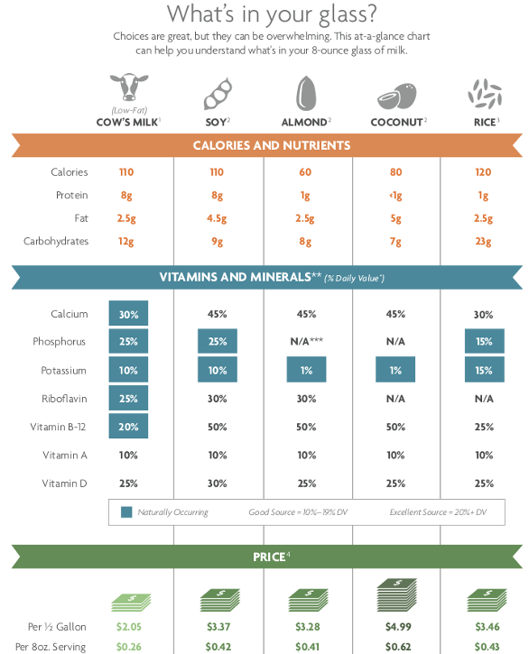
Animal Systems Career Focus Area
You and a friend are at lunch when you open a bottle of chilled milk. Your friend is consuming chilled almond milk. Which drink is a healthier choice? Why?

Slide 130
Animal Systems Career Focus Area
Should we, as consumers, be concerned about the hormones found in milk? Read the following article from the National Dairy Council/Dairy Good to find out!
https://dairygood.org/content/2018/should-i-be-concerned-about-hormones-in-milk
Create a Facebook post that answers the question (Should we, as consumers, be concerned about the hormones found in milk?).

Slide 131
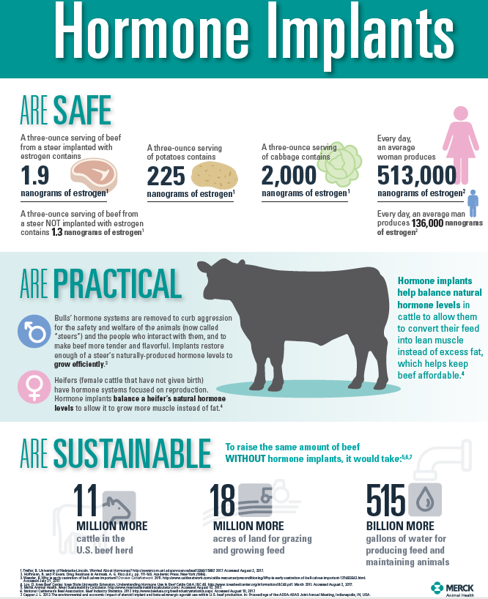
Animal Systems Career Focus Area
Utilizing the infographic, compare and contrast the pros and cons of using hormone implants in beef animals.

Slide 132
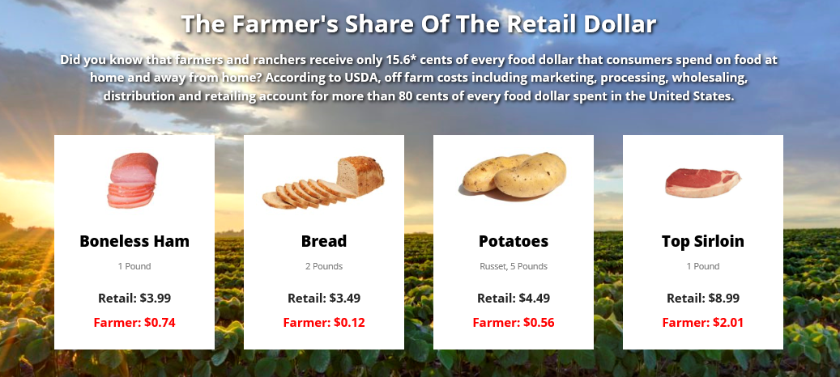
Animal Systems Career Focus Area
Where does the money go when you purchase a food product at the store?

Slide 133
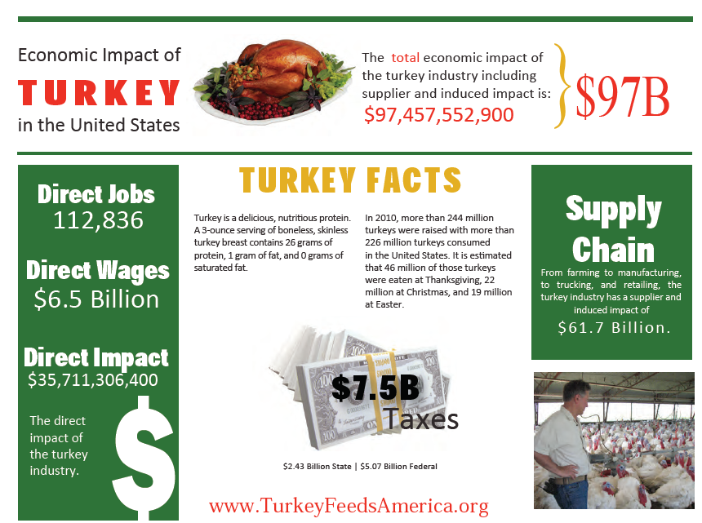
Animal Systems Career Focus Area
1. What impact does turkey production have in the U.S.?
2. How has turkey production impacted you?

Slide 134
Animal Systems Career Focus Area
Watch this video: https://youtu.be/O5EEGNK-q7g.
1. Create a flow chart to describe the production process of a broiler chicken.

Slide 135
Animal Systems Career Focus Area
Watch this video: https://www.chickencheck.in/chicken-guarantees/.
Using three to five sentences, describe the broiler chicken production process to someone who feels broiler chickens are produced inhumanely and inefficiently in crowded or caged conditions.

Slide 136
Animal Systems Career Focus Area
As of 2017, which of the following states is number one in beef cattle production?
a. Colorado
b. Kansas
c. Texas
d. Nebraska

Slide 137
Animal Systems Career Focus Area
As of 2017, which of the following states is number one in beef cattle production?
a. Colorado
b. Kansas
c. Texas
d. Nebraska

Slide 138
Animal Systems Career Focus Area
Approximately how long does it take beef to go from farm to fork?
a. 1 to 2 years
b. 2 to 3 years
c. 3 to 4 years
d. 4 to 5 years

Slide 139
Animal Systems Career Focus Area
Approximately how long does it take beef to go from farm to fork?
a. 1 to 2 years
b. 2 to 3 years
c. 3 to 4 years
d. 4 to 5 years

Slide 140
Animal Systems Career Focus Area
Watch this video: https://youtu.be/_FKJ5EKgmhU.
Using three to five sentences, reflect on how antibiotics are selected, administered and regulated in the animal industry.

Slide 141
Animal Systems Career Focus Area
Select one of the common myths from the animal production industry. Using two to three sentences, write a script to discuss this myth with a friend.
https://www.meatinstitute.org/index.php?ht=a/GetDocumentAction/i/115211

Slide 142
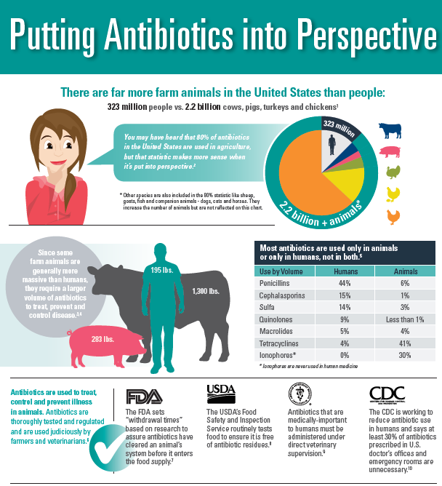
Animal Systems Career Focus Area
The general public has a negative view about the use of antibiotics in animal agriculture. Using the “Putting Antibiotics into Perspective” infographic, develop a one-minute elevator speech to share the truth about antibiotic usage in animals.

Slide 143
Animal Systems Career Focus Area
Using the Coalition for Safe Affordable Food state activity website (http://coalitionforsafeaffordablefood.org/state-action-center/), create a tweet that highlights a current event in your state.

Slide 144
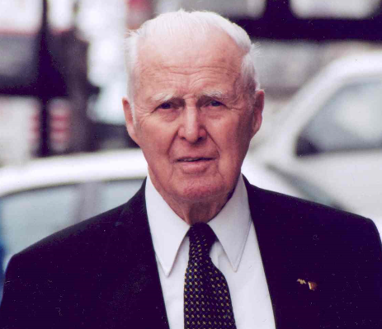
Animal Systems Career Focus Area
This scientist not only was awarded the Nobel Peace Prize for his work in addressing hunger globally, but he also developed the World Food Prize to recognize those individuals making an impact in the world of agriculture.
a. George Washington Carver
b. John Deere
c. Phillip Nelson
d. Dr. Norman Borlaug

Slide 145
Animal Systems Career Focus Area
This scientist not only was awarded the Nobel Peace Prize for his work in addressing hunger globally, but he also developed the World Food Prize to recognize those individuals making an impact in the world of agriculture.
a. George Washington Carver
b. John Deere
c. Phillip Nelson
d. Dr. Norman Borlaug

Slide 146
Animal Systems Career Focus Area
Using the World Food Prize Laureates page, find a laureate of interest to you and write a two- to three-sentence blog post about their accomplishments and agricultural impact.
https://www.worldfoodprize.org/index.cfm?nodeID=90971&audienceID=1

Slide 147
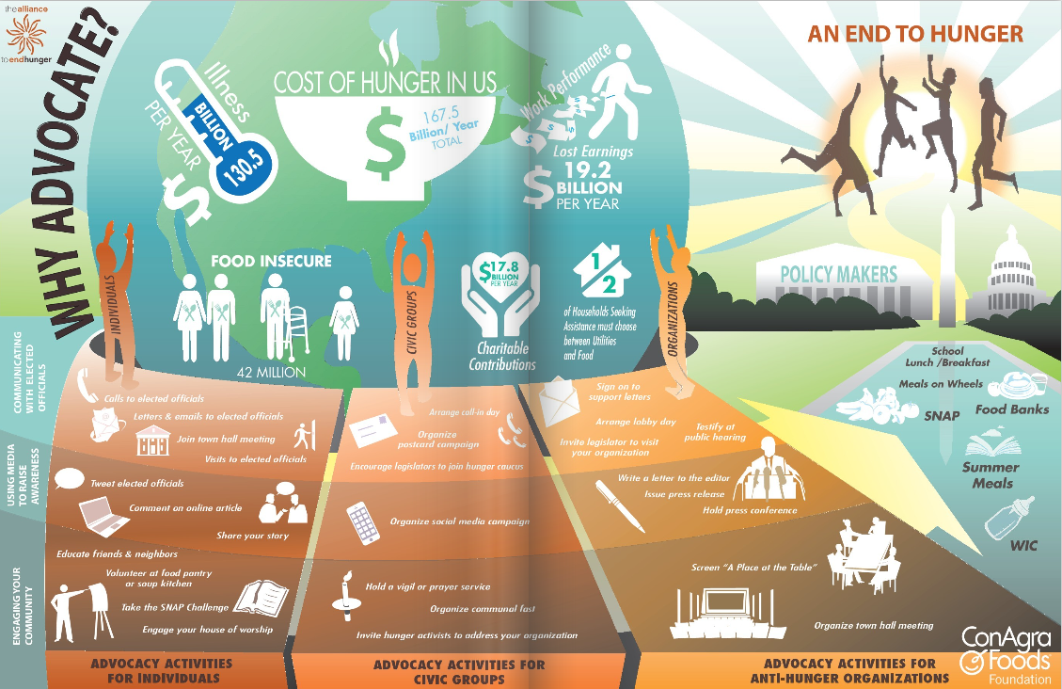
Animal Systems Career Focus Area
Using two to three sentences, explain why and how you should advocate for hunger.

Slide 148
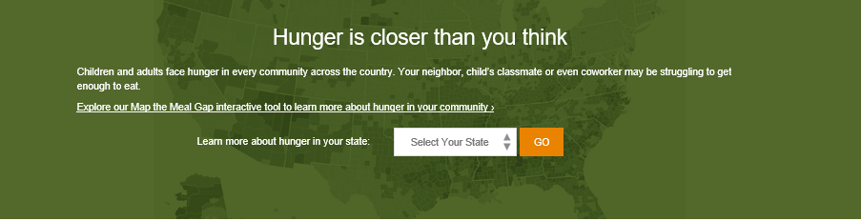
Animal Systems Career Focus Area
Go to the Feeding America “Hunger Is Closer than You Think” webpage (http://www.feedingamerica.org/hunger-in-america/) and select your state. Draw a picture that accurately represents what your state looks like regarding hunger.

Slide 149
Animal Systems Career Focus Area
Which of the following livestock species consumes the least amount of corn each year?
a. Poultry
b. Beef
c. Pork
d. Dairy

Slide 150
Animal Systems Career Focus Area
Which of the following livestock species consumes the least amount of corn each year?
a. Poultry
b. Beef
c. Pork
d. Dairy

Slide 151
Animal Systems Career Focus Area
Using the website https://www.ffanewhorizons.org/category/ag-101/career-pathways/, select an agricultural career pathway and describe five skills necessary to be successful in that area of agriculture.

Slide 152
Animal Systems Career Focus Area
Select a career focus area of interest to you (use AgExplorer.ffa.org) and create a tweet about that focus area.

Slide 153
Animal Systems Career Focus Area
How do we know that young dairy calves are healthy? Why are they separated? Watch the video to find out and then journal a response.
https://youtu.be/BLCo7pKQsxM

Slide 154
Animal Systems Career Focus Area
Identify four ways animals are kept safe during cold winters. Why is this so important?
https://youtu.be/dLzGHn-An2c

Slide 155
Animal Systems Career Focus Area
What are the pros and cons of being a small animal veterinarian?
https://youtu.be/8VVOowRAUAM

Slide 156
Animal Systems Career Focus Area
How do we know if a horse is experiencing movement issues? Give two examples.
https://youtu.be/zLilgxrSLYo

Slide 157
Animal Systems Career Focus Area
What must be done in swine operations to ensure swine herd health? Give three examples.
https://youtu.be/oKmRd6-cniI

Slide 158
Animal Systems Career Focus Area
What can humans do to handle cattle humanely, safely and calmly? Give three examples.
https://youtu.be/JawE6CLKHhc

Slide 159
Animal Systems Career Focus Area
Watch the video available at https://youtu.be/xhtQf22GzJs and answer the following questions:
1. What is artificial insemination?
2. Why do farmers utilize artificial insemination?

Slide 160
Animal Systems Career Focus Area
Watch the video available at https://youtu.be/fhnaoXacB8U and answer the following questions:
1. What behavioral characteristics indicate a cow is
about to have a calf?
2. What is the gestation for a cow?
3. Why do farmers and/or vets like to be around when
a new animal is born?

Slide 161
Animal Systems Career Focus Area
Watch the video available at https://youtu.be/R3FvgnSItWc
and identify five careers that can be found within the animal science industry.

Slide 162
Animal Systems Career Focus Area
Watch the video available at https://youtu.be/MmCCrV1RI9Y and respond to the following questions:
1. What is a wildlife biologist?
2. What personality characteristics do you need to have
to be successful in an animal biology career?
Identify three characteristics.

Slide 163
Animal Systems Career Focus Area
Compare and contrast animal welfare and animal rights.

Slide 164
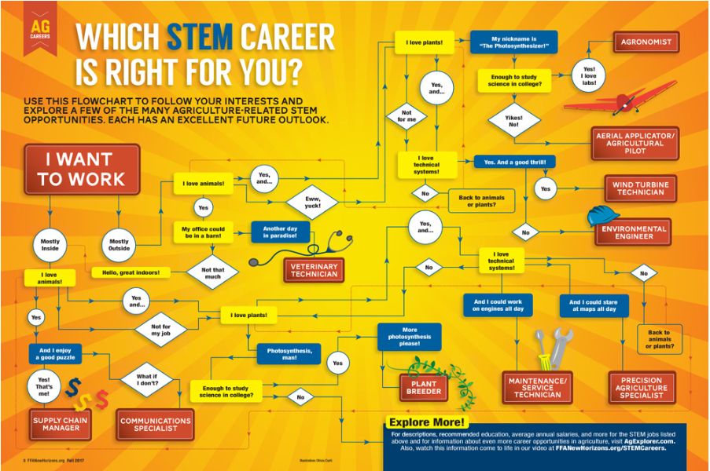
Animal Systems Career Focus Area
1. Use the infographic to determine what STEM career is right for you.
2. Why do you think you ended up at this career? (Think about your personality and skills as you answer this question.)
(Image can be found at https://www.ffanewhorizons.org/2017/08/28/which-stem-career-is-right-for-you/.)

