Slide 1

Bell Ringers for the Agricultural Science Classroom
Agribusiness Systems Career Focus Area

Slide 2
Agribusiness Systems Career Focus Area
A farmer and his hired help were carrying grain to the barn. The farmer carried one sack of grain and the hired help carried two sacks. Who carried the heavier load and why?

Slide 3
Agribusiness Systems Career Focus Area
Q: A farmer and his hired help were carrying grain to the barn. The farmer carried one sack of grain and the hired help carried two sacks. Who carried the heavier load and why?
A: The farmer. His hired help only carried two sacks while the farmer carried one sack filled with grain.

Slide 4
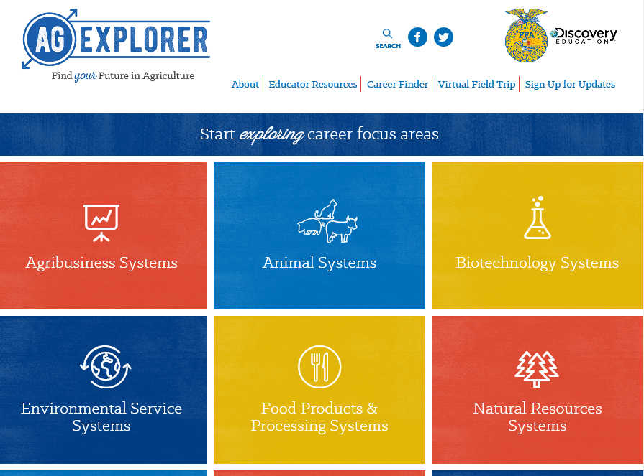
Agribusiness Systems Career Focus Area
Go to AgExplorer.ffa.org and complete the Career Finder.

Slide 5
Agribusiness Systems Career Focus Area
Video journaling: Watch this short video clip and reflect in writing. Be ready to share your responses with the class.
7 Billion — National Geographic: https://www.youtube.com/watch?v=sc4HxPxNrZ0

Slide 6
Agribusiness Systems Career Focus Area
How many people does one U.S. farm feed?
a. 56 people
b. 165 people
c. 202 people
d. 233 people

Slide 7
Agribusiness Systems Career Focus Area
How many people does one U.S. farm feed?
a. 56 people
b. 165 people
c. 202 people
d. 233 people

Slide 8
Agribusiness Systems Career Focus Area
Which state has the most farms?
a. Missouri
b. Iowa
c. Oklahoma
d. Texas

Slide 9
Agribusiness Systems Career Focus Area
Which state has the most farms?
a. Missouri
b. Iowa
c. Oklahoma
d. Texas

Slide 10
Agribusiness Systems Career Focus Area
True or False
The majority of farms in the U.S. are owned by corporations. Explain your answer in one to two sentences.

Slide 11
Agribusiness Systems Career Focus Area
True or False
The majority of farms in the U.S. are owned by corporations. Explain your answer in one to two sentences.

Slide 12
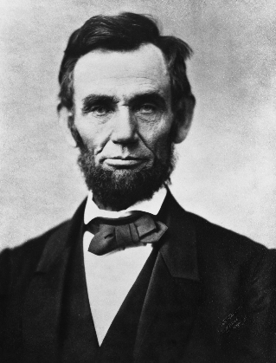
Agribusiness Systems Career Focus Area
Which U.S. president (pictured below) was responsible for establishing the United States Department of Agriculture (USDA)?
a. Abraham Lincoln
b. Thomas Jefferson
c. Alexander Hamilton
d. Woodrow Wilson

Slide 13
Agribusiness Systems Career Focus Area
Which U.S. president (pictured below) was responsible for establishing the United States Department of Agriculture (USDA)?
a. Abraham Lincoln
b. Thomas Jefferson
c. Alexander Hamilton
d. Woodrow Wilson

Slide 14
Agribusiness Systems Career Focus Area
The farm value of 100 pounds of milk (~12 gallons) is $18.90. How much of that price goes back to the farmer?
a. $5.07
b. $7.21
c. $12.10
d. $17.02

Slide 15
Agribusiness Systems Career Focus Area
The farm value of 100 pounds of milk (~12 gallons) is $18.90. How much of that price goes back to the farmer?
a. $5.07
b. $7.21
c. $12.10
d. $17.02

Slide 16
Agribusiness Systems Career Focus Area
Identify five careers you could have in the Agribusiness Systems Career Focus Area.
(HINT: You can use AgExplorer to help find the answer.)

Slide 17
Agribusiness Systems Career Focus Area
Identify five careers you could have in the Agribusiness Systems Career Focus Area.
Examples: Accountant, communications specialist, grain elevator manager, event manager, etc.

Slide 18
Agribusiness Systems Career Focus Area
Identify five colleges/universities that offer agriculture-related degrees.

Slide 19
Agribusiness Systems Career Focus Area
Identify five colleges/universities that offer agriculture-related degrees.

Slide 20
Agribusiness Systems Career Focus Area
Identify five colleges/universities that offer agriculture-related degrees.
Examples: Purdue University, University of Illinois, Kansas State, Texas Tech, University of Maryland, etc.

Slide 21
Agribusiness Systems Career Focus Area
What career area is the largest employer in the world?
a. Medicine
b. Manufacturing
c. Education
d. Agriculture

Slide 22
Agribusiness Systems Career Focus Area
What career area is the largest employer in the world?
a. Medicine
b. Manufacturing
c. Education
d. Agriculture

Slide 23
Agribusiness Systems Career Focus Area
Draw a picture of what the word agriculture means to you. You have five minutes to complete the drawing.

Slide 24
Agribusiness Systems Career Focus Area
When Olaf purchased a farm in 2016, he decided to refinance the existing farm mortgage. The accrued interest from the existing mortgage was added to the new mortgage. The last payment on the existing mortgage was made on March 31, 2016. Interest on the mortgage accrues at the rate of $88.28 per day. What was the amount of accrued interest added to the new mortgage on November 1, 2016? Calculate to the nearest cent.

Slide 25
Agribusiness Systems Career Focus Area
Q: When Olaf purchased a farm in 2016, he decided to refinance the existing farm mortgage. The accrued interest from the existing mortgage was added to the new mortgage. The last payment on the existing mortgage was made on March 31, 2016. Interest on the mortgage accrues at the rate of $88.28 per day. What was the amount of accrued interest added to the new mortgage on November 1, 2016? Calculate to the nearest cent.
A: (30+31+30+31+31+30+31) x $88.28 = $18,891.92

Slide 26
Agribusiness Systems Career Focus Area
When determining the effect of growing more acres of a crop in an enterprise budget, the value least likely to change would be
a. Total average costs.
b. Total operating costs.
c. Operating costs per acre.
d. Total variable costs.

Slide 27
Agribusiness Systems Career Focus Area
When determining the effect of growing more acres of a crop in an enterprise budget, the value least likely to change would be
a. Total average costs.
b. Total operating costs.
c. Operating costs per acre.
d. Total variable costs.

Slide 28
Agribusiness Systems Career Focus Area
A whole farm schedule of expected returns and expenses is a
a. Balance sheet.
b. Partial budget.
c. Depreciation schedule.
d. Budget.

Slide 29
Agribusiness Systems Career Focus Area
A whole farm schedule of expected returns and expenses is a
a. Balance sheet.
b. Partial budget.
c. Depreciation schedule.
d. Budget.

Slide 30
Agribusiness Systems Career Focus Area
Which of the following contributes the largest amount of expense to the total farm overhead expenses?
a. Interest on long-term debt
b. Building depreciation
c. Utilities
d. Hired labor

Slide 31
Agribusiness Systems Career Focus Area
Which of the following contributes the largest amount of expense to the total farm overhead expenses?
a. Interest on long-term debt
b. Building depreciation
c. Utilities
d. Hired labor

Slide 32
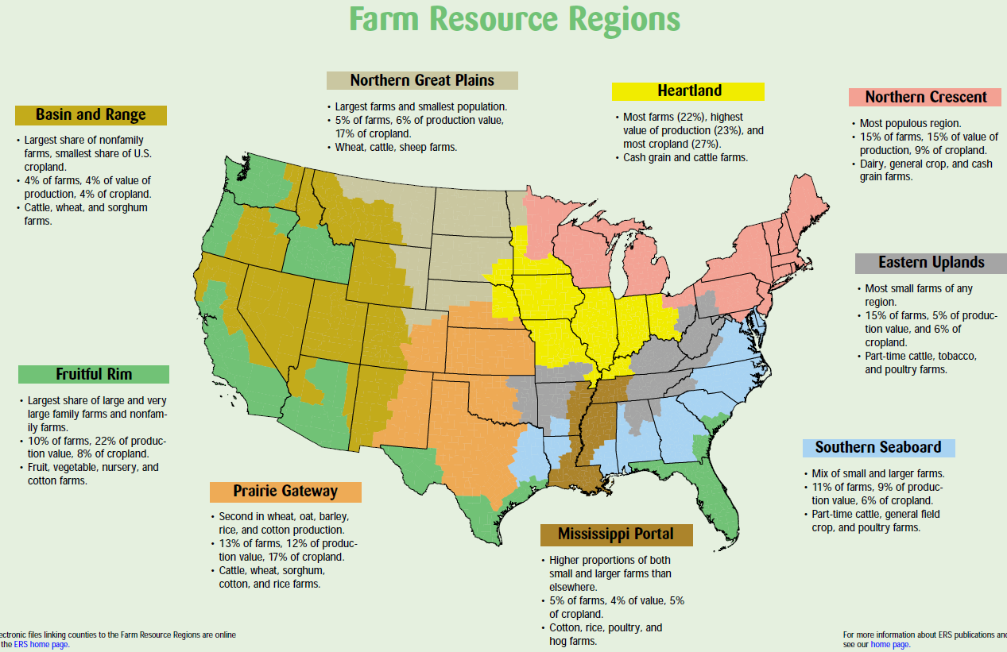
Agribusiness Systems Career Focus Area
What region do we live in, and what are some of our greatest commodities according to the map from the USDA?

Slide 33
Agribusiness Systems Career Focus Area
Utilizing the State Agricultural Facts map (https://www.agclassroom.org/teacher/ag_facts.cfm) identify and write down five interesting facts that you did not know about your state.

Slide 34

Agribusiness Systems Career Focus Area
Write a tweet about how agriculture impacted you this weekend.

Slide 35
Agribusiness Systems Career Focus Area
Watch the following video:
https://youtu.be/XVbOOMCjktA.
Why is growing plants in space important?
Why is figuring out how to grow plants in space challenging?

Slide 36
Agribusiness Systems Career Focus Area
Watch the following video:
https://youtu.be/0PU6BkSMUoA.
What careers exist in agriculture that are not production based?
What role do America’s farmers play in our economy?

Slide 37
Agribusiness Systems Career Focus Area
Find an impactful member of the agricultural community from history. Create a tweet about the impact that person had on the agriculture industry.

Slide 38
Agribusiness Systems Career Focus Area
Read the following article and respond with six emojis that represent your thoughts/feelings about the material:
https://newsela.com/read/elem-san-francisco-hotel-rooftop-bees/id/41820.

Slide 39
Agribusiness Systems Career Focus Area
Write a two-minute elevator speech about what agriculture is/means. This elevator speech should be written for a student at the elementary level that has never taken an agriculture class.

Slide 40
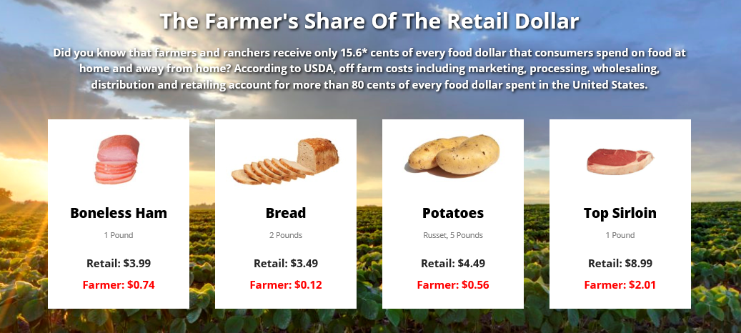
Agribusiness Systems Career Focus Area
Where does all the money go when you purchase a food product at the store?

Slide 41
Agribusiness Systems Career Focus Area
Using this website, https://www.ffanewhorizons.org/category/ag-101/career-pathways/, select an agricultural career pathway and describe five skills necessary to be successful in that area of agriculture.

Slide 42
Agribusiness Systems Career Focus Area
Select a career focus area of interest to you (use AgExplorer.ffa.org), and create a tweet about that focus area.

Slide 43
Agribusiness Systems Career Focus Area
Identify as many agriculture courses that are offered in your school as you can.

Slide 44
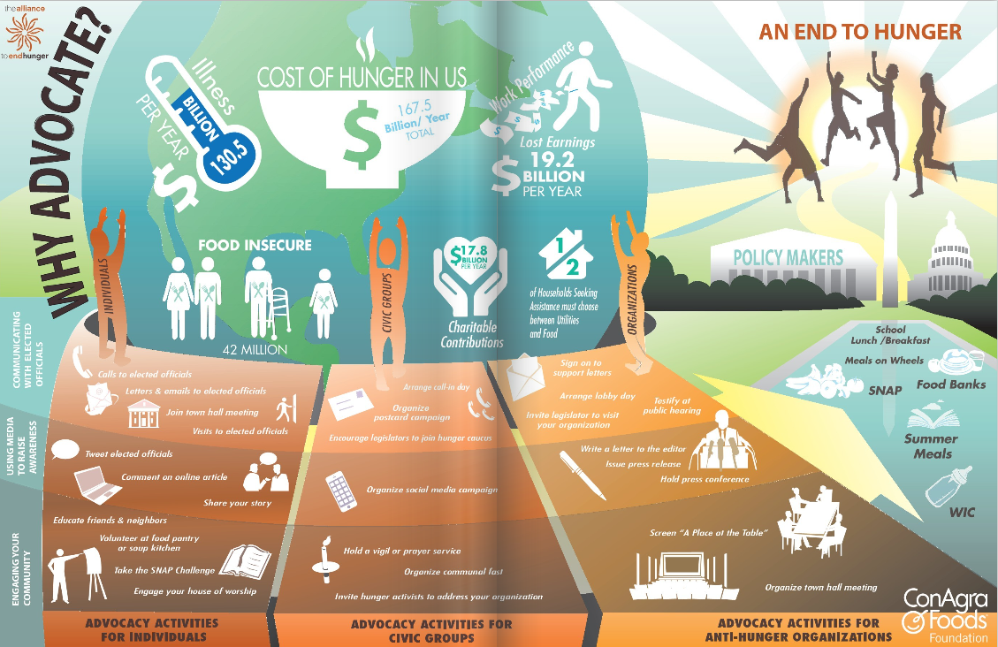
Agribusiness Systems Career Focus Area
Why and how should you advocate for hunger? Your response should be two to three sentences. (Image can be found at http://alliancetoendhunger.org/aeh-playbook/.)

