Slide 1

Bell Ringers for the Agricultural Science Classroom
Careers and Supervised Agricultural Experience (SAE) Programs

Slide 2
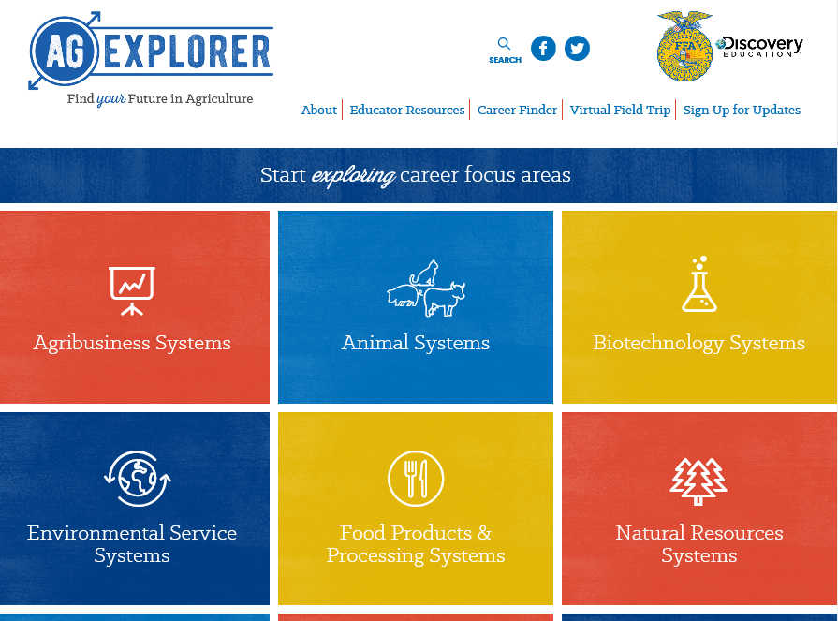
Careers and Supervised Agricultural Experience (SAE) Programs
Go to AgExplorer.ffa.org and complete the Career Finder.

Slide 3
Careers and Supervised Agricultural Experience (SAE) Programs
Video journaling: Watch this short video clip, reflect in writing and be prepared to share responses with the class. (https://www.youtube.com/watch?v=sc4HxPxNrZ0)

Slide 4
Careers and Supervised Agricultural Experience (SAE) Programs
Video journaling: Watch this short video clip, reflect in writing and be prepared to share responses with the class.
(https://www.youtube.com/watch?v=2pXuAw1bSQo)

Slide 5
Careers and Supervised Agricultural Experience (SAE) Programs
Video journaling: Watch this short video clip, reflect in writing and be prepared to share responses with the class.
(https://www.youtube.com/watch?v=_6xlNyWPpB8)

Slide 6
Careers and Supervised Agricultural Experience (SAE) Programs
Which of the following is a term used in the forestry industry to describe the segment that works with maintenance and cultivation of trees?
a. Vermiculture
b. Silviculture
c. Parasitology
d. Viticulture

Slide 7
Careers and Supervised Agricultural Experience (SAE) Programs
Which of the following is a term used in the forestry industry to describe the segment that works with maintenance and cultivation of trees?
a. Vermiculture
b. Silviculture
c. Parasitology
d. Viticulture

Slide 8
Careers and Supervised Agricultural Experience (SAE) Programs
What are the parts of the 3-Component Model for School-Based Agricultural Education?
a. Animals, plants, foods
b. Family, friends, agriculture
c. Careers, classroom, SAE
d. Classroom, SAE, FFA

Slide 9
Careers and Supervised Agricultural Experience (SAE) Programs
What are the parts of the 3-Component Model for School-Based Agricultural Education?
a. Animals, plants, foods
b. Family, friends, agriculture
c. Careers, classroom, SAE
d. Classroom, SAE, FFA

Slide 10
Careers and Supervised Agricultural Experience (SAE) Programs
Identify five skills you could gain by having a supervised agricultural experience (SAE) program.

Slide 11
Careers and Supervised Agricultural Experience (SAE) Programs
Q: Identify five skills you could gain by having a supervised agricultural experience (SAE) program.
A: Time management, responsibility, etc.

Slide 12
Careers and Supervised Agricultural Experience (SAE) Programs
Marlene has two soybean plots to determine which hybrid will yield the most product. What type of supervised agricultural experience (SAE) program would this student have?

Slide 13
Careers and Supervised Agricultural Experience (SAE) Programs
Q: Marlene has two soybean plots to determine which hybrid will yield the most product. What type of supervised agricultural experience (SAE) program would this student have?
A: Crop Production Research

Slide 14
Careers and Supervised Agricultural Experience (SAE) Programs
What is a supervised agricultural experience (SAE) proficiency award?
a. More paperwork I have to complete
b. A way to get recognition for my SAE
c. The best way to document my SAE
d. The only way for my advisor to grade my SAE

Slide 15
Careers and Supervised Agricultural Experience (SAE) Programs
What is a supervised agricultural experience (SAE) proficiency award?
a. More paperwork I have to complete
b. A way to get recognition for my SAE
c. The best way to document my SAE
d. The only way for my advisor to grade my SAE

Slide 16
Careers and Supervised Agricultural Experience (SAE) Programs
Which of the following SAEs would a student excel at if they enjoy science, agriculture and finding answers to questions that have not yet been discovered?
a. Exploratory
b. Placement
c. Entrepreneurship
d. Research

Slide 17
Careers and Supervised Agricultural Experience (SAE) Programs
Which of the following SAEs would a student excel at if they enjoy science, agriculture and finding answers to questions that have not yet been discovered?
a. Exploratory
b. Placement
c. Entrepreneurship
d. Research

Slide 18
Careers and Supervised Agricultural Experience (SAE) Programs
Identify five careers you could have in the Animal Systems Career Focus Area.

Slide 19
Careers and Supervised Agricultural Experience (SAE) Programs
Q: Identify five careers you could have in the Animal Systems Career Focus Area.
Examples: Veterinary science, parasitologist, carcass merchandiser, apiary worker/beekeeper, etc.

Slide 20
Careers and Supervised Agricultural Experience (SAE) Programs
Identify five careers you could have in the Agribusiness Systems Career Focus Area.

Slide 21
Careers and Supervised Agricultural Experience (SAE) Programs
Q. Identify five careers you could have in the Agribusiness Systems Career Focus Area.
Examples: Accountant, communications specialist, grain elevator manager, event manager, etc.

Slide 22
Careers and Supervised Agricultural Experience (SAE) Programs
Identify five careers you could have in the Biotechnology Systems Career Focus Area.

Slide 23
Careers and Supervised Agricultural Experience (SAE) Programs
Q: Identify five careers you could have in the Biotechnology Systems Career Focus Area.
Examples: Animal geneticist, biostatistician, embryologist, dispatcher, etc.

Slide 24
Careers and Supervised Agricultural Experience (SAE) Programs
Identify five careers you could have in the Environmental Service Systems Career Focus Area.

Slide 25
Careers and Supervised Agricultural Experience (SAE) Programs
Q: Identify five careers you could have in the Environmental Service Systems Career Focus Area.
Examples: Climate change analyst, environmental engineer, formulation chemist, nematologist, etc.

Slide 26
Careers and Supervised Agricultural Experience (SAE) Programs
Identify five careers you could have in the Food Products and Processing Systems Career Focus Area.

Slide 27
Careers and Supervised Agricultural Experience (SAE) Programs
Q: Identify five careers you could have in the Food Products and Processing Systems Career Focus Area.
Examples: Brand manager, extension agent, flavor technologist, graphic designer, food safety specialist, etc.

Slide 28
Careers and Supervised Agricultural Experience (SAE) Programs
Identify five careers you could have in the Natural Resources Systems Career Focus Area.

Slide 29
Careers and Supervised Agricultural Experience (SAE) Programs
Q: Identify five careers you could have in the Natural Resources Systems Career Focus Area.
Examples: Arborist, conservationist, ecologist, forester, geologist, etc.

Slide 30
Careers and Supervised Agricultural Experience (SAE) Programs
Identify five careers you could have in the Plant Systems Career Focus Area.

Slide 31
Careers and Supervised Agricultural Experience (SAE) Programs
Q: Identify five careers you could have in the Plant Systems Career Focus Area.
Examples: Aerial applicator/Agricultural pilot, agronomist, crop advisor, formulation chemist, floral designer, etc.

Slide 32
Careers and Supervised Agricultural Experience (SAE) Programs
Identify five careers you could have in the Power, Structural and Technical Systems Career Focus Area.

Slide 33
Careers and Supervised Agricultural Experience (SAE) Programs
Q: Identify five careers you could have in the Power, Structural and Technical Systems Career Focus Area.
Examples: Construction foreman, brand manager, electrical engineer, design engineer, hydraulic technician, etc.

Slide 34
Careers and Supervised Agricultural Experience (SAE) Programs
What is the difference between a bachelor's degree, a master’s degree and a doctorate?

Slide 35
Careers and Supervised Agricultural Experience (SAE) Programs
What is your dream job and why?

Slide 36
Careers and Supervised Agricultural Experience (SAE) Programs
What is the purpose and role of the United States Department of Agriculture (USDA)?

Slide 37
Careers and Supervised Agricultural Experience (SAE) Programs
What is the purpose and role of the United States Department of Agriculture (USDA)?
“To provide leadership on food, agriculture, natural resources, rural development, nutrition, and related issues based on public policy, the best available science, and effective management.”

Slide 38
Careers and Supervised Agricultural Experience (SAE) Programs
What career area is the largest employer in the world?
a. Medicine
b. Manufacturing
c. Education
d. Agriculture

Slide 39
Careers and Supervised Agricultural Experience (SAE) Programs
What career area is the largest employer in the world?
a. Medicine
b. Manufacturing
c. Education
d. Agriculture

Slide 40
Careers and Supervised Agricultural Experience (SAE) Programs
Draw a picture of what the word agriculture means to you. You have five minutes to complete the drawing.

Slide 41
Careers and Supervised Agricultural Experience (SAE) Programs
Find a natural resources resource/publication (https://www.fs.usda.gov/naspf/resources-and-publications) of interest to you and determine the following:
1. What is the issue?
2. Accomplishments/program status
3. Future direction. Be ready to share!

Slide 42
Careers and Supervised Agricultural Experience (SAE) Programs
What is the purpose and role of the U.S. Forest Service?

Slide 43
Careers and Supervised Agricultural Experience (SAE) Programs
Watch this video: https://youtu.be/g7FuDeOpSUY.
1. What role does Zoetis play in the animal industry?
2. Why does Zoetis care so much?

Slide 44
Careers and Supervised Agricultural Experience (SAE) Programs
Watch the video available at https://youtu.be/wfILgW3Lglk and respond to the following questions:
1. What role does CSX Transportation play in the
agriculture industry?
2. Identify two careers you could have through CSX
Transportation.

Slide 45
Careers and Supervised Agricultural Experience (SAE) Programs
Watch the video available at https://youtu.be/gUtdRHUf6gw and respond to the following questions
1. What role does Monsanto play in the agriculture
industry?
2. How does science help Monsanto find solutions to feeding the growing population?

Slide 46

Careers and Supervised Agricultural Experience (SAE) Programs
1. What role does RFDTV: Rural America’s Most Important Network play in communicating agriculture?
2. What career area would you be involved in if you worked for RFDTV?

Slide 47
Careers and Supervised Agricultural Experience (SAE) Programs
Watch the video available at https://youtu.be/0PU6BkSMUoA and respond to the following questions:
What careers exist in agriculture that are not production
based?
2. What role do America’s farmers play in our economy?

Slide 48
Careers and Supervised Agricultural Experience (SAE) Programs
Watch the video available at https://youtu.be/B_WSLbw3ApA and respond to the following question:
What benefits are there to being employed in agriculture?
Identify three.

Slide 49
Careers and Supervised Agricultural Experience (SAE) Programs
Watch the video available at https://youtu.be/FxMHl5Gr2Yg and respond to the following question:
What are scientists doing to help to feed a growing population?

Slide 50
Careers and Supervised Agricultural Experience (SAE) Programs
What relationship exists between science and agriculture? Give two examples to illustrate your response.

Slide 51
Careers and Supervised Agricultural Experience (SAE) Programs
What is the role of the Centers for Disease Control in our food supply?

Slide 52
Careers and Supervised Agricultural Experience (SAE) Programs
What is the role of the Centers for Disease Control in our food supply?
“They work with state and local health departments and other federal agencies to investigate foodborne outbreaks.”

Slide 53

Careers and Supervised Agricultural Experience (SAE) Programs
Find an impactful member of the agricultural community from history. Create a tweet about the impact that person had on the agriculture industry.

Slide 54
Careers and Supervised Agricultural Experience (SAE) Programs
Read the following article and respond with six emojis that represent your thoughts/feelings about the material: https://newsela.com/read/elem-san-francisco-hotel-rooftop-bees/id/41820.

Slide 55
Careers and Supervised Agricultural Experience (SAE) Programs
Read the article “Cool Jobs: Linking animal health to human health,” https://www.sciencenewsforstudents.org/article/cool-jobs-linking-animal-health-human-health.
Identify five careers you could potentially have related to what is discussed in the article.

Slide 56
Careers and Supervised Agricultural Experience (SAE) Programs
Read the article “Fish get pooped living in polluted water,” https://www.sciencenewsforstudents.org/article/fish-get-pooped-living-polluted-water.
1. Create a numbered lab procedure to outline the research study that was performed in this article.
2. What implications will this research have for the future of our natural resources systems?

Slide 57
Careers and Supervised Agricultural Experience (SAE) Programs
Read the article “New ‘tattoo’ could lead to drought-tolerant crops,” https://www.sciencenewsforstudents.org/article/new-tattoo-could-lead-drought-tolerant-crops.
1. Using three to five sentences, describe the impact this technology could have on addressing the growing food crisis in the world.

Slide 58
Careers and Supervised Agricultural Experience (SAE) Programs
Read the article “Robots will control everything you eat,” https://www.sciencenewsforstudents.org/article/robots-will-control-everything-you-eat.
1. List three facts and three opinions you have regarding the utilization of robots in agriculture.

Slide 59
Careers and Supervised Agricultural Experience (SAE) Programs
Write a two-minute elevator speech about what agriculture is/means. This elevator speech should be written for a student at the elementary level that has never taken an agriculture class.

Slide 60
Careers and Supervised Agricultural Experience (SAE) Programs
Create an SAE idea card for your SAE or an SAE you are interested in pursuing. For a blank SAE idea card go to FFA.org.

Slide 61
Careers and Supervised Agricultural Experience (SAE) Programs
Watch an SAE video found on the National FFA website (FFA.org/ffa-video-center).
Identify five skills that you could learn from having an SAE.

Slide 62
Careers and Supervised Agricultural Experience (SAE) Programs
Watch the video “Day in the Life of a Disney Food Scientist” (http://u7.ift.org/Knowledge-Center/Learn-About-Food-Science/Day-In-The-Life/Disney-and-IFT.aspx).
As you watch the video, create a flow chart that maps out the day of a Disney food scientist.

Slide 63
Careers and Supervised Agricultural Experience (SAE) Programs
Watch the video “Michele Perchonok: Food Scientist at NASA” (http://www.ift.org/knowledge-center/learn-about-food-science/day-in-the-life/michele-perchonok.aspx).
What role does a food scientist play in developing foods and food packaging for astronauts?

Slide 64
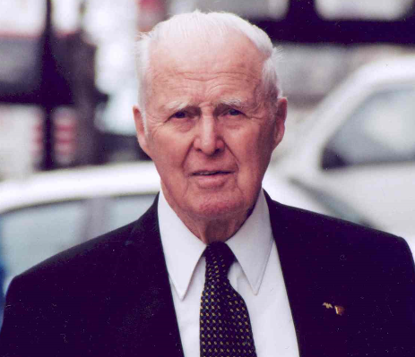
Careers and Supervised Agricultural Experience (SAE) Programs
This scientist was not only awarded the Nobel Peace Prize for his work in addressing hunger globally, but he also developed the World Food Prize to recognize those individuals making an impact in the world of agriculture.
a. George Washington Carver
b. John Deere
c. Phillip Nelson
d. Dr. Norman Borlaug

Slide 65
Careers and Supervised Agricultural Experience (SAE) Programs
This scientist was not only awarded the Nobel Peace Prize for his work in addressing hunger globally, but he also developed the World Food Prize to recognize those individuals making an impact in the world of agriculture.
a. George Washington Carver
b. John Deere
c. Phillip Nelson
d. Dr. Norman Borlaug

Slide 66
Careers and Supervised Agricultural Experience (SAE) Programs
Using the World Food Prize Laureates page, find a laureate of interest to you and write a two- to three-sentence blog post about their accomplishments and agricultural impact.
https://www.worldfoodprize.org/index.cfm?nodeID=90971&audienceID=1

Slide 67
Careers and Supervised Agricultural Experience (SAE) Programs
Watch the video “Ag & Bio Engineering: Meeting the Needs of Humankind” (https://youtu.be/WM16bY0W8o8).
What does an agricultural and biological engineer do?
What impact do they have on the world and economy?

Slide 68
Careers and Supervised Agricultural Experience (SAE) Programs
Read “On the Record: Chris Johns” in FFA New Horizons: https://www.ffanewhorizons.org/2017/08/30/on-the-record-chris-johns/.
Write a Facebook post about Chris John’s experiences and how FFA helped him to find his passion.

Slide 69
Careers and Supervised Agricultural Experience (SAE) Programs
Read “On the Record: Easton Corbin” in FFA New Horizons: https://www.ffanewhorizons.org/2017/02/24/what-i-know-easton-corbin/.
Write a Facebook post about Easton Corbin’s experiences and how FFA helped him to find his passion.

Slide 70
Careers and Supervised Agricultural Experience (SAE) Programs
Read “On the Record: Ray Starling” in FFA New Horizons: https://www.ffanewhorizons.org/2017/03/14/qa-ray-starling-special-assistant-to-the-president/.
Write a Facebook post about Ray Starling’s experiences and how FFA helped him to find his passion.

Slide 71
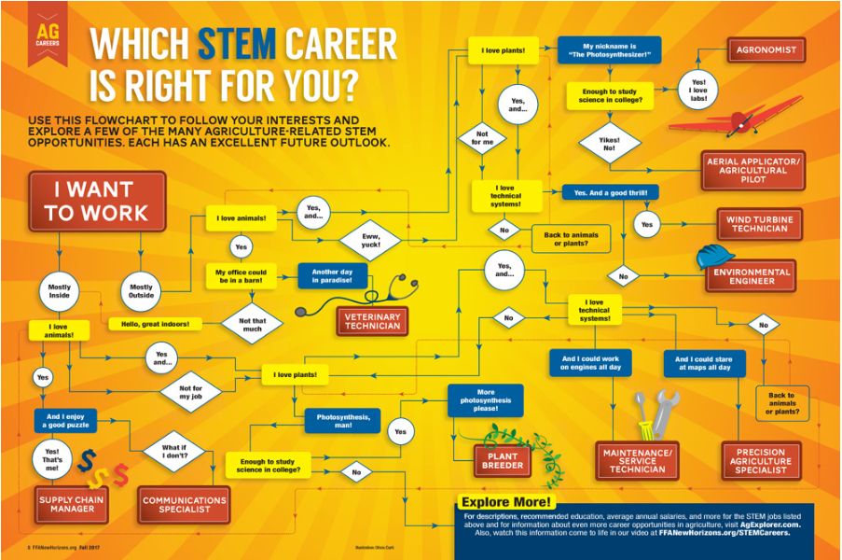
Careers and Supervised Agricultural Experience (SAE) Programs
Use the infographic to determine what STEM career is right for you.
Why do you think you ended up at this career? (Think about your personality and skills as you answer this question.)
(Image can be found at https://www.ffanewhorizons.org/2017/08/28/which-stem-career-is-right-for-you/.)

Slide 72
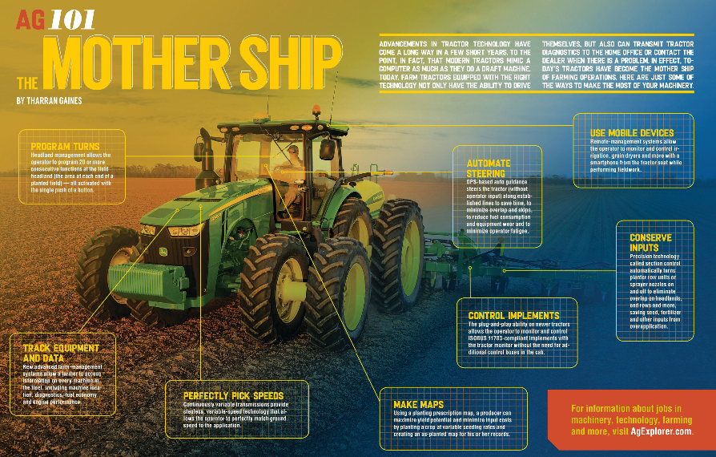
Careers and Supervised Agricultural Experience (SAE) Programs
How has agricultural technology evolved over the years?
What impact does this change have on the agriculture industry’s ability to feed a growing population?
(Image can be found at https://www.ffanewhorizons.org/2017/11/22/ag-101-the-mother-ship/.)

Slide 73
Careers and Supervised Agricultural Experience (SAE) Programs
Using the website available at https://www.ffanewhorizons.org/category/ag-101/career-pathways/, select an agricultural career pathway and describe five skills necessary to be successful in that area of agriculture.

Slide 74
Careers and Supervised Agricultural Experience (SAE) Programs
Take the Money Management Quiz: https://sorted.org.nz/tools/money-personality-quiz.
Do you think the results are accurate?
How can this insight into your money management help you in your SAE?

Slide 75
Careers and Supervised Agricultural Experience (SAE) Programs
Take this career quiz: https://www.goconstruct.org/personality-quiz/index.htm.
1. Which careers are you most suited for in
construction?
2. Is this result accurate?
3. Why or why not?

Slide 76
Careers and Supervised Agricultural Experience (SAE) Programs
Select a career focus area of interest to you (use AgExplorer.ffa.org) and create a tweet about that focus area.

Slide 77
Careers and Supervised Agricultural Experience (SAE) Programs
What are the pros and cons of being a small animal veterinarian?
https://youtu.be/8VVOowRAUAM

Slide 78
Careers and Supervised Agricultural Experience (SAE) Programs
What can humans do to handle cattle humanely, safely and calmly? Give three examples.
https://youtu.be/JawE6CLKHhc

Slide 79
Careers and Supervised Agricultural Experience (SAE) Programs
Watch the video available at https://youtu.be/xhtQf22GzJs and respond to the questions:
1. What is artificial insemination?
2. Why do farmers utilize artificial insemination?

Slide 80
Careers and Supervised Agricultural Experience (SAE) Programs
Watch the video available at https://youtu.be/R3FvgnSItWc and identify five careers that can be found within the animal science industry.

Slide 81
Careers and Supervised Agricultural Experience (SAE) Programs
Watch the video available at https://youtu.be/MmCCrV1RI9Y and respond to the questions:
1. What is a wildlife biologist?
2. What personality characteristics do you need to be
successful in an animal biology career? Identify three characteristics.

Slide 82
Careers and Supervised Agricultural Experience (SAE) Programs
How many National FFA proficiency award areas exist?
a. 23
b. 39
c. 47
d. 52

Slide 83
Careers and Supervised Agricultural Experience (SAE) Programs
How many National FFA proficiency award areas exist?
a. 23
b. 39
c. 47
d. 52

Slide 84
Careers and Supervised Agricultural Experience (SAE) Programs
Watch the video available at https://youtu.be/kVMEfoaLB5Y and respond to the following questions:
1. What skills do you need to be successful in an ag
and turf technician career?
2. What education requirements exist for this type of
career?

