Slide 1

Bell Ringers for the Agricultural Science Classroom
Food Products and Processing Systems Career Focus Area

Slide 2
Food Products and Processing Systems Career Focus Area
What kind of cheese is made backward?

Slide 3
Food Products and Processing Systems Career Focus Area
Q: What kind of cheese is made backward?
A: EDAM cheese (made spelled backward)

Slide 4
Food Products and Processing Systems Career Focus Area
There are six eggs in the basket. Six people each take one of the eggs. How can it be that one egg is left in the basket?

Slide 5
Food Products and Processing Systems Career Focus Area
Q: There are six eggs in the basket. Six people each take one of the eggs. How can it be that one egg is left in the basket?
A: The last person took the basket with the last egg still inside.

Slide 6
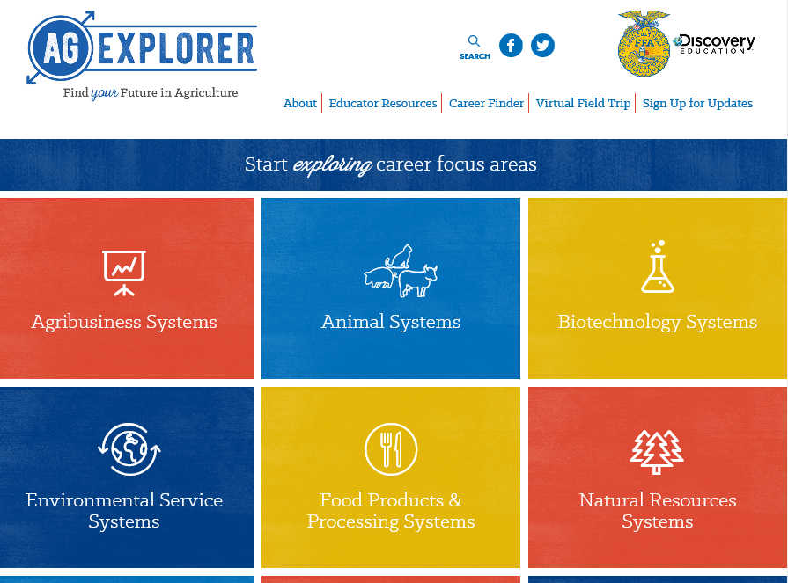
Food Products and Processing Systems Career Focus Area
Go to AgExplorer.ffa.org and complete the Career Finder.

Slide 7
Food Products and Processing Systems Career Focus Area
Video journaling: Watch this short video clip, reflect in writing and be prepared to share responses with the class.
(https://www.youtube.com/watch?v=sc4HxPxNrZ0)

Slide 8
Food Products and Processing Systems Career Focus Area
What are the five food groups now recognized by the government? What shape is used to show the portions for these food groups?

Slide 9
Food Products and Processing Systems Career Focus Area
Q: What are the five food groups now recognized by the government? What shape is used to show the portions for these food groups?
A:Dairy, fruits, grains, proteins, vegetables
A: The food groups are displayed in the “MyPlate” graphic.

Slide 10
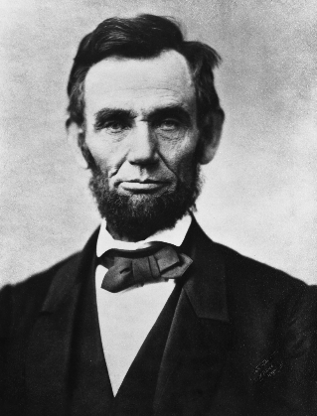
Food Products and Processing Systems Career Focus Area
Which U.S. president (pictured below) was responsible for establishing the United States Department of Agriculture (USDA)?
a. Abraham Lincoln
b. Thomas Jefferson
c. Alexander Hamilton
d. Woodrow Wilson

Slide 11
Food Products and Processing Systems Career Focus Area
Which U.S. president (pictured below) was responsible for establishing the United States Department of Agriculture (USDA)?
a. Abraham Lincoln
b. Thomas Jefferson
c. Alexander Hamilton
d. Woodrow Wilson

Slide 12
Food Products and Processing Systems Career Focus Area
On average, how many times per year does the average American family consume pizza?
a. 10
b. 20
c. 30
d. 40

Slide 13
Food Products and Processing Systems Career Focus Area
On average, how many times per year does the average American family consume pizza?
a. 10
b. 20
c. 30
d. 40

Slide 14
Food Products and Processing Systems Career Focus Area
What are the parts of the 3-Component Model for School-Based Agricultural Education?
a. Animals, plants, foods
b. Family, friends, agriculture
c. Careers, classroom, SAE
d. Classroom, SAE, FFA

Slide 15
Food Products and Processing Systems Career Focus Area
What are the parts of the 3-Component Model for School-Based Agricultural Education?
a. Animals, plants, foods
b. Family, friends, agriculture
c. Careers, classroom, SAE
d. Classroom, SAE, FFA

Slide 16
Food Products and Processing Systems Career Focus Area
Identify five careers you could have in the Food Products and Processing Systems Career Focus Area.

Slide 17
Food Products and Processing Systems Career Focus Area
Q: Identify five careers you could have in the Food Products and Processing Systems Career Focus Area.
A: Examples: Brand manager, extension agent, flavor technologist, graphic designer, food safety specialist, etc.

Slide 18
Food Products and Processing Systems Career Focus Area
Identify five colleges/universities that offer agriculture-related degrees.

Slide 19
Food Products and Processing Systems Career Focus Area
Q: Identify five colleges/universities that offer agriculture-related degrees.
A: Examples: Purdue University, University of Illinois, Kansas State, Texas Tech, University of Maryland, etc.

Slide 20
Food Products and Processing Systems Career Focus Area
What is the purpose and role of the United States Department of Agriculture (USDA)?

Slide 21
Food Products and Processing Systems Career Focus Area
What is the purpose and role of the United States Department of Agriculture (USDA)?
“To provide leadership on food, agriculture, natural resources, rural development, nutrition, and related issues based on public policy, the best available science, and effective management.”

Slide 22
Food Products and Processing Systems Career Focus Area
What career area is the largest employer in the world?
a. Medicine
b. Manufacturing
c. Education
d. Agriculture

Slide 23
Food Products and Processing Systems Career Focus Area
What career area is the largest employer in the world?
a. Medicine
b. Manufacturing
c. Education
d. Agriculture

Slide 24
Food Products and Processing Systems Career Focus Area
What is the minimum internal temperature for poultry to ensure safety during consumption?
a. 145°
b. 150°
c. 155°
d. 160°
e. 165°

Slide 25
Food Products and Processing Systems Career Focus Area
What is the minimum internal temperature for poultry to ensure safety during consumption?
a. 145°
b. 150°
c. 155°
d. 160°
e. 165°

Slide 26
Food Products and Processing Systems Career Focus Area
What is the minimum internal temperature for pork to ensure safety during consumption?
a. 145°
b. 150°
c. 155°
d. 160°
e. 165°

Slide 27
Food Products and Processing Systems Career Focus Area
What is the minimum internal temperature for pork to ensure safety during consumption?
a. 145°
b. 150°
c. 155°
d. 160°
e. 165°

Slide 28
Food Products and Processing Systems Career Focus Area
What is the minimum internal temperature for beef to ensure safety during consumption?
a. 145°
b. 150°
c. 155°
d. 160°
e. 165°

Slide 29
Food Products and Processing Systems Career Focus Area
What is the minimum internal temperature for beef to ensure safety during consumption?
a. 145°
b. 150°
c. 155°
d. 160°
e. 165°

Slide 30
Food Products and Processing Systems Career Focus Area
What country consumes more eggs per capita each year?
a. Mexico
b. USA
c. France
d. Portugal
e. India

Slide 31
Food Products and Processing Systems Career Focus Area
What country consumes more eggs per capita each year?
a. Mexico
b. USA
c. France
d. Portugal
e. India

Slide 32
Food Products and Processing Systems Career Focus Area
How much protein does one eight-ounce glass of milk contain?
a. 2 grams
b. 4 grams
c. 6 grams
d. 8 grams
e. 10 grams

Slide 33
Food Products and Processing Systems Career Focus Area
How much protein does one eight-ounce glass of milk contain?
a. 2 grams
b. 4 grams
c. 6 grams
d. 8 grams
e. 10 grams

Slide 34
Food Products and Processing Systems Career Focus Area
Hunger in America is a large concern. Approximately how many people in America are affected by hunger?
a. 18 million
b. 28 million
c. 38 million
d. 48 million
e. 58 million

Slide 35
Food Products and Processing Systems Career Focus Area
Hunger in America is a large concern. Approximately how many people in America are affected by hunger?
a. 18 million
b. 28 million
c. 38 million
d. 48 million
e. 58 million

Slide 36
Food Products and Processing Systems Career Focus Area
When is National Pizza Day?
a. January 10
b. February 9
c. April 21
d. May 6

Slide 37
Food Products and Processing Systems Career Focus Area
When is National Pizza Day?
a. January 10
b. February 9
c. April 21
d. May 6

Slide 38
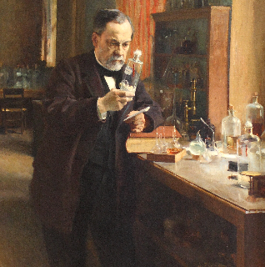
Food Products and Processing Systems Career Focus Area
What well-known scientist (pictured here) discovered that when you heat liquids to high temperatures you can kill bacteria? HINT: This led to the process of pasteurization.
a. Marie Curie
b. Albert Einstein
c. Fanny Farmer
d. Louis Pasteur

Slide 39
Food Products and Processing Systems Career Focus Area
What well-known scientist (pictured here) discovered that when you heat liquids to high temperatures you can kill bacteria? HINT: This led to the process of pasteurization.
a. Marie Curie
b. Albert Einstein
c. Fanny Farmer
d. Louis Pasteur

Slide 40
Food Products and Processing Systems Career Focus Area
Go to the Smash Your Food game and select two foods. Estimate their sugar, salt and oil composition. Then, “smash” the food to see how well you did. Record your results and be ready to share.
(https://fit.webmd.com/teen/food/game/smash-your-food-game)

Slide 41
Food Products and Processing Systems Career Focus Area
Play the game Blastoff (https://www.fns.usda.gov/blastoff) and answer the following questions:
What did you select for breakfast, lunch, snack, dinner and activity?
Did you ever change your choices during the game? Why or why not?
What did you learn about food choice during this game?

Slide 42
Food Products and Processing Systems Career Focus Area
Complete a MyPlate food group nutrition quiz: https://www.choosemyplate.gov/quiz.

Slide 43
Food Products and Processing Systems Career Focus Area
You throw away the outside and cook the inside, then eat the outside and throw away the inside. What is it?

Slide 44
Food Products and Processing Systems Career Focus Area
Q: You throw away the outside and cook the inside, then eat the outside and throw away the inside. What is it?
A: Corn on the cob

Slide 45
Food Products and Processing Systems Career Focus Area
What has to be broken before you can use it?

Slide 46
Food Products and Processing Systems Career Focus Area
Q: What has to be broken before you can use it?
A: An egg

Slide 47
Food Products and Processing Systems Career Focus Area
Draw a picture of what the word agriculture means to you. You have five minutes to complete the drawing.

Slide 48
Food Products and Processing Systems Career Focus Area
The percent daily value recommendation on a Nutrition Facts Label is based on a _______ calorie diet.
a. 1,000
b. 1,500
c. 2,000
d. 3,000

Slide 49
Food Products and Processing Systems Career Focus Area
The percent daily value recommendation on a Nutrition Facts Label is based on a _______ calorie diet.
a. 1,000
b. 1,500
c. 2,000
d. 3,000

Slide 50

Food Products and Processing Systems Career Focus Area
In food science, labeling is an important component to keep food safe and allow the consumer to know how their food was processed and preserved. What is the name and purpose of the symbol shown here?
a. Sunnol, sun drying
b. Plantera, plant modification
c. Pasteur, pasteurization
d. Radura, irradiation

Slide 51
Food Products and Processing Systems Career Focus Area
In food science, labeling is an important component to keep food safe and allow the consumer to know how their food was processed and preserved. What is the name and purpose of the symbol shown here?
a. Sunnol, sun drying
b. Plantera, plant modification
c. Pasteur, pasteurization
d. Radura, irradiation

Slide 52
Food Products and Processing Systems Career Focus Area
Which of the following are considered “bad fats” in the everyday human diet?
a. Monounsaturated
b. Saturated
c. Polyunsaturated
d. Polarized

Slide 53
Food Products and Processing Systems Career Focus Area
Which of the following are considered “bad fats” in the everyday human diet?
a. Monounsaturated
b. Saturated
c. Polyunsaturated
d. Polarized

Slide 54
Food Products and Processing Systems Career Focus Area
What does USDA stand for?
a. Unified States Department of Agriculture
b. United Stated Department of Aquaculture
c. United States Department of Agriculture
d. Unknown Status for Domestic Agriculture

Slide 55
Food Products and Processing Systems Career Focus Area
What does USDA stand for?
a. Unified States Department of Agriculture
b. United Stated Department of Aquaculture
c. United States Department of Agriculture
d. Unknown Status for Domestic Agriculture

Slide 56

Food Products and Processing Systems Career Focus Area
Describe, in one to two sentences, the purpose and labeling requirements for this seal.

Slide 57
Food Products and Processing Systems Career Focus Area
Q: Describe, in one to two sentences, the purpose and labeling requirements for this seal.
A: The USDA Organic seal means that the product meets the following USDA standards of an organic food product: (1) “produced without excluded methods,” (2) “produced using allowed substances” and (3) “overseen by a USDA National Organic Program-authorized certifying agent.”

Slide 58
Food Products and Processing Systems Career Focus Area
To make one pound of cheddar cheese, it requires approximately ___ pounds of milk.
a. 8
b. 10
c. 22
d. 44

Slide 59
Food Products and Processing Systems Career Focus Area
To make one pound of cheddar cheese, it requires approximately ___ pounds of milk.
a. 8
b. 10
c. 22
d. 44

Slide 60
Food Products and Processing Systems Career Focus Area
According to the Food and Nutrition Board of the National Academy of Sciences, all people need at least ___ milligrams of calcium per day.
a. 10
b. 100
c. 1,000
d. 1,000,000

Slide 61
Food Products and Processing Systems Career Focus Area
According to the Food and Nutrition Board of the National Academy of Sciences, all people need at least ___ milligrams of calcium per day.
a. 10
b. 100
c. 1,000
d. 1,000,000

Slide 62
Food Products and Processing Systems Career Focus Area
In 1984, President Ronald Reagan proclaimed a National Ice Cream Month. It has been celebrated annually every _____.
a. June
b. July
c. August
d. September

Slide 63
Food Products and Processing Systems Career Focus Area
In 1984, President Ronald Reagan proclaimed a National Ice Cream Month. It has been celebrated annually every _____.
a. June
b. July
c. August
d. September

Slide 64
Food Products and Processing Systems Career Focus Area
Most dairy cows are milked two to three times per day. On average, a cow will produce ___ gallons of milk each day.
a. 1 to 2
b. 8 to 9
c. 15 to 16
d. 20 to 21

Slide 65
Food Products and Processing Systems Career Focus Area
Most dairy cows are milked two to three times per day. On average, a cow will produce ___ gallons of milk each day.
a. 1 to 2
b. 8 to 9
c. 15 to 16
d. 20 to 21

Slide 66
Food Products and Processing Systems Career Focus Area
Which of the following flavors of ice cream is the most popular by sales volume?
a. Raspberry
b. Strawberry
c. Vanilla
d. Chocolate

Slide 67
Food Products and Processing Systems Career Focus Area
Which of the following flavors of ice cream is the most popular by sales volume?
a. Raspberry
b. Strawberry
c. Vanilla
d. Chocolate

Slide 68
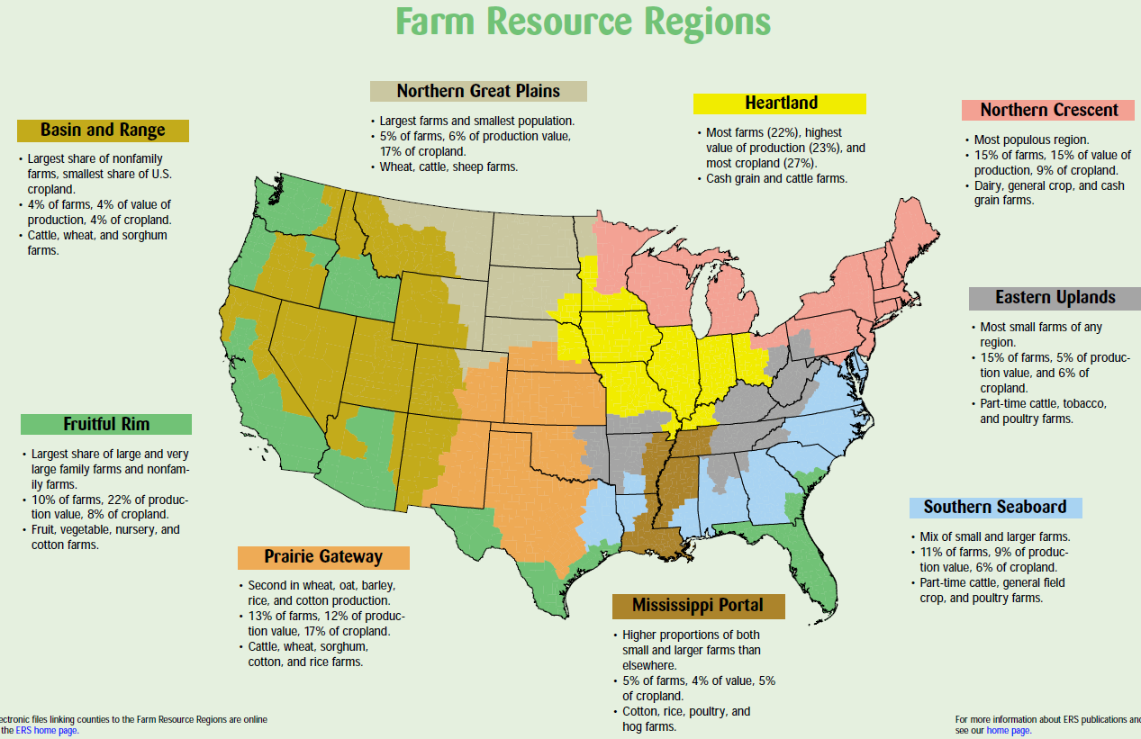
Food Products and Processing Systems Career Focus Area
What region do we live in, and what are some of our greatest commodities according to the map from the USDA?
Image can be found at https://www.ers.usda.gov/webdocs/publications/42298/32489_aib-760_002.pdf?v=42487.

Slide 69
Food Products and Processing Systems Career Focus Area
Utilizing the State Agricultural Facts map (https://www.agclassroom.org/teacher/ag_facts.cfm), identify and write down five interesting facts that you did not know about your state.

Slide 70

Food Products and Processing Systems Career Focus Area
Write a tweet about how agriculture impacted you this weekend.

Slide 71
Food Products and Processing Systems Career Focus Area
Using Food-a-Pedia (https://www.supertracker.usda.gov/foodapedia.aspx), compare and contrast the nutrition facts of two foods you regularly consume.

Slide 72
Food Products and Processing Systems Career Focus Area
Watch the following video:
https://youtu.be/gUtdRHUf6gw.
What role does Monsanto play in the agriculture industry?
How does science help Monsanto find solutions to feed the growing population?

Slide 73
Food Products and Processing Systems Career Focus Area
Watch the following video:
https://youtu.be/FxMHl5Gr2Yg.
What are scientists doing to help feed a growing population?

Slide 74
Food Products and Processing Systems Career Focus Area
What relationship exists between science and agriculture? Give two examples to illustrate your response.

Slide 75
Food Products and Processing Systems Career Focus Area
What is the purpose of a literature review in agriscience research?

Slide 76
Food Products and Processing Systems Career Focus Area
Q: What is the purpose of a literature review in agriscience research?
A: To support and show previously completed research that directly relates to your research.

Slide 77
Food Products and Processing Systems Career Focus Area
Q: What is the purpose of the materials and methods section in an agriscience report/research study?
A: To give readers a clear understanding of the process and materials required to complete the research. Materials and methods also allow the reader to know how to replicate the study.

Slide 78
Food Products and Processing Systems Career Focus Area
What is a hypothesis? Why is a hypothesis created when completing agricultural research?

Slide 79
Food Products and Processing Systems Career Focus Area
Q: What is a hypothesis? Why is a hypothesis created when completing agricultural research?
A: A hypothesis is a brief statement of the anticipated results from a study being conducted. The hypothesis will be revisited in the results and conclusions section of the study write-up.

Slide 80
Food Products and Processing Systems Career Focus Area
What is the role/purpose of an abstract when writing an agriscience research study?

Slide 81
Food Products and Processing Systems Career Focus Area
Q: What is the role/purpose of an abstract when writing an agriscience research study?
A: The abstract is a brief summary of the purpose of the study, background information on the topic being studied, the materials/methods, the results and conclusions.

Slide 82
Food Products and Processing Systems Career Focus Area
Visit the USDA website at https://www.fsis.usda.gov/wps/portal/informational/aboutfsis/state-fact-sheets.
Find your state and pull up the fact sheet.
1. What is the role of FSIS?
2. How many FSIS employees are in your state?
3. What agricultural commodity does your state excel
in?

Slide 83
Food Products and Processing Systems Career Focus Area
What is the role of the Centers for Disease Control in our food supply?

Slide 84
Food Products and Processing Systems Career Focus Area
Q: What is the role of the Centers for Disease Control in our food supply?
A: “They work with state and local health departments and other federal agencies to investigate foodborne outbreaks.”

Slide 85
Food Products and Processing Systems Career Focus Area
Which of the following are essential steps in maintaining safe food in your household? (CDC video: https://youtu.be/zE0ypKtFuWQ)
a. Separate
b. Clean
c. Chill
d. Cook
e. All of the above

Slide 86
Food Products and Processing Systems Career Focus Area
Which of the following are essential steps in maintaining safe food in your household? (CDC video: https://youtu.be/zE0ypKtFuWQ)
a. Separate
b. Clean
c. Chill
d. Cook
e. All of the above

Slide 87
Food Products and Processing Systems Career Focus Area
Foodborne germs can infect our food when proper safety steps are not taken. Utilizing this website, https://www.cdc.gov/foodsafety/symptoms.html,
select a foodborne germ of interest. Design a billboard to advertise and inform the public about that foodborne germ.

Slide 88
Food Products and Processing Systems Career Focus Area
Which group of people are MOST “at-risk” for foodborne illnesses?
a. Pregnant women
b. Adults 65 years or older
c. Children under the age of five
d. People with diabetes, cancer or HIV/AIDS
e. All of the above

Slide 89
Food Products and Processing Systems Career Focus Area
Which group of people are MOST “at-risk” for foodborne illnesses?
a. Pregnant women
b. Adults 65 years or older
c. Children under the age of five
d. People with diabetes, cancer or HIV/AIDS
e. All of the above

Slide 90
Food Products and Processing Systems Career Focus Area
Which of the following foods caused the most illnesses between 2009 and 2015?
a. Fish
b. Dairy
c. Chicken
d. Vegetable row crops

Slide 91
Food Products and Processing Systems Career Focus Area
Which of the following foods caused the most illnesses between 2009 and 2015?
a. Fish
b. Dairy
c. Chicken
d. Vegetable row crops

Slide 92
Food Products and Processing Systems Career Focus Area
Find an impactful member of the agricultural community from history. Create a tweet about the impact that person had on the agriculture industry.

Slide 93
Food Products and Processing Systems Career Focus Area
Read the article “Climate Change Could Make Food Less Healthy,” and write a three- to five-sentence response. https://www.sciencenewsforstudents.org/blog/analyze/analyze-climate-change-could-make-food-less-healthy

Slide 94
Food Products and Processing Systems Career Focus Area
Write a two-minute elevator speech about what agriculture is/means. This elevator speech should be written for a student at the elementary level that has never taken an agriculture class.

Slide 95
Food Products and Processing Systems Career Focus Area
What is your favorite after-school snack?
Draw a flow chart to illustrate how that snack went from the farm to your plate.

Slide 96
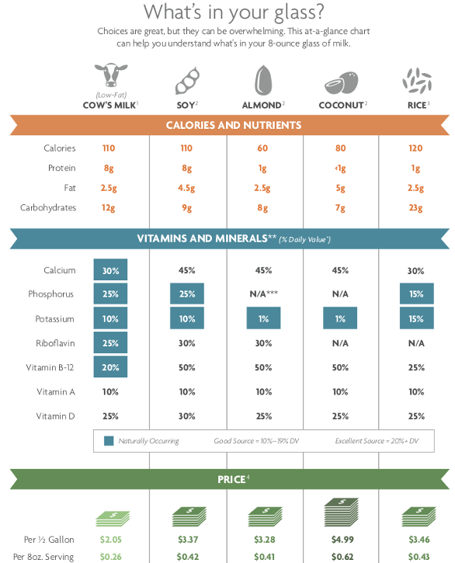
Food Products and Processing Systems Career Focus Area
You and a friend are at lunch when you open a bottle of chilled milk. Your friend is consuming chilled almond milk. Which drink is a healthier choice? Why?

Slide 97
Food Products and Processing Systems Career Focus Area
Why does Swiss cheese have holes?
a. A mouse nibbled through the cheese.
b. Carbon dioxide bubbles formed in the cheese.
c. Carbon monoxide bubbles formed in the cheese.
d. Holes are essential to the curing process and add
to the tangy flavor.

Slide 98
Food Products and Processing Systems Career Focus Area
Why does Swiss cheese have holes?
a. A mouse nibbled through the cheese.
b. Carbon dioxide bubbles formed in the cheese.
c. Carbon monoxide bubbles formed in the cheese.
d. Holes are essential to the curing process and add
to the tangy flavor.

Slide 99
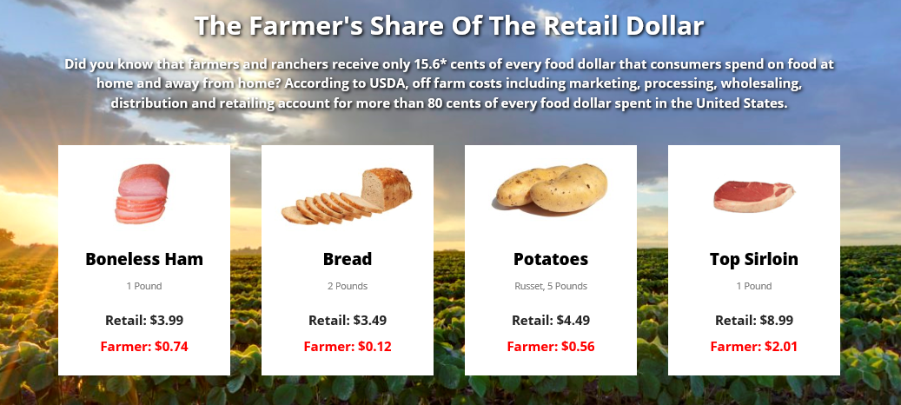
Food Products and Processing Systems Career Focus Area
Where does the money go when you purchase a food product at the store?

Slide 100
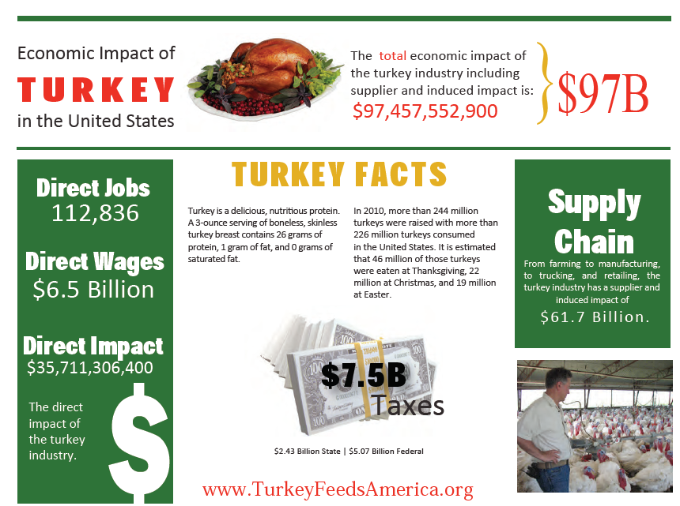
Food Products and Processing Systems Career Focus Area
1. What impact does turkey production have in the U.S.?
2. How has turkey production impacted you?

Slide 101
Food Products and Processing Systems Career Focus Area
Using the Coalition for Safe Affordable Food state activity website (http://coalitionforsafeaffordablefood.org/state-action-center/), create a tweet to highlight a current event in your state.

Slide 102
Food Products and Processing Systems Career Focus Area
Watch the video “World Without Food Science.” (http://u7.ift.org/knowledge-center/learn-about-food-science/world-without-food-science.aspx)
Write a list of five thoughts or reactions you experienced while watching the video.

Slide 103
Food Products and Processing Systems Career Focus Area
Watch the video “Day in the Life of a Disney Food Scientist.” (http://u7.ift.org/Knowledge-Center/Learn-About-Food-Science/Day-In-The-Life/Disney-and-IFT.aspx)
As you watch the video, create a flow chart that maps out the day of a Disney food scientist.

Slide 104
Food Products and Processing Systems Career Focus Area
Watch the video “Michele Perchonok: Food Scientist at NASA.” (http://www.ift.org/knowledge-center/learn-about-food-science/day-in-the-life/michele-perchonok.aspx)
What role does a food scientist play in developing foods and food packaging for astronauts?

Slide 105

Food Products and Processing Systems Career Focus Area
Why are we able to buy milk that does not have to be refrigerated?
What benefit does this technology serve for meeting the global food supply needs?
Watch the video “Brian Thane: Food Packaging Professional” (http://www.ift.org/knowledge-center/learn-about-food-science/day-in-the-life/food-packaging-professional.aspx), and create a three- to five-sentence response that answers the questions listed above.

Slide 106
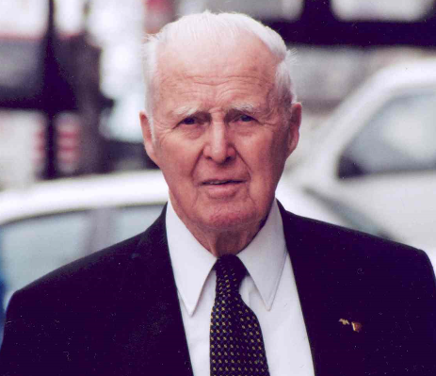
Food Products and Processing Systems Career Focus Area
This scientist not only was awarded the Nobel Peace Prize for his work in addressing hunger globally, but he also developed the World Food Prize to recognize those individuals making an impact in the world of agriculture.
a. George Washington Carver
b. John Deere
c. Phillip Nelson
d. Dr. Norman Borlaug

Slide 107
Food Products and Processing Systems Career Focus Area
This scientist not only was awarded the Nobel Peace Prize for his work in addressing hunger globally, but he also developed the World Food Prize to recognize those individuals making an impact in the world of agriculture.
a. George Washington Carver
b. John Deere
c. Phillip Nelson
d. Dr. Norman Borlaug

Slide 108
Food Products and Processing Systems Career Focus Area
Using the World Food Prize Laureates page, find a laureate of interest to you and write a two- to three-sentence blog post about their accomplishments and agricultural impact.
https://www.worldfoodprize.org/index.cfm?nodeID=90971&audienceID=1

Slide 109
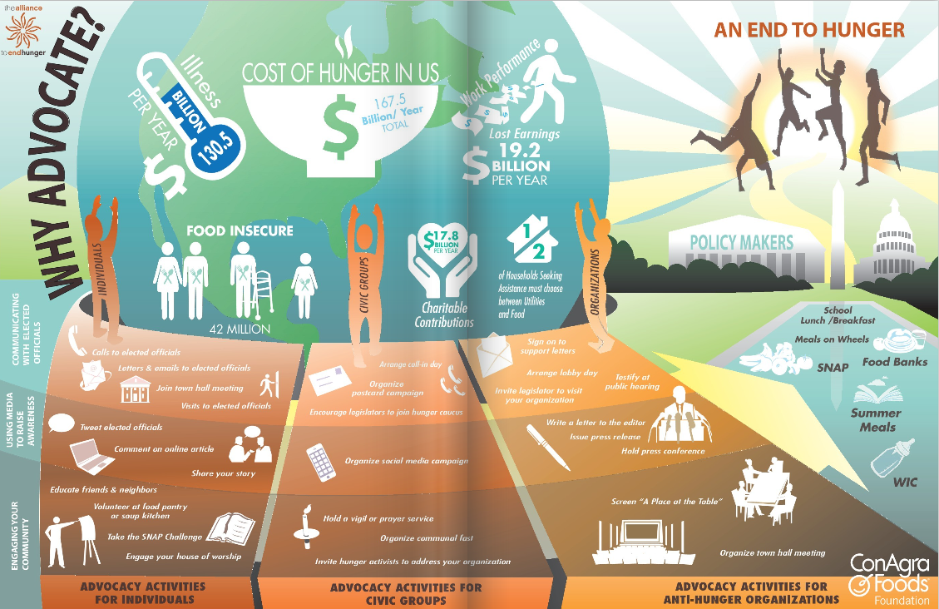
Food Products and Processing Systems Career Focus Area
Using two to three sentences, explain why and how you should advocate for hunger.
(Image can be found at http://alliancetoendhunger.org/aeh-playbook/.)

Slide 110

Food Products and Processing Systems Career Focus Area
Is this true or not true? Why or why not?

Slide 111
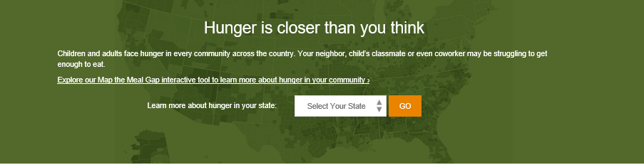
Food Products and Processing Systems Career Focus Area
On the Feeding America “Hunger Is Closer Than You Think” website (http://www.feedingamerica.org/hunger-in-america/), select your state. Draw a picture that accurately represents what your state looks like regarding hunger.

Slide 112
Food Products and Processing Systems Career Focus Area
Which of the following should you NEVER do to bagels or any bread product if you want to maintain freshness?
a. Freeze
b. Refrigerate
c. Let it sit on the counter
d. Set it in the pantry

Slide 113
Food Products and Processing Systems Career Focus Area
Which of the following should you NEVER do to bagels or any bread product if you want to maintain freshness?
a. Freeze
b. Refrigerate
c. Let it sit on the counter
d. Set it in the pantry

Slide 114
Food Products and Processing Systems Career Focus Area
How many U.S. states grow wheat?
a. 22
b. 32
c. 42
d. 52

Slide 115
Food Products and Processing Systems Career Focus Area
How many U.S. states grow wheat?
a. 22
b. 32
c. 42
d. 52

Slide 116
Food Products and Processing Systems Career Focus Area
Every state in the U.S. produces honey. Which state leads in honey production?
a. California
b. Florida
c. Montana
d. North Dakota

Slide 117
Food Products and Processing Systems Career Focus Area
Every state in the U.S. produces honey. Which state leads in honey production?
a. California
b. Florida
c. Montana
d. North Dakota

Slide 118
Food Products and Processing Systems Career Focus Area
Coffee is a popular choice for many Americans and can have some health benefits! Which of the following issues are decreased when a person is a long-term coffee drinker?
a. Crohn’s disease
b. Arthritis
c. Type II diabetes
d. Common cold

Slide 119
Food Products and Processing Systems Career Focus Area
Coffee is a popular choice for many Americans and can have some health benefits! Which of the following issues are decreased when a person is a long-term coffee drinker?
a. Crohn’s disease
b. Arthritis
c. Type II diabetes
d. Common cold

Slide 120
Food Products and Processing Systems Career Focus Area
Select a career focus area of interest to you (use AgExplorer.ffa.org) and create a tweet about that focus area.

Slide 121
Food Products and Processing Systems Career Focus Area
Identify as many agriculture courses that are offered in your school as you can.

Slide 122
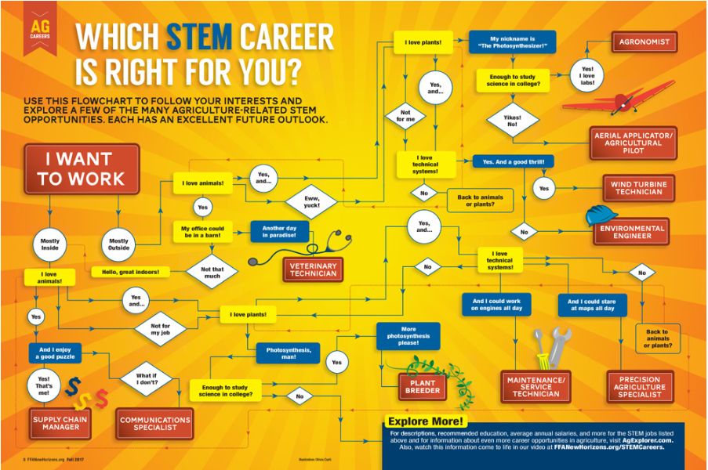
Food Products and Processing Systems Career Focus Area
Use the infographic to determine what STEM career is right for you.
Why do you think you ended up at this career? (Think about your personality and skills as you answer this question.)
(Image can be found at https://www.ffanewhorizons.org/2017/08/28/which-stem-career-is-right-for-you/.)

