Slide 1

Bell Ringers for the Agricultural Science Classroom
Natural Resources and Environmental Service Systems Career Focus Areas

Slide 2
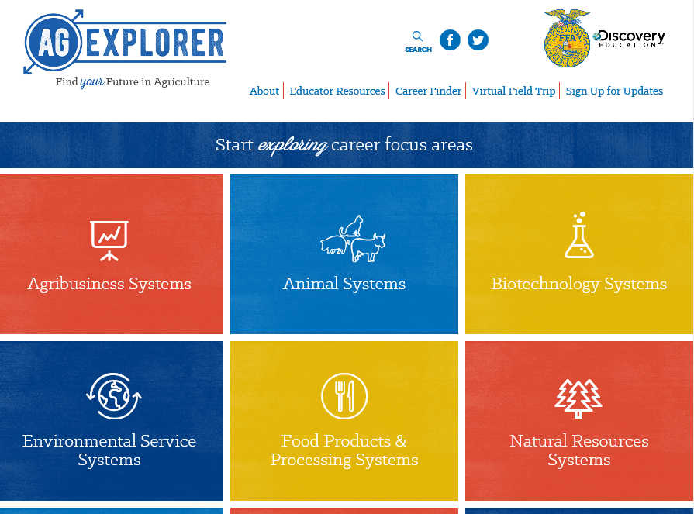
Natural Resources and Environmental Service Systems Career Focus Areas
Go to AgExplorer.ffa.org and complete the Career Finder.

Slide 3
Natural Resources and Environmental Service Systems Career Focus Areas
Video journaling: Watch this short video clip, reflect in writing and be prepared to share responses with the class. (https://www.youtube.com/watch?v=sc4HxPxNrZ0)

Slide 4
Natural Resources and Environmental Service Systems Career Focus Areas
Video journaling: Watch this short video clip, reflect in writing and be prepared to share responses with the class.
(https://www.youtube.com/watch?v=2pXuAw1bSQo)

Slide 5
Natural Resources and Environmental Service Systems Career Focus Areas
Video journaling: Watch this short video clip, reflect in writing and be prepared to share responses with the class. (https://www.youtube.com/watch?v=_6xlNyWPpB8)

Slide 6
Natural Resources and Environmental Service Systems Career Focus Areas
How many people does one U.S. farm feed?
a. 56 people
b. 165 people
c. 202 people
d. 233 people

Slide 7
Natural Resources and Environmental Service Systems Career Focus Areas
How many people does one U.S. farm feed?
a. 56 people
b. 165 people
c. 202 people
d. 233 people

Slide 8
Natural Resources and Environmental Service Systems Career Focus Areas
Which state has the most farms?
a. Missouri
b. Iowa
c. Oklahoma
d. Texas

Slide 9
Natural Resources and Environmental Service Systems Career Focus Areas
Which state has the most farms?
a. Missouri
b. Iowa
c. Oklahoma
d. Texas

Slide 10
Natural Resources and Environmental Service Systems Career Focus Areas
True or False
The majority of farms in the U.S. are owned by corporations. Explain your answer in one to two sentences.

Slide 11
Natural Resources and Environmental Service Systems Career Focus Areas
True or False
The majority of farms in the U.S. are owned by corporations. Explain your answer in one to two sentences.

Slide 12
Natural Resources and Environmental Service Systems Career Focus Areas
What state has the largest number of aquaculture farms?
a. California
b. North Carolina
c. Louisiana
d. Florida
e. Mississippi

Slide 13
Natural Resources and Environmental Service Systems Career Focus Areas
What state has the largest number of aquaculture farms?
a. California
b. North Carolina
c. Louisiana
d. Florida
e. Mississippi

Slide 14
Natural Resources and Environmental Service Systems Career Focus Areas
Approximately how much of the U.S. is covered in trees?
a. 1/8
b. 1/4
c. 1/3
d. 2/3

Slide 15
Natural Resources and Environmental Service Systems Career Focus Areas
Approximately how much of the U.S. is covered in trees?
a. 1/8
b. 1/4
c. 1/3
d. 2/3

Slide 16
Natural Resources and Environmental Service Systems Career Focus Areas
Which of the following is a term used in the forestry industry to describe the segment that works with maintenance and cultivation of trees?
a. Vermiculture
b. Silviculture
c. Parasitology
d. Viticulture

Slide 17
Natural Resources and Environmental Service Systems Career Focus Areas
Which of the following is a term used in the forestry industry to describe the segment that works with maintenance and cultivation of trees?
a. Vermiculture
b. Silviculture
c. Parasitology
d. Viticulture

Slide 18
Natural Resources and Environmental Service Systems Career Focus Areas
Develop a list of everyday items that are produced from animal and plant byproducts. You have two minutes.

Slide 19
Natural Resources and Environmental Service Systems Career Focus Areas
Q: Develop a list of everyday items that are produced from animal and plant byproducts. You have two minutes.
A: Manufacturing: adhesives, lubricants, solvents
Construction: lumber, paint, brushes, tar paper, tool handles
Personal Care Items: shampoo, soap, cosmetics, lotions, toothpaste
Healthcare: pharmaceuticals, surgical sutures, X-ray film, latex gloves
Transportation: biofuels, lubricants, antifreeze, tires, upholstery
Sports: uniforms, baseball bats, leather equipment
Printing: ink, paper
Education: crayons, textbooks, chalk, desks, pencils
Entertainment: strings for musical instruments

Slide 20
Natural Resources and Environmental Service Systems Career Focus Areas
Biodiesel is a fuel source created from which common agricultural commodity?
a. Corn
b. Soybeans
c. Wheat
d. Sorghum

Slide 21
Natural Resources and Environmental Service Systems Career Focus Areas
Biodiesel is a fuel source created from which common agricultural commodity?
a. Corn
b. Soybeans
c. Wheat
d. Sorghum

Slide 22
Natural Resources and Environmental Service Systems Career Focus Areas
In what year did John Deere begin manufacturing the steel plow?
a. 1791
b. 1802
c. 1837
d. 1868

Slide 23
Natural Resources and Environmental Service Systems Career Focus Areas
In what year did John Deere begin manufacturing the steel plow?
a. 1791
b. 1802
c. 1837
d. 1868

Slide 24
Natural Resources and Environmental Service Systems Career Focus Areas
Identify five careers you could have in the Biotechnology Systems Career Focus Area.

Slide 25
Natural Resources and Environmental Service Systems Career Focus Areas
Q: Identify five careers you could have in the Biotechnology Systems Career Focus Area.
A: Examples: Animal geneticist, biostatistician, embryologist, dispatcher, etc.

Slide 26
Natural Resources and Environmental Service Systems Career Focus Areas
Identify five careers you could have in the Environmental Service Systems Career Focus Area.

Slide 27
Natural Resources and Environmental Service Systems Career Focus Areas
Q: Identify five careers you could have in the Environmental Service Systems Career Focus Area.
A: Examples: Climate change analyst, environmental engineer, formulation chemist, nematologist, etc.

Slide 28
Natural Resources and Environmental Service Systems Career Focus Areas
Identify five careers you could have in the Natural Resources Systems Career Focus Area.

Slide 29
Natural Resources and Environmental Service Systems Career Focus Areas
Q: Identify five careers you could have in the Natural Resources Systems Career Focus Area.
A: Examples: Arborist, conservationist, ecologist, forester, geologist, etc.

Slide 30
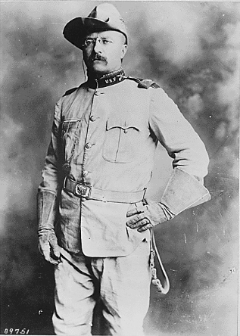
Natural Resources and Environmental Service Systems Career Focus Areas
Which U.S. President (pictured here) was known as a conservationist for his work with the National Parks system?
a. George Washington
b. Abraham Lincoln
c. John F. Kennedy
d. Teddy Roosevelt

Slide 31
Natural Resources and Environmental Service Systems Career Focus Areas
Which U.S. President (pictured here) was known as a conservationist for his work with the National Parks system?
a. George Washington
b. Abraham Lincoln
c. John F. Kennedy
d. Teddy Roosevelt

Slide 32
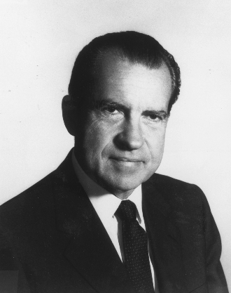
Natural Resources and Environmental Service Systems Career Focus Areas
Which U.S. President (pictured here) is known for proposing and beginning the Environmental Protection Agency (EPA)?
a. George Washington
b. Abraham Lincoln
c. John F. Kennedy
d. Richard Nixon

Slide 33
Natural Resources and Environmental Service Systems Career Focus Areas
Which U.S. President (pictured here) is known for proposing and beginning the Environmental Protection Agency (EPA)?
a. George Washington
b. Abraham Lincoln
c. John F. Kennedy
d. Richard Nixon

Slide 34
Natural Resources and Environmental Service Systems Career Focus Areas
What career area is the largest employer in the world?
a. Medicine
b. Manufacturing
c. Education
d. Agriculture

Slide 35
Natural Resources and Environmental Service Systems Career Focus Areas
What career area is the largest employer in the world?
a. Medicine
b. Manufacturing
c. Education
d. Agriculture

Slide 36
Natural Resources and Environmental Service Systems Career Focus Areas
What type of tree can you carry in your hand?

Slide 37
Natural Resources and Environmental Service Systems Career Focus Areas
Q: What type of tree can you carry in your hand?
A: A palm

Slide 38
Natural Resources and Environmental Service Systems Career Focus Areas
You throw away the outside and cook the inside, then eat the outside and throw away the inside. What is it?

Slide 39
Natural Resources and Environmental Service Systems Career Focus Areas
Q: You throw away the outside and cook the inside, then eat the outside and throw away the inside. What is it?
A: Corn on the cob

Slide 40
Natural Resources and Environmental Service Systems Career Focus Areas
Draw a picture of what the word agriculture means to you. You have five minutes to complete the drawing.

Slide 41
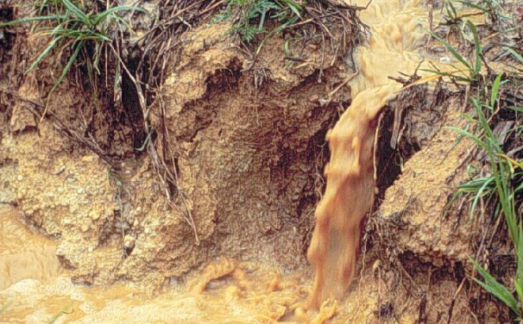
Natural Resources and Environmental Service Systems Career Focus Areas
Write down five words that come to mind when you look at this picture.

Slide 42
Natural Resources and Environmental Service Systems Career Focus Areas
One acre contains how many square feet?
a. 34,650
b. 43,560
c. 43,600
d. 36,350

Slide 43
Natural Resources and Environmental Service Systems Career Focus Areas
One acre contains how many square feet?
a. 34,650
b. 43,560
c. 43,600
d. 36,350

Slide 44
Natural Resources and Environmental Service Systems Career Focus Areas
The study of insects and their relationship with the forest is called ______.
a. Dendrology
b. Forest pathology
c. Forest hydrology
d. Forest entomology

Slide 45
Natural Resources and Environmental Service Systems Career Focus Areas
The study of insects and their relationship with the forest is called ______.
a. Dendrology
b. Forest pathology
c. Forest hydrology
d. Forest entomology

Slide 46
Natural Resources and Environmental Service Systems Career Focus Areas
Which of the following is the MOST significant reason species have become threatened or endangered?
a. Controlled as pests
b. Pesticides
c. Illegal killing
d. Landscape alteration

Slide 47
Natural Resources and Environmental Service Systems Career Focus Areas
Which of the following is the MOST significant reason species have become threatened or endangered?
a. Controlled as pests
b. Pesticides
c. Illegal killing
d. Landscape alteration

Slide 48
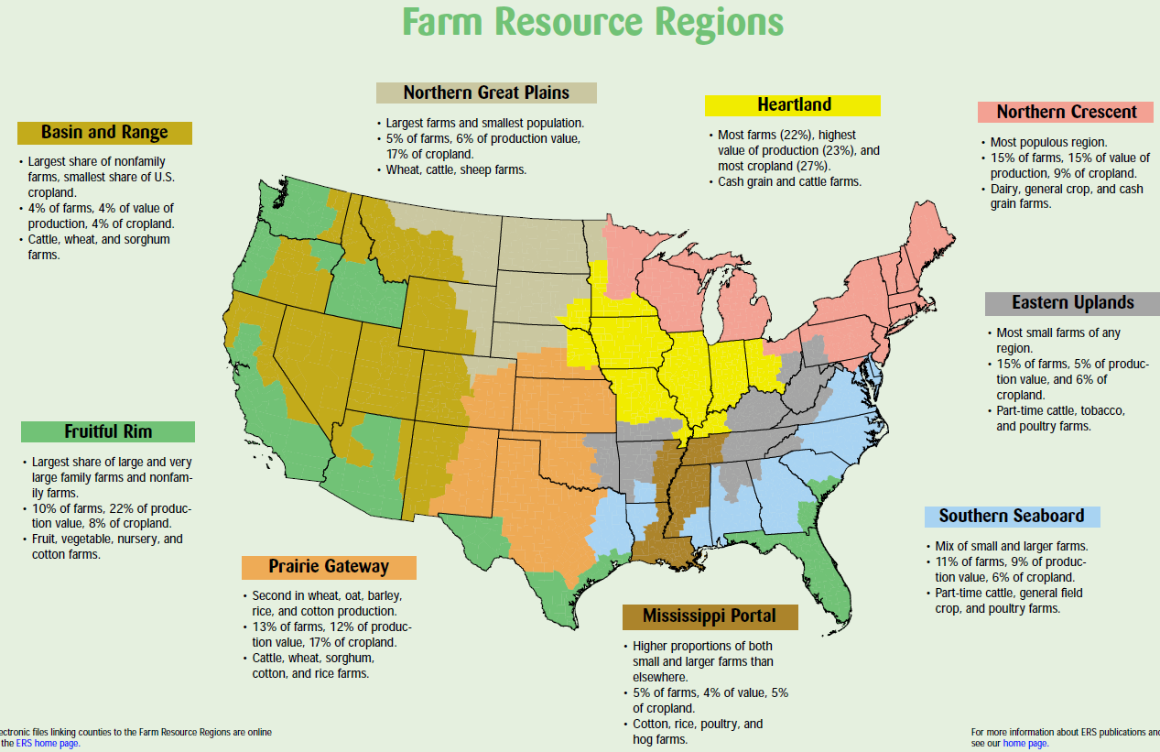
Natural Resources and Environmental Service Systems Career Focus Areas
What region do we live in, and what are some of our greatest commodities according to the map from the USDA?
(Image can be found at https://www.ers.usda.gov/webdocs/publications/42298/32489_aib-760_002.pdf?v=42487.)

Slide 49
Natural Resources and Environmental Service Systems Career Focus Areas
Utilizing the State Agricultural Facts map (https://www.agclassroom.org/teacher/ag_facts.cfm), identify and write down five interesting facts that you did not know about your state.

Slide 50

Natural Resources and Environmental Service Systems Career Focus Areas
Write a tweet about how agriculture impacted you this weekend.

Slide 51
Natural Resources and Environmental Service Systems Career Focus Areas
Find a natural resources resource/publication (https://www.fs.usda.gov/naspf/resources-and-publications) of interest to you and determine the following:
What is the issue?
Accomplishments/program status
Future direction. Be ready to share!

Slide 52
Natural Resources and Environmental Service Systems Career Focus Areas
What is the purpose and role of the U.S. Forest Service?

Slide 53
Natural Resources and Environmental Service Systems Career Focus Areas
Watch the following video:
https://youtu.be/B_WSLbw3ApA.
What benefits are there to being employed in agriculture? Identify three.

Slide 54
Natural Resources and Environmental Service Systems Career Focus Areas
What relationship exists between science and agriculture? Give two examples to illustrate your response.

Slide 55
Natural Resources and Environmental Service Systems Career Focus Areas
What is the purpose of a literature review in agriscience research?

Slide 56
Natural Resources and Environmental Service Systems Career Focus Areas
Q: What is the purpose of a literature review in agriscience research?
A: To support and show previously completed research that directly relates to your research.

Slide 57
Natural Resources and Environmental Service Systems Career Focus Areas
What is the purpose of the materials and methods section in an agriscience report/research study?

Slide 58
Natural Resources and Environmental Service Systems Career Focus Areas
Q: What is the purpose of the materials and methods section in an agriscience report/research study?
A: To give readers a clear understanding of the process and materials required to complete the research. Materials and methods also allow the reader to know how to replicate the study.

Slide 59
Natural Resources and Environmental Service Systems Career Focus Areas
What is a hypothesis? Why is a hypothesis created when completing agricultural research?

Slide 60
Natural Resources and Environmental Service Systems Career Focus Areas
Q: What is a hypothesis? Why is a hypothesis created when completing agricultural research?
A: A hypothesis is a brief statement of the anticipated results from a study being conducted. The hypothesis will be revisited in the results and conclusions section of the study write-up.

Slide 61
Natural Resources and Environmental Service Systems Career Focus Areas
What is the role/purpose of an abstract when writing an agriscience research study?

Slide 62
Natural Resources and Environmental Service Systems Career Focus Areas
Q: What is the role/purpose of an abstract when writing an agriscience research study?
A: The abstract is a brief summary of the purpose of the study, background information of the topic being studied, the materials/methods, the results and conclusions.

Slide 63
Natural Resources and Environmental Service Systems Career Focus Areas
Find an impactful member of the agricultural community from history. Create a tweet about the impact that person had on the agriculture industry.

Slide 64
Natural Resources and Environmental Service Systems Career Focus Areas
Read the article “Climate Change Could Make Food Less Healthy,” and write a three- to five-sentence response.
https://www.sciencenewsforstudents.org/blog/analyze/analyze-climate-change-could-make-food-less-healthy

Slide 65
Natural Resources and Environmental Service Systems Career Focus Areas
Read the article “Fish get pooped living in polluted water,” https://www.sciencenewsforstudents.org/article/fish-get-pooped-living-polluted-water.
1. Create a numbered lab procedure to outline the research study that was performed in this article.
2. What implications will this research have for the future of our natural resource systems?

Slide 66
Natural Resources and Environmental Service Systems Career Focus Areas
Write a two-minute elevator speech about what agriculture is/means. This elevator speech should be written for a student at the elementary level that has never taken an agriculture class.

Slide 67
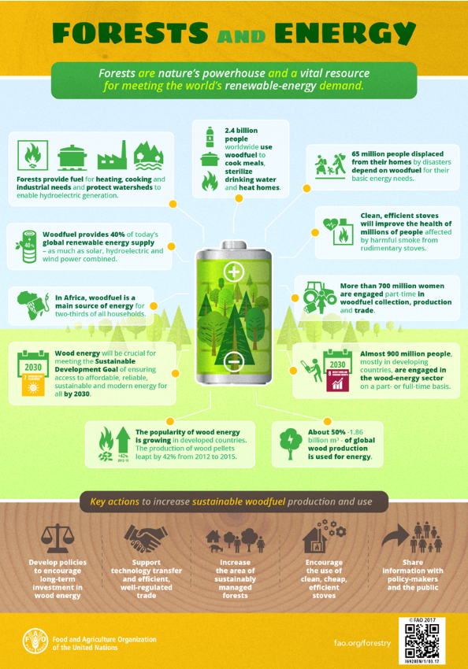
Natural Resources and Environmental Service Systems Career Focus Areas
1. What role do forests play in the need for energy across the world?
2. Why do we need to maintain and improve our forest lands?
(Image can be found at http://www.fao.org/resources/infographics/infographics-details/en/c/852816/.)

Slide 68
Natural Resources and Environmental Service Systems Career Focus Areas
The role of this governmental agency is to protect the health of humans and the environment.
a. USDA
b. EPA
c. FSIS
d. CDC

Slide 69
Natural Resources and Environmental Service Systems Career Focus Areas
The role of this governmental agency is to protect the health of humans and the environment.
a. USDA
b. EPA
c. FSIS
d. CDC

Slide 70
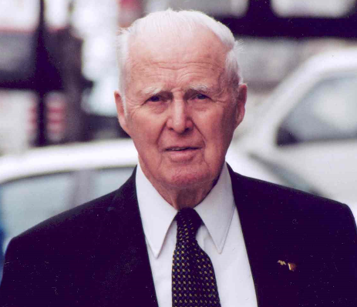
Natural Resources and Environmental Service Systems Career Focus Areas
This scientist not only was awarded the Nobel Peace Prize for his work in addressing hunger globally, but he also developed the World Food Prize to recognize those individuals making an impact in the world of agriculture.
a. George Washington Carver
b. John Deere
c. Phillip Nelson
d. Dr. Norman Borlaug

Slide 71
Natural Resources and Environmental Service Systems Career Focus Areas
This scientist not only was awarded the Nobel Peace Prize for his work in addressing hunger globally, but he also developed the World Food Prize to recognize those individuals making an impact in the world of agriculture.
a. George Washington Carver
b. John Deere
c. Phillip Nelson
d. Dr. Norman Borlaug

Slide 72
Natural Resources and Environmental Service Systems Career Focus Areas
Using the World Food Prize Laureates page, find a laureate of interest to you and write a two- to three-sentence blog post about their accomplishments and agricultural impact.
https://www.worldfoodprize.org/index.cfm?nodeID=90971&audienceID=1

Slide 73
Natural Resources and Environmental Service Systems Career Focus Areas
How many U.S. states grow wheat?
a. 22
d. 32
c. 42
d. 52

Slide 74
Natural Resources and Environmental Service Systems Career Focus Areas
How many U.S. states grow wheat?
a. 22
d. 32
c. 42
d. 52

Slide 75
Natural Resources and Environmental Service Systems Career Focus Areas
Every state in the U.S. produces honey. Which state leads in honey production?
a. California
b. Florida
c. Montana
d. North Dakota

Slide 76
Natural Resources and Environmental Service Systems Career Focus Areas
Every state in the U.S. produces honey. Which state leads in honey production?
a. California
b. Florida
c. Montana
d. North Dakota

Slide 77
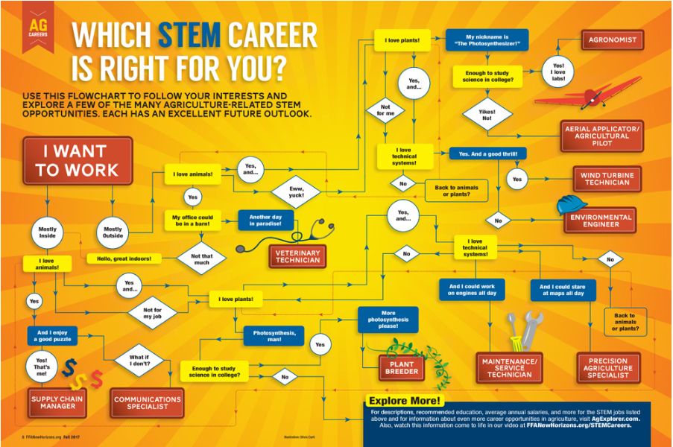
Natural Resources and Environmental Service Systems Career Focus Areas
Use the infographic above to determine what STEM career
is right for you.
Why do you think you ended up at this career? (Think about your personality and skills as you answer this question.)
(Image can be found at https://www.ffanewhorizons.org/2017/08/28/which-stem-career-is-right-for-you/.)

Slide 78
Natural Resources and Environmental Service Systems Career Focus Areas
Using this website, https://www.ffanewhorizons.org/category/ag-101/career-pathways/, select an agricultural career pathway and describe five skills necessary to be successful in that area of agriculture.

Slide 79
Natural Resources and Environmental Service Systems Career Focus Areas
Select a career focus area of interest to you (use AgExplorer.ffa.org) and create a tweet about that focus area.

Slide 80
Natural Resources and Environmental Service Systems Career Focus Areas
Identify as many agriculture courses that are offered in your school as you can.

Slide 81
Natural Resources and Environmental Service Systems Career Focus Areas
How will agriculture look in the year 2050 given the rate at which technology progresses?

Slide 82
Natural Resources and Environmental Service Systems Career Focus Areas
Watch the video available at https://youtu.be/MmCCrV1RI9Y and respond to the following questions:
1. What is a wildlife biologist?
2. What personality characteristics do you need to have to be successful in an animal biology career? Identify three characteristics.

Slide 83
Natural Resources and Environmental Service Systems Career Focus Areas
What goes around and around the wood but never goes into the wood?

Slide 84
Natural Resources and Environmental Service Systems Career Focus Areas
Q: What goes around and around the wood but never goes into the wood?
A: The bark on a tree

Slide 85
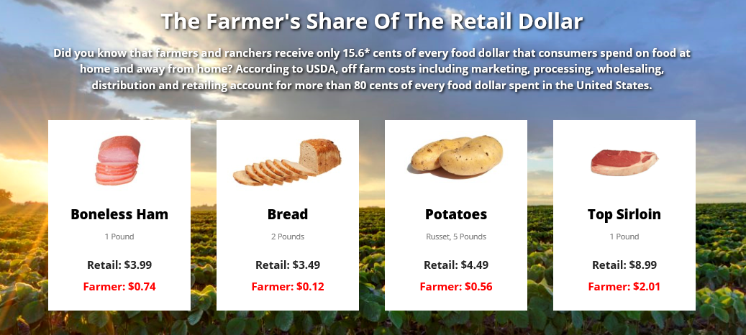
Natural Resources and Environmental Service Systems Career Focus Areas
Where does the money go when you purchase a food product at the store?
(Image can be found at https://nfu.org/.)

