Slide 1

Bell Ringers for the Agricultural Science Classroom
Plant Systems Career Focus Area

Slide 2
Plant Systems Career Focus Area
If a red house is made from red bricks, a blue house is made from blue bricks, a pink house is made from pink bricks and a black house is made from black bricks, what is a green house made of?

Slide 3
Plant Systems Career Focus Area
Q: If a red house is made from red bricks, a blue house is made from blue bricks, a pink house is made from pink bricks and a black house is made from black bricks, what is a green house made of?
A: Greenhouses are made of glass or other transparent material.

Slide 4
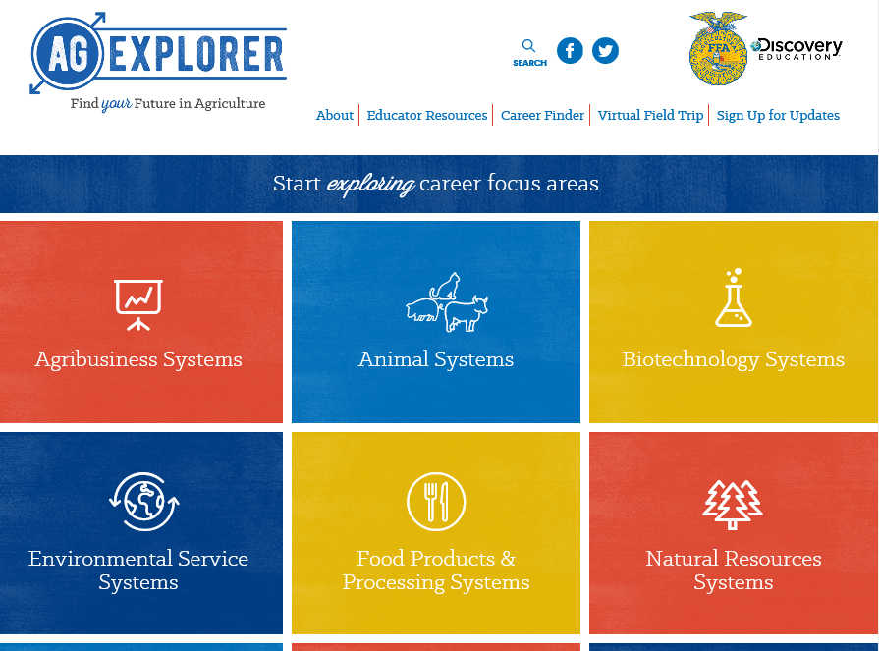
Plant Systems Career Focus Area
Go to AgExplorer.ffa.org and complete the Career Finder.

Slide 5
Plant Systems Career Focus Area
Video journaling: Watch this short video clip, reflect in writing and be ready to share responses with the class. (https://www.youtube.com/watch?v=sc4HxPxNrZ0)

Slide 6
Plant Systems Career Focus Area
Video journaling – Watch a short video clip, reflect in writing and share out.
(https://www.youtube.com/watch?v=2pXuAw1bSQo)

Slide 7
Plant Systems Career Focus Area
Video journaling – Watch a short video clip, reflect in writing and share out.
(https://www.youtube.com/watch?v=_6xlNyWPpB8)

Slide 8
Plant Systems Career Focus Area
How many people does one U.S. farm feed?
a. 56 people
b. 165 people
c. 202 people
d. 233 people

Slide 9
Plant Systems Career Focus Area
How many people does one U.S. farm feed?
a. 56 people
b. 165 people
c. 202 people
d. 233 people

Slide 10
Plant Systems Career Focus Area
Which state has the most farms?
a. Missouri
b. Iowa
c. Oklahoma
d. Texas

Slide 11
Plant Systems Career Focus Area
Which state has the most farms?
a. Missouri
b. Iowa
c. Oklahoma
d. Texas

Slide 12
Plant Systems Career Focus Area
True or False
The majority of farms in the U.S. are owned by corporations. Explain your answer in one to two sentences.

Slide 13
Plant Systems Career Focus Area
True or False
The majority of farms in the U.S. are owned by corporations. Explain your answer in one to two sentences.

Slide 14
Plant Systems Career Focus Area
Approximately how much of the U.S. is covered in trees?
a. 1/8
b. 1/4
c. 1/3
d. 2/3

Slide 15
Plant Systems Career Focus Area
Approximately how much of the U.S. is covered in trees?
a. 1/8
b. 1/4
c. 1/3
d. 2/3

Slide 16
Plant Systems Career Focus Area
Which of the following is a term used in the forestry industry to describe the segment that works with maintenance and cultivation of trees?
a. Vermiculture
b. Silviculture
c. Parasitology
d. Viticulture

Slide 17
Plant Systems Career Focus Area
Which of the following is a term used in the forestry industry to describe the segment that works with maintenance and cultivation of trees?
a. Vermiculture
b. Silviculture
c. Parasitology
d. Viticulture

Slide 18
Plant Systems Career Focus Area
Develop a list of everyday items that are produced from animal and plant byproducts. You have two minutes.

Slide 19
Plant Systems Career Focus Area
Develop a list of everyday items that are produced from animal and plant byproducts. You have two minutes.
Manufacturing: adhesives, lubricants, solvents
Construction: lumber, paint, brushes, tar paper, tool handles
Personal Care Items: shampoo, soap, cosmetics, lotions, toothpaste
Healthcare: pharmaceuticals, surgical sutures, X-ray film, latex gloves
Transportation: biofuels, lubricants, antifreeze, tires, upholstery
Sports: uniforms, baseball bats, leather equipment
Printing: ink, paper
Education: crayons, textbooks, chalk, desks, pencils
Entertainment: strings for musical instruments

Slide 20
Plant Systems Career Focus Area
Biodiesel is a fuel source created from which common agricultural commodity?
a. Corn
b. Soybeans
c. Wheat
d. Sorghum

Slide 21
Plant Systems Career Focus Area
Biodiesel is a fuel source created from which common agricultural commodity?
a. Corn
b. Soybeans
c. Wheat
d. Sorghum

Slide 22
Plant Systems Career Focus Area
In what year did John Deere begin manufacturing the steel plow?
a. 1791
b. 1802
c. 1837
d. 1868

Slide 23
Plant Systems Career Focus Area
In what year did John Deere begin manufacturing the steel plow?
a. 1791
b. 1802
c. 1837
d. 1868

Slide 24
Plant Systems Career Focus Area
Identify five careers you could have in the Plant Systems Career Focus Area.

Slide 25
Plant Systems Career Focus Area
Q: Identify five careers you could have in the Plant Systems Career Focus Area.
A: Examples: Aerial applicator/agricultural pilot, agronomist, crop advisor, formulation chemist, floral designer, etc.

Slide 26
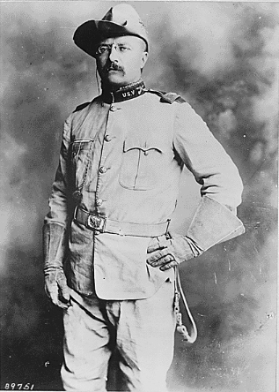
Plant Systems Career Focus Area
Which U.S. President (pictured here) was known as a conservationist for his work with the National Parks system?
a. George Washington
b. Abraham Lincoln
c. John F. Kennedy
d. Teddy Roosevelt

Slide 27
Plant Systems Career Focus Area
Which U.S. President (pictured here) was known as a conservationist for his work with the National Parks system?
a. George Washington
b. Abraham Lincoln
c. John F. Kennedy
d. Teddy Roosevelt

Slide 28
Plant Systems Career Focus Area
Unscramble the basic plant terminology:
wrelfo _____________________
emts _____________________
afle _____________________
ootr _____________________
rthuultroeic _____________________

Slide 29
Plant Systems Career Focus Area
Unscramble the basic plant terminology:
wrelfo _____________________
emts _____________________
afle _____________________
ootr _____________________
rthuultroeic _____________________
flower
stem
leaf
root
horticulture

Slide 30
Plant Systems Career Focus Area
Identify five colleges/universities that offer agriculture-related degrees.

Slide 31
Plant Systems Career Focus Area
Q: Identify five colleges/universities that offer agriculture-related degrees.
A: Examples: Purdue University, University of Illinois, Kansas State, Texas Tech, University of Maryland, etc.

Slide 32
Plant Systems Career Focus Area
Which of the following is not a grain?
a. Corn
b. Soybeans
c. Wheat
d. Sorghum

Slide 33
Plant Systems Career Focus Area
Which of the following is not a grain?
a. Corn
b. Soybeans
c. Wheat
d. Sorghum

Slide 34
Plant Systems Career Focus Area
What career area is the largest employer in the world?
a. Medicine
b. Manufacturing
c. Education
d. Agriculture

Slide 35
Plant Systems Career Focus Area
What career area is the largest employer in the world?
a. Medicine
b. Manufacturing
c. Education
d. Agriculture

Slide 36
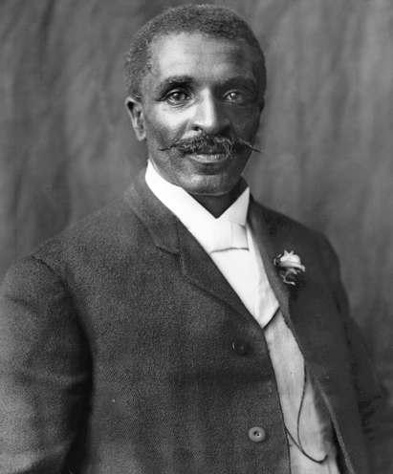
Plant Systems Career Focus Area
Pictured below, and known for his research with alternative agriculture crops (e.g., sweet potatoes, soybeans, peanuts), this scientist persevered and made a lasting impact on the agriculture industry.
a. Langston Hughes
b. Martin Luther King Jr.
c. Booker T. Washington
d. George Washington Carver

Slide 37
Plant Systems Career Focus Area
Pictured below, and known for his research with alternative agriculture crops (e.g., sweet potatoes, soybeans, peanuts), this scientist persevered and made a lasting impact on the agriculture industry.
a. Langston Hughes
b. Martin Luther King Jr.
c. Booker T. Washington
d. George Washington Carver

Slide 38
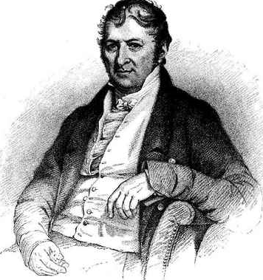
Plant Systems Career Focus Area
Cotton is an important commodity in American agriculture. What scientist (pictured below) is responsible for developing the cotton gin to increase the ability to process cotton?
a. Eli Whitney
b. Thomas Jefferson
c. Norman Borlaug
d. John Deere

Slide 39
Plant Systems Career Focus Area
Cotton is an important commodity in American agriculture. What scientist (pictured below) is responsible for developing the cotton gin to increase the ability to process cotton?
a. Eli Whitney
b. Thomas Jefferson
c. Norman Borlaug
d. John Deere

Slide 40
Plant Systems Career Focus Area
What type of tree can you carry in your hand?

Slide 41
Plant Systems Career Focus Area
Q: What type of tree can you carry in your hand?
A: A palm

Slide 42
Plant Systems Career Focus Area
What goes around and around the wood but never goes into the wood?

Slide 43
Plant Systems Career Focus Area
Q: What goes around and around the wood but never goes into the wood?
A: The bark on a tree

Slide 44
Plant Systems Career Focus Area
You throw away the outside and cook the inside, then eat the outside and throw away the inside. What is it?

Slide 45
Plant Systems Career Focus Area
Q: You throw away the outside and cook the inside, then eat the outside and throw away the inside. What is it?
A: Corn on the cob

Slide 46
Plant Systems Career Focus Area
Draw a picture of what the word agriculture means to you. You have five minutes to complete the drawing.

Slide 47
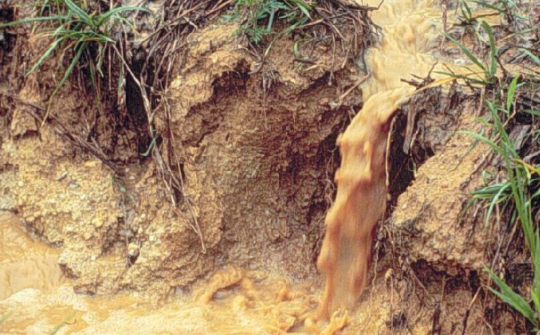
Plant Systems Career Focus Area
Write down five words that come to mind when you look at this picture.

Slide 48
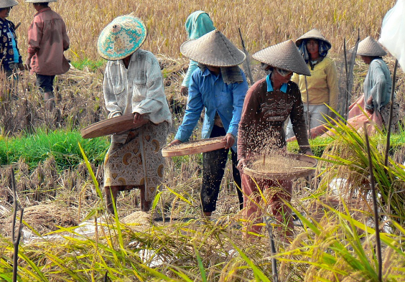
Plant Systems Career Focus Area
Write down five words that come to mind when you look at this picture.

Slide 49
Plant Systems Career Focus Area
What does USDA stand for?
a. Unified States Department of Agriculture
b. United Stated Department of Aquaculture
c. United States Department of Agriculture
d. Unknown Status for Domestic Agriculture

Slide 50
Plant Systems Career Focus Area
What does USDA stand for?
a. Unified States Department of Agriculture
b. United Stated Department of Aquaculture
c. United States Department of Agriculture
d. Unknown Status for Domestic Agriculture

Slide 51

Plant Systems Career Focus Area
Using one to two sentences, explain the purpose and labeling requirements for this seal.

Slide 52
Plant Systems Career Focus Area
Q: Using one to two sentences, explain the purpose and labeling requirements for this seal.
A: The USDA Organic seal means that the product meets the following USDA standards of an organic food product: (1) “produced without excluded methods,” (2) “produced using allowed substances” and (3) “overseen by a USDA National Organic Program-authorized certifying agent.”

Slide 53
Plant Systems Career Focus Area
The country that is the leading exporter of cut flowers to the United States floral industry is:
a. Holland
b. Ecuador
c. Mexico
d. Columbia

Slide 54
Plant Systems Career Focus Area
The country that is the leading exporter of cut flowers to the United States floral industry is:
a. Holland
b. Ecuador
c. Mexico
d. Columbia

Slide 55
Plant Systems Career Focus Area
Botanical names are written in
a. English.
b. Latin.
c. Greek.
d. German.

Slide 56
Plant Systems Career Focus Area
Botanical names are written in
a. English.
b. Latin.
c. Greek.
d. German.

Slide 57
Plant Systems Career Focus Area
______ is the single most important element to keep flowers fresh after delivery from a supplier.
a. Air/ventilation
b. Water
c. Light
d. Cool temperatures

Slide 58
Plant Systems Career Focus Area
______ is the single most important element to keep flowers fresh after delivery from a supplier.
a. Air/ventilation
b. Water
c. Light
d. Cool temperatures

Slide 59
Plant Systems Career Focus Area
One acre contains how many square feet?
a. 34,650
b. 43,560
c. 43,600
d. 36,350

Slide 60
Plant Systems Career Focus Area
One acre contains how many square feet?
a. 34,650
b. 43,560
c. 43,600
d. 36,350

Slide 61
Plant Systems Career Focus Area
The study of insects and their relationship with the forest is called ______.
a. Dendrology
b. Forest pathology
c. Forest hydrology
d. Forest entomology

Slide 62
Plant Systems Career Focus Area
The study of insects and their relationship with the forest is called ______.
a. Dendrology
b. Forest pathology
c. Forest hydrology
d. Forest entomology

Slide 63
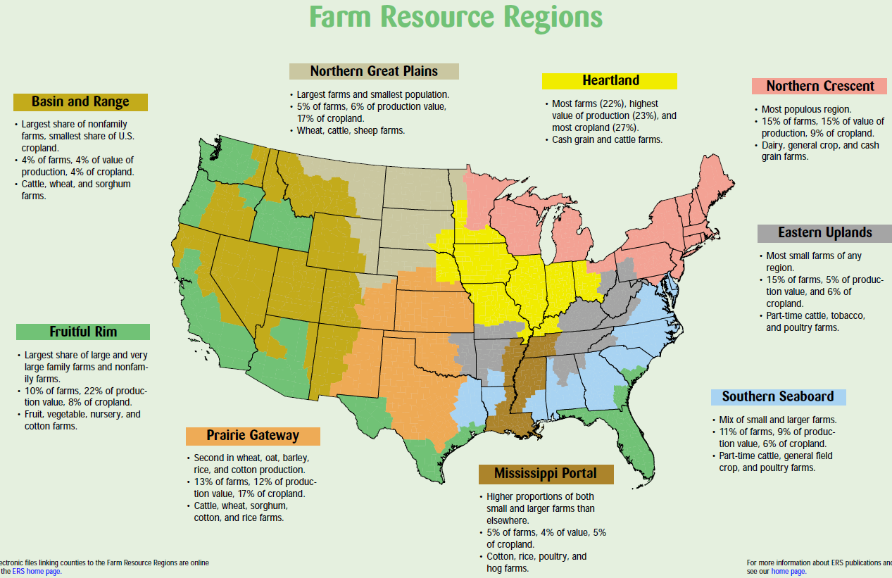
Plant Systems Career Focus Area
What region do we live in, and what are some of our greatest commodities according to the map from the USDA?
(Image can be found at https://www.ers.usda.gov/webdocs/publications/42298/32489_aib-760_002.pdf?v=42487.)

Slide 64
Plant Systems Career Focus Area
Utilizing the State Agricultural Facts map (https://www.agclassroom.org/teacher/ag_facts.cfm), identify and write down five interesting facts that you did not know about your state.

Slide 65

Plant Systems Career Focus Area
Write a tweet about how agriculture impacted you this weekend.

Slide 66
Plant Systems Career Focus Area
Watch the video available at https://youtu.be/gUtdRHUf6gw, and respond to the following questions:
1. What role does Monsanto play in the agriculture industry?
2. How does science help Monsanto find solutions for feeding the growing population?

Slide 67

Plant Systems Career Focus Area
1. What role does RFDTV: Rural America’s Most Important Network play in communicating agriculture?
2. What career area would you be involved in if you worked for RFDTV?

Slide 68
Plant Systems Career Focus Area
Watch the video available at https://youtu.be/XVbOOMCjktA, and respond to the following questions:
1. Why is growing plants in space important?
2. Why is figuring out how to grow plants in space challenging?

Slide 69
Plant Systems Career Focus Area
Watch the video available at https://youtu.be/FxMHl5Gr2Yg, and respond to the following question:
1. What are scientists doing to help feed a growing population?

Slide 70
Plant Systems Career Focus Area
What relationship exists between science and agriculture? Give two examples to illustrate your response.

Slide 71
Plant Systems Career Focus Area
What is the purpose of a literature review in agriscience research?

Slide 72
Plant Systems Career Focus Area
Q: What is the purpose of a literature review in agriscience research?
A: To support and show previously completed research that directly relates to your research

Slide 73
Plant Systems Career Focus Area
What is the purpose of the materials and methods section in an agriscience report/research study?

Slide 74
Plant Systems Career Focus Area
Q: What is the purpose of the materials and methods section in an agriscience report/research study?
A: To give readers a clear understanding of the process and materials required to complete the research. Materials and methods also allow the reader to know how to replicate the study.

Slide 75
Plant Systems Career Focus Area
What is a hypothesis? Why is a hypothesis created when completing agricultural research?

Slide 76
Plant Systems Career Focus Area
Q: What is a hypothesis? Why is a hypothesis created when completing agricultural research?
A: A hypothesis is a brief statement of the anticipated results from a study being conducted. The hypothesis will be revisited in the results and conclusions section of the study write-up.

Slide 77
Plant Systems Career Focus Area
What is the role/purpose of an abstract when writing an agriscience research study?

Slide 78
Plant Systems Career Focus Area
Q: What is the role/purpose of an abstract when writing an agriscience research study?
A: The abstract is a brief summary of the purpose of the study, background information of the topic being studied, the materials/methods, the results and conclusions.

Slide 79
Plant Systems Career Focus Area
In which career development event (CDE) do participants often create a floral arrangement?
a. Nursery/landscape
b. Horticulture
c. Floriculture
d. Forestry

Slide 80
Plant Systems Career Focus Area
In which career development event (CDE) do participants often create a floral arrangement?
a. Nursery/landscape
b. Horticulture
c. Floriculture
d. Forestry

Slide 81
Plant Systems Career Focus Area
Find an impactful member of the agricultural community from history. Create a tweet about the impact that person had on the agriculture industry.

Slide 82
Plant Systems Career Focus Area
Read the following article and respond with six emojis that represent your thoughts/feelings about the material: https://newsela.com/read/elem-san-francisco-hotel-rooftop-bees/id/41820.

Slide 83
Plant Systems Career Focus Area
Read the article “Fish get pooped living in polluted water,” https://www.sciencenewsforstudents.org/article/fish-get-pooped-living-polluted-water.
1. Create a numbered lab procedure to outline the research study that was performed in this article.
2. What implications will this research have for the future of our natural resource systems?

Slide 84
Plant Systems Career Focus Area
Read the article “New ‘tattoo’ could lead to drought-tolerant crops,” https://www.sciencenewsforstudents.org/article/new-tattoo-could-lead-drought-tolerant-crops.
1. Using three to five sentences, describe the impact this technology could have on addressing the growing food crisis in the world.

Slide 85
Plant Systems Career Focus Area
Read the article “Robots will control everything you eat,” https://www.sciencenewsforstudents.org/article/robots-will-control-everything-you-eat.
1. List three facts and three opinions you have regarding the utilization of robots in agriculture.

Slide 86
Plant Systems Career Focus Area
Write a two-minute elevator speech about what agriculture is/means. This elevator speech should be written for a student at the elementary level that has never taken an agriculture class.

Slide 87

Plant Systems Career Focus Area
From the infographic, select one of the five benefits of school gardens, and using two to five sentences, explain why this benefit would be the greatest for YOUR school and program.
(Image can be found at http://www.fao.org/resources/infographics/infographics-details/en/c/1107110/.)

Slide 88
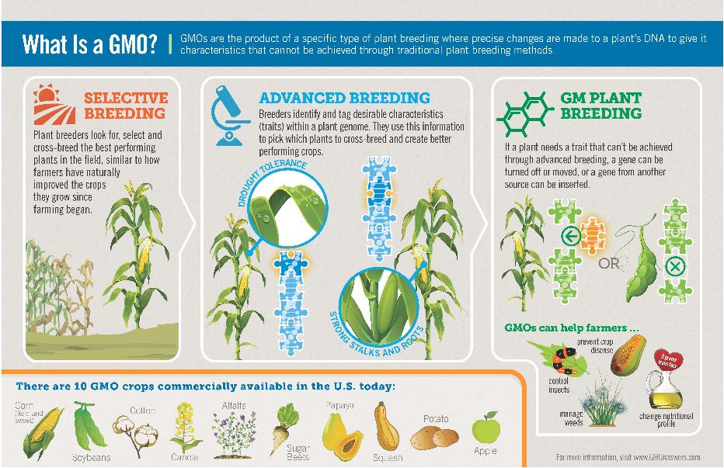
Plant Systems Career Focus Area
Use the infographic “What Is a GMO?” to explain what a GMO is. Imagine you are writing this explanation to a friend; use two to five sentences.
(Image can be found at https://gmoanswers.com/gmo-basics.)

Slide 89
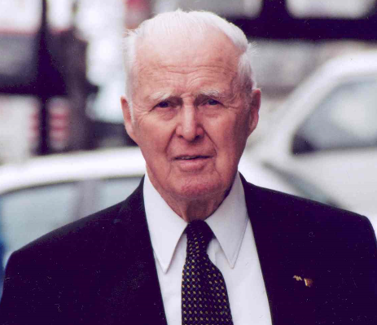
Plant Systems Career Focus Area
This scientist not only was awarded the Nobel Peace Prize for his work in addressing hunger globally, but he also developed the World Food Prize to recognize those individuals making an impact in the world of agriculture.
a. George Washington Carver
b. John Deere
c. Phillip Nelson
d. Dr. Norman Borlaug

Slide 90
Plant Systems Career Focus Area
This scientist not only was awarded the Nobel Peace Prize for his work in addressing hunger globally, but he also developed the World Food Prize to recognize those individuals making an impact in the world of agriculture.
a. George Washington Carver
b. John Deere
c. Phillip Nelson
d. Dr. Norman Borlaug

Slide 91
Plant Systems Career Focus Area
Using the World Food Prize Laureates page, find a laureate of interest to you and write a two- to three-sentence blog post about their accomplishments and agricultural impact. (https://www.worldfoodprize.org/index.cfm?nodeID=90971&audienceID=1)

Slide 92
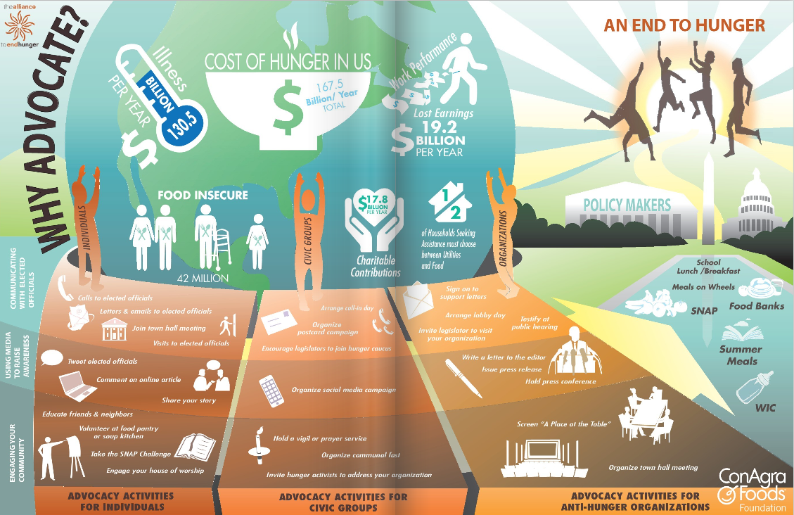
Plant Systems Career Focus Area
Using two to three sentences, explain why and how you should advocate for hunger.
(Image can be found at http://alliancetoendhunger.org/aeh-playbook/.)

Slide 93
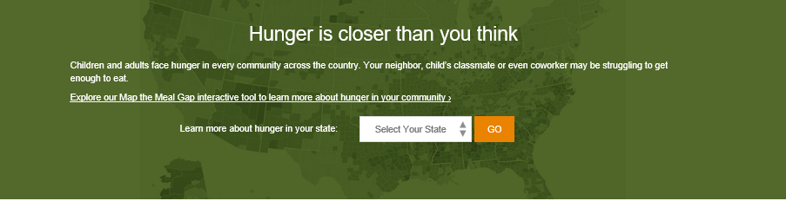
Plant Systems Career Focus Area
Go to the Feeding America “Hunger is Closer than You Think” website (http://www.feedingamerica.org/hunger-in-america/) and select your state. Draw a picture that accurately represents what your state looks like regarding hunger.

Slide 94
Plant Systems Career Focus Area
How many U.S. states grow wheat?
a. 22
b. 32
c. 42
d. 52

Slide 95
Plant Systems Career Focus Area
How many U.S. states grow wheat?
a. 22
b. 32
c. 42
d. 52

Slide 96
Plant Systems Career Focus Area
Every state in U.S. produces honey. Which state leads in honey production?
a. California
b. Florida
c. Montana
d. North Dakota

Slide 97
Plant Systems Career Focus Area
Every state in U.S. produces honey. Which state leads in honey production?
a. California
b. Florida
c. Montana
d. North Dakota

Slide 98
Plant Systems Career Focus Area
New crop protection products go through many steps before being approved for use in the industry. Approximately how long does the process from concept development to approval take?
a. 2 years
b. 7 years
c. 11 years
d. 13 years

Slide 99
Plant Systems Career Focus Area
New crop protection products go through many steps before being approved for use in the industry. Approximately how long does the process from concept development to approval take?
a. 2 years
b. 7 years
c. 11 years
d. 13 years

Slide 100
Plant Systems Career Focus Area
What country consumes the most coffee in the world?
a. Brazil
b. Columbia
c. England
d. United States

Slide 101
Plant Systems Career Focus Area
What country consumes the most coffee in the world?
a. Brazil
b. Columbia
c. England
d. United States

Slide 102
Plant Systems Career Focus Area
Which state is the leader in total corn production?
a. Nebraska
b. Iowa
c. Illinois
d. Minnesota

Slide 103
Plant Systems Career Focus Area
Which state is the leader in total corn production?
a. Nebraska
b. Iowa
c. Illinois
d. Minnesota

Slide 104
Plant Systems Career Focus Area
Which country consumes the most corn?
a. China
b. United States
c. European Union
d. Brazil

Slide 105
Plant Systems Career Focus Area
Which country consumes the most corn?
a. China
b. United States
c. European Union
d. Brazil

Slide 106
Plant Systems Career Focus Area
Which of the following grain commodities also goes by the name “milo”?
a. Corn
b. Soybean
c. Alfalfa
d. Sorghum

Slide 107
Plant Systems Career Focus Area
Which of the following grain commodities also goes by the name “milo”?
a. Corn
b. Soybean
c. Alfalfa
d. Sorghum

Slide 108
Plant Systems Career Focus Area
Ethanol is a fuel made from what grain commodity?
a. Corn
b. Soybeans
c. Wheat
d. Coffee

Slide 109
Plant Systems Career Focus Area
Ethanol is a fuel made from what grain commodity?
a. Corn
b. Soybeans
c. Wheat
d. Coffee

Slide 110
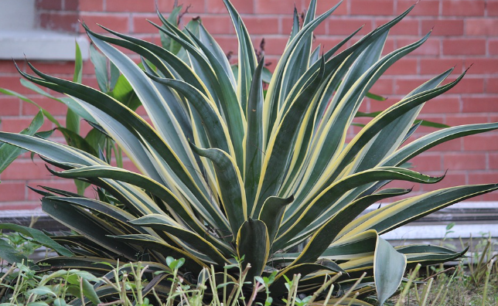
Plant Systems Career Focus Area
Identify the following plant:
a. African violet.
b. Dumb cane.
c. Aloe plant.
d. Snake plant.

Slide 111
Plant Systems Career Focus Area
Identify the following plant:
a. African violet.
b. Dumb cane.
c. Aloe plant.
d. Snake plant.

Slide 112
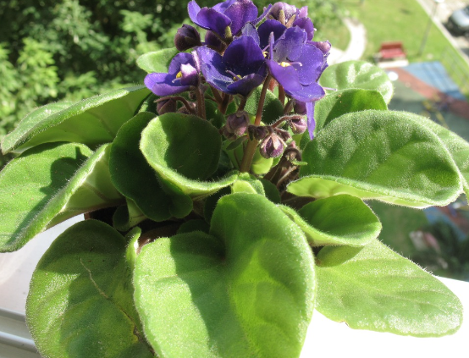
Plant Systems Career Focus Area
Identify the following plant:
a. African violet.
b. Dumb cane.
c. Aloe plant.
d. Snake plant

Slide 113
Plant Systems Career Focus Area
Identify the following plant:
a. African violet.
b. Dumb cane.
c. Aloe plant.
d. Snake plant.

Slide 114

Plant Systems Career Focus Area
Identify the following tool:
a. Propagation mat.
b. Shade fabric.
c. Polyethylene film.
d. Peat moss.

Slide 115
Plant Systems Career Focus Area
Identify the following tool:
a. Propagation mat.
b. Shade fabric.
c. Polyethylene film.
d. Peat moss.

Slide 116
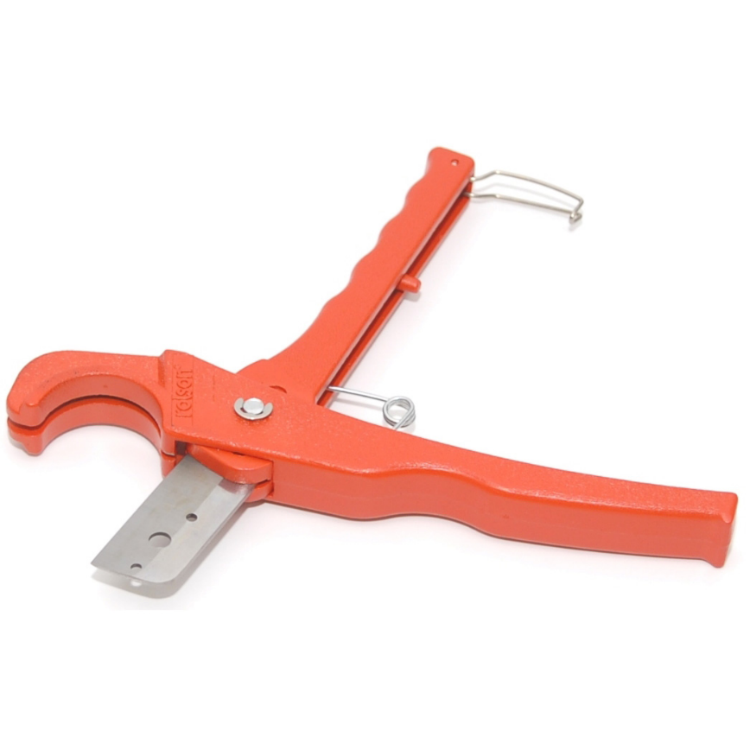
Plant Systems Career Focus Area
Identify the following tool:
a. Peat moss.
b. PVC pipe cutter.
c. Anvil blade pruners.
d. Bypass pruners.

Slide 117
Plant Systems Career Focus Area
Identify the following tool:
a. Peat moss.
b. PVC pipe cutter.
c. Anvil blade pruners.
d. Bypass pruners.

Slide 118
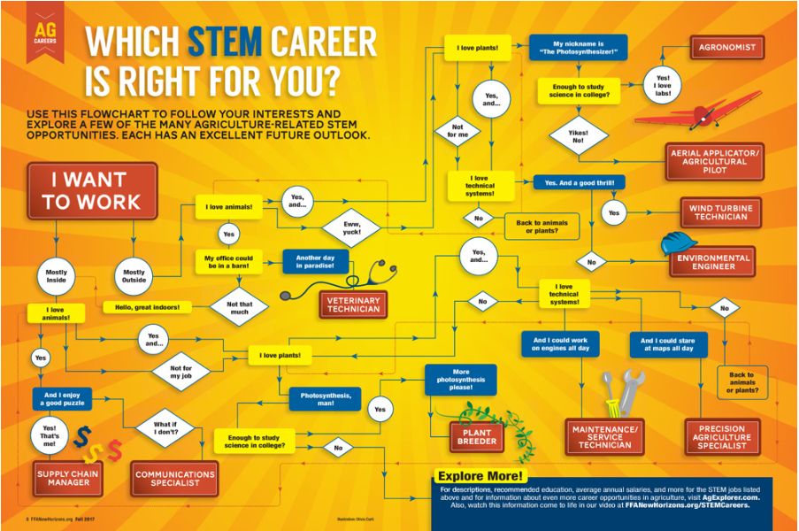
Plant Systems Career Focus Area
Use the infographic to determine what STEM career is
right for you.
Why do you think you ended up at this career? (Think about your personality and skills as you answer this question.)
(Image can be found at https://www.ffanewhorizons.org/2017/08/28/which-stem-career-is-right-for-you/.)

Slide 119
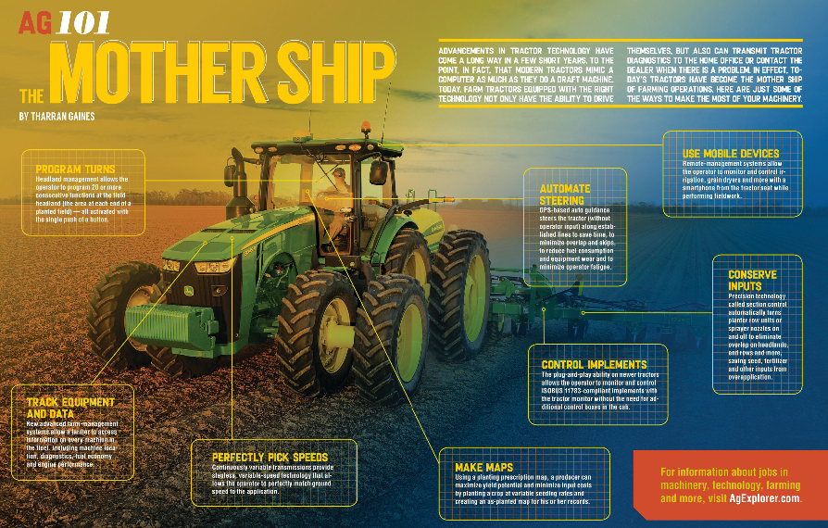
Plant Systems Career Focus Area
1. How has agricultural technology evolved over the years?
What impact does this change have on agriculture’s ability
to feed a growing population?
(Image can be found at https://www.ffanewhorizons.org/2017/11/22/ag-101-the-mother-ship/.)

Slide 120
Plant Systems Career Focus Area
Select a career focus area of interest to you (use AgExplorer.ffa.org) and create a tweet about that focus area.

Slide 121
Plant Systems Career Focus Area
Identify as many agriculture courses that are offered in your school as you can.

Slide 122
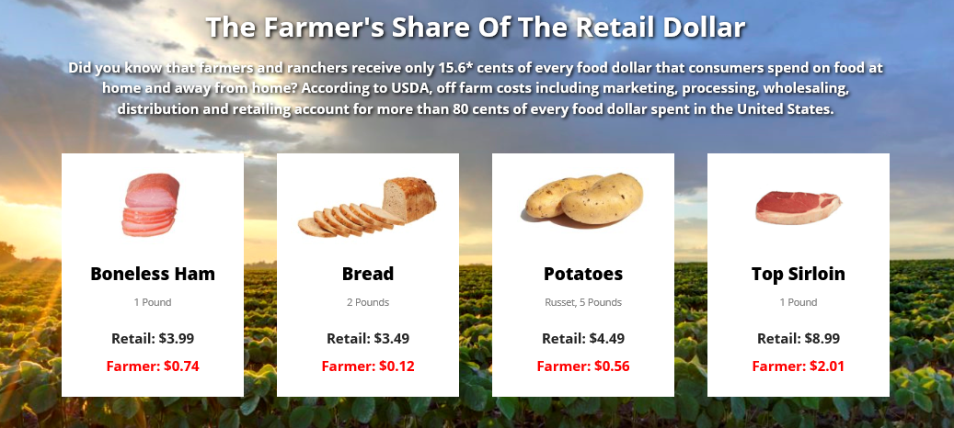
Plant Systems Career Focus Area
Where does the money go when you purchase a food product at the store?
(Image can be found at https://nfu.org/.)

