Slide 1

Bell Ringers for the Agricultural Science Classroom
Power, Structural and Technical Systems Career Focus Area

Slide 2
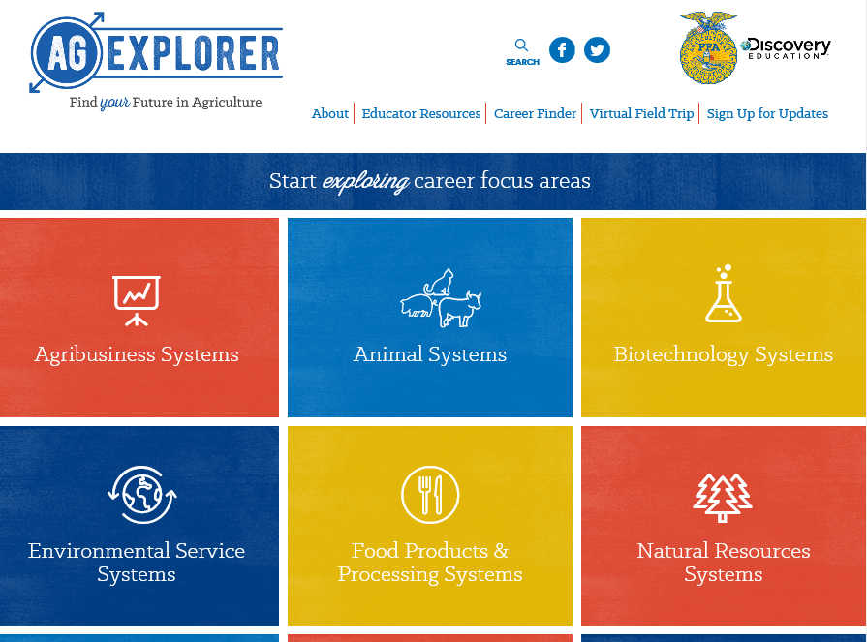
Power, Structural and Technical Systems Career Focus Area
Go to AgExplorer.ffa.organd complete the Career Finder.

Slide 3
Power, Structural and Technical Systems Career Focus Area
Video journaling: Watch this short video clip, reflect in writing and be ready to share responses with the class. (https://www.youtube.com/watch?v=sc4HxPxNrZ0)

Slide 4
Power, Structural and Technical Systems Career Focus Area
Biodiesel is a fuel source created from which common agricultural commodity?
a. Corn
b. Soybeans
c. Wheat
d. Sorghum

Slide 5
Power, Structural and Technical Systems Career Focus Area
Biodiesel is a fuel source created from which common agricultural commodity?
a. Corn
b. Soybeans
c. Wheat
d. Sorghum

Slide 6
Power, Structural and Technical Systems Career Focus Area
In what year did John Deere begin manufacturing the steel plow?
a. 1791
b. 1802
c. 1837
d. 1868

Slide 7
Power, Structural and Technical Systems Career Focus Area
In what year did John Deere begin manufacturing the steel plow?
a. 1791
b. 1802
c. 1837
d. 1868

Slide 8
Power, Structural and Technical Systems Career Focus Area
In what year was barbed wire invented and utilized for livestock?
a. 1791
b. 1802
c. 1837
d. 1867

Slide 9
Power, Structural and Technical Systems Career Focus Area
In what year was barbed wire invented and utilized for livestock?
a. 1791
b. 1802
c. 1837
d. 1867

Slide 10
Power, Structural and Technical Systems Career Focus Area
What are the parts of the 3-Component Model for School-Based Agricultural Education?
a. Animals, plants, foods
b. Family, friends, agriculture
c. Careers, classroom, SAE
d. Classroom, SAE, FFA

Slide 11
Power, Structural and Technical Systems Career Focus Area
What are the parts of the 3-Component Model for School-Based Agricultural Education?
a. Animals, plants, foods
b. Family, friends, agriculture
c. Careers, classroom, SAE
d. Classroom, SAE, FFA

Slide 12
Power, Structural and Technical Systems Career Focus Area
Identify two ways you can advocate for agriculture.

Slide 13
Power, Structural and Technical Systems Career Focus Area
Q: Identify two ways you can advocate for agriculture.
A: Example: Utilize social media in a professional manner.

Slide 14
Power, Structural and Technical Systems Career Focus Area
Identify five careers you could have in the Power, Structural and Technical Systems Career Focus Area.

Slide 15
Power, Structural and Technical Systems Career Focus Area
Q: Identify five careers you could have in the Power, Structural and Technical Systems Career Focus Area.
A: Example: Construction foreman, brand manager, electrical engineer, design engineer, hydraulic technician, etc.

Slide 16
Power, Structural and Technical Systems Career Focus Area
Identify five colleges/universities that offer agriculture-related degrees.

Slide 17
Power, Structural and Technical Systems Career Focus Area
Q: Identify five colleges/universities that offer agriculture-related degrees.
A: Examples: Purdue University, University of Illinois, Kansas State, Texas Tech, University of Maryland, etc.

Slide 18
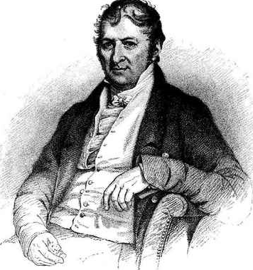
Power, Structural and Technical Systems Career Focus Area
Cotton is an important commodity to American agriculture. What scientist (pictured here) is responsible for developing the cotton gin to increase the ability to process cotton?
a. Eli Whitney
b. Thomas Jefferson
c. Norman Borlaug
d. John Deere

Slide 19
Power, Structural and Technical Systems Career Focus Area
Cotton is an important commodity to American agriculture. What scientist (pictured here) is responsible for developing the cotton gin to increase the ability to process cotton?
a. Eli Whitney
b. Thomas Jefferson
c. Norman Borlaug
d. John Deere

Slide 20
Power, Structural and Technical Systems Career Focus Area
If an electric train is traveling south, which way is the smoke blowing?

Slide 21
Power, Structural and Technical Systems Career Focus Area
Q: If an electric train is traveling south, which way is the smoke blowing?
A: There is no smoke if the train is electric.

Slide 22
Power, Structural and Technical Systems Career Focus Area
In a one-story pink house, there was a pink person, a pink cat, a pink fish, a pink computer, a pink chair, a pink table, a pink telephone, a pink shower — everything was pink! What color were the stairs?

Slide 23
Power, Structural and Technical Systems Career Focus Area
Q: In a one-story pink house, there was a pink person, a pink cat, a pink fish, a pink computer, a pink chair, a pink table, a pink telephone, a pink shower — everything was pink! What color were the stairs?
A: It is a one-story house, which means there aren’t any stairs.

Slide 24
Power, Structural and Technical Systems Career Focus Area
Which weighs more, a pound of feathers or a pound of bricks?

Slide 25
Power, Structural and Technical Systems Career Focus Area
Q: Which weighs more, a pound of feathers or a pound of bricks?
A: Neither, they both weigh one pound.

Slide 26
Power, Structural and Technical Systems Career Focus Area
Draw a picture of what the word agriculture means to you. You have five minutes to complete the drawing.

Slide 27
Power, Structural and Technical Systems Career Focus Area
Steel angle iron is sold for $1.46 per linear foot, steel rod is sold for $0.94 per linear foot and steel pipe is sold for $2.76 per linear foot. If 35.5 feet of angle iron, 12 feet of rod and 100 inches of pipe are purchased, and 7 percent taxes are paid with the purchase, what is the approximate total price for the metal?
a. $78.14
b. $86.11
c. $92.14
d. $100.11

Slide 28
Power, Structural and Technical Systems Career Focus Area
Steel angle iron is sold for $1.46 per linear foot, steel rod is sold for $0.94 per linear foot and steel pipe is sold for $2.76 per linear foot. If 35.5 feet of angle iron, 12 feet of rod and 100 inches of pipe are purchased, and 7 percent taxes are paid with the purchase, what is the approximate total price for the metal?
a. $78.14
b. $86.11
c. $92.14
d. $100.11
35.5’ x $1.46/ft = $51.83
12’ x $0.94/ft = $11.28
100” / 12” x $2.76/ft = $23
Total = $86.11
$86.11 x 1.07tax = $92.14

Slide 29
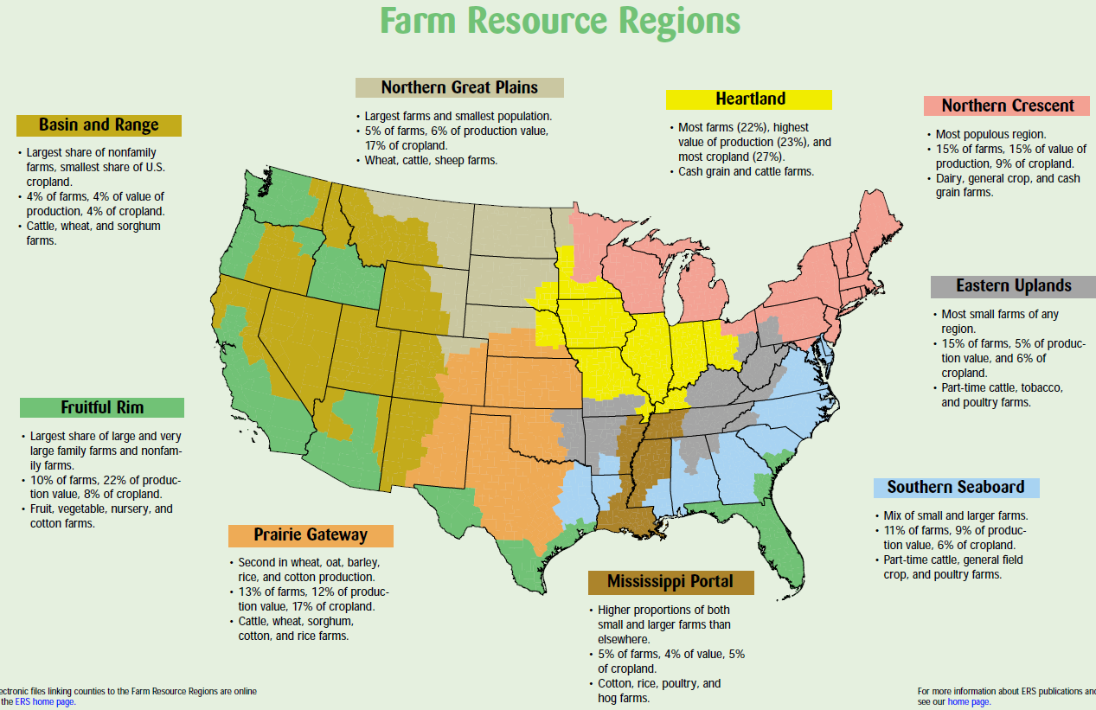
Power, Structural and Technical Systems Career Focus Area
What region do we live in, and what are some of our greatest commodities according to the map from the USDA?
(Image can be found at https://www.ers.usda.gov/webdocs/publications/42298/32489_aib-760_002.pdf?v=42487.)

Slide 30
Power, Structural and Technical Systems Career Focus Area
Utilizing the State Agricultural Facts map (https://www.agclassroom.org/teacher/ag_facts.cfm), identify and write down five interesting facts that you did not know about your state.

Slide 31

Power, Structural and Technical Systems Career Focus Area
Write a tweet about how agriculture impacted you this weekend.

Slide 32
Power, Structural and Technical Systems Career Focus Area
Watch the following video: https://youtu.be/wfILgW3Lglk.
What role does CSX Transportation play in the agriculture industry?
Identify two careers you could have through CSX Transportation.

Slide 33
Power, Structural and Technical Systems Career Focus Area
Watch the following video: https://youtu.be/0PU6BkSMUoA .
What careers exist in agriculture that are not production based?
What role do America’s farmers play in our economy?

Slide 34
Power, Structural and Technical Systems Career Focus Area
Watch the following video:
https://youtu.be/B_WSLbw3ApA.
What benefits are there to being employed in agriculture?
Identify three.

Slide 35
Power, Structural and Technical Systems Career Focus Area
Find an impactful member of the agricultural community from history. Create a tweet about the impact that person had on the agriculture industry.

Slide 36
Power, Structural and Technical Systems Career Focus Area
Read the article “Robots will control everything you eat,” https://www.sciencenewsforstudents.org/article/robots-will-control-everything-you-eat.
List three facts and three opinions you have regarding the utilization of robots in agriculture.

Slide 37
Power, Structural and Technical Systems Career Focus Area
Write a two-minute elevator speech about what agriculture is/means. This elevator speech should be written for a student at the elementary level that has never taken an agriculture class.

Slide 38
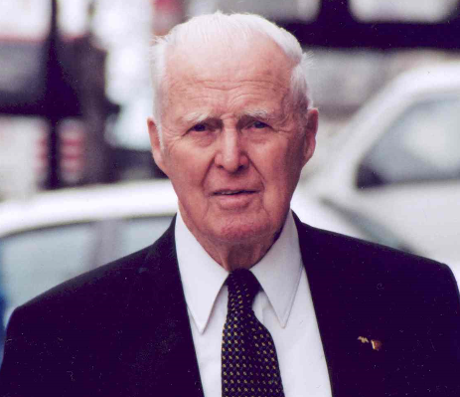
Power, Structural and Technical Systems Career Focus Area
This scientist not only was awarded the Nobel Peace Prize for his work in addressing hunger globally, but he also developed the World Food Prize to recognize those individuals making an impact in the world of agriculture.
a. George Washington Carver
b. John Deere
c. Phillip Nelson
d. Dr. Norman Borlaug

Slide 39
Power, Structural and Technical Systems Career Focus Area
This scientist not only was awarded the Nobel Peace Prize for his work in addressing hunger globally, but he also developed the World Food Prize to recognize those individuals making an impact in the world of agriculture.
a. George Washington Carver
b. John Deere
c. Phillip Nelson
d. Dr. Norman Borlaug

Slide 40
Power, Structural and Technical Systems Career Focus Area
Using the World Food Prize Laureates page, find a laureate of interest to you and write a two- to three-sentence blog post about their accomplishments and agricultural impact. (https://www.worldfoodprize.org/index.cfm?nodeID=90971&audienceID=1)

Slide 41
Power, Structural and Technical Systems Career Focus Area
Watch the video “Ag & Bio Engineering: Meeting the Needs of Humankind” (https://youtu.be/WM16bY0W8o8).
1. What does an agricultural and biological engineer do?
2. What impact do they have on the world and economy?

Slide 42
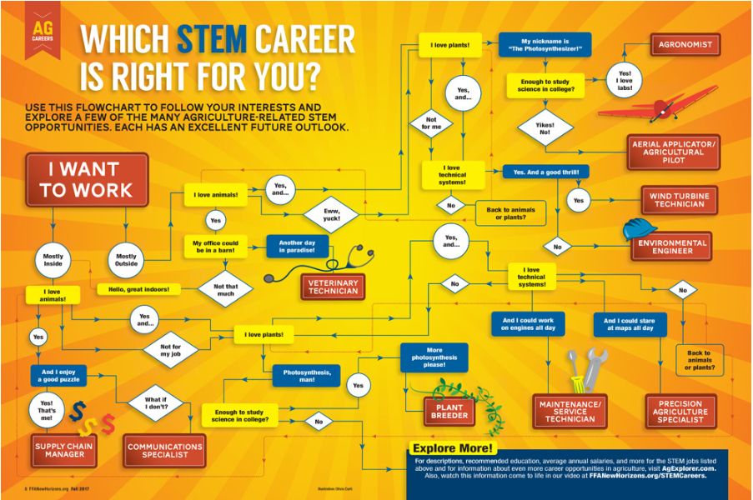
Power, Structural and Technical Systems Career Focus Area
Use the infographic above to determine what STEM career is right for you.
Why do you think you ended up at this career? (Think about your personality and skills as you answer this question.)
(Image can be found at https://www.ffanewhorizons.org/2017/08/28/which-stem-career-is-right-for-you/.)

Slide 43
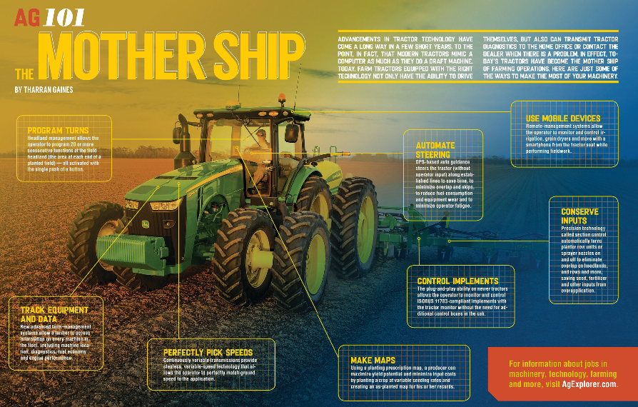
Power, Structural and Technical Systems Career Focus Area
How has agricultural technology evolved over the years?
What impact does this change have on agriculture’s ability to feed a growing population?
(Image can be found at https://www.ffanewhorizons.org/2017/11/22/ag-101-the-mother-ship/.)

Slide 44
Power, Structural and Technical Systems Career Focus Area
Go to the website https://www.ffanewhorizons.org/category/ag-101/career-pathways/, select an agricultural career pathway and describe five skills necessary to be successful in that area of agriculture.

Slide 45
Power, Structural and Technical Systems Career Focus Area
Select a career focus area of interest to you (use AgExplorer.ffa.org) and create a tweet about that focus area.

Slide 46
Power, Structural and Technical Systems Career Focus Area
Identify as many agriculture courses that are offered in your school as you can.

Slide 47
Power, Structural and Technical Systems Career Focus Area
How will agriculture look in the year 2050 given the rate at which technology progresses?

Slide 48
Power, Structural and Technical Systems Career Focus Area
Watch the video available at https://youtu.be/kVMEfoaLB5Y, and respond to the following questions:
What skills do you need to be successful in an ag and turf technician career?
What education requirements exist for this type of career?

Slide 49
Power, Structural and Technical Systems Career Focus Area
If each outlet on an electrical circuit theoretically uses 1.5 amperes, approximately how many outlets may safely be installed on a circuit meant to carry a maximum of 20 amperes?
a. 10 outlets
b. 13 outlets
c. 18 outlets
d. 20 outlets

Slide 50
Power, Structural and Technical Systems Career Focus Area
If each outlet on an electrical circuit theoretically uses 1.5 amperes, approximately how many outlets may safely be installed on a circuit meant to carry a maximum of 20 amperes?
a. 10 outlets
b. 13 outlets
c. 18 outlets
d. 20 outlets
Outlets = 20 amps ÷ 1.5 amps/outlet = 13.33 outlets

Slide 51
Power, Structural and Technical Systems Career Focus Area
You are applying for a fuel tax rebate. The amount of fuel road tax is 32 cents per gallon. If the refund is 50 percent of this amount, what is the refund for 8,000 gallons of fuel?
a. $1,280
b. $2,560
c. $3,840
d. $5,120

Slide 52
Power, Structural and Technical Systems Career Focus Area
You are applying for a fuel tax rebate. The amount of fuel road tax is 32 cents per gallon. If the refund is 50 percent of this amount, what is the refund for 8,000 gallons of fuel?
a. $1,280
b. $2,560
c. $3,840
d. $5,120
$0.16 x 8,000 = $1,280

Slide 53
Power, Structural and Technical Systems Career Focus Area
A skid steer was purchased five years ago for $44,600 and has an estimated 10-year life. If the accumulated depreciation is $23,400, what is the current book value?
a. $21,200
b. $23,400
c. $28,600
d. $44,600

Slide 54
Power, Structural and Technical Systems Career Focus Area
A skid steer was purchased five years ago for $44,600 and has an estimated 10-year life. If the accumulated depreciation is $23,400, what is the current book value?
a. $21,200
b. $23,400
c. $28,600
d. $44,600
$44,600 - $23,400 = $21,200

Slide 55
Power, Structural and Technical Systems Career Focus Area
Assume convenience outlets will be placed a maximum of 20 feet apart along the outside walls in the farm machinery shed. If the shed is rectangular, measuring 60 feet by 225 feet, what is the minimum number of convenience outlets required for this installation?
a. 29
b. 27
c. 15
d. 14

Slide 56
Power, Structural and Technical Systems Career Focus Area
Assume convenience outlets will be placed a maximum of 20 feet apart along the outside walls in the farm machinery shed. If the shed is rectangular, measuring 60 feet by 225 feet, what is the minimum number of convenience outlets required for this installation?
a. 29
b. 27
c. 15
d. 14
225 + 225 + 60 + 60 = 570ft → 570ft/20ft = 28.5

Slide 57
Power, Structural and Technical Systems Career Focus Area
What is another name for “stick” welding?
a. Gas metal arc welding
b. Tungsten inert gas welding
c. Shielded metal arc welding
d. Flux core arc welding

Slide 58
Power, Structural and Technical Systems Career Focus Area
What is another name for “stick” welding?
a. Gas metal arc welding
b. Tungsten inert gas welding
c. Shielded metal arc welding
d. Flux core arc welding

Slide 59
Power, Structural and Technical Systems Career Focus Area
What is the approximate temperature of the arc in shielded metal arc welding?
a. 1,250 to 1,850 degrees Fahrenheit
b. 2,000 to 3,500 degrees Fahrenheit
c. 4,000 to 5,500 degrees Fahrenheit
d. 6,500 to 7,000 degrees Fahrenheit

Slide 60
Power, Structural and Technical Systems Career Focus Area
What is the approximate temperature of the arc in shielded metal arc welding?
a. 1,250 to 1,850 degrees Fahrenheit
b. 2,000 to 3,500 degrees Fahrenheit
c. 4,000 to 5,500 degrees Fahrenheit
d. 6,500 to 7,000 degrees Fahrenheit

Slide 61
Power, Structural and Technical Systems Career Focus Area
What is the name of the mix of base metal and filler rod that remains after a weld is complete?
a. Slag
b. Bead
c. Crater
d. Electrode

Slide 62
Power, Structural and Technical Systems Career Focus Area
What is the name of the mix of base metal and filler rod that remains after a weld is complete?
a. Slag
b. Bead
c. Crater
d. Electrode

Slide 63
Power, Structural and Technical Systems Career Focus Area
How many board feet are 15 pieces of 1” x 4” lumbers that are 8 feet long (use nominal not actual measurements).
a. 15
b. 40
c. 60
d. 66

Slide 64
Power, Structural and Technical Systems Career Focus Area
How many board feet are 15 pieces of 1” x 4” lumbers that are 8 feet long (use nominal not actual measurements).
a. 15
b. 40
c. 60
d. 66
(1in. x 4in. x 8ft)/12 x 15 = 39.99

Slide 65
Power, Structural and Technical Systems Career Focus Area
A total of 478.5 feet of steel rod is used to construct a hay feeding rack, and the rod weighs 0.658 pounds per foot of length. If the filler metal from welding adds an additional 2.8 pounds to the overall weight, what is the approximate total weight of the hay feeding rack?
a. 224 lbs.
b. 273 lbs.
c. 318 lbs.
d. 329 lbs.

Slide 66
Power, Structural and Technical Systems Career Focus Area
A total of 478.5 feet of steel rod is used to construct a hay feeding rack, and the rod weighs 0.658 pounds per foot of length. If the filler metal from welding adds an additional 2.8 pounds to the overall weight, what is the approximate total weight of the hay feeding rack?
a. 224 lbs.
b. 273 lbs.
c. 318 lbs.
d. 329 lbs.
[(478.5 ft) x (0.68 lbs./ft)] + 2.8 lbs. = 328.18 lbs.

