Slide 1




Slide 2


Collegiate FFA
Collegiate FFA provides a number of professional development opportunities to help students get an edge in today’s job market.
Whether you are looking for a career in education or industry, Collegiate FFA has what you need to jump start your career!

Slide 3
Collegiate FFA Programs
National Collegiate Agriculture Ambassadors
International Collegiate Agricultural Leadership Program
New Century Farmer

Slide 4
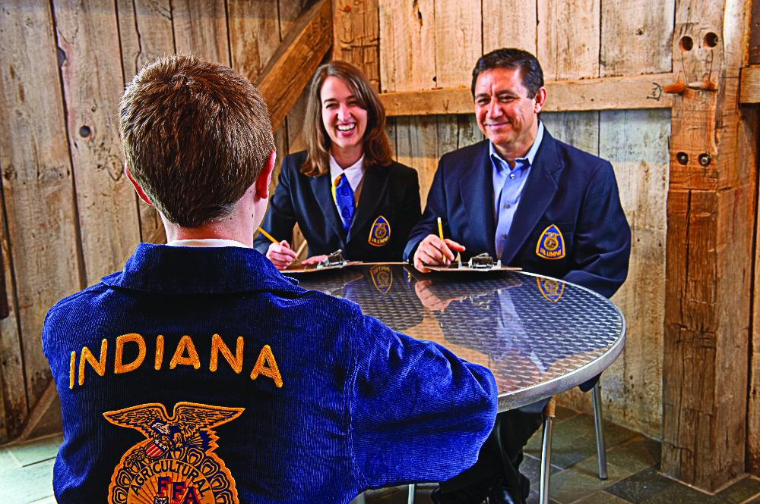
National FFA Alumni Association
Members of the National FFA alumni are parents, business leaders and former FFA members although you need not be a former FFA member to join.
Their focus is to help FFA members achieve their goals.
The National FFA alumni works hard to make your FFA experience even better through fundraising efforts, including raising up to $100,000 annually in scholarship money.
The national FFA relies on alumni members for student recruiting, scholarship money, aiding in camps, conferences, national FFA convention and other personal development programs.

Slide 5

National FFA Foundation
Mission Statement
The National FFA Foundation builds partnerships with industry, education, government, foundations and individuals to secure resources for the future of education, agriculture and student leader development.

Slide 6
Many FFA programs are made possible because of the funding efforts of the National FFA Foundation.
The foundation was established in 1944 to enable business and industry, organizations, past FFA members and other individuals to cooperate in supporting and furthering the programs of the FFA.
Since 1944 the business community has contributed more than $200 million to FFA.
Sponsors so many great opportunities possible, we never want to forget to thank them for all they do!

Slide 7
Agricultural Careers
More Than 300 agricultural careers
Prepare for a career in agriculture or a related field—the more you learn, the more you can earn! Your agricultural education classes and FFA can help you to determine the right career for you now.
The skills you gain today will put you ahead of the crowd when it comes time to look for a job.
Eight career pathways assist in categorizing all of the different career opportunities in agriculture within similar areas of knowledge and skill development.
Check out the Official FFA Student Handbook to learn more about those pathways.

Slide 8
Agricultural Careers
Aerial Crop Duster
GPS Technicians
Meat Science Researchers
Veterinarians
Waste Water Treatment Plant Operators
Cell Biologist
Farm Investment Managers
Nutritionists and Dieticians
Produce Buyers
Aquaculturalists
Golf Course Superintendents
Crop Farm Managers
Habitat Conservationists
Greenhouse Managers
Quality Control Specialists
USDA Inspectors
Poultry Inseminator
Fishing Vessel Operators
Toxicologists
Chemical Sales Representatives
Wildlife Managers
Dairy Herd Supervisors
Agricultural Educators
Hazardous Materials Specialists

Slide 9
Eight Career Pathways in Agriculture
Agribusiness Systems
  Business related careers like marketing, sales, communications and management within agricultural sectors.
Animal Systems
  Careers caring for and raising animals.
Biotechnical Systems
  Careers in bacteriology, bioengineering, microbiology, research and other science-based fields.
Environmental Service Systems
  Careers focused on environmental, resource and pollution management.

Slide 10
Eight Career Pathways in Agriculture
Food Products and Processing Systems
  Careers in food science, toxicology, food processing and many more fields.
Natural Resources Systems
  Careers which balance natural resource use with environmentally sensitive practices.
Plant Systems
  Careers focused on plant growth and production for food production and horticultural display.
Power, Structural and Technical Systems
  Careers with technical mechanical skills including welding, engineering and maintenance.

